Slide 1
Inducing Learning gLMPM - (induction is opposite to deduction, deduction = querying, induction = learning the right query)
Peter Vojtas

Slide 2
Content
We have extended the portfolio of models in hope some of them will fit to user’s behavior. Let’s try to find methods to learn from data generated by respective models
Heuristics
Identification of aggregation function (tuning parameters)
statistical
There was some learning of LMPM preferences in NSWI166 – specific methods under specific circumstances of data distribution,
Our experiments involve:
Experiment 1. LMPM learning, more general data distribution, hill/valley attribute preferences
Experiment 2. Data generated by product disjunction on respective PC contour lines
Experiment 3. Data generated by product conjunction on respective PC contour lines
Experiment 4. Arbitrary Pareto compliant contour lines

Slide 3
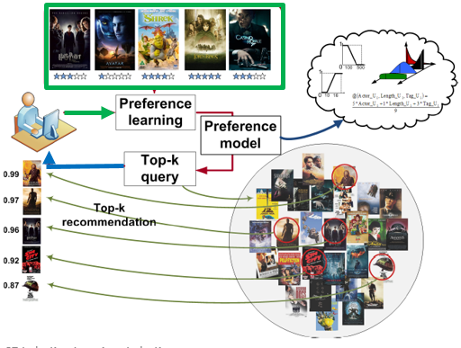
User’s
preference learning
We have User behavior
Implicit behavior interpreted as explicit rating
Would like to
have an
gLMPM user model to compute top-k for recommendation
Can we make this recommendation visual? Human intuitive?

Slide 4
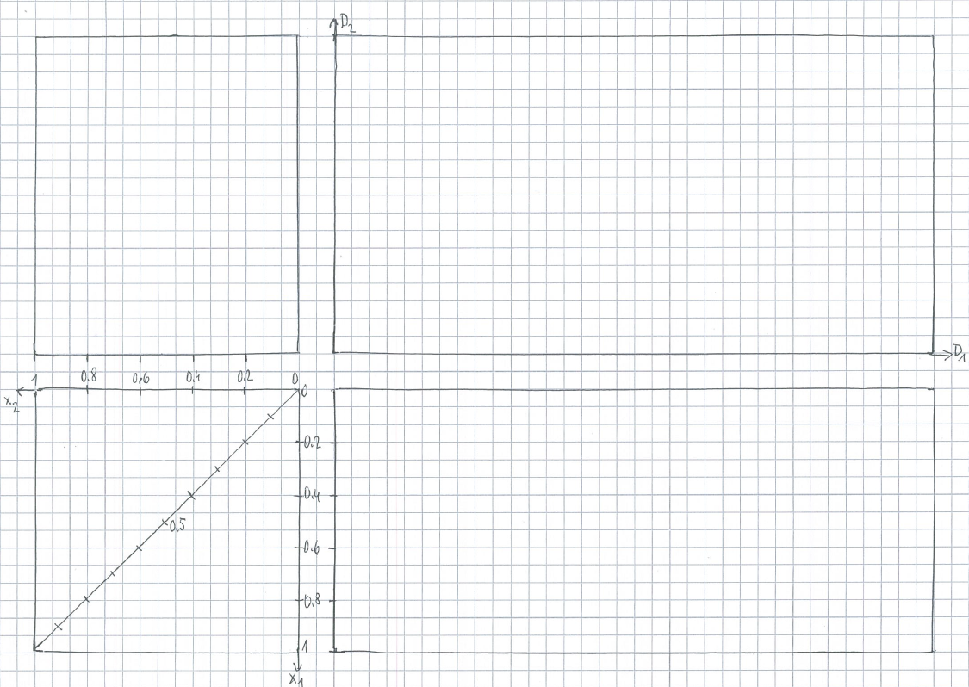
Repetition - learning from NSWI166, go to
C1 TEST M2 A2
X .5
A .3
B .3
A .3
Y .5
D .5
B .3
E .7
C .4
Z .6
F .7
C .4
D .5
E .7
B .3
F .7
C .4
A .3
X .5
Y .5
Z .6

Slide 5
Experiment 1.
LMPM learning, more general data distribution, hill/valley attribute preferences

Slide 6
Generating data
D₂
Ex.1 can be hill – valley
We would like to generate data in such a way that learning aggr. needs a new method
There will be no data with same preference
Choose aggr.
(2x₁ + x₂)/3
1
0
D₁
x₂
x₁
1

Slide 7
Generating data
D₂
Ex.1 can be hill – valley , new @ methods needed
Draw all decimal valued contour lines of (2x₁ + x₂)/3
And chose one point on each.
Only for copying
1
0
D₁
x₂
x₁
1

Slide 8
Generating data
D₂
Ex.1 can be hill – valley , new @ methods needed
We have decimal valued contour lines of (2x₁ + x₂)/3
points on each.
Chose attr. prefs. hill/valley
1
0
D₁
x₂
x₁
1

Slide 9
Generating data
D₂
0.4
Ex.1 can be hill – valley , new @ methods needed
We have decimal valued contour lines of (2x₁ + x₂)/3
points on each. and
attr. prefs.
Each point has four coimages in DC – chose one possibility rotating choice in quadrants (this can be changed in future data set generation).
Pref.score is also ID
Fix also train/ test set.
0.1
0.5
0.9
0.8
0.7
0.6
0.2
1
0
0.3
D₁
x₂
x₁
1

Slide 10
train
D₂
valley
hill
0.4
0.1
Ex.1 method i1
First decide hill / valley – projection smaller / bigger.
To learn an LMPM model, first a method i1 for atr.prefs.
We find four candidates for peak / valley points by center of mass (min and max pairs). Chose a red one, more regularly dividing train set
Find candidates in PC
hill
0.9
0.7
0.6
1
0
valley
0.3
D₁
x₂
0.1
0.3
0.6
0.4
0.7
0.9
x₁
1

Slide 11
train
D₂
0.4
0.1
Ex.1.1 method i1. a1. Learning gives attr. prefs and training set images in PC. Points are Pareto compliant
Let’s first try to find a max NW-SE angle for all train points preserves Pareto (0.1 to 0.3)
Angle method a1: Let’s chose angle axis as our guess for aggregation
0.9
0.7
0.6
1
0
0.3
D₁
x₂
0.1
0.3
0.6
0.4
0.7
0.9
x₁
1

Slide 12
test
D₂
Ex.1.1 method i1a1.
We have an estimation of atr.prefs. and aggregation, hence a model m1.i1.a1
Using m1.i1.a1 find images of test set
Let’s calculate error (graphically)
0.5
0.8
0.2
1
0
D₁
x₂
0.2
0.5
0.8
x₁
1

Slide 13
train
D₂
0.4
Ex.1.2 method i1a2. Learning gives attr. prefs and training set images in PC by i1. a2 method: construct an angle of connections point with “it’s” value on the diagonal – and get the angle axis.
Expected directions NW-SE, violated by 0.7 – confidence 5/6. Lines create an angle (much smaller than previous one), chose again an axis
0.1
0.9
0.7
0.6
1
0
0.3
D₁
x₂
0.1
0.3
0.6
0.4
0.7
0.9
x₁
1

Slide 14
test
D₂
Ex.1.2 method 2. Error on test set
Second angle axis method as our guess for aggregation
Clean data, remain necessary for test set and calculate error (graphically)
0.5
0.8
0.2
1
0
D₁
x₂
0.2
0.5
0.8
x₁
1

Slide 15
test
D₂
Example1
résumé
attr. pref. easy as we know triangles over whole domain
We know @ are weighted average, two methods for @
Both “angle” quite good, second a little better
0.4
0.1
0.5
0.9
0.8
0.7
0.6
0.2
1
0
0.3
D₁
i1a2
x₂
i1a1
x₁
1

Slide 16
Experiment 2. Data generated by product disjunction on respective PC contour lines

Slide 17
Do users behave in accordance with classical MV logic?
&_{G}^{.2}
&_{L}^{.2}
_{la}&_{P}^{.2}
Note, bottom left diagonal plane cut with all connectives and their ordering
Upper left contour lines of conjunction, bottom right contour lines of disjunctions
Having attribute preferences – this enlarges portfolio of possible aggregations
&_{G}^{.5}
x = sqrt(0.2)
_{la}&_{P}^{.5}
&_{L}^{.5}
_{la}&_{P}^{.8}
V_{G}^{.5}
&_{L}^{.8}
&_{G}^{.8}
V_{L}^{.5}
_{la}V_{P}^{.5}
V_{L}
V_{P}
_{la}V_{P}^{.8}
z
V_{G} = &_{G}
V_{L}^{.8}
V_{G}^{.8}
x = 1-sqrt(1-0.9)
&_{P}
&_{L}

Slide 18
D₂
generate
Ex.2 data generated by product logic
disjunction and attr. Prefs.
This is a base for generating examples
Only for copying
0.1
0.6
0.5
0.9
0.9
0.7
0.8
1
0.3
D₁
0
0.4
x₂
0.3
0.1
0.5
0.7
0.4
0.9
0.1
0.6
0.8
0.9
x₁
1

Slide 19
D₂
generate
Ex.2 data generated by product logic
disjunction and attr. Prefs.
Start to work
Decide which DC points are training and which are testing
Chose train/test
0.1
0.6
0.5
0.9
0.9
0.7
0.8
1
0.3
D₁
0
0.4
x₂
0.1
x₁
1

Slide 20
D₂
train
hill
Ex.2.1 method m2i1a1. Data generated by product logic
disjunction, as in m1i1 chose first red ideal points, blue later.
Attr. prefs and training set images in PC. Again, points Pareto compliant.
m2a1 by m1a1 as weighted average (angle almost 0º).
angle very small – lowers confidence substantially
0.1
0.5
0.9
hill
0.7
0.8
1
0
D₁
x₂
0.4
0.1
0.5
0.4
0.7
0.9
0.8
0.9
x₁
1

Slide 21
D₂
test
Ex.2.1 method i1a1. error on test set (calculated to true degree in generating set – here from product disjunction) and think of low confidence.
0.1
B.6
0.5
C.9
0.9
0.7
0.8
1
A.3
D₁
0
0.4
x₂
A.3
Shifted
m2i1a1
B.6
C.9
x₁
1

Slide 22
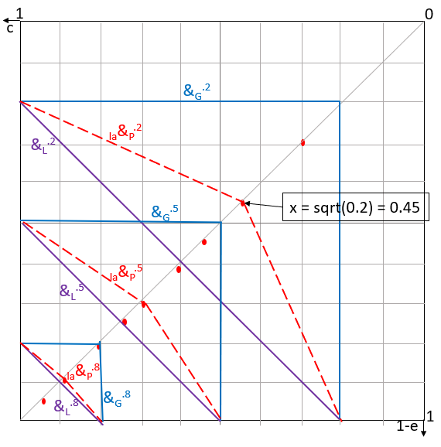
Error versus confidence
c – confidence – proportion of compliance with model assumptions
e - error – proportion of maximal possible error
Ideal c=1, e=0 (depict c, 1-e)
How to aggregate c and 1-e to get usability of learning results?
Guess: c-e-aggregation is conjunctive
Minimal confidence c=0 and maximal error e=1 make results of learning not usable. So, on 0-axis we have usability 0
Are c, 1-e independent? Product logic conjunction?
Do c↑1, 1-e↓0 behave opposite, i.e., c↑1, e↑1, rather not Lukasiewicz
Dependent? Goedel logic? Probably yes.
How to test these hypotheses?

Slide 23
D₂
train
Ex.2.2 method 2a and 2b Data, attr. Prefs, training set in PC as before.
Let’s try to find agg. In form of Eckhardt geometry / Pareto min (solid outline) /max (outline dashed) method. There are no violations of Pareto order, so confidence is high.
0.1
0.5
0.9
0.7
0.8
1
0
D₁
x₂
0.4
0.1
0.5
0.4
0.7
0.9
0.8
0.9
x₁
1

Slide 24
D₂
train + test
Ex.2.2 method 2a – Pareto minimal region.
error on test set
Image of test set in PC is always same (point identifiers are pref.score)
0.3 lies in Eckhardt geometry minimal region of 0.5 (learned from training example) – gives to error 0.2
0.6 lies in 0.8 e=0.2
0.9 lies in 1, e=0.1
In total error = 0.5
0.1
0.6
0.5
0.9
0.9
0.7
0.8
1
0.3
D₁
0
0.4
x₂
0.3
0.1
0.5
0.4
0.7
0.9
0.8
0.6
0.9
0.9
x₁
1

Slide 25
D₂
train + test
Ex.2.2 method 2b – Pareto maximal region.
error on test set
Image of test set in PC is always same (point identifiers are pref.score)
0.3 lies in Eckhardt geometry maximal region of 0.4 – gives to error 0.1
0.6 lies in 0.4, e+0.1
0.9 lies in 0.5, e+0.4
Total error = 0.6
0.1
0.6
0.5
0.9
0.9
0.7
0.8
1
0.3
D₁
0
0.4
x₂
0.3
0.1
0.5
0.4
0.7
0.9
0.8
0.6
0.9
0.9
x₁
1

Slide 26
D₂
Ex.2.2 comparing methods 1, 2a, 2b error on test set
Image of test set in PC is always same
Image of test set in PC is always same (point identifiers are pref.score)
a1 – error graphical
a2a – error = 0.5
geometry minimal
a2b – error = 0.6
0.1
0.6
0.5
0.9
0.9
0.7
0.8
1
0.3
D₁
0
0.4
x₂
0.3
0.1
0.5
0.4
0.7
a2a
0.9
a2b
0.8
0.6
0.9
a1
Ex2, m2i1
x₁
1

Slide 27
D₂
train
Ex.2.3 method 3. Data, attr. Prefs, training set in PC as before.
Let’s try to find agg. in form of many valued disjunction – connecting points to known behavior on axis and corresponding intersection with diagonal. Confidence is 5/6 high – there is only one violation with 0.7 contour line.
For test set we must approximate corresponding contour lines
0.1
0.6
0.5
0.9
0.9
0.7
0.8
1
0.3
D₁
0
0.4
x₂
0.1
0.5
0.4
0.7
0.9
0.8
0.9
x₁
1

Slide 28
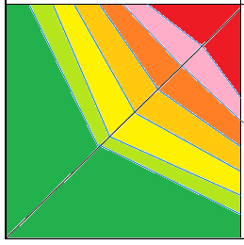
D₂
train
Ex.2.3 method 3.
Approximating missing contour lines
Data, attr. Prefs, training set in PC as before. We found
agg. in form of many valued disjunction.
Missing 0.6 and 0.7 are heuristically constructed by equidistant points on diagonal.
0.1
0.6
0.5
0.9
0.9
0.7
0.8
1
0.3
D₁
0
0.4
<0.4
x₂
0.8
0.6
0.4
0.1
0.9
0.7
0.5
0.5
0.4
0.7
0.9
0.8
x₁
1

Slide 29
D₂
test
Ex.2.3 method 3.
Error on test set
Data, attr. Prefs, training set in PC as before. We found
agg. in form of many valued disjunction.
Missing 0.6 and 0.7 are added. As f₁, f₂ did not change, images in PC are same.
0.3 lies in region of 0.4 – gives error +0.1
0.6 gives to error +.1
0.9 lies on border of 0.9, so error is 0
Overall error is 0.2
0.1
0.6
0.5
0.9
0.9
0.7
0.8
1
0.3
D₁
0
0.4
x₂
<0.4
0.8
0.6
0.4
0.1
0.5
0.3
0.9
0.7
0.5
0.4
0.7
0.9
0.8
0.6
0.9
x₁
1

Slide 30
D₂
train
Ex.2.4 method 4. Data, attr. Prefs, training set in PC as before.
Let’s try to find agg. in form of many valued conjunction – connecting points to known behavior on axis and corresponding intersection with diagonal. Confidence is very low, zero – there is no intersection of estimated contour lines with diagonal – learning failed
0.1
0.6
0.5
0.9
0.9
0.7
0.8
1
0.3
D₁
0
0.4
x₂
0.1
0.5
0.4
0.7
0.9
0.8
0.9
x₁
1

Slide 31
D₂
generate
Example2
résumé
attr. pref. easy as we know triangles over whole domain
We do not know @
models and have to try many
Methods
a1 – e>0.6
a2a – e=0.5
a2b – e=0.6
a3 – e=0.2
a4 – failed c=0
0.1
0.6
0.5
0.9
0.9
0.7
0.8
1
0.3
D₁
0
0.4
x₂
x₁
1

Slide 32
Experiment 3.
Data generated by product conjunction on respective PC contour lines

Slide 33
Do users behave in accordance with classical MV logic?
&_{G}^{.2}
&_{L}^{.2}
_{la}&_{P}^{.2}
Note, bottom left diagonal plane cut with all connectives and their ordering
Upper left contour lines of conjunction, bottom right contour lines of disjunctions
Having attribute preferences – this enlarges portfolio of possible aggregations
&_{G}^{.5}
x = sqrt(0.2)
_{la}&_{P}^{.5}
&_{L}^{.5}
_{la}&_{P}^{.8}
V_{G}^{.5}
&_{L}^{.8}
&_{G}^{.8}
V_{L}^{.5}
_{la}V_{P}^{.5}
V_{L}
V_{P}
_{la}V_{P}^{.8}
z
V_{G} = &_{G}
V_{L}^{.8}
V_{G}^{.8}
x = 1-sqrt(1-0.9)
&_{P}
&_{L}

Slide 34
generate
D₂
Ex.3generated by product logic
Conjunction, again
Nine different preference degrees.
Basis for generating data points
Only for copying
0.3
0.2
0.7
0.9
0.6
0.1
0.4
0.5
0.1
1
0
D₁
x₂
0.1
0.2
0.4
0.6
0.1
0.5
0.3
0.9
0.9
0.7
x₁
1

Slide 35
generate
D₂
Ex.3generated by product logic
Conjunction, again
Nine different preference degrees.
Basis for generating data points
Only for copying
0.3
0.2
0.7
0.9
0.6
0.1
0.4
0.5
0.1
1
0
D₁
x₂
0.9
x₁
1

Slide 36
D₂
Ex.3data generated by product logic
conjunction
i1 as before
One Pareto violation 0.3 is dominated by 0.1
Does it influence confidence?
0.3
0.2
0.7
0.9
0.6
0.1
0.4
0.5
0.1
1
0
D₁
x₂
0.2
0.3
0.6
0.1
0.1
0.5
0.9
x₁
1

Slide 37
D₂
Ex.3data generated by product logic
conjunction
a1 - Or-like aprox. never intersects diagonal
m3i1a1 Confidence =0
0.3
0.2
0.7
0.9
0.6
0.1
0.4
0.5
0.1
1
0
D₁
x₂
0.2
0.3
0.6
0.1
0.1
0.5
0.9
x₁
1

Slide 38
D₂
Ex.3data generated by product logic
conjunction
a2-And-like aprox. intersects diagonal
0.1 causes problem, decreases confidence
Also 0.9 violates contour lines 0.6 and 0.5
Let us continue with 0.2, 0.3, 0.5, 0.6 which are order compliant and do not intersect smaller / larger lines
0.3
0.2
0.7
0.9
0.6
0.1
0.4
0.5
0.1
1
0
D₁
x₂
0.2
0.3
0.6
0.1
0.5
0.9
x₁
1

Slide 39
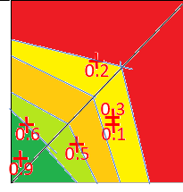
D₂
Ex.3data
a2-And-like aprox. intersects diagonal
0.1 problem,
0.9 violates
continue with 0.2, 0.3, 0.5, 0.6
0.3
0.2
0.7
0.9
0.6
0.1
0.4
0.5
0.1
1
0
D₁
0.2
0.3
0.6
0.1
0.5
0.9
1

Slide 40
D₂
Ex.3data
a2-And-like aprox. intersects diagonal
0.1 problem,
0.9 violates
continue with 0.2, 0.3, 0.5, 0.6
0.7
0.1
0.4
1
0
D₁
0.1
0.4
0.7
1

Slide 41
D₂
Ex.3data generated by product logic
conjunction
a2-And-like aprox. intersects diagonal
0.1 causes problem, decreases confidence
Also 0.9 violates contour lines 0.6 and 0.5
Let us continue with 0.2, 0.3, 0.5, 0.6 which are order compliant and do not intersect smaller / larger lines
0.3
0.2
0.7
0.9
0.6
0.1
0.4
0.5
0.1
1
0
D₁
0.1
0.2
0.4
0.3
0.6
0.1
0.5
0.9
0.7
1

Slide 42
generate
D₂
Example3
résumé
3data generated by product logic
conjunction
i1 makes candidate data in PC with one violation of Pareto order
We do not know @
models and try conjunction and disjunction
Methods
a1 – or like fails
a2 – fit well
Rather low confidence
0.3
0.2
0.7
0.9
0.6
0.1
0.4
0.5
0.1
1
0
D₁
x₂
x₁
1

Slide 43
Can we generate data in DC?
Arbitrary Pareto compliant contour lines

Slide 44
D₂
Ex.3 generate regular contour lines in the PC,
Fix attribute preferences, construct corresponding images in DC and chose points in layers between contour lines in the DC
Now arbitrary choice in DC layers gives a learning task
1
0
D₁
x₂
x₁
1

Slide 45
D₂
.1
Ex.3 generate regular contour lines in the PC,
Fix attribute preferences, construct corresponding images in DC and chose points in layers between contour lines in the DC
Now arbitrary choice of points in DC layers gives a learning task
We can try to cheat some methods
.3
.6
.8
.9
.4
.7
.5
1
2
D₁
0
x₂
.1
x₁
1

Slide 46
D₂
.1
Ex.3 learn and test regular contour lines in the PC,
Fix attribute preferences, construct corresponding images in DC and chose points in layers between contour lines in the DC
Now arbitrary choice of points in DC layers gives a learning task
We can try to cheat some methods
.3
.6
.8
.9
.4
.7
.5
1
2
D₁
0
x₂
.1
x₁
1

Slide 47
D₂
Ex.3 design contour lines in DC that are not concentric
We can choose arbitrarily points in layers in DC
Here it seems we do not have any Pareto compliance
We must preserve only monotony
1
0
D₁
x₂
x₁
1

Slide 48
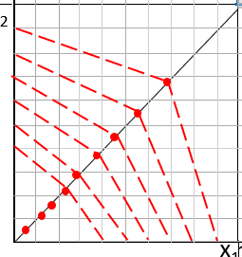
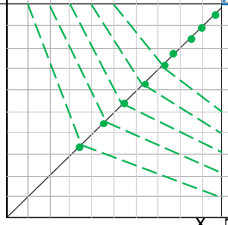
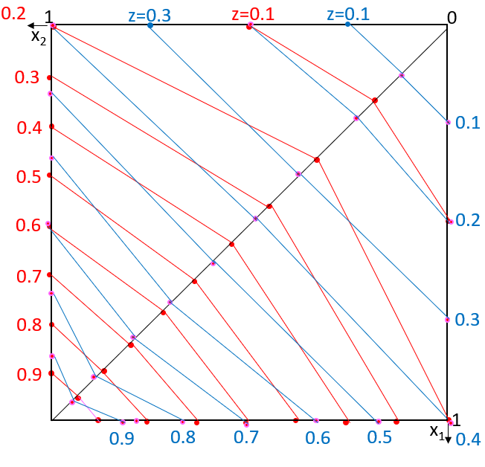
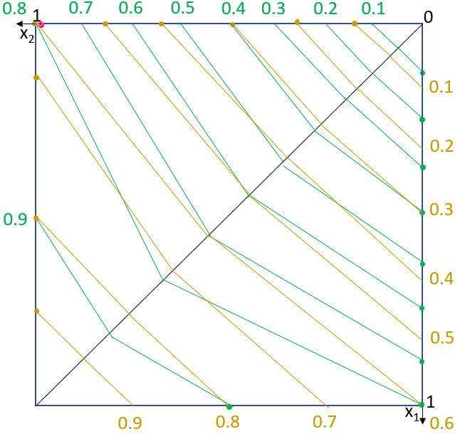
learning users so far
We did not try to learn convex combinations
Learning from data generated by product conjunction and disjunction showed success (partial)
Nevertheless, we have to give up exact behavior on the diagonal
This leads us to a class of connectives where point is on contour line connecting (some) point on the diagonal and respective point on the 0 or 1 axis (of course not violating order and without any intersections of contour lines)

Slide 49
Experiment 4.
Arbitrary Pareto compliant contour lines

Slide 50
D₂
Ex4. Generate
Ex.4 Yet again a new idea – let’s call it “Wild guess”.
It assumes almost arbitrary borders between different preference degrees (z does not correlate with intersection of the diagonal)
Let’s chose PC points in respective layers from (0,0) to (1,1) point
.1
A.7
.2
C
.6
E
.5
.9
D
B.7
B
.8
.3
f₂
0
.4
x₂
D₁
1
.3
.2
.1
.1
.5
.4
B.7
.6
f₁
.8
A.7
.9
1
x₁

Slide 51
D₂
Ex4. Train and test
Ex.4 Yet again a new idea – let’s call it “Wild guess”.
It assumes almost arbitrary borders between different preference degrees (z does not correlate with intersection of the diagonal)
Let’s chose PC points in respective layers from (0,0) to (1,1) point
.1
A.7
.2
.6
.5
.9
B.7
.8
.3
0
.4
x₂
D₁
1
.1
1
x₁

Slide 52
Randomly generated data
.8
Ex4. Train and test
Ex.4 Yet again a new idea – let’s generate randomly data in DC.
For each data point we need 3 numbers between 1 and 9 normalized domains are divided equidistant
(x₁, x₂ score 0.z)
8 7 7
8 9 4
6 4 6
8 3 7
9 4 4
4 7 1
7 6 1
5 2 9
8 6 2
7 1 2
D₂
.4
.1
.7
.1
.2
.6
.4
.7
.9
.2
x₂
D₁
1
0
1
x₁

Slide 53
Randomly generated data
.8
Ex4. Train and test
Ex.4 Yet again a new idea – let’s generate randomly data in DC.
For each data point we need 3 numbers between 1 and 9 normalized domains are divided equidistant
(x₁, x₂ score 0.z)
9 4 4
3 5 8
2 9 5
5 8 4
7 1 4
2 9 7
4 8 8
8 9 6
4 6 7
9 2 8
D₂
.5
.6
.7
.8
.4
.7
.8
.4
.8
.4
x₂
D₁
1
0
1
x₁

Slide 54
4-D learning? advantage of visual insight disappeared

Slide 55
$$\frac{2∗\frac{x_{1}+x_{2}}{2}+3∗\frac{2∗x_{3}+x_{4}}{3}}{5}= \frac{2∗y_{1,2}+3∗y_{3,4}}{5}=z$$
4d points easy to depict&compute
L
D₂,D₄
R
L
R
d .8
d
D
x₂
x₄
D₁
D₃
This is a template for you future solutions
4D points have coordinates multiples of 0.1 and 4D contour lines are also multiples of 0.1.
d
d
x₁,x₃

Slide 56
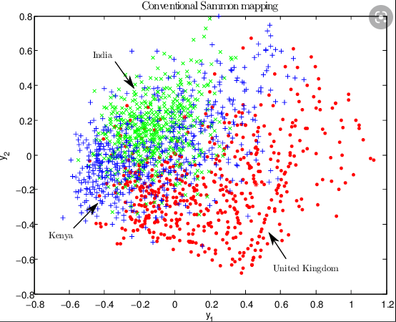
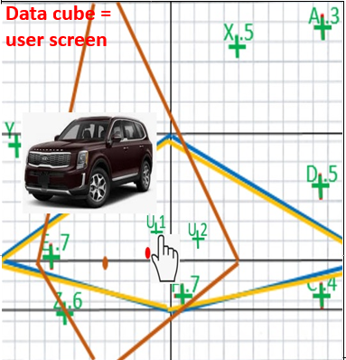
Conclusions
No libraries, paper work, one should be able to verify results given by a software
Graphical motivation, data visualization – mockup?
Aggregation of partial results (attribute score, several recommenders, …)
ChRF challenge response framework as in NSWI166 applies too, we reduce reality to models
Image is only illustrative
Can we make visualization
compliant with preferences?

Slide 57
Thanks
Questions?

