Slide 1
Preferential Logic, generalized LMPM, and-like, or-like decisions
Aggregations Beyond weighted average
How to combining baseline recommenders – hopefully one of these models fits the user

Slide 2
Content
What is User Preference? How do people aggregate uncertain/vague/necessary/ possible perception?
Preferential logic (many valued, fuzzy) contour lines
And/Or user behavior in 2D
Convex combinations of & and V
Heuristics preserving Pareto ordering
Aggregating two 2D-recomenders/ two 2D-users
Aggregating ordered lists
How do sports aggregate season winner = combining baseline recommenders
Only list-based aggregation
Mixing results in ordered lists, content based, preference and/or confidence score, …

Slide 3
What is human preference? (Psychology)
Preferences could be conceived as an attitude toward a set of properties of context, memory, and affect – a gage of how much uncertainty one is willing to tolerate (Preference by se daly pojmout jako postoj k souboru vlastností kontextu, paměti a afektu – měřítko toho, kolik nejistoty je člověk ochoten tolerovat)
One type of computational … decision-making theories predicts specific behavioral patterns of risky preferences.
Choices are based on the integration of probability and utility information into expected utilities, and trade-off comparisons of computed outcomes.
Probability + utility – numeric, linear, AI learn,
Fuzzy interpreted as preference, instead of vagueness
Many valued logic NEW

Slide 4
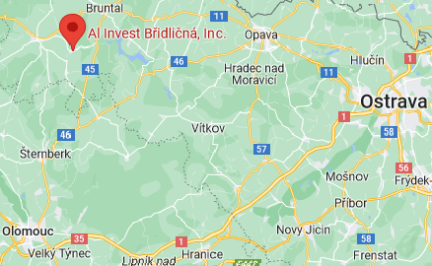
Another possible integration - Many valued logic
Motivation comes from antic philosophy – modalities “possible”, “necessary” do not behave like in 0-1 logic
Lukasiewicz – in 20’s tried to formalize modal logic using real valued logic, Alan Turing – logic with “undecidable” (halting problem), SQL semantics,
Second motivation comes from repetitive inexact measurements, Karl Menger, 1949-51 ensemble flou,
Processing (military, radar) pictures is next motivation R.E. Bellman, R.E. Kalaba, L.A. Zadeh, Abstraction and Pattern classification, 1964.
Fuzzy controllers – V. Novak (OSU) Metallurgic Plant Břidličná, a.s., 1995 furnace fuzzy control,
Our last motivation is interpreting truth degrees as preference degrees – looking for new aggregations in PC-preference cube (later was fuzzy considered usually as (linguistic) vagueness)

Slide 5
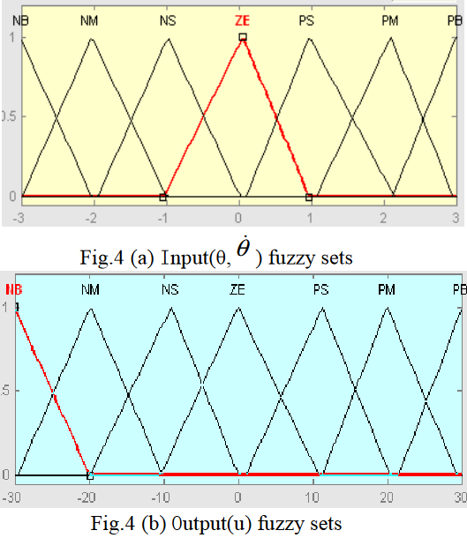
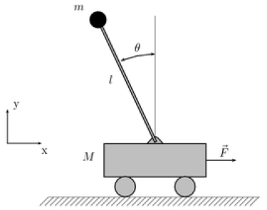
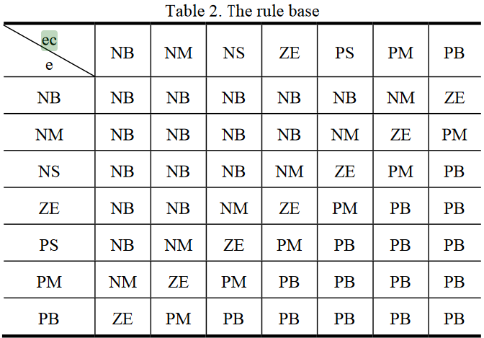
Inverted pendulum – IF THEN rules
IF angle “NM” AND
derivative “PB”
THEN force “PM”
Procedural instruction
Consider as logic rule
IF-THEN ?implication?
AND ?conjunction?
$$\dot{θ}$$
θ angle
$\dot{θ}$ derivative
θ
$$\dot{θ}$$
"NB" to represent "negative big“, "NM“- "negative medium“, “NS“- “negative small“, "ZE" to represent "zero“, "PS" to represent "positive small“, "PM“-"positive medium“, "PB" -" positive big"

Slide 6
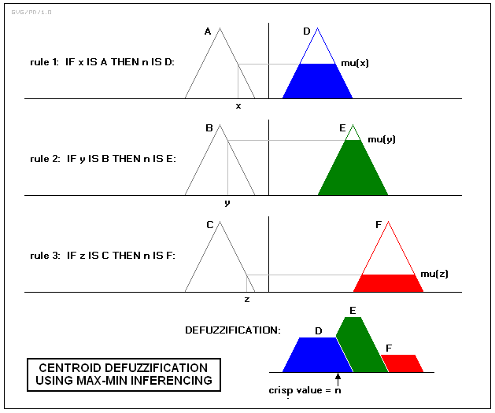
Inverted pendulum – IF THEN rules
e.g. IF angle “NM” AND
derivative “PB”
THEN force “PM”

Slide 7
Many valued/fuzzy/preferential propositional logic
Syntax
atomic propositions Φ₀ = {price, color, angle, p, q, buy(john, item1)…}
logical connectives &, →, ¬, … get all propositions ϕ v ψ ∈Φ
graded propositions (ϕ,a), (ψ,b) … a, b preference degrees, [0, 1]
Semantics
possible worlds v: Φ₀ → [0,1],
truth functions of connectives •: [0,1]x[0,1] → [0,1], extension of classical connectives, enables to extended v to v: Φ → [0, 1].
Possible world satisfaction
Comparative notion of truth of Petr Hajek, a possible world v: Φ₀ → [0,1] is a model of (ϕ,a), i.e., v $⊨$ (ϕ,a) if v(ϕ) ≥ a
note that order is absent , i.e (ϕ,a), (ψ,b) and a < b do not imply v(ϕ) < v(ψ)
This is a serious problem for recommendation, as it changes the order of items! Let’s study changing order of items (ordinal scale)

Slide 8
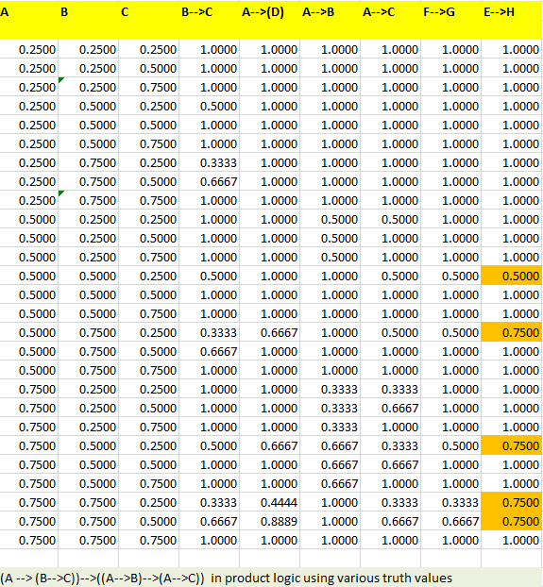
“Historical” many valued connectives Two valued tautologies need not be tautologies anymore Set of all tautologies can be computationally very complicated what is the many valued logic suitable to describe a specific user? Luckily, to apply our rules we do not need logical axioms, modus ponens is sufficient
, &, ∧

Slide 9
Many valued/fuzzy/preferential propositional logic
Syntax
atomic propositions Φ₀ = {price, color, angle, p, q, buy(john, item1)…}
logical connectives &, →, ¬, … get all propositions ϕ v ψ ∈Φ
graded propositions (ϕ,a), (ψ,b) … a, b preference degrees, [0, 1]
Semantics
possible worlds v: Φ₀ → [0,1],
truth functions of connectives •: [0,1]x[0,1] → [0,1], extension of classical connectives, enables to extended v to v: Φ → [0, 1].
Possible world satisfaction
Comparative notion of truth of Petr Hajek, a possible world v: Φ₀ → [0,1] is a model of (ϕ,a), i.e., v $⊨$ (ϕ,a) if v(ϕ) ≥ a
Proofs, deduction
Difficult axiomatization , for IF-THEN rules is modus ponens sufficient (mnemonic body, head, rule notation)
$$\frac{\left(B.b\right), (B →_{I} H.r)}{(H. C_{I}(b, r))}$$

Slide 10
Many valued/fuzzy/preferential propositional logic
Proofs, deduction → computation
Difficult axiomatization (Classical tautologies are often no more valid), for IF-THEN rules is modus ponens sufficient (mnemonic body, head, rule notation)
Body can be complex, e.g., a conjunction of attribute
Or even an aggregation (a function preserving Pareto order in the preference cube)
Implication can be neglected if r=1, the confidence of rule
$$\frac{\left(B.b\right), (B →_{I} H.r)}{(H. C_{I}(b, r))}$$
$$\frac{\left(B_{1}.b_{1}\right),\left(B_{2}.b_{2}\right),…,\left(B_{n}.b_{n}\right),(B_{1}∧B_{2}∧…∧B_{n}→_{I} H.r)}{(H. C_{I}(∧^{∘}\left(b_{1},b_{2},…,b_{n}\right), r))}$$
$$\frac{\left(B_{1}.b_{1}\right),\left(B_{2}.b_{2}\right),…,\left(B_{n}.b_{n}\right),({@\left(B_{1},B_{2},…,B_{n}\right) }_{ }→_{I} H.r)}{(H. C_{I}(@^{∘}\left(b_{1},b_{2},…,b_{n}\right), r))}$$

Slide 11
Preferential logic – approach real data experiments
We can try fuzzy logic connectives as aggregation, integration of partial preferences, we need
Monotonicity (preserves Pareto ordering)
On 0 (fail, refute) and 1 (true, accept) behave as classical logic
We can try (also mathematically motivated) Grabisch, M., Marichal, J., Mesiar, R., & Pap, E. (2009). Aggregation Functions (Encyclopedia of Mathematics and its Applications). Cambridge: Cambridge University Press.
Some heuristics from our production
Convex combination of conjunctions and disjunctions
Various sport deciding winner in multidiscipline
Of course, our weighted average
Data (toy, generated, historical, online)
Rich class of aggregations – i.e., if A, B not Pareto comparable, then it can occur both A<B and B<A

Slide 12
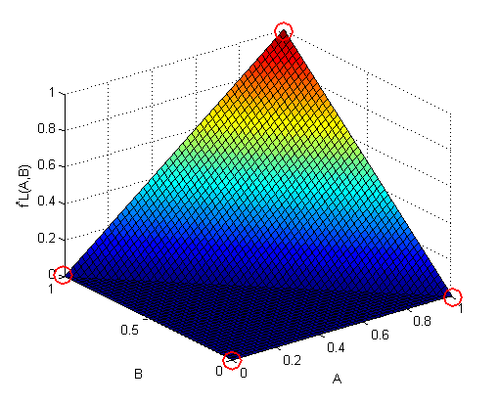
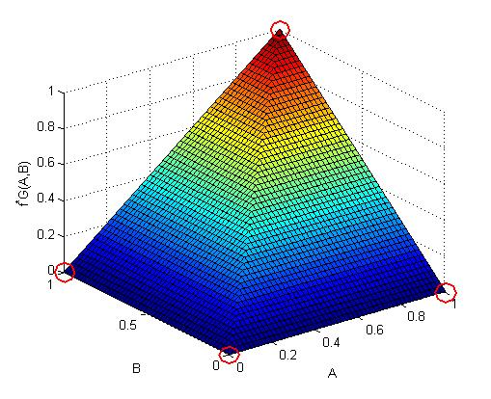
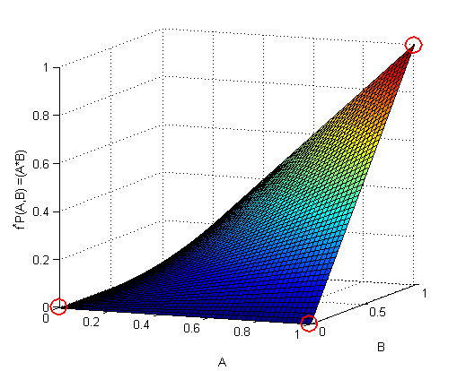
Conjunctions b&r = h Lukasiewicz Goedel Product max{0, b+r-1} min{b, r} b*r
“Historical” many valued connectives graphically
depicted in PC-preference cube

Slide 13
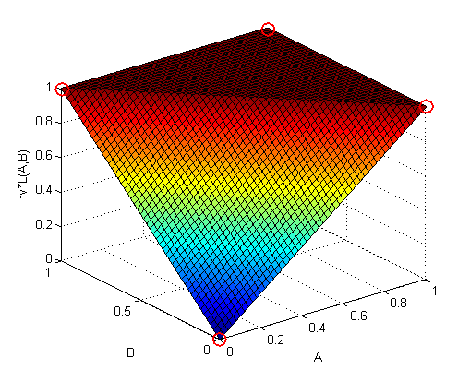
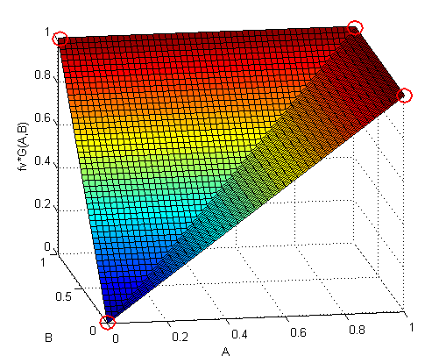
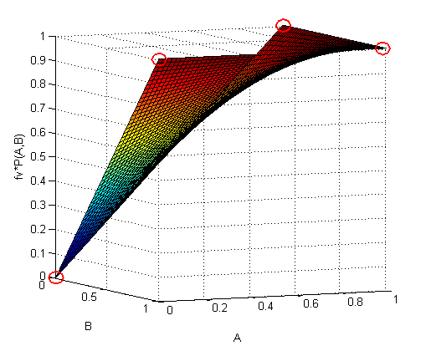
Disjunctions b v r by deMorgan and ¬•(x) = 1-x Lukasiewicz logic – ∨•_{L}(x,y) = min (1, x+y) Goedel logic – ∨•_{G}(x,y) = max (x, y) Product logic - ∨•_{P}(x,y) = x+y-xy Lukasiewicz Goedel Product min{1, b+r} max{b, r} b+r-b*r
“Historical” many valued connectives graphically
depicted in PC-preference cube

Slide 14
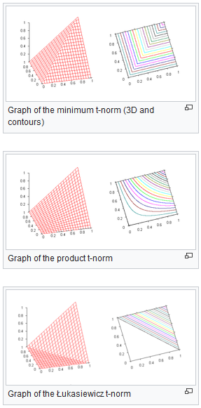
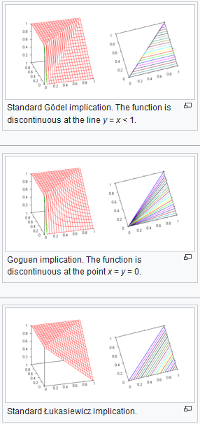
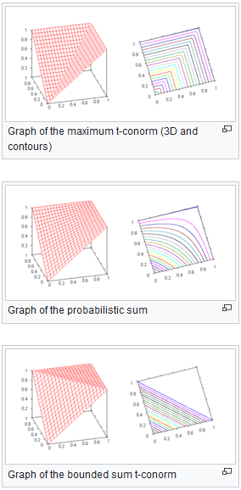
Fuzzy logic connectives – math approach
Commutative, Monotone, Associative, (a, 1) = a, nilpotent, Archimedean, partially ordered abelian monoid conjunctions implications disjunctions

Slide 15
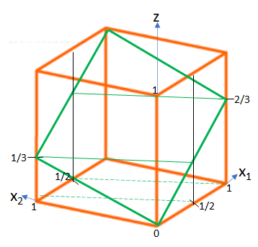
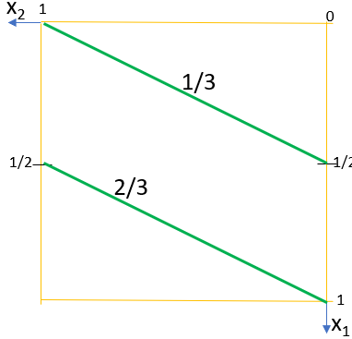
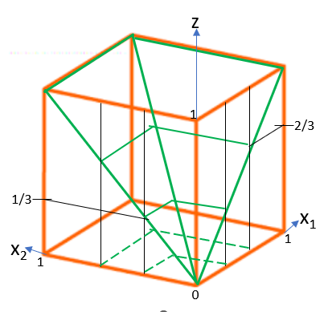
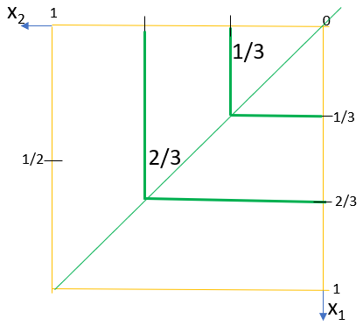
Representing preference cube surfaces in 2D by contour lines
$$z=\frac{2x_{1}+x_{2}}{3}$$
$$z=\min_{ }{(x_{1},x_{2})}$$

Slide 16
Representing preference cube surfaces in 2D by contour lines
Some contour lines are not linear (e.g., product) – we will approximate them by lines connecting values on axes and value on the diagonal
Behavior on the PC diagonal, product conjunction z-contour line
z = x*x, z-contour line of &_{P} goes through diagonal at x=sqrt(z)
Behavior on the PC diagonal, product disjunction z-contour line
z = 2x-x² leads to equation -x² +2x – z = 0, and x=1-sqrt(1-z) in relative enumeration of the diagonal
Lukasiewicz connectives contour lines are parallel to average aggregation with a plateau 0 (&_{L}) and/or 1 (v_{L}) , respectively
Goedel connectives contour lines are solutions of equations z = min{x₁, x₂}, z = max{x₁, x₂} , respectively

Slide 17
“Historical” many valued “&” PC contour lines
1
0
Preference Logic Conjunction
Border conditions
&(1, x₂) = x₂
&(x₁, 1) = x₁
&(0, x₂) = &(x₁, 0) = 0
Lukasiewicz &_{L}(x₁, x₂) =
= max{0, x₁ + x₂ - 1}
Goedel &_{G}(x₁, x₂) =
= min{x₁ , x₂}
Product &_{P}(x₁, x₂) =
= x₁ * x₂ with linear approximation depicted
Enumeration of the diagonal wrt. product &_{P} , 0.1 to 0.9
x₂
&_{G}^{.2}
_{la}&_{P}^{.2}
&_{L}^{.2}
&_{G}^{.5}
x = sqrt(0.2) = 0.45
_{la}&_{P}^{.5}
&_{L}^{.5}
_{la}&_{P}^{.8}
&_{L}^{.8}
&_{G}^{.8}
x₁
1

Slide 18
Preference Logic Conjunction
&(1, x₂) = x₂ , &(x₁, 1) = x₁ , &(0, x₂) = &(x₁, 0) = 0
Lukasiewicz &_{L}(x₁, x₂) = = max{0, x₁ + x₂ - 1}
Goedel &_{G}(x₁, x₂) = = min{x₁ , x₂}
Product &_{P}(x₁, x₂) = = x₁ * x₂ with linear approxima-tion depicted, Enumeration of the diagonal wrt. &_{P} , z = 0.1, x = 0.32 relative to length of the diagonal
z = 0.2, x = 0.45 , z = 0.3, x = 0.55
z = 0.4, x = 0.63 , z = 0.5, x = 0.71
z = 0.6, x = 0.77, z = 0.7, x = 0.84
z = 0.8, x = 0.89, z = 0.9, x = 0.95
&_{G}^{.2}
&_{L}^{.2}
_{la}&_{P}^{.2}
&_{G}^{.5}
x = sqrt(0.2)
_{la}&_{P}^{.5}
&_{L}^{.5}
_{la}&_{P}^{.8}
&_{L}^{.8}
&_{G}^{.8}

Slide 19
“Historical” many valued ”V” PC contour lines
Preference Logic Disjunction
Border conditions
V(0, x₂) = x₂
V(x₁, 0) = x₁
V(1, x₂) = V(x₁, 1) = 1
Lukasiewicz V_{L}(x₁, x₂) =
= min{1, x₁ + x₂ }
Goedel V_{G}(x₁, x₂) =
= max{x₁ , x₂}
Product V_{P}(x₁, x₂) =
= x₁ + x₂ - x₁ * x₂
with linear approximation depicted
Enumeration of the diagonal wrt. product V_{P} , 0.1 to 0.9
1
0
x₂
V_{G}^{.5}
V_{L}^{.5}
_{la}V_{P}^{.5}
_{la}V_{P}^{.8}
V_{L}^{.8}
V_{G}^{.8}
x = 1-sqrt(1-0.9) = 1-sqrt(0.1)=1-0.32
x₁
1

Slide 20
Preference Logic Disjunction
V(0, x₂) = x₂ , V(x₁, 0) = x₁ , V(1, x₂) = V(x₁, 1) = 1
Lukasiewicz V_{L}(x₁, x₂) = = min{1, x₁ + x₂ }
Goedel V_{G}(x₁, x₂) = = max{x₁ , x₂}
Product V_{P}(x₁, x₂) = = x₁ + x₂ - x₁ * x₂ with linear approximation depicted, enumeration of the V_{P} , z = 0.1, x = 0.05 relative to length of the diagonal
z = 0.2, x = 0.11 , z = 0.3, x = 0.16
z = 0.4, x = 0.23 , z = 0.5, x = 0.29
z = 0.6, x = 0.37, z = 0.7, x = 0.45
z = 0.8, x = 0.55, z = 0.9, x = 0.68
V_{G}^{.5}
V_{L}^{.5}
_{la}V_{P}^{.5}
_{la}V_{P}^{.8}
V_{L}^{.8}
V_{G}^{.8}
x = 1-sqrt(1-0.9)

Slide 21
Disjunctions V^{.8} from PC to DC
D₂
Preference Logic PC → DC
Contour lines V_{L}, V_{G} and V_{P} at
z = 0.8 in PC → DC
Notice, that behavior on the diagonal is different from LMPM weighted average
DC represents user’s screen, this enlarges portfolio of possible aggregations
Enumeration of the diagonal wrt. product V_{P} , 0.1 to 0.9
Smaller domain causes unnecessary complexity –
we can zoom-in , get rid of zeros
1
0
D₁
x₂
x₁
1

Slide 22
Conjunctions &^{.3} from PC to DC
D₂
Preference Logic PC → DC
Contour lines &_{L}, &_{G} and &_{P} at
z = 0.3 in PC → DC
Notice, that behavior on the diagonal is different from LMPM weighted average
DC represents user’s screen, this enlarges portfolio of possible aggregations
Enumeration of the diagonal wrt. product &_{P} , 0.1 to 0.9
Smaller domain causes unnecessary complexity –
we can zoom-in, get rid of zeros
1
0
D₁
x₂
1
x₁

Slide 23
Calculate preference degree wrt. &_{P}, V_{P} resp.
Preference Product Logic
We have two users, the green one u and the red one u, with different attribute preferences.
The green one aggregates attribute preferences with V_{P} and the red one with &_{P} ,
overall preference degree of images of a data point B in PC can be approximated between respective contour lines
for B 0.5 and 0.6 wrt &_{P} thanks border conditions on x₂ axis with x₁ = 1, and
for B 0.7 and 0.8 wrt V_{P} thanks border conditions on x₁ axis with x₂ = 0,
D₂
f₂^{u}
f₂^{u}
B
1
0
D₁
x₂
B
f₁^{u}
f₁^{u}
B
V_{P}^{.7-.8}
1
&_{P}^{.5-.6}
x₁

Slide 24
Both Goedel (dis/con)junction – two users
Preference Product Logic
We have two users, the green one u and the red one u, with different attribute preferences.
The green one aggregates with V_{G} and the red one with &_{G} ,
overall preference degree of images of a data point B in PC can be approximated
for B 0.68 wrt &_{G} thanks border conditions on the diagonal, and
for B 0.6 wrt V_{G} thanks border conditions on the diagonal,
What can be group preference?
D₂
f₂^{u}
f₂^{u}
B
1
0
D₁
x₂
V_{G}^{.6}
&_{G}^{.68}
B
f₁^{u}
f₁^{u}
B
1
x₁

Slide 25
Both Lukasiewicz (dis/con)junction
Preference Product Logic
We have two users, the green one u and the red one u, with different attribute preferences.
The green one aggregates with V_{L} and the red one with &_{L} ,
overall preference degree of images of a data point B in PC can be approximated
for B 0.5 wrt &_{L} thanks border conditions on x₂ axis with x₁ = 1, and
for B 0.9 wrt V_{L} thanks border conditions on x₁ axis with x₂ = 0,
What can be group preference?
D₂
f₂^{u}
f₂^{u}
B
1
0
D₁
x₂
V_{L}^{.9}
&_{L}^{.5}
B
f₁^{u}
f₁^{u}
B
x₁
1

Slide 26
Do users behave in accordance with classical MV logic?
&_{G}^{.2}
&_{L}^{.2}
_{la}&_{P}^{.2}
Note, bottom left diagonal plane cut with all connectives and their ordering
Upper left contour lines of conjunction, bottom right contour lines of disjunctions
Having attribute preferences – this enlarges portfolio of possible aggregations
&_{G}^{.5}
x = sqrt(0.2)
_{la}&_{P}^{.5}
&_{L}^{.5}
_{la}&_{P}^{.8}
V_{G}^{.5}
&_{L}^{.8}
&_{G}^{.8}
V_{L}^{.5}
_{la}V_{P}^{.5}
V_{L}
V_{P}
_{la}V_{P}^{.8}
z
V_{G} = &_{G}
V_{L}^{.8}
V_{G}^{.8}
x = 1-sqrt(1-0.9)
&_{P}
&_{L}

Slide 27
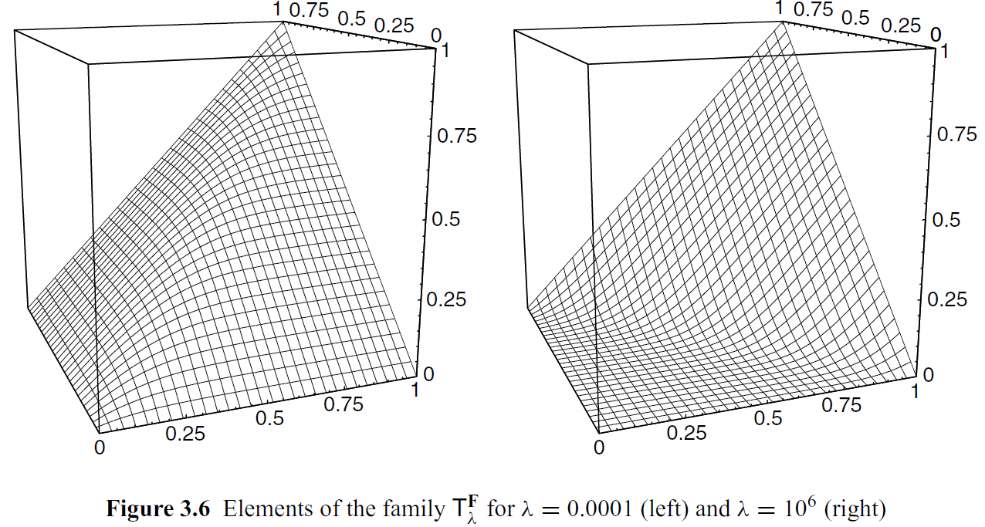
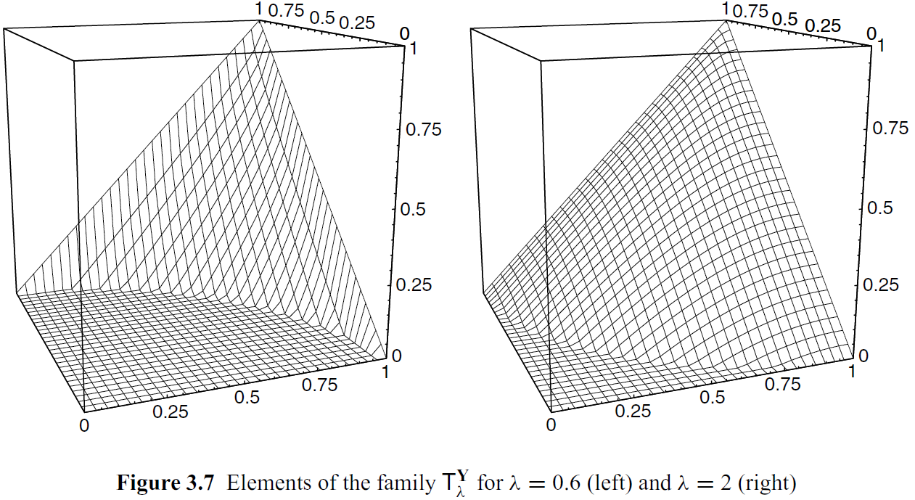
Grabisch, M., Marichal, J., Mesiar, R., & Pap, E. (2009). Aggregation Functions
(Encyclopedia of Mathematics and its Applications). Cambridge: Cambridge University Press.
doi:10.1017/CBO9781139644150
Frank t-norm
Yager t-norm

Slide 28
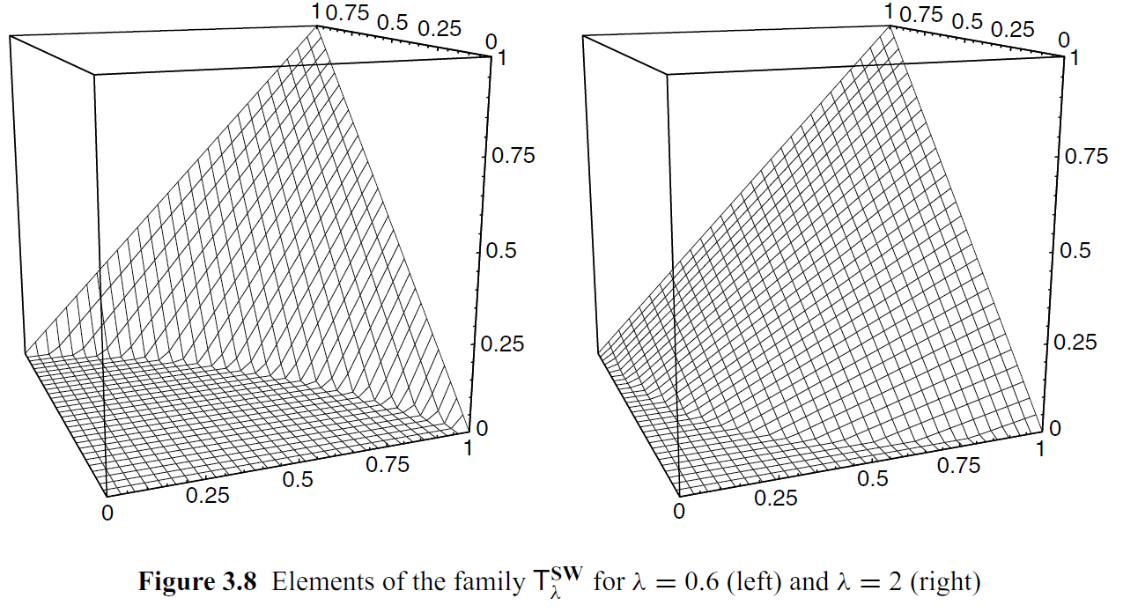
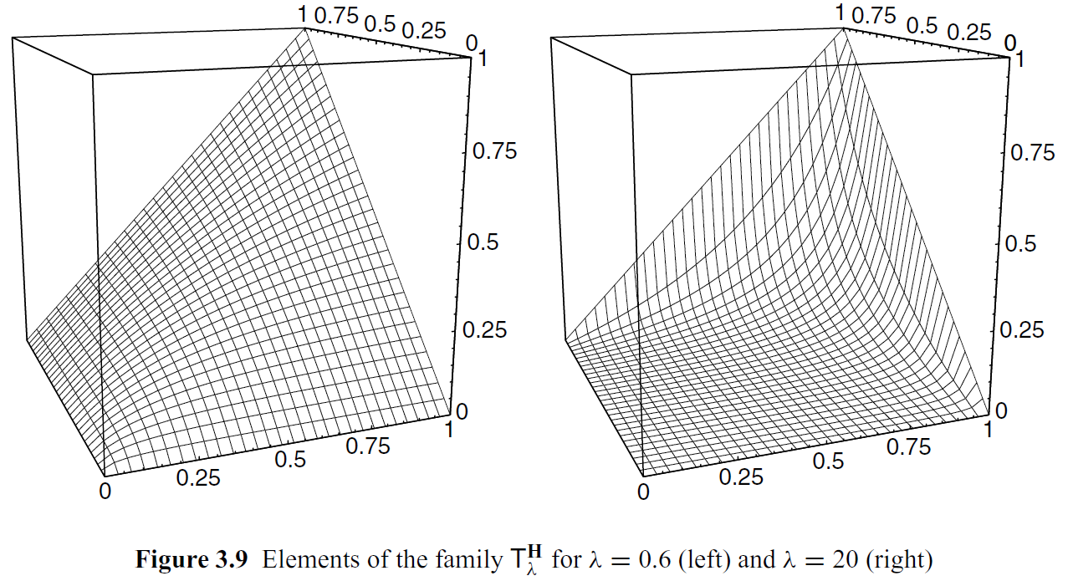
Grabisch, M., Marichal, J., Mesiar, R., & Pap, E. (2009). Aggregation Functions
(Encyclopedia of Mathematics and its Applications). Cambridge: Cambridge University Press.
doi:10.1017/CBO9781139644150
Sugeno-Weber t-norm
Hamacher t-norm

Slide 29
Identification of aggregation functions
Try to fit data with an aggregation (whatever)
This can be considered an inductive method (nevertheless not a stochastic one)
How to evaluate results?
…

Slide 30
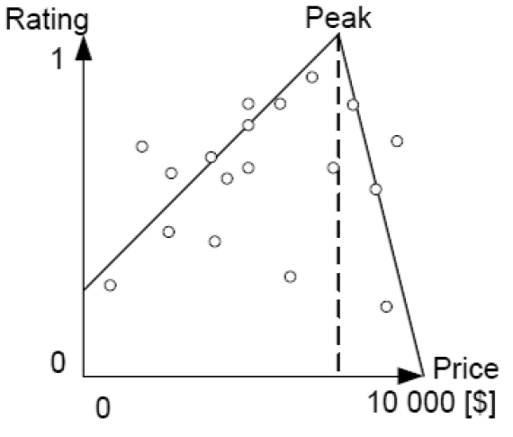
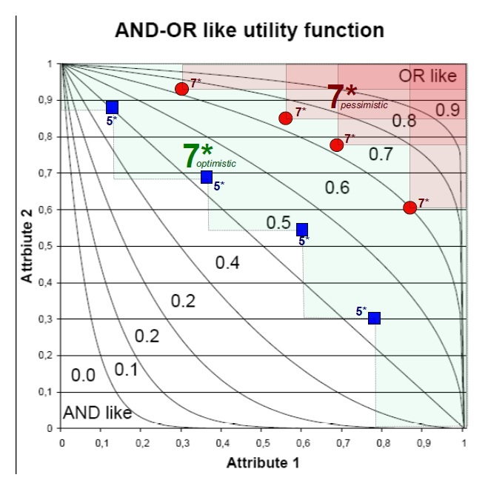
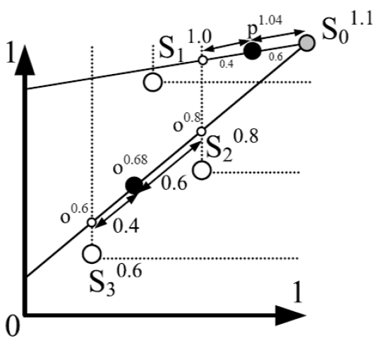
Some heuristics from our production

Slide 31
Notice, our LMPM can be turned around
x₁
2d-ideal
1
It can be important for design of the user interface
Where do users intuitively look for better results (in geometrical sense)
up-right (north-east)?
down-left (south-west)?
We can organize user –studies
Or to use eye-tracking system
Maybe 3D intuition, or a VR one
x₂
D₁
0
1
D₂

Slide 32
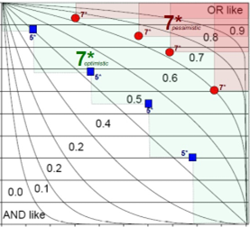
Notice, our LMPM can be turned around
x₁
2d-ideal
1
Two methods in one image
Accept behaves OR-like
Refute behaves AND-like
(see contour lines)
Each known item with rating 0.7 and 0.5 creates two areas/contour lines
red one – minimal (pessimistic) with forced preference at least 0.7
Green one – maximal (optimistic) without contradiction with 0.5 rated items
x₂
D₁
0
1
D₂

Slide 33
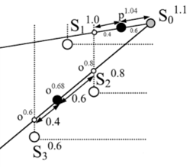
Notice, our LMPM can be turned around
x₁
1
Geometric method
Learn (approximate) aggregation from data
We have some known ratings +
The ideal point gets 1.1
A new data point (black solid circle )
Connect it to ideal
Give it rating proportional to intersection of Pareto areas from known ratings
x₂
D₁
0
1
D₂

Slide 34
Convex combination of &’s and V’s
Heuristics says
In the PC “reject 00 corner” behave conjunctively (if all are bad then do not tolerate extreme failure)
In the PC “accept 11 corner” behave disjunctively (you tolerate some weakness if all other are very good)
Let us try @^{c} convex combination of & and V. For product @_{P}^{cα} on the diagonal the z-contour line is
@_{P}^{c}(x, x)$= αx^{2}+\left(1−α\right)\left(2x−x^{2}\right)=z$
On the border of PC for all &,V use
$\&^{\text{•}}\left(1,x\right)=\&^{\text{•}}\left(x,1\right)=x$ ,
$⋁\text{•}\left(0,x\right)=⋁\text{•}\left(x,0\right)=x$ , gives
$@^{\text{c}}\left(0,x\right)=@^{\text{c}}\left(x,0\right)=\left(1−α\right)x and$
$@^{c}\left(1,x\right)=@^{c}\left(x,1\right)=\left(1−α\right)+αx$
1-α
z

Slide 35
Convex combination of &’s and V’s
On the border of PC for all &,V use
$@^{\text{c}}\left(0,x\right)=@^{\text{c}}\left(x,0\right)=\left(1−α\right)x=z$gives $x= \frac{z}{1−α}$
$@^{c}\left(1,x\right)=@^{c}\left(x,1\right)=\left(1−α\right)+αx$ gives $x=\frac{z+α−1}{α}$
On the diagonal for &_{P} and V_{P} we get
@_{P}^{c}(x, x)$= αx^{2}+\left(1−α\right)\left(2x−x^{2}\right)=z$ hence solution can be one of
$x=\frac{α−1±\sqrt{α^{2}+2α\left(z−1\right)+1−z}}{2α−1}$
In what follows we will depict several contour lines for different α (see also excel)
1-α
z

Slide 36
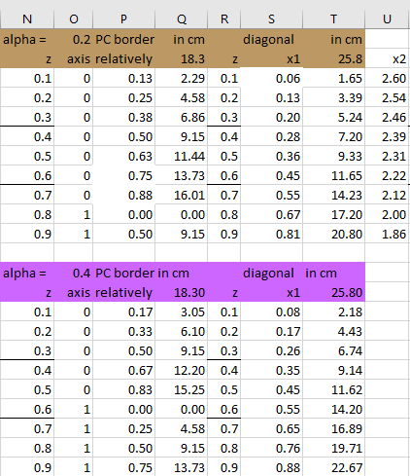
How did we get this for @_{P}^{c}?
Which axis is z-cl on?
=IF(N3<1-$O$1,"0","1")
=IF(N3<1-$O$1,(N3/(1-$O$1)),(N3-1+$O$1)/$O$1)
Behavior on the diagonal
x₁ =(($O$1-1)+SQRT($O$1^2+2*$O$1*(R3-1)+1-R3))/(2*$O$1-1)

Slide 37
more influence of conjunction
Preference Product Logic Convex combination – illustrative, to get ideas
Contour lines
α*&_{P}(x₁, x₂) +
+ (1-α)*V_{P}(x₁, x₂)
with linear approximation between diagonal and PC border
For α = 0.6 orange bigger
For α = 0.8 violet biggest
Means bigger influence of conjunction
For small z (especially for α = 0.8) contour line C_{z} shows AND-like behavior
0.2
1
z=0.3
z=0.1
z=0.1
0
x₂
0.3
0.4
0.1
0.5
0.6
0.2
0.7
0.8
0.3
0.9
x₁
1
0.9
0.8
0.7
0.6
0.5
0.4

Slide 38
more influence of disjunction
Preference Product Logic Convex combination – illustrative, to get ideas
Contour lines
α*&_{P}(x₁, x₂) +
+ (1-α)*V_{P}(x₁, x₂)
with linear approximation
For α = 0.2 brown biggest
For α = 0.4 blue bigger
Means bigger influence of disjunction
For large z (especially for α = 0.2) contour line C_{z} shows OR-like behavior
Sorry for quality, this is a working draft
0.8
1
0.7
0.6
0.5
0.4
0.3
0.2
0.1
0
x₂
0.1
0.2
0.9
0.3
0.4
0.5
x₁
1
0.9
0.8
0.7
0.6

Slide 39
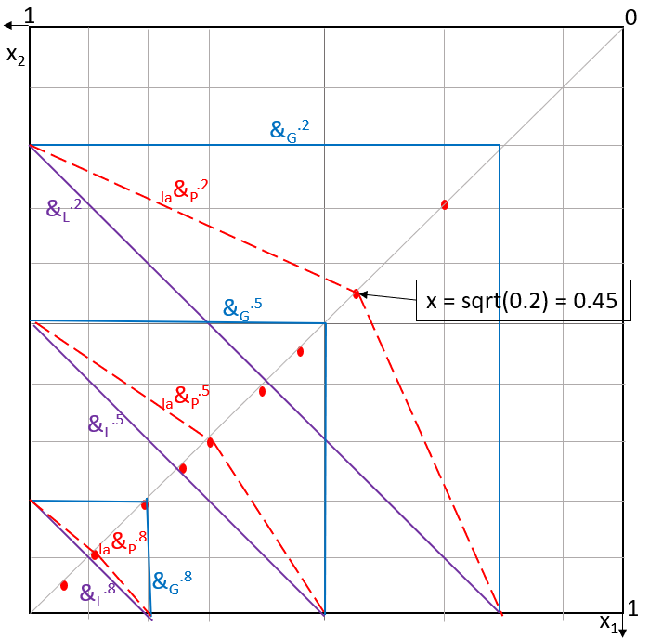
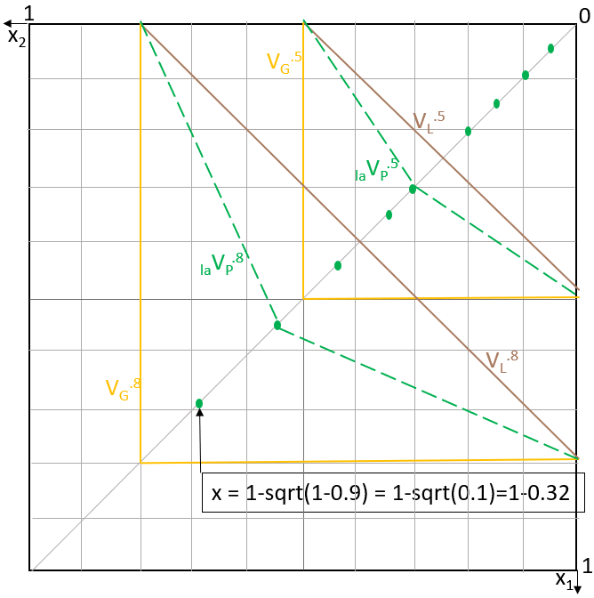
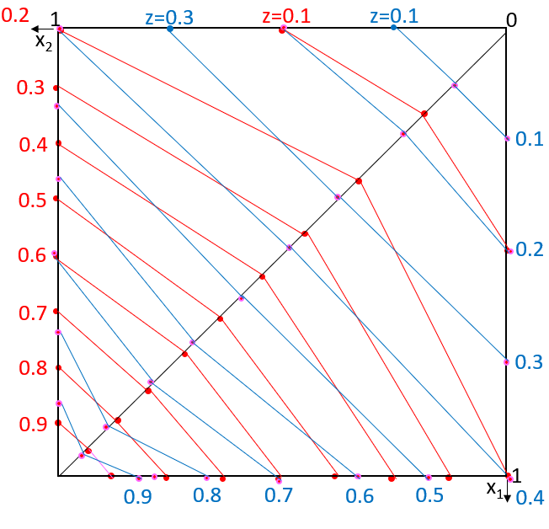
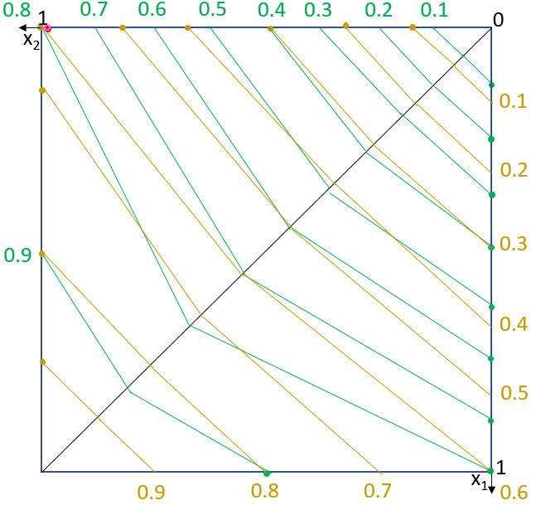
Modelling users so far
We try to create a large family of preferential aggregators to increase the chance that a user will behave like this
idea of convex combinations
α*&_{P} + (1-α)*V_{P}
shows for extreme values desired behavior, but for different α
From empirical observation we know that users behave and-like if all attribute preferences are small and one is very small, and or-like in opposite case

Slide 40
Let us generate ideas
Let us freely generate ideas, heuristics and try to mimic user’s preference
Typically, a preference cube with and-like and or-like behavior can look like in this image
Of course, we must
- draw contour lines
- Try its behavior on data
- Maybe we can somehow measure whether user behaves like this
- Do not violate Pareto ordering
to get intuition in other recommender models besides gLMPM
1
0
x₂
1
x₁

Slide 41
D₂
Let us freely generate ideas, heuristics and try to mimic user’s preference
Typically, a preference cube with and-like and or-like behavior can look like in this image
Let’s generate ideas in PC and have a look on consequences in DC because in DC we can see if our “guess” really fits user preferences
Red cl_{0.26} (approximately)
green cl_{0.81} (approx.) when preserving convention that cl value
Is on diagonal (not necessary)
C
E
D
B
f₂
x₂
D₁
1
0
f₁
1
x₁

Slide 42
D₂
Let us freely generate ideas, heuristics and try to mimic user’s preference
Nevertheless, we must, at least, require preservation of Pareto order (of course we can discuss also this requirement – e.g., if it is not violated too often)
C
E
D
B
f₂
x₂
1
0
D₁
f₁
1
x₁

Slide 43
D₂
construction
Yet another idea guided by an assumption that or-like and and-like behavior is further influences by changing weights when moving from and to or.
Here, for small z the and-like contour line gives bigger weight for x₁ coordinate (A₁ attribute) and with growing z we get influence of x₂ (A₂ attribute) greater
Please depict some contour lines in DC
C
E
D
f₂
B
x₂
D₁
1
0
f₁
1
x₁

Slide 44
D₂
Yet again a new idea –
Let us work in DC (representing user interface)
Maybe there are some ideas observed from user’s behavior
What does it here “and-like refutation” and “or-like acceptance” mean?
Simplified to “quarter plane”
Start in DC, construct PC contour lines
C
E
D
B
f₂
x₂
D₁
1
0
1
f₁
x₁

Slide 45
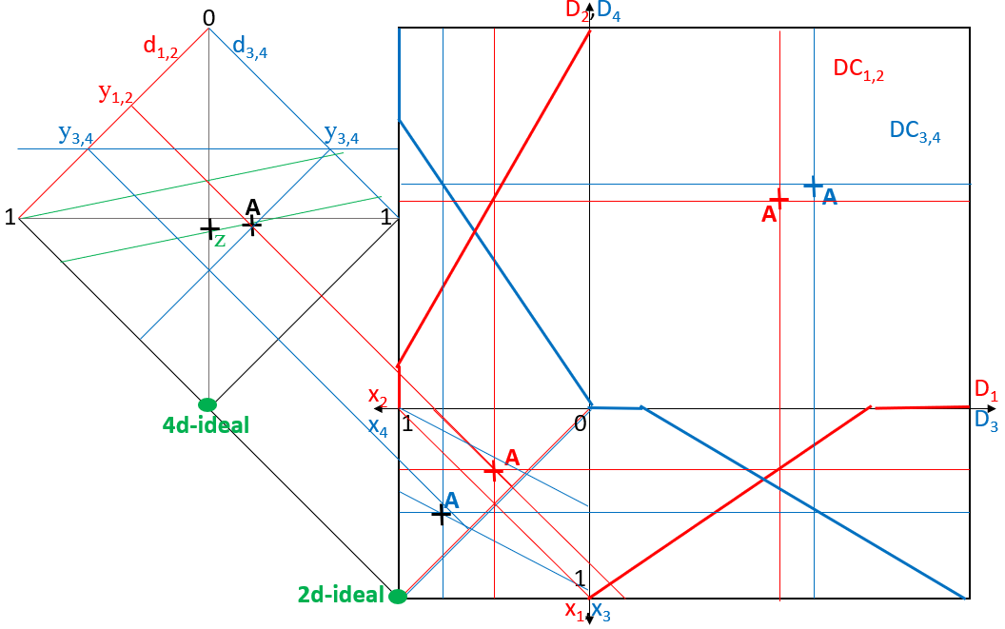
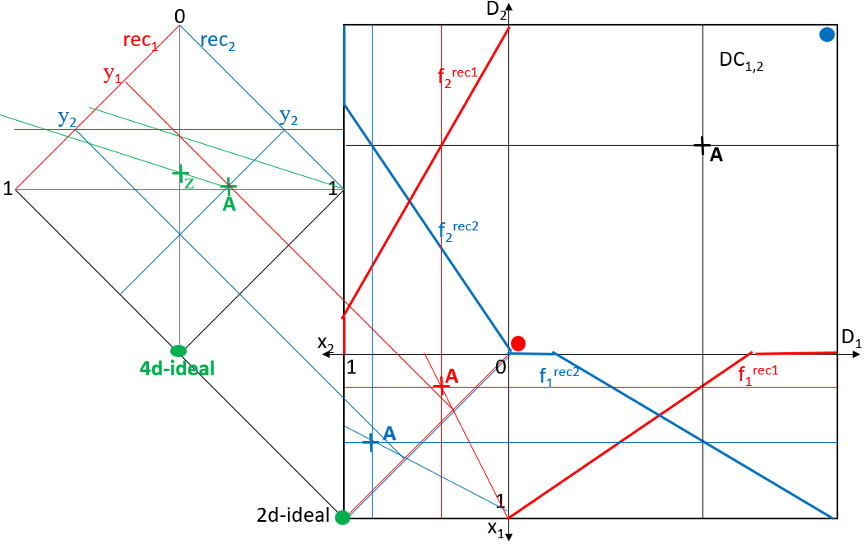
4D(8D) more combinations data x users x …
A 4D aggregation is necessary for aggregation of results of
Two users
Two recommenders
Note, that this is different from DC₄ = 2xDC₂ in first lecture
The task has several parameters, we check only few
Attribute preferences f₁^{rec1}, f₂^{rec1}, f₁^{rec2}, f₂^{rec2} / f₁^{u1}, f₂^{u1}, f₁^{u2}, f₂^{u2},
Aggregations @₁, @₂, in 2D-PC
Aggregation/confidence in 4D-PC

Slide 46
4D(8D) more combinations data x users x …
Assume single 2D-DC
A 4D aggregation is necessary for aggregation of results of
Two users
Two recommenders
Note, that this is different from DC₄ = 2xDC₂ in first lecture
The task has several parameters, we check only few
Attribute preferences f₁^{rec1}, f₂^{rec1}, f₁^{rec2}, f₂^{rec2} / f₁^{u1}, f₂^{u1}, f₁^{u2}, f₂^{u2},
Aggregations @₁, @₂, in 2D-PC
Aggregation/confidence in 4D-PC

Slide 47
Two recommender systems with different confidence/
/weight rec₁ with w₁=2/3 and rec₂ with w₁=1/3
Two RS 2D-DC → 4D-PC
0
D₂
rec₁
rec₂
y₁
DC_{1,2}
f₂^{rec1}
y₂
y₂
A
1
z
1
A
f₂^{rec2}
x₂
D₁
4d-ideal
1
A
0
f₁^{rec2}
f₁^{rec1}
Assume, we have two recommenders with f₁, f₂, and weights corresponding confidence, differing from 4D case just one 2D-DC, two 2D-PCs. Results is in 4D-PC resulting in z
A
1
2d-ideal
x₁

Slide 48
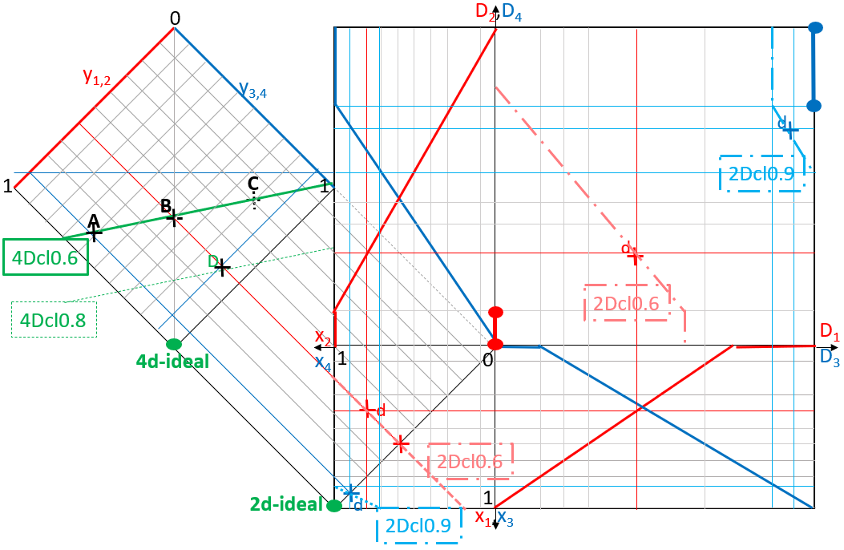
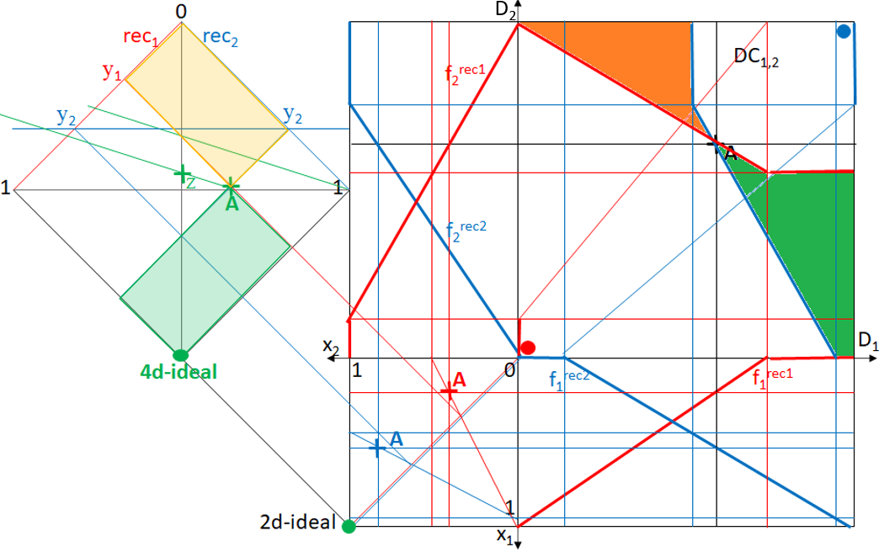
4D data, one user, DC₄ → PC₄
2D data, two users, DC₂ → PC₄
4D data, one user, PC₄ → DC₄
2D data, two users, PC₄ → DC₂

Slide 49
Two recommender systems, rec₁ with w₁=2/3 and
rec₂ with w₁=1/3
4D-PC → 2D-DC, two RS
0
D₂
rec₁
rec₂
y₁
DC_{1,2}
f₂^{rec1}
y₂
y₂
A
1
z
1
A
f₂^{rec2}
x₂
D₁
4d-ideal
1
A
0
f₁^{rec2}
f₁^{rec1}
Two recommenders as before. What is coimage of A on 2D-DC? All points on intersection of 2D-PC cls – only A itself. 4d-ideal need not have source! What is the best possible point?
A
1
2d-ideal
x₁

Slide 50
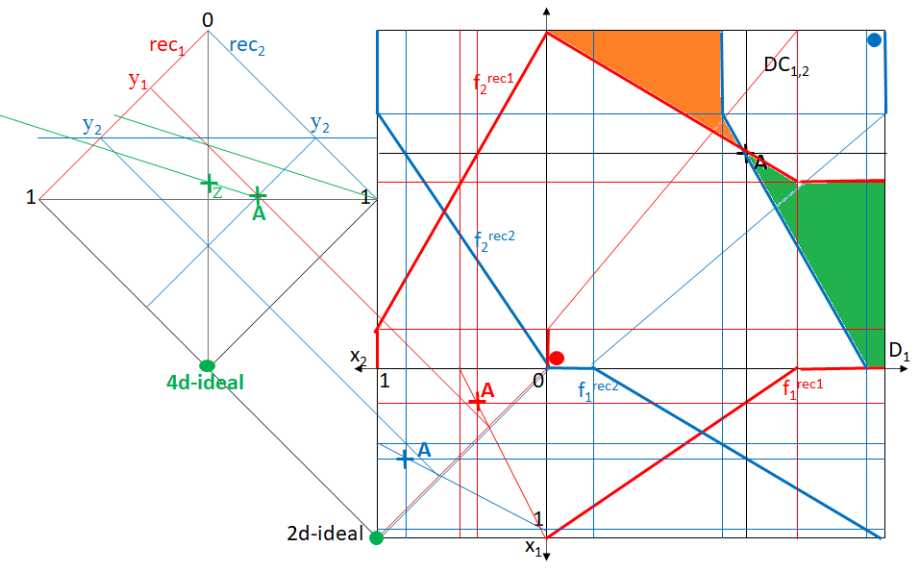
Two recommender systems, rec₁ with w₁=2/3 and
rec₂ with w₁=1/3
4D-PC → 2D-DC, two RS
D₂
Two recommenders as before. Which data points (are) dominate(d by) A in both recommenders.Green, orange areas of 2D-DC are intersection of areas above, below both cls. The rest?

Slide 51
Two RSs, rec₁ with w₁=2/3 and rec₂ with w₁=1/3,
Merging two lists of same data
Merging two RSs
0
D₂
rec₁
rec₂
c₂
f₂^{rec2}
f₂^{rec1}
a₁
DC_{1,2}
b₁
b₂
c₁
a₂
A
1
1
C
B
A
B
C
x₂
D₁
4d-ideal
1
0
f₁^{rec2}
f₁^{rec1}
Two recommenders as before. What is coimage of A on 2D-DC? All points on intersection of 2D-PC cls – only A itself. 4d-ideal does not have source! What is the best possible point?
C
B
A
A
B
C
1
2d-ideal
x₁

Slide 52
Two RSs, various weights,
Merging two lists of same data
Merging two RSs data
0
D₂
rec₁
rec₂
c₂
f₂^{rec2}
f₂^{rec1}
a₁
DC_{1,2}
b₁
b₂
c₁
a₂
A
1
1
C
B
A
B
C
x₂
D₁
4d-ideal
1
0
f₁^{rec2}
f₁^{rec1}
Two recommenders as before. What are allowed areas of 4D-PC for their aggregations. In Pareto order are A, B, C not comparable. Data points are on DC diagonal …
C
B
A
A
B
C
1
2d-ideal
x₁

Slide 53
Two RSs, same attribute preferences and @’s as before
Let us gain insight into their aggregation varying 4D @’s
Let’s try another distribution of 2DC data
0
D₂
rec₁
rec₂
c₂
f₂^{rec2}
f₂^{rec1}
DC_{1,2}
a₁
b₂
a₂
A
c₁
b₁
1
A
1
C
B
C
B
x₂
D₁
4d-ideal
1
C
0
f₁^{rec2}
f₁^{rec1}
Changing weight of RSs can
change overall result. Here we can see ordering different from orderings of single RSs.
Is arbitrary ordering possible?
A
B
A
B
C
1
2d-ideal
x₁

Slide 54
Two RSs, experiment, where is 2D-DC mapped? Let’s try DC
corner points. Much depends on baseline aggregation.
Merging two RSs
0
D₂
rec₁
rec₂
f₂^{rec2}
f₂^{rec1}
B
A
DC_{1,2}
b₁
b₂
This can be seen also as a two /
three level hierarchical aggregation
First baseline single attribute
recommenders
Second 2D-PC
Third 4D-PC
d₁
d₂
B
1
1
C
A
D
x₂
1
C
D
D₁
B=D
C=A
4d-ideal
0
f₁^{rec2}
f₁^{rec1}
A and C do not change 4D-PC position, unless attribute preference
changes.
One can experiment with various pairs of 2D-PC aggregations @₁, @₂, …
1
2d-ideal
C=A
D=B
x₁

Slide 55
foto

Slide 56
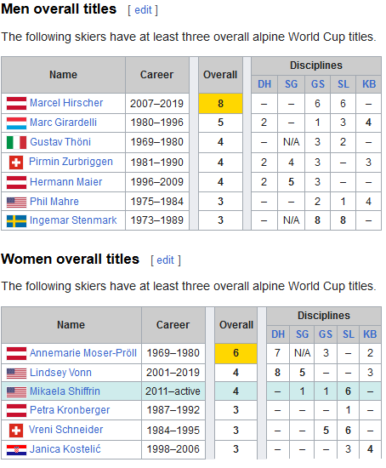
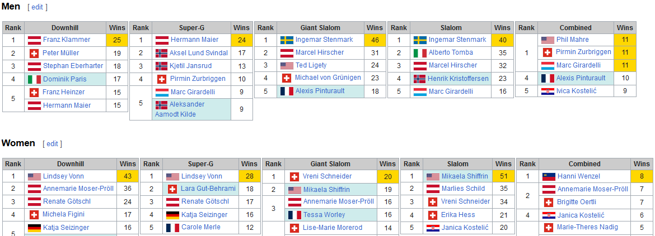
FIS Alpine Ski World Cup

Slide 57
Numerical data + discrete domains
The ratio scale has a zero value at the location that corresponds to the absence of the monitored character (Poměrová stupnice má nulovou hodnotu na místě, které odpovídá nepřítomnosti sledovaného znaku)
How various sports decide winners (order results)
FIS Alpine giant slalom
F1 cars
Women tennis WTA
Tour de France
Decathlon, modern pentathlon, women's heptathlon,
Can sports motivate recommenders? – yet another model – check whether it fits
Athlete = item
Race = recommender = voter = attribute
How do recommenders aggregate lists?
Ensemble, bandits, d’Hondt, D’21, … (more Peška)
Single user

Slide 58
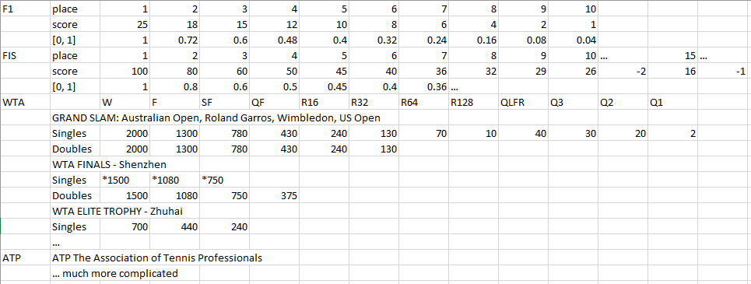
Let’s start with lists, give score? Use aggregation?
Various lists (from baseline recommenders) merging results are used
Bandits
Ensemble
Even 2D-LMPM can be seen as merging of two lists created by attribute preferences
Single race/match – the whole season is
evaluated by sum of all/some/top-k
races/matches

Slide 59
FIS Alpine best four women GS season 21-22
_{score}
_{6.3 20.3}
GS-25.1, 6.3
0
GS-11.3,20.3
h
H^{1,3}_{0,14}
v
S^{5,4}_{3,7}
s
s,w
V^{2,0}_{1,3}
w,h
v
W^{3,1}_{4,4}
H
1
S
1
V
H = Sara Hector
W = Tessa Worley
S = Mikaela Shiffrin
V = Petra Vlhova
W
1
_{score}
_{25.1}
_{11.3}
4d-ideal
x₂
H
0
If our data are already FIS Alpine points (rounded up) – the in fact we do not need data cube. Let’s play around with this idea, the we can even aggregate 8 dimensions. See next slide
S
W
W
S
V
1
H
V
x₁

Slide 60
FIS Alpine women GS season 21-22, all but first race(of 9)
GS-25.1, 6.3
28.12, 8.1
GS-11.3,20.3
21.12, 22.12
_{6.3 8.1}
_{20.3 22.12}
0
h
w
s
v
0
h
1
0
s
This is
8-D PC
H
v
swvw
S
sv
v
V
whh
hs
H
w
H
W
h
1
S
1
S
s
V
V
S
v
V
w
W
W
W
H
_{25.1}
_{11.3}
_{28.12}
_{21.12}
1
S
1
4d-ideal
x₂
0
If our data are already FIS Alpine points (rounded up), points normalized to[0,1], all are preference cubes.We can aggregate 8-D. B and R to G, Orange and Purple to Lavender. G and L to Brown
W
W
H
V
W
H
V
1
S
x₁
W
H
S
V
W

Slide 61
FIS Alpine WGS 21-22, last 8 races(of 9), time weighted
GS-25.1, 6.3
28.12, 8.1
GS-11.3,20.3
21.12, 22.12
_{6.3 8.1}
_{20.3 22.12}
0
h
w
v
s
0
h
1
0
s
This is
8-D PC
H
v
swvw
S
sv
H
h
v
V
whh
hs
w
H
W
1
S
1
S
s
V
V
S
W
w
W
V
v
W
H
_{25.1}
_{11.3}
_{28.12}
_{21.12}
1
S
1
4d-ideal
x₂
0
We have two data for each B, R, O, P equally weighted. Newer 2B : R = G, never 2O : Purple = L, much newer 3G : L = Brown. In oldest P were H,S best, newest G was best V, whole season W best also
W
W
H
V
W
H
V
1
S
x₁
W
H
S
V
W

Slide 62
FIS Alpine women GS last four races 21-22
GS-25.1, 6.3
GS-11.3,20.3
_{Rank}
_{6.3 20.3}
H^{1,3}_{0,14}
S^{5,4}_{3,7}
V^{2,0}_{1,3}
W^{3,1}_{4,4}
0
h
₁
₂
₃
₄
₅
₆
₇
₈
₉
₁₀
₁₁
W
v
s
s,w
V
H
w,h
v
W
S
H
1
S
1
V
S
W
V
H
1
H
1 2 3 4 5 6 7 8 9 10 11
_{Rank}
_{25.1}
_{11.3}
4d-ideal
x₂
0
Let’s try to deal with position ranking as an attribute. We use F1 scoring system. Then last four races (as in F1 rules where points have a time restricted validity).
S
W
W
S
V
1
H
V
x₁

Slide 63
FIS Alpine women GS best four races final weighted
GS-25.1, 6.3
GS-11.3,20.3
_{Rank}
H^{1,3}_{0,14}
S^{5,4}_{3,7}
V^{2,0}_{1,3}
W^{3,1}_{4,4}
0
₁
₂
₃
₄
₅
₆
₇
₈
₉
₁₀
₁₁
HWS
sw/2
v/2
v,h/2
VH
hws/2
v
WS
V
How to depict weight 2 for final? Depict all other weights/2
ws
v
v
h
h
1
1
V
SW
H
1
1 2 3 4 5 6 7 8 9 10 11
_{Rank}
4d-ideal
x₂
0
Last experiment shows aggregation like WTA. Only limited number of best races counts, Grans Slam has weight 2, here we can use FIS score round up as only ranking 1, 2, 3 appears
V
WS
1
HWS
HV
x₁

Slide 64
Aggregating 2/4 lists/RSs, sports experiment
Well, mostly aggregating points score, no content
Various sports decide winners differently
Evaluated on best four in FIS Alpine GS-giant slalom
FIS Alpine giant slalom (sum of points whole season – if you miss a competition, you lose)
F1 cars (only top 10 classified, last 52 weeks count, …)
Women tennis WTA – Grand Slam weighted (rules are changing: 16 best tournaments for singles and 11 doubles. Now (corona?) best six singles plus 25% of your best six doubles results within the previous 52 weeks)
Tour de France – Sum of times with winner bonification – possible to use also for FIS, how to count did not attend, did not finish, …
Decathlon, modern pentathlon, women's heptathlon, try yourself
Can sports motivate recommenders? – yet another model – check whether it fits
Athlete/driver = item
Race = recommender = voter = attribute
Single user (sport association)
whole season ≈ aggregate base RSs

Slide 65
Mixing results in ordered lists, content based, preference and/or confidence score, …
Let’s try mixing of data
Aggregate product logic users, one or-like, second and-like
How do recommenders aggregate only lists?
Ensemble, bandits, d’Hondt, D’21, … (more Peška)
…

Slide 66
Baseline + (returned)clicked, visible did not click
rec₁
rec₂
D₂
0
a₂
b₂
d₁
a₁
A
A
c₁
b₁
d₂
D
B
c₂
1
1
D
C
B
C
C
1
0
D₁
4d-ideal
x₂
A
A
Let’s combine content and behavior. What we see, having only one behavior score makes it more influential, it’s not fair!
Let’s try more
B
B
B
D
A
D
D
C
1
C
x₁
C

Slide 67
Baseline + (ctr,vtr,v,nv) x (time of last visit)
rec₁
rec₂
D₂
0
a₂
A
d₁
a₁
b₂
c₂
A
A
c₁
b₁
D
D
d₂
1
1
B
D
C
C
C
B
B
C
1
0
D₁
4d-ideal
x₂
A
A
Combine content and two behavior score. Ctr, click later, not visible, visible and ignored. Second is time of last visit – the older the less influential another score. All data only illustrative …
B
B
B
D
A
D
D
C
1
C
x₁
C

Slide 68
Both product (dis/con)junction (see slide 13)
0
D₂
rec₁
rec₂
f₂^{u}
b₂⁻
b₂⁻
b₂⁺
b₂⁺
1
1
B
f₂^{u}
B
1
0
D₁
4d-ideal
x₂
Two users evaluate with product connectives (considering attributes independent), the green one aggregates with V_{P}, the red one with &_{P}, the total gives weight 2 to OR-like
B
f₁^{u}
f₁^{u}
B
V_{P}^{.7-.8}
1
&_{P}^{.5-.6}
x₁

Slide 69
Thanks
Comments, questions?

