Slide 1

Recommender Systems: good or evil?
Ladislav Peška

Slide 2


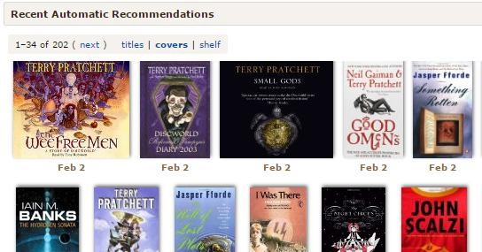
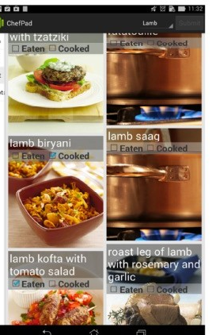


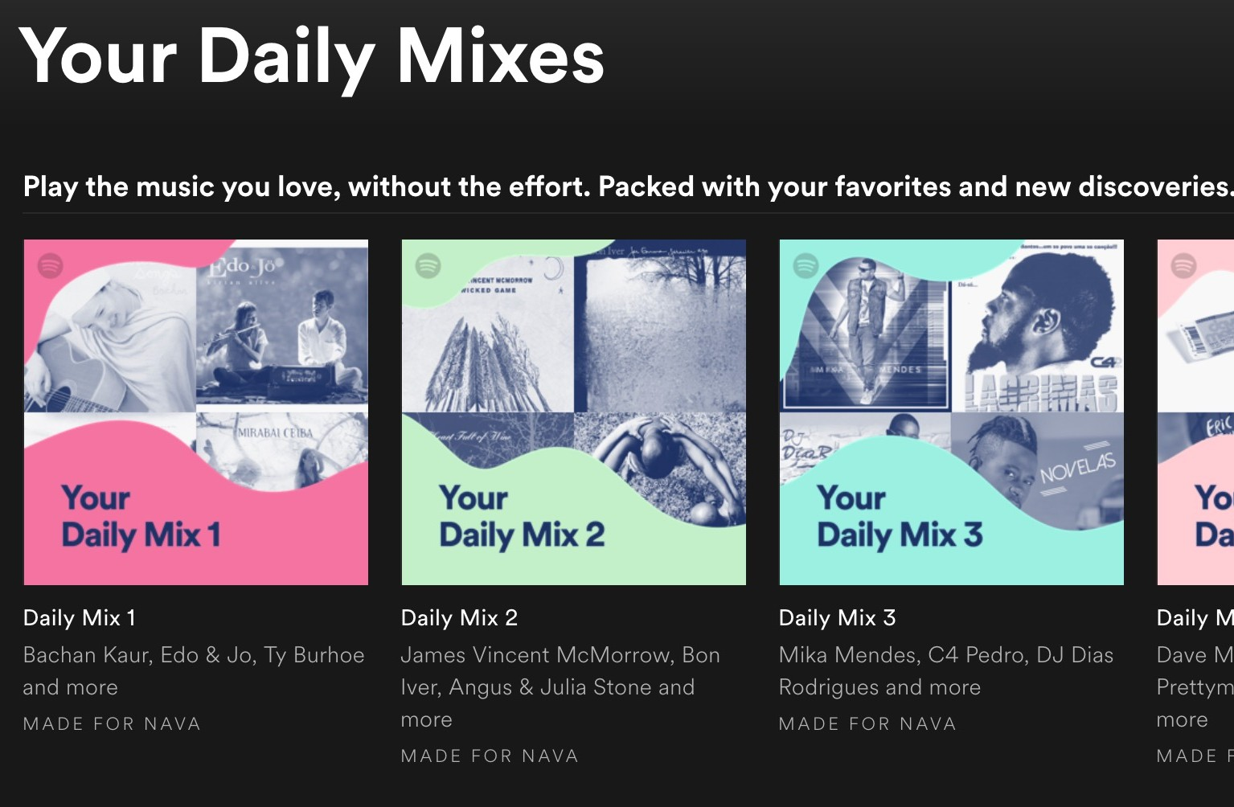
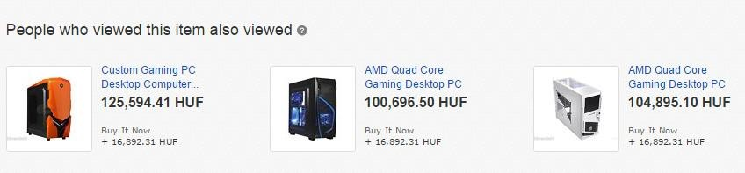
What are recommender systems, anyway?
Sub-area of information retrieval
  Provide recommendations without explicit query from the user
  Ideally, display items that are:
    Hard to find for the user
    Relevant for the task at hand
  Like a search engine, where the query is you yourself ☺

Slide 3

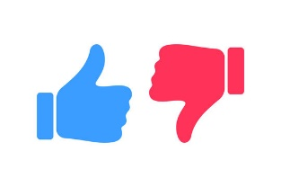


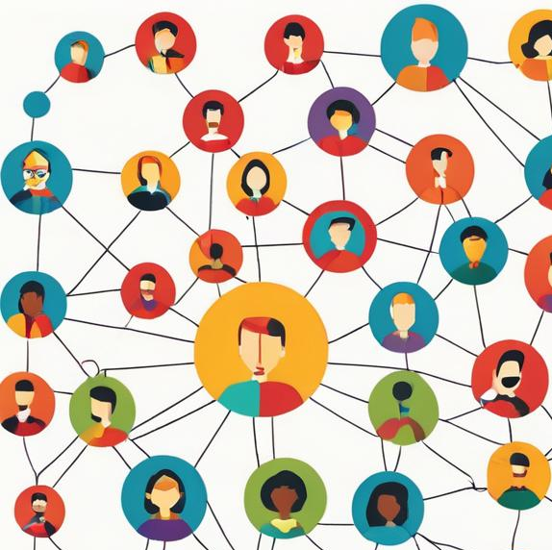
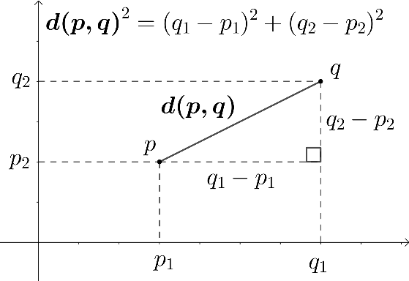

What are recommender systems, anyway?
How recommender systems work?
  Based on similarity!
  Using feedback of your users
  Using content of your items
  ... and other stuff ☺
What do you mean by similarity?
  Jaccard: |A$∩$B| / |A$∪$B|; A, B are sets
  L2 (Euclidean): 1 / Euclidean distance
    Eucl_dist: $\sqrt{\sum_{i=0}^{|A|}{{(A_{i}−B_{i})}^{2} }}$; A, B are vectors
  ...

Slide 4
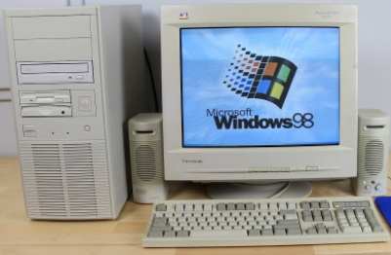

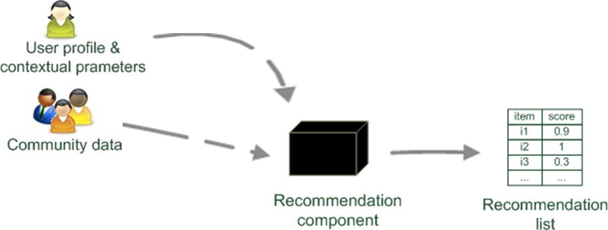

Prehistory: user KNN model
Prehistory =
Collaborative filtering: lets give you what your friends like
  Active user $u$ (we want to recommend to this user)
  All known ratings of all users:
    Rating matrix R(users X items)
User K-Nearest Neighbors algorithm
  Calculate similarity of $u$ to all other users $\overline{u}$ (w.r.t. vectors of rated items)
  Select K users that are most similar to $u$ -> $\{u_{1},u_{2},u_{3}\}$
  Recommend top items that $u$ does not know,
  but $\left\{u_{1},u_{2},u_{3}\right\}$ liked them
0.9
0.4
0.6
0.7
0.1

Slide 5

Prehistory: user KNN model
Prehistory =
Collaborative filtering: lets give you what your friends like
  Active user $u$ (we want to recommend to this user)
  All known ratings of all users:
    Rating matrix R(users X items)
User K-Nearest Neighbors algorithm
  Calculate similarity of $u$ to all other users $\overline{u}$
  Select K users that are most similar to $u$ -> $\{u_{1},u_{2},u_{3}\}$
  Recommend top items that $u$ does not know,
  but $\left\{u_{1},u_{2},u_{3}\right\}$ liked them
0.9
0.4
0.6
0.7
0.1

Slide 6

Prehistory: user KNN model
Prehistory =
Collaborative filtering: lets give you what your friends like
  Active user $u$ (we want to recommend to this user)
  All known ratings of all users:
    Rating matrix R(users X items)
User K-Nearest Neighbors algorithm
  Calculate similarity of $u$ to all other users $\overline{u}$
  Select K users that are most similar to $u$ -> $\{u_{1},u_{2},u_{3}\}$
  Recommend top items that $u$ does not know,
  but $\left\{u_{1},u_{2},u_{3}\right\}$ liked them
Σ( )-

Slide 7
Prehistory: user KNN model
Prehistory =
Collaborative filtering: lets give you what your friends like
  Active user $u$ (we want to recommend to this user)
  All known ratings of all users:
    Rating matrix R(users X items)
User K-Nearest Neighbors algorithm
  Calculate similarity of $u$ to all other users $\overline{u}$
  Select K users that are most similar to $u$ -> $\{u_{1},u_{2},u_{3}\}$
  Recommend top items that $u$ does not know,
  but $\left\{u_{1},u_{2},u_{3}\right\}$ liked them
Σ( )-
=>

Slide 8

Prehistory: user KNN model
Prehistory =
Collaborative filtering: lets give you what your friends like
  Active user $u$ (we want to recommend to this user)
  All known ratings of all users:
    Rating matrix R(users X items)
User K-Nearest Neighbors algorithm
  Calculate similarity of $u$ to all other users $\overline{u}$
  Select K users that are most similar to $u$ -> $\{u_{1},u_{2},u_{3}\}$
  Recommend items that $u$ does not know, but $\left\{u_{1},u_{2},u_{3}\right\}$ liked them
Do not use this in real systems!

Slide 9
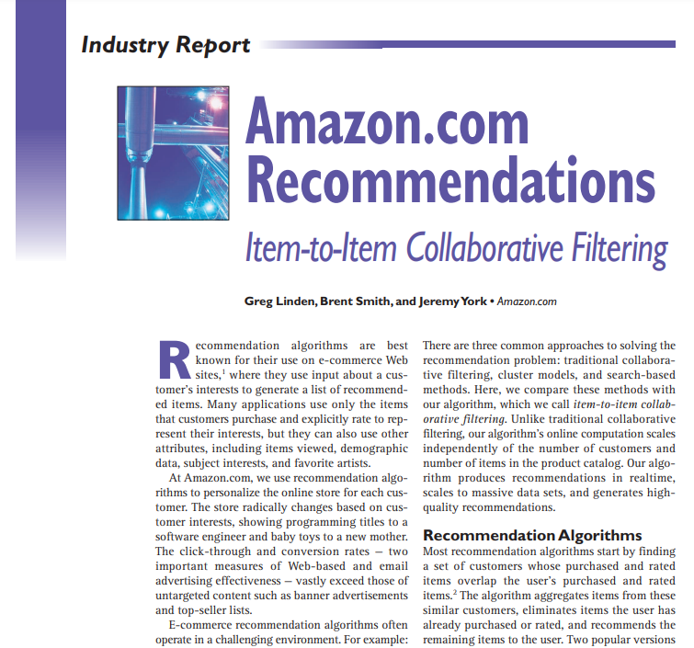
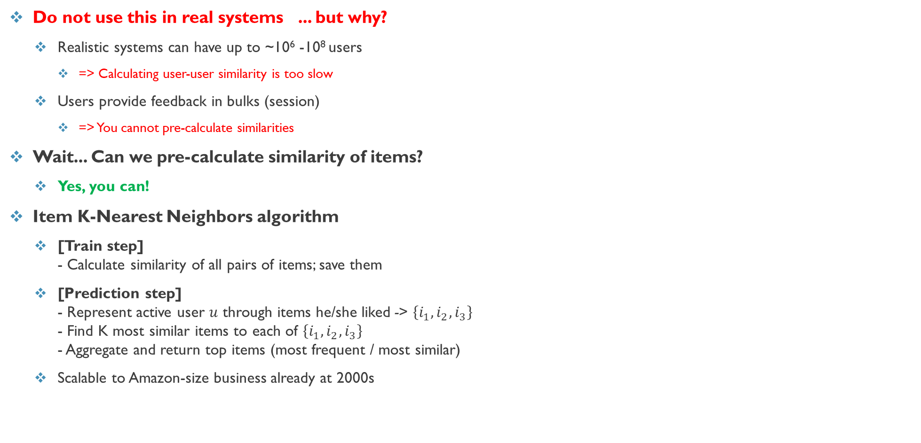
Usable prehistory: item KNN model
Prehistory =
Do not use this in real systems ... but why?
  Realistic systems can have up to ~10⁶ -10⁸ users
    => Calculating user-user similarity is too slow
  Users provide feedback in bulks (session)
    => You cannot pre-calculate similarities
Wait... Can we pre-calculate similarity of items?
  Yes, you can!
Item K-Nearest Neighbors algorithm
  [Train step]
  - Calculate similarity of all pairs of items; save them
  [Prediction step]
  - Represent active user $u$ through items he/she liked -> $\left\{i_{1},i_{2},i_{3}\right\}$
  - Find K most similar items to each of $\left\{i_{1},i_{2},i_{3}\right\}$
  - Aggregate and return top items (most frequent / most similar)
  Scalable to Amazon-size business already at 2000s

Slide 10
Usable prehistory: item KNN model
Prehistory =
Do not use this in real systems ... but why?
  Realistic systems can have up to ~10⁶ -10⁸ users
    => Calculating user-user similarity is too slow
  Users provide feedback in bulks (session)
    => You cannot pre-calculate similarities
Wait... Can we pre-calculate similarity of items?
  Yes, you can!
Item K-Nearest Neighbors algorithm
  [Train step]
  - Calculate similarity of all pairs of items; save them
  [Prediction step]
  - Represent active user $u$ through items he/she liked -> $\left\{i_{1},i_{2},i_{3}\right\}$
  - Find K most similar items to each of $\left\{i_{1},i_{2},i_{3}\right\}$
  - Aggregate and return top items (most frequent / most similar)
  Scalable to Amazon-size business already at 2000s
So, RecSys is good, right? ...Right!?

Slide 11
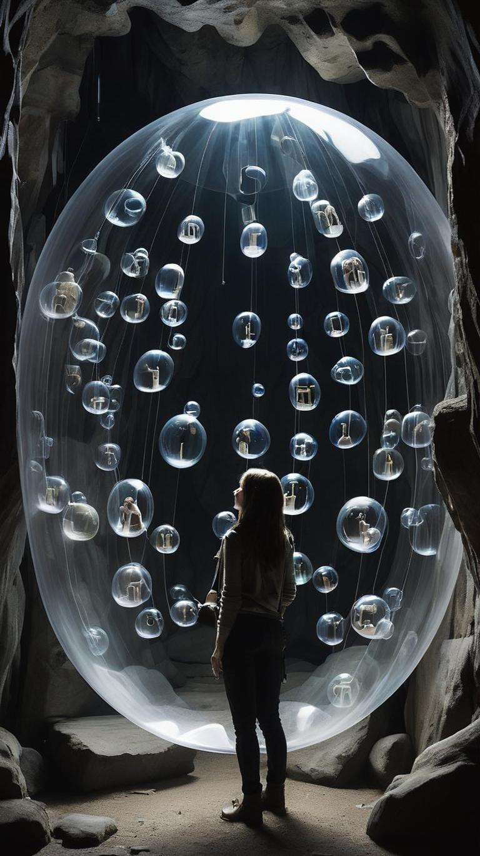
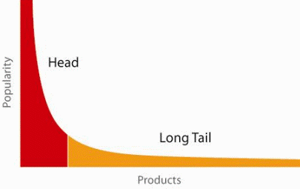
Are recommender systems good or bad?
So, RecSys is good, right? ...Right!? ... Well, it depends
  Can help users to find otherwise hard-to-find „hidden gems“
  Can improve reachability of niche items
  Can personalize content to fit everyone’s individual taste, needs, or preferences
Even if we have no bad intentions...
  We have to work with imprecise, biased data
  Recommending algorithms can amplify or create biases themselves (popularity amplification, ...)
  Users’ behavior is influenced by what we propose to them
Unless we intervene, our data become gradually more and more biased
rare item
RecSys
likes
popular items
[Implicitly: nobody likes ]
„close enough“
„Rich gets richer“

Slide 12

Are recommender systems good or bad?
What if there are multiple sub-groups? [social network]
Animal lowers
Motor heads
RecSys
Supply content according to each group’s preferences
RecSys may contribute to
society radicalization

Slide 13
Are recommender systems good or bad?
What if there are multiple sub-groups? [social network]
Animal lowers
Motor heads
RecSys
We lack the supply of other groups’ opinions
... OVER TIME...
Personalized recommendations may
contribute to societal polarization
Anti-machine
Animal hunters
RecSys may contribute to
society radicalization

Slide 14
Are recommender systems good or bad?
Personalized recommendations may contribute to societal polarization
  Over-supplying groups by content supporting their own pre-existing beliefs or biases
  Often, the content is created by members of such groups
  ECHO CHAMBER: same opinions are resonating in a closed bubble, amplifying over time
Can we do anything about it?
RecSys may contribute to
society radicalization

Slide 15
Can we do something about it?
YES*
Personalized recommendations may contribute to societal polarization
  Over-supplying groups by content supporting their own pre-existing beliefs or biases
  Often, the content is created by members of such groups
  ECHO CHAMBER: same opinions are resonating in a closed bubble, amplifying over time
Can we do anything about it?
* ...to some extent

Slide 16
Are recommender systems good or bad?
Personalized recommendations may contribute to societal polarization
  Over-supplying groups by content supporting their own pre-existing beliefs or biases
  Often, the content is created by members of such groups
  ECHO CHAMBER: same opinions are resonating in a closed bubble, amplifying over time
Can we do anything about it?
  Current research focus on fairness-preservation, bursting echo chambers, multi-objective...
  Implementation in industry exist... But may interfere with business goals...
What can I do about it?
  Kick off your studies at MatFyz
  Survive first 1-2 years
  * Enroll for NSWI166 and NDBI021 courses to get necessary knowledge
  Change the world ☺
*optional
RecSys may contribute to
society radicalization

Slide 17


Recommender Systems
THANK YOU!
QUESTIONS?
Ladislav Peška; ladislav.peska@matfyz.cuni.cz; S208
https://scholar.google.com/citations?hl=cs&user=xoPVWqcAAAAJ&view_op=list_works&sortby=pubdate
https://www.ksi.mff.cuni.cz/~peska/

