Slide 1
Security Development Lifecycle
Matej Groman, Juraj Komlosi
Kentico software

Slide 2
Before we start…
Who are we?
Why are we here?
What are your expectations?
Organizational information

Slide 3
Agenda
What is S-SDLC
S-SDLC phases
Training, Requirements,
Design, Development
Verification, Maintenance
Penetration testing

Slide 4
What is SDLC
Notes:
*https://www.numpyninja.com/post/sdlc-software-development-life-cycle-phases-process-what-is-sdlc

Slide 5
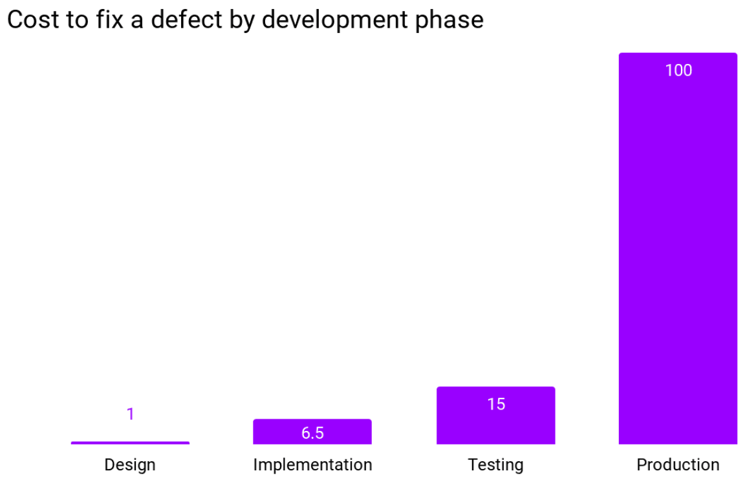
SDLC concepts
Methodologies
Waterfall
Agile
Responsibilities
Teams
Notes:
*https://www.researchgate.net/figure/IBM-System-Science-Institute-Relative-Cost-of-Fixing-Defects_fig1_255965523

Slide 6
Kentico SDLC
Product manager takes in new idea
Dev team break down to tasks, estimates cost (shaping)
Dev team plan next opportunity (planning)
Take tasks from backlog
Usually 2-6 weeks
Outcome from opportunity – new feature
All testing must be part of finishing the opportunity
Some time dedicated to fixing reported bugs / TD

Slide 7
What is S-SDLC
Main motivation
increase the security of the developed features
reduce the number of security issues
reduce the severity of the security issues in the time
avoid privacy issues
S-SDLC concepts:
Education
Continuous process improvement
Accountability

Slide 8
What is S-SDLC
S-SDLC is a framework, not a checklist
Challenge – align people, change mindset
Processes CAN help
Education WILL help
Shift-left mindset
It is not only about the security team
Security is covered in all development aspects

Slide 9
SDLC Process
Analysis
Design
Develop
Test
Deploy
Maintenance
Secure SDLC Process
Security features
Risk analysis
Threat modeling
Static analysis Secure coding
Black Box testing
Penetration test
Training
Incident Response
Vulnerability management Fixing security bugs
Notes:
Source: https://www.researchgate.net/profile/Neha-Mahendra/publication/310757536_A_Categorized_Review_on_Software_Security_Testing/links/58a3d9faaca272d3a4983a63/A-Categorized-Review-on-Software-Security-Testing.pdf

Slide 10
Training phase
Goal is to motivate people to dedicate time to think about security
Know-how (skillset)
Train technical skills - how to detect and exploit issues
Labs, code samples, CTF games, write ups…
Mindset
Explain benefits and goals of S-SDLC
cost of fixing issue in the design vs. testing phase
potential impacts of an undiscovered security vulnerability

Slide 11
Training phase – lessons learned
Notes from Kentico training sessions
Team members struggle with sharing knowledge effectively
Juice shop exercise – solution didn’t meet dev expectations, they didn’t know product so they focused on features not security
What really works – dogfooding – fix your own bug
Preparing workshop for 70+ employees
Continuous process – newhires

Slide 12
Requirements phase
Goal is to define a list of security requirements
Definition of a new feature = functional + security requirements
Define acceptance criteria
What security tests should be performed

Slide 13
Requirements phase - examples
Login form
SDLC Requirement: User is able to log in by providing username and password
S-SDLC Consideration: After X incorrect attempts user account is blocked to prevent brute-force attacks; Login form must not leak sensitive information (if an account with given email address exists)
File upload
SDLC Requirement: User uploads multimedia files using system file selector or Drag&Drop functionality
S-SDLC Consideration: System must check file type to forbid uploading forbidden file types; System must ensure that file is uploaded to designated folder where user has access; The action must be logged with relevant metadata…

Slide 14
Design phase
Goal is to integrate security into the overall design of an application
Crucial phase to avoid insecure design (OWASP)
Important activity:
Threat modeling (STRIDE)
Example – insecure design (cms context)

Slide 15
Design phase – example 1
Login form
Attacker can inject arbitrary input
Attacker might intercept request from client to server
Attacker might use side channel (response time) to gain information
Weak cryptography used for password storage - or collisions
Cookie generated in predictable way → attacker can forge the Auth cookie and bypassing the Login form

Slide 16
Design phase – example 2
File upload
How does the upload affect server performance?
attacker might upload large files concurrently to perform DoS attack
Attacker might use “listing” functionality to exfiltrate data from the server
Attacker might upload malicious files and gain control over the server

Slide 17
Development phase
The goal is to implement the security measures and controls
Key objectives:
Implement security controls
Code security review
Secure coding practices
Integration with security tools

Slide 18
Development phase - practices
Secure default
Default option or outcome should be the most secure
E.g. selecting the hashing algorithm, when no argument is specify do not return “plaintext” but “sha256”
Prevents issues when someone “forgets” to set it up properly
Fail safe
Catch exception & recover gracefully
Dispose of objects
If error message contains sensitive data, do not send it to user - replace with generic message
Least privilege
By default no access, add only necessary permissions
E.g. “No one is able to retrieve data except […]”

Slide 19
Development – client side security
False sense of security
Do not rely on FE validation
Limited controls
It cannot prevent attacks that occur in transit between the client and server
Requests can be modified (Proxy tool - Postman)
Encode / sanitize / validate data against trusted BE data
E.g. sending allowed extensions to FE and validate against it on upload request

Slide 20
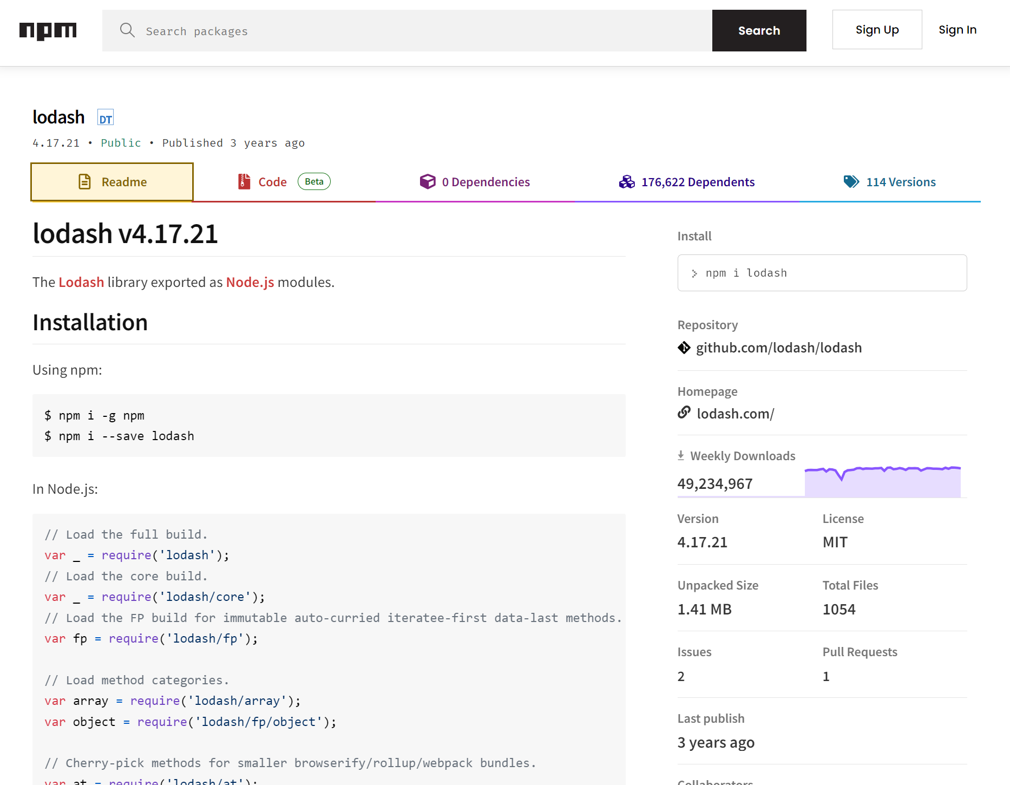
Development – 3rd party dependencies

Slide 21
Verification phase
The goal is to systematically evaluate and validate defined security measures, controls, and requirements
OWASP framework
Penetration testing
Security issue classification – CVSS
CI/CD pipelines - automation

Slide 22
Maintenance phase
Releasing security patches
Handling 0-day vulnerabilities
Bug bounty programs
Creating best practices for end users

Slide 23
Q&A

