Slide 1
Workshop
Matej Groman, Juraj Komlosi
Kentico software

Slide 2
Agenda
Intro to penetration testing
Hands-on pentest of our application
6 exercises
Different types of vulnerabilities

Slide 3
Penetration testing
Focused on finding security vulnerabilities in application
Usually part of verification phase (S-SDLC)
Goal is to „think like an attacker“
Know how to locate vulnerable places
Know how to exploit it
OWASP - materials
Black / Grey / White box

Slide 4
OWASP Top 10 - 2021
Broken Access Control
Cryptographic Failures
Injection
Insecure Design
Security Misconfiguration
Vulnerable and Outdated Components
Identification and Authentication Failures
Software and Data Integrity Failures
Security Logging and Monitoring Failures
Server-Side Request Forgery

Slide 5
A01: Broken Access Control (IDOR)
User can access restricted data using direct access
GET https://esh.op/shopping-cart?id=1
POST …/change-password with body:
Fix: functional access control, least privilege principle
{
userId: 1,
newPass: ****
}

Slide 6
Paypal – IDOR to add secondary users
Severity: 7.1 (High)
Bounty: $10,500
https://hackerone.com/reports/415081

Slide 7
A03: Injection
Cross Site Scripting (XSS)
User input:
Server HTML template:
Resulting HTML:
SQL Injection
User input:
SQL query:
File Injection
<script>alert(„XSS“)</script>
<div> Hello {username} </div>
<div> Hello <script>alert(„XSS“)</script> </div>
‘ OR 1=1 --
SELECT * FROM users WHERE username = ‘{input}‘ AND password…

Slide 8
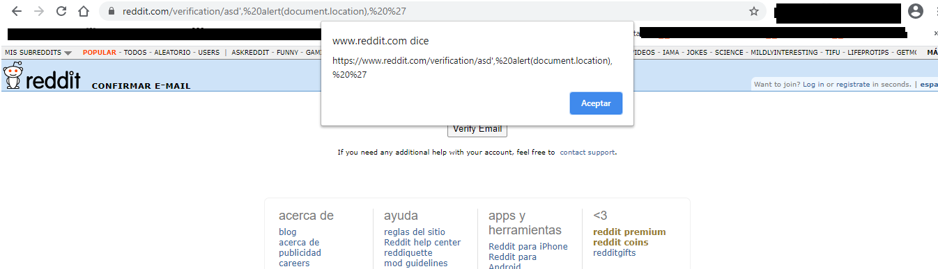
reddit.com - Reflected XSS via URL path
Severity: 7-8.9 (High)
Bounty: $5000
https://hackerone.com/reports/1051373

Slide 9
A04: Insecure design / Business logic
Problem is in design
E.g. missing security controls, breaking security best practices
Recover account – security questions
Attacker can gather those info using OSINT
Hashing URLs for authentication purposes
User can provide and hash arbitrary data – generate custom URLs

Slide 10
Pentest time!

Slide 11
How to set up environment
Download and install Burp Suite Community
Open embedded browser and go to the application
https://mffkenticoworkshop-0.azurewebsites.net/
Do not forget to change the instance number
You are ready to go!

Slide 12
SQL Injection in Contact Macro
We suspect that one of the macros used in Contact groups contains SQL injection, try to find and exploit it!
This is a blind SQL injection - you won’t see the result in response, but injected query will execute on background. If the query fails, it will be logged to Event log

Slide 13
SQL Injection in Contact Macro - Solution
Go to Contact Groups, create new group and go to Conditions.
Select 'Contact has value in field' macro.
It allows us to insert arbitrary input before operator in where clause (e.g. WHERE <field> contains <value>).
You can identify it by inserting `, recalculating group and then checking event log.
Final payload (change FirstName of the administrator account)
1=1; UPDATE CMS_User SET FirstName='Joe' WHERE UserID = 53--
Finish the WHERE clause of the original query with any True statement, e.g. 1=1
Add ; to finish first query
Arbitrary query to drop table, dump data or anything
Comment out everything else with --

Slide 14
Privilege Escalation
No user with lower permission set should be able to gain higher permissions.
Your goal is to access Event log with user
user@localhost.local
Pass.word1
System is set so you can only access applications defined in Digital Channel Manager role and Users application.

Slide 15
Privilege Escalation - Solution
Go to Users and check your account details.
You are able to modify which roles are assigned to you.
All roles (except Administrator) are available. There is already role for Role Management, so you can assign it to you
Now you have Roles application available.
You can create new role with permission to access Event log

Slide 16
Account Takeover
In this challenge, you want to take over administrator account using the user@localhost.local.
Start in the Users application.
This can be done using standard UI (without modifying requests)

Slide 17
Account Takeover - Solution
Go to Users and check Administrator details.
You can see that you are able to edit users with higher privileges.
Change email to any email in your possesion
Go to forgotten password page and request password reset for given email. (The SMTP server is not set up, so check email queue where you can view the email link)

Slide 18
Stored XSS via Frontend Component
We are looking for one of the core components which contain a XSS vulnerability.
You can exploit it as un-authenticated user from the Dancing Goat site! (use private window)
Start by submitting payloads to Send us a message form

Slide 19
Stored XSS via Frontend Component
Go to <base url>/contacts and inject <img src=0 onerror=alert(1) /> into available fields
Check Contact management in the administration
Click account details – the payload will execute

Slide 20
Stored XSS via URL input
When we think about URL, we usually imagine some address starting with http(s)://, but these are not the only protocols that can be used.
Try to find XSS by exploiting input that expects URL using Forms application.

Slide 21
Stored XSS via URL input - Solution
Go to Forms/AfterFormSubmission and set the action to “Redirect to URL”
Insert payload starting with javascript: protocol.
javascript:alert(document.cookie)
Our input is then inserted something like this: <a href={value}../>
Go to Dancing Goat site and submit a form. Alert will pop up.

Slide 22
Reflected XSS via Form Builder
TBD

Slide 23
File Injection
One of the biggest security concerns regarding web applications is file upload, which can lead to all kinds of vulnerabilities from stored XSS to remote code execution (RCE).
Try to upload malicious xml file containing XSS, although .xml is not listed as allowed extension for given content type.
In Pages, start by editing Cafe content type and uploading the file here.

Slide 24
File Injection - Solution
Open DevTools/Burp Suite proxy. Go to Pages and create new Cafe item or edit existing one. In Photo content field try to upload new file with .xml extension.
Analyze request to /api/cmd and look for allowedExtensions in JSON data.
Resend / edit request and change png to xml
If upload is successful, you will see a URL to the file in response.
Go check it (/getmedia/.../payload.xml) to validate that the file was uploaded and XSS is working.

Slide 25
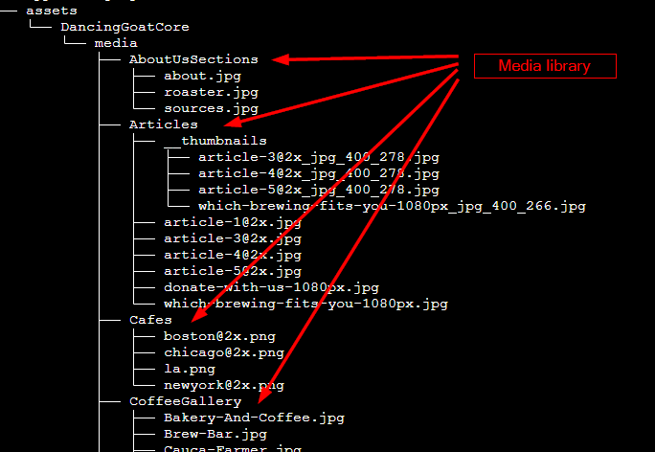
Path traversal
View all folders in assets using this attack in Media Libraries
Exploit usually works by “going up” in folder structure (../..)

Slide 26
Path traversal - Solution
Go to Media Library, create new library
In Folder name insert following payload: ..\..\. You will see content (only folders in tree view) of folder assets in the site.
There is no limit, so feel free to see other folders
we are on Linux file system
Try deleting content by deleting Media library (destructive)

Slide 27
Thanks!

