Slide 1
Compliance
Juraj Komlosi
Kentico software

Slide 2
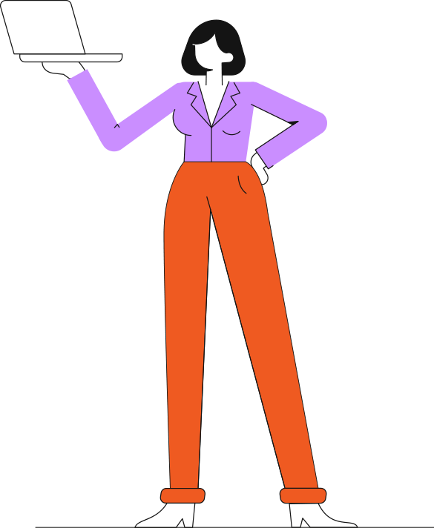
Agenda
Compliance
ISO 27001
SOC 2

Slide 3
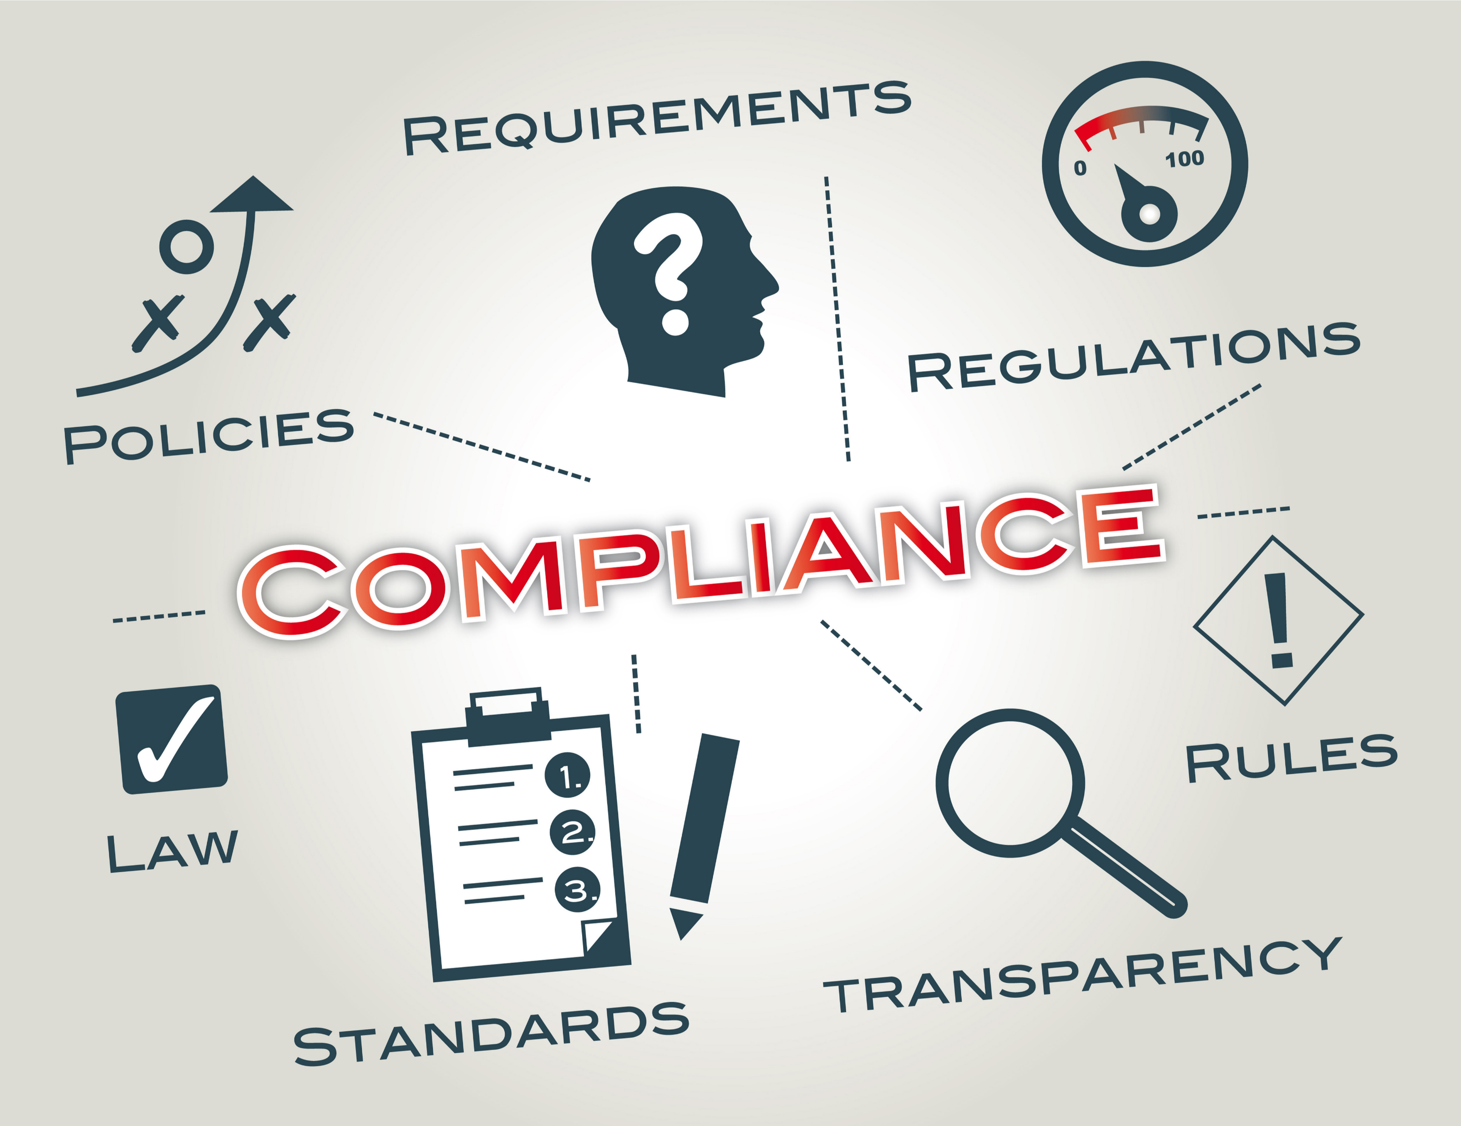
What is Compliance?
Privacy laws
GDPR
CCPA
…
Industry standards
ISO standards
SOC
HIPAA
…
Notes:
*https://dqsacademy.co.za/wp-content/uploads/2019/10/shutterstock_180834869.png

Slide 4
Motivation to adopt compliance
We live in a digital age.
You must keep your business's digital assets safe
Data breaches and cyberattacks are significant threats.
Notes:
*https://venngage.com/blog/data-breach-2022/

Slide 5
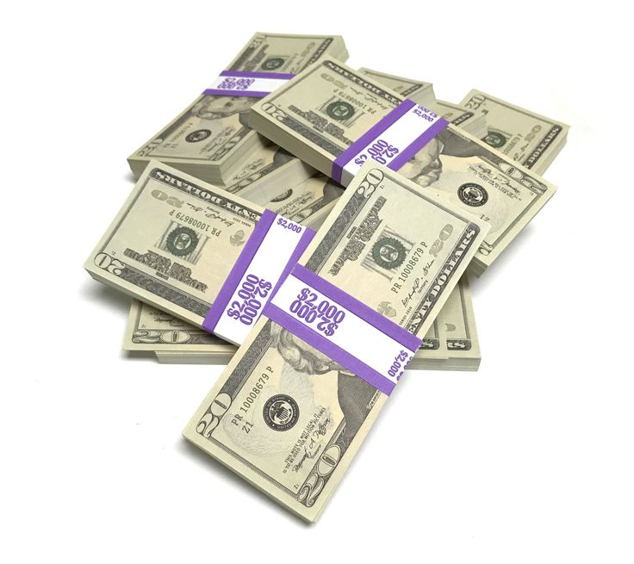
Data breach example
PAID
$1.5 billion
Equifax data breach – 2017
PII of 147 million people
Unpatched software
entry for hackers (76 days in the system)
Weak sensitive data protection
Hackers found usernames and passwords (in plaintext)
Poor sec-ops processes – traffic inspection
Failed to renew certificate (for 19 months)
Incident response
Data breach was not published until more than a month

Slide 6
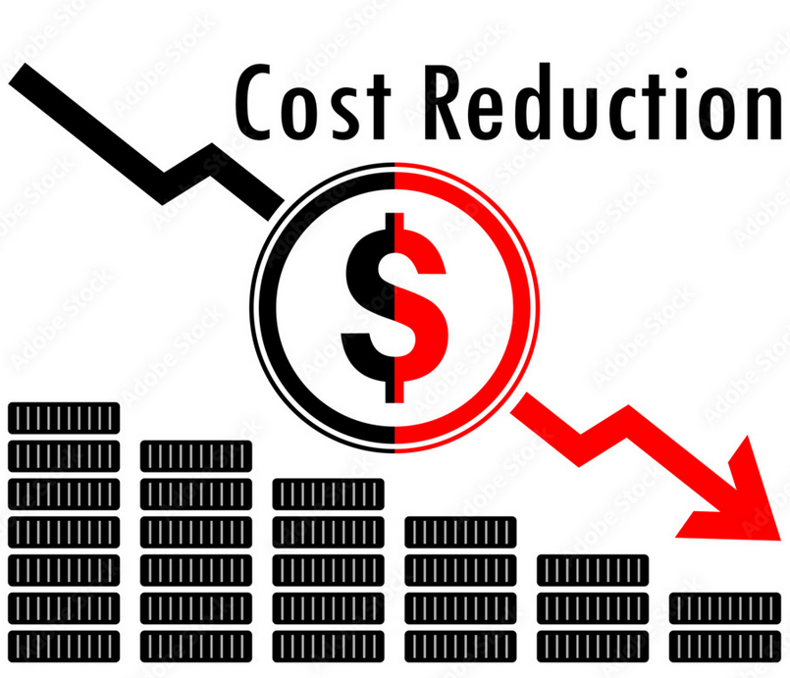
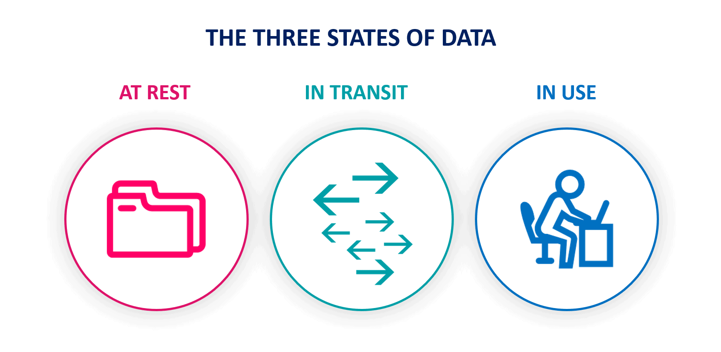
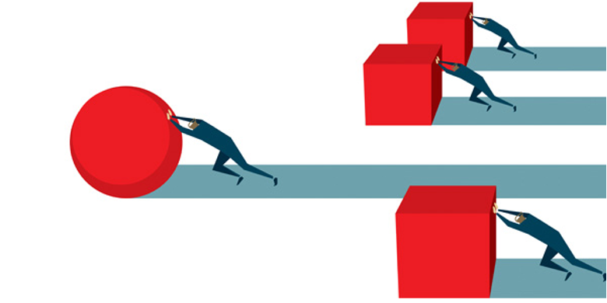
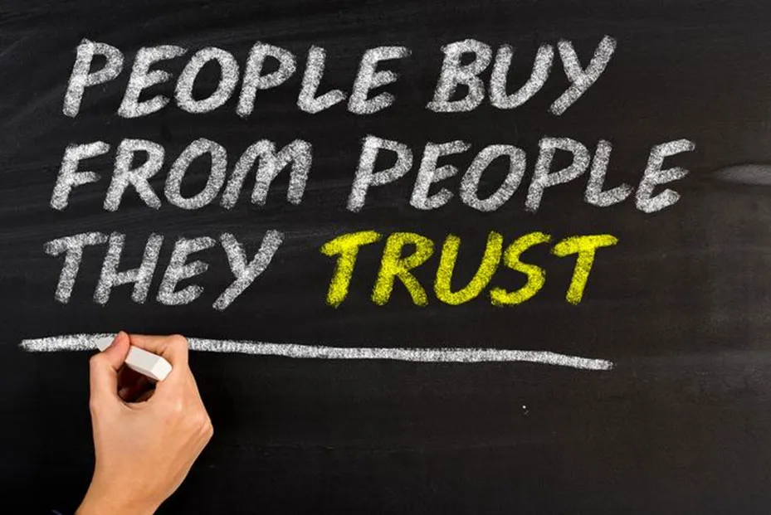
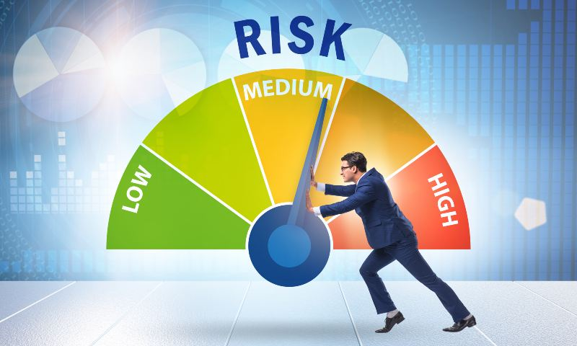
Key aspects
Data protection & security
Risk mitigation
Customer trust
Competitive advantage
Cost savings
Notes:
*https://www.sealpath.com/wp-content/uploads/2014/08/three-states-of-data-1638x801.png
*https://afeusa.org/articles/risk-mitigation-and-how-it-works/
*https://salestips-raulsanchezgilo.medium.com/how-to-win-customer-trust-35-ways-27d88cf6773a
*https://www.hausmanmarketingletter.com/9-tips-to-develop-your-sustainable-competitive-advantage/
*https://stock.adobe.com/cz/images/vector-illustration-of-business-cost-reduction-cost-saving-concept-money-symbol-with-arrow-stretching-drop-fall/246286161

Slide 7
ISO standards
Most common ISO certifications:
ISO 27001 – Information security management systems
ISO 27017 - Information security in cloud computing
ISO 9001 – Quality management systems
ISO 20000 – IT service management
Demo
Statement of Applicability – ISO 27001

Slide 8
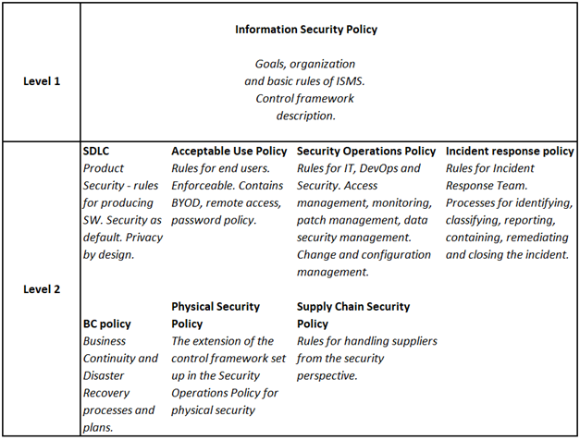
Information Security Management System
Policies & Processes
ISMS helps to:
identify,
manage and
protect the data against risks

Slide 9
Demo
Examples of data classification
Examples of ISMS policies
Notes:
Source: https://www.researchgate.net/profile/Neha-Mahendra/publication/310757536_A_Categorized_Review_on_Software_Security_Testing/links/58a3d9faaca272d3a4983a63/A-Categorized-Review-on-Software-Security-Testing.pdf

Slide 10
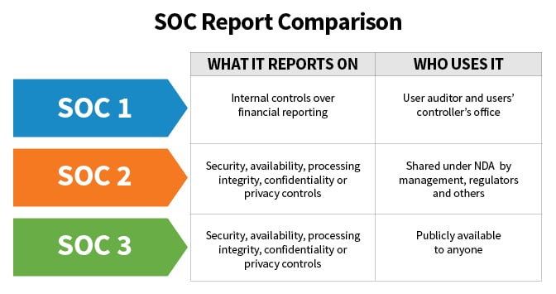
System and Organization controls (SOC)
Developed by the American Institute of CPAs (AICPA)
Type of SOC certifications
SOC 1
SOC 2 Type 1 or Type 2
SOC 3

Slide 11
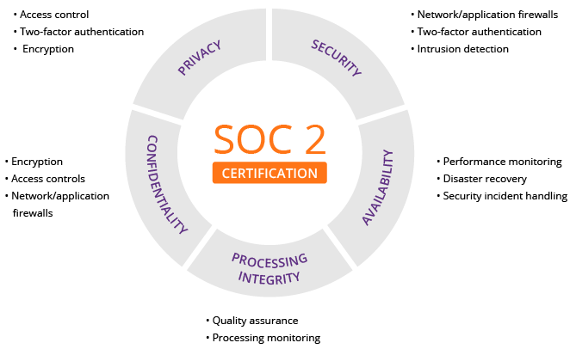
SOC 2
5 “trust service principles”
security, availability, processing integrity, confidentiality and privacy.
Notes:
*https://www.imperva.com/learn/data-security/soc-2-compliance/

Slide 12
What is the difference?
Notes:
*https://www.timewatch.com/wp-content/uploads/2023/03/infographic-soc2-vs-iso-27001-timewatch-scaled.webp

Slide 13
SOC 2 – how to prepare
Decide type of the SOC 2 (Type 1 or Type 2)
Get senior management buy-in
Gap analysis
Demo
Define responsibilities within organization
Implement controls
Audit

Slide 14
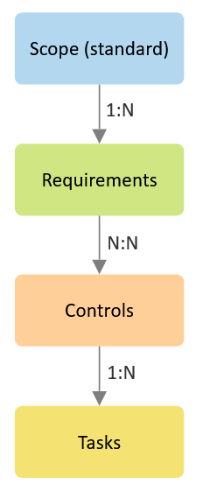
Government, Risk and Compliance tool
What do platforms offer?
Most common compliance standards
Pre-defined compliance requirements
Process automation
What is up to you?
Define controls
Map controls to requirements
Assign tasks
Review

Slide 15
Government, Risk and Compliance tool
Demo
https://kentico.uk.kcmgrc.com/

Slide 16
SOC 2 report
Demo

Slide 17
Security awareness training
Demo – KnowBe4
Awareness is a key
Phishing attacks
Email phishing
Example
AitM attack
Example

Slide 18
Disaster recovery
Goal
Minimize downtime
Recovery time object (RTO)
Protect critical data
Ensure business continuity
Recovery point object (RPO)
DR tests
Simulate most likely disasters
Recover & Learn
Notes:
*https://www.msp360.com/resources/blog/rto-vs-rpo-difference/

Slide 19
Disaster recovery
Demo
Example of DR tests

Slide 20
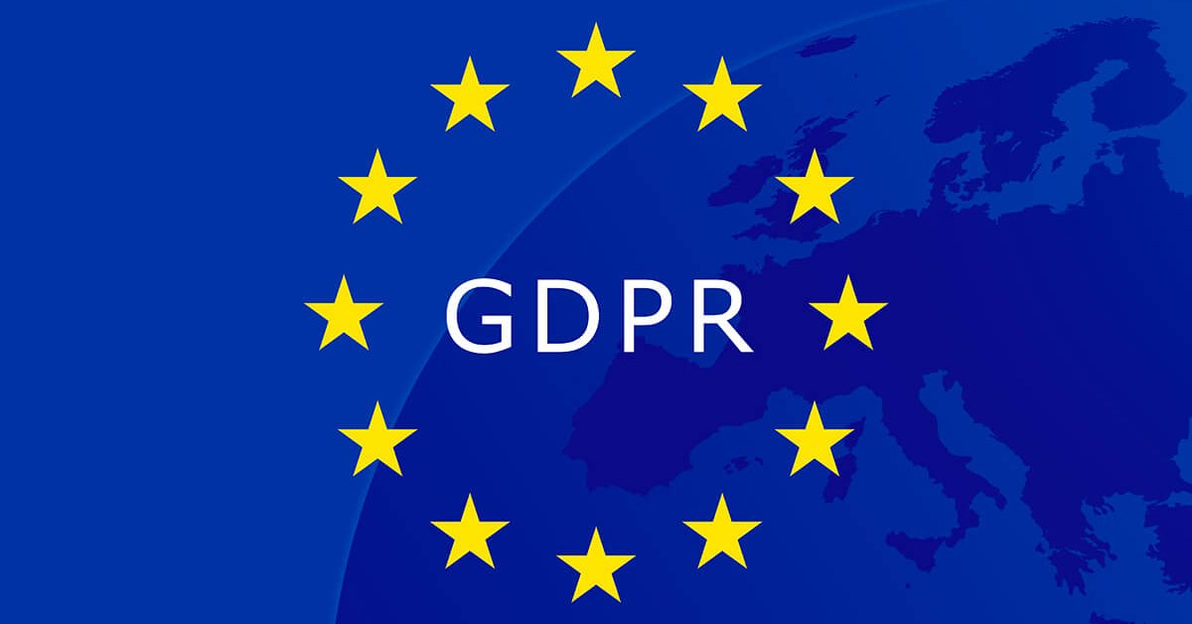
Privacy – world-wide
Not only !!!

Slide 21
Privacy – United States
Notes:
*https://blog.didomi.io/en-us/us-data-privacy-laws

Slide 22
Q&A

Slide 23
Resources
Equifax data breach
https://www.csoonline.com/article/567833/equifax-data-breach-faq-what-happened-who-was-affected-what-was-the-impact.html
Enron scandal – consequences SOX/SOC
https://en.wikipedia.org/wiki/Enron_scandal
SOC standard
https://www.itgovernance.co.uk/soc-reporting
SOC 2 report template
https://us.aicpa.org/content/dam/aicpa/interestareas/frc/assuranceadvisoryservices/downloadabledocuments/soc2_csa_ccm_report.pdf
Disaster recovery
https://en.wikipedia.org/wiki/Disaster_recovery

