Slide 1
Cloud security
Matej Groman, Juraj Komlosi
Kentico software

Slide 2
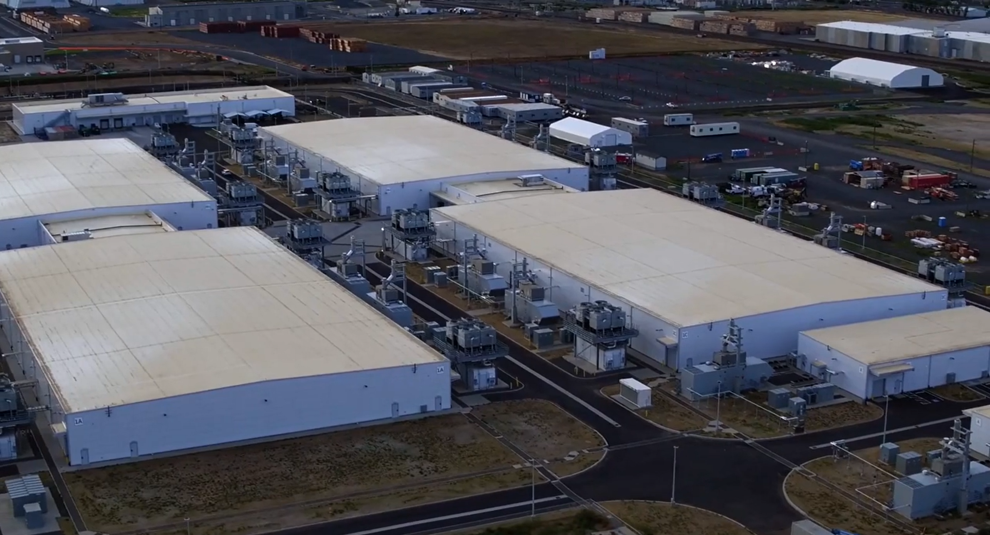
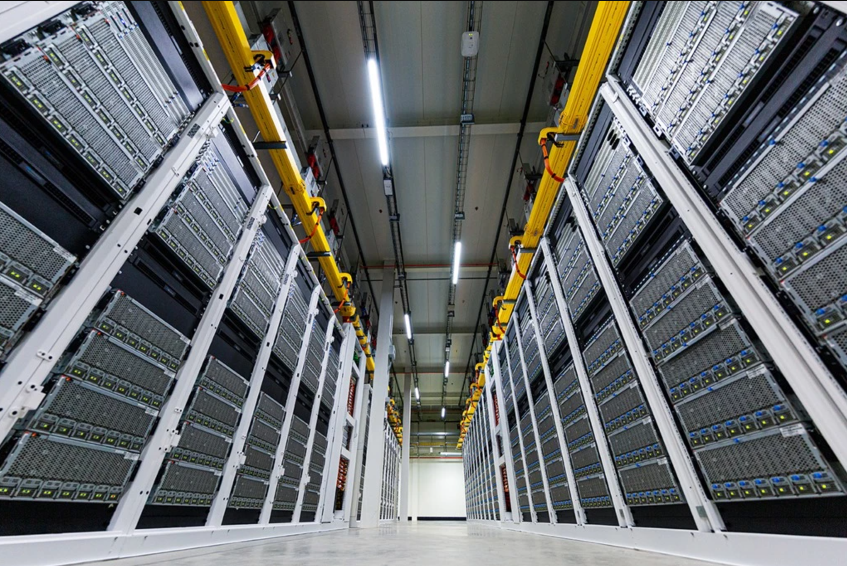
What is cloud?
Notes:
https://azure.microsoft.com/en-us/blog/the-anatomy-of-a-datacenter-how-microsofts-datacenter-hardware-powers-the-microsoft-cloud/

Slide 3
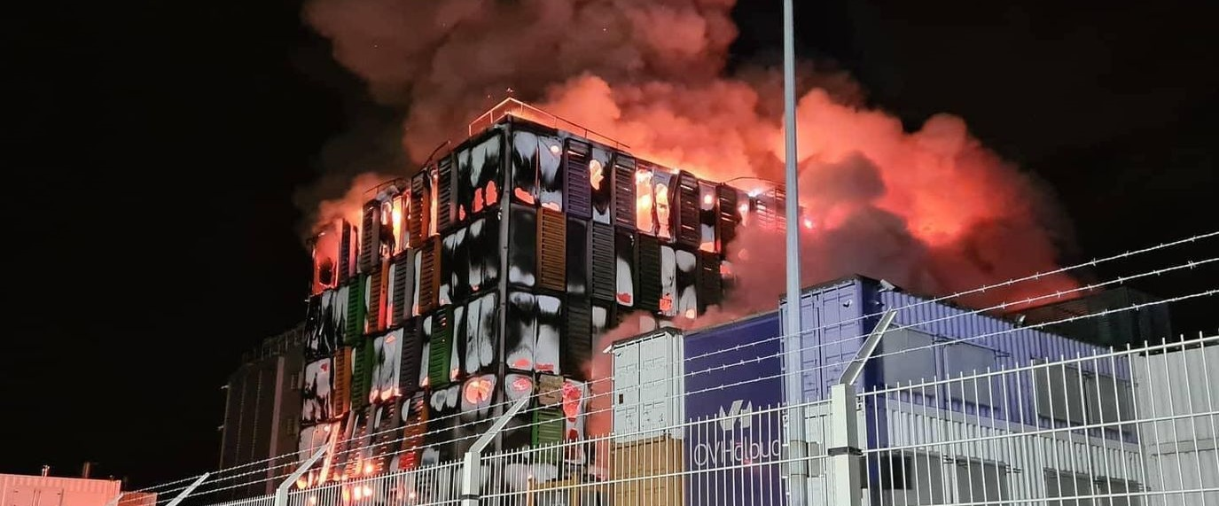
What is cloud?
Notes:
https://www.hostingy.net/pozar-v-datacentru-ovh-odstavil-statisice-webu/

Slide 4
On-Prem or Cloud
Data storage
Maintenance & Security updates
Costs
Permission management
Scalability
Patterns from On-Prem often do not work in Cloud

Slide 5
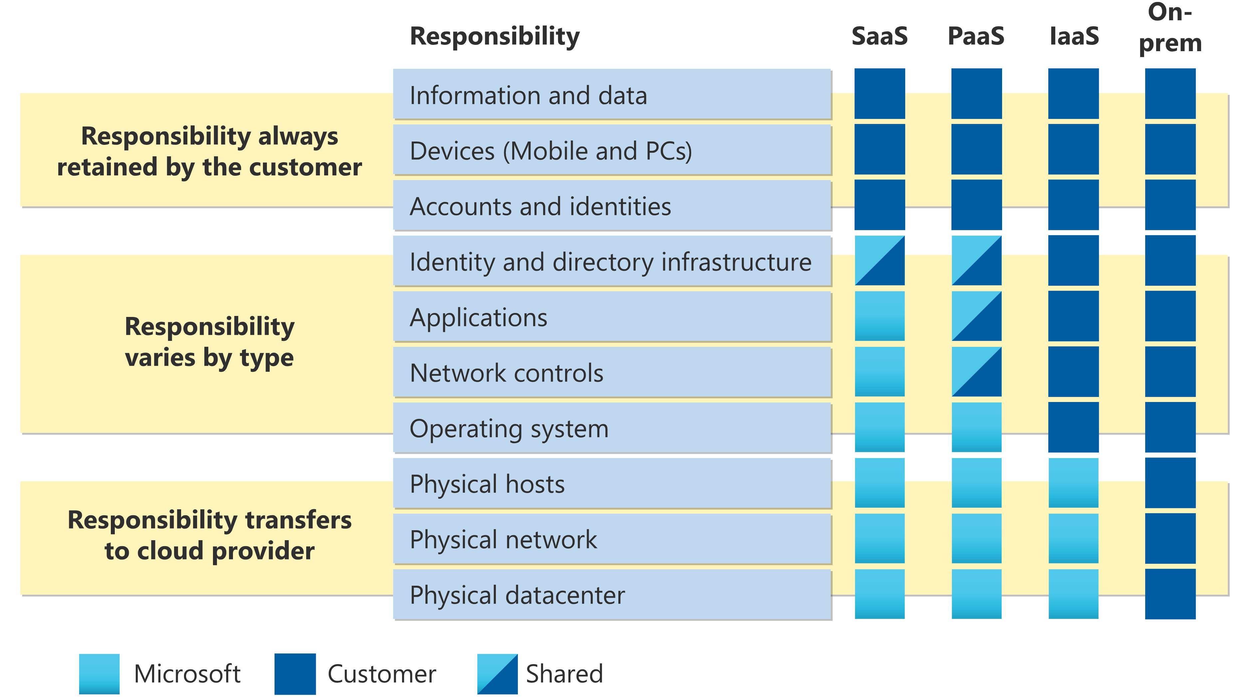
Shared responsibility model
Notes:
https://learn.microsoft.com/en-us/azure/security/fundamentals/media/shared-responsibility/shared-responsibility.svg

Slide 6
Attacks on cloud
Some of the real-world attacks & security issues

Slide 7
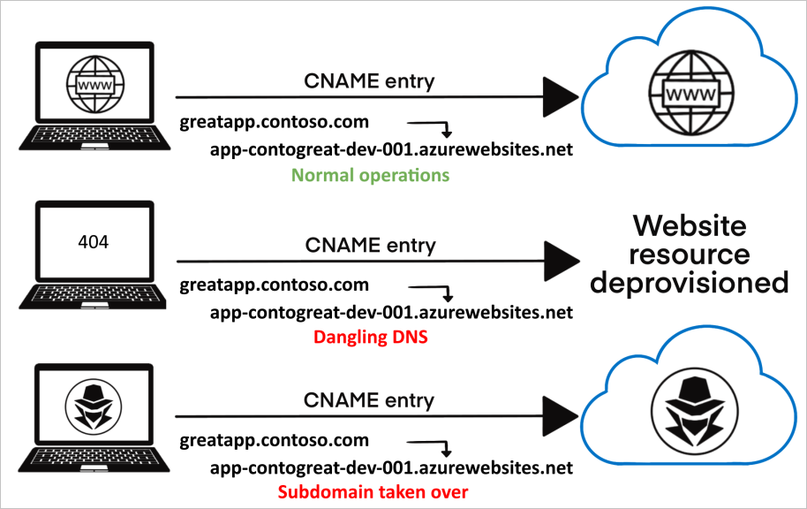
Subdomain takeover

Slide 8
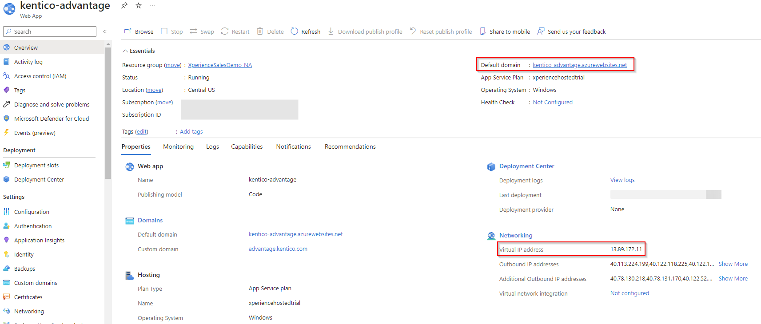
Subdomain takeover - Example

Slide 9
Expose of private data
Caused by configuration issues or human error
Typical examples
AWS S3 buckets
Azure SAS tokens
Database – connection string
API

Slide 10
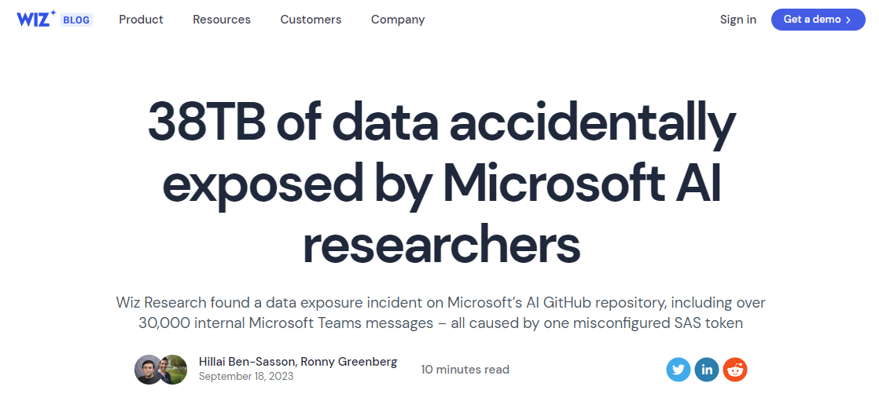
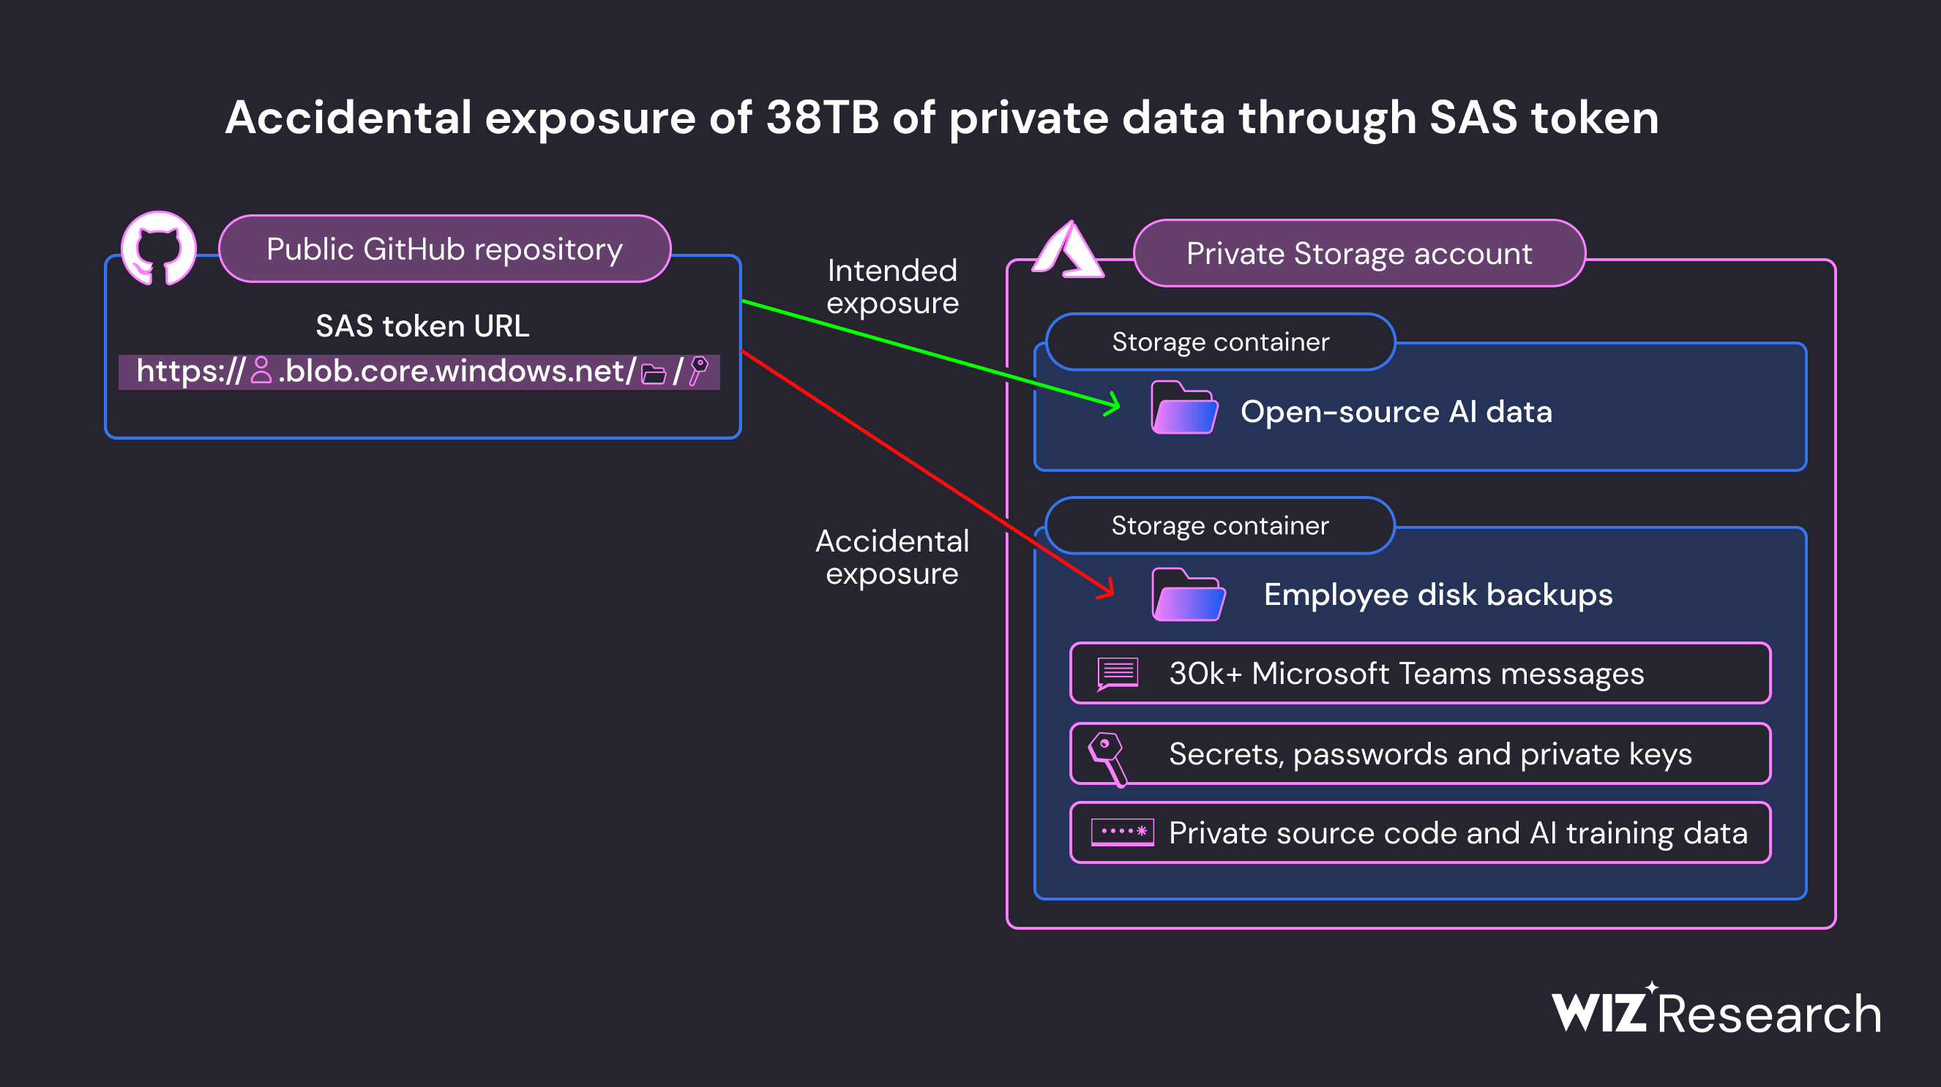
Expose of private data - Example

Slide 11
Permission control issues
Compromised user account offers extensive access and control
Typical issues
Lack of ownership
Lack of separation - flat structure
Over-powered users
Service Principals / Service accounts
Lack of separation (QA and Prod, projects, teams)

Slide 12
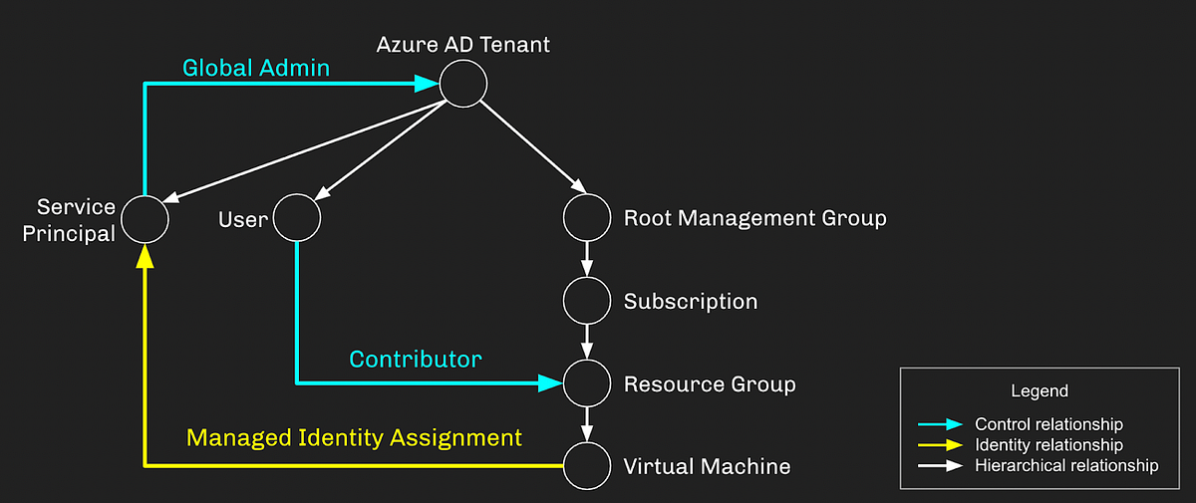
Permission control - Example
Notes:
https://posts.specterops.io/managed-identity-attack-paths-part-1-automation-accounts-82667d17187a

Slide 13
How to secure cloud?
Techniques and principles for improving cloud security

Slide 14
Infrastructure hardening
Iterative process
Mitigating non-conformities against security baseline
Improvements to existing solution
More advanced features
Provide better security
Are complex – overwhelming to understand
Cost more

Slide 15
Infrastructure hardening - Example

Slide 16
Infrastructure hardening - Example

Slide 17
Automation
Using CI/CD mitigate human error
Usually several steps including manual approval
Scalable without exhausting human resources
Allows quick roll-back
Monitoring & Audit log

Slide 18
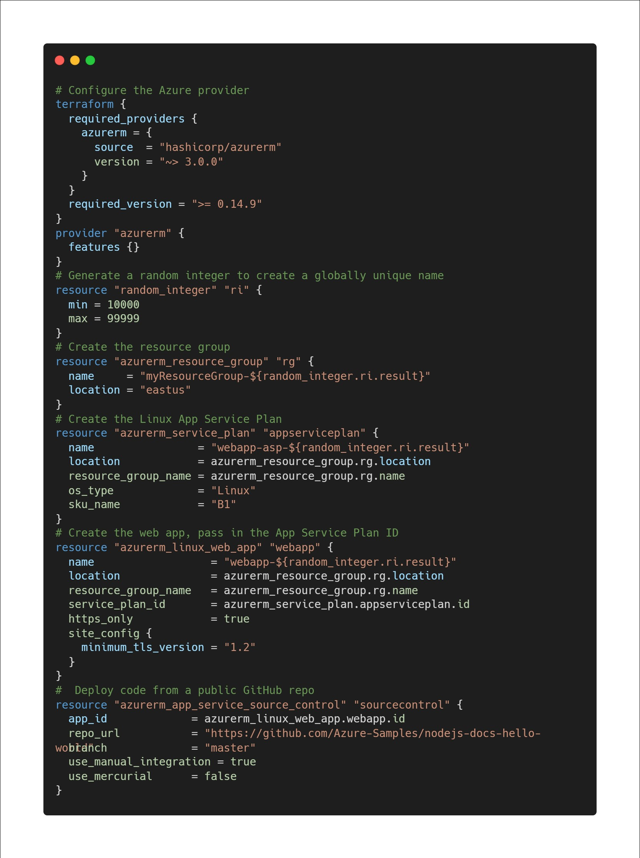
Infrastructure as a Code
All resources are defined as configuration
Deployment using API
IaC provider does following steps
Consumes configuration
Creates deployment plan
Use Cloud API to create & configure resources
Validates final state
Benefits
Consistency
speed of deployment
config can be versioned in SCM

Slide 19
Business continuity
We want to prepare for the worst possible scenarios
Compromised infrastructure
Integrity of data
Availability issues
Alerting / Monitoring
Point-in-time restore (PITR)
Georeplication
Disaster recovery drill

Slide 20
Xperience by Kentico - Infrastructure

Slide 21
Resources
https://www.hackerone.com/application-security/guide-subdomain-takeovers
https://www.wiz.io/blog/38-terabytes-of-private-data-accidentally-exposed-by-microsoft-ai-researchers

