Slide 1
NSWI170: Lab 04 Displaying 7-seg Digits
Martin Kruliš

Slide 2
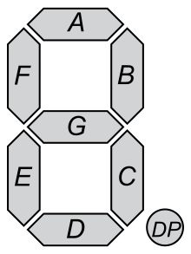
Display
Warmup – prepare bitmasks for all digits
Remember 1 ~ LED off, 0 ~ LED on (0b10000000 = digit 8)
Verify your bitmasks (see constant digits in funshield library)
Everything but DP is ON
Segments encoded in byte
DP
G
F
E
D
C
B
A

Slide 3
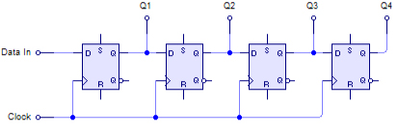
Shift Register
74HC959D Shift Registers
Serial input (sequence of bits), parallel output
Input is controlled by a clock signal
See https://en.wikipedia.org/wiki/Shift_register

Slide 4
Fun Shield Display
Shift Registers Controlling Display
Given mask may be displayed at selected positions
Only one mask can be displayed at a time
Bits 0-3 indicate which digits are
active
7 segment mask
Arduino feed
(data + clock)
Two connected 8-bit shift registers

Slide 5
Using Shift Registers
Controlling the output latch
Outputs are cached (pins do not change)
Raising edge triggers the update
We need to do this to make any change “visible”
digitalWrite(latch_pin, LOW)
digitalWrite(latch_pin, HIGH)
Sending the data
shiftOut(data_pin, clock_pin, bitOrder, value)
bitOrder = MSBFIRST or LSBFIRST
value = byte (8 bits) to be send bit-by-bit
Do not forget setting the pins to output

Slide 6
Using Shift Registers
Algorithm
Send the segment mask value (1 byte)
Use MSBFIRST order
Send which positions are active (1 byte)
In MSBFIRST, positions correspond to lower bits
Trigger the latch
Set it to LOW then to HIGH
Data loaded by previous steps will be sent to outputs (i.e., the digit will appear on the display)

Slide 7
Display Counter Value
Preparation
Write a function displayDigit(byte digit, byte pos)
Implement the algorithm from the previous slide
Task 1
Use your code from labs #03 (any version of buttons incrementing the counter)
Modify it so that
Counter goes only from 0-9
Display the counter value as the rightmost digit of the 7-seg display (remaining digits must be blank) using the displayDigit()

Slide 8
Changing Digit Position
This is today’s final assignment, details are in ReCodEx
Task 2
Modify the counter to run modulo 10000
Formatted as 4-digit number with leading zeros
Make sure you handle the modular arithmetic correctly
One digit (position) is shown at a time
Rightmost digit (units) at start
Button 3 changes the digit/order in loop (1, 10, …)
Buttons 1 and 2 increment/decrement selected digit
I.e., button 1 performs +1, +10, +100, or +1000, based on which order is selected (displayed)
Button 2 analogically (-1, -10, …)

Slide 9
Bonuses
Waiting Animation
Create a “snake” animation that goes round the whole display
Only one LED is on at any given time
The snake should move using constant velocity and complete the cycle in exactly 1s
Prepare 7seg masks for letters
Some letters need to be lowercased, some uppercased, be creative
Use it to spell out “hello world” message letter by letter using single display position

Slide 10
Discussion

