Slide 1
Computer Systems
CPU
Jakub Yaghob

Slide 2
Von Neumann architecture
Simple, slower
CPU
Memory
I/O

Slide 3
Harvard architecture
Microcontrollers
Multiple address spaces
Instruction Memory
CPU
Data Memory
I/O

Slide 4
Real PC architecture
External Graphics
Card
Sandy Bridge
PCI express ×16
2133-1066 MHz
DDRIII
Channel 1
Memory controller
Cache
GFX
System Agent
Mem BUS
Core
DDRIII
Channel 2
Core
Display link
4×DMI
Line out
Audio Codec
Line in
South Bridge (PCH)
D-sub, HDMI, DVI, Display port
S/PDIF out
S/PDIF in
exp
slots
BIOS
PCI express ×1
Super I/O
LPC
Lan
Adap
USB
SATA
SATA
Parallel Port
Floppy
Drive
PS/2 keybrd/ mouse
mouse
DVD
Drive
Hard
Disk
Serial Port
LAN

Slide 5
CPU
Architecture
HW
ISA
"Simple" machine
Executes instructions
Instruction – simple command

Slide 6
Instructions - motivation
How can we execute the following code?
if(a<3) b = 4; else c = a << 2;
for(int i=0;i<5;++i) a[i] = i;
int f(int p) { return p+1; }
void g() { auto r = f(42); }

Slide 7
Instruction classes
Load instructions
Store instructions
Move instruction
Arithmetic and logic instructions
Jumps
Unconditional x conditional
Direct x indirect x relative
Call, return
…

Slide 8
Registers
Types
General, integer, floating point, address, branch, flags, predicate, application, system, vector, …
Naming
Direct x stack
Aliasing

Slide 9
Registers – example 32-bit x86
EAX | AX | AH | AL |  | CS
EBX | BX | BH | BL |  | DS
ECX | CX | CH | CL |  | ES
EDX | DX | DH | DL |  | SS
ESI |  | SI |  |  | FS
EDI |  | DI |  |  | GS
EBP |  | BP |  |  | EFLAGS |  | FLAGS
ESP |  | SP |  |  | EIP |  | IP

Slide 10
Registers – example IA-64

Slide 11
MIPS – simple assembler
Execution environment
32-bit registers r0-r31
r0 is always 0, writes are ignored
r31 is a link register for the jal instruction
No stack
No flags
PC register

Slide 12
MIPS – register aliases
Register | Name | Purpose | Preserve
$r0 | $zero | 0 | N/A
$r1 | $at | Assembler temporary | No
$r2-$r3 | $v0-$v1 | Return value | No
$r4-$r7 | $a0-$a3 | Function arguments | No
$r8-$r15 | $t0-$t7 | Temporaries | No
$r16-$r23 | $s0-$s7 | Saved temporaries | Yes
$r24-$r25 | $t8-$t9 | Temporaries | No
$r26-$r27 | $k0-$k1 | Kernel registers – DO NOT USE | N/A
$r28 | $gp | Global pointer | Yes
$r29 | $sp | Stack pointer | Yes
$r30 | $fp | Frame pointer | Yes
$r31 | $ra | Return address | Yes

Slide 13
MIPS – instructions
Arithmetic
add $rd,$rs,$rt
R[rd] = R[rs]+R[rt]
addi $rd,$rs,imm16
R[rd] = R[rs]+signext(imm16)
sub $rd,$rs,$rt
subi $rd,$rs,imm16

Slide 14
ISA comparison
MIPS
x86
ADD $t1,$t1,$t0
ADDI $t1,$t1,1
ADD $t2,$t0,$t1
ADD eax,ebx
ADD eax,1
MOV eax,ebx
ADD eax,ecx

Slide 15
MIPS – instructions
Logic operations
and/or/xor/nor $rd,$rs,$rt
andi/ori/xori $rd,$rs,imm16
R[rd] = R[rs] and/or/xor zeroext(imm16)
No not instruction, use nor $rd,$rs,$rs
Shifts
sll/slr $rd,$rs,shamt
R[rd] = R[rs] << / >> shamt
sra $rd,$rs,shamt

Slide 16
ISA comparison
MIPS
x86
NOR $t1,$t2
SLL $t1,$t1,3
MOV eax,ebx
NOT eax
SHL eax,3

Slide 17
MIPS – instructions
Memory access
lw $rd,imm16($rs)
R[rd] = M[R[rs] + signext32(imm16)]
sw $rt,imm16($rs)
M[R[rs] + signext32(imm16)] = R[rt]
lb $rd,imm16($rs)
R[rd] = signext32(M[R[rs] + signext32(imm16)])
lbu $rd,imm16($rs)
R[rd] = zeroext32(M[R[rs] + signext32(imm16)])
sb $rt,imm16($rs)
M[R[rs] + signext32(imm16)] = R[rt]
Moves
li $rd,imm32
R[rd] = imm32
move $rd,$rs
R[rd] = R[rs]

Slide 18
ISA comparison
MIPS
x86
LW $t1,1234($t0)
SW $t1,1234($t0)
LB $t1,1234($t0)
LI $t1,5678
MOVE $t1,$t0
MOV eax,[ebx+1234]
MOV [ebx+1234],eax
MOV al,[ebx+1234]
MOV eax,5678
MOV eax,ebx

Slide 19
MIPS – instructions
Jumps
j addr
PC = addr
jr $rs
PC = R[rs]
jal addr
R[31] = PC+4; PC = addr

Slide 20
ISA comparison
MIPS
x86
J label
JR $ra
JAL fnc
JMP label1
JMP [ebx]
CALL fnc

Slide 21
MIPS – instructions
Conditional jumps
beq $rs,$rt,addr
If R[rs]=R[rt] then PC=addr else PC=PC+4
bne $rs,$rt,addr
Testing
slt $rd,$rs,$rt
If R[rs]<R[rt] then R[rd] = 1 else R[rd] = 0
sltu $rd,$rs,$rt
Unsigned version
slti $rd,$rs,imm16
If R[rs]<signext(imm16) then R[rd] = 1 else R[rd] = 0
sltiu $rd,$rs,imm16
If R[rs]<zeroext(imm16) then R[rd] = 1 else R[rd] = 0

Slide 22
ISA comparison
MIPS
x86
BEQ $t0,$t1,label
SLT $t2,$t1,$t0
BNE $t2,$zero,label
SLTI $t2,$t1,5
BNE $t2,$zero,label
CMP eax,ebx
JZ label
CMP eax,ebx
JL label
CMP eax,5
JL label

Slide 23
Flags
Only used by some ISA
Control execution
Check status of the last instruction
Usual flags
Z – zero flag
S – sign flag
C – carry flag

Slide 24
CPU
Architecture
Memory controller
Cache hierarchy
Core
Registers
Types
Logical processor
Hyper threading
Instructions

Slide 25
Instruction
Simple command to the CPU
Encoding
Assembler
Operands
Instruction flow
PC
Stack?
SP

Slide 26
ISA
Instruction set architecture
Abstract model of CPU
Classification
CISC – Complex Instruction Set Computer
RISC – Reduced Instruction Set Computer
VLIW – Very Long Instruction Word
EPIC – Explicitly Parallel Instruction Computer
Orthogonality
Accumulator
Load-Execute-Store

Slide 27
CPU – simplified scheme
Package
CORE 0
CORE 1
CORE 2
CORE 3
T0
T4
T1
T5
T2
T6
T3
T7
EU
EU
EU
EU
L1I
L1I
L1I
L1I
L1D
L1D
L1D
L1D
L2
L2
L2
L2
L3/LLC

Slide 28
Real CPU scheme – package
Intel Coffee Lake

Slide 29
Real CPU scheme – core

Slide 30
Real CPU die

Slide 31
CPU architecture – pipeline
Current CPU
14-19 stages

Slide 32
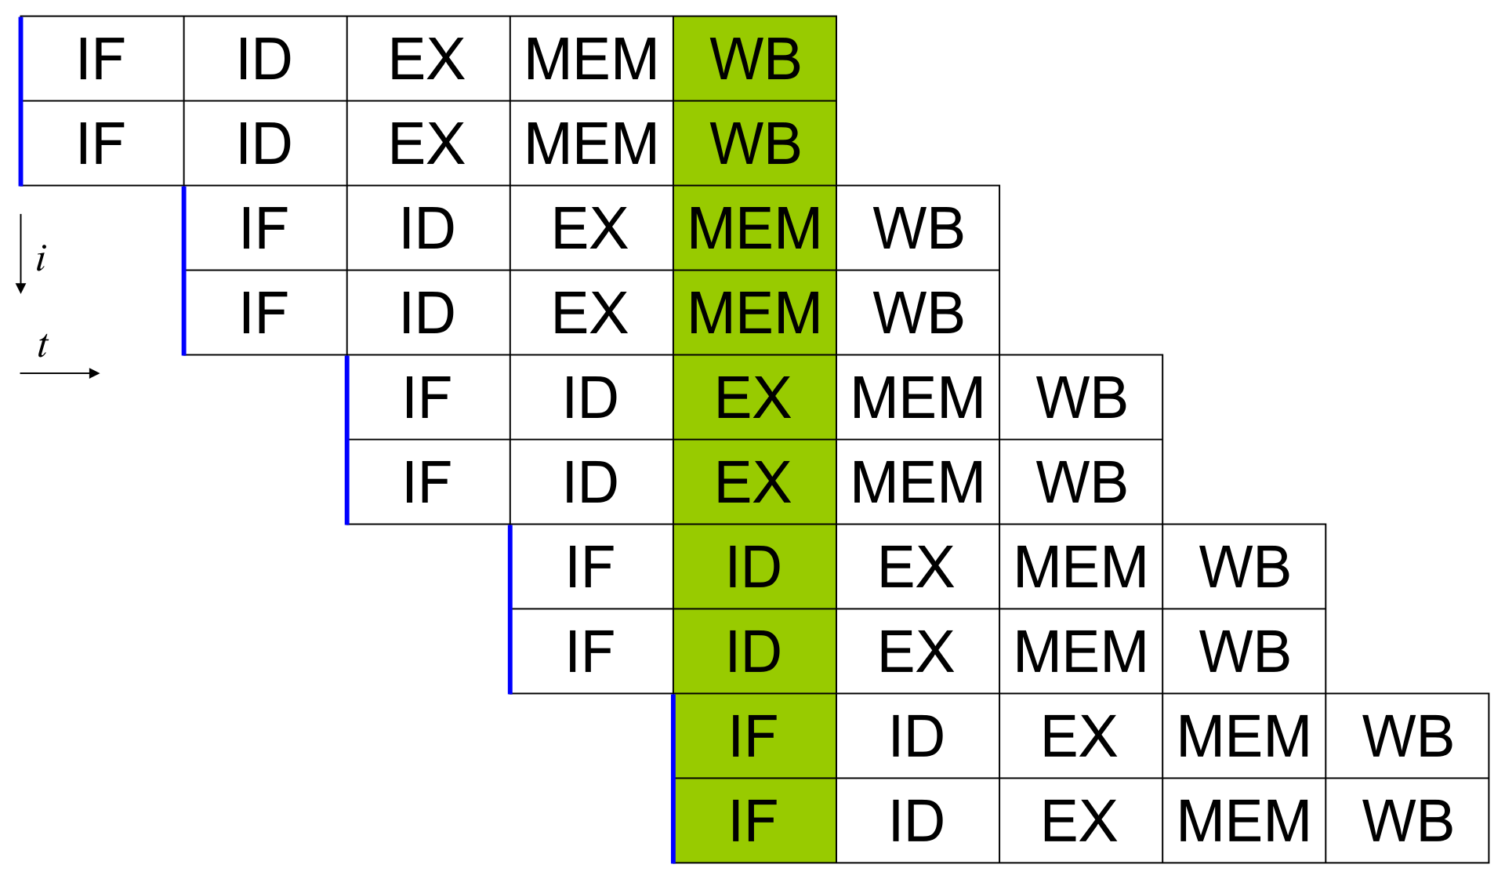
CPU architecture – superscalar processor
Current CPU
5-way, asymmetric

Slide 33
CPU architecture – out-of-order execution
Decoder
µOPs
Reservation station (pool)
Port 0
Port 1
Port 5
Port 6
Port 2
Port 3
Port 4
Port 7
I/V ALU
I/V ALU
I/V ALU
I ALU
AGU
AGU
AGU
AGU
I/V MUL
I/V MUL
Vec Shuff
I Logic
Load
Load
Store
I/V Logic
I/V Logic
F ADD
Branch
String
Bit scan
Comp Int
F FMA
F FMA
AES
SQRT
I/F DIV
Reorder buffer
Branch

