Slide 1
NSWI150 - Virtualization and Cloud Computing
Cloud Technologies
Filip Zavoral

Slide 2

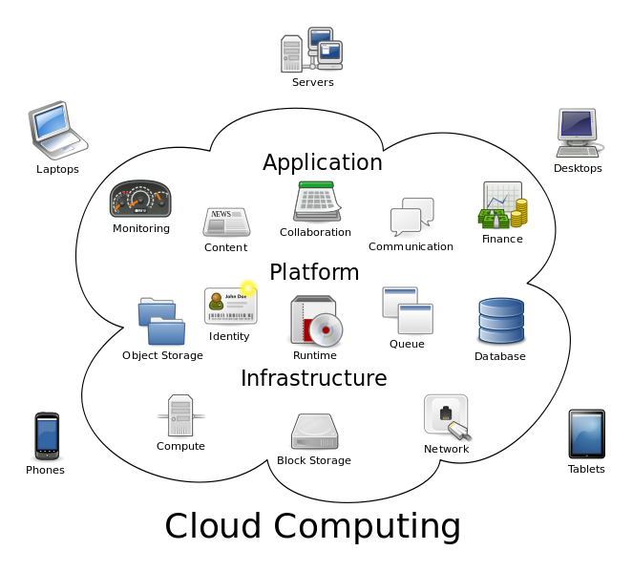
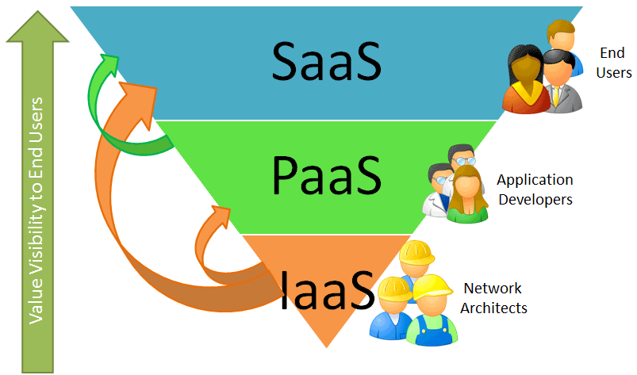
Cloud Computing

Slide 3
Cloud Computing Components
Computing Services Execution Models | Virtual Machines | Web Sites | Cloud Services/Apps
 | Containers, μ-svcs | Serverless / Lambdas | Mobile services
 | Hi-Perf Computing | Management, Orchestration, Monitoring
Storage & Data | Key-Value Tables | Column Store | Document DB
 | Graph DB | Blobs | Caching
Data Processing | Map/Reduce | Hadoop Zoo | Reporting
Networking | Virtual Network | Connect | Traffic Manager
Messaging | Service Bus | Queue/Topic/Relay | Event Hub
Multi- & Media | Media Services | Streaming | Content Delivery
Other Services | Machine Learning | Searching / Indexing | Maps / GIS
 | Gaming | Language / Translate | Marketplace
Languages / SDK | C++ .Net Java PHP Python Node.js ...
  Azure, Amazon Web Services, Google Cloud Platf, IBM BlueMix, OpenCloud,
  ... and many others

Slide 4
Computing services
Execution models
virtual machines
web sites
cloud services, web/worker roles
containers & microservices, orchestration
serverless computing
mobile services
high performance computing
cloud management, monitoring

Slide 5
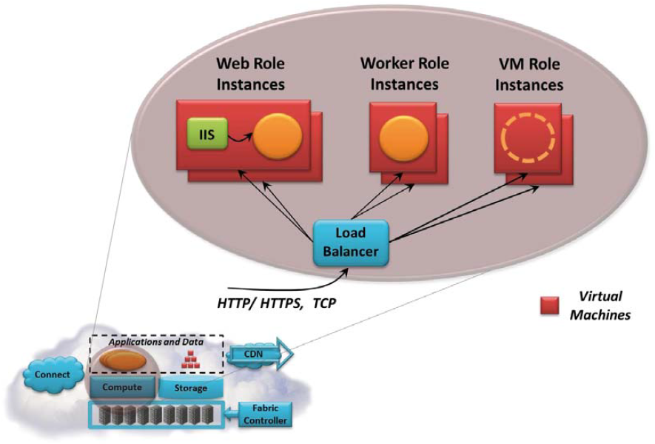
Execution Models
Execution / computing models
  how to deploy and run your code in the cloud
  the level of services provided
    for running your own applications
    IaaS, PaaS
    I don't have to care about anything vs. I can do anything
  service architectures
  granularity of computing units, scalability

Slide 6
Service-oriented Computing - IaaS, PaaS, SaaS
Private
Infrastructure
as a Service
Platform
as a Service
Software
as a Service
SW
Applications
Applications
Applications
Applications
You manage
Runtimes
Runtimes
Runtimes
Runtimes
Security & Integration
Security & Integration
Security & Integration
Security & Integration
Databases
Databases
Databases
Databases
virtual
Servers
Servers
Managed by vendor
Servers
Servers
Virtualization
Virtualization
Virtualization
Virtualization
HW
Server HW
Server HW
Server HW
Server HW
Storage
Storage
Storage
Storage
Networking
Networking
Networking
Networking

Slide 7
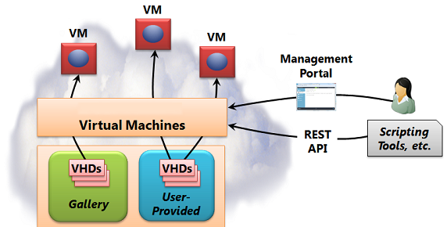
Virtual Machine
Virtual machines
  own image / gallery
    VM extensions
  more cloud services
    storage, networking, AI, ...
  administration
    portal / scripting console / API
  use cases
    development / test environment
    applications, services
    datacenter expansion
    disaster recovery
    ... whatever
Payment options
  Pay-as-you-go
  Savings plan
    fixed hourly amount
  Reserved instances
    stable predictable workloads
  Spot
    unused capacity
  ... payment calculator

Slide 8
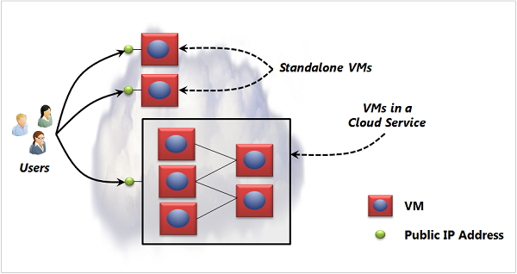
Virtual Machine
IaaS
  Infrastructure-as-a-Service
  fault tolerance, monitoring
  aktualizace gallery
  SLA - Service Level Agreement
    99.9x% availability
      ≈ several hours per year
    hardware failure - storage, CPU, memory
    datacenter failures - network / power
    hw upgrade, sw maintenance
Grouping
  load balancing
  availability set
    different nodes
    no single point of failure
    maintenance, upgrade, failure
    rolling updates
  communication
Multiple Datacenter Deployment
Cloud Design Patterns
Notes:
99.99% ~= 52 min
avail set - pokyn pro fabric controller nevypinat hostitelsky OS celeho setu najednou (aktualizace / maintenance)

Slide 9
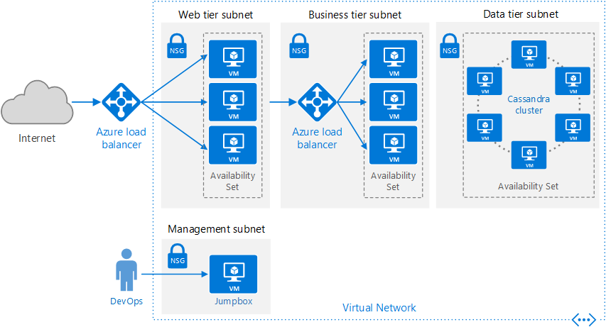
VM - Multi-tier Application Architecture
internal / external
load balancer
Network Security Group
restricted communication
bastion host - bašta
secured admin access
Notes:
samostatne podsite pro kazdopu vrstvu
NSG - Network Security Group - omezuje komunikaci jen mezi sousednimi vrstvami
uk: bæstiən
us: bæsčən

Slide 10
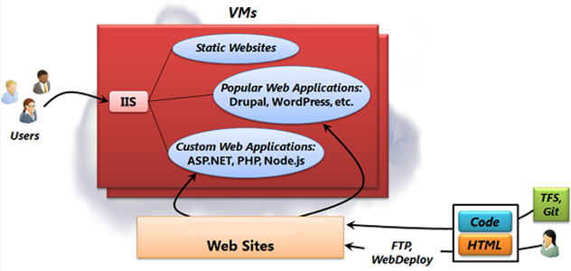
Web Sites
Web Sites / Web Apps
  web application on various platforms
  frequent use of cloud infrastructures
    typical use case
    unpredictable scalability
  possible using virtual machines
    ☹ unnecessarily complex
    ☹ instalation, configuration a maintenance, ...
Notes:
https://azure.microsoft.com/en-us/documentation/articles/fundamentals-application-models/

Slide 11
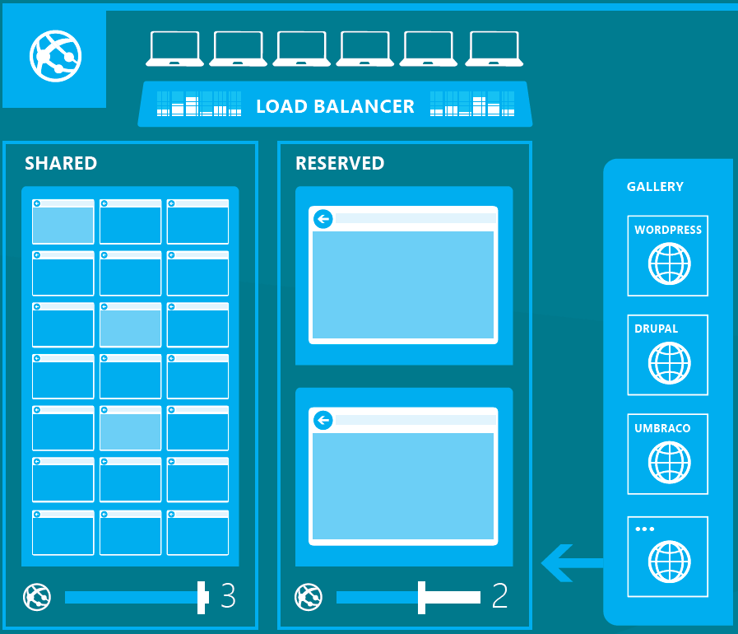
Web Sites
Web Sites / Web Apps
  Platform-as-a-Service, PaaS
    preconfigured installations
    complet framework - OS, db, web server, libraries, ...
    administration, updates, component maintenance
    just upload html/php/js/...
  dynamic instances, load balancing
    automatic scalability - based on a schedule / usage / quotas
  various isolation levels
    shared / private VM
  various frameworks, languages, db
    JAVA, .Net, PHP, Node.js, *-SQL
    Drupal, WordPress, ...
  WebJobs
    scripts / jobs
    on demand / non-stop / schedule
    queues, scheduler

Slide 12
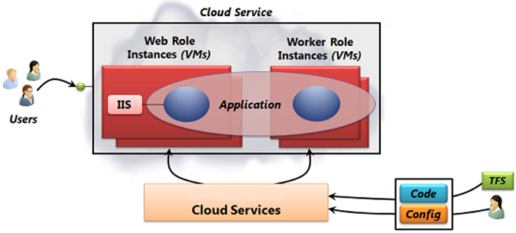
Web/Worker Roles
Cloud Services
  scalable SaaS services
    WS - restricted access, cannot install anything, not all services are available
    VM - full access, administration, maintenance, no automatic scalability
  application model with more roles
  web / worker roles
    front-end: GUI, http
    back end: computation, application logic, data processing
  useful for multi-layer scalable applications

Slide 13
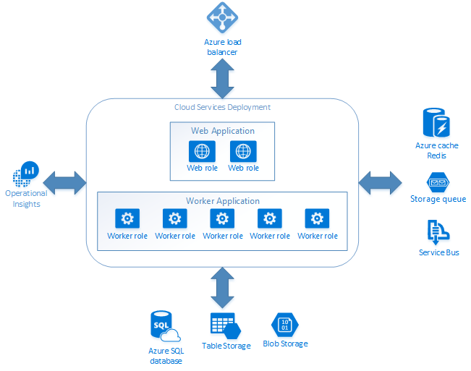
Web/Worker Roles
Web/Worker Roles
  one address, more web/worker roles
    multi-tier applications
    automatic load balancing and availability set
  administrative access to VM
    installation of necessary software
    interconnection of a cloud application with private nodes
  development and production environment (staging area)
    simple development/testing and upgrade
    partial upgrade
  hw/sw monitoring
    agents inside web/worker roles
independent scalability

Slide 14
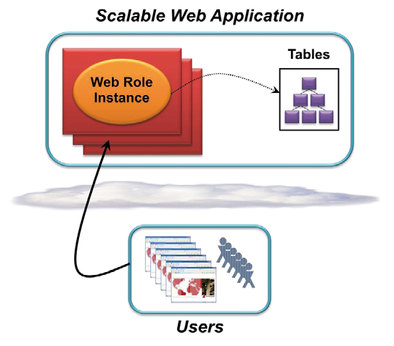
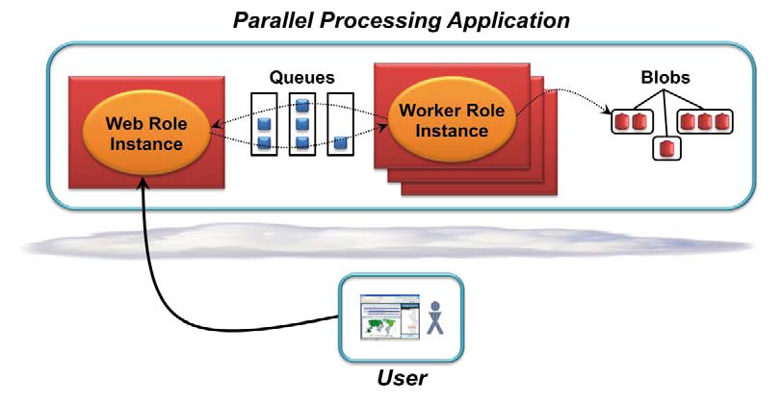
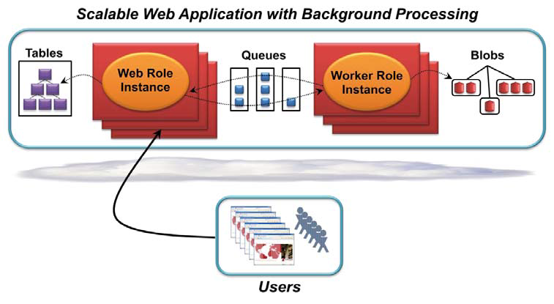
Cloud Services - Scenarios

Slide 15
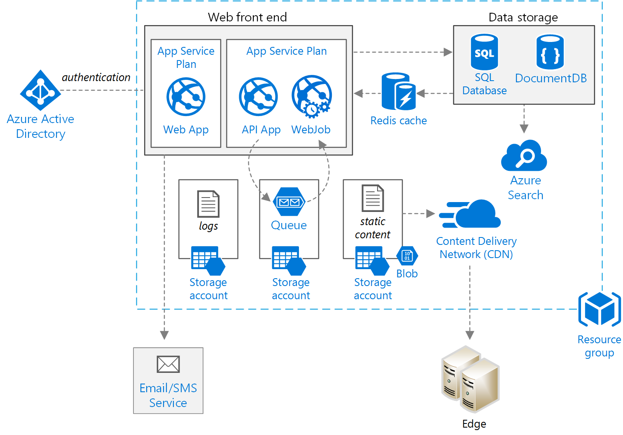
Complex Scalable Web Application

Slide 16
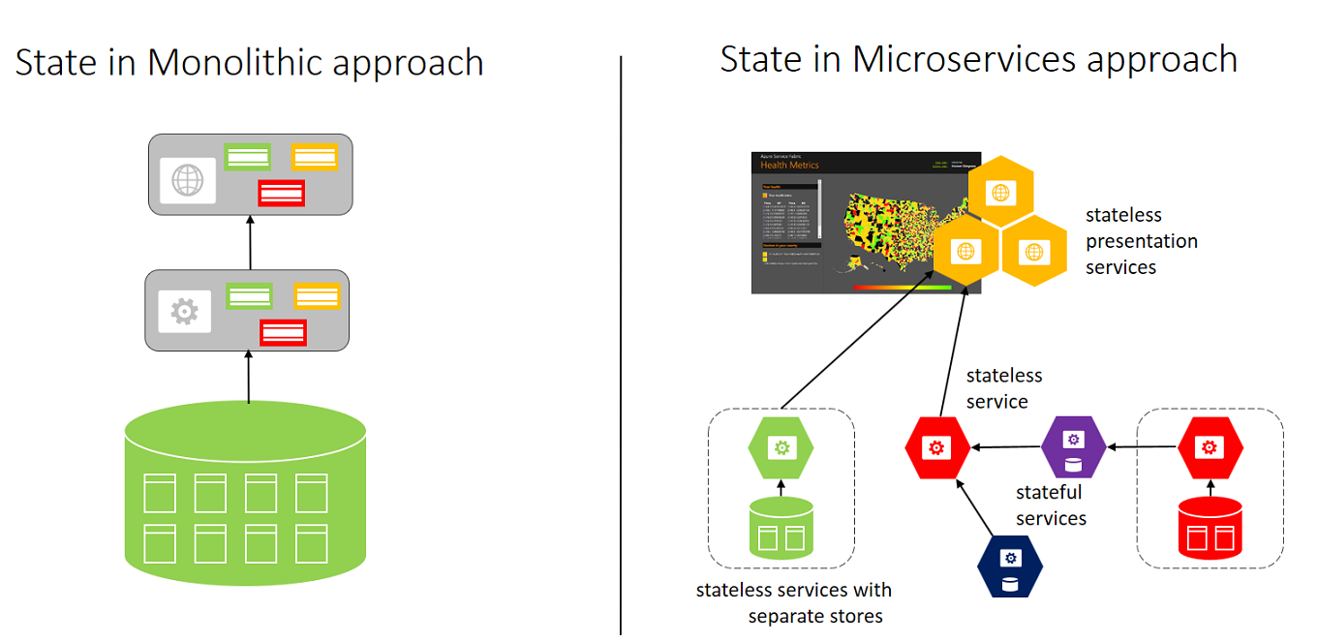
Containers & Microservices
Containers
  commodization of cloud platforms
Microservices
  design pattern
  decomposition
    small independent services
    self-contained, bounded contexts
    API
  flexibility, fine-grained scalability
  effective implementation using containers
    e.g.: user profiles, shopping carts,
    inventory processing, queues, caches, ...
  stateless / stateful ↬
Microservice
Resource Consolidation
Notes:
https://azure.microsoft.com/en-us/blog/azure-container-service-now-and-the-future/

Slide 17
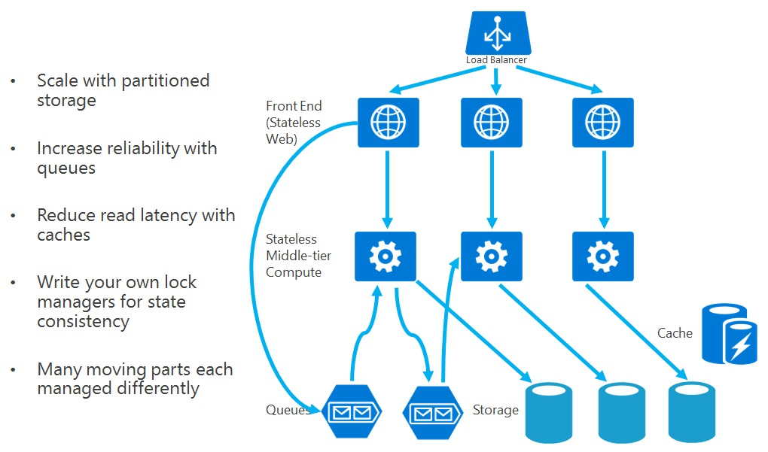
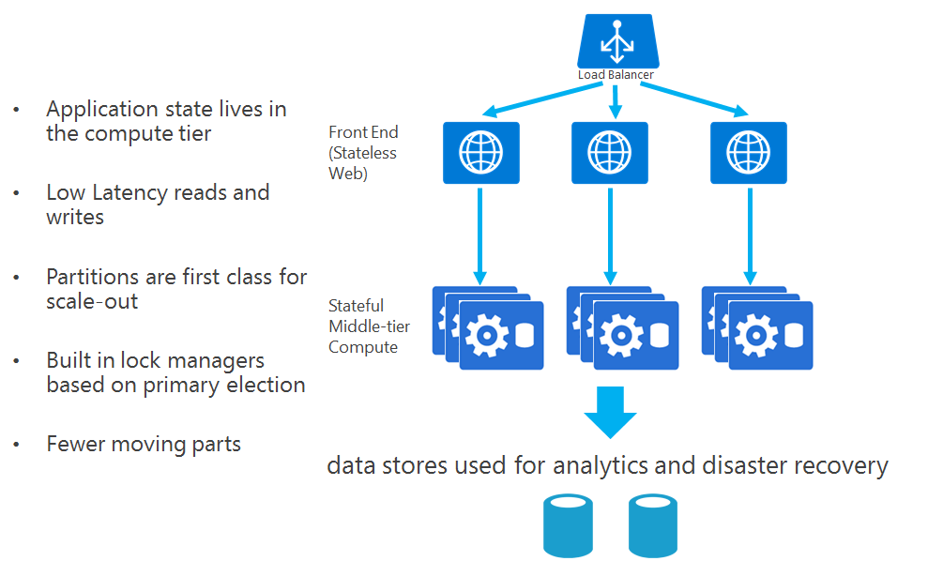
Stateless / stateful services
Stateless service
  no state
    disposable
    external
  no need for synchronization, state replication, persistence, ...
Stateful service
  automatically persistent state
  transaction support
  high availability, reliability, low latency
  quorum - replication
  more complex
Notes:
https://azure.microsoft.com/en-us/documentation/articles/service-fabric-application-scenarios/
https://azure.microsoft.com/en-us/documentation/articles/service-fabric-reliable-services-introduction/
https://docs.microsoft.com/en-us/dotnet/standard/microservices-architecture/architect-microservice-container-applications/scalable-available-multi-container-microservice-applications

Slide 18
Microservice antipatterns
  Monolith in Microservices
  Chatty Microservices
  Distributed Monolith
  Over-Microservices
  Violating Single Responsibility
  Spaghetti Architecture
  Distributed Data Inconsistency
  Tight Coupling
  Lack of Observability
  Ignoring Human Costs
Antipatterns
Notes:
https://blog.bitsrc.io/10-microservice-anti-patterns-278bcb7f385d

Slide 19




Container Management Systems & Orchestration
Orchestration
  thousands of contejners!
  scheduling
    job scheduling
    resource scheduling
  automatized host allocation
  load balancing
  availability sets
  health checking & logging, service restarting
  automatic service replication
  procedural vs. declarative description
    desired state
    Infrastructure as Code
"Containers without orchestration are a toy"
Notes:
https://tomaskubica.cz/post/2017/o-kontejnerech-cloudu-vesmiru-a-vubec-se-zvlastnim-zretelem-na-kubernetes/

Slide 20
Consensus & Replicated State Machine
Consensus algorithm
  based on a majority of nodes
  a group of 5 nodes can continue even if 2 nodes fail
  more failures ⇝ stop
Typical use-case: replicated state machine
  each node maintains transition functions, its state and a command log
  one step: distributed consensus - next command
  equal sequence of commands ⇝ equal sequence of states
  client POV: one fault-tolerant service 
Paxos, Raft, ...
⇝ PDS
Notes:
replikovany konecny autromat

Slide 21
Container Management Systems & Orchestration
Google
  Borg
    Cluster Management System
      development since 2005
    100k jobs, 10k nodes
      Production / Non-Prod jobs - priority
    Borgmaster - 5x replicated - Paxos
      failure detection, relibility, availability
  Borg-based tools & zoo
    naming, service discovery
    load balancing
    horizontal/vertical autoscaling
    rollout tools
      deployment and configuration
    workflow tools
      multijob pipelines with interdependencies between the stages
    monitoring tools
      gathering, aggregating and presentation, alert triggers
Leader Election

Slide 22
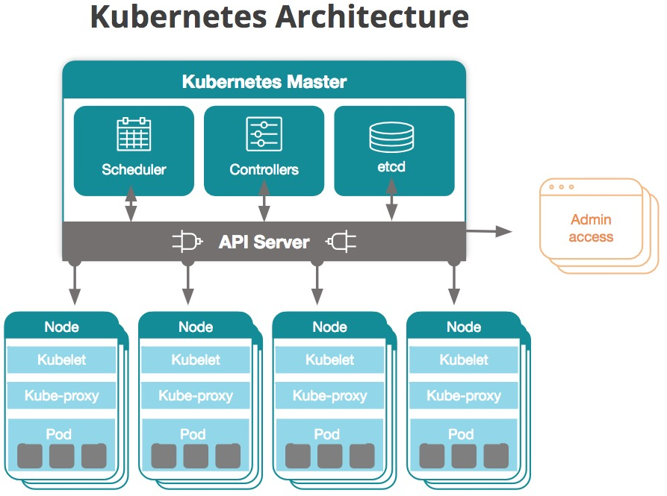
Container Management Systems & Orchestration
Google
  Omega
    redesign a reimplementation 2013
    Based on Borg and Apache Mesos
    Paxos-based transaction-oriented store
    Scalability!
  Kubernetes
    open source since 2014
    first released 2015
      Google Container Engine, Azure Container Services, AWS EC2 Container Services for Kub.
    application deployment, scheduling, updating, maintenance, scaling
    active container management
      a state of the cluster conforms to a specification
    pod
      a set of containers always allocated to the same node
    rolling updates
      uninterrupted availability
https://tomaskubica.cz/tag/kubernetes/
Notes:
https://en.wikipedia.org/wiki/Kubernetes
http://dl.acm.org/ft_gateway.cfm?id=2898444&ftid=1693821&dwn=1 Borg Omega Kubernetes
http://fakecineaste.blogspot.com/2018/09/borg-omega-kubernetes.html
https://tomaskubica.cz/tag/kubernetes/

Slide 23
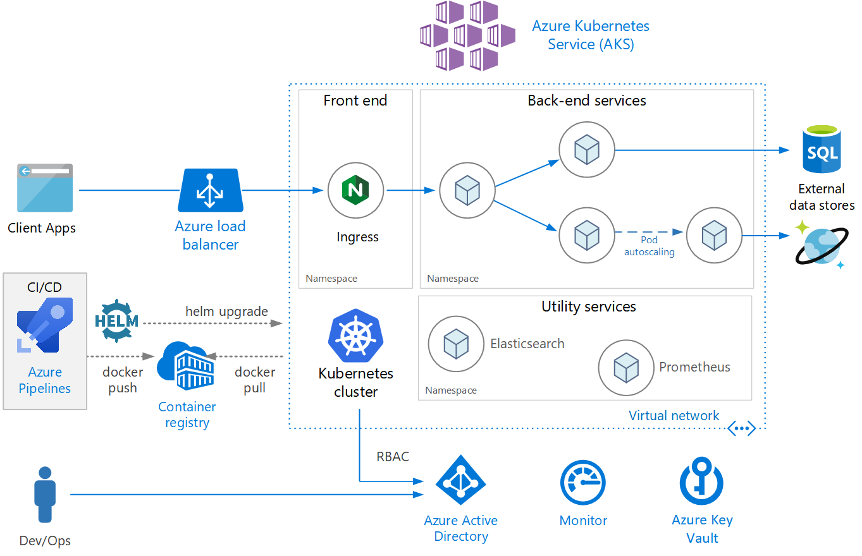
Microservices & Kubernetes
Notes:
https://docs.microsoft.com/cs-cz/azure/architecture/reference-architectures/containers/aks-microservices/aks-microservices
RBAC - Role Based Access Control
https://en.wikipedia.org/wiki/Role-based_access_control
HELM - spravce balicku pro Kubernetes

Slide 24
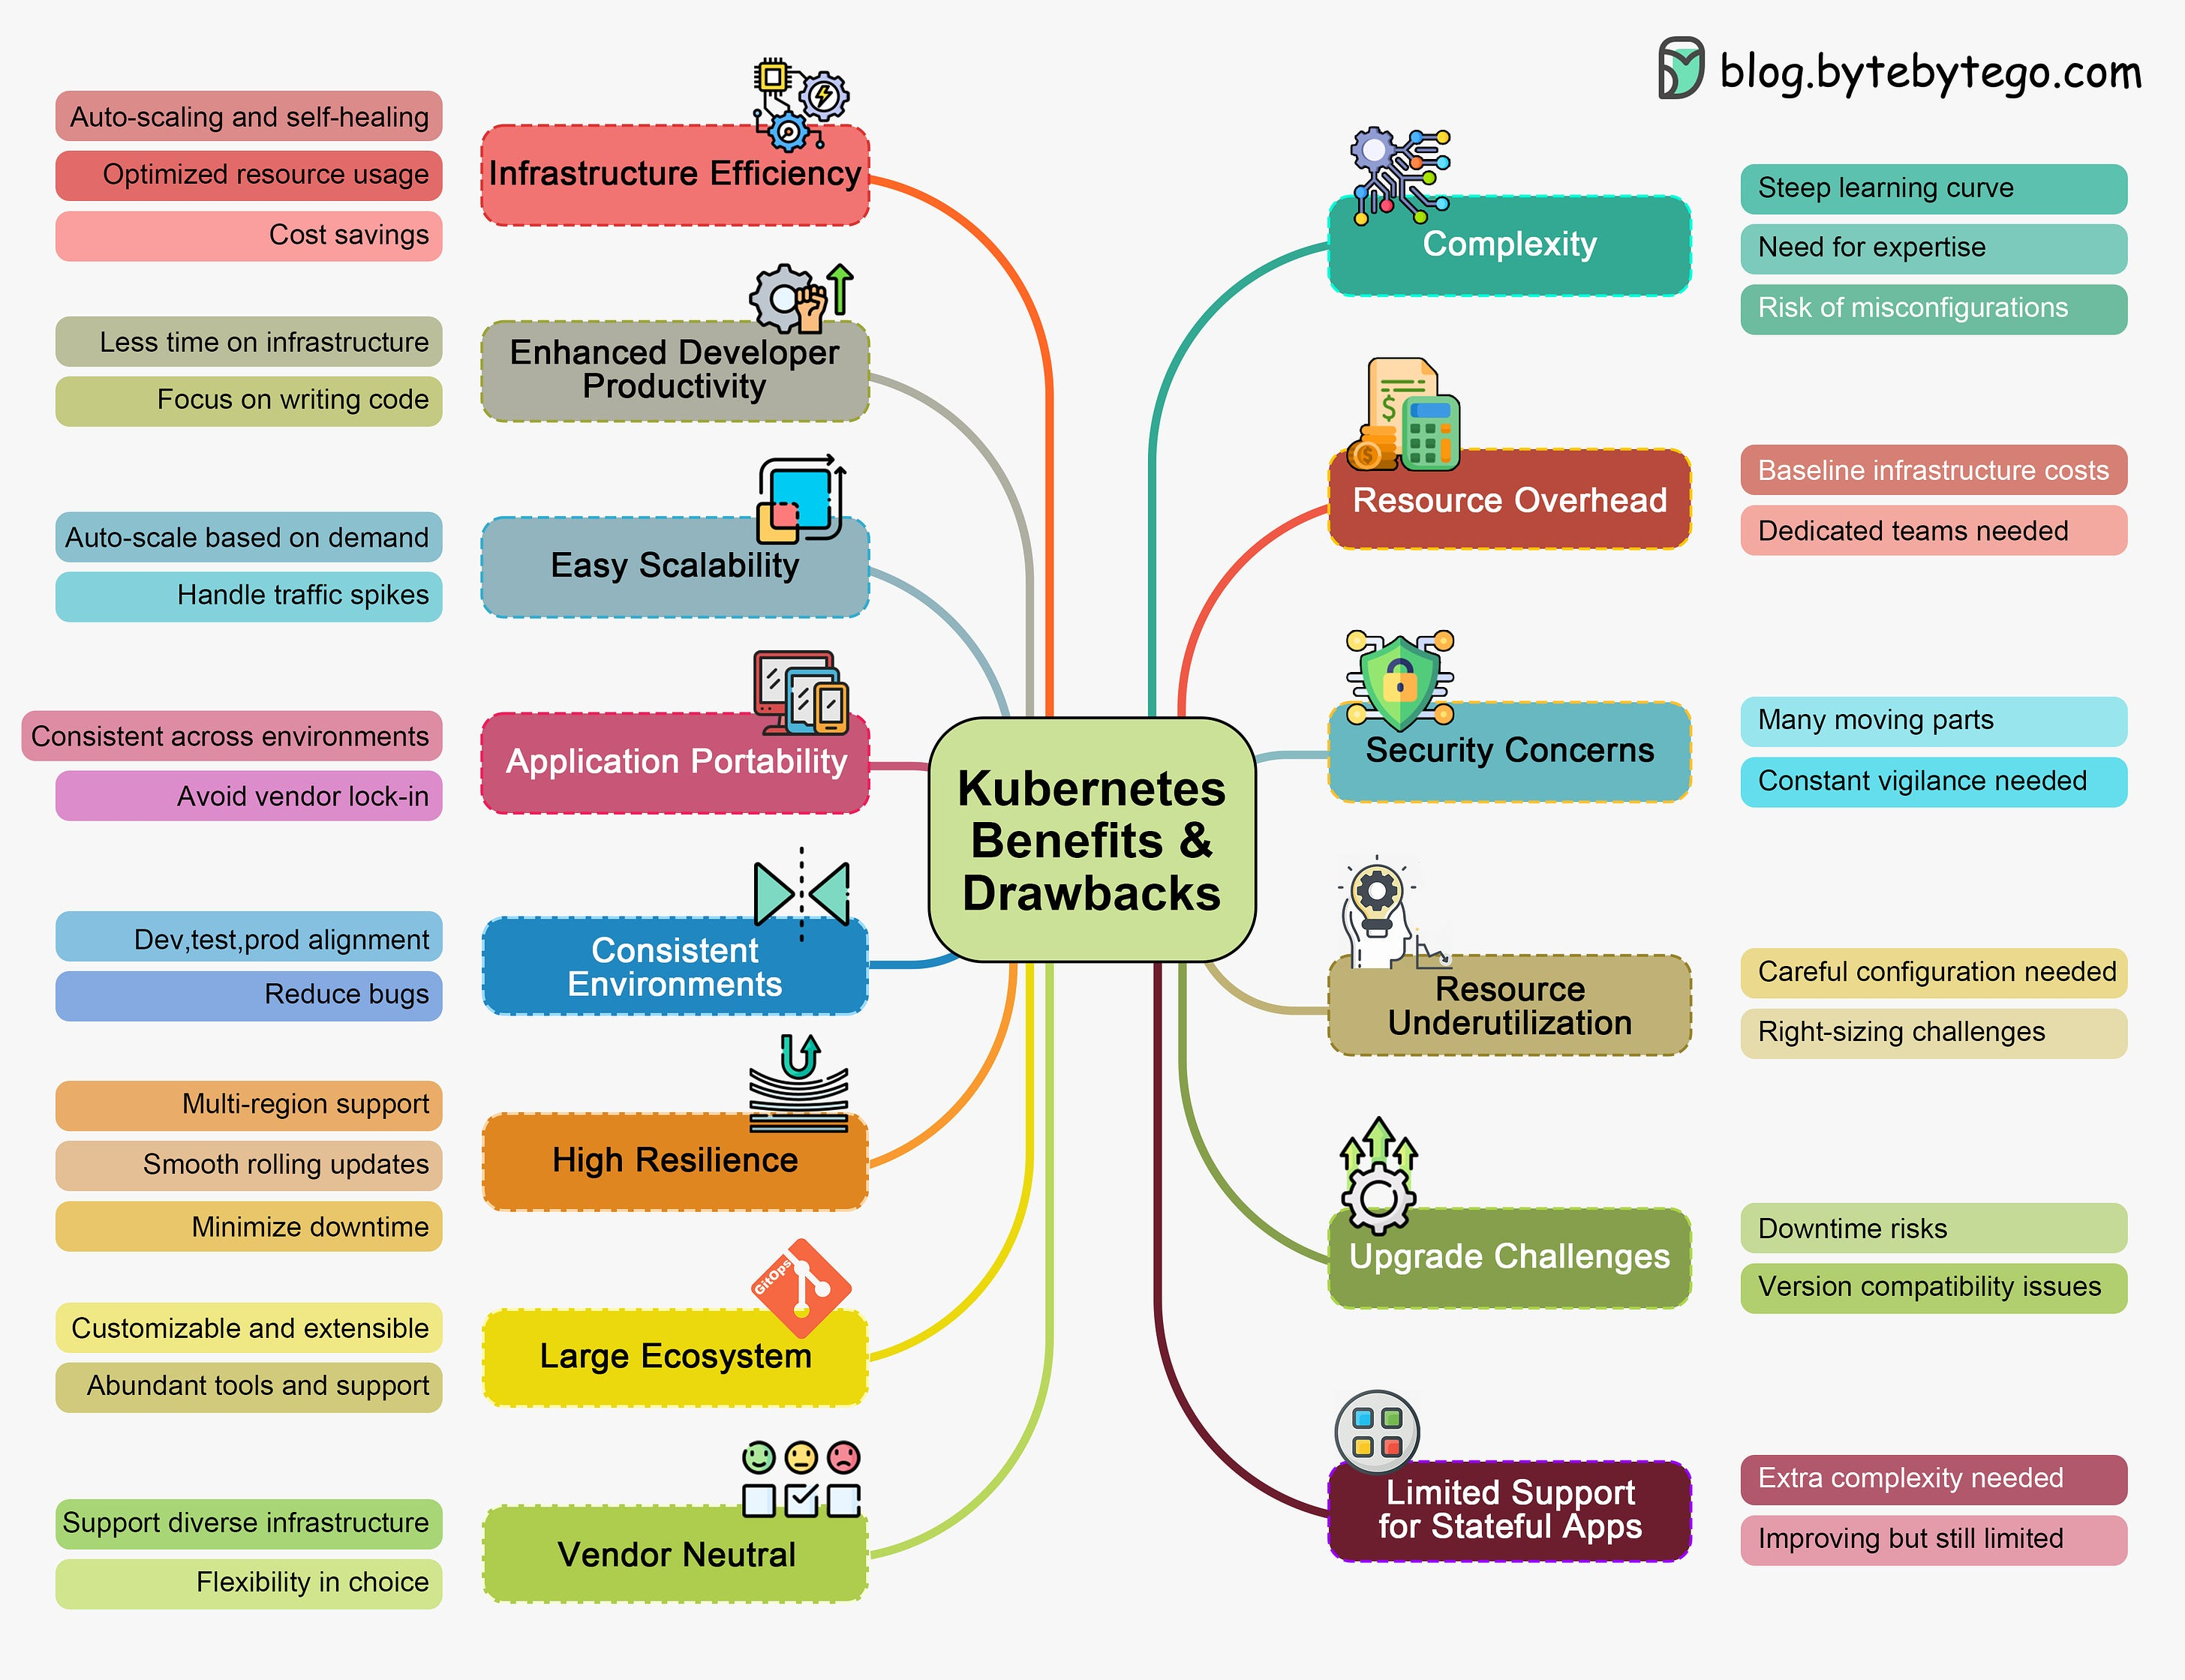
Kubernetes - Benefits & Drawbacks

Slide 25
Container Management Systems & Orchestration
Azure
  Service Fabric - API
    development since 2008
      open source since 2018
      Windows, .Net ⇝ Linux, ...
    Containers
    Reliable Stateful/Stateless Services
      N consistent copies (quorum) - replication and local persistence
    Reliable Actors
      stateless & stateful actor objects, simplified single-threaded programming model
    Guest Executables
      any exe / language / prog model
      packaged as application - versioning, upgrade, monitoring, health, etc.
  Cloud Services ⇝ Service Fabric
    CS: code bound to a VM instance (Web/Worker Role)
    SF: code bound to SF - abstract layer
      faster (re)boot, dense hosting, multiplatform (Win/Lx), management
  orchestration
    Azure Container Service, Kubernetes (AKS), Apache Mesos, Deis
Azure SQL Database cluster
100s machines ~ 10.000s containers ~ 100.000 databases
each db is a stateful microservice
Notes:
Guest Exec don't call API directly
https://cloudify.co/container-microservices-orchestration/
https://azure.microsoft.com/en-in/services/kubernetes-service/
https://tomaskubica.cz/post/2018/service-fabric-ocima-kubernetes-spravce-architektura-a-kdy-co-pouzit/

Slide 26
Container Management Systems & Orchestration
Amazon Web Services
  EC2 Container Service
    tight integration with AWS
    proprietary solution - lock-in
    task definition
  Kubernetes
Open Stack
  OpenStack Heat
    native part of OpenStack
    templates - plain text file, desired state
    autoscaling, high availability
...
  Terraform
    IaaS, independent open source
    providers - OpenStack, vSphere, Amazon AWS, Azure
  Mesosphere DC/OS (Mesos + Marathon), ..
images to use
CPU / memory for each container
launch type, which determines the infrastructure
containers linked together in a task
networking mode
ports from the container
failure behavior
starting command
environment variables
data volumes
role and permissions

Slide 27
Evolution of Deployment Models
Evolution of deployment and instantiation
  physical servers
  virtualization
    reduced provisioning times
    increased hardware utilization, flexible scaling
    deployment - separate (often manual) task
    many applications did not utilize the virtual resources very well
  containers & PaaS
    self-contained images, automatic deployment
    vastly improved deployment and resource utilization
    applications are deployed once or in a fixed number of instances
    deployment of new instances when demands increase
  serverless computing
    deployment of individual functions (instead of complete applications)
    dynamic instantiation as requests come in
    automatic scaling based on current demand

Slide 28
Serverless Computing
No infrastructure, no OS, no installation
  Function-as-a-Service
⇝ just write a function
  no servers to provision or manage
    automatic deployment, startup, shutdown, scaling
    inherent availability and fault tolerance
    no charges for idle capacity
  no persistence, no internal state
    external persistent store
  bindings to other cloud services
  event-driven
Serverless execution models
AWS Lambda / Step Fnc
Azure Functions / Logic Apps
Google Cloud Functions
asynchronous | synchronous | poll-based
event-based | push - direct call | polled by consumer functions
Notes:
https://www.slideshare.net/AmazonWebServices/serverless-architecture-patterns
https://cloudacademy.com/blog/google-cloud-functions-serverless/
https://medium.com/@ste.grider/serverless-showdown-aws-lambda-vs-firebase-google-cloud-functions-cc7529bcfa7d
Logic Apps - manazerske deklarativni klikatko
Functions - naprgane
push - zdroj dat zada o jejich zpracovani
poll-based - consumer si zada o data

Slide 29
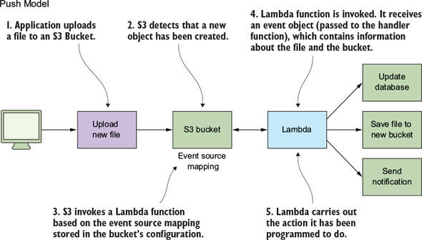
Serverless Computing - Use Cases
Use cases
  timer-based processing
  ServiceBus / EventHub / SaaS event processing
  serverless mobile backend / web application
  real-time stream processing
  real-time chatbot messaging
event driven
Notes:
S3 bucket - amazon object storage

Slide 30
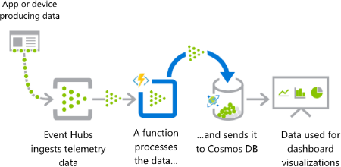
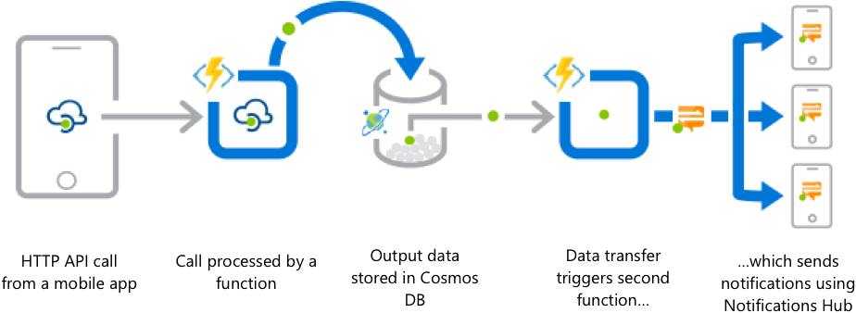
Serverless Computing - Triggers
Triggers
  timer
  http request
  ESB / queue / topic
  event hub, event grid, IoT hub
  file, database, BLOB
  mobile apps / notification service
  email gateway
  ...
Pipes & Filters

Slide 31


Serverless Computing - Advantages & Benefits
Provider perspective $$$
  higher density of computing units
  easier scalability, reduced overhead
Business perspective $
  the cost is based on the number of function executions
    measured in milliseconds instead of hours
  smaller deployable units ⇝ faster delivery
  reduced cost of infrastructure engineers
Developer perspective
  no backend infrastructure
    zero system administration
  easier operational management, faster set up
  inherent scalability
User perspective
  new features quicker than before

Slide 32

Serverless Computing - Challenges & Limitations
Performance
  response latency - greater than code running on a dedicated VM
  additional latency for the runtime wakeup
Architecture and design
  architectural complexity ⇝ currently not suitable for large projects
  significant restrictions on the local state
  immature technology ⇝ component fragmentation, unclear best-practices
Monitoring and debugging
  lack of tools, limited possibility to attach profilers/debuggers
  the runtime environment is not open source
    it cannot be precisely replicated in a local environment
Security
  the total attack surface is significantly larger
    more components
  no control of the endpoint and network level
  mono-culture properties of the server network
    a single flaw can be applied globally

Slide 33
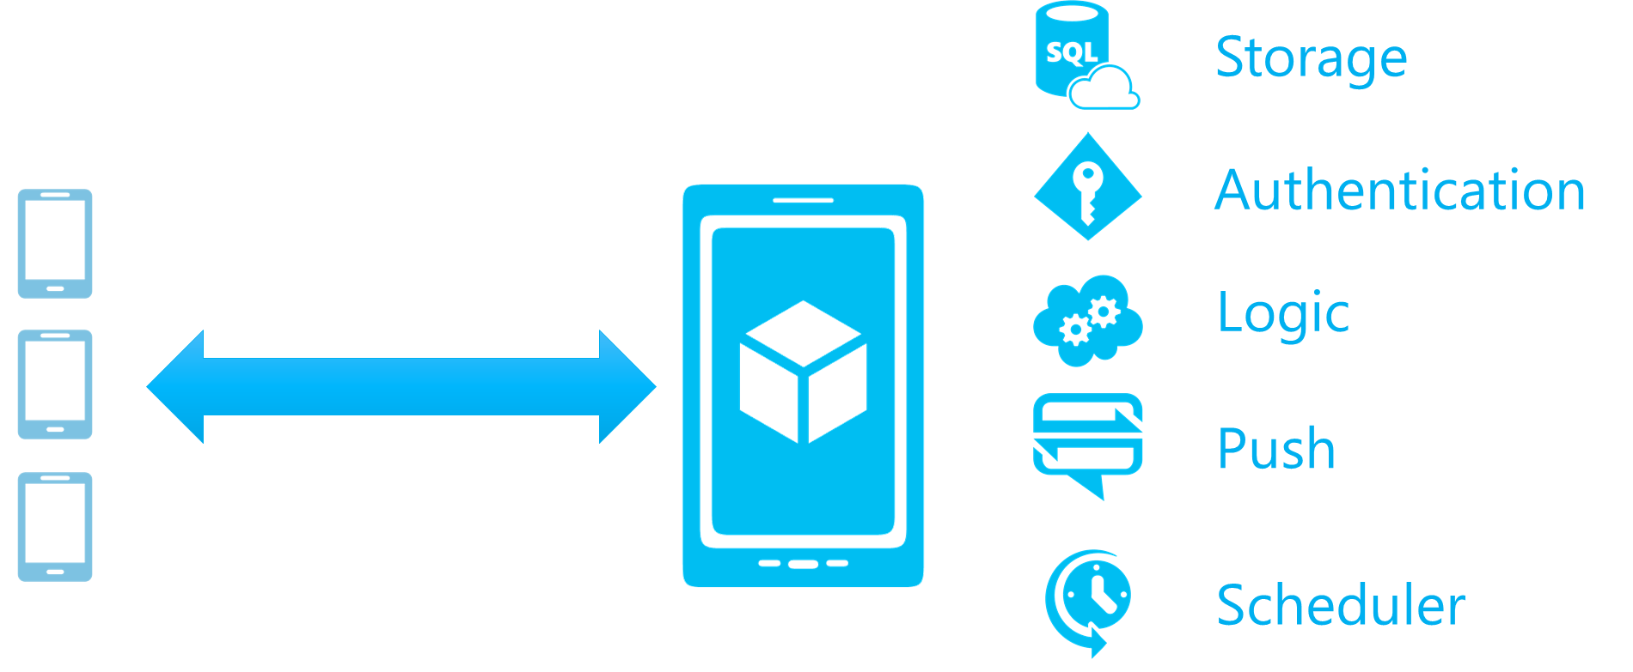
Mobile Services
Mobile Services
  Backend-as-a-Service
    cloud back-end "in a minute"
  mobile client
    multiplatform - Android, iOS
Data and app services
  backend logic
  access to DB a other services
    REST API / libraries
    proxy
  backend job scheduler
    push notification, remove old data, ...
Offline support
  caching, synchronization
  conflict detection
    server / client side resolution
Authentication services
  sign in using third-party services
  integration with social networks
    Facebook, Google, MS, Twitter, ...
insert 123 to abc
begin transaction
select xx from yy, zz
update tr, where bb
insert abc set ...
insert xyz set ...
commit
Notes:
https://firebase.google.com/

Slide 34
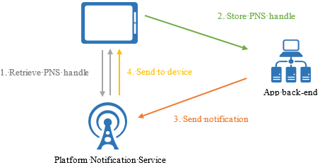
Mobile Services - Push Notifications
Push Notifications
  replacement of background applications
    IM, e-mail, updates, calendar, news, ...
  PNS handle
    device and application identifier
    platform dependent
Problems
  platform dependency
    PNS - Platform Notification Service
      APNS - Apple Push Notification Service
      FCM - Firebase Cloud Messaging
  scalability
    handle refresh when the app starts
      millions of devices - heavy traffic
    PNS don't support broad/multicast
  routing
    no support for targeted addressing
    addressing: device + app ※ users / groups
Notes:
http://msdn.microsoft.com/en-us/library/windowsazure/jj927170.aspx

Slide 35
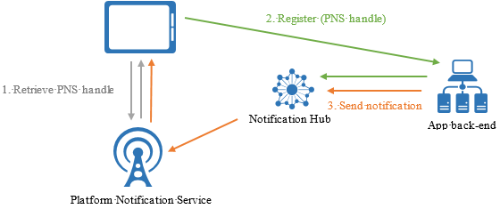
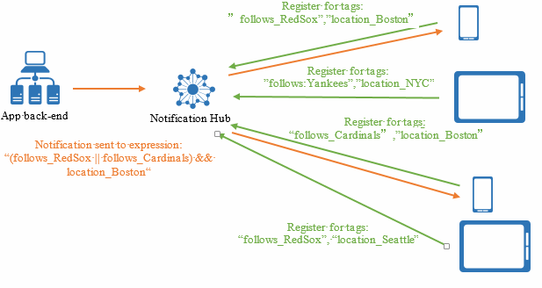
Mobile Services - Notification Hub
Delivery patterns
  Push to device
  Push to user
  Push to segment - dynamic tags
  Location-based push
  Silent push - push-to-pull
  Scheduled push
  Personalized push - device push variables, key-value pairs
Notification Hub
  multiplatform
  public/subscribe routing
    registration -
    client specifies tag(s)
  scalability
    millions of notifications per one call
  personalization, security, telemetry, ...
Notes:
https://azure.microsoft.com/en-us/documentation/articles/notification-hubs-tags-segment-push-message/
https://docs.microsoft.com/en-us/azure/notification-hubs/notification-hubs-push-notification-overview

Slide 36
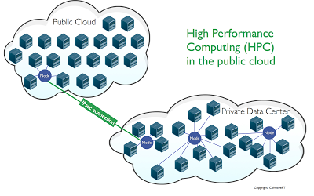
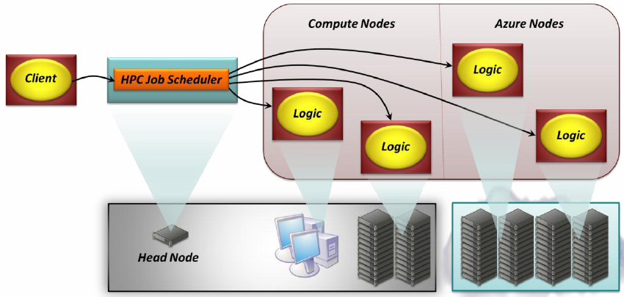
High-Performance Computing
Hi-Perf Cloud Computing
  unexpected / periodic performance req.
  investment ⇝ operating expenses
  cluster – private / cloud / hybrid
    whole infrastructure / expansion of on-premise
  job scheduler, cluster manager/engine
    proprietary vs. external - lock-in prevention
  protected data transfer, VPN, IPsec
  GPGPU computing
  TPU - tensor / matrix op
    high latency / very high throughput
    extreme parallelism
Problems / limitations
  private and sensitive data
  dependence on external sw
  big data - transfer
Notes:
Approximately 40% of HPC today is done in the cloud

Slide 37
Modely HPC
Loosely coupled cluster/grid computing
  application distributed across a large set of nodes
  small (or even no) mutual dependence
  master/slave, hierarchy, fault-tolerance
  GPU acceleration
Tightly coupled HPC
  distributed computing / app
  high mutual dependence of nodes, tightly connected
  MPI, shared-memory, low latency (μs)
  RDMA - zero copy networking
    no CPU / cache / context switch required
    RDMA-based network adapters - 40 Gb/s
Data-intensive computing
  non-linear data-flow schema
  big data optimalization (TB+)
  distributed data sharing
  fast access to data resources / services
  more emphasis on communication throughput
  than CPU performance
infrastructure
front-end
master
worker
Notes:
https://d0.awsstatic.com/whitepapers/Intro_to_HPC_on_AWS.pdf

Slide 38
High-Performance Computing
Azure - Batch / Big Compute
  job scheduling, auto-scaling - PaaS
  Batch SDK, Batch Service
  HP instances
    MPI latency 3 μs
    RDMA non-blocking 32 Gb/s throughput
  GPGPU - since 2017
    NVidia Tesla
    NC-Series - computing nodes
      Kepler K80, Pascal P100, Volta V100
    ND-Series - AI, ML
      Pascal P40
      single prec fp, larger GPU memory (24 GB)
    NV-Series - visualization nodes
      Maxwell M60
Notes:
Azure NC - focused to computations - Kepler (starsi - maji ale rychlejsi pocitani s double)
Azure NV - focused to visualization - Maxwell (novejsi ale pomalejsi double)

Slide 39

High-Performance Computing
Google - Cloud Dataflow
  managed service for batch and streaming big data processing
  scheduling, on-demand resources
  auto-scaling, monitoring, fault-tolerance
  integration to external services
    Storage, BigTable, BigQuery, DataStore, DataProc (MapReduce), Pub/Sub, ...
  Dataflow Programming Model
    Pipelines, PCollections (data), Transforms, I/O sources/sinks
  GPGPU
    NVidia Tesla - Kepler K80, Pascal P100
Amazon - AWS HPC
  on-demand server nodes
    Cluster Compute instances
    Cluster GPU instances - P100, V100
    FPGA instances - Xilinx, Field Programmable Gate Array
  Placement Group
    high communication throughput
      10 Gb/s, low latency
Notes:
DPM - bobox-like
FPGA - programovatelna hradlova pole

Slide 40
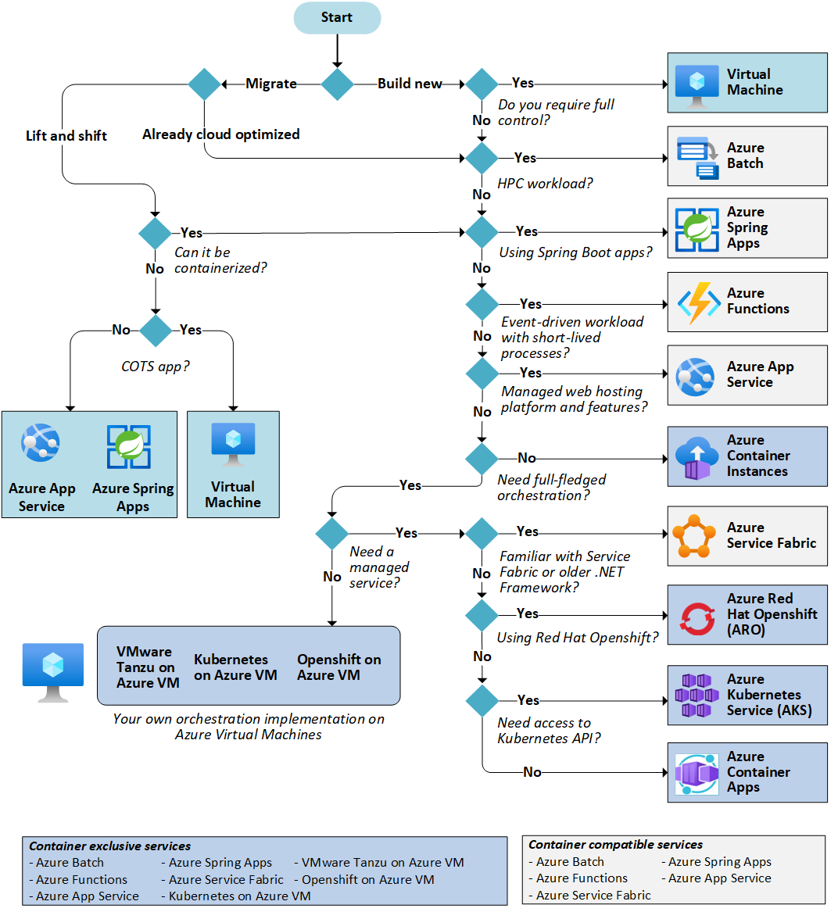
Choosing a Proper Computing Service

Slide 41
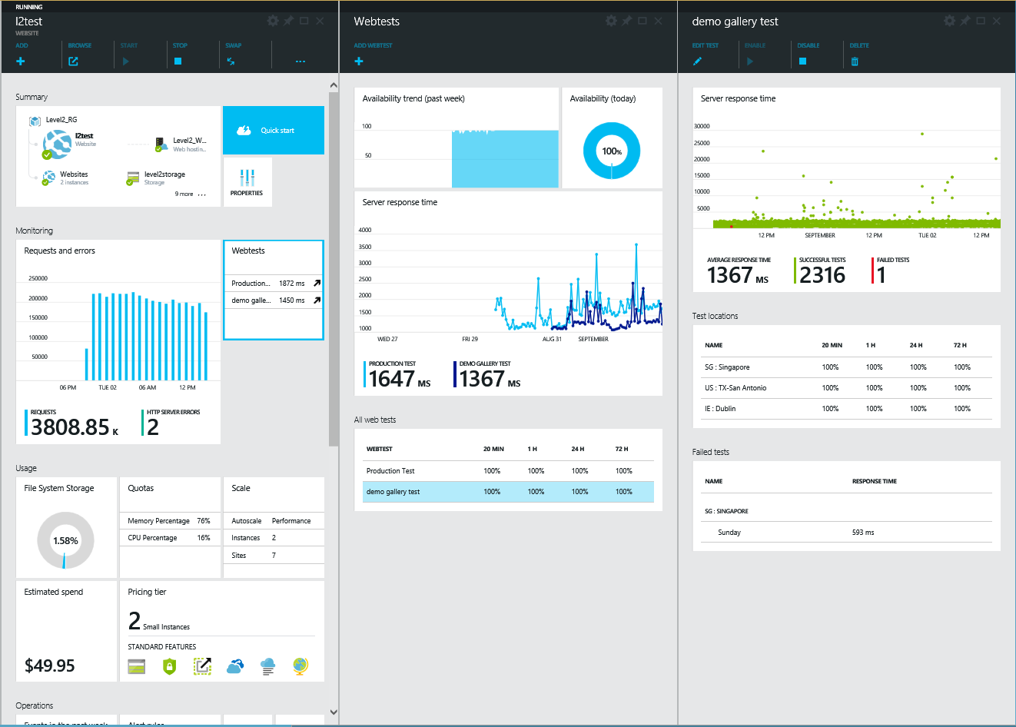
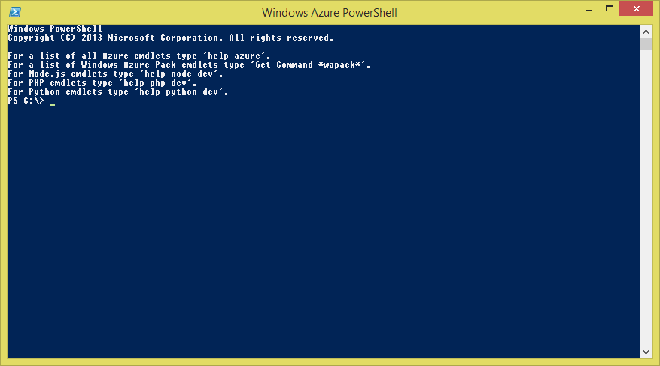
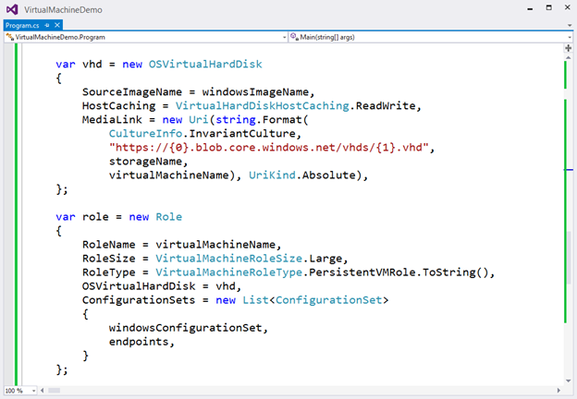
Management
  web portal
  mobile console
  scripting
  API / SDK / libraries
  REST API - CRUD
  debugging / tuning
http://My.tables.MyCloud/<MyTable>(PartitionKey='PK',RowKey='RK')?$select=<FirstProperty>
Add OS Image
https://management.core.net/<id>/services/images
<OSImage xmlns:i="http://www.w3.org/2001/XMLSchema-instance">
<Label>image-label</Label>
<MediaLink>uri-of-the-containing-blob</MediaLink>
<Name>image-name</Name>
<OS>Linux|Windows</OS>
<Description>image-description</Description>
<ImageFamily>image-family</ImageFamily>
<PublishedDate>published-date</PublishedDate>
<ShowInGui>true/false</ShowInGui>
<Privacy>http://www.example.com/privacypolicy.html</Privacy>
<IconUri>http://www.example.com/favicon.png</IconUri>
<RecVMSize>Small/Large/Medium/ExtraLarge</RecVMSize>
<Language>language-of-image</Language>
</OSImage>
Notes:
sprava a ovladani

Slide 42
Management - Web Portal
Web portal
  subscription, billing
  integrated marketplace
  resource management
  configuration, scaling
  deployment, monitoring
  role-based access control
Platforms
  Azure Portal
  Google Cloud Console
  BlueMix Dashboard
  AWS Management Console
    AWS Management Portal for vCenter
  OpenStack Horizon
Mobile console
  selected functionality
  dashboard, alerts

Slide 43
Management - Scripting
Scripting
  Infrastructure-as-a-Code
  batch / repeatable actions
  procedural / declarative / specification
  Azure Script Center
    PowerShell
  Google Cloud Shell
  AWS CloudFormation
    infrastructure templates
Azure Service Management Cmdlets
Azure Active Directory Cmdlets
Azure Cmdlets for Antimalware
Azure Automation Cmdlets
Azure Data Factory Cmdlets
Azure ExpressRoute Cmdlets
Azure HD Insight Cmdlets
Azure Key Vault Cmdlets
Azure Key Vault Manager Cmdlets
Azure Managed Cache Cmdlets
Azure Profile Cmdlets
Azure Resource Manager Cmdlets
Azure Rights Management Cmdlets
Azure Storage Cmdlets
Azure Site Recovery Cmdlets
Azure SQL Database Cmdlets
Azure Traffic Manager Cmdlets
Add OS Image
https://management.core.net/<id>/services/images
<OSImage xmlns:i="http://www.w3.org/2001/XMLSchema-instance">
<Label>image-label</Label>
<MediaLink>uri-of-the-containing-blob</MediaLink>
<Name>image-name</Name>
<OS>Linux|Windows</OS>
<Description>image-description</Description>
<ImageFamily>image-family</ImageFamily>
<PublishedDate>published-date</PublishedDate>
<ShowInGui>true/false</ShowInGui>
<Privacy>http://www.example.com/privacypolicy.html</Privacy>
<IconUri>http://www.example.com/favicon.png</IconUri>
<RecVMSize>Small/Large/Medium/ExtraLarge</RecVMSize>
<Language>language-of-image</Language>
</OSImage>
# List all compute instances in the project
gcloud compute instances list
# Grep the console output from all instances
gcloud compute instances list | \
awk 'NR > 1 { print "--zone " $2 " " $1 }' | \
xargs -L1 gcloud compute instances get-serial-port-output | \
grep BREAK-IN

Slide 44
Management - PowerShell
param(
[parameter(Mandatory=$false)]
[String] $CredentialName = "Use *Default Automation Credential* Asset",
[parameter(Mandatory=$false)]
[String] $SubscriptionName = "Use *Default Azure Subscription* Variable Value",
)
function CheckScheduleEntry ([string]$TimeRange) # Define function to check current time against specified range
{
$currentTime = (Get-Date).ToUniversalTime()
$midnight = $currentTime.AddDays(1).Date
try {
if($TimeRange -like "*->*") {
$timeRangeComponents = $TimeRange -split "->" | foreach {$_.Trim()}
} else {
Write-Output "WARNING: Invalid time range format"
}
$Uri = Connect-AzureVM -AzureConnectionName $ConnectionName -serviceName $ServiceName -VMName $VMName
Backup-AzureVM -serviceName $ServiceName -VMName $VMName -backupContainerName $backupContainerName
Start-AzureVM -ServiceName $ServiceName -Name $VMName
} catch {
Write-Output "WARNING: Exception encountered. Details: $($_.Exception.Message)
return $false
}
} # End function CheckScheduleEntry

Slide 45
Management - API
API / SDK / Libraries
  Visual Studio - Azure SDK
    IDE integration / .Net - *#
  Google Cloud SDK
    client libraries: Java, Python, Node.js, Ruby, Go, PHP
  AWS SDK
    Java, .Net, Ruby, Android, iOS, Node.js (JavaScript), PHP, Python, Go
REST API - CRUD
  Representational State Transfer
    Create, Read, Update, Delete
  service & data access
  language / platform independent
http://My.tables.MyCloud/<MyTable>(PartitionKey='PK',RowKey='RK')?$select=<FirstProperty>

Slide 46
Monitoring
Health dashboard
  complex view on the operation of infrastructure in the cloud
  alerts
Topologic views
  monitoring of main cloud components
  clustering
Reports
  current state, trends, workload
What-If
  capacity-based scheduling
Policy-Based optimalization
  based on monitoring – finding the best place to run an expected workload
Performance Analytics
  useful for virtual server scalability
thousads of VM
Health Endpoint Monitoring

Slide 47
Debugging And Profiling
Behavior and performance of programs
  differences of local and cloud environment
  infrastructure support needed
  performance profiling
Debugging
  attached to a running process
  snapshot / call stack
  logpoint injection, statistics
Profiling
  instrumentation, statistics
  invasiveness ※ accuracy
Platforms
  Azure: VS remote Debugging, Azure Service Profiler
  Google Stackdriver - debugger, profiler, monitoring, alerts, dashboards, ...
  Amazon AWS Cloud9 - IDE, debugger
Notes:
https://cloud.google.com/stackdriver/

Slide 48
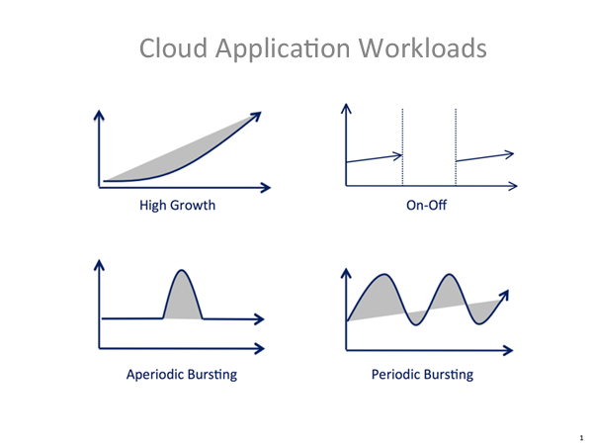
Typical Use-Cases
Software development
  multiplatform development and test environment, VM
Applications with variable load
  online ticket sale
Parallel/HPC computations
  complex modelling
Masive scalability
  social networks, multiplayer
High availability
  SaaS
Short or unpredictable lifetime
  marketing campaign, startup
Overflowing applications
  insufficient infrastructure, inadequate policies

Slide 49
Cloud Computing Properties
Multitenancy
  one resource (service, data, connection ...) is used by many users
  virtualized resources are logically separated
    impossibility of accessing other client's resources
Thin provisioning
  virtual storage space allocation
  requested capacity is virtually allocated (promised) to a client
    it can be used by other systems until it is used
    ⇝ SLA
Scalability, elasticity
  dynamic / on request performance adaptation
  services are charged according to their use
Reliability, availability
  various levels of backup systems
    hw, infrastructure, data centers
  fault tolerant (replicated) management software
Up-to-date
  software is automatically updated

Slide 50
Scalability Dimensions
Vertical scalability
  scale-up (scale-down)
  increasing resource properties
  the load is allocated to one node
  ☺ simple, ☹ more expensive, technological limits
Horizontal scalability
  scale-out (scale-in)
  many resources of the same type, load balancing
  minimalization of dependencies, shared resource reduction
  homogeneous stateless nodes
  synchronization, consistency
  ☹ more complex, ☺ potentially more efficient
Compute/Data Partitioning
Data Replication & Synchronization
Premium
P2
[400-500]
Premium
P1
scale
up
Standard
S2
[500-600]
Scale up/down
Standard
S1
[200-300]
Basic
Basic
[500-600]
Basic
[0-100]
Basic
[100-200]
Basic
[200-300]
Basic
[300-400]
Basic
[400-500]
Basic
[600-700]
scale-out
Scale out/in

Slide 51
2. Data management
NoSQL, key/value tables
column stores, document db, graph db
BLOB
data analytics & reporting
Map/Reduce, Hadoop zoo

Slide 52
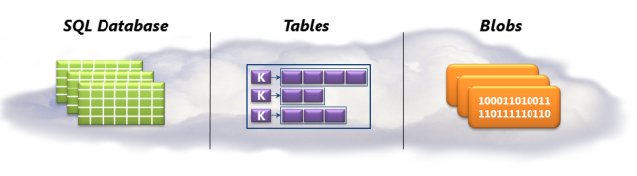
Data Management
SQL
  Different implementations, libraries - JDBC, ADO.NET, ...
    cloud optimized
  PaaS - maintenance, administration, federation, replication
    Accessible for both cloud and external applications
  Usually distributed architecture - availability, scalability
    primary / secondary replica, replicated services
    load balancing, cluster index
NoSQL database
  Key/Value Tables, Column Stores, Blobs
  Document stores, Graph databases, ...
BigData ⇝
performance!

Slide 53
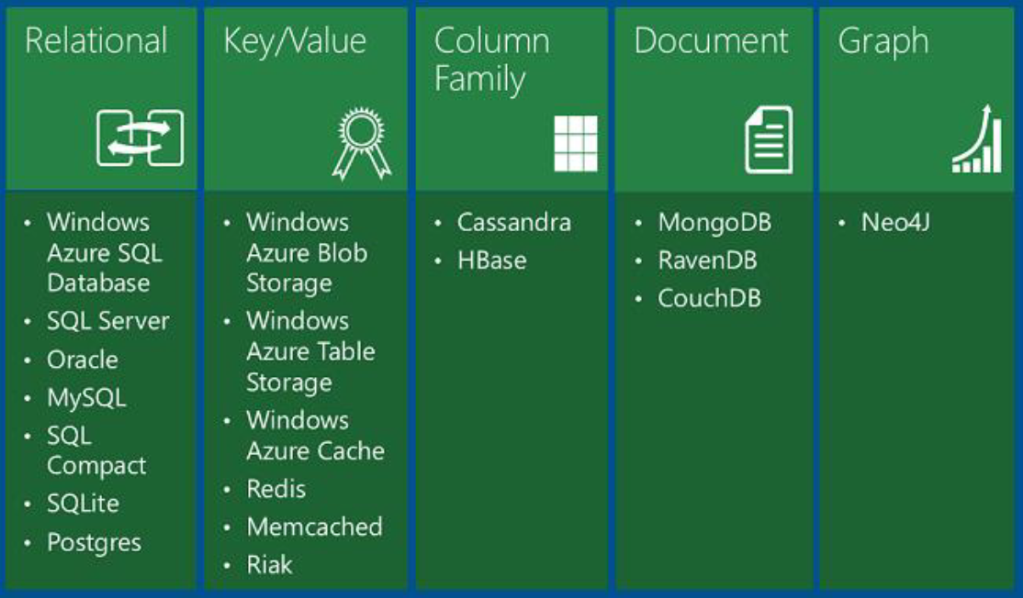
Data Management
NDBI040 - Big Data Management Moderní db koncepty

Slide 54
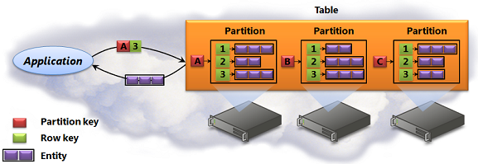
Key-Value Tables
Key-Value Tables
  NoSQL – not a relational database
  very fast scalable access to BIG (TB) typed data
    replication ⊕ sharding
    does not support complex queries (join, multi-key ordering, ...)
  identification
    Key = PartitionKey / RowKey ↬
scale-out
Sharding
Notes:
replikace - stejna data na ruznych replikach
sharding - rozdeleni dat na repliky podle nejakeho predpisu

Slide 55
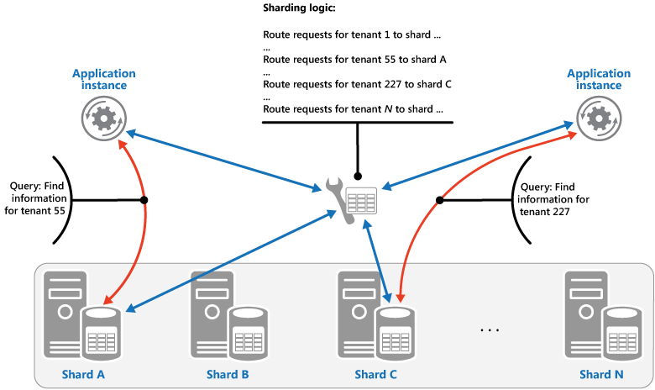
Sharding
    horizontal partitioning of a data store - shards
    Lookup - map of shard keys, data of one logical unit are located on one shard
    Range of shard keys ➟ interval queries
    Hashed shard keys ➟ uniform distribution

Slide 56
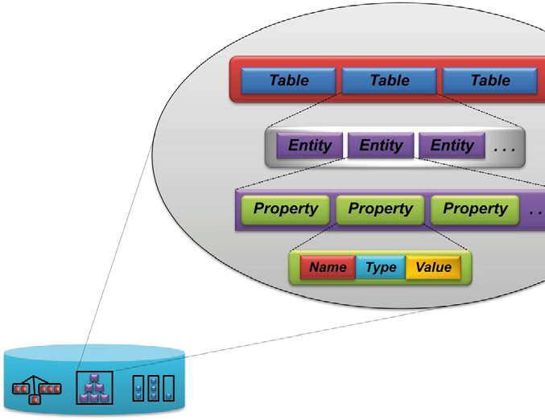
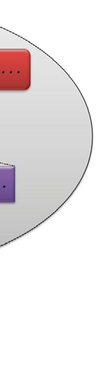
Key-Value Tables - Data Model
Structured access
  Account / Table / Partition / Entity / Property
Table
  a set of rows
  unique identification: PartitionKey/RowKey
  PartitionKey - distribution of entities among different replicated stores
  RowKey - unique identification within a partition
  ordering only using PK/RK
  data denormalization
Entity
  set of Properties (attributes)
    name / type / value
  always PartitionKey/RowKey a Timestamp
    PK/RK – user-defined content
  additional attributes application-defined
    no fixed data scheme
    different entities can have different atributes

Slide 57
Key-Value Tables - Partitioning & Scalability
Partitioning
  atomic operations on one partition
  data distribution driven by application
  PartitionKey/RowKey
    related entities on one node - equal PK
    uniform distribution of entities between partitions - different PK
    efficient queries - filter using PK
Examples
  blogging server
    topics, posts/entries/contributions
    PartitionKey: téma
    RowKey: date/time
    additional attributes: text, rating, ...
  versioned document repository
    PK: filename
    RK: version
    additional attributes: date, id, notes, ...
    textual data usually stored in BLOB
https://myaccount.table.mycloud/Customers()
?$filter=PartitionKey_eq_'MyPartitionKey'
_and_RowKey_eq_'MyRowKey1'
REST API:
Query Tables/Entities
Create/Delete Table
Set/Get Table ACL
Insert/Merge/Replace/
Update/Delete Entity
efficient query:
current discussion entries
Event Sourcing
CQRS - Command and Query Responsibility Segregation

Slide 58
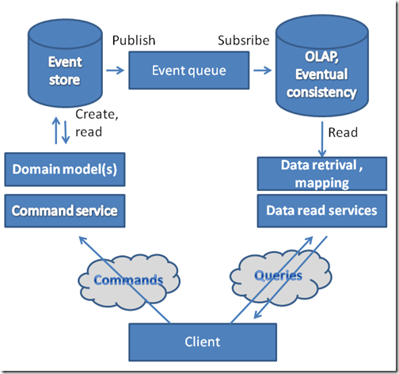
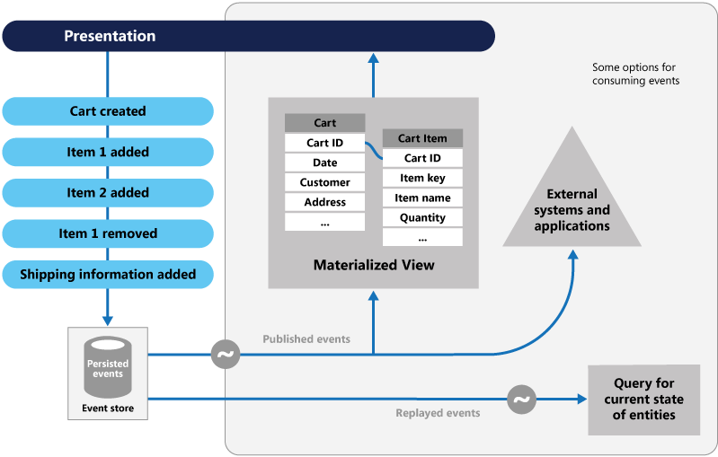
Data Processing Design Patterns
CQRS - Command and Query Responsibility Segregation
  separate interfaces for r/w operations
  scalability, eventual consistency
Materialized Views
  optimized for expected queries
Event Sourcing
  append-only store
    full series of events
    rather than storing
    just the current state
  performance, scalability
  full history

Slide 59
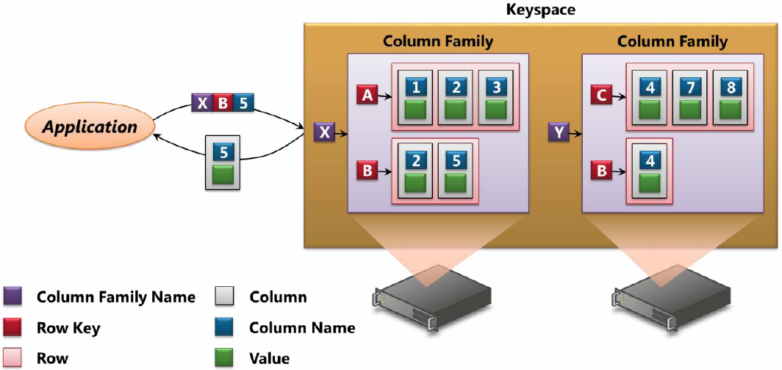
Column Stores
Column-oriented architecture
  more complex data structures than Key/Value
  columns – many many many (thousands, millions, ...)
  addressing scheme: column family / row / column → value
  no schema – various values of various types
  columns - static, dynamic
    row ≈ data matching the assumed query - materialized view
    efficient data access (read)
  versioning, timestamps
C-store
Cassandra
MonetDB
HBase ...
Notes:
partitioning dle column family

Slide 60
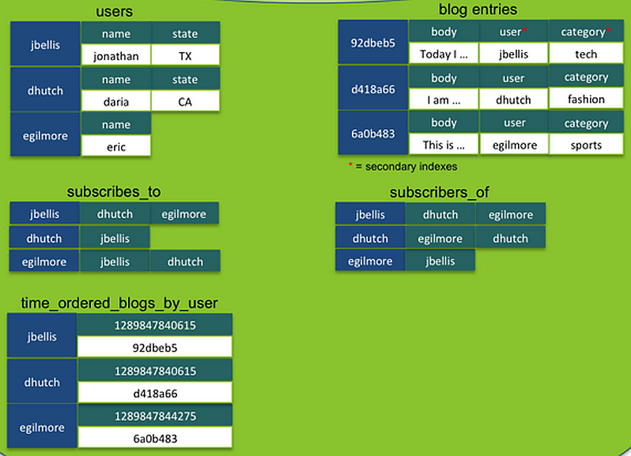
Column Stores
Column-oriented architecture
  ordering by row / column – fast access
  joins not supported
    hand-made indexes, runtime, expensive
  collections
    set
    list
    map
  replication
    consisteny level
    per-request
    sequential c.
    external c.
    eventual c.
dynamic columns
secondary index
Index Table
Materialized View
Notes:
obr z Cassandry
dynamic columns - bezejmenne, kolekce
external c. - seq + finite time (ms) limit

Slide 61
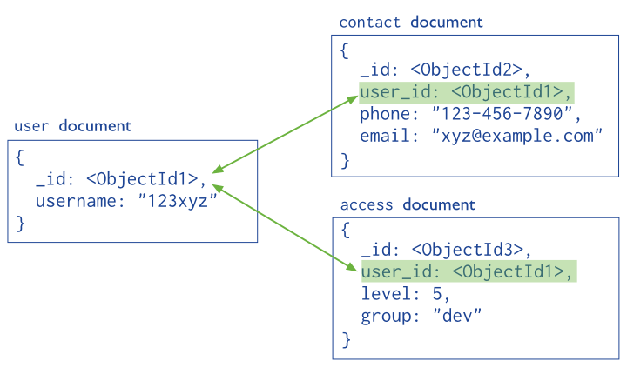
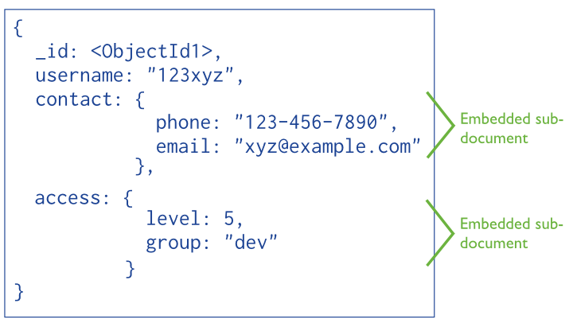
Document Stores
Document
  storage unit - store / retrieve
    XML, JSON, BSON, RDF, CSV, ..., ...
    DB engine understands the format
  event logging, content management, RT analytics, ...
  sharding
    range-based / hash-based partitioning
  journaling
    append-only, write-ahead redo logs
Structure
  references
    normalized data model
    complex m:n relations
    evaluation more expensive
  embedded document
    denormalized data model
    simple, faster
MongoDB
RavenDB
TerraStore
...

Slide 62
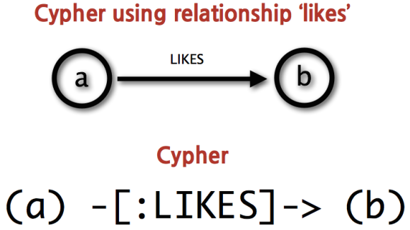
Graph Databases
Large-scaled graphs
  social networks - relations
  recommender systems, fraud detection, ...
  using relation db - ineficient
    large number of expensive joins
  libraries / REST API / graph query languages
  in-memory / distributed
Entities
  nodes
  properties
  anotated oriented multiedges
Operations
  breadth/deep-first search
  subgraph matching / isomorphism, wildcards
  graph propertiers: shortest path, diameter, ...
  similarity queries
Neo4j, OrientDB Oracle Sp7 Graph Virtuoso, GraphX AllegroGraph,
JanusGraph, ...
MATCH (john {name: 'John'})-[:friend]->()-[:friend]->(fof)
WHERE fof.name =~ 'S.*'
RETURN fof.name
Neo4j - Cypher
Notes:
Cypher - Neo4j QL
Janus Graph - cinani - jedina efektivne distribuovana, non-in-memory, multiple storage backends

Slide 63
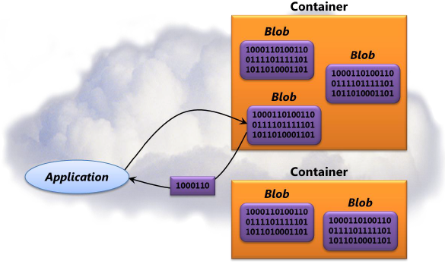
BLOB
Binary Large Objects
  unstructured BIG (TB) binary data
  stored in replicated BLOB-containeres
    container name ≈ PartitionKey
  filesystem integration, persistency
    VM virtual disk
  video, backup - cheap
BLOB types
  Block Blob
    sequence of blocks (up to millions)
    optimalized for sequential access - streams
    fast write/append and sequential read
  Page Blob
    page-oriented
    random read/write access
    higher overhead
Static Content Hosting

Slide 64
BLOB
http://<account>.blob.mycloud/<container>/<blobname>
Account
Container
Blob
Pages/ Blocks
pic01.jpg
images
Block/Page
pic02.jpg
myaccount
Block/Page
videos
vid1.avi
RESTful API
  PutBlob, GetBlob, DeleteBlob, CopyBlob, SnapshotBlob, LeaseBlob

Slide 65
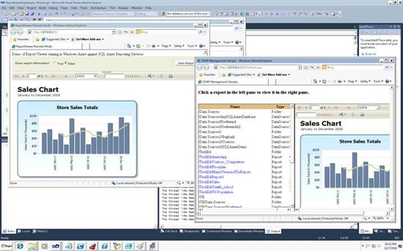
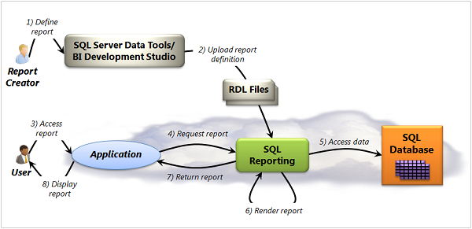
Business Analytics
SQL Reporting
  reporting, business analytics
    RDL
  data mining upon SQL / NoSQL
    decision trees/forests
    regression analysis
    clustering, ...
  various output types
    graphs, tables, reports, agregations, ...
    various formats (XML, PDF, ...)
Notes:
http://www.codeproject.com/Articles/9260/Project-RDL-Open-Source-Report-Definition-Language

Slide 66
RDL Example
<ReportItems>
<Matrix>
<Corner>
<ReportItems>
<Textbox Name='Corner'><Value>Year\Category</Value><Style><BorderStyle><Default>Solid</Default></BorderStyle>
<BorderWidth><Left>1pt</Left><Right>1pt</Right><Top>1pt</Top><Bottom>1pt</Bottom></BorderWidth>
<FontWeight>bold</FontWeight></Style></Textbox>
</ReportItems>
</Corner>
<ColumnGrouping>
<Height>0.25in</Height>
<DynamicColumns>
<Grouping>
<GroupExpressions><GroupExpression>=Fields!Category.Value</GroupExpression></GroupExpressions>
</Grouping>
<ReportItems>
<Textbox Name='Category'><Value>="" + Fields!Category.Value + " = "+Sum(Fields!Sales.Value)</Value><Style>
<BorderStyle><Default>Solid</Default></BorderStyle>
<BorderWidth><Left>1pt</Left><Right>1pt</Right><Top>1pt</Top><Bottom>1pt</Bottom></BorderWidth>
<FontWeight>bold</FontWeight></Style></Textbox>
</ReportItems>
<Subtotal>
<ReportItems>
<Textbox><Value>Grand Total</Value><Style>
</ReportItems>
</Subtotal>
</DynamicColumns>
</ColumnGrouping>
. . .
structure
formating
data
"calculations"

Slide 67
Hadoop & Map/Reduce
Distributed Data Processing
  BigData
    hard to be proceesed by a single DBMS
    low-cost hardware
    fault-tolerance, replication
  Map / Reduce paradigm
    massive parallelization, distributed computing
    implementations: Hadoop, Spark, MR-MPI, Marissa, ...
  components & related concepts
    HDFS - distributerd FS
    Pig, PigLatin - parallelization platform, high-level language
    Hive, HiveQL - data warehouse & querying, data analysis
    ... ... ...
  related BigData technologies
    Spark, Flink, Presto

Slide 68


Map/Reduce
  https://0x0fff.com/wp-content/uploads/2014/12/MapReduce-v3.png
Notes:
https://0x0fff.com/wp-content/uploads/2014/12/MapReduce-v3.png

Slide 69
Map/Reduce
Map/Reduce
  map
    each node independently
    input → (key, value)
  reduce
    (key, list of values[]) → output
    values are merged for each key
    processing, result
  intermediate results can be duplicated
    processing of very large data volumes
    fault tolerance
Word count
  word frequency in many documents
  map( file, text) → ( word, count)
  reduce( word, list of counts) → count
map(String key, String value):
// key: document name
// value: document contents
for each word w in value:
EmitIntermediate( w, count(w));
reduce(String key, List values):
// key: a word
// values: a list of counts
int result = 0;
for each v in values:
result += v;
Emit( result);

Slide 70

Map/Reduce - Word Count
Word count
  map( file, text) → ( word, count)
  reduce( word, list of counts) → count
Hello world

Slide 71
Map/Reduce - Common Friends
Common friends
  person → list of friends ⇝ p1, p2 → friends
  map( person, [friends]) → ( [person1, person2], [friends])
  reduce( [person1, person2], [friends])
  → [person1, person2], [common friends]
canonical ordering
A
B
C
D
E
map( B, A C D):
[A B] → C D
[B C] → A D
[B D] → A C
map( D, B C E):
[B D] → C E
[C D] → B E
[D E] → B C
A → B ...
B → A C D
C → B D ...
D → B C E
E → D ...
reduce( [B D], [A C] [C E]):
intersection of the lists
[B D] → C
https://highlyscalable.wordpress.com/2012/02/01/mapreduce-patterns/

Slide 72

Map/Reduce - Architecture
Master/slave architecture
  jobtracker - single master server
    client interface
    job queue, FIFO processing, assignment of jobs to tasktrackers
  tasktrackers - slave servers, single server per node in the cluster
    processing tasks
    data movement between map and reduce
 good for:
  non-relational (nonstructured) data
  big data volumes
  batch/offline processing
  suitable comuting model
 not so good for:
  small data - overhead
  communication / synchronization between nodes
  low latency, interactivity, transaction processing
  data-driven pipelines, iterative operations, ... ⇝ alternative technologies
distributed filesystem
Notes:
http://users.sdsc.edu/~glockwood/comp/mapreduce.php

Slide 73

Hadoop Zoo

Slide 74

Hadoop Zoo
HDFS
  Hadoop Distributed File System, optimalized for Hadoop
HBase
  NoSQL database
  column oriented storage for Hadoop
Pig, PigLatin
  Hi-level language for data analysis, compiled to map/reduce jobs
HIVE, HiveQL
  data warehousing infrastructure
  SQL-like language for HDFS/HBase queries
Mahout
  framework for machine learning and data mining
Zookeeper
  high-performance coordination service for distributed applications
  consensus, naming, synchronization, group membership, leader election, queues, event notifications, configuration, workflow & cluster management , sharding, ...

Slide 75
HDFS
HDFS
  Hadoop Distributed File System
    10⁴ nodes, 10⁶ files, PB data
Properties
  fault tolerant HW
    replication, fault detection and recovery
    optimalized for cheap HW
      failure is not an exception
  file streaming
    optimalized for throughput, not for access latency
  big files
  write-once-read-many
    already written file cannot be changed
    support for append in special cases (HDFS-265)
  "Moving computation is cheaper than moving data"

Slide 76

HDFS
HDFS architecture
  NameNode
    master - metadata management
    files / folders, their mapping to blocks, block placement
  DataNode
    slave - block storage, read/write operations, no file abstraction
    NameNode can replicate or delete any block
  file system operations
    write: NameNode creates a file and allocates a DataNode
    read: NameNode determines file blocks, client communicates with a DataNode directly
  replication
    file attribute - number of replicas
    replicas are allocated on different nodes
    disk / node fault tolerance
    write: deferred replication
  HCFS - HDFS interface
    other implementations of FS
    Azure Blob Storage, CassandraFS, CephFS, CleverSafe Object Store, GlusterFS, GridGain, Lustre, MapR FS, Quantcast FS, Symtantec Veritas Cluster FS, ...

Slide 77


Pig
Pig
  Map/Reduce drawbacks
    low-level
    does not support more complex data-flow
  Pig - runtime environment for web-scale data processing
  transformation to a sequence of MapReduce jobs
  BigData - batch processing
PigLatin
  hi-level language for data analysis
  data-parallel language
  operations for manipulations with s relational data
  imperative style of programming
  extensibility

Slide 78

Pig Data Flow & Pig Latin
visits = load ‘/data/visits’ as (user, url, time);
gVisits = group visits by url;
visitCounts = foreach gVisits generate url, count(visits);
urlInfo = load ‘/data/urlInfo’ as (url, category, pRank);
visitCounts = join visitCounts by url, urlInfo by url;
gCategories = group visitCounts by category;
topUrls = foreach gCategories generate top(visitCounts,10);
store topUrls into ‘/data/topUrls’;

Slide 79
Compilation into Map-Reduce
Every group or join operation
forms a map-reduce boundary
Map₁
Load Visits
Group by url
Reduce₁
Map₂
Foreach url
generate count
Load Url Info
Join on url
Reduce₂
Map₃
Group by category
Reduce₃
Foreach category
generate top10(urls)

Slide 80
Pig Latin Operations
load | Read data from file system
store | Write data to file system
foreach | Apply expression to each record and output one or more records
filter | Apply predicate and remove records that do not return true
group/cogroup | Collect records with the same key from one or more inputs
join | Join two or more inputs based on a key; various join algorithms available
order | Sort records based on a key
distinct | Remove duplicate records
union | Merge two data sets
split | Split data into 2 or more sets, based on filter conditions
stream | Send all records through a user provided executable
sample | Read a random sample of the data
limit | Limit the number of records

Slide 81
Pig Latin vs. Map Reduce
Usrs = load 'users' as (name, age);
Fltr = filter Usrs by age >= 18;
Pags = load 'pages' as (user, url);
Jned = join Fltr by name, Pags by user;
Grpd = group Jned by url;
Smmd = foreach Grpd generate group,
COUNT(Jned) as clicks;
Srtd = order Smmd by clicks desc;
Top5 = limit Srtd 5;
store Top5 into 'top5sites';

Slide 82

Hive
Hive, HiveQL
  Data warehousing infrastructure
    ETL tools - data extract/transform/load
    hi-level operations on low-level data
    HBase / HDFS files access
    query execution via MapReduce
  Hive QL
    SQL-like language for queries on HDFS
    extensible - MapReduce mappers and reducers
    ☺ comfortable
    ☹ very low performance
SELECT customer.name, sum(orders.cost)
FROM customers INNER JOIN
ON (customer.id = orders.customer_id)
WHERE customer.zipcode = '63105'
GROUP BY customer.id;
Notes:
http://gigaom.com/2013/11/06/facebook-open-sources-its-sql-on-hadoop-engine-and-the-web-rejoices/#!

Slide 83

Spark & Flink
Apache Spark
  MapReduce not optimized for iterative operations
  multistage in-mem / distributed mem
    approx. 10-100x faster than MR
    easy programmable
  operations:
    map, reduce, join, group-by, filter
    batch / iterative / streaming jobs
    useful for machine learning, data analysis, ...
  extensions
    SparkSQL, MLlib, GraphX, Spark Streaming
Apache Flink
  distributed streaming dataflow engine
    data parallelism
  DataSet / DataStream / Table API
    bounded / unbounded (rt) data sets

Slide 84
Presto
Presto
  'not only SQL on Hadoop'
  originally a proprietary Facebook technology
    2013 Open Source
  data connectors / pluggable backends
    HDFS, Kafka, various SQL/NoSQL, ...
  performance
    iterative / interactive operations
    pipeline task execution, caching, data-local computation, ...
    intermediate results in memory
    10x faster than Hive
  commercially successful
    Facebook
    Netflix
    Airbnb
    Teradata
    Dropbox
    Uber
    LinkedIn
Notes:
http://gigaom.com/2013/11/06/facebook-open-sources-its-sql-on-hadoop-engine-and-the-web-rejoices/#!

Slide 85

HBase / Hadoop Architecture

Slide 86
BigData 2.0 Processing Systems

Slide 87

BigPicture of BigData

Slide 88
3. Communication
networking, messaging
virtual network
direct connection, bastion
traffic manager
messaging - service bus
queue, topic, relay, event hub, event grid
caching, CDN

Slide 89

Virtual Network
dedicated private network
Azure Express Route
AWS Direct Connect
Google Cloud Interconnect
Virtual Network, VN Gateway
  propojení s vlastní sítí
    extension of the on-premise network
    access to cloud services from your datacenter
    access to local services from cloud components
  datacenter interconnection
    Site-to-Site, Multi-Site
    geographic scalability

Slide 90


Virtual Network
Point-to-Point, Point-to-Site
  VPN - gateway, network admin
  client-side sw, no networking, no admin
Bastion
  protects VM from exposing RDP/SSH ports to the world
  no public IP required
  secure RDP/SSH access
  connection through the portal
Notes:
The user connects to the portal using a browser - The user selects the VM to connect to - The RDP/SSH session opens in the browser

Slide 91

Traffic Manager, Load Balancer
Priority / Failover
Performance / Geographic
Round Robin
Weighted RR
...
Traffic Manager
  load balancing between datacenters
    internet-facing load balancing
  routing rules
    defined by application developers
    cookie-based afinity
  useful for global-wide applications, geographic scalability
    health checks, automatic failover
Notes:
performance - nejblizsi
Geo - presne podle zeme - zakony, nabidky, restrikce, ...
weighted - app defined vahy jednotlivych uzlu

Slide 92

Multi-region Load Balancing
Notes:
https://learn.microsoft.com/en-us/azure/architecture/high-availability/reference-architecture-traffic-manager-application-gateway
Azure Traffic Manager uses DNS-based routing to load balance incoming traffic across the two regions. Traffic Manager resolves DNS queries for the application to the public IP addresses of the Application Gateway (AppGW) endpoints. The public endpoints of the AppGWs serve as the backend endpoints of Traffic Manager. Traffic Manager resolves DNS queries based on a choice of six routing methods. The browser connects directly to the endpoint.
The Application Gateways (AppGWs) receive HTTP(S) traffic from the browser and load balance requests across the backend pool of virtual machines (VMs) in the web tier. Deploying the AppGWs to all three zones provides zone redundancy for the AppGWs. The AppGWs also distribute traffic across the three zones in the web tier. AppGWs include a Web Application Firewall (WAF) that inspects traffic and protects the application from web exploits and vulnerabilities.
The web tier is the first layer of the three-tier application. It hosts VMs in three availability zones. The Application Gateways distribute traffic to each of the three availability zones. The web tier contains the user interface. It also parses user interactions and passes traffic destined to the data tier to internal load balancer.
The internal load balancers distribute traffic to the business-tier VMs across the three availability zones. They use a single, private IP address for easy configuration. The private IP addresses of the load balancers are zone redundant. The IP addresses persist in all three zones and can survive any single zone failure.
The business tier processes the user interactions and determines the next steps. It connects the web and data tiers. The VMs in the business tier route traffic to the availability group listener of the databases.
The data tier stores the application data, typically in a database, object storage, or file share. The architecture has SQL server on VMs distributed across three availability zones. They are in an availability group and use a distributed network name (DNN) to route traffic to the availability group listener for load balancing.

Slide 93

Cloud Messaging - Service Bus
Service Bus
  Relay ※ Message Broker
  synchroneous ※ asynchroneous
  publish-subscribe, loosely coupled communication
  group communication 1:N
    competing / partitioned consumers
  API outside the cloud
    e.g., airlines, schedule updates, booking, ...
  Relays ※ Queues, Topics, Event Hubs, Push Notifications
Platforms
  Azure Service Bus Queues / Topics
  Google Cloud Pub/Sub
  AWS Simple Queue Service

Slide 94

Relay
Relay
  bi-directional channel
  synchroneous
  identified
  secured
Motivation
  both parties
  behind a firewall
    incoming ports blocked
  NAT
    IP address

Slide 95

Queue
Message queueing
  fault-tolerant uni-directional communication
  asynchroneous
  message
    structured / unstructured part
  scalability
    sender(s) / receiver(s) mutually independent
      one message ⇝ one recipient
    automatic load balancing
Receive modes
  Receive/Delete
    simple, possibility of message loss
    idempotentní / non-critical messages
  Peek/Lock/Complete/Abandon
    fault tolerant
Competing Consumers
Queue-based Leveling
Priority Queue
Notes:
RD - zpráva se hned smaže, když příjemce zhavaruje, zpráva se ztratí
PLCA - lock do C

Slide 96


Queue-based Design Patterns
  Competing Consumers
    a queue between a service and clients
  Queue-based Load Leveling
  Throttling
    přiškrcení
    non-critical services

Slide 97

Publish/Subscribe, Topic
Publish/Subscribe, Topics
  subscription defined by a filter
    WHERE clause
  each subscription receives its own copy
    one message can be processed by more recipients
  Receive/Delete, Peek/Complete
Partitioned broker
  Queue / Topic
    load balancing - more broker replicas - scale-out
  replica addressing
    Partition Key / internal algorithm (RR)
InvoiceTotal > 10000
OR ClientRating <3
AND LastName LIKE ‘V%’
Notes:
Partition Key - součást strukturované části zprávy

Slide 98

Event Hub
Event / IoT Hub
  real-time streaming services
  reliability, fault tolerance
  high throughput - Mb/s
    telemetry, logs, IoT, ...
  partitioned consumer model
    (queues, topics: competing cm)
    higher level of scalability
    fixes number of partitions
      2 ⋯ 32 ⋯ 1024
Protocols
  HTTP
    low performace
  AMQP
    Advanced Message Queuing Protocol
    binary, message orientation, performance
    queuing, routing, publish-and-subscribe
    delivery semantics
      at-most-once, at-least-once, exactly-once
    RabbitMQ, ApacheQpid, Aure EventHub ...
  MQTT
event ingestor
Notes:
ingestor - požírač
https://docs.microsoft.com/en-us/azure/event-hubs/event-hubs-overview
http://blogs.biztalk360.com/understand-azure-event-hubs/
https://en.wikipedia.org/wiki/Advanced_Message_Queuing_Protocol
https://www.spiceworks.com/tech/networking/articles/amqp-vs-mqtt/

Slide 99

Event Hub
Publisher / producer
  single event / event batch
    reduced communication overhead
  partition-based ordering
  consumed data remain available
    retention period (~ 1 day)
Partition addressing
    partition id
    partition key
      grouping, hash-based addressing
    shared pk
      shared by a set of related publishers
    round robin
      load balancing
Notes:
shared pk - mnozina publishers muze posilat data do stejne partition
id - prima adresace / key - hash (preferred - loose coupling)

Slide 100


Event Hub
Consumer / receiver
  processing data from one partition
Consumer group
  application ≈ processing state / view
    set of consumers and partition offsets
  event ➟ more consumer groups
    one consumer per CG and partition
Checkpointing
  consumed partition offset
    per consumer group
  next event to be consumed after dis- / re-connecting
partition
offset
Notes:
kazdy consumer ma vlastní view
https://docs.microsoft.com/en-us/azure/#pivot=products&panel=all

Slide 101

Push-based Messaging
Push-based pub/sub
  automatically pushes messages to subscribers
    real-time, reactive event service
    no need to poll the Queue or Topics
  event handler: serverless function / lambda
    AWS Lambda, Google / Azure Function, Azure Logics App
  external connectors
Azure Event Grid
AWS Simple Notification Service
Pipes & Filters

Slide 102
Service Bus - Advanced Features
ESB Advanced features
  message sessions
    FIFO guarantee in processing messages
  auto-forwarding
    chaining a queue or subscription to another queue or topic
  dead-lettering
    secondary subqueue - messages that can't be delivered to any receiver, or messages that can't be processed
  scheduled delivery, message deferral
    delayed processing
  auto-delete on idle
    idle interval after which the queue is automatically deleted
  duplicate detection
    'ensuring' idempotency
  geo-disaster recovery
    enables data processing to continue operating in a different region

Slide 103

Caching
Caching
  access to SQL, Tables & Blobs is fast ...
  ... but access to memory is much faster
  intra-app, inter-app, inter-cloud
    local / distributed
  in-memory key/value store
    value: any chunk of data
    possibly structured
  Memcached
    ‘free & open source, high-performance, distributed memory object caching system’
    Memcached protokol - large hash-table distributed across nodes
    key ⇝ hash ⇝ node ⇝ value
  Redis
    persistent in-mem db, transakce
    composite types - collections, hash, set, list, ...
    pub / sub
Cache-aside ...
Notes:
memcached - jen cache - starší, jednodušší, na více platformách, dříve rychlejší
redis - in-mem db - novější, mocnější, komplikovanější, dnes výkonově srovnatelný
https://www.quora.com/What-are-the-differences-between-memcached-and-redis
http://db-engines.com/en/system/Memcached%3BRedis

Slide 104

CDN
Content Delivery Network
  many CDN nodes worldwide
  a user requests a file
  DNS routes the request to the closest Point-of-Presence (POP) location
  if the POP does not have the file in a cache, it requests the origin
  the origin returns the file, incl. Time-to-Live (TTL)
  the POP caches the file (until TTL)
  additional users may request the same file - cached

Slide 105
Caching Patterns
Cache-Aside
  data loaded on demand when an application requests it
  an e-commerce website caching product details
Write-Through
  every operation is written to both the cache and the data store - consistency
  banking systems - consistent account balances across transactions
Write-Behind / Write-Back
  writes are recorded in the cache and later written to db asynchronously
  CDNs updating content in cache first
Write-Around
  write operations bypass the cache and directly update the data store
  Logging operations - logs are written directly to storage
Read-Through
  the cache acts as the primary interface for reads
  User profile service fetching and caching user data on cache misses
Notes:
https://levelup.gitconnected.com/mastering-caching-in-distributed-applications-e7449f4db399

Slide 106
4. Other cloud services
machine learning
video & media services
maps / GIS
marketplace
... ...

Slide 107

Machine Learning etc.
Artificial Intelligence / Machine Learning / Deep Learning
  application of historical data to a particular problem
    model training
  supervised / unsupervised methods / LLM
  domain-specific API
    search engines, similarity search, image / video search
    image / video / speech / face recognition, emotion detection
    fraud detection / prevention, sentiment analysis
    clustering, classification, anomaly detection
    personal assistants / chatbots
    linguistic / translation services
    online product recommendations
    ... ... ...
  *

Slide 108

Methods of Machine Learning

Slide 109

Multi- & Media
Video & Media Services
  uploadig - blob
  encoding, format conversions
  indexing, searching, media analytics
    motion detection, time-lapse, face & emotions, OCR, video summarization, ...
  protection, encrypted streaming, licensing
  embeded content - subtitles, links, callouts
  advertising - targeted ad insertion
  streaming, live encoding
Notes:
http://msdn.microsoft.com/en-us/library/windowsazure/hh973632
https://msdn.microsoft.com/library/dn735912.aspx
time-lapse - vynechani nudnych framu

Slide 110

Live Media Streaming

Slide 111





Maps / GIS
Maps / Geographic Information Systems
  mapy
    free / private / special
    map layers
  semantic/relational data
    pubs, weather, traffic, ...
  searching, spatial indexes, routes
    clustering, layers, heatmaps, ...
  offline / online / cache
  API, web, mobile
Google Maps API
  Maps Geocoding
  Maps Distance Matrix
  Maps Roads, Geolocations
  Street View
  Places, Elevation, Directions, ...
Azure Maps, Amazon Maps

Slide 112

Marketplace
Marketplace
  ecosystem!
  G-Play, Azure Store, AWS Marketplace, ...
    applications/services
    data - video, mp3, e-books, ...
  publishers
    segmentation, evaluation
    pricing
    updates
    ranking
    feedback
  customers
    identity ➟ credibility
    reviews / ranking
    updates
    subscriptions
    push
  publishing / subscription API

Slide 113
& more...
Miscellaneous cloud services
  language and translation services
    translation API ... (implemented by औ ) ... LLM
  searching / indexing
    text, image, video, similarity search
  Internet of Things
    communication, device control & monitoring, data stream analytics
  micropayments, billing, marketing, support for e-commerce
  ..., ..., ...
Cloud identity, security and access control
  ➟ ^{special guest star}
Notes:
http://nvidianews.nvidia.com/news/nvidia-gpus-to-accelerate-microsoft-azure?mkt_tok=3RkMMJWWfF9wsRoiuKvMZKXonjHpfsX%2F4%2B0uWKe3gIkz2EFye%2BLIHETpodcMSsJrNK%2BTFAwTG5toziV8R7HAKs1v3NsQXBXgHi%2F6k7Xsbp9HcLpn9cU8rvzy

Slide 114

Cloud Services Comparison

Slide 115
Cloud Services Comparison
Notes:
https://www.basvankaam.com/the-ultimate-collection/

Slide 116

Cloud interoperability - near future

Slide 117
Design patterns
for cloud computing
⇝

Slide 118
Cloud Identity, Security
& Access Control
⇝
Special Guerst Star
Michael Grafnetter

Slide 119
to be continued ...
NSWI151 - Administrace virtualizační infrastruktury
  Jakub Yaghob
  praktická administraci moderních virtualizačních řešení
  plánování, nasazení, zabezpečení a údržba virtualizační infrastruktury
  VMware vSphere, Microsoft Hyper-V
NSWI152 - Vývoj cloudových aplikací
  Filip Zavoral ⇝ Havit, Datamole
  praktický vývoj, deployment, konfigurace a monitoring aplikací
  správa cloudového prostředí
  Windows Azure, IoT, ...

Slide 120
⇝

Slide 121



Gaming
Server-side
  tenký klient, mobil
  problém: latence, propustnost
  multiplayer / community
  Azure/AWS GPU M60
Client-side
  deployment
  prostředí, mapy, levely
  save to cloud + change device
  multiplayer / social gaming
  DRM – boj proti
Mobile clients
  save & play everywhere
  autentizace
  push-notifications

Slide 122

Titanfall
>100,000 Virtual Machines
Notes:
Diablo III, SimCity, Battlefield 4 – všichni měli problémy se zátěží při launchi. V případě Titanfallu se tomu chtěli vyhnout a zvolili „tajnou“ zbraň – cloud.
Přenesení věcí, které tradičně počítala konzole, do cloudu – převážně umělá inteligence počítačových spoluhráčů.
Konzole tradičně používaly model, kdy hráči sami hostují multiplayerové hry – s tím se pojí spousta nevýhod (synchronizace, co když jeden vypadne, omezení propustnosti...).
Díky tomu, že cloud slouží jako hub, ke kterému se připojují všichni hráči (k nejbližšímu datacentru), ping záleží jen na jejich vlastní rychlosti připojení.
Jakmile se naplní kapacita jednoho datacentra, dá se traffic přesměrovat do jiného – při betatestu se zapojily 2 miliony hráčů a evropské DC přestalo zvládat, tak začali posílat hráče do US.

Slide 123
Druhy cloudů
Veřejný cloud (Public cloud)
  poskytování služeb (IaaS, PaaS, SaaS) třetí stranou - nejčastější typ
  zajištěna vysoká škálovatelnost a účtování podle využívaných zdrojů
Soukromý cloud (Private cloud)
  infrastruktura poskytující služby pouze jedné organizaci
  schopnost účtování jednotlivým složkám organizace
Komunitní cloud (Community cloud)
  cloud využívaný komunitou - spolupracující firmy, projekt apod.
Hybridní cloud (Hybrid cloud)
  cloud složený z více různých cloudů, např. několika veřejných a soukromého
  cloud interoperability - Sky Computing

Slide 124


Open Stack
Cloud Lock-in
  functionality, licenses, development
OpenStack
  2010 NASA + Rackspace
  now OpenStack Foundation
    > 500 companies, since 2014
  open source - public / private cloud
  API based on Amazon EC2 a S3
    EC2 API - comp Elastic Cloud
    GCE API - comp G Cloud Engine
Compute - Nova
Object Storage - Swift
Block Storage - Cinder
Image Service - Glance
Networking - Neuron
Identity - Keystone
Dashboard - Horizon
Orchestration - Heat
Workflow - Mistral
Telemetry - Ceilometer
Database - Trove
Map Reduce - Sahara
Bare Metal - Ironic
Messaging - Zaqar
Shared FS - Manila
DNS - Designate
Search - Searchlight
Key Manager - Barbican
Notes:
https://en.wikipedia.org/wiki/OpenStack

Slide 125









Microsoft Azure
Notes:
https://azure.microsoft.com/en-us/services/
https://azureplatform.azurewebsites.net/en-us/

Slide 126
Microsoft Azure
Virtual Machines - Provision Windows and Linux virtual machines in minutes
App Service - Create web and mobile apps for any platform and any device
SQL Database - Managed relational SQL Database-as-a-service
Storage - Durable, highly available, and massively scalable cloud storage
Cloud Services - Create highly available, infinitely scalable cloud applications and APIs
DocumentDB - Managed NoSQL document database-as-a-service
Azure Active Directory - Synchronize on-premises directories and enable single sign-on
Backup - Simple and reliable server backup to the cloud
HDInsight - Provision cloud Hadoop, Spark, R Server, HBase, and Storm clusters
RemoteApp - Deploy Windows client apps in the cloud, run on any device
Batch - Run large-scale parallel and batch compute jobs
StorSimple - Hybrid cloud storage for enterprises, reduces costs and improves data security
Visual Studio Team Services - Services for teams to share code, track work, and ship software
API Management - Publish APIs to developers, partners and employees securely and at scale
Azure IoT Hub - Connect, monitor, and control millions of IoT assets
CDN - Deliver content to end-users through a robust network of global data centers
ExpressRoute - Dedicated private network fiber connections to Azure
Site Recovery - Orchestrate protection and recovery of private clouds
Azure DNS - Host your DNS domain in Azure
Machine Learning - Powerful cloud-based predictive analytics
Service Fabric - Build and operate always-on, scalable, distributed applications
Multi-Factor Authentication - Safe access to data and apps, extra level of authentication
Visual Studio Application Insights - Detect and diagnose issues in your web apps and services
SQL Data Warehouse - Elastic data warehouse-as-a-service with enterprise-class features
Virtual Network - Provision private networks, optionally connect to on-premises datacenters
Media Services - Encode, store, and stream video and audio at scale
Stream Analytics - Real-time stream processing
Azure Active Directory Domain Services - Join Azure VM to a domain w/o domain controllers
Event Hubs - Ingest, persist, and process millions of events per second
Data Factory - Orchestrate and manage data transformation and movement
Key Vault - Safeguard and maintain control of keys and other secrets
Service Bus - Connect across private and public cloud environments
Azure Active Directory B2C - Consumer identity and access management in the cloud
Scheduler - Run your jobs on simple or complex recurring schedules
Azure DevTest Labs - Quickly create environments to deploy and test applications
Notification Hubs - Scalable, cross-platform push notification infrastructure
Automation - Simplify cloud management with process automation
Log Analytics - Collect, search and visualize machine data from on-premises and cloud
Security Center - Prevent, detect, and respond to threats with increased visibility
BizTalk Services - Seamlessly integrate the enterprise and the cloud
Traffic Manager - Route incoming traffic for high performance and availability
Redis Cache - Access to a secure, dedicated cache for your Azure applications
Search - Fully-managed search-as-a-service
Load Balancer - Deliver high availability and network performance to your applications
VPN Gateway - Establish secure, cross-premises connectivity
Application Gateway - Layer 7 Load Balancer with built-in HTTP balancing and delivery cntrl
Data Catalog - Data source discovery to get more value from existing enterprise data assets
Virtual Machine Scale Sets - Highly available, auto scalable Linux or Windows virtual machines
Power BI Embedded - Embed fully interactive, stunning data visualizations in your applications
Mobile Engagement - Increase app usage and user retention
Data Lake Store - Hyperscale repository for big data analytics workloads
Data Lake Analytics - Distributed analytics service that makes big data easy
Cognitive Services - Add smart API capabilities to enable contextual interactions
Azure Container Service - Use Docker based tools to deploy and manage containers
SQL Server Stretch Database - Dynamically stretch on-premises SQL Server databases to Azure
HockeyApp - Deploy mobile apps, collect feedback and crash reports, and monitor usage
Functions - Process events with serverless code
Logic Apps - Automate the access and use of data across clouds without writing code
Cortana Intelligence - Transform your business with big data and advanced analytics
IoT Suite - Capture and analyze untapped data to improve business results
Operations Management Suite - Manage your cloud and on-premises infrastructure
Apache Spark for Azure HDInsight - Apache Spark in the cloud for mission critical deployments
Apache Storm for HDInsight - Real-time stream processing made easy for big data
R Server for HDInsight - Predictive modeling, machine learning, and analysis for big data
Encoding - Studio Grade encoding at cloud scale
Live and On-Demand Streaming - Deliver content to all devices with business scale
Azure Media Player - A single layer for all your playback needs
Content Protection - Securely deliver content using AES, PlayReady, Widevine, and Fairplay
Blob Storage Accounts - REST-based object storage for unstructured data
Premium Storage - Low latency and high throughput storage
Web Apps - Quickly create and deploy mission critical Web apps at scale
Mobile Apps - Build and host the backend for any mobile app
API Apps - Easily build and consume Cloud APIs
Text Analytics API - Easily evaluate sentiment and topics to understand what users want
Recommendations API - Predict and recommend items your customers want
Academic Knowledge API - Academic content in the Microsoft Academic Graph
Computer Vision API - Distill actionable information from images
Emotion API - Personalize experiences with emotion recognition
Face API - Detect, analyze, organize, and tag human faces in photos
Bing Speech API - Convert speech to text and back again to understand user intent
Web Language Model API - Predictive language models trained on web-scale data
Language Understanding Intelligent Service - Understanding commands from your users
Speaker Recognition API - Use speech to identify and authenticate individual speakers
Bing Search APIs - Web, image, video, and news search APIs for your app
Bing Autosuggest API - Give your app intelligent options for searches
Bing Spell Check API - Detect and correct spelling mistakes in your app
Media Analytics - Speech and Vision services at enterprise scale, compliance, and security
Queue Storage - Effectively scale apps according to traffic
File Storage - File shares that use the standard SMB 3.0 protocol
Tables Storage - NoSQL key-value storage using semi-structured datasets
Notes:
https://azure.microsoft.com/en-us/services/

Slide 127


Google Cloud Platform - Compute Engine / App Engine
App Engine - PaaS
Translate API
Prediction API
Big Query
Compute Engine - IaaS
Cloud Datastore
Cloud SQL
Cloud Endpoints
Cloud Storage
Notes:
http://stackoverflow.com/questions/22697049/what-is-the-difference-between-google-app-engine-and-google-compute-engine
Compute Eng - IaaS
App Eng - PaaS - Python, Java, PHP, Go
Google App Engine - General purpose application development platform for the cloud
Google Cloud Storage - High speed cloud data storage on Googles infrastructure
Prediction API - Googles machine learning technology
BigQuery - Interactive analysis of very large data sets
Datastore - NoSQL
Cloud SQL - A relational SQL database in the cloud

Slide 128
Google Cloud Platform
Compute
  Compute Engine - Run large-scale workloads on virtual machines
  App Engine - A platform for building scalable web apps and mobile backends
  Container Engine - Run Docker containers powered by Kubernetes
  Container Registry - Fast, private Docker image storage on GCP
  Cloud Functions - A serverless platform for event-based microservices
Storage and Databases
  Cloud Storage - Powerful and effective object storage with global edge-caching
  Cloud SQL - A fully-managed, relational MySQL database
  Cloud Bigtable - A fast, managed, massively scalable NoSQL database service
  Cloud Datastore - A managed NoSQL database for storing non-relational data
  Persistent Disk - Reliable, high-perf block storage for virtual machine instances
Networking
  Cloud Virtual Network - Managed networking functionality for your resources
  Cloud Load Balancing - High performance, scalable load balancing
  Cloud CDN - Low-latency, low-cost content delivery using global network
  Cloud Interconnect - Connect your infrastructure to Google's network edge
  Cloud DNS - Reliable, resilient, low-latency DNS
Big Data
  BigQuery - A fast and managed data warehouse for large-scale data analytics
  Cloud Dataflow - A rt data processing service for batch and stream data proc
  Cloud Dataproc - A managed Spark and Hadoop service
  Cloud Datalab - An interactive tool for large-scale data analysis and visual
  Cloud Pub/Sub - Connect your services with reliable asynchronous messaging
  Genomics - Power your science with Google Genomics
Machine Learning
  Cloud Machine Learning Platform - Machine Learning services
  Vision API - Derive insight from images with our powerful Cloud Vision API
  Speech API - Speech to text conversion powered by machine learning
  Natural Language API - Processing text using machine learning
  Translate API - Create multilingual apps and translate text into other languages
Management Tools
  Stackdriver Overview - Monitoring, logging, and diagnostics GCP and AWS
  Monitoring - Monitoring for applications running on GCP and AWS
  Logging - Logging for applications running on GCP and AWS
  Error Reporting - Identify and understand your application errors
  Trace - Find performance bottlenecks in production
  Debugger - Investigate your code’s behavior in production
  Deployment Manager - Create and manage cloud resources with templates
  Cloud Console - Your integrated Google Cloud Platform management console
  Cloud Shell - Manage your infrastructure and applications from the cmd-line
  Cloud Mobile App - Manage GCP services from Android or iOS
  Billing API - management of billing for your projects in the GCP
  Cloud APIs - Programmatic interfaces for all Google Cloud Platform services
Developer Tools
  Cloud SDK - Command-line interface for GCP products and services
  Deployment Manager - Create and manage cloud resources with templates
  Cloud Source Repositories - Fully-featured private Git repositories
  Cloud Endpoints - Create RESTful services from your code
  Cloud Tools for Android Studio - Build backend services for your Android apps
  Cloud Tools for IntelliJ - Debug production cloud applications inside of IntelliJ
  Cloud Tools for PowerShell - Full cloud control from Windows PowerShell
  Cloud Tools for Visual Studio - Deploy Visual Studio applications to GCP
  Google Plug In for Eclipse - Simplifies development in the Eclipse IDE
  Cloud Test Lab - On-demand app testing with the scalability of a cloud service
Identity & Security
  Cloud Identity & Access Management - Fine-grained access control
  Cloud Resource Manager - Hierarchically manage resources by project/org
  Cloud Security Scanner - Scan your App Engine apps for common vulnerabilities

Slide 129


Amazon Web Services / Elastic Cloud

Slide 130
Amazon Web Services / Elastic Cloud
Compute
  Elastic Compute Cloud (EC2) - scalable virtual machines using Xen
  Elastic MapReduce (EMR)
  Lambda (LAMBDA) - compute service that runs code in response to events
Networking
  Route 53 - highly available and scalable DNS
  Virtual Private Cloud (VPC) - logically isolated set of EC2, VPN connection
  AWS Direct Connect - dedicated network connections into AWS data centers
  Elastic Load Balancing (ELB) - automatically distributes incoming traffic
Storage and content delivery
  CloudFront - CDN
  Simple Storage Service (S3) - Web Service based storage
  Glacier - low-cost, long-term storage, redundancy, low-frequent access times
  AWS Storage Gateway - iSCSI block storage, cloud-based backup
  Elastic Block Store (EBS) - persistent block-level storage volumes for EC2
  AWS Import/Export - accelerates moving large amounts of data in/out AWS
  Elastic File System (EFS) - file storage service
Database
  DynamoDB - low-latency NoSQL backed by SSDs
  ElastiCache - in-memory caching, implementation of Memcached and Redis
  Relational Database Service (RDS) - MySQL, Oracle, SQL Server, PostgreSQL
  Redshift - petabyte-scale data warehousing with column-based storage
  SimpleDB - run queries on structured data, "the core functionality of a database"
  AWS Data Pipeline - data transfer between different AWS services
Analytics
  Machine Learning
  Kinesis - real-time data processing over large, distributed data streams
Deployment
  CloudFormation - file-based interface for provisioning other AWS resources
  AWS Elastic Beanstalk - quick deployment and management of applications
  AWS OpsWorks - configuration of EC2 services using Chef
  AWS CodeDeploy - automated code deployment to EC2 instances
Management
  Identity and Access Management (IAM) - authentication service
  AWS Directory Service - connection to an existing Active Directory
  CloudWatch - monitoring for AWS cloud resources and applications
  AWS Management Console - web-based management and monitoring
  CloudHSM - data security - dedicated Hardware Security Module (HSM)
  AWS Key Management Service (KMS) - control keys used to data encryption
Application services
  API Gateway - service for publishing and maintaining web service APIs
  CloudSearch - basic full-text search and indexing of textual content
  DevPay - billing and account management system
  Elastic Transcoder (ETS) - video transcoding
  Flexible Payments Service (FPS) - interface for micropayments
  Simple Email Service (SES) - bulk and transactional email sending
  Simple Queue Service (SQS) - message queue for web applications
  Simple Notification Service (SNS) - multi-protocol "push" messaging
  Simple Workflow (SWF) - workflow service for building scalable, resilient apps
  Cognito - user identity and data synchronization service across mobile devices
  AppStream - streaming of resource intensive applications from the cloud
Miscellaneous
  Product Advertising API - electronic commerce
Notes:
https://en.wikipedia.org/wiki/Amazon_Web_Services

Slide 131

InterCloud
InterCloud - Cloud Delivery Platform
  cloud interoperability
    protocols, formats, common mechanisms
    application centric platform
    'cloud roaming'
  IEEE, CISCO, ...
  challenges
    security, trust, governance, legal issues, QoS, monitoring, arbitrage, billing,
Notes:
https://www.intercloud.com/

