Slide 1
Virtual Machines - history

Slide 2
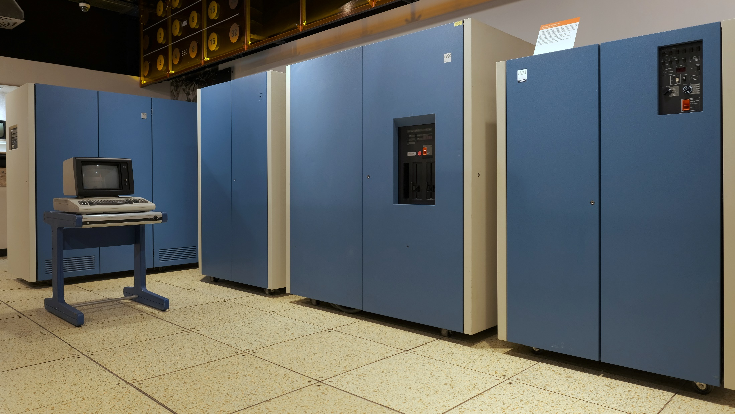
IBM S/370 – 4381 (1983-1992)
4381 Model Group 24 (1988): 20 MHz dual CPU, 128KB cache, 64MB RAM, 890K USD (2M USD@2020)

Slide 3
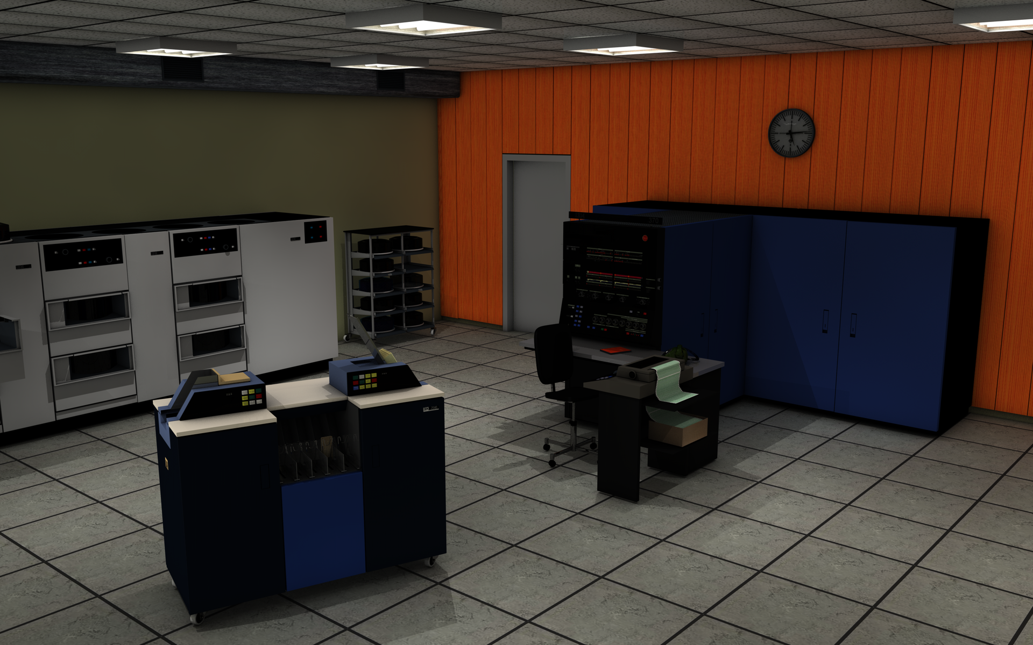
IBM S/370 - 145 (1971, up to 512 KB RAM, ~1M USD)

Slide 4
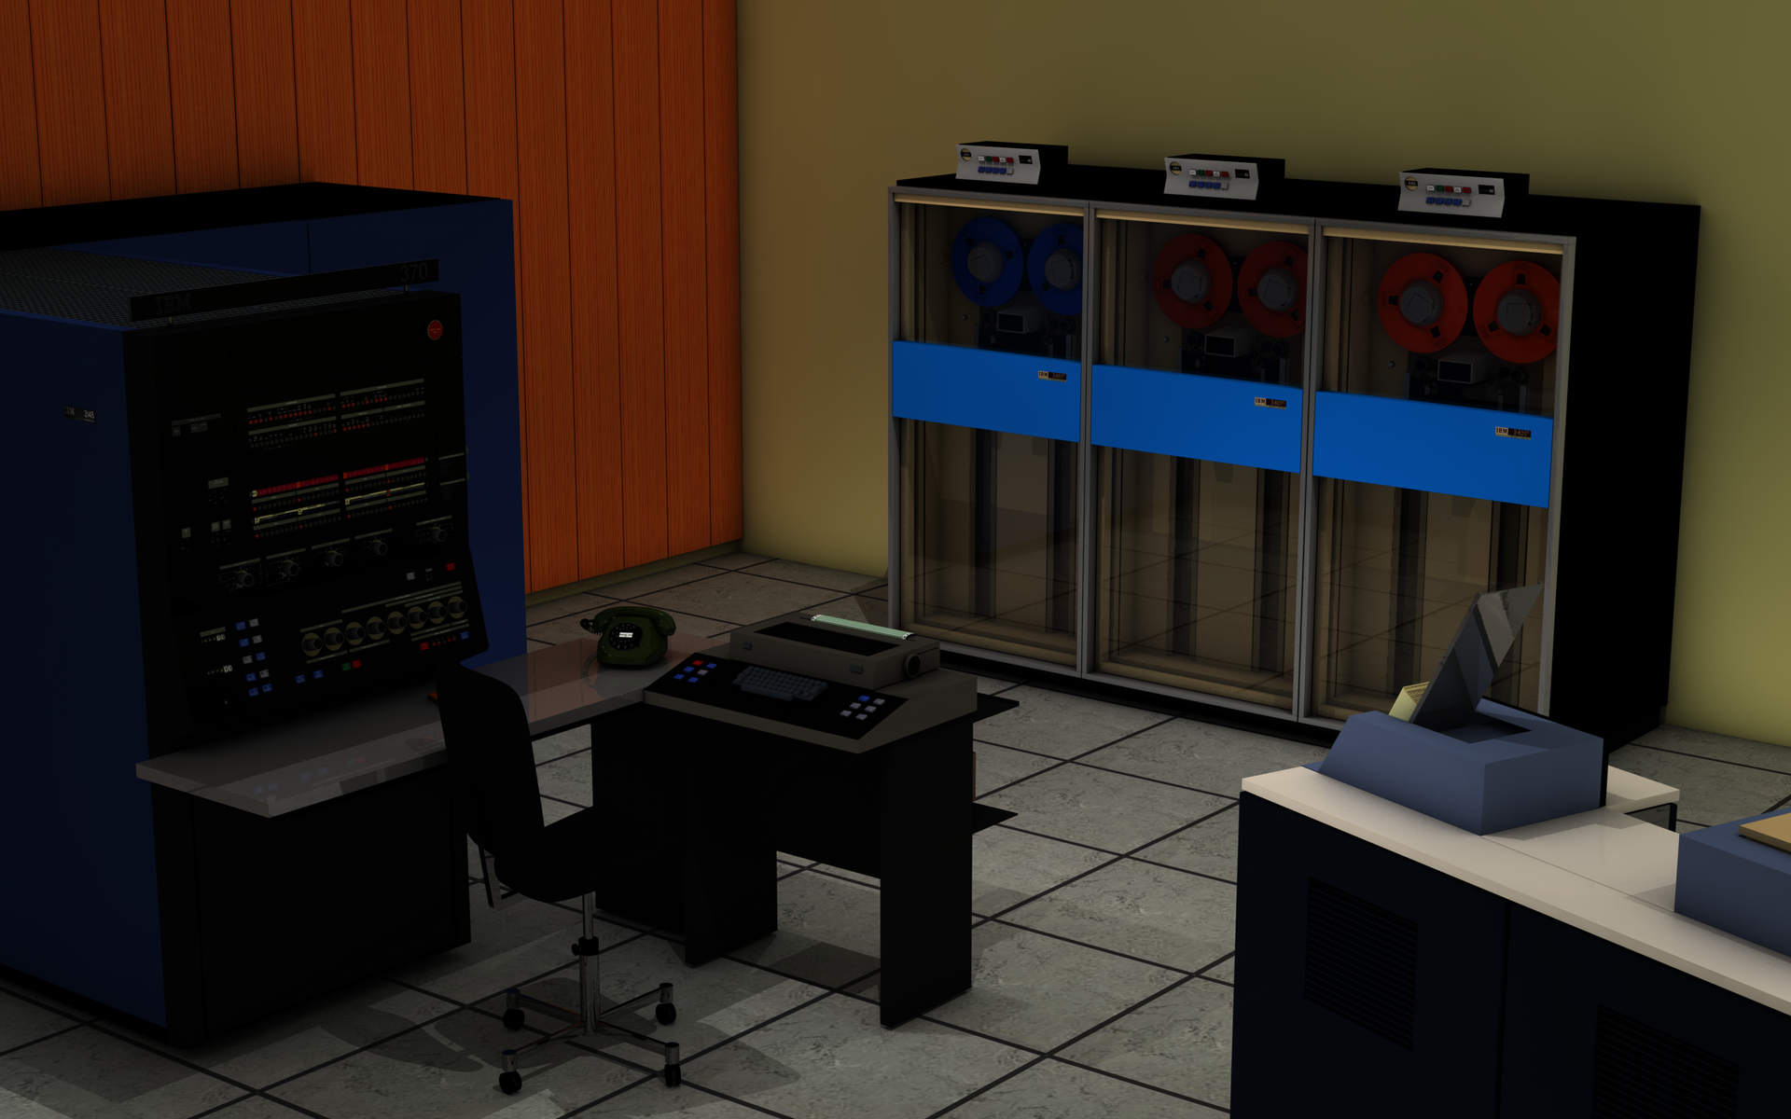
IBM S/370 - 145 (1971)

Slide 5
Virtual Machines - history
The first era of VM
1972 – IBM VM for S/370
Coexistence of different OSes
Time-sharing and virtual memory for OSes not implementing them
Debugging of OSes
Including a VM under a VM
Every tenth S/370 used a VM
1980... – Gradual decline
Mainframes overcome by cheaper architectures (minicomputers, PC)
New hardware did not support VM
The growing dominance of Unix
VM is a complication for inter-process communication

Slide 6
VM - requirements
Formal Requirements for Virtualizable Third Generation Architectures
Gerald J. Popek and Robert P. Goldberg, 1974
Equivalence / Fidelity
A program running under the VMM should exhibit a behavior essentially identical to that demonstrated when running on an equivalent machine directly.
Resource control / Safety
The VMM must be in complete control of the virtualized resources
Efficiency / Performance
A statistically dominant fraction of machine instructions must be executed without VMM intervention

Slide 7
CPU virtualization

Slide 8
True virtualization
True virtualization
Three layers of software
Guest user processes
Only user-mode CPU instructions
Guest OS kernel
All CPU instructions
Privileged mode expected
But shall not be granted
Hypervisor
All CPU instructions
Exclusive control over the hardware
This picture is misleading
User process
User mode
OS kernel
Privileged mode
virtual CPU
Hypervisor
CPU

Slide 9
True virtualization
Hypervisor
User process
OS kernel
CPU
User mode
Privileged mode instructions
The correct picture
All levels of the software directly interact with CPU by executing instructions
OS kernels use privileged instructions
We must not allow their direct execution (Popek-Goldberg: Safety)
We must allow direct execution of the other instructions (Performance)
OS kernel must run with a different privilege setting than the Hypervisor
Compression of privileges
Mapping of 3 privilege levels onto the 2 levels available in typical CPU

Slide 10
True virtualization
Hypervisor
User process
OS kernel
CPU
Privileged mode instructions
User mode
Privileged mode
Trap-and-emulate (IBM 1972)
OS kernels use privileged instructions but run in the user mode
Every privileged instruction in the kernel causes a trap (synchronous interrupt)
The hypervisor emulates the instruction
The emulation allows verification of access rights, virtualization etc.
Performance considerations
Every syscall goes through hypervisor
Every I/O instruction in kernel is emulated
S/370 had "channel programs" = single I/O instruction started the whole I/O operation

Slide 11
True virtualization
Hypervisor
User process
OS kernel
CPU
User mode
Privileged mode
Non-root mode
Root mode
Intel/AMD root/non-root modes
Control transferred between levels
User -> Kernel: Simultaneously with switching CPU to the privileged mode
SYSCALL, some synchronous (software) interrupts
User/Kernel -> Hypervisor: VM Exit event = switch to hypervisor mode
Asynchronous (hardware) interrupts
Some synchronous (software) interrupts (e.g. page faults)

Slide 12
Hardware support for virtualization – a new dimension of privilege
application process
CPU
Intel VT-x / AMD-V
Details differ
„Root“ mode
Like a CPU without virtualization
Usable to run the host OS
„Non-root“ mode
Limited access to the privileged of the CPU state
Unwanted actions cause „VM exit“
Mode switch
A part of the CPU state is read from/stored to memory
Address-space switch included
VM exit
PL = 3
application registers
non-root
guest VMCS
guest OS kernel
PL = 0
VM entry
(host app)
access control
PL = 3
privileged registers
host VMCS
root
VMM
(+ host OS kernel)
PL = 0
VM exit

Slide 13
Approach to virtualization
Do we believe that the kernel can sufficiently isolate processes?
Does the CPU support three privilege levels etc.?
Can the binary code of an unmodified kernel run in the user mode?
Is the emulation of privileged instructions sufficiently fast?
Do we want to modify the source code of the kernel?
Application virtualization (chroot 1982)
(FreeBSD jail 2000)
(Solaris Containers 2004)
(Docker 2013)
Hardware-based Virtualization
(Xen HVM 2005) (VMWare 2006)
Para-virtualization
(Xen 2003)
Binary Translation (VMWare 1999)
Trap and Emulate
(IBM VM 1972)

Slide 14
Virtualization - history
The second era of VM
1999 – VMWare Workstation
Software virtualization (Binary Translation)
VMM as an app in Windows NT
2002 – VMWare ESX Server
VMM replaces the host OS
2003 – Xen
Para-virtualization
Host OS modified (in source code)
2007 – Linux KVM
VMM integrated into the OS kernel
2008 – Microsoft Hyper-V
VMM cooperates with the host OS
Non-cooperating guest OS possible
The x86 is unsuitable for VM
Legacy of the Intel 80286 CPU
1982 – still in the first era of VM
The first mitigation attempts
2005 – Intel VT-x
2006 – AMD-V
Gradually improved performance
Improved HW support
Para-virtualization in critical OS parts
Performance loss is now insignificant for most applications
Variations in performance too big for Real-Time applications and performance measurement

Slide 15
VMM implementation

Slide 16
Para-virtualization
“machine A”
“machine B”
Para-virtualization
Lower layers of OS kernels are modified
Instead of controlling hardware, these layers call the hypervisor
Hypervisor (VMM)
Creates an illusion of a machine dedicated for each kernel
The illusion is not perfect; difficult parts replaced by cooperation of the modified kernel
VM controller
Provides administrator control
VM OS kernel
Provides file and network services for the controller and hypervisor
PA1
PA2
PB1
PB2
VM Controller
OS kernel A
OS kernel B
Hypervisor
VM OS kernel
modified
modified
CPU

Slide 17
True virtualization
“machine A”
“machine B”
True virtualization
OS kernels directly work with virtual CPUs and other HW
Hypervisor (VMM)
Creates an illusion of a machine dedicated for each kernel
The illusion is perfect, emulating every bit of CPU and other HW
Modern physical CPUs help creating this illusion
VM controller
Provides administrator control
VM OS kernel
Provides file and network services for the controller and hypervisor
PA1
PA2
PB1
PB2
VM Controller
Hypervisor
OS kernel A
OS kernel B
VM OS kernel
virtual CPU
virtual CPU
virtual CPU
CPU

Slide 18
Reality: Mixed true and para-virtualization
“machine A”
“machine B”
Hardware support makes CPU virtualization “easy”
Negligible overhead
Implementing a hypervisor is still a tremendous task
This does not apply to most other HW
OS kernels “modified” by the means of device drivers
Actions forwarded to the VM OS
Fast communication infrastructure
Implemented in the Hypervisor
PA1
PA2
PB1
PB2
VM Controller
Hypervisor
OS kernel A
OS kernel B
VM OS kernel
virtual device drivers
virtual device drivers
virtual CPU
virtual CPU
virtual CPU
CPU

Slide 19
Virtualization of Virtual Memory

Slide 20
Virtual memory in a physical computer
Virtual address space of a process
A
B
C
D
E
Physical address space
OS
Y
Z
U
D
E
X
A
All code works in a virtual address space, including the OS kernel
OS defines the mapping of virtual to physical addresses (including for itself)
Intel/AMD: 2 to 5 levels of page tables, stored in the physical memory
CPU translates addresses using the TLB in most cases
On a TLB miss, the CPU will read the page tables to fill the TLB
On a page-table miss, the CPU will wake-up the OS by executing a synchronous interrupt

Slide 21
Memory as seen by the hypervisor
Guest physical address space
Host physical address space
The hypervisor must allow co-existence of several VMs
The physical address space of each VM is virtualized
The mapping is defined by the hypervisor
An equivalent of page mapping by an OS

Slide 22
Virtual memory in a VM
Guest process virtual address space
A
B
C
D
E
Guest physical address space - virtualized
OS
Y
Z
U
D
E
X
A
Host physical address space
A
D
OS
Y
Z
A composition of two mappings
The mapping defined by the guest OS for a process
The guest-host mapping defined by the hypervizor

Slide 23
Virtual memory in a VM – EPT (Intel) / NPT (AMD)
The CPU holds two mappings and performs the composition
Each (guest-physical) address in the GPT (starting with the CR3) must be translated by the NPT (to a host-physical address)
For 5 levels, 25 memory-accesses required!
The TLB stores the composed mapping

Slide 24
Virtualization of I/O

Slide 25
I/O access in a physical computer
App processes must perform I/O by invoking an kernel syscall
The OS kernel communicates with the I/O device
I/O instructions (privileged), or
Memory-mapped I/O device (protected by virtual memory mapping)
app process
CPU
OS kernel
I/O device

Slide 26
I/O access in a VM – exclusive mode
Privileged I/O instructions cause synchronous interrupts
Executed by an instruction emulator in the VMM
Besides the I/O device, the related interrupt system and/or DMA controller must also be virtualized
Exclusive mode
Only one VM can access the device
app process
CPU
OS kernel
I/O device
VMM

Slide 27
I/O access in a VM – exclusive mode
When the communication with the device (including the DMA etc) is possible using non-privileged instructions
Memory-mapped devices, or
configurable access into I/O address space
Exclusive mode
Only one VM can access the device
Suitable for the host-OS running in a privileged VM
app process
CPU
OS kernel
I/O device
VMM

Slide 28
I/O access in a VM – shared mode
Access to the I/O device caught and emulated by the VMM
The emulation state is independent for each VM
The emulated type of hardware does not have to exactly match the physical device
Shared mode
VMM extracts logical actions from the emulated virtual devices
The logical actions are performed by the physical device
app process
CPU
OS kernel
VMM
virtual I/O device
I/O device

Slide 29
I/O access in a VM – shared mode, para-virtualization
Guest OS modified
Modified source code, or
a device driver for a non-existent device
Advantages
The modified guest OS sends logical commands instead of physical I/O
Emulation of I/O instructions not needed
Single logical command instead of a sequence of I/O instructions
Synchronization of logical commands from different VMs is simpler
app process
CPU
modified OS kernel
VMM
I/O zařízení

Slide 30
I/O access in a VM – multi-port I/O device
Non-privileged access to I/O
Configurable I/O space protection required
Shared mode
The I/O device presents itself more than once in the I/O space - ports
The I/O device maintains an independent state for each port
The I/O device synchronizes logical commands from the ports on the shared physical device
Expensive hardware
Mostly NICs
app process
CPU
OS kernel
I/O device
I/O port
VMM
I/O port

Slide 31
VM-VMM Communication (Example: Microsoft Hyper-V)

Slide 32
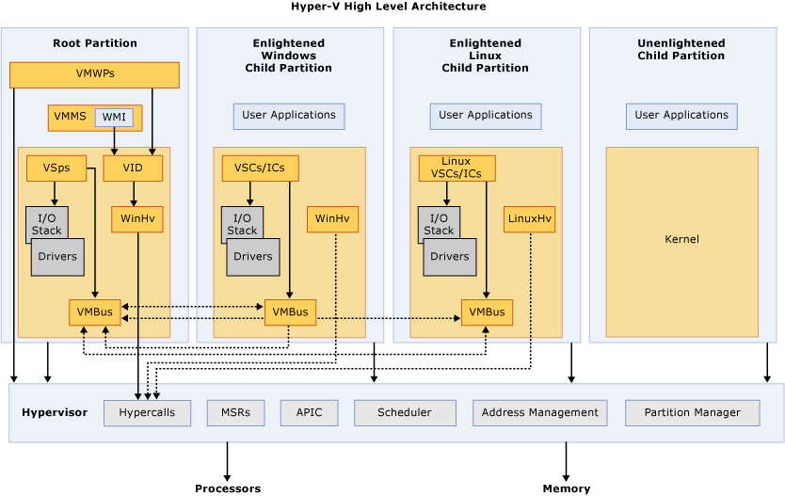
Microsoft Hyper-V

Slide 33
Guest-to-Hypervisor Interface (Microsoft Hyper-V)
Partition
A set of virtual processors and other hardware, plus its configuration
Root partition – typically used to run the Host OS and VM Management
Inter-partition messaging
The hypervisor supports a simple message-based inter-partition communication mechanism.
Messages can be sent by the hypervisor to a partition or can be sent from one partition to another.
Guest Physical Address Space
The GPA mappings are defined by the partition’s parent.
At the time they are mapped, they are specified in terms of the parent’s GPA space.
Guest Virtual Address Space
The hypervisor exposes operations to flush the TLB (on one virtual processor).

Slide 34
Guest-to-Hypervisor Interface (Microsoft Hyper-V)
Virtual MSRs
Physical MSRs used by Kernels to read/alter CPU configuration
VMM emulates additional Machine Status Registers (MSR) not present in HW
VMM-aware VM Kernel can read/write virtual MSRs to exchange configuration information with VMM
Emulation too slow for real communication
Hypercall
Call Hypervisor from Guest (privileged mode)
Exposed as procedure call to a special guest-physical page
Provided by Hypervisor on request from Guest (via a virtual MSR)
VM Kernel must map the guest-physical page to a guest-virtual page
The page contains either special instructions or nothing – both cases cause VM exit
Arguments passed/returned in registers or VPAP
Virtual Processor Assist Page (VPAP)
Special guest-physical page per virtual processor (core/logical thread)
Both Hypervisor and Guest can read/write

Slide 35
Guest-to-Hypervisor Interface (Microsoft Hyper-V)
Hypercall
Call Hypervisor from Guest (privileged mode)
Exposed as procedure call to a special guest-physical page
Arguments passed/returned in registers or VPAP
One Hypercall may serve several logical requests
Chained into an array of arguments
All Hypercalls return within 50 microseconds
Avoids blocking in the Hypervisor (giant lock?)
Longer requests serviced in continuation-style
The Hypercall return address is set before the instruction that invoked it
Arguments adjusted to indicate that part of the request is already done
On the next VM Entry, the Hypercall is entered again

