Slide 1
Compiler principles
Processor architectures
Jakub Yaghob

Slide 2
Processor architectures
Processor architecture is a target language
  For compilers targeting a processor code
  It influences the compiler backend, namely code generator
  It can affect an intermediate code form and instructions, used high-level optimizations

Slide 3
Registers
The fastest memory
Precious resource
  x86 has 7 of 32-bits integer registers
  x86_64 has 15 of 64-bit integer registers
  IA-64 has 128 of 64-bits integer registers
Different register types for different data types
  Integer, floating point, address, vector
Different access modes
  Direct
  Stack (x87 FPU)

Slide 4
Instruction set
RISC
  Small number of simple instructions
    e.g. no division
CISC
  Complex instructions, wide repertoire
Load-Execute-Store
  Register-only operands for arithmetics
Orthogonality
  x86 has non-orthogonal instruction set

Slide 5
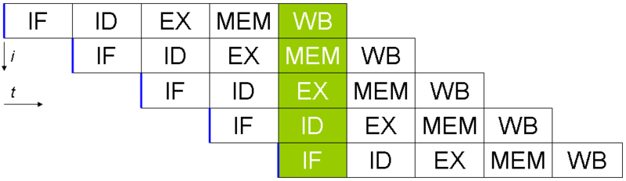
Pipelining
Next instruction fetch and decode started before the previous instruction was finished
Each stage and each instruction has a latency
  Problem with operand dependency (RAW)

Slide 6
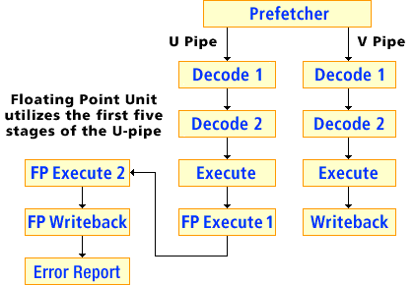
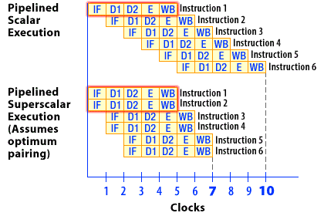
Superscalar processor
More equal units capable of parallel instruction execution

Slide 7
Out-of-Order Execution
Instruction fetch
Instruction dispatch to an instruction queue
The instruction waits until its input operands are available
The instruction is issued to its execution unit
The results are queued
When all older instructions written their results to the register file, the instruction writes its result

Slide 8
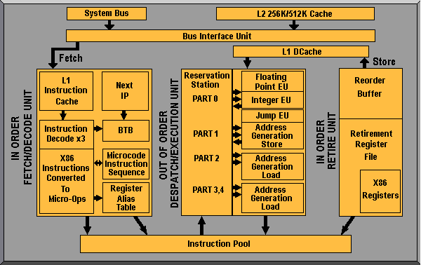
Out-of-Order Execution – AMD

Slide 9
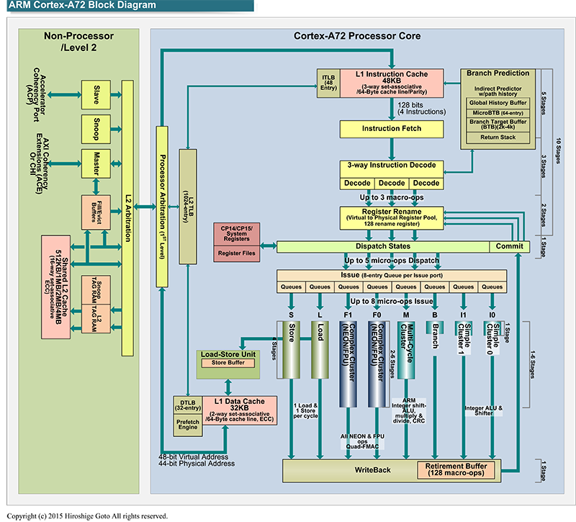
Out-of-Order Execution – ARM Cortex-A72

Slide 10
Branch prediction
Deep pipelines have a problem with not taken conditional jumps
Dynamic branch prediction
  BTB
  CPU uses history (patterns of some length) for branch prediction
  Static prediction used when no history is available
Static branch prediction
  No hint
    Forward jump is not taken, backward jump is taken
  Hint
    A compiler computes branch probability and generates appropriate branch hint
Delay slot

Slide 11
Speculative execution
Execution of a code in advance which is not used later
Significant disproportion between CPU and memory speed
Usually used for read operations in advance
CPU postpones write operations
Memory barriers
Code speculation
  Check for successful execution
Data speculation
  Moved forward even with possible pointer-aliasing

Slide 12
SIMD instructions
Sometimes called multimedia instructions
Integer and float data types
Expression vectorization already in intermediate code or later in code generation
Considerable (constant) execution speedup
Sometimes difficult detection of vectorization opportunity

Slide 13
VLIW
Instruction encoding
  Templates in IA-64
ILP (Instruction Level Parallelism)
  Concurrency encoded directly in instructions
  Dependencies in concurrency group
    RAW, WAW disallowed
    WAR allowed

Slide 14
SoC (System on Chip) + microcontrollers
Small memory space
  Optimization for size of code and data
    One-bit variables
Separated memory spaces
  Code and several data address spaces
  Different access
Simple pipeline, no superscalarity

Slide 15
Code generation
Memory allocation
Instruction selection
Register allocation
Instruction scheduling
Output
  Output file format
  Objects
    Code, data, relocations, external and public symbols, debug information

Slide 16
Memory allocation
Code
  Jump resolving
Static data
  Global data
Stack
  Local variables and function parameters
Size of data types
Memory placement
Data alignment
Decide, what is in memory and what gets an allocated register

Slide 17
Instruction selection
1:N
  One intermediate code instruction corresponds with N target instructions
  Simple, the generated code is considerably suboptimal
M:N
  M intermediate code instructions correspond with N target instructions
  NP-complete problem of selection
  Heuristics
More possibilities of code generation
  CISC, SIMD, VLIW
Non-orthogonal instruction set problem

Slide 18
Register allocation
What is placed to the memory and what is placed into a register of a required register type
Non-orthogonal instruction set problem
Coloring of a graph of variable liveness
  The graph is constructed only for a selected variable type (e.g. integer variables)
  The number of colors is equal to the number of available registers of the selected type
  When there is no graph coloring, remove “less important” graph nodes and try again
  We don’t need to find an optimal graph coloring, we are looking for any graph coloring

Slide 19
Instruction scheduling
Rearrange instructions keeping semantic and avoiding pipeline stalls
  RAW, WAW, WAR dependencies
  Construct graph of data dependency
    Oriented graph, where an edge represents instruction ordering for data availability
    Find any topological order
  Instruction latency, speculations, superscalarity, out-of-order execution
  Usually performed upon one basic block

