Slide 1
Crypto
Principles of Distributed Systems
Tomáš Faltín
KSI MFF

Slide 2
Bitcoin

Slide 3
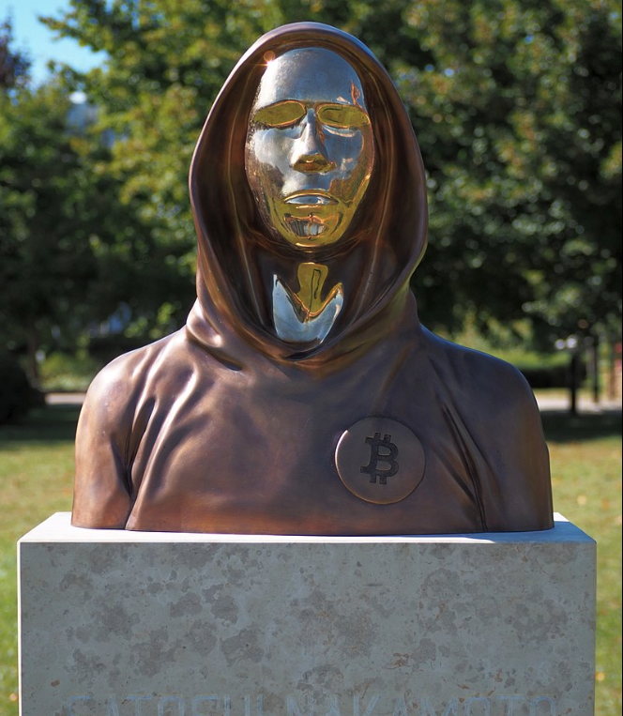
History
Can I trust that the money is authentic?
Can the digital money be spent only once?
Can no one else claim my money?
Paper "Bitcoin: A Peer-to-Peer Electronic Cash System” by Satoshi Nakamoto in 2009

Slide 4
Overview
Concepts & technologies for digital money ecosystem
Distributed, P2P system
bitcoins created through mining every ~10 min
Mining = competing to find solution to a mathematical problem while processing transactions
Limited to 21 mil. (by 2140)

Slide 5
Bitcoin
The Bitcoin protocol - A decentralized P2P network
Blockchain - A public transaction ledger
Consensus Rules - A set of rules
Proof-Of-Work algorithm A mechanism for reaching consensus

Slide 6
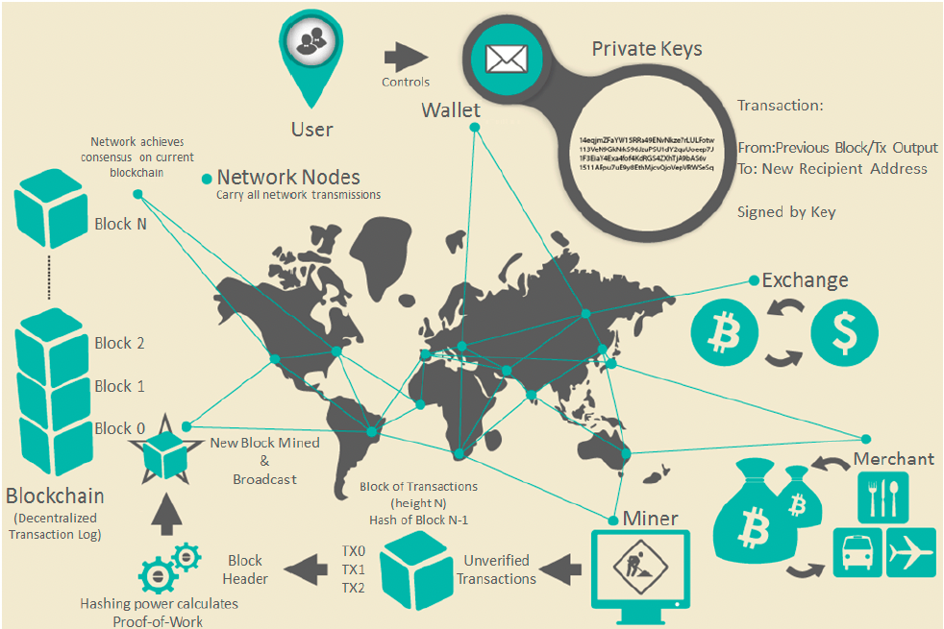
High Level

Slide 7
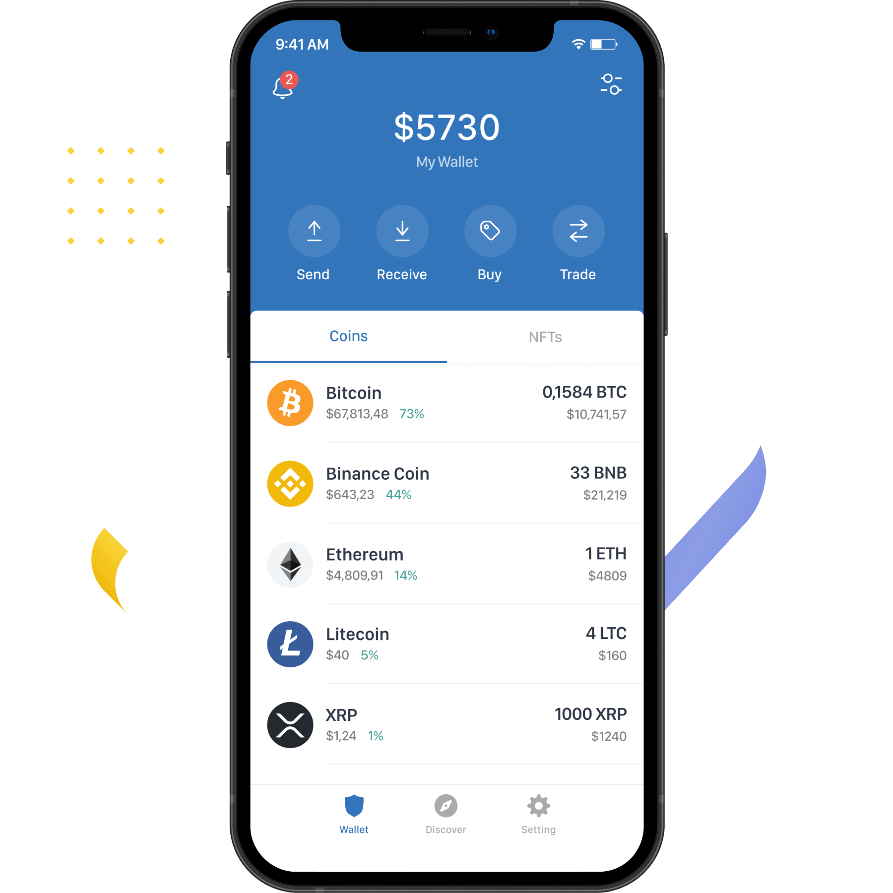
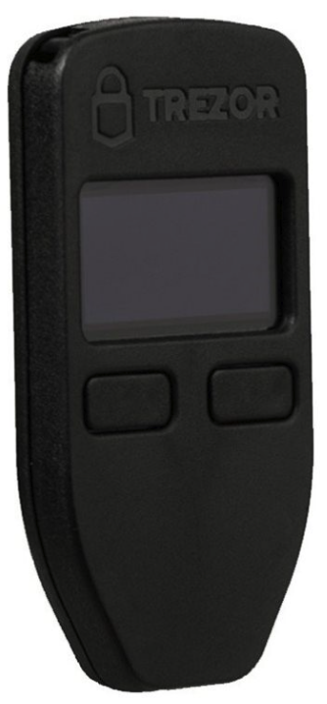
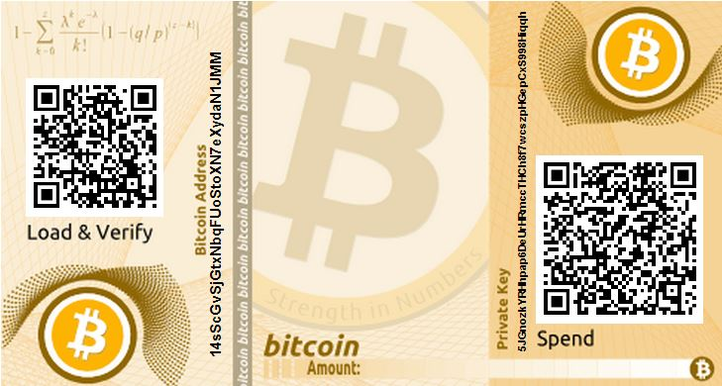
Wallet
UI to the bitcoin interface
Desktop, mobile, web, HW, paperwallets, …
A bitcoin node that stores and manages keys

Slide 8
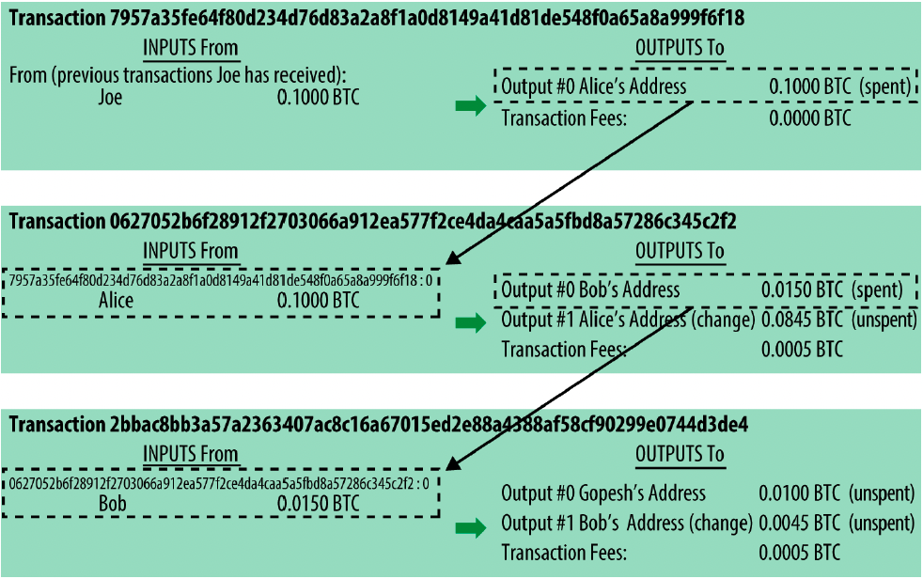
Transactions
Bitcoin transfer from the owner to another user
Propagation via flooding mechanism
Notes:
Spending = signing a transaction that transfers value from a previous transaction over to a new owner identified by a Bitcoin address.
Making change
Different types of transactions: common, aggregating, distributed
Flooding = forward to all other nodes
A common misconception about bitcoin transactions is that they must be "confirmed" by waiting 10minutes for a new block, or up to 60 minutes for a full six confirmations. Although confirmations ensure the transaction has been accepted by the whole network, such a delay is unnecessary for small-value items such as a cup of coffee. A merchant may accept a valid small-value transaction with no confirmations, with no more risk than a credit card payment made without an ID or a signature, as merchants routinely accept today.
Joe -> Alice: https://www.blockchain.com/btc/tx/7957a35fe64f80d234d76d83a2a8f1a0d8149a41d81de548f0a65a8a999f6f18
Alice -> Bob: https://www.blockchain.com/btc/tx/0627052b6f28912f2703066a912ea577f2ce4da4caa5a5fbd8a57286c345c2f2

Slide 9
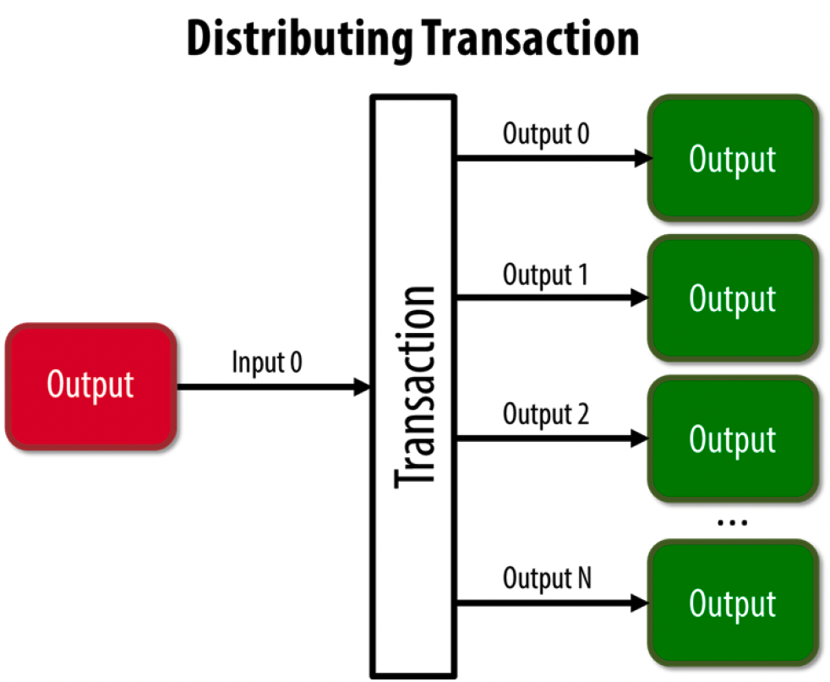
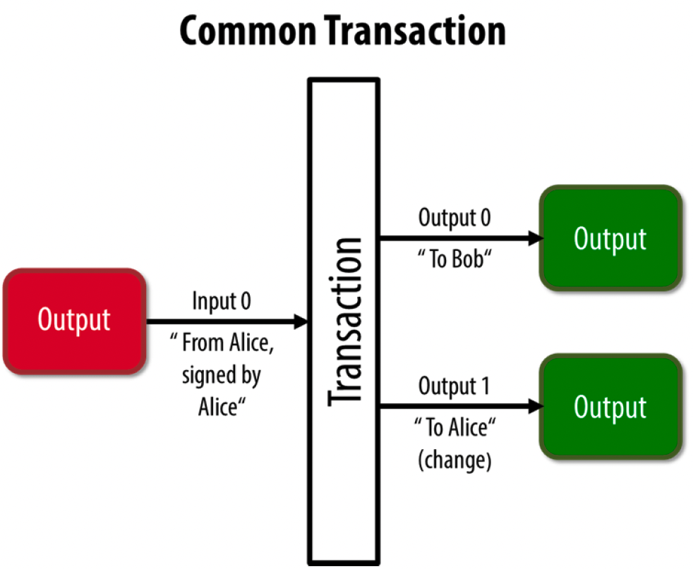
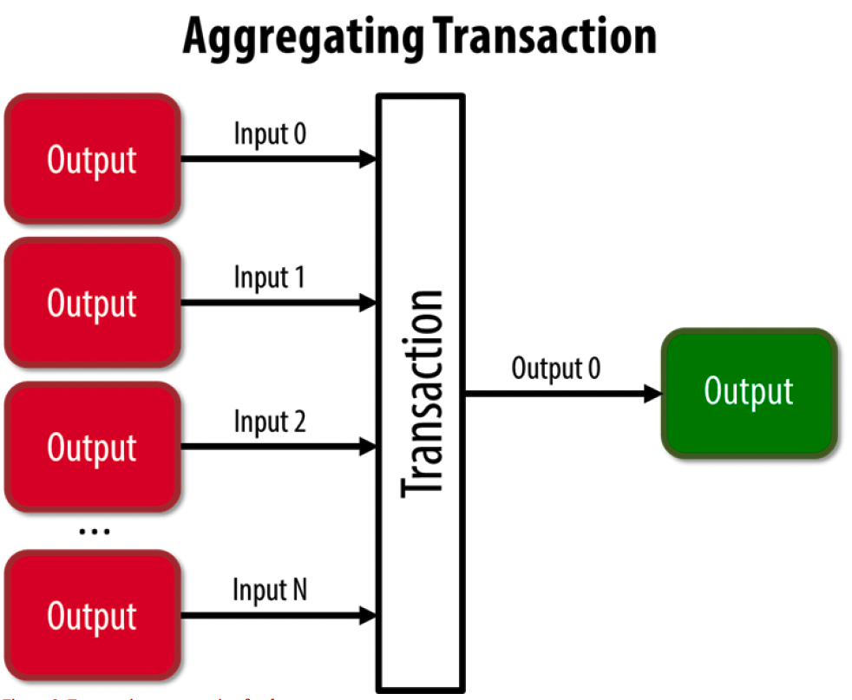
Transactions

Slide 10
Mining
Process of including transactions into the blockchain
Validation of transactions by solving a puzzle (Proof-of-Work)
Creation of new bitcoins (reward, currently 6.25 BTC)
Notes:
Transactions bundled into blocks
New transactios are constantly flowing into the network from user wallets and other applications. As these are seen by the Bitcoin network nodes, they get added to a temporary pool of unverified transactions maintained by each node. Asminers construct a new block, they add unverified transactions from this pool to the new block and then attempt to prove the validity of that new block, with the mining algorithm (Proof-of-Work).

Slide 11
Going Into Details

Slide 12
Bitcoin Ownership
Digital keys
Private secret key
Public key
Bitcoin address
Generated from the public key
Digital signature
(Most) transactions require to be included in blockchain
Generated from the secret key
Notes:
Keys are inside the wallets

Slide 13
Public And Private Keys
Need an irreversible function (elliptic curve multiplication, prime number exponentiations, …)
Digital signatures through asymmetric cryptography
Private key = a number between <1,2²⁵⁶)
Notes:
Hash = SHA256

Slide 14
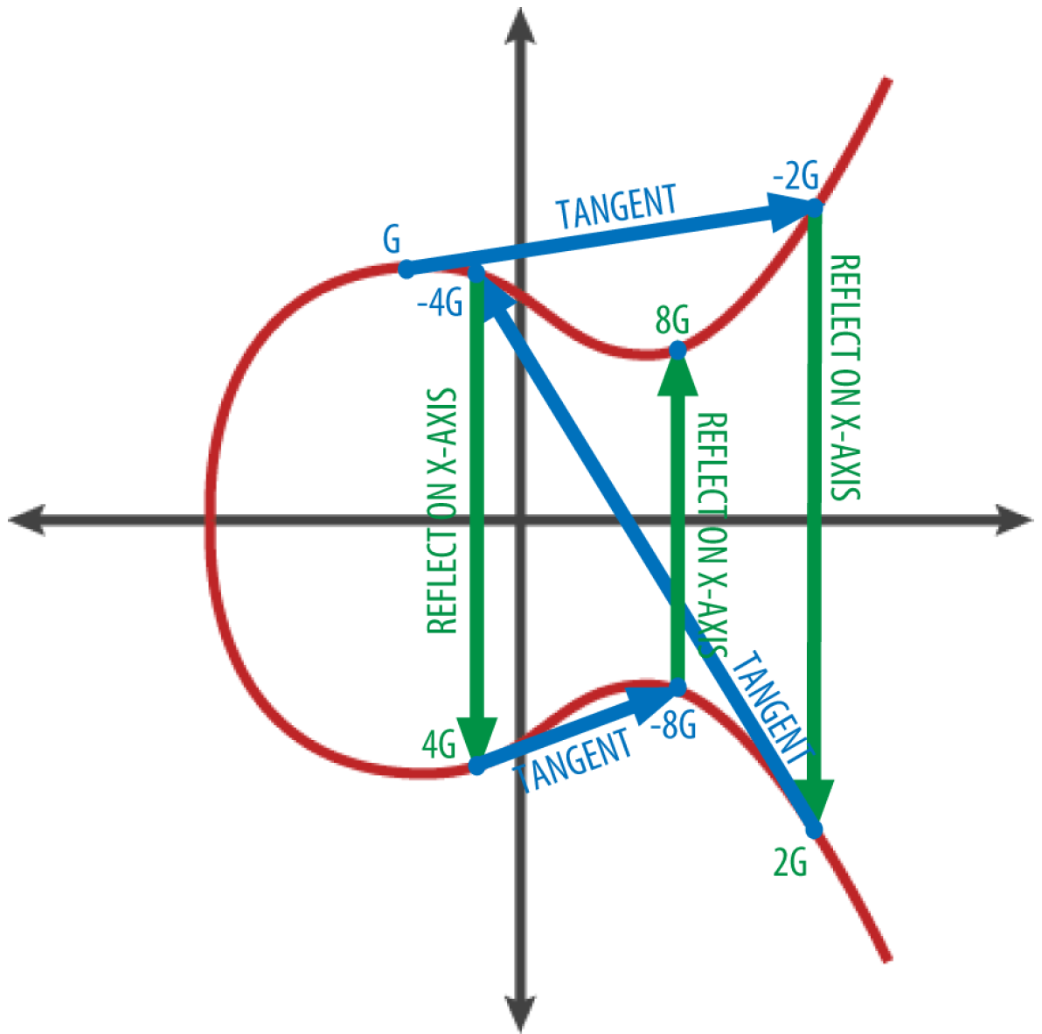
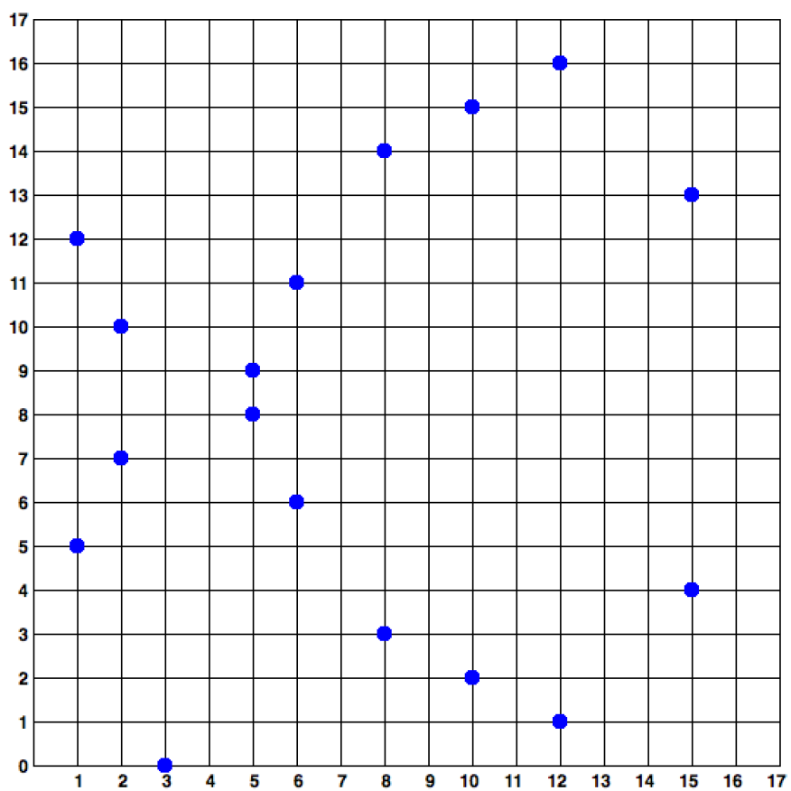
Public Keys
Calculated from private key using elliptic curve multiplication
K (public key) = k (private key) * G
f(x, y): y² mod p = (x³ + 7) mod p
p = 2²⁵⁶ - 2³² – 2⁹ – 2⁸ – 2⁷ – 2⁶ – 2⁴ – 1
defined by a secp256k1 standard
Reverse operation: finding the discrete logarithm
Notes:
In elliptic curves, adding a point to itself is the equivalent of drawing a tangent line on the point and finding where it intersects the curve again, then reflecting that point on the x-axis.
t

Slide 15
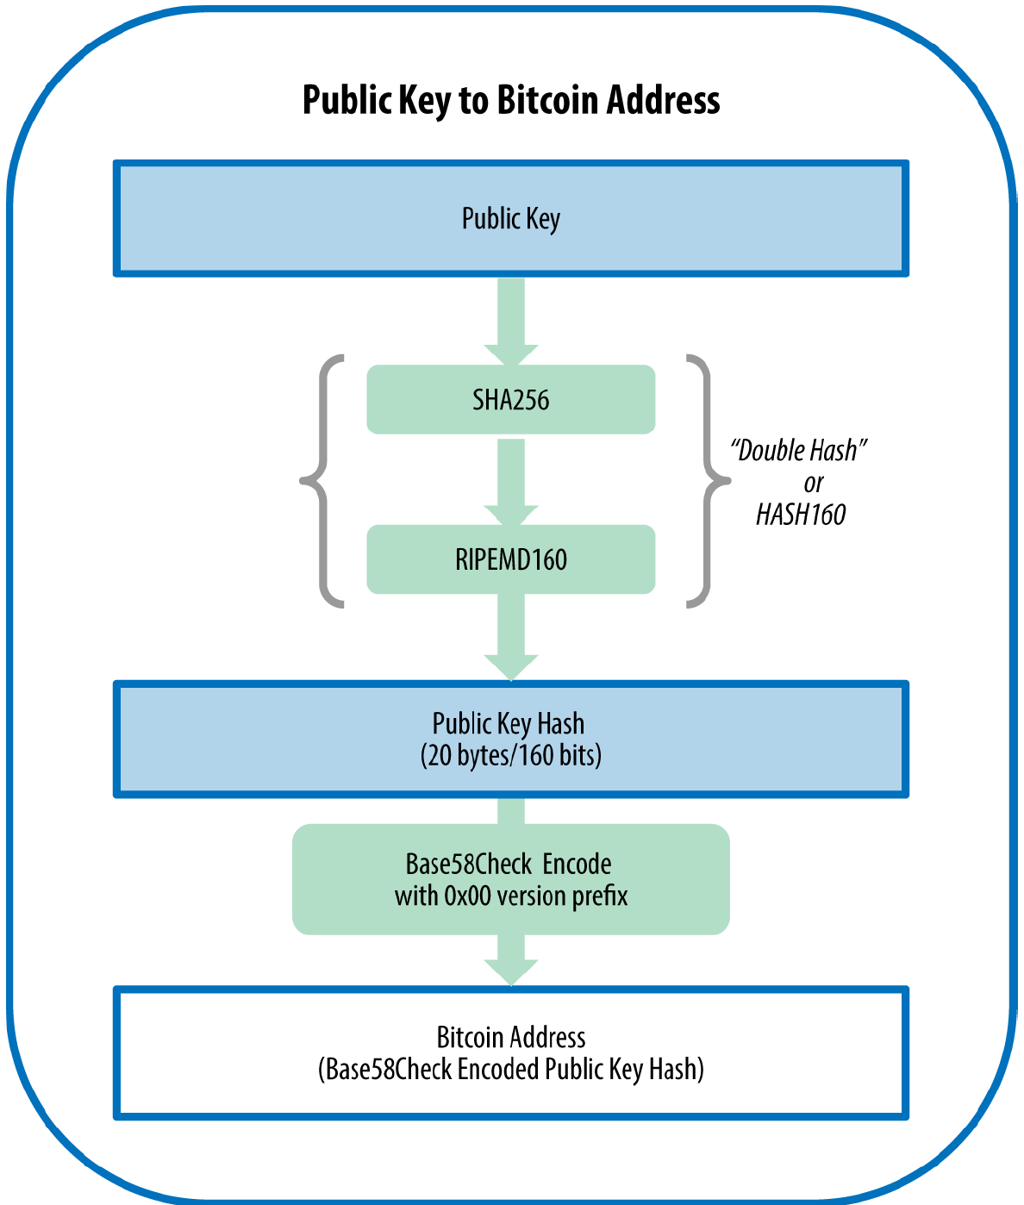
Addresses
Produced from a public key and starts with 1
SHA256, RIPEMD160
A = RIPEMD160(SHA256(K))
Encoded using Base58Check
Use only x coordinate (y can be computed)
Pay-to-Script addresses
Address created from a script
Multisig Addresses
Requires M-of-N signatures
Notes:
Explain Base58check
P2SH starts with 3
Multisig
Vanity addresses for Xmas

Slide 16
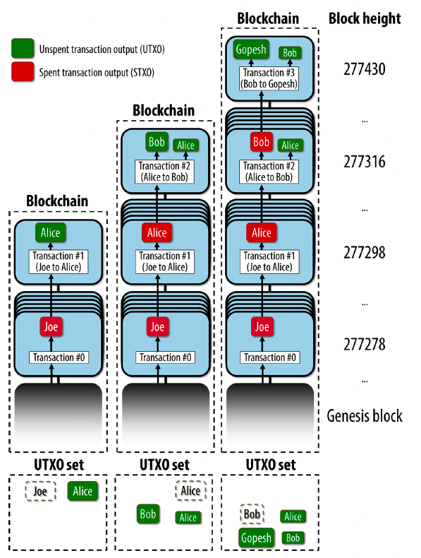
Transactions
Transfer of value between participants
UTXO = unspent transaction outputs
Full nodes track UTXO set
Received bitcoin ~ blockchain contains an UTXO
Change returned as another transaction output
Coinbase transactions = reward for the miners
Creates new bitcoins

Slide 17
Transaction Outputs
An amount of bitcoin in satoshi (0.00000001 BTC)
scriptPubKey (locking script/witness script)
A cryptographic puzzle determining the requirements
Notes:
Explain satoshi!

Slide 18
Transaction Inputs
Indentifier of UTXO
Output index
scriptSig - unlocking script
sequence
Notes:
- Need UTXO to get the info

Slide 19
Transaction Fees
Affect the processing priority
Calculated based on the size of transaction (in KB) or dynamically
Implied from the difference between inputs and outputs
Notes:
Typically automatic by wallet
Clients Must include dynamic fees
Diff between input & output
- bitcoinfees.earn.com

Slide 20
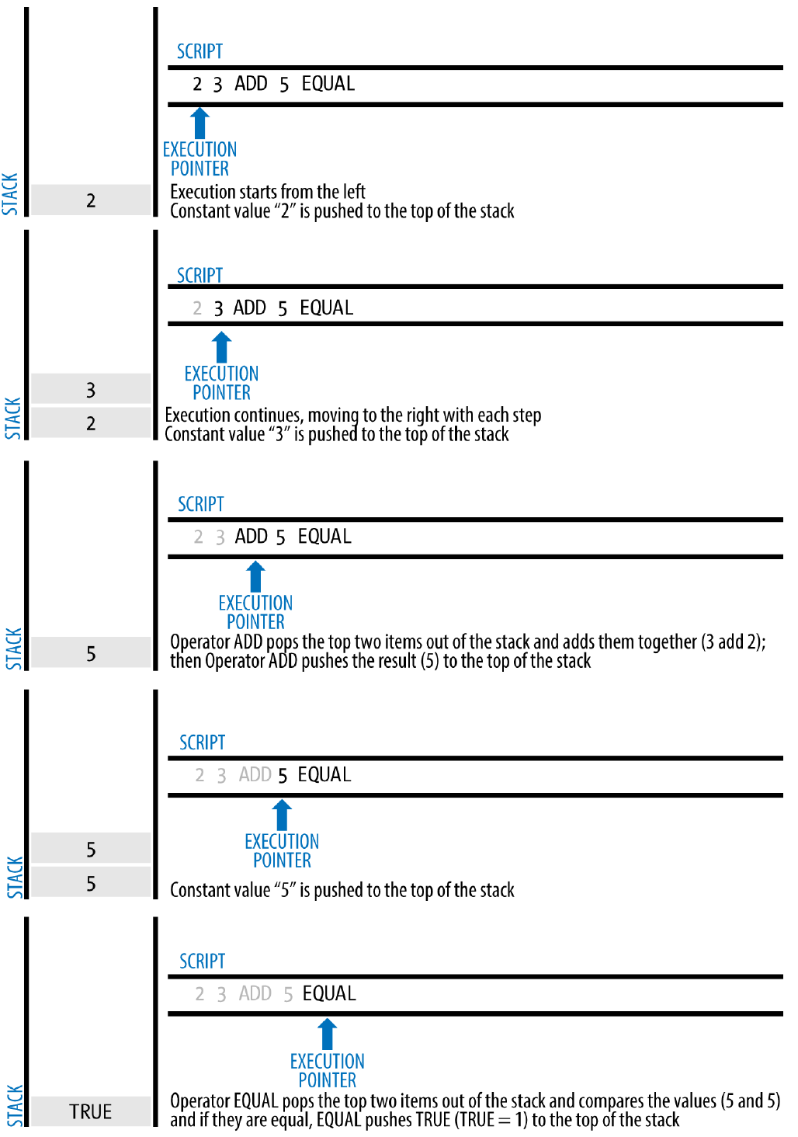
Script Language
Script, Forth-like stack-based execution language
Stateless, Turing incomplete
Notes:
- Need UTXO to get the info

Slide 21
Pay-To-Public-Key-Hash (P2PKH)
Major transaction’s script
Notes:
- Need UTXO to get the info

Slide 22
Digital Signatures
Undeniable proof for authorization
Transaction cannot be modified after signing
Each transaction signed independently
Using ECDSA
Functions: CHECK(MULTI)SIG, CHECK(MULTI)SIGVERIFY
SIGHASH (Signature Hash Type): ALL, NONE, SINGLE, ANYONECANPAY
Notes:
TODO: explain sighash

Slide 23
Elliptic Curve Digital Signature Algorithm (ECDSA)
Creates a temporal private + public key pair
Signing: S = k⁻¹ (Hash(m) + dA * R) mod n
k - a temporal private key
R - x coordinate of the temporal public key
dA - the signing private key
m - the transaction
Verification: P = S⁻¹ * Hash(m) * G + S⁻¹ * R * Qa
R, S - signature values
Qa - public key
M - the transaction
G - generator point
Notes:
Generated same way as already shown

Slide 24
Multisignature
X-of-3 multisignature
X-of-15 in P2SH
Notes:
- a bug in multiseg

Slide 25
Pay-to-Script-Hash (P2SH)
Script replaced with a hash fingerprint (redeem script)
Script must be presented on spending
Not recursive
Advantages
Makes the transaction smaller
Shifts burden from output (UTXO) into input (blockchain)
Notes:
= pay to a script matching this hash, a script that will be presented later when this output is spent
Advantages:
Complex scripts are replaced by shorter fingerprints in the transaction output, making the transaction smaller.
Scripts can be coded as an address, so the sender and the sender’s wallet don’t need complex engineering to implement P2SH.
P2SH shifts the burden of constructing the script to the recipient, not the sender.
P2SH shifts the burden in data storage for the long script from the output (which additionally to being stored on the blockchain is in the UTXO set) to the input (only stored on the blockchain).
P2SH shifts the burden in data storage for the long script from the present time (payment) to a future time (when it is spent).
P2SH shifts the higher transaction fee costs of a long script from the sender to the recipient, who has to include the long redeem script to spend it.

Slide 26
Data Recording Output (RETURN)
Create transaction outputs to record data on the blockchain
E.g., proof-of-existence of a file (https://proofofexistence.com/)
80B data portion
Create a provably unspendable output which does not need to be stored in UTXO set
Notes:
Before the operator, controversial, because of bloated blockchain and UTXO which cannot be spent
Used together with some services…

Slide 27
Absolute Timelocks
nLockTime – Per-transaction timelock
< 500mil. – not valid before the given block height
>= 500mil. – not valid before the given UNIX epoch
Double spending problem
Check Lock Time Verify (CLTV) – Per-output timelock
UTXO can be spent with nLockTime set to >=
Notes:
- Explain double spending

Slide 28
Relative Timelocks
nSequence (< 2³¹)
Behavior based on type flag
0: Not valid before given number of blocks, or
1: Not valid before given number of seconds (multiples of 512s)
CHECKSEQUENCEVERIFY (CSV)
Notes:
The clock doesn’t start counting before UTXO is recorded
Useful for lightning networks
nSequence originaly for mofification of transactions in mempool, but never implemented
nSequence
0 – blocks,
1 - seconds

Slide 29
Median Time Passed
Timestamps set by miners
Potential motivation to lie
Median-Time-Passed is a median timestamp of last 11 blocks (~2h)
Consensus time for timelock operations
Notes:
Wall-time vs. consensuse time
Each node its own tim

Slide 30
Fee Snipping Attack
to snipe higher-fee transaction from future to rewrite past blocks
Fixed by limiting nLockTime to the next block
Notes:
Today, this attack is not very lucrative, because block reward is much higher than total fees per block. But at some point in the future, transaction fees will be the majority of the mining reward (or even the entirety of the mining reward). At that time, this scenario becomes inevitable.

Slide 31
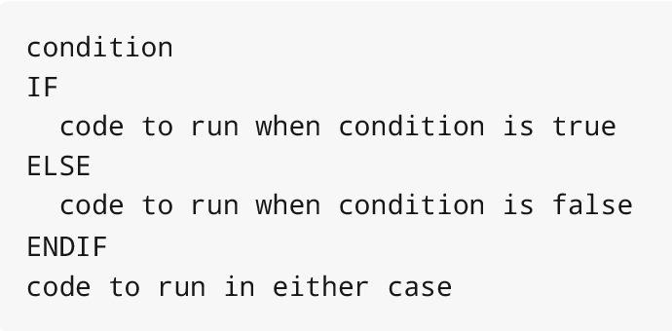
Flow Control (if-else)
IF-ELSE-ENDIF
Can be nested
VERIFY guard clause – terminates if FALSE

Slide 32
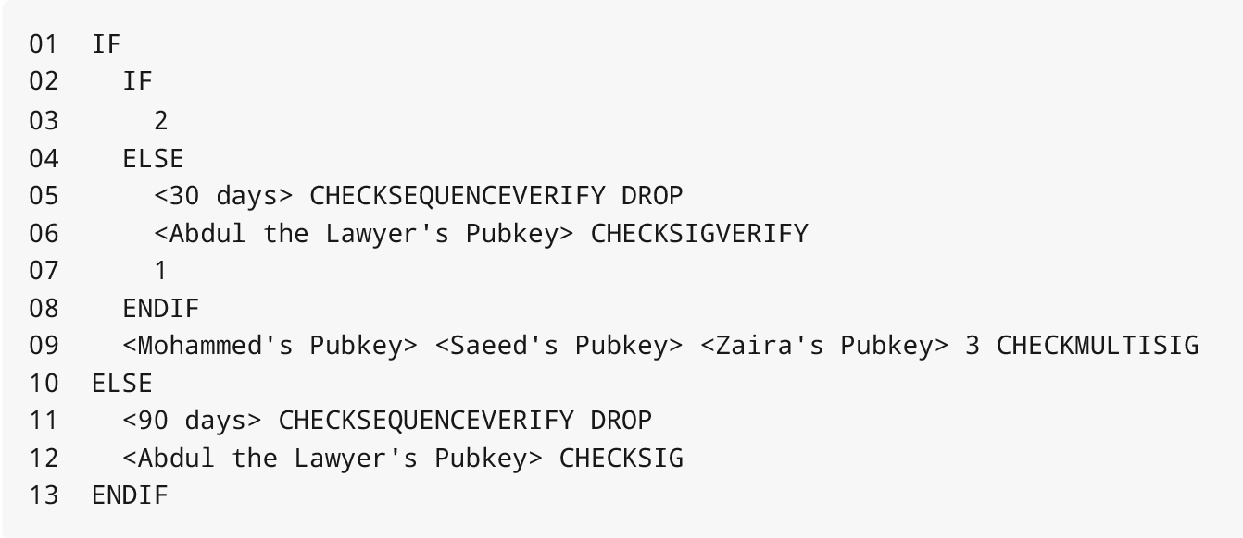
A Complex Example
Unlocking script A:
Unlocking script B:
Unlocking script C:
Notes:
A: Unlocking script for the first execution path (2-of-3 multisig)
B: Unlocking script for the second execution path (Lawyer + 1-of-3)
C: Unlocking script for the third execution path (Lawyer only)

Slide 33
Segregated Witness (segwit)
Architectural change of separating unlocking script/scriptSig
Data moved into a separated witness data
Soft Fork
Notes:
Explain soft fork
In the context of bitcoin, a digital signature is one type of witness, but a witness is more broadly any solution that can satisfy the conditions imposed on an UTXO and unlock that UTXO for spending. The term “witness” is a more general term for an “unlocking script” or “scriptSig.”
By moving the witness outside the transaction data, the transaction hash used as an identifier no longer includes the witness data. Since the witness data is the only part of the transaction that can be modified by a third party (see[segwit_txid]), removing it also removes the opportunity for transaction malleability attacks. With Segregated Witness,transaction hashes become immutable by anyone other than the creator of the transaction, which greatly improves the implementation of many other protocols that rely on advanced bitcoin transaction construction, such as paymentchannels, chained transactions, and lightning networks
The witness data is often a big contributor to the total size of a transaction. More complex scripts such as those used for multisig or payment channels are very large. In some cases these scripts account for the majority (more than 75%)of the data in a transaction. By moving the witness data outside the transaction data, Segregated Witness improvesbitcoin’s scalability. Nodes can prune the witness data after validating the signatures, or ignore it altogether whendoing simplified payment verification. The witness data doesn’t need to be transmitted to all nodes and does not needto be stored on disk by all nodes.
Segregated Witness upgrades the signature functions (CHECKSIG, CHECKMULTISIG, etc.) to reduce the algorithm’scomputational complexity. Before segwit, the algorithm used to produce a signature required a number of hashoperations that was proportional to the size of the transaction. Data-hashing computations increased in O(n) withrespect to the number of signature operations, introducing a substantial computational burden on all nodes verifyingthe signature. With segwit, the algorithm is changed to reduce the complexity to O(n).
Segregated Witness signatures incorporate the value (amount) referenced by each input in the hash that is signed.Previously, an offline signing device, such as a hardware wallet, would have to verify the amount of each input beforesigning a transaction. This was usually accomplished by streaming a large amount of data about the previoustransactions referenced as inputs. Since the amount is now part of the commitment hash that is signed, an offlinedevice does not need the previous transactions. If the amounts do not match (are misrepresented by a compromisedonline system), the signature will be invalid.

Slide 34
Pay-to-Public-Key-Hash (P2PKH)
Old P2PKH

Slide 35
Pay-to-Witness-Public-Key-Hash (P2WPKH)
P2WPKH
A witness version
A witness program
Similar for P2WSH
Notes:
The critical difference between them is the length of the hash
The public key hash in P2WPKH is 20 byte The script hash in P2WSH is 32 bytes
Pay-to-Witness-Script-Hash (P2WSH)

Slide 36
Segregated Witness Transaction Identifiers
Transaction signatures could have been modified
Potential for DoS
2 new fields:
Txid – double SHA256 hash of transaction without the witness data
Wtxid – double SHA256 hash of transaction with the witness data
Notes:
Txid – same as before, has empty scriptSigs -> immutable
Wtxid – without data equals to txid,

Slide 37
Segregated Witness’ New Signing Algorithms
CHECK(MULTI)SIG(VERIFY)
Signatures applied on commitment hash
SIGHASH_ALL uses all inputs and outputs
Hash operations increases in O(n²) with number of operations in Tx
Very large transactions can cause performance problem (DoS) of the whole network
New algorithm increases only in O(n)
Commitment hash includes the value of each input
Notes:
An attacker could therefore create a transaction with a very large number of signature operations, causing the entire Bitcoin network to have to perform hundreds or thousands of hash operations to verify the transaction.
a signer can commit to a specific input value without needing to "fetch" and checkthe previous transaction referenced by the input. In the case of offline devices, such as hardware wallets, this greatlysimplifies the communication between the host and the hardware wallet, removing the need to stream previoustransactions for validation. A hardware wallet can accept the input value "as stated" by an untrusted host. Since thesignature is invalid if that input value is not correct, the hardware wallet doesn’t need to validate the value beforesigning the input.

Slide 38
The Bitcoin Network

Slide 39
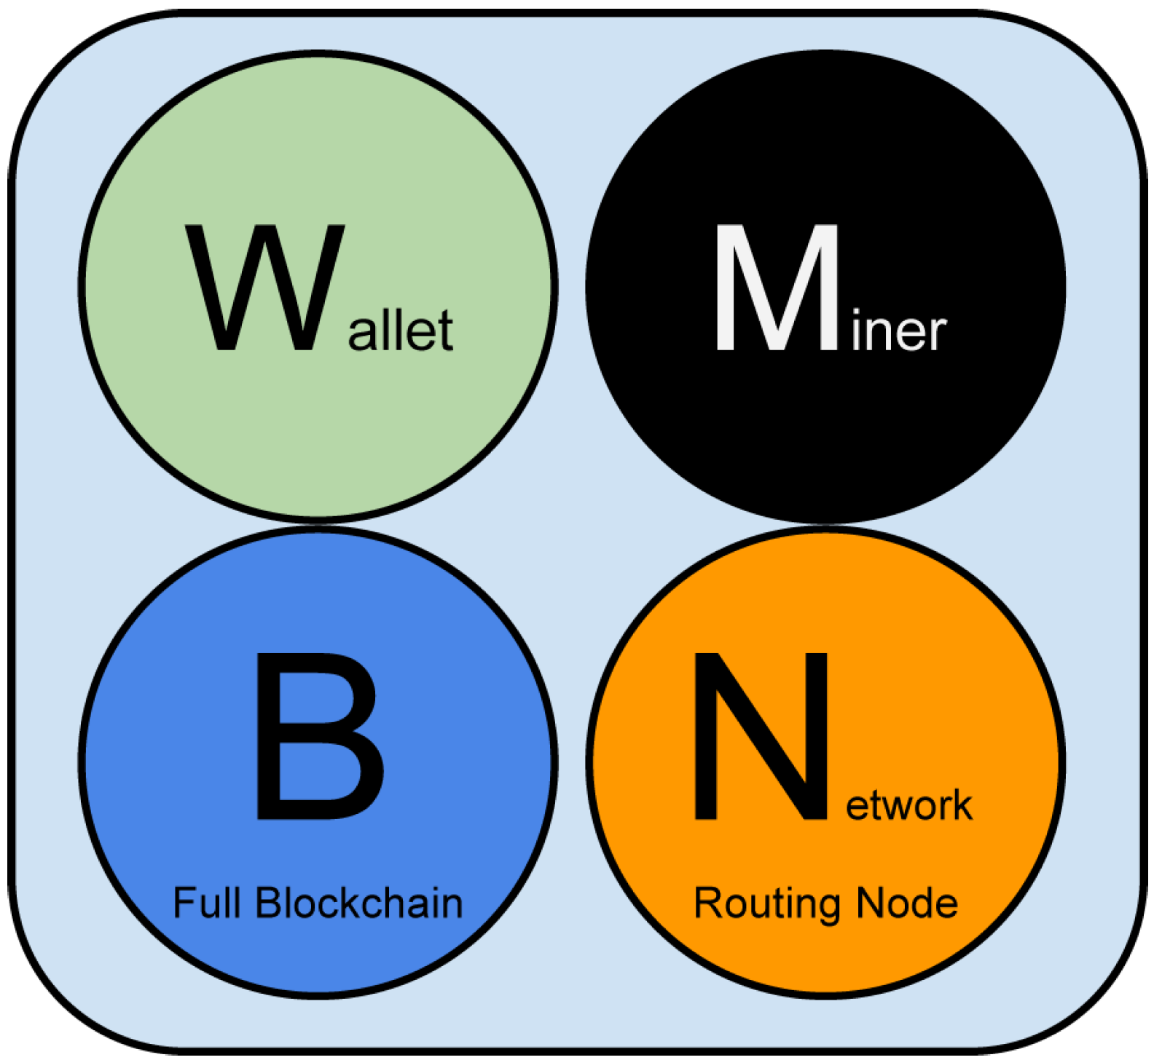
Network Architecture
Bitcoin protocol = P2P protocol on top of the internet
Stratum protocol = protocol for lighweight devices
Node’s functions: wallet, mining, blockchain, routing
Notes:
P2P example torrent
Some nodes maintain only a subset of the blockchain and verify transactions using a method called simplified payment verification, or SPV. These nodes are known as SPV nodes or lightweight nodes.

Slide 41
Bitcoin Relay Networks
A network minimizing latency between miners
V1: Bitcoin Relay Network
V2: FIBRE – UDP-based

Slide 42
Simple Payment Verification (SPV) Nodes
Not storing the whole blockchain
Download only block headers
Verify transactions using views on demand from peers
SPV node establishes link between the transaction and the block containing it using merkle path
+6 additional blocks atop of the block with the transaction
Cannot verify, e.g., double spending of transactions
Double spending, DoS, network partition or Sybil attacks
Connect randomly to several nodes to decrease probability
Notes:
An SPV node can definitely prove that a transaction exists but cannot verify that a transaction, such as a double-spend of the same UTXO, doesn’t exist because it doesn’t have a record of all transactions. This vulnerability can be used in a denial-of-servic eattack or for a double-spending attack against SPV nodes. To defend against this, an SPV node needs to connect randomly to several nodes, to increase the probability that it is in contact with at least one honest node. This need to randomlyconnect means that SPV nodes also are vulnerable to network partitioning attacks or Sybil attacks, where they are connected to fake nodes or fake networks and do not have access to honest nodes or the real Bitcoin network.

Slide 43
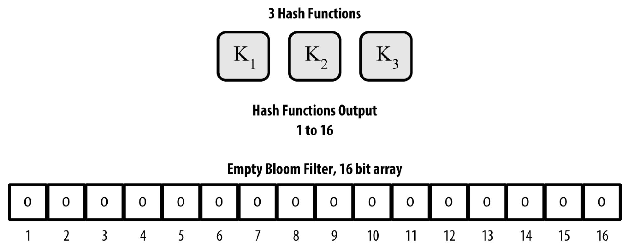
Bloom Filters
A probabilistic filter protecting privacy
A bitset of size N and variable number of M hash functions
Notes:
Privacy problems with SPV
Used in DBs as well

Slide 44
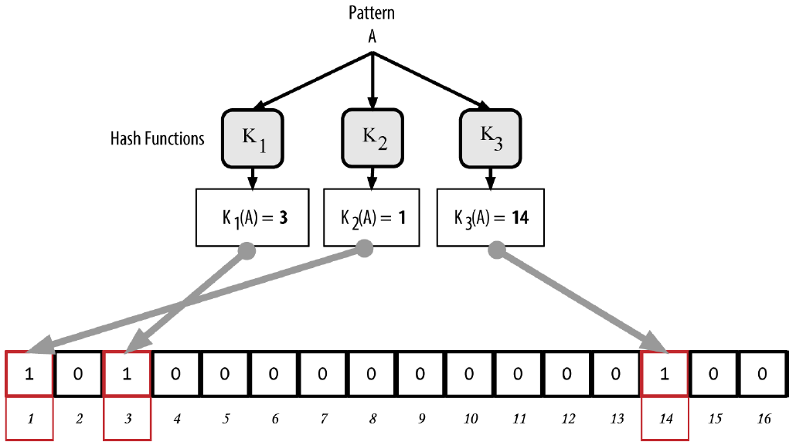
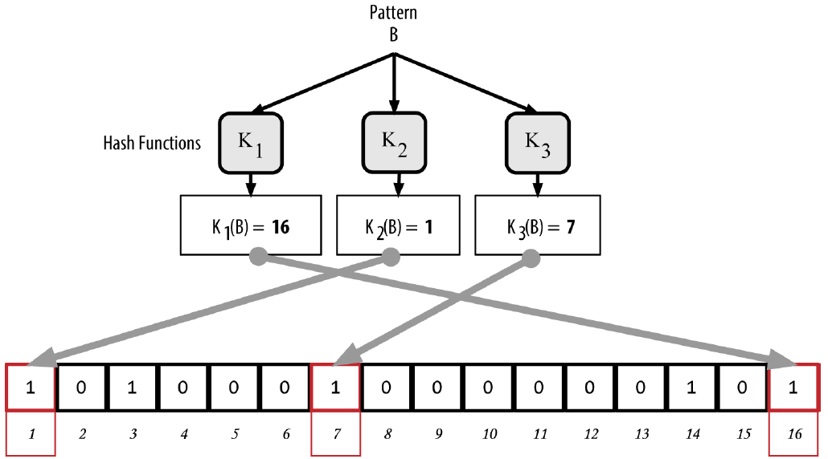
Bloom Filters - Insert

Slide 45
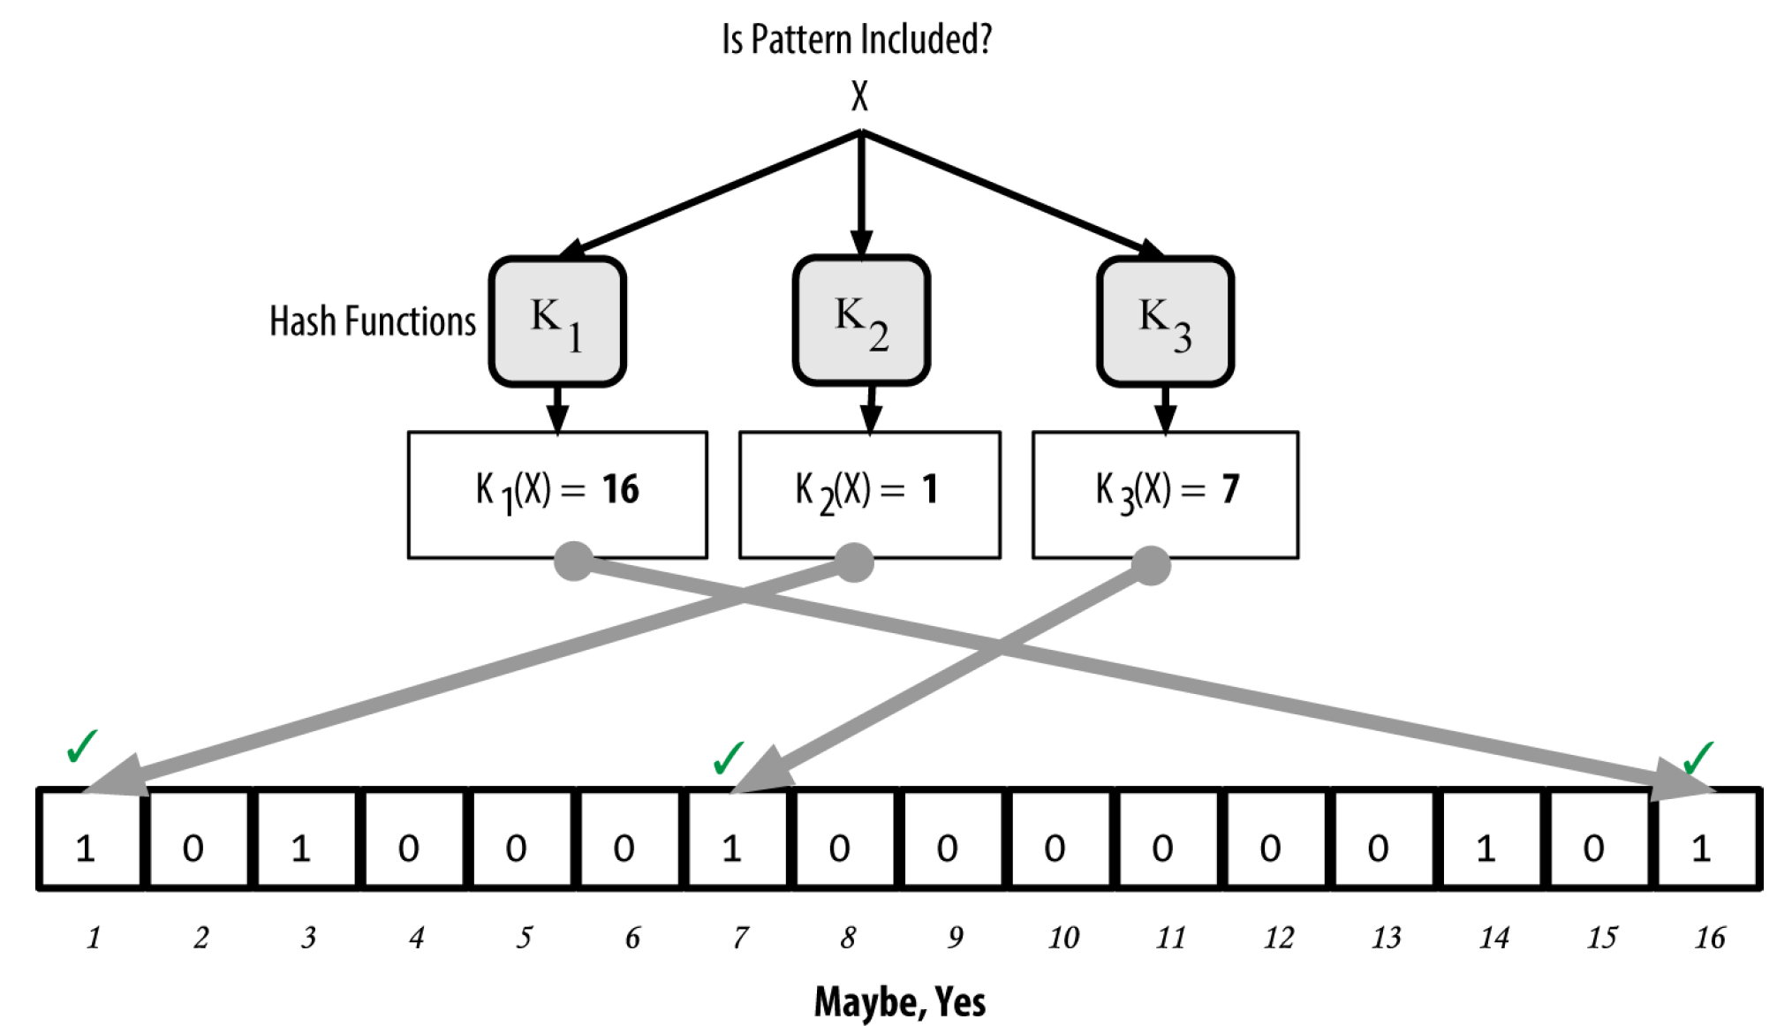
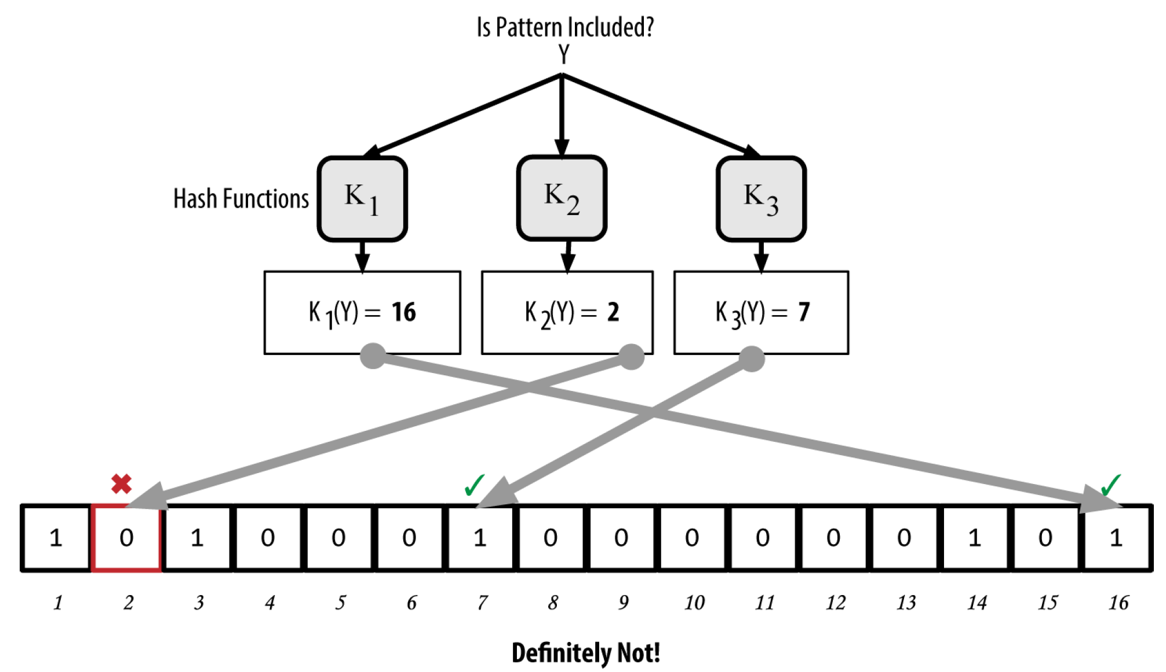
Bloom Filters - Search

Slide 46
Bloom Filters In SPV
To filter interesting transaction received from peers
Extract public key hash, script hash and transaction ID from UTXO controlled by the wallet into the bloom filter
Send filter load to a peer along with the filter
A peer pre-filters transaction for SPV
Notes:
Can be iteratively added
Bloom filters are a way to reduce the loss of privacy. Without them, an SPV node would have to explicitly list the addresses it was interested in, creating a serious breach of privacy. However, even with bloom filters, an adversary monitoring the traffic of an SPV client or connected to it directly as a node in the P2P network can collect enough information over time to learn the addresses in the wallet of the SPV client.

Slide 47
Encrypted And Authenticated Connections
Problem only for SPV nodes
Tor Transport (The Onion Routing network)
Network offering encryption and encapsulation of data through randomized paths
P2P Authentication & Encryption
Allow nodes to authenticate using ECDSA
Notes:
Full nodes have no problem

Slide 48
Transaction Pool (Memory Pool/Mempool)
A temporal list of unconfirmed transactions
Sometimes a separated pool for orphaned transactions
Orphan = transaction with a missing parent
Sometimes UTXO pool
Set of unspent outputs
Notes:
- Explain orphaned transaction

Slide 49
The Blockchain

Slide 50
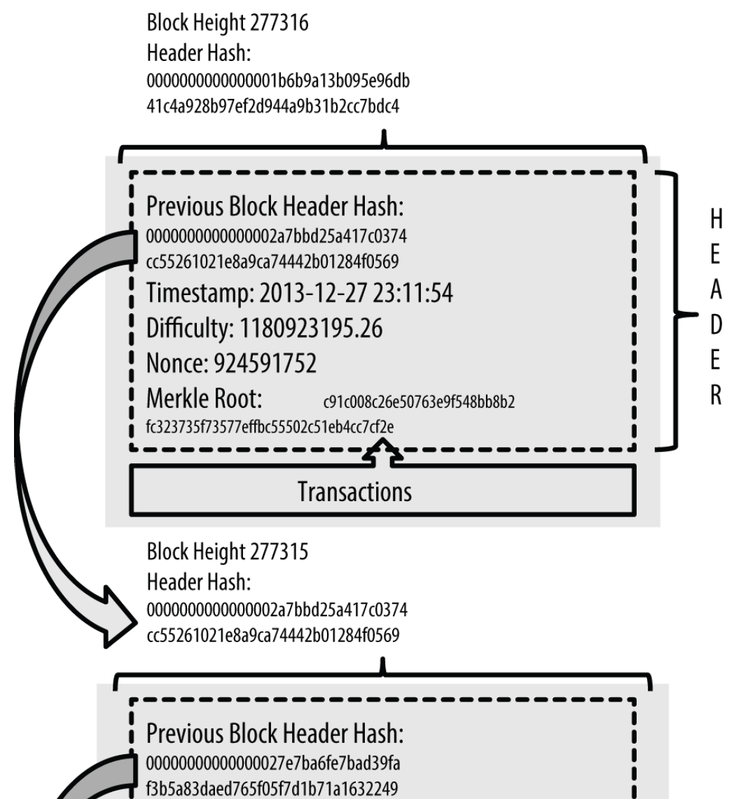
The Blockchain
An ordered back-linked list of blocks of transactions
Each block identified by SHA256 of its header
The header contains a parent header and thereby affects the hash
(Can be referenced by the height as well)
Each block references a parent block
The genesis block = the first block ever
Notes:
In flat file or simple DB (LevelDB)
When the parent is modified in any way, the parent’s hash changes. The parent’s changed hash necessitates a change in the "previous block hash" pointer of the child. This in turn causes the child’s hash to change, which requires a change in the pointer of the grandchild, which in turn changes the grandchild, and so on. This cascade effect ensures that once a block has many generations following it, it cannot be changed without forcing a recalculation of all subsequent blocks.

Slide 51
Structure Of The Block
Notes:
In flat file or simple DB (LevelDB)
When the parent is modified in any way, the parent’s hash changes. Theparent’s changed hash necessitates a change in the "previous block hash" pointer of the child. This in turn causes thechild’s hash to change, which requires a change in the pointer of the grandchild, which in turn changes the grandchild,and so on. This cascade effect ensures that once a block has many generations following it, it cannot be changed withoutforcing a recalculation of all subsequent blocks.

Slide 52
Structure Of The Header
Notes:
Note that the block hash is not actually included inside the block’s data structure, neither when the block is transmitted
on the network, nor when it is stored on a node’s persistence storage as part of the blockchain. Instead, the block’s hash is
computed by each node as the block is received from the network. The block hash might be stored in a separate database
table as part of the block’s metadata, to facilitate indexing and faster retrieval of blocks from disk.

Slide 53
Merkle Trees (Binary Hash Trees)
A data structure used to efficiently summarizing and verifying the integrity of large dataset
A binary tree containing cryptographic hashes
Need 2 * log₂N calculations to check for element existence

Slide 54
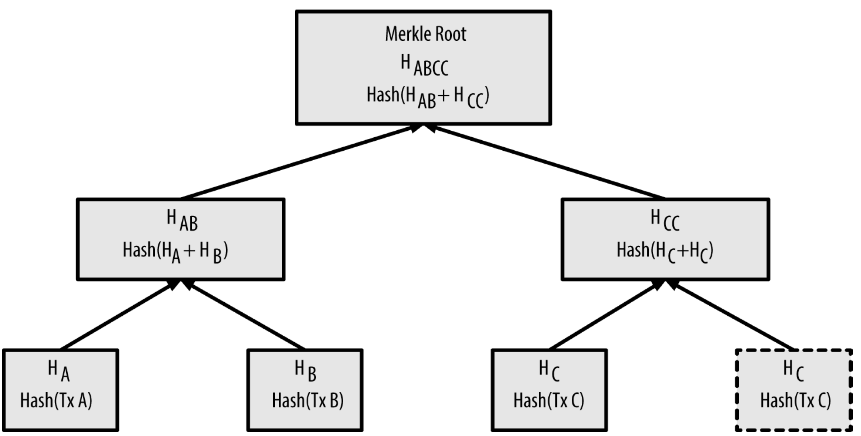
Merkle Trees - Building
Constructed bottom-up
H_{X} = SHA256(SHA256(X))
H_{X+Y} = SHA256(SHA256(H_{X}+H_{Y}))
Notes:
- Double SHA256

Slide 55
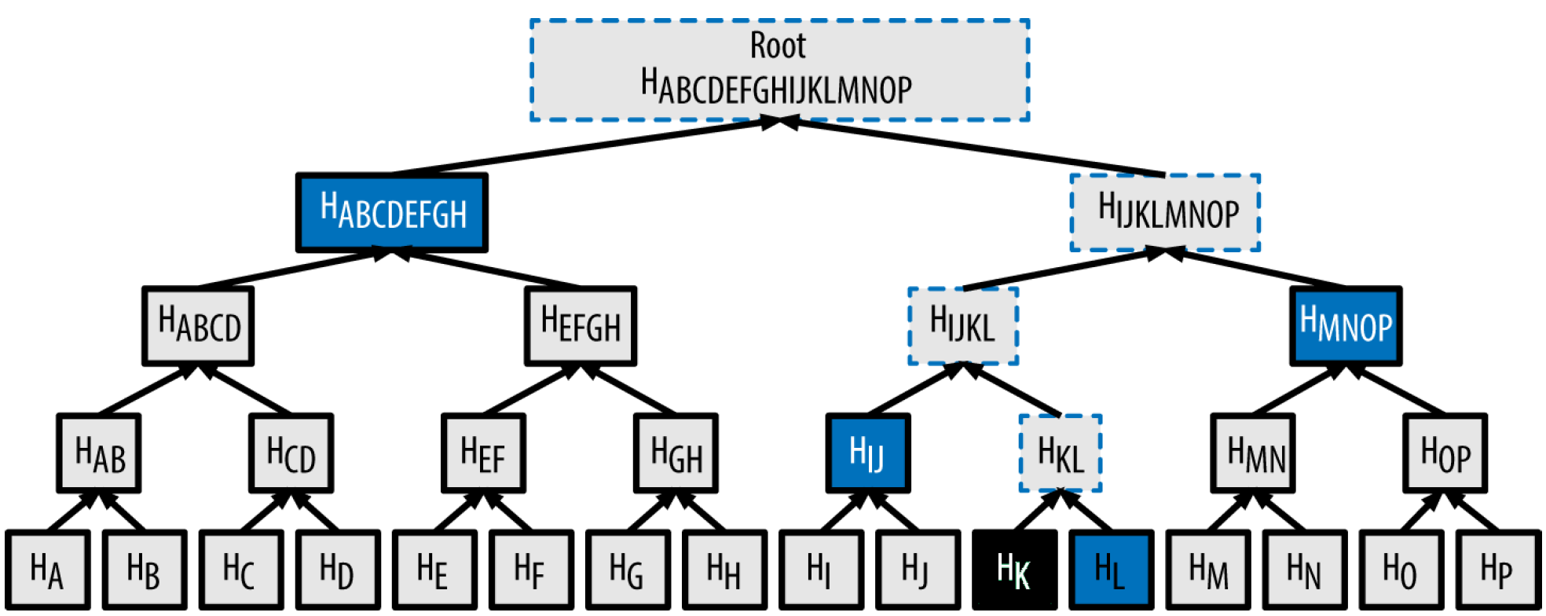
Merkle Trees - Search
Merkle path = authentication path
Notes:
To prove that a specific transaction is included in a block, a node only needs to produce log~2~(N) 32-byte hashes, constituting an authentication path or merkle path
connecting the specific transaction to the root of the tree

Slide 56
Merkle Trees in SPV
SPV = Simplified Payment Verification
Merkle path used for verification of a transaction inside a block
Notes:
Consider, for example, an SPV node that is interested in incoming payments to an address contained in its wallet. TheSPV node will establish a bloom filter (see [bloom_filters]) on its connections to peers to limit the transactions received toonly those containing addresses of interest. When a peer sees a transaction that matches the bloom filter, it will send thatblock using a merkleblock message. The merkleblock message contains the block header as well as a merkle path thatlinks the transaction of interest to the merkle root in the block. The SPV node can use this merkle path to connect thetransaction to the block and verify that the transaction is included in the block. The SPV node also uses the block headerto link the block to the rest of the blockchain.

Slide 57
Mining & Consensus

Slide 58
Mining
A decentralized mechanism of clearing and validation of transactions
Enables consensus without central authority
Miners validate and record transactions on the global ledger
Rewards for miners: A coinbase/block reward and transaction fee
Miners compete in solving a difficult math problem based on hash
Proof-of-Work = solution to the problem
The maximum amount of newly created BTCs halves every 210k blocks (~ 4 years)
Notes:
Bitcoin miners also earn fees from transactions. Every transaction usually includes a transaction fee, in the form of asurplus of bitcoin between the transaction’s inputs and outputs. The winning bitcoin miner gets to "keep the change" onthe transactions included in the winning block. Today, the fees represent 0.5% or less of a bitcoin miner’s income, thevast majority coming from the newly minted bitcoin. However, as the block reward decreases over time and the numberof transactions per block increases, a greater proportion of bitcoin mining earnings will come from fees. Gradually, themining reward will be dominated by transaction fees, which will form the primary incentive for miners. After 2140, theamount of new bitcoin in each block drops to zero and bitcoin mining will be incentivized only by transaction fees.
The most important and debated consequence of fixed and diminishing monetary issuance is that the currency tends to beinherently deflationary. Deflation is the phenomenon of appreciation of value due to a mismatch in supply and demand thatdrives up the value (and exchange rate) of a currency. The opposite of inflation, price deflation, means that the money hasmore purchasing power over time.

Slide 59
Decentralized Consensus
Bitcoin has no central authority
The consensus is an emergent artifact of the asynchronous interaction of independent nodes all following simple rules

Slide 60
Independent Transaction Verification
Each node validates forwarded transactions agains many criterias
Syntax, non-empty inputs/outputs, values in ranges, …
Notes:
wallet software creates transactions by collecting UTXO, providing the appropriate unlocking scripts, and then constructing new outputs assigned to a new owner. The resulting transaction is then sent to the neighboring nodes in the Bitcoin network so that it can be propagated across the entire Bitcoin network.

Slide 61
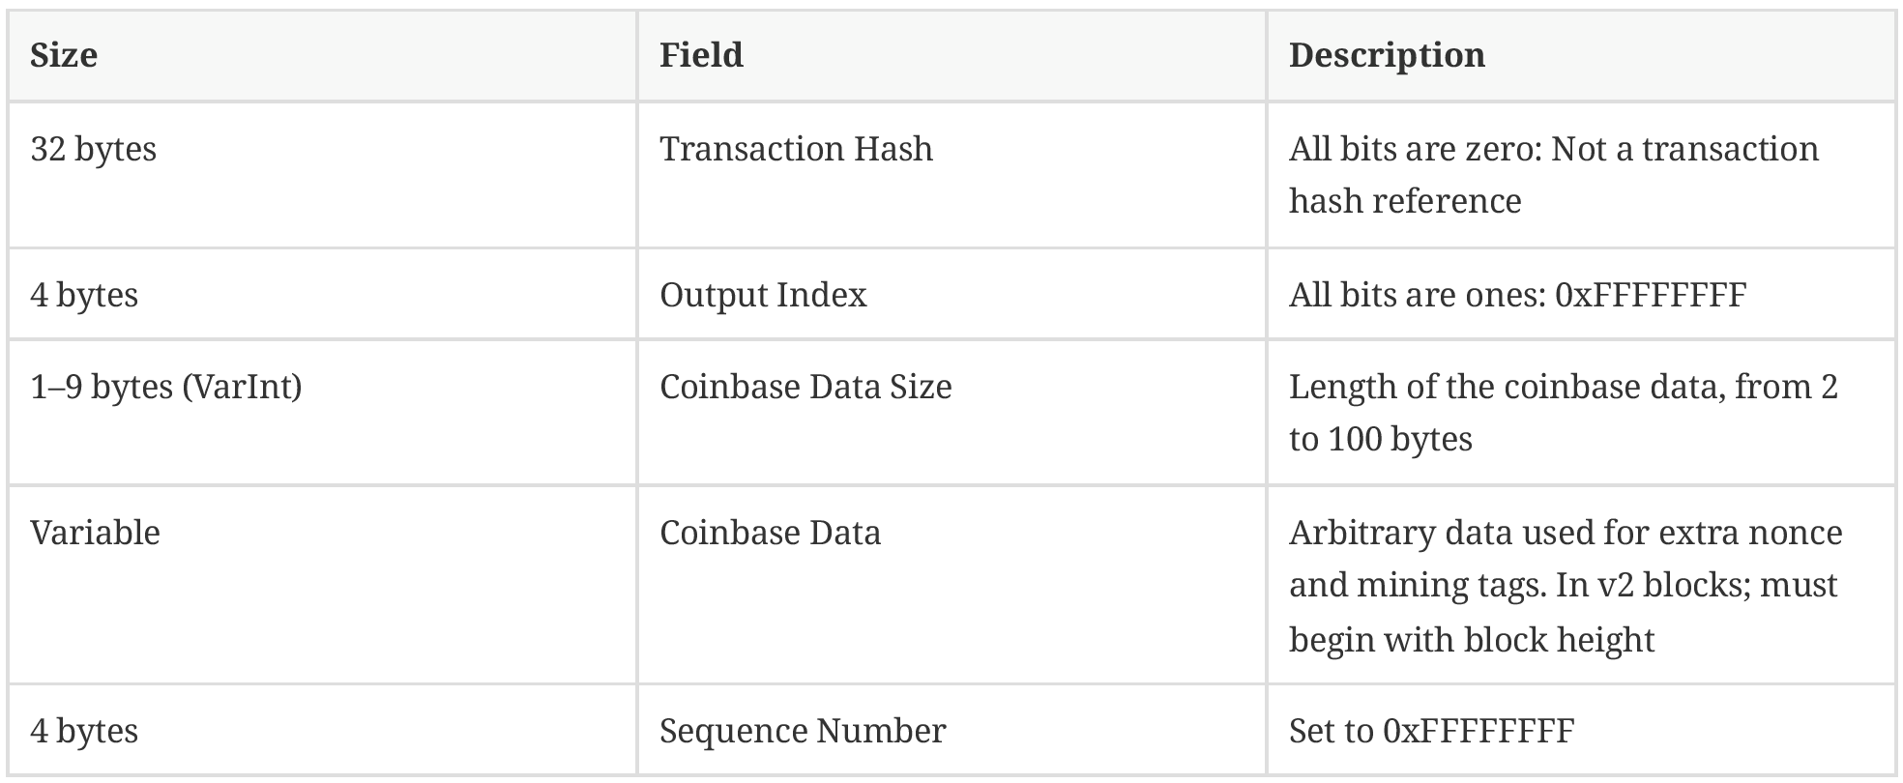
Aggregating Transactions Into Blocks
After validation, transactions added into memory pool
Transaction aggregated into a candidate block
Adding the coinbase transaction
Does not consume UTXO inputs

Slide 62
Proof-of-Work Algorithm
Hashing the block header repeatedly, changing one parameter until the resulting hash matches a specific target
Nonce = A number used to vary outputs of the hash function

Slide 63
Adjusting Difficulty
The target determines the difficulty of the Proof-of-Work algorithm
The target is set so the mining power result in 10-minutes intervals
Each node retargets the Proof-of-Work algorithm every 2,016 blocks
Compares with expected time and adjust accordingly
To avoid extreme volatility, change is not more than factor of 4

Slide 64
Validating A New Block
An independent validation by every node of the network
Miners cannot cheat
A lot of validation criterias
Syntax, block header hash, block timestamp, block size, coinbase transaction, all transactions are valid
Notes:
The block data structure is syntactically valid
The block header hash is equal to or less than the target (enforces the Proof-of-Work)
The block timestamp is less than two hours in the future (allowing for time errors)
The block size is within acceptable limits
The first transaction (and only the first) is a coinbase transaction
All transactions within the block are valid using the transaction checklist discussed in [tx_verification]
Why don’t miners write themselves a transaction for a thousand bitcoin instead of the correct reward? Because every node validates blocks according to the same rules.

Slide 65
Assembling And Selecting Chains Of Blocks
Once block validated, attempt to assemble chain with most PoW
Nodes maintain main blockchain, secondary blockchains and orphans
Orphan = block without a parent
Received blocks connected to the main/secondary chain
Recorverging to secondary chain if more cumulative work
Consensus by selecting the greatest-comulative-work valid chain
“Voting” which chain is the main – extending the chain with a new block is the vote
Notes:
blocks that do not have a known parent in the known chains (orphans).

Slide 66
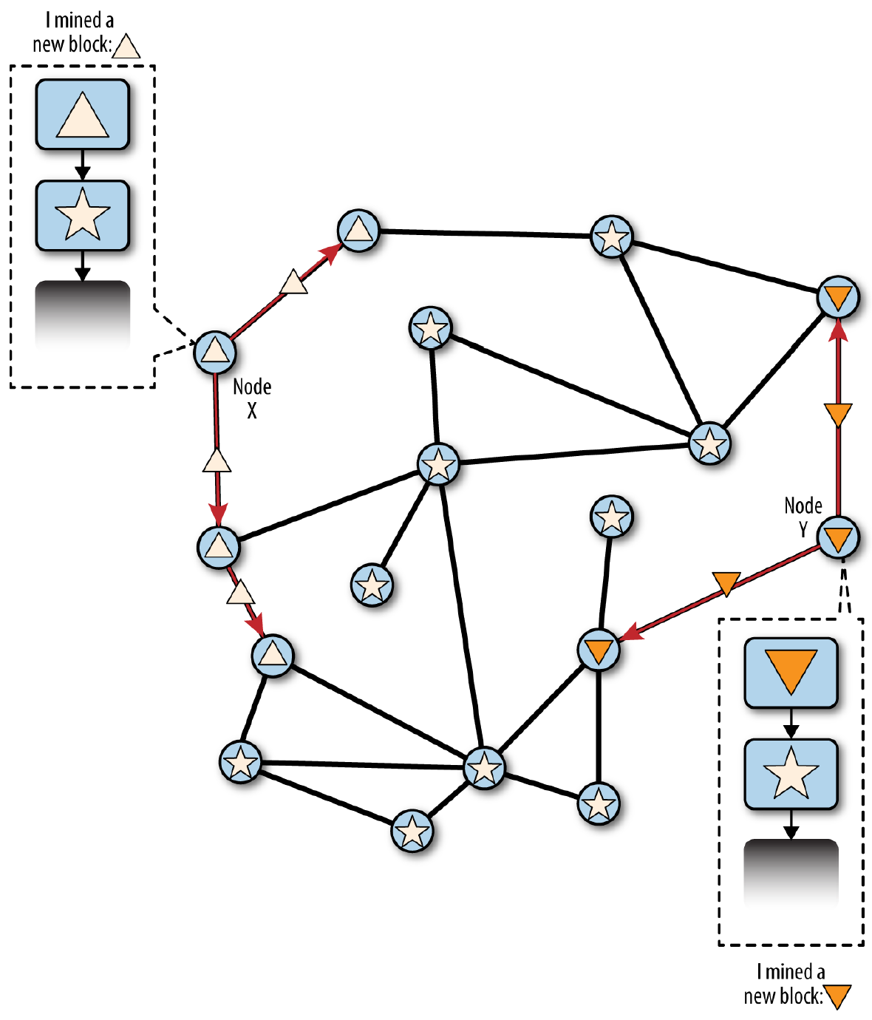
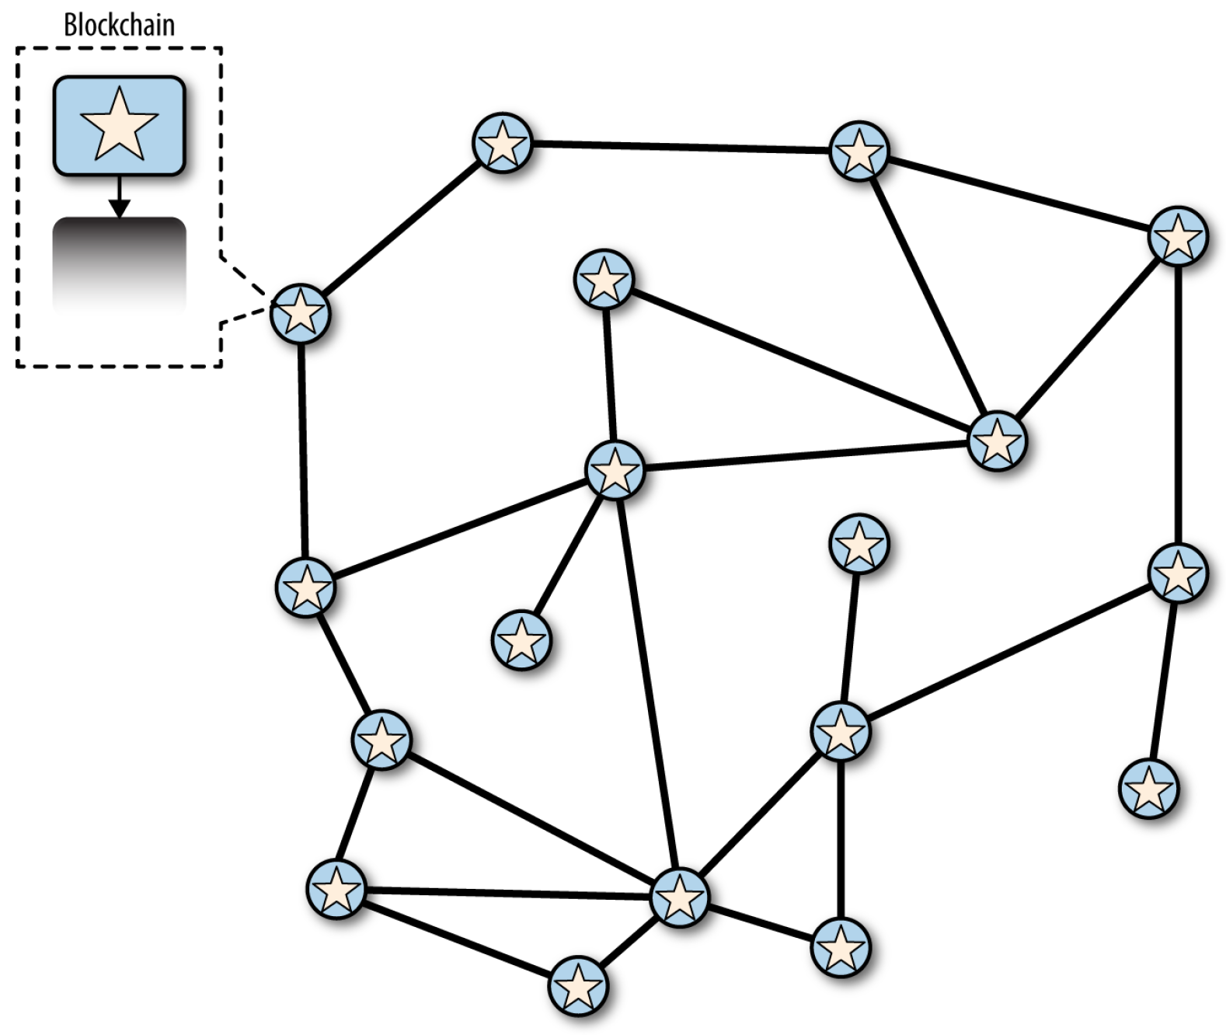
Forks
Different copies of blockchain not always consistent, e.g., delays

Slide 67
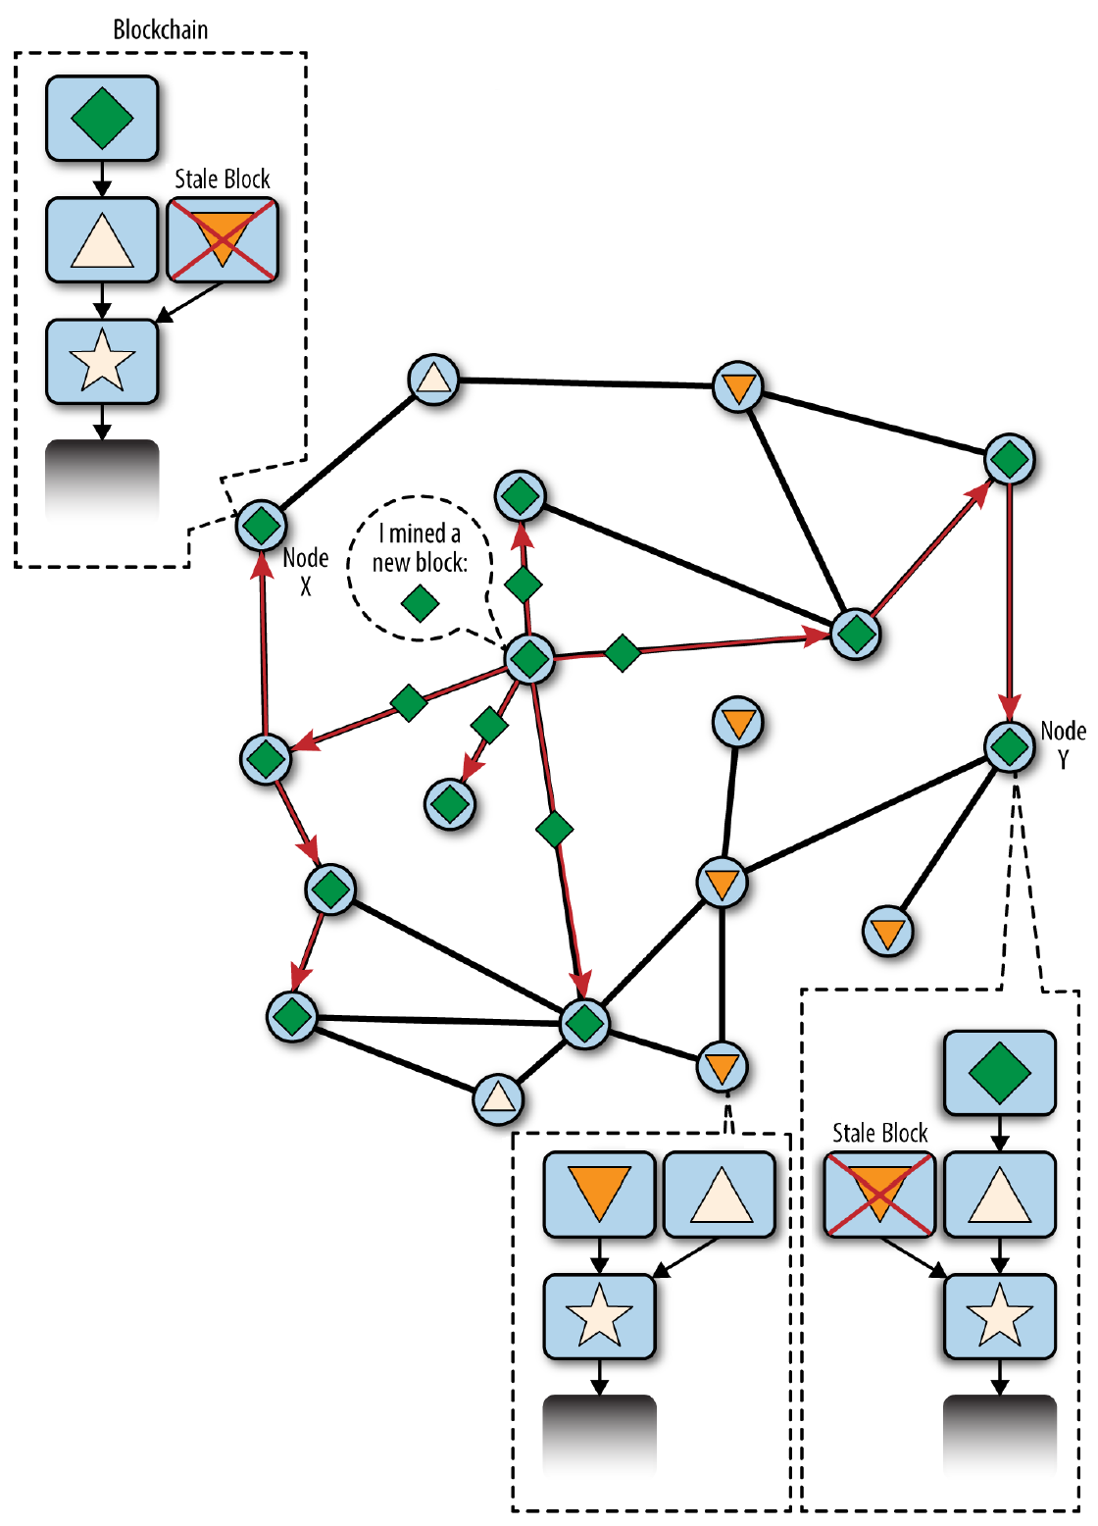
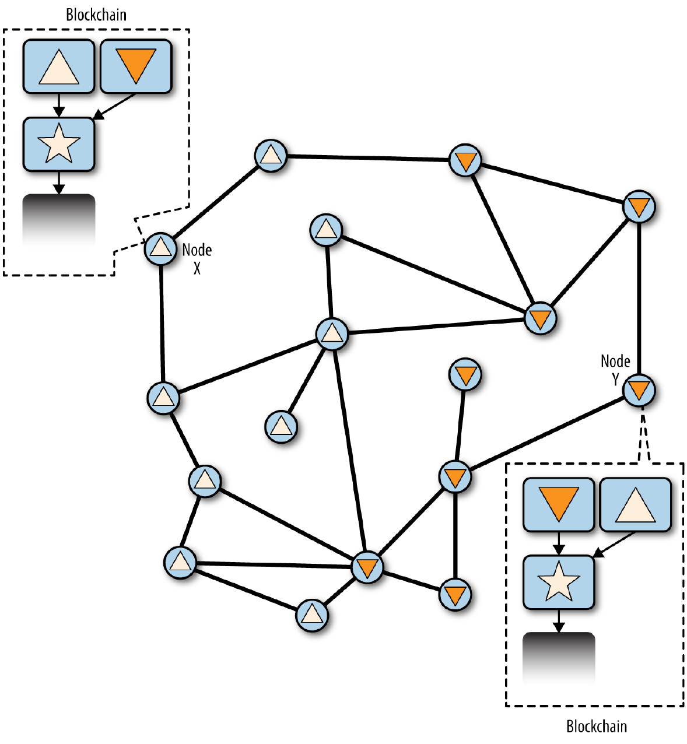
Fork Resolution
Notes:
It is theoretically possible for a fork to extend to two blocks, if two blocks are found almost simultaneously by miners on
opposite "sides" of a previous fork. However, the chance of that happening is very low. Whereas a one-block fork might
occur every day, a two-block fork occurs at most once every few weeks.

Slide 68
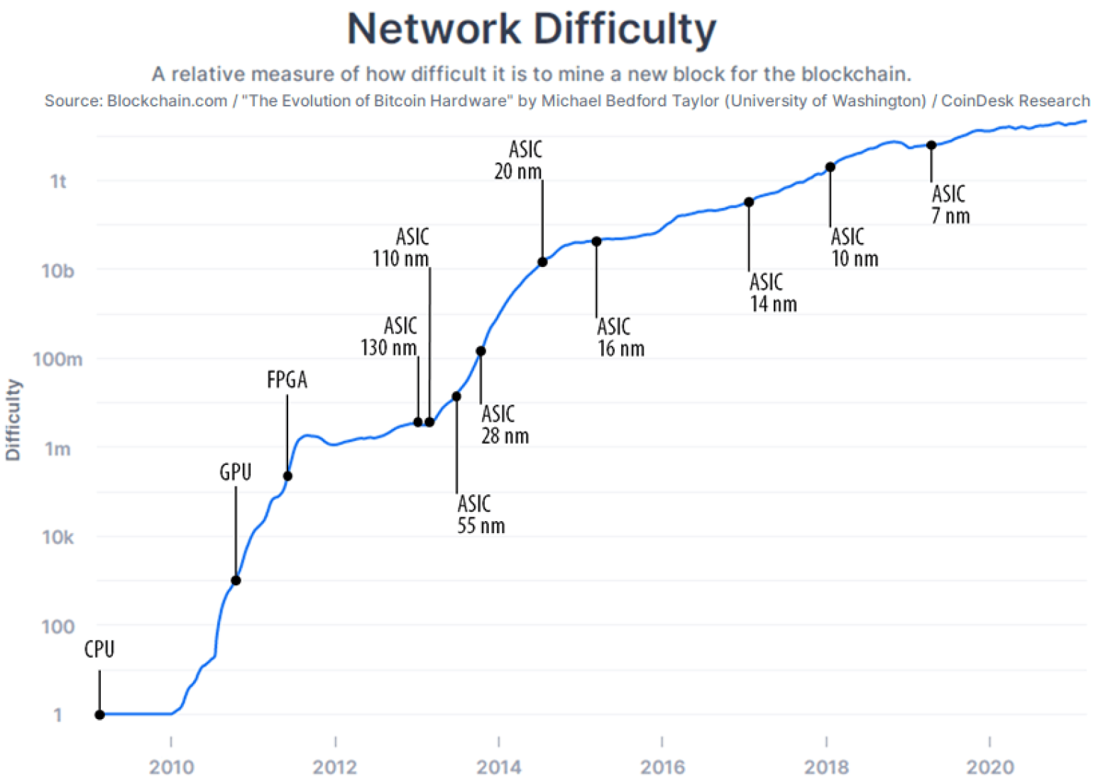
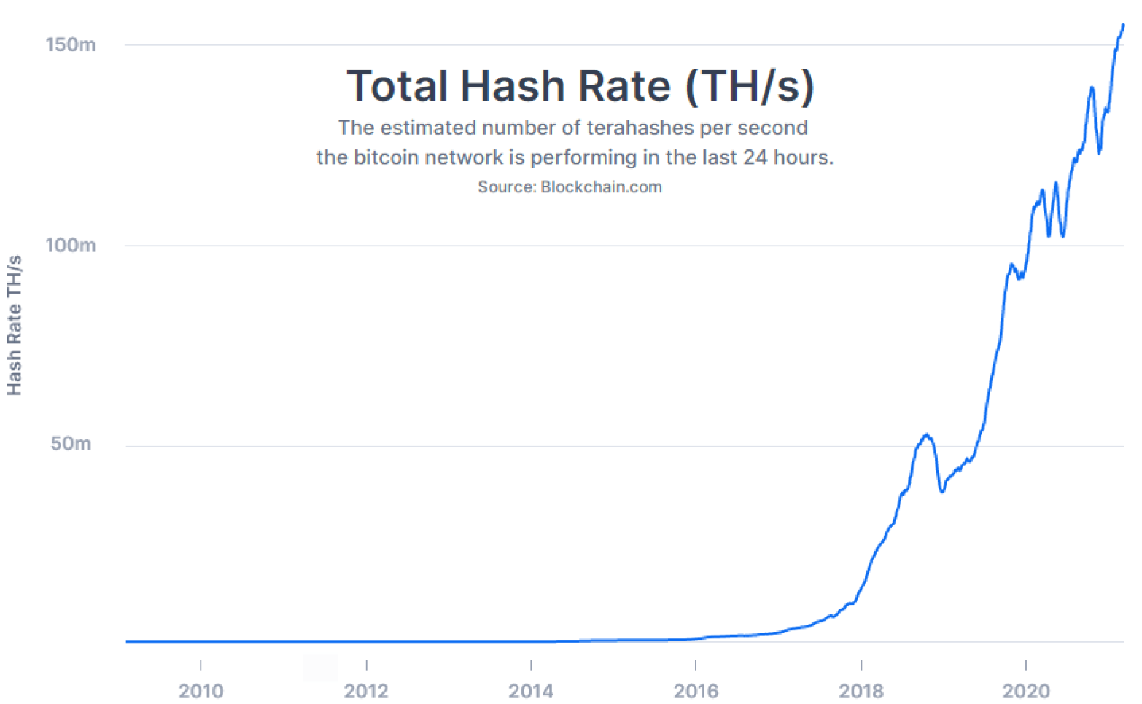
Mining Race
Mining related to the cost of electricity
The hashing power increased exponentionaly (Moore’s Law)
CPU → GPU → FPGA → ASIC
The extra nounce solution
Notes:
The difficulty of mining is closely related to the cost of electricity and the exchange rate of bitcoin vis-a-vis the currency
used to pay for electricity. High-performance mining systems are about as efficient as possible with the current
generation of silicon fabrication, converting electricity into hashing computation at the highest rate possible. The
primary influence on the mining market is the price of one kilowatt-hour of electricity in bitcoin, because that
determines the profitability of mining and therefore the incentives to enter or exit the mining market.

Slide 69
Mining Pools
Solo miners have no chance any longer
E.g., P = (14 * 10¹² / 3 * 10¹⁸) * 210,240 = 0.98
HW with 14TH/s ~ $2,500 + $1.5/day for electricity
3EH/s – network wide hashing rate
210,240 – number of blocks in 4 years
Managed pools
Pool operator
P2Pool
No central operator
Blockchain like system, e.g., sharechain
Notes:
TODO: make up-to-date computation
Mining pools coordinate many hundreds or thousands of miners, over specialized pool-mining protocols. The individual
miners configure their mining equipment to connect to a pool server, and specify a Bitcoin address, which will receive
their share of the rewards. Their mining hardware remains connected to the pool server while mining, synchronizing
their efforts with the other miners. Thus, the pool miners share the effort to mine a block and then share in the rewards.

Slide 70
Consensus Attacks
Attack future or recent past (~ tens of blocks)
Large computation power needed for very deep forks
Causes DoS, cannot steal bitcoins

Slide 71
51% Attack
Majority of miners (51%) can cause deliberate forks
Theoretically ~30% of hashing power should be enough
Double spend on attackers transactions
Wait >= 6 confirmations, or
Multisignature account with few confirmations
DoS of addresses
Ignore specific addresses
Notes:
Security research groups have used statistical modeling to claim that various types of consensus attacks are possible with as little as 30% of the hashing power.
thecentralization of control caused by mining pools has introduced the risk of for-profit attacks by a mining pool operator.The pool operator in a managed pool controls the construction of candidate blocks and also controls which transactions are included. This gives the pool operator the power to exclude transactions or introduce double-spend transactions.

Slide 72
Changing Consensus Rules
Hard forks
Not forward compatible changes
Change of consensus rules (a bug, modification)
Software forks (Bitcoin XT, Bitcoin Classic, Bitcoin Unlimited)
Forcing minority to upgrade or stay on a minority chain
Potentially creating two competing systems
Soft forks
Forward compatible change (non-upgraded clients continue to operates)
E.g., redefining NOP opcodes
Notes:
Technical debt,
Validation relaxation
Irreversible upgrades

Slide 73
Blockchain Applications

Slide 74
Applications
Digital Notary
Proof-of-existence - providing a proof that a document existed at the time recorded
Lighthouse
Crowdfunding application
Namecoin
Decentralized name registration database
Colored coins
A protocol for creating your own digital currencies (tokens)
Publicaly assigning a color to a specific UTXO
Metacoin
A protocol with a different state function, i.e., APPLY(S, TX) = S instead of error
Counterparty
A protocol for creating/trading/exchange virtual assets and tokens
Embeds metadata using OP_RETURN or multisignature
Platform for other applications, e.g., Spells of Genesis, Folding Coin
Payment Channels
Notes:
Namecoin - created in 2010, Namecoin is best described as a decentralized name registration database. In decentralized protocols like Tor, Bitcoin and BitMessage, there needs to be some way of identifying accounts so that other people can interact with them, but in all existing solutions the
Only kind of identifier available is a pseudorandom hash like1LW79wp5ZBqaHW1jL5TCiBCrhQYtHagUWy. Ideally, one would like to be able to have an
account with a name like "george". However, the problem is that if one person can create an
account named "george" then someone else can use the same process to register "george" for
themselves as well and impersonate them. The only solution is a first-to-file paradigm, where the
first registrant succeeds and the second fails - a problem perfectly suited for the Bitcoin consensus
protocol. Namecoin is the oldest, and most successful, implementation of a name registration
system using such an idea.
Colored coins - the purpose of colored coins is to serve as a protocol to allow people to create their
own digital currencies - or, in the important trivial case of a currency with one unit, digital tokens
on the Bitcoin blockchain. In the colored coins protocol, one "issues" a new currency by publicly
assigning a color to a specific Bitcoin UTXO, and the protocol recursively defines the color of other
UTXO to be the same as the color of the inputs that the transaction creating them spent (some
special rules apply in the case of mixed-color inputs). This allows users to maintain wallets
containing only UTXO of a specific color and send them around much like regular bitcoins,
backtracking through the blockchain to determine the color of any UTXO that they receive.
From a technical standpoint, the Bitcoin ledger can be thought of as a state transition system, where there is
a "state" consisting of the ownership status of all existing bitcoins and a "state transition function" that takes
a state and a transaction and outputs a new state which is the result.
Metacoins - the idea behind a metacoin is to have a protocol that lives on top of Bitcoin, using
Bitcoin transactions to store metacoin transactions but having a different state transition function,
APPLY'. Because the metacoin protocol cannot prevent invalid metacoin transactions from
appearing in the Bitcoin blockchain, a rule is added that if APPLY'(S,TX) returns an error, the
protocol defaults to APPLY'(S,TX) = S. This provides an easy mechanism for creating an arbitrary
cryptocurrency protocol, potentially with advanced features that cannot be implemented inside of
Bitcoin itself, but with a very low development cost since the complexities of mining and networking
are already handled by the Bitcoin protocol.

Slide 75
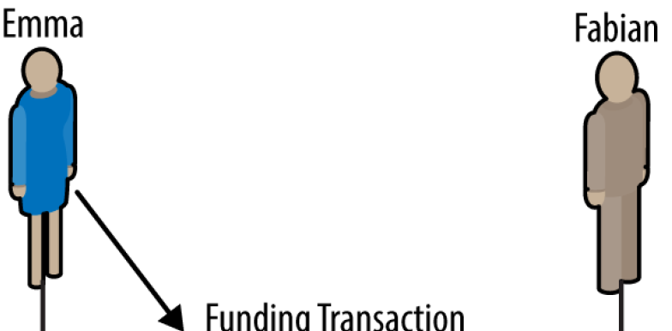
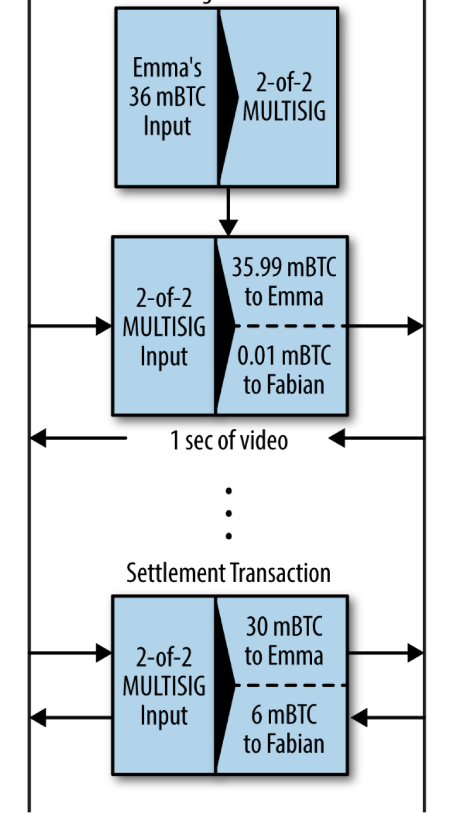
State Channels
Mechanism for exchanging transactions between two parties held off-chain
Established by funding transaction that locks a shared state on blockchain
Exchanging commitment transactions off-chain
Closing channel using settlement transaction on blockchain
Problems:
What if Fabian disappears?
What if Emma transmits a commitment transaction into blockchain?
Notes:
Virtual channel - similar to TCP
Emma cannot risk funding a 2-of-2 multisig unless she has a guaranteed refund. To solve this problem, Emma constructsthe funding and refund transactions at the same time. She signs the funding transaction but doesn’t transmit it toanyone. Emma transmits only the refund transaction to Fabian and obtains his signature.

Slide 76
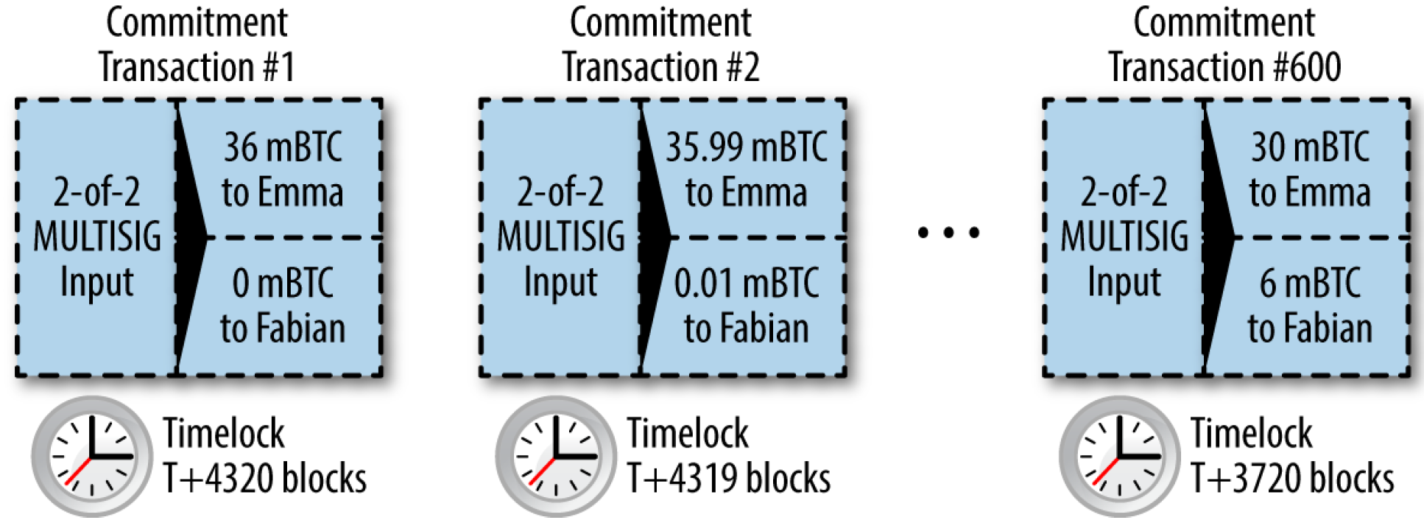
Trustless Channels
Create funding + refund transaction
Use refund transaction as commitment
Set nLockTime as upper bound of the channel’s life
Notes:
By establishing a maximum timelock when the channel is first opened, they limit the lifetime of the channel. Worse, they
force channel implementations to strike a balance between allowing long-lived channels and forcing one of the
participants to wait a very long time for a refund in case of premature closure
The second problem is that since each subsequent commitment transaction must decrement the timelock, there is an
explicit limit on the number of commitment transactions that can be exchanged between the parties

Slide 77
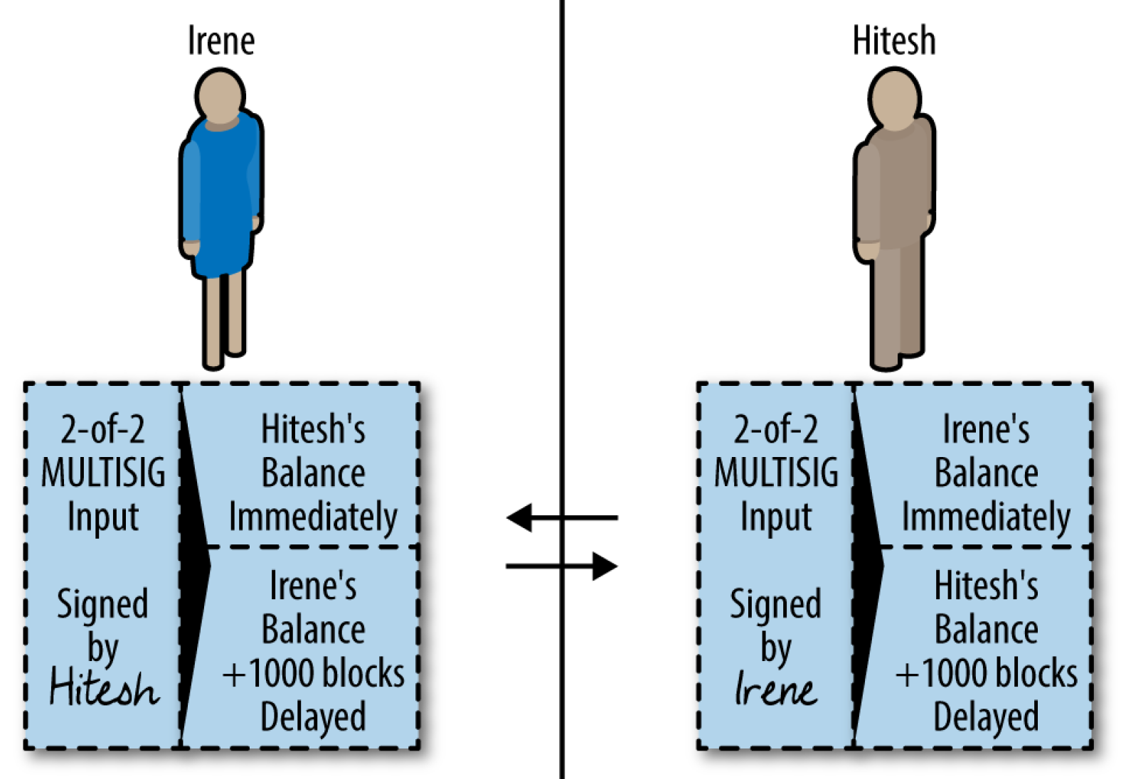
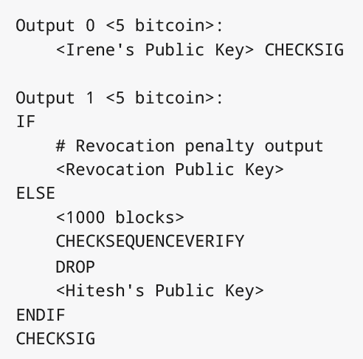
Asymmetric Revocable Commitments
Establish channel with a funding transaction
Participants create a single asymmetric transaction each
Input: 2-of-2 funding output, signed by the other party
Output 0: return funding to the other party immediately
Output 1: return funding to yourself delayed
Include a revocation key
Allows to punish the cheater by taking the entire balance
Two secret halves generated by each participant + shared public key
Notes:
The only way to cancel a transaction is by double-spending its inputs with another transaction before it is mined
In each round, both parties reveal their half of the revocation secret to the other party, thereby giving the other party
(who now has both halves) the means to claim the penalty output if this revoked transaction is ever broadcast.
The revocation protocol is bilateral, meaning that in each round, as the channel state is advanced, the two parties
exchange new commitments, exchange revocation secrets for the previous commitments, and sign each other’s new
commitment transactions. As they accept a new state, they make the prior state impossible to use, by giving each other
the necessary revocation secrets to punish any cheating.

Slide 78
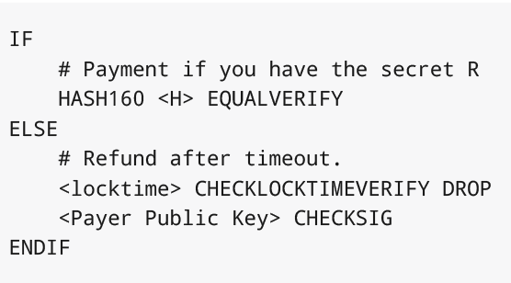
Hash Time Lock Contracts (HTLC)
Commit funds to a redeemable secret with an expiration time
The recipient creates a secret and hash
HTLC can be redeemed by anyone who knows the secret

Slide 79
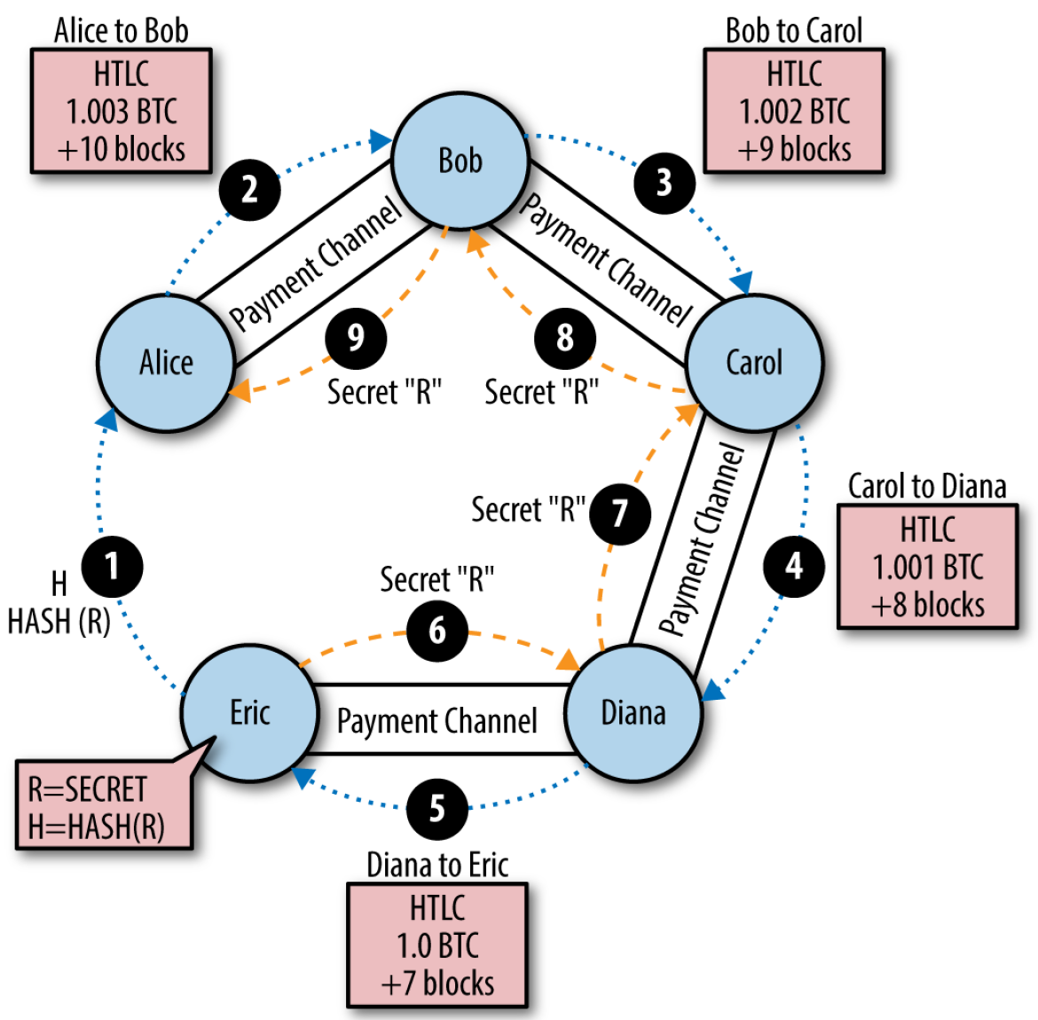
Lightning Network
A network of bidirectional end-to-end payment channels
To route payment from channel to channel without trusting any of the intermediaries
Alice is committing 1.003 of her channel balance to be paid to Bob if Bob knows the secret, or refunded back to Alice’s balance if 10 blocks elapse.
Notes:
Alice wants to pay Eric 1 bitcoin. However, Alice is not connected to Eric by a payment channel
"Alice is committing 1.003 of her channel balance to be paid to Bob if Bob knows the secret, or refunded back to
Alice’s balance if 10 blocks elapse."

Slide 80
Lightning Network - Routing
Route is known to Alice’s node only
Using onion-routed protocal based on Sphinx scheme
Intermediate nodes can verify their portion and find next hop
Nodes know only previous and next hop
Cannot identify a length of the path
No exit nodes, the payment updates channel balances only
Messages are padded to 20 hops
Message from Alice to Eric
wrapped in message encrypted to Diana with Eric as recipient
wrapped in message encrypted to Carol with Diana as recipient
…
Notes:
Using this onion-routed protocol, Alice wraps each element of the path in a layer of encryption, starting with the end andworking backward. She encrypts a message to Eric with Eric’s public key. This message is wrapped in a messageencrypted to Diana, identifying Eric as the next recipient.

Slide 81
Lightning Network Benefits
Used with any blockchain supporting multisignature, timelocks and smart contracts
Better privacy
Speed – transactions settled in milliseconds (HTLC are not commited to the block)

