Slide 1
Fundamental Principles of Modern Parallel Programming
NPRG042 Programming in Parallel Environment
Martin Kruliš

Slide 2
OS Multitasking and Multiprocessing
Operating system
  Manages processes (threads) and hardware resources (CPU cores)
  Uses scheduling algorithms to assign computing resources to scheduling units
Multitasking
  Concurrent executions of multiple processes
Multiprocessing
  Multiple CPUs (cores) in one system
  More challenging for the scheduler
  Affinity

Slide 3
OS Scheduling States (Refresher)
Created
  Awaits admission
Terminated
  Until the parent process reads the result
Ready
  Wait for scheduling
Running
  CPU assigned
Blocked
  Wait for resources
Created
Terminated
(zombie)
Running
Ready
Blocked

Slide 4
Multitasking (Refresher)
Cooperative
  Unit of scheduling must explicitly and voluntarily yield control
  All processes must cooperate
    Special systems
  Scheduling in OS reduced on starting the process and making context switch after the yield
    OS does not initiate a context switch
Preemptive
  Each running unit of scheduling has an assigned time slice
  OS needs some external source of interrupt (HW timer)
  If the unit of scheduling blocks or is terminated before the time slice ends, nothing of interest happens
  If the unit of scheduling consumes the whole time slice
    interrupted by the external source
    changed to READY state
    OS will make a context switch

Slide 5
OS Scheduling (Refresher)
Objectives
  Maximize/optimize CPU utilization (based on the workload)
  Fair allocation of CPU
  Maximize throughput
    Number of processes that complete their execution per time unit
  Minimize turnaround time
    The amount of time taken by a process to finish
  Minimize waiting time
    Time a process waits in the READY state
  Minimize response time
    Time to respond in interactive applications
Notes:
Also note, that different applications (scheduling units) may have different objectives of their own (e.g., computing threads vs GUI interactive threads).

Slide 6

Scheduling

Slide 7
OS Scheduling – Priority (Refresher)
Priority
  A number expressing the importance of the process
  Unit of scheduling with greater priority should be scheduled before (or more often than) unit of scheduling with lower priority
  The priority of the process is the sum of a static priority and dynamic priority
    Static priority
      Assigned at the start of the process
        Users’ hierarchy or importance
    Dynamic priority
      Adding fairness to the scheduling
      Once in a time, the dynamic priority is increased for all READY units of scheduling
      The dynamic priority is initialized to 0 and is reset to 0 after the unit of scheduling is scheduled for execution

Slide 8
OS Scheduling Algorithms
Completely fair scheduler (CFS)
  Implemented in Linux kernel
    Currently the default scheduler
  SUs are stored in a red-black tree
    Indexed by their total execution time (called virtual runtime)
    One tree per CPU core
  Maximum execution time
    A time slice calculated for each unit
    Total waiting time divided by the current number of processes
      The longer it waits, the greater
  Scheduling algorithm
    The leftmost node in the RB tree is selected (lowest virtual runtime)
    If the process completes its execution, it is removed from the schedule
    If the process reaches its maximum execution time or is somehow stopped or interrupted, it is reinserted into the tree with a new time key
      Actual time spent on the CPU is added to the virtual runtime
  Virtual runtime decays over time
Notes:
https://developer.ibm.com/tutorials/l-completely-fair-scheduler/
The virtual runtime decays over time. The rate of the decay is determined by the static priority assigned to the process.

Slide 9
Process vs. Thread
Process
  Code (loaded in memory)
  Memory space
  Other system resources
    File handles
    Network sockets
    Synchronization primitives
    …
Thread
  Position in code (program counter)
  Own stack (rest is shared)
  Access to some system resources may require synchronization
  CPU state
    Must be saved when thread is removed from CPU core and reloaded when the thread resumes

Slide 10
Threads
Thread from coding perspective
  A handle representing the OS-allocated thread
    Usually wrapped in an object in traditional OOP languages
  Using the handle, a programmer can perform some operations
    Suspending/resuming the thread
    Affect scheduling slightly (setting priority, yielding the rest of the time slice)
    Waiting for termination, forcefully terminating the thread
  Thread code is a function (delegate, lambda, …)
  Thread can be blocked on synchronization primitives
  Main thread
    Created automatically when the process starts, wraps main() function

Slide 11
Fork Join
Fork-join parallel model
  One of the oldest patterns
    Named after POSIX fork() operation which duplicates the running process
  Pros
    Easy to understand and handle
  Cons
    Thread creation is costly
    Join operation blocks the waiting thread
    Fits only limited algorithmic patterns (like divide and conquer)
  Very limited use in modern parallel apps
    When you need a detached thread that lives for a long time

Slide 12
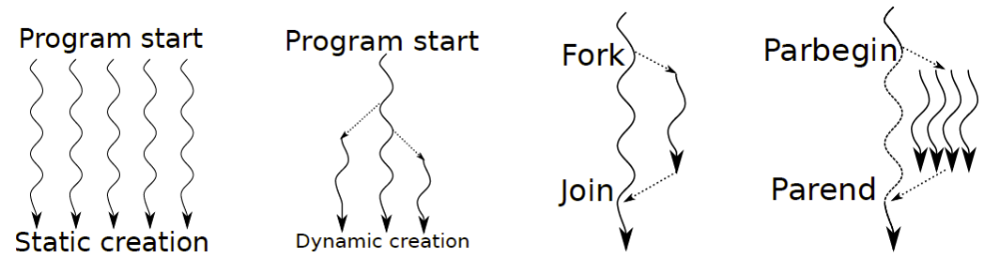
Thread Pool
A pool of re-usable threads
  Threads are not given specific tasks
  They wait for specific tasks to be assigned to them
  Challenges
    How many threads to create
    When to create the threads (and when to join/terminate them)
And this question is even more difficult to answer in heterogeneous systems or when some threads need to be I/O bound.
Notes:
Fig 3.5 from Thomas Rauber,Gudula Rünger: Parallel Programming: For Multicore and Cluster Systems, 2023, ISBN 978-3031289231

Slide 13
Thread Pool
Thread Pool
  All threads execute the same code
    Waiting for a new task, then running it
  Queueing tasks, synchronization
    May involve complex scheduling
  Idle threads
    Are usually blocked on a conditional variable (event) so it does not consume the CPU
  Issue with frequently blocking tasks
    Oversubscription, dynamic expansion
Worker thread pseudo-code
  while (!terminating) {
  t = scheduler.nextTask();
  if (t != null) {
  t.run();
  } else {
  condVar.wait();
  }
  }

Slide 14
Tasks
Task
  An object that represents a piece of parallel work
    Carries both the code (method) and data to be processed (references, indices, …)
  Tasks may have dependencies
    Which tasks must be completed before a task can be executed
  Task spawning
    Only from the main thread (static task scheduling)
    Tasks can spawn other tasks (dynamic task scheduling), the usual choice in current tools
  Task execution
    In the thread pool, scheduling strategies
    Special cases (e.g., enforced execution in UI/main thread).

Slide 15
Tasks
Blocking task spawning
  {
  first_phase();
  var t1 = Task.Run(…);
  var t2 = Task.Run(…);
  Task.WaitAll(t1, t2);
  finalization();
  }
Continuation task spawning
  {
  first_phase();
  var t1 = Task.Run(…);
  var t2 = Task.Run(…);
  Task.WhenAll(t1, t2)...() => {
  finalization();
  }
  }

Slide 16
Tasks
Scheduling
  Task states
    Waiting for dependencies (not a subject of scheduling yet)
    Waiting to be scheduled
    Running (nonpreemptively, but may cooperatively yield)
    Completed (holding result, resolving waiting dependencies…)
  Queue(s) holding tasks to be scheduled
    Global queue (does not scale well, parallel bottleneck)
    Queue per worker thread (difficult to load balance)
  Other considerations
    Which tasks share data (cache optimizations)
Not suitable for heavily blocking code (like I/O)

Slide 17

Scheduling Levels
There are many levels to consider…
Task mapping
Task scheduler
OS scheduler
Higher abstractions (eg., parallel loops)
T1
T2
T3
T4
T5
T6
…
T7
…
T8
T9
Creating, interconnecting, and waiting for tasks
Queues, dependencies
Consumed time, priorities, CPU affinity
fixed

Slide 18
Synchronization
Definition
  Coordination of operations to reach a sequential-like execution result
Types
  Task (work) synchronization
    Task dependencies, barriers, events
  Data synchronization
    Implicit – guaranteed by previous task synchronization
    Explicit – application of synchronization primitives on critical sections
      Mutex, spin-lock, atomic operations
Overhead, limits concurrency

Slide 19

Synchronization primitives
Semaphore and Mutex
  Protected counter and a queue of waiting for US
  Atomic operations UP and DOWN
  Mutex – a semaphore with counter set to 1 (i.e., it’s a bool)
    Operations are usually denoted LOCK and UNLOCK
void down() {
if (counter > 0) --counter;
else {
queue.push(myUS);
myUS.block();
}
}
void up() {
if (counter == 0 && !queue.empty()) {
US = queue.popany();
US.unblock();
}
else ++counter;
}

Slide 20
Syncronization
Atomic operations
  CPU instructions with an atomic execution of a read-update-write operation
    Load/store, increment/decrement, add/sub, and/or/xor, CAS
  Update a single int word (up to 128b for some operations on some archs)
Spin-locks
  Locks implemented using atomic operations with active waiting
bool cas(T* var, T old, T newVal)
{
if (*var != old) return false;
*var = newVal;
return true;
}
int old = *addr, assumed;
do {
assumed = old;
int desired = someFnc(old);
old = cas(addr, assumed, desired);
} while (assumed != old);

Slide 21
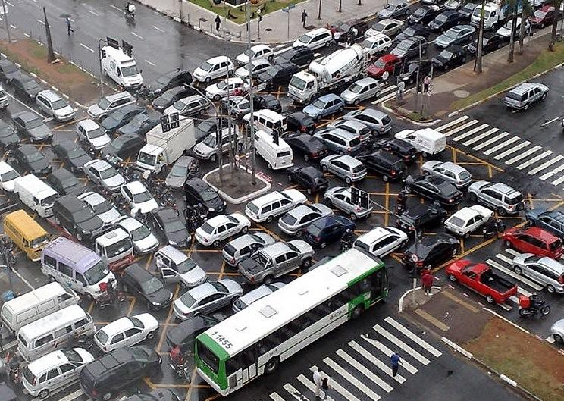

Deadlock

Slide 22
Deadlock
Deadlock
  A state of a group of units of scheduling and resources, where every member of the group waits for an action, which can be performed by other member in the group
Necessary conditions for deadlock (Coffman)
  Mutual exclusion
    At least one resource in exclusive mode
  Hold and wait
    US holding a resource requests for another one
  No preemption
    Resources cannot be reclaimed without harm
  Circular wait
    There is a circle in a deadlock modelling graph
T1
R1
R2
T2

Slide 23
Deadlock – example
Shared mutexes
Mutex m1, m2;
Thread 1
m1.lock();
m2.lock();
m2.unlock();
m1.unlock();
Thread 2
m2.lock();
m1.lock();
m1.unlock();
m2.unlock();
Notes:
Mutexes are exclusive (condition 1)
Both threads acquire 1 lock and then request another (condition 2)
Mutex locks are not preemptive by design (condition 3)
Alernate lock orderings in both threads create the dependency cycle (condition 4)
Solutions – remove one of the Coffman’s conditions
Cannot be removed
We could merge m1 and m2 to m12 (not always possible)
Cannote be removed
We can make total ordering on the mutexes and the threads must always lock in this order (may be difficult to implement).

Slide 24
Smart Broker – Case Study
Architecture diagram
Worker
Monitor
Read-only
Webapp
Async. calls
(multi-threaded)
Worker
Core
Module
Broker
Worker
Scheduling configuration
Basic statistics
(waiting jobs)
Core runs multi-threaded itself
Worker
queues
Rules for job enqueueing
Notes:
The broker handles message (job) dispatching between the application core module and workers. One worker processes one job at a time; waiting jobs are queued by the broker. Monitor polls the broker to provide data (info) directly to the web frontend via WebSocket connection.
Each module accesses the broker asynchronously (i.e., the calls are considered multi-threaded).
Broker has internal scheduling configuration which may change over time (applying self-adaptive protocols) that handles how the jobs are enqueued (there are multiple queues, jobs may have priorities, there is some feedback collected from workers, …).

Slide 25
Smart Broker – Case Study
Queues
  New jobs (from the core) are pushed here
  When a worker becomes available, a job is popped out of the queue
  There may be multiple queues (per worker, per priority, …)
Possible improvement
  Split each queue in two (one for pushing, one for popping)
  At some points, data from the first queue are moved to the second
job
job
Potential risk of deadlock
Notes:
The deadlock can be mitigated by placing a fixed order on locks (if any operation requires both locks, the left one must be acquired before the other one).

Slide 26
Smart Broker – Case Study
Scheduling configuration (rules)
  Required when a new job needs to be placed in one of the queues
    Possibly also when a worker browses for a new job to process
  A background process of the broker monitors the overall situation and may decide to change the configuration once in a while
  Configuration update may take a long time (compared to other operations)
Solution
  Use RW lock
  Multi-versioning with atomic swap of the configuration instance
    The configuration representation must be immutable (once constructed)

Slide 27
Smart Broker – Case Study
Basic operational statistics
  Number of jobs enqueued
    Incremented when a new job comes in, decremented when a worker takes a job
  Number of jobs completed
    Incremented when a worker reports job completion
  Connected workers
    Incremented/decremented when a worker is connected/disconnected
Solutions
  RW lock
  Update/read all variables using atomic operations

Slide 28
Lock Pitfalls
Recursive locking
void updateAll() {
mutex.lock();
updateOne();
...
mutex.unlock();
}
void updateOne() {
mutex.lock();
...
mutex.unlock();
}
Locks and exceptions
  void safeUpdate() {
  mutex.lock();
  update_first();
  // an exception is thrown
  update_another();
  mutex.unlock();
  }
Solution:
1. Use recursive mutex
2. Divide methods to public/private; only public use mutex(es) and the public only call private methods
Solution:
1. Diligent use of try-catch + exception re-throw
2. Use of lock guards (static variables that wrap mutex and unlock it at the end of existence)

Slide 29

Discussion

