Slide 1
Parallel Programming Introduction
NPRG042 Programming in Parallel Environment
Martin Kruliš

Slide 2
Technical Details
Course
  Everything important is here https://www.ksi.mff.cuni.cz/teaching/nprg042-web/
  Join the #nprg042-para channel on Mattermost
Lecture
  Combines PDC theory with an introduction to several technologies
Labs/Seminars alternating every 2 weeks (in the same room)
  Labs (after the technological lectures) – crash courses into the technologies
    Please, bring in your laptops
  Seminars (every other week) – explaining/evaluating home assignments
  Mind the schedule on the web!

Slide 3
Technical Details
Grading
  5 home assignments, all mandatory (at least 1 point from each)
  1-4 points for each assignment based on your speedup
    Reference solutions are calibrated for 3 points
  Beware the deadlines!
    Submit after the deadline must pass the 2-point threshold, but only 1 point is awarded
    No submissions after June 30 (parlab is being used and upgraded over the summer)
  12 or more points (at least 2p from each assignment): excellent (mark 1)
  9-11 points: well done (mark 2)
  6-8 points: ok (mark 3)
  If you have at least 5 points, you can ask for (oral) exam at the end

Slide 4
Literature
Books
  Thomas Rauber,Gudula Rünger: Parallel Programming: For Multicore and Cluster Systems, 2023, ISBN 978-3031289231,
  Peter Pacheco: An Introduction to Parallel Programming, 2011, ISBN 978-0123742605
  T.G.Mattson, B.A.Sanders, B.L.Massingill: Patterns for Parallel Programming, Addison-Wesley, 2005, ISBN 978-0-321-22811-6
  M.McCool, A.D.Robinson, J.Reinders: Structured Parallel Programming, Morgan Kaufmann, 2012, ISBN 978-0-12-415993-8
  Threading Building Blocks, www.threadingbuildingblocks.org
Online sources
  https://tcpp.cs.gsu.edu/curriculum/
  More on the course’s web page

Slide 5
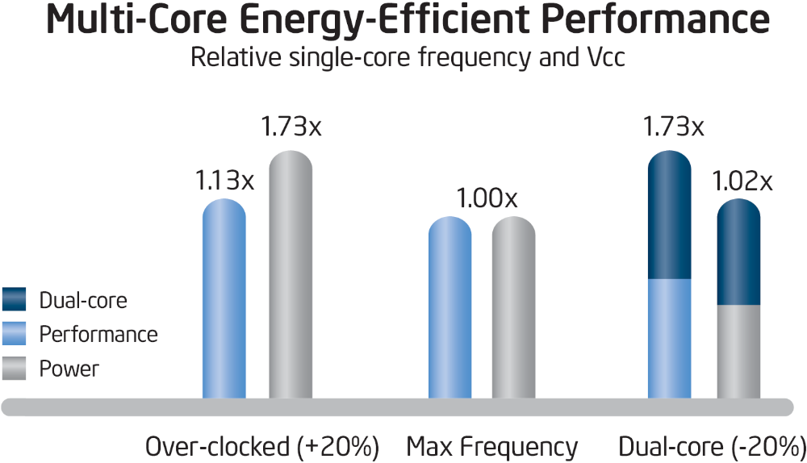
Motivation
Notes:
Taken from Intel research (a few years after 2000).

Slide 6
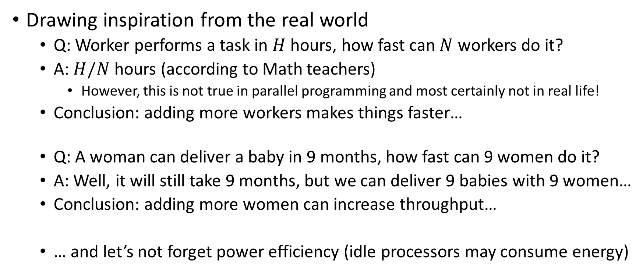
Motivation
Drawing inspiration from the real world
  Q: Worker performs a task in $H$ hours, how fast can $N$ workers do it?
  A: $H/N$ hours (according to Math teachers)
    However, this is not true in parallel programming and most certainly not in real life!
  Conclusion: adding more workers makes things faster…
  Q: A woman can deliver a baby in 9 months, how fast can 9 women do it?
  A: Well, it will still take 9 months, but we can deliver 9 babies with 9 women…
  Conclusion: adding more women can increase throughput…
  … and let’s not forget power efficiency (idle processors may consume energy)

Slide 7
Motivation
Parallelism is difficult…
  … since people (programmers) are not used to think that way
  Quick quiz:
    A family of four (Mom, Dad, Son, and Daughter) needs to pass a narrow tunnel
    They have but 1 candle which lasts 12 minutes
    Dad takes 1 minute, Mom 2m, Son 4m, and Daughter 5m to pass the tunnel
    Two people can walk through the tunnel together at most and their speed is that of the slower person
  As you can see, sometimes we need to let go of the basic assumptions to get a better (optimal) solution

Slide 8
This Course
This course will cover…
  In theory (lectures only)
    Fundamental principles of parallel programming
    Algorithms and patterns used in parallel programming
    Practical examples
    TBA – the theoretical lectures are being re-designed this year
  In theory and practice (lectures, labs, and home assignments)
    Asynchronous programming in C# (tasks)
    Intel Threading Building Blocks (C++)
    OpenMP (C++)
    SYCL and GPGPU (C++)
    Spark (distributed computing in Python)

Slide 9
This Course
This course will not cover…
  Languages and compilers
    You already need to know C#, C++, and Python in detail to pass the course
  Sequential optimizations (recommending NPRG054: HPC SW development)
  Operating systems aspects
    OS scheduler (among others) plays a significant role in the utilization of parallel hardware
    We are focusing on application programming only
  PRAM and other theoretical models
    Although the course has theory included, it focuses on practical parallel programming
    Models like PRAM are not particularly useful
      Unrealistic assumptions, too far from practical programming

Slide 10
Pervasive Concepts
Concurrency
  Property of a (sequentially written) algorithm to execute some operations in parallel (i.e., concurrently)
  Parallelization is the exploitation of concurrency using a given technology
Example:
for (int i = 0; i < 16; ++i)
{
salary[i] *= raise;
}
0
0
1
2
3
0
4
8
12
1
4
5
6
7
1
5
9
13
2
10
8
9
10
11
2
14
…
6
11
12
13
14
15
3
7
15
15
vectorized
executed by 4 threads
serial

Slide 11
Pervasive Concepts
Asynchrony
  Turing machines (as well as beginner programmers) assume that basic operations are performed instantaneously
  That is not true in modern computers even for the most basic operations
  Example: increment operation
...
++x;
...
...
++x;
...
x=1
x=0
x=0
x=1
Core #0
Core #1
L1
L1
x=1
x=0
x=0
x=1
L2
L2
x=1
x=1
x=0
x=0
L3
x=1
x=0
Memory
x=0
x=1

Slide 12
Pervasive Concepts
Locality (of time and space)
  Important concept not only for parallel programming but for many domains outside computer science
  Dividing problems/organization/data/… into smaller units promotes local autonomy and increases efficiency
    Locality of reference makes memory caches effective
  Good localization promotes concurrency
  Localization also inevitably introduces overhead
    Caused by division or aggregation
    Caused by communication
      To build upon the memory caches example – the MOESI protocol

Slide 13
Flynn’s Taxonomy
Single Instruction, Single Data (SISD)
  Traditional von Neumann architecture (truly sequential execution)
Single Instruction, Multiple Data (SIMD)
  Vector processors (SSE, AVX)
Multiple Instruction, Single Data (MISD)
  Very specialized (mission critical) system that increases robustness
Multiple Instruction, Multiple Data (MIMD)
  All modern parallel systems
  Usually expressed as SPMD (single program, multiple data)

Slide 14
MIMD Breakdown
CPU1
CPU2
Shared memory (accessible by all computing units)
  Symmetric multiprocessors (SMP)
    Desktop PCs, laptops, cell phones
    Easiest to program
    Do not scale well, only for a small number of CPUs (cores)
  Nonuniform memory access (NUMA)
    Servers, clusters (like our parlab)
    Uniformly addressable from all CPUs
    Some memory blocks may be physically closer, and the access time significantly varies
    Each CPU has a cache, which mitigates the effect of NUMA
      Cache coherent NUMA (ccNUMA), similar problems to SMP
System bus
RAM
RAM1
RAM3
CPU1
CPU3
CPU2
CPU4
RAM2
RAM4

Slide 15
MIMD Breakdown
Distributed memory
  Each process has its own address space, message passing
  Programmer needs to explicitly handle the communication
    And the distribution of the data
  Massively parallel processors (MPP)
    CPUs and network tightly coupled
  Clusters
    Composed of off-the-shelf computers connected by an off-the-shelf network
    Tightly-coupled clusters (in the same rack/server room)
      Fast communication (the wires can be relatively short)
    Grids – large, heterogeneous, connected via Internet

Slide 16
More Terminology
Task
  Sequence of instructions that perform a larger logical step of an algorithm
    Like a function call
  Usually associated with data (fragments)
Unit of execution (UE)
  Process or thread
  Tasks are mapped to UEs
Processing element (PE)
  HW element that executes a stream of instructions

Slide 17
More Terminology
Load balancing
  How well the work is distributed among processing elements
Synchronization
  Enforcing necessary ordering constraints (usually related to memory ops)
Synchronous vs. asynchronous
  Coupling two events in time
Race condition
  The outcome of a program depends on the scheduling (of units of execution)
Deadlock

Slide 18
Performance
Sequential algorithms
  Usually evaluated using asymptotical time (memory) complexity
Parallel algorithms
  Asymptotical complexity is not enough…
  Scalability – how well the algorithm adapts to adding more processors
  Efficiency – how well the algorithm can utilize processors (what’s the overhead)

Slide 19
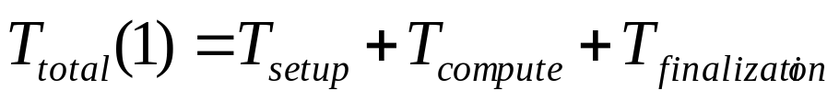
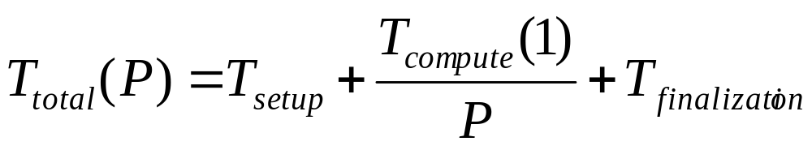
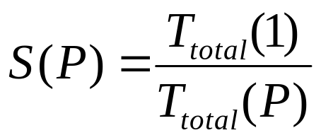
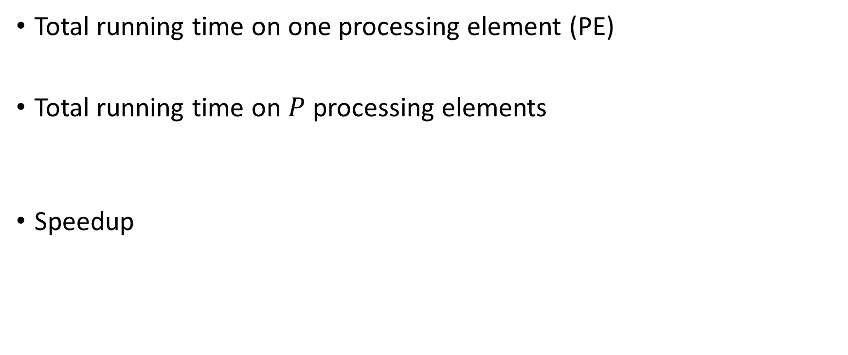
Performance Modeling
Total running time on one processing element (PE)
Total running time on $P$ processing elements
Speedup
Setup and finalization are phases that run sequentially (preparation to run in parallel and aggregation of the results)

Slide 20
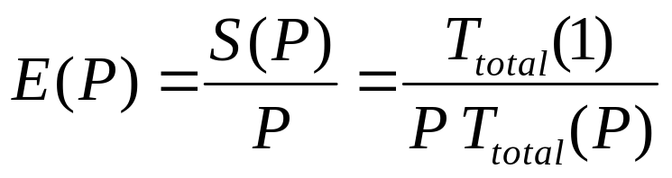
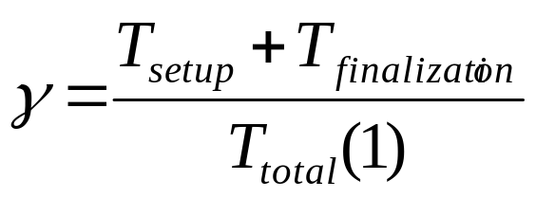
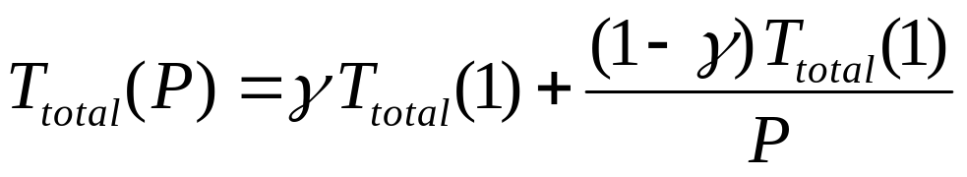
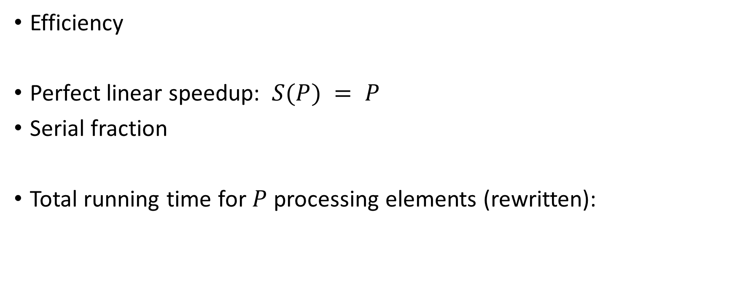
Performance Modeling
Efficiency
Perfect linear speedup: $S(P) = P$
Serial fraction
Total running time for $P$ processing elements (rewritten):
On rare occasions, we can get super-linear speedup: S(P) > P

Slide 21
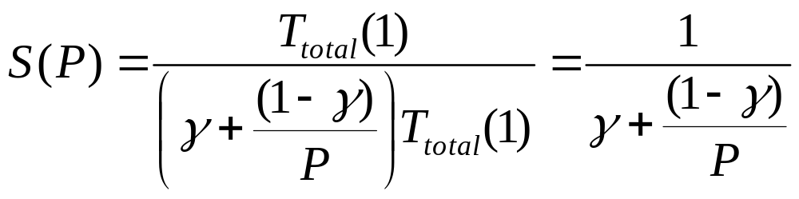
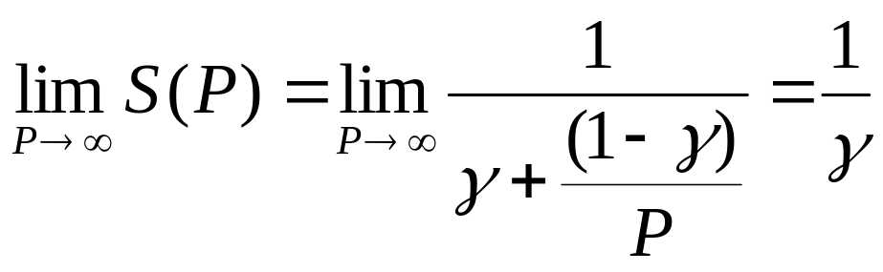
Amdahl’s law
Rewriting the speedup
Assuming no overhead in the parallel part
For very large number of CPUs
Example: Let us have a program, where the serial fraction is only 1%. We will never pass 100x speedup no matter how many CPUs we summon to do our bidding…

Slide 22
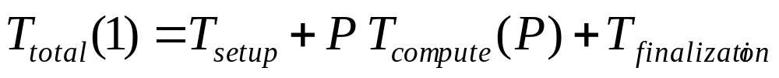
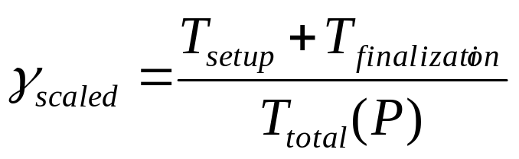
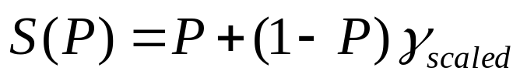
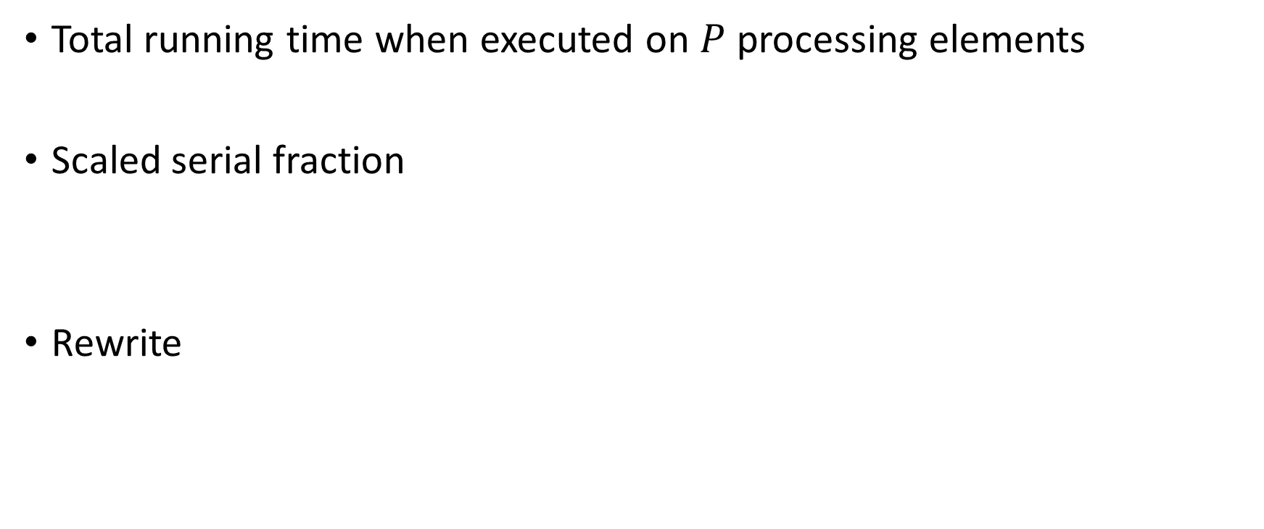
Gustafson’s law
Total running time when executed on $P$ processing elements
Scaled serial fraction
Rewrite
Speedup estimated by Gustafson
(using only the scaled serial fraction)

Slide 23
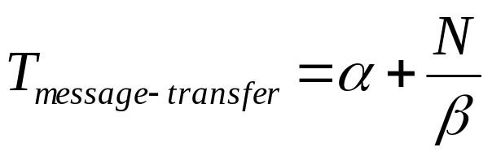
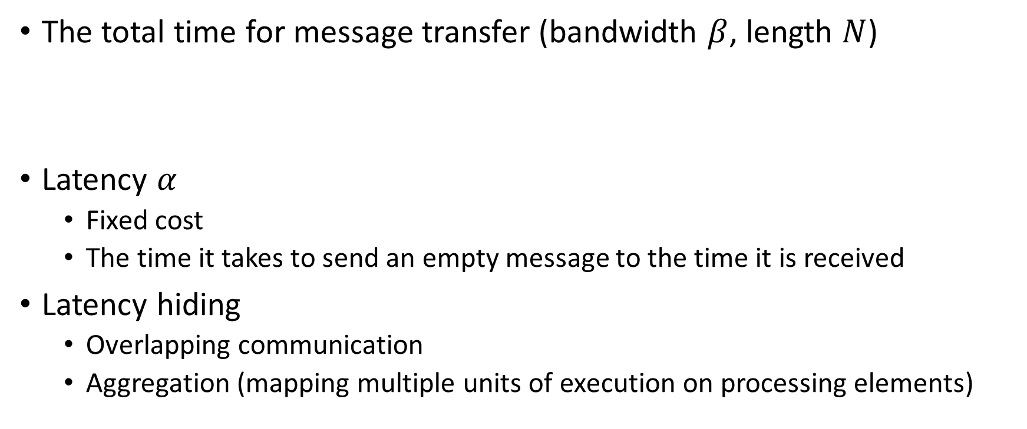
Communication
The total time for message transfer (bandwidth $β$, length $N$)
Latency $α$
  Fixed cost
  The time it takes to send an empty message to the time it is received
Latency hiding
  Overlapping communication
  Aggregation (mapping multiple units of execution on processing elements)

Slide 24

Discussion

