Slide 1
System architecture
Jakub Yaghob
Martin Kruliš

Slide 2
Terminology – 1
Distributed systems
  Host/node/system
    One computer
  Cluster
    A set of nodes connected together by a network
    Usually homogenous
  Grid
    A set of clusters connected by internet

Slide 3
Terminology – 2
One system
  Socket/package
    Physical CPU
    Multiple sockets connected together by a high-speed connection
    Cache hierarchy
    Cores
  NUMA node
    Main memory
    Can contain processing units
  Core
    Owns execution units
    Shared registers
    Contains logical CPUs
  Logical CPU/thread
    Processing unit
    Executes instructions
    Private registers
    Hyper-threading

Slide 4
NUMA system – 4S
MEM0
MEM1
CPU0
CPU1
CPU3
CPU2
MEM3
MEM2

Slide 5
NUMA system – 8S
CPU0
CPU4
CPU1
CPU7
CPU5
CPU3
CPU6
CPU2

Slide 6
NUMA – physical memory layout
Block
Interleaving
NODE0
NODE1
NODE2
NODE3

Slide 7
Simplified package architecture
Package
CORE 0
CORE 1
CORE 2
CORE 3
T0
T4
T1
T5
T2
T6
T3
T7
EU
EU
EU
EU
L1I
L1I
L1I
L1I
L1D
L1D
L1D
L1D
L2
L2
L2
L2
L3/LLC

Slide 8
Cache terminology
Cache line
  Data transferred between memory and cache in atomic blocks
    64B
Cache hit
  Data load/store from/to a cache
Cache line load
  Cache line read from main memory
Cache line flush
  Cache line stored to main memory
Cache miss
  A cache line is selected for eviction
  If it is modified, cache line will be flushed
  The cache line is loaded
False sharing
  Private data of different threads in the same cache line

Slide 9
Cache coherency
Coherency inside the package
  Inclusive x exclusive caches
Coherency between packages
  ccNUMA
  MESI protocol
    Modified, Exclusive, Shared, and Invalid
    Snooping
Cache line ping-pong
  Moving cache line among caches/packages in rapid succession

Slide 10
MESI protocol
R
R/W
M
W
E
R
RX+F
R+F
RX+F
W+RX
R/~S+R
W+RX
S
I
R+F
R/S+R
R
RX+F

Slide 11
Latencies
Action | Cycles | Time (3GHz)
Local L1 cache hit | 4 | 1-2 ns
Local L2 cache hit | 14 | 4-6 ns
Branch misprediction | 16 | 5-6 ns
Local L3 cache hit | 40-75 | 12-40 ns
Mutex lock/unlock |  | 75 ns
Remote L3 | 100-300 | 30-100 ns
Local memory |  | 100 ns
Remote memory |  | 100-300 ns
Send 1KB over FDR InfiniBand |  | 900 ns
Send 1KB over 1GB Ethernet |  | 20000 ns

Slide 12
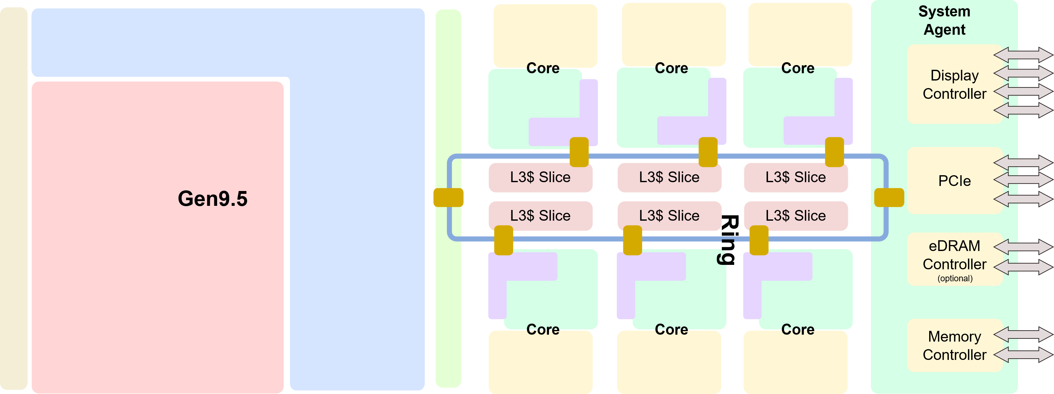
Package schema

Slide 13
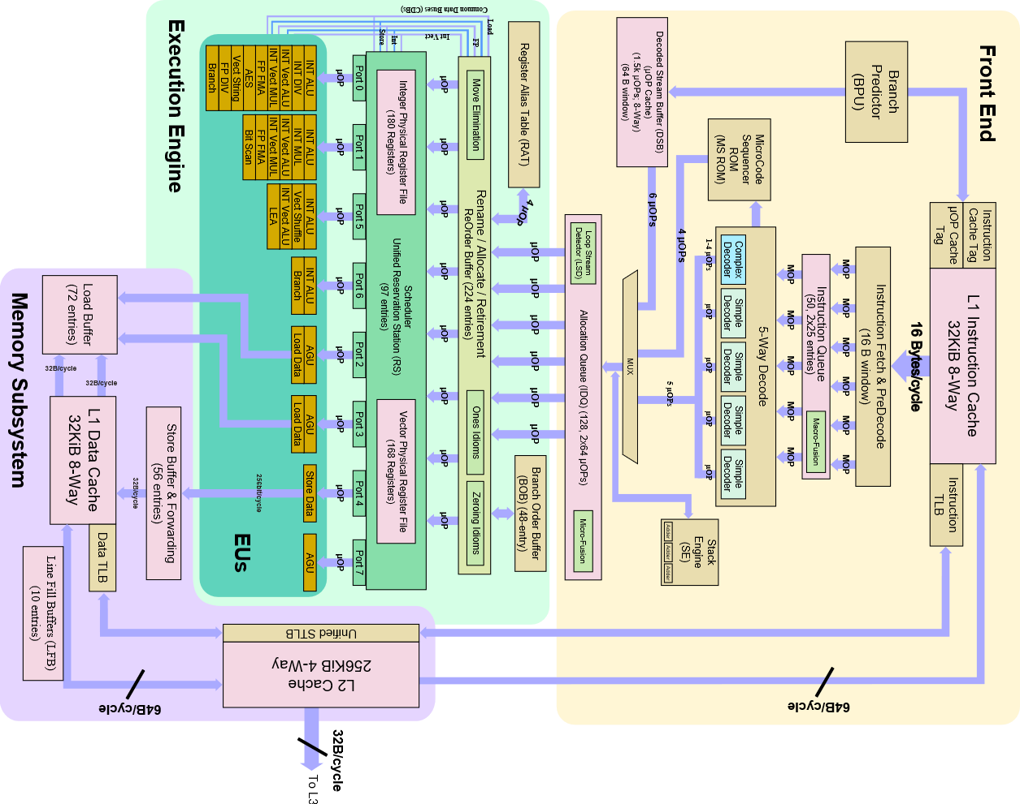
Core schema

