Slide 1
CUDA Introduction
Martin Kruliš

Slide 2
History
1996 - 3Dfx Voodoo 1
  First graphical (3D) accelerator for desktop PCs
1999 - NVIDIA GeForce 256
  First Transform&Lightning unit
2000 - NVIDIA GeForce2, ATI Radeon
2001 - GPU has programmable parts
  DirectX – vertex and fragment shaders (v1.0)
2006 - OpenGL, DirectX 10, Windows Vista
  Unified shader architecture in HW
  Geometry shader added

Slide 3
History
2007 - NVIDIA CUDA
  First GPGPU solution, restricted to NVIDIA GPUs
2007 - AMD Stream SDK (previously CTM)
2009 - OpenCL, Direct Compute
2012 - NVIDIA Kepler Architecture
2014 – NVIDIA Maxwell Architecture
2016 – NVIDIA Pascal, Vulkan API
2018 – NVIDIA Volta
… awaiting NVIDIA Ampere

Slide 4
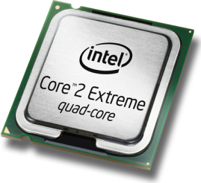
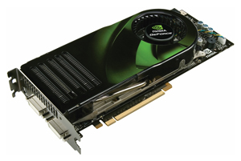
GPU in comparison with CPU
CPU
  Few cores per chip
  General purpose cores
  Processing different threads
  Huge caches to reduce memory latency
    Locality of reference problem
GPU
  Many cores per chip
  Cores specialized for numeric computations
  SIMT thread processing
  Huge amount of threads and fast context switch
    Results in more complex memory transfers
Architecture Convergence

Slide 5
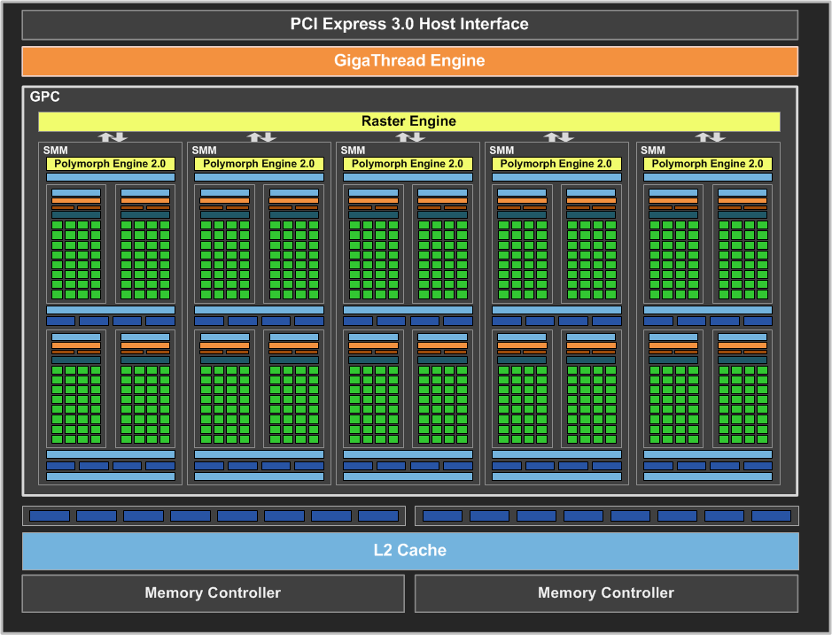
GPU Architecture
Streaming multiprocessor (SM)
Maxwell GPU
CUDA core

Slide 6
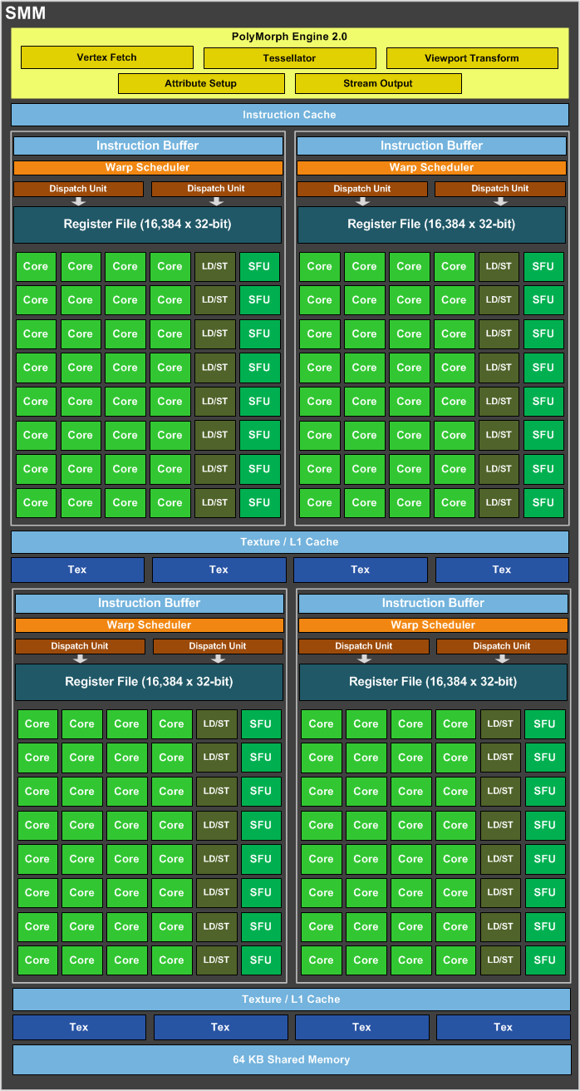
GPU Architecture
Maxwell Architecture
  4 identical parts
    32 cores
    64 kB shared memory
    2 instruction schedulers
  CC 5.0
  SMM
    (Streaming Multiprocessor -
    Maxwell)

Slide 7
GPU Arch.
Volta SM
  7.x CC
  8x tensor core
  (64 FMA/clock each)

Slide 8
GPU Execution Model
Data Parallelism
  Many data elements are processed concurrently by the same routine
  GPUs are designed under this particular paradigm
    Also have limited ways to express task parallelism
Threading Execution Model
  One function (kernel) is executed in many threads
    Much more lightweight than the CPU threads
  Threads are grouped into blocks (work groups) of the same size

Slide 9
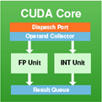
SIMT Execution
Single Instruction Multiple Threads
  All cores are executing the same instruction
  Each core has its own set of registers
Instruction Decoder and Warp Scheduler
registers
registers
registers
registers
registers
registers

Slide 10
SIMT vs. SIMD
Single Instruction Multiple Threads
  Width-independent programming model
  Serial-like code
  Achieved by hardware with a little help from compiler
  Allows code divergence
Single Instruction Multiple Data
  Explicitly expose the width of SIMD vector
  Special instructions
  Generated by compiler or directly written by programmer
  Code divergence is usually not supported or tedious

Slide 11
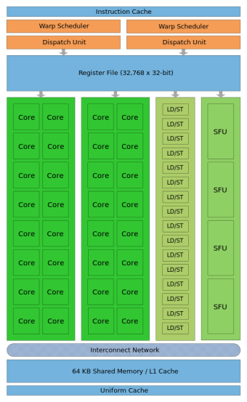
Thread-Core Mapping
How are threads assigned to SMPs
Grid
Block
Warp
Thread
The same kernel
Simultaneously run on SM cores. Threads in a warp run in lockstep.
Assigned to SM
Core
GPU
Streaming Multiprocessor
Notes:
Warp is made by subsequent 32 threads of the block according to their thread ID (i.e., threads 0-31, 32-63, …). Warp size is 32 for all compute capabilities.
Thread ID is threadIdx.x in one dimension, (threadIdx.x + threadIdx.y*blockDim.x) in two dimensions and threadId.x + threadId.y*blockDim.x + threadId.z*blockDim.x*blockDim.y) in three dimensions.
Multiple kernels may run simultaneously on the GPU (since Fermi) and multiple blocks may be assigned simultaneously to an SM (if the registers, the schedulers, and the shared memory can accommodate them).

Slide 12
CUDA
Compute Unified Device Architecture
  NVIDIA parallel computing platform
  Implemented solely for GPUs
  First API released in 2007
  Used in various libraries
    cuFFT, cuBLAS, …
  Many additional features
    OpenGL/DirectX Interoperability, computing clusters support, integrated compiler, …
Alternatives
  Vulkan, OpenCL, AMD Stream SDK, C++ AMP

Slide 13
Device Detection
Device Detection
  int deviceCount;
  cudaGetDeviceCount(&deviceCount);
  ...
  cudaSetDevice(deviceIdx);
Querying Device Information
  cudaDeviceProp deviceProp;
  cudaGetDeviceProperties(&deviceProp,
  deviceIdx);
Device index is from range 0, deviceCount-1

Slide 14
Device Features
Compute Capability
  Prescribed set of technologies and constants that
  a GPU device must implement
    Incrementally defined
  Architecture dependent
  CC for known architectures:
    1.0, 1.3 – Tesla, 2.0, 2.1 – Fermi
    3.x – Kepler (Tesla K20m – CC 3.5)
    5.x – Maxwell (GTX 980 – CC 5.2)
    6.x – Pascal
    7.x – Volta

Slide 15
Kernel Execution
Kernel
  Special function declarations
    __device__ void foo(…) { … }
    __global__ void bar(…) { … }
  Kernel Execution
    bar<<<Dg, Db [, Ns [, S]]>>>(args);
    Dg – dimensions and sizes of blocks spawned
    Db – dimensions and sizes of threads per block
    Ns – dynamically allocated shared memory per block
    S – stream index

Slide 16
Kernel Execution
Spawning Properties
  __global__ void vecAdd(float *x) { … }
  vecAdd<<<42, 64>>>(x);
  Spawns 42 blocks, 64 threads in each block
    Not all of them has to run simultaneously
  Number of blocks should be greater than # of SMPs
  Number of threads should be multiple of warp size (32 on all current architectures), at least 64
  Instead of numbers, dim3 structures may be used
    Specifying size of grid and blocks in 3 dimensions

Slide 17
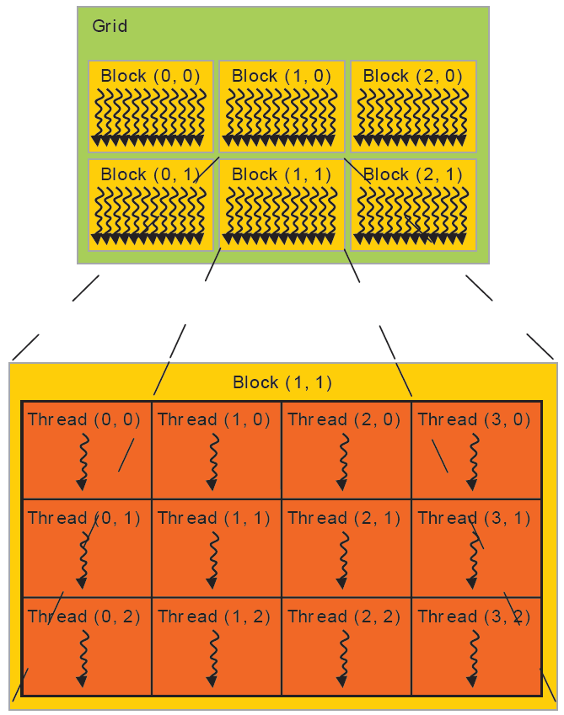
Kernel Execution
dim3(3,2)
Grid
  Consists of blocks
  Up to 3 dimensions
Each Block
  Consist of threads
  Same dimensionality
Kernel Constants
  gridDim, blockDim
  blockIdx, threadIdx
  .x, .y, .z
dim3(4,3)
Notes:
Note that logically, the threads (and blocks) are organized that the x- coordinate is closest. In other words, linearized index of a thread in a block is idx = x + y*blockDim.x + z*blockDim.x*blockDim.y.

Slide 18
GPU Memory
Note that details about host memory interconnection are platform specific
GPU Device
Host Memory
GPU Chip
SMP
~ 25 GBps
Global Memory
L2 Cache
L1 Cache
Registers
Core
…
Host
Core
…
L1 Cache
Registers
Core
PCI Express
(16/32 GBps)
> 100 GBps
…
Core
CPU

Slide 19
Memory Allocation
Device (Global) Memory Allocation
  C-like allocation system
    The programmer must distinguish host/GPU pointers!
    float *vec;
    cudaMalloc((void**)&vec, count*sizeof(float));
    cudaFree(vec);
Host-Device Data Transfers
  Explicit blocking functions
    cudaMemcpy(vec, localVec, count*sizeof(float),
    cudaMemcpyHostToDevice);
Notes:
Note that C++ bindings (with type control) exist.

Slide 20
Code Example
__global__ void vec_mul(float *X, float *Y, float *res) {
int idx = blockIdx.x * blockDim.x + threadIdx.x;
res[idx] = X[idx] * Y[idx];
}
...
float *X, *Y, *res, *cuX, *cuY, *cuRes;
...
cudaSetDevice(0);
cudaMalloc((void**)&cuX, N * sizeof(float));
cudaMalloc((void**)&cuY, N * sizeof(float));
cudaMalloc((void**)&cuRes, N * sizeof(float));
cudaMemcpy(cuX, X, N * sizeof(float), cudaMemcpyHostToDevice);
cudaMemcpy(cuY, Y, N * sizeof(float), cudaMemcpyHostToDevice);
vec_mul<<<(N/64), 64>>>(cuX, cuY, cuRes);
cudaMemcpy(res, cuRes, N * sizeof(float), cudaMemcpyDeviceToHost);

Slide 21
Few More Things…
Synchronization
  Memory transfers are synchronous by default
    Explicit cudaMemcpyAsync() exists
  Kernel execution is asynchronous
    But synced with other executions/memory transfers
  cudaDeviceSynchronize()
Error Checking
  Most functions return error code
    Should be equal to cudaSuccess
  cudaGetLastError()
    E.g., after kernel execution

Slide 22
Compilation
The nvcc Compiler
  Used for compiling both host and device code
  Defers compilation of the host code to gcc (linux) or Microsoft VCC (Windows)
    $> nvcc –cudart static code.cu –o myapp
  Can be used for compilation only
    $> nvcc –compile … kernel.cu –o kernel.obj
    $> cc –lcudart kernel.obj main.obj –o myapp
  Device code is generated for target architecture
    $> nvcc –arch sm_13 …
    $> nvcc –arch compute_35 …
Compile for real GPU with compute capability 1.3 and to PTX with capability 3.5

Slide 23
NVIDIA Tools
System Management Interface
  nvidia-smi (CLI application)
  NVML library (C-based API)
    Query GPU details
      $> nvidia-smi -q
    Set various properties (ECC, compute mode …), …
      $> nvidia-persistenced –-persistence-mode
        Set drivers to persistent mode (recommended)
NVIDIA Visual Profiler
  $> nvvp &
  Use X11 SSH forwarding (GPUlab not ready yet)

Slide 24

Discussion

