Slide 1
Advanced Programming in Parallel Environment
Spark
Jakub Yaghob

Slide 2
Spark
Apache Spark
Unified analytics engine for large-scale data processing
Initial release: 2014
Speed
Much faster then Hadoop
Easy of use
Write applications in Java, Python, R, and Scala
Interactive shell
Generality
Combine streaming, SQL, and analytics
Runs everywhere
Spark runs on Hadoop, Mesos, Kubernetes, standalone, or in a cloud

Slide 3
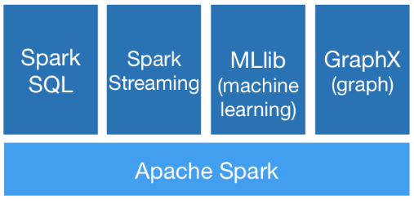
Spark
Contains
High-level API in Java, Python, R, and Scala
Optimized engine for general execution graph
DAG
MapReduce with only 2 levels
High-level tools
SparkSQL
MLlib
Spark Streaming
GraphX

Slide 4
Spark application
Components
Application
Independent set of processes on a cluster (+isolation, -no shared data among applications without writing to an external storage)
Coordinated by SparkContex object in your main program (driver program)
Driver program must listen for incoming connections from its executors – must be network addressable from executors
Driver schedules tasks – it should be on the same local network
Driver program has a web UI – tasks, executors, storage
Cluster manager
Allocate resources across applications
Executor
On nodes of the cluster
Executes computations and stores data
Stays up for the duration of the application
Runs task in multiple threads

Slide 5
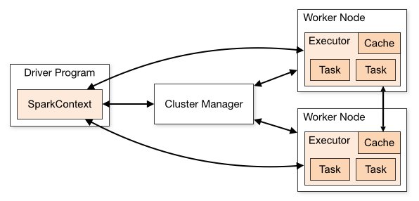
Spark application structure
App structure
Create SparkContext object
Connect to the cluster manager(s)
Acquire executors from cluster manager(s)
Send your application code to the executors
Pass Java/Python code/files to the SparkContext
SparkContext sends tasks to the executors to run

Slide 6
Cluster managers
Cluster managers
Spark is agnostic to the underlying cluster manager
Supported cluster managers
Standalone
Simple CM included with Spark, easy to setup a cluster
Apache Mesos
General CM able to run Hadoop MapReduce and service applications
Hadoop YARN
Resource manager in Hadoop 2
Kubernetes
Automated deployment, scaling, and management of containerized applications

Slide 7
Data holders
Possible data holders
RDD
Resilient distributed dataset
Immutable collection of elements partitioned across the nodes that can be operated in parallel
Possibly in-memory
Automatically recover from node failures
Core API, from initial release, all languages
Dataset
Distributed collection of data
Since v1.6, available only for Java and Scala
Strong typing and lambdas from RDD
Using Spark SQL optimized execution engine
DataFrame
Like Dataset, organized into named columns
Since v1.3, all languages
Like a table in a relational DB

Slide 8
DataFrame
Construction
Well known data file formats
CSV, JSON, …
Other sources
External DB, existing RDD, tables from Hadoop, …
Transformations
Create a new DataFrame from the existing one
Lazily evaluated, triggered by an action
Actions
Returns a result to the driver or writes to disk

Slide 9
DataFrame transformations and actions
Transformations (examples)
select – select a set of columns
join – join with another DataFrame
groupBy – groups using specified columns
filter – filter rows using a condition (bool or string)
Actions (examples)
show(n) – display the first n rows
count – number of rows in DataFrame
collect – return data back to the driver
Example
df.groupBy("hour").count().show(4)
df.filter(df.age > 3).collect()

Slide 10
DataFrame partitioning

Slide 11
Spark query execution
Query execution steps
Create a logical plan
Transform the logical plan to a physical plan
Generate code
Execute the tasks on a cluster

Slide 12
Advanced Spark 3.x features
Adaptive Query Execution (AQE)
Runtime statistics retrieved from completed stages of the query plan are used to re-optimize the execution plan
Dynamically coalescing shuffle partitions
Combine adjacent small partitions into bigger partitions, reducing the number of tasks
Dynamically switching join strategies
Optimize join strategy at runtime based on the join relation size
Dynamically optimizing skew joins
Detect data skew and split skew partitions into smaller sub-partitions

Slide 13
Advanced Spark 3.x features
Dynamic partition pruning
Data warehouse queries
One or more fact tables referencing any number of dimensional tables
Pruning at runtime by reusing the dimension table broadcast results in hash joins
Accelerator-aware scheduling
GPU/CUDA with RAPIDS

Slide 14
Parallel aspects
SparkContext type
parallelize(col, slices)
Distribute a local collection to form an RDD
accumulator(ival)
Creates an Accumulator with initial value
broadcast(ival)
Broadcast read-only Broadcast variable to the cluster
RDD type
aggregate(zeroval, seqop, combop)
Aggregate elements of each partition and then the results for all partitions
barrier
All tasks launched together
cache
Partitions cached in memory
reduce(op)

Slide 15
Shared variables
Accumulator
Worker tasks can call add(v) operation
Only driver can read accumulator by calling value() function
No other operations are defined
Broadcast
Cached read-only variable
Tasks can read it by calling value() function

Slide 16
Launching application
Interactive shell
Only Scala and Python
YOUR_SPARK_HOME/bin/pyspark
Standalone applications
Unified launcher
YOUR_SPARK_HOME/bin/spark-submit
Important parameters
--master – URL of the master node for the cluster
--class – entry point for the application
Master URL
local - locally with one worker thread (no para)
local[K] – locally with K worker threads
local[*] – locally with max number of worker threads (=cores)
spark://HOST:PORT – standalone Spark cluster master
CM://HOST:PORT – connect to cluster manager [mesos,yarn,k8s]

Slide 17
Launching application in SLURM environment
Use prepared environment
Environment home
/mnt/home/_teaching/advpara/spark
Spark cluster startup script
spark-slurm.sh
Requires
Spark Charliecloud image directory – spark
Network interface with IP networking – eno1 for w[201-208]
R/W directory – your home or project dir, mounted as /mnt/1
Application – path from the container (/mnt/1/…)
Launch the script using sbatch command

