Slide 1
Lab 10
C++20 ranges, RAII
4. 12. 2023

Slide 2
Outline
Ranges overview
RAII
Doxygen
(N)RVO
Task 10
2023/2024
Programming in C++ (labs)
2

Slide 3
The starting code in public GitLab
https://gitlab.mff.cuni.cz/teaching/nprg041/mejzlik/labs-cpp-pub
2023/2024
Programming in C++ (labs)
3

Slide 4
0) Previously in the labs

Slide 5
From the previous tasks
Prefer using prepared STD methods to doing things manually
e.g. std::string's `contains`, `find` methods
When implementing two logically opposite operators, implement the second one by calling the already implemented one
e.g. implement `operator!=` by calling `not operator==`
In lab 09 I wrote sampling of chars from C-string array
Beware of C array behaviour!
constexpr const char LETTERS[] = "abcdefghijklmopqrstuvwxyz";
std::uniform_int_distribution<size_t> char_dist(0, sizeof(LETTERS) - 1);
This should be 2 to not include \0 in the sampling
constexpr const char S1[] = "0123456789"; // '\0' included implicitly
constexpr const char* S2 = "0123456789";
std::cout << sizeof(S1) << std::endl;
// 11
std::cout << sizeof(S2) << std::endl;
// 8 (!) size of a pointer
2023/2024
Programming in C++ (labs)
5

Slide 6
Term project
Use GIT when working on it
To be accepted, there must be visible a history of development using GIT
19. 1. 2024 is the deadline for technological demo
Working CMake project with all dependencies included and used
The logic does not need to be there yet
Cross platform!
Test it on at least Windows and Linux machine
Use lab computers or spawn a virtual machine (VirtualBox, VMWare Workstation)
The solution must contain user documentation
e.g. set of linked MD files telling the user how the software shall be used
As for developer documentation
Reasonable doxygen comments with generated documentation will suffice
https://www.doxygen.nl/manual/starting.html
Submit it by sending me a link to the repo
Include enough test data so a user can test all the functionality
Feel free to ask for iterative feedback during the development
2023/2024
Programming in C++ (labs)
6

Slide 7
1) C++20 ranges

Slide 8
Introduction to C++20 Ranges
Evolution step from iterators, it is an abstraction over iterators not replacement
Ranges are abstractions for a sequence of values, providing a more intuitive way to work with collections than traditional iterators.
Comparison with Iterators
Unlike iterators, which often require manual handling of begin and end, ranges encapsulate this concept, enhancing safety and readability.
Benefits:
Improved code readability
Reduced risk of errors
Easier composition of operations
Further reading
https://www.youtube.com/watch?v=SYLgG7Q5Zws
https://www.youtube.com/watch?v=d_E-VLyUnzc
https://www.youtube.com/watch?v=3MBtLeyJKg0
2023/2024
Programming in C++ (labs)
8

Slide 9
Enhancing range-based for loops with C++20
std::vector<int> xs({ 1, 2, 3, 4, 5 });
// Using indices like in good old C days
for (size_t i = 0; i < xs.size(); ++i)
std::print("{}, ", xs[i]);
std::println("");
// Manual iterator iteration
for (auto it = xs.begin(); it != xs.end(); ++it)
std::print("{}, ", *it);
std::println("");
// C++11: basic range-based for loop
for (auto& x : xs)
std::print("{}, ", x);
std::println("");
// C++20: Non-trivial views for (auto& x : xs | std::views::reverse)
std::print("{}, ", x);
std::println("");
Using indices
Everpresent danger of out-of-bounds UBs
Using iterators
Better, but iterators are well-dressed pointers
C++11 range-based for loop
Only for the whole container
No other possibilities like reverse, etc
C++20 ranges
Tons of possible views
Lazy evaluation
Piping operator
2023/2024
Programming in C++ (labs)
9

Slide 10
Overview of the C++20 Range Library
Views (range adaptors):
Lightweight, non-owning, lazy evaluated range adaptors
https://en.cppreference.com/w/cpp/ranges#Range_adaptors
Constrained algorithms:
Range-aware versions of STD algorithms (previous two labs)
In separate namespace, the old versions work as before
Applied eagerly
https://en.cppreference.com/w/cpp/algorithm/ranges
auto even_nums = xs | views::filter([](int x){ return x % 2 == 0; });
Ranges they operate on are "guraded" by concepts - another C++20 big feature
std::ranges::fill(xs, 10);
2023/2024
Programming in C++ (labs)
10

Slide 11
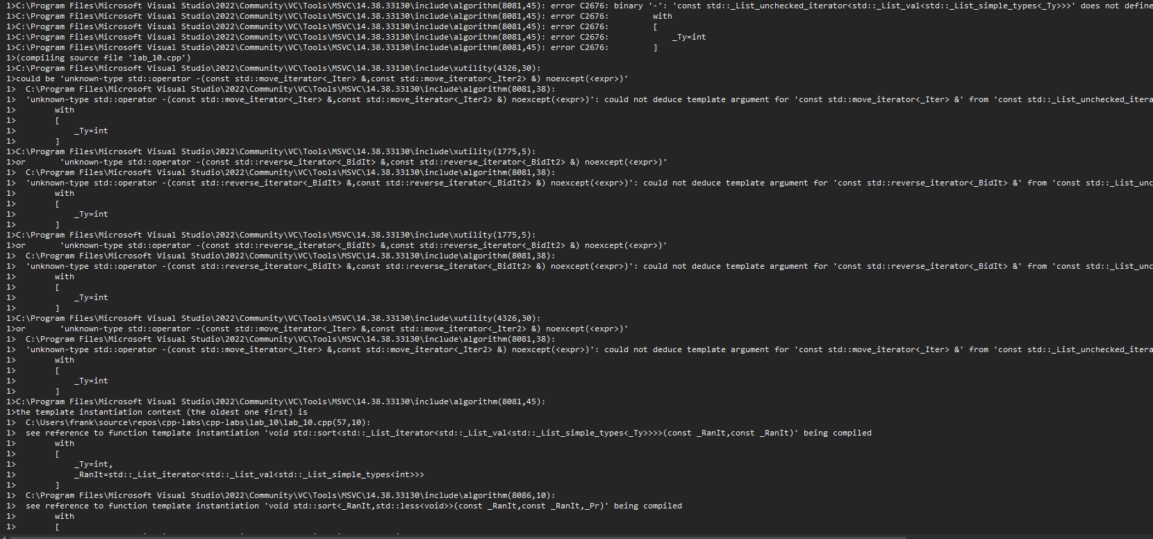
Peek into concepts
Without concepts
With concepts
std::list<int> list({ 3, 2, 1 });
// std::sort requires random access iterators!
std::sort(list.begin(), list.end());
Hundreds of lines of errors
std::list<int> list({ 3, 2, 1 });
// std::sort requires random access iterators!
std::sort(list.begin(), list.end());
2023/2024
Programming in C++ (labs)
11

Slide 12
What is a sentinel?
In the old STD library, begin/end iterators must be of the same type
In ranges, .end() can return a sentinel
It must be equality_comparable_with the given iterator
Can help communicate with the compiler to produce more optimised code
e.g. we know that the string will always contain '!'
std::string str("Hello!");
std::ranges::find(str.begin(), std::unreachable_sentinel, '!');
Further reading
https://godbolt.org/z/h3wFst
2023/2024
Programming in C++ (labs)
12

Slide 13
Projections
Projection is unary callable that changes what the caller sees
The default is std::identity
e.g. too see the element as its subset
struct Human {
std::string name;
size_t id;
};
using namespace std::ranges;
std::vector<Human> xs2({ {"Bob", 10}, {"Alice", 3} });
// Sort by the name?
sort(xs2, greater{}, [](const Human& x) { return x.name; });
// Shorter! With less then (default)
sort(xs2, {}, &Human::name);
// Sort by the ID?
sort(xs2, greater{}, [](const Human& x) { return x.id; });
// Shorter! With less then (default)
sort(xs2, {}, &Human::id);
2023/2024
Programming in C++ (labs)
13

Slide 14
Views vs ranges
Mind, that there are two related namespace
std::views::filter
These are range adaptors that return ranges from std::ranges namspace
std::ranges::filter_view
These are concrete classes returned by the adaptors
2023/2024
Programming in C++ (labs)
14

Slide 15
Views
STD algorithms are great but they
Are hard to compose
Are eager to evaluate
std::vector<int> xs = { 5, 3, 1, 4, 2 };
auto square = [](auto i) { return i * i; };
auto is_even = [](auto i) { return i % 2 == 0; };
// The usual "calling" composition
auto view1 = std::views::transform(
std::views::filter(xs, is_even),
square);
std::ranges::copy(view1, std::ostream_iterator<int>(std::cout, " "));
// For better readibility, overloaded | operator
auto view2 = xs | std::views::filter(is_even) | std::views::transform(square);
std::ranges::copy(view2, std::ostream_iterator<int>(std::cout, " "));
2023/2024
Programming in C++ (labs)
15

Slide 16
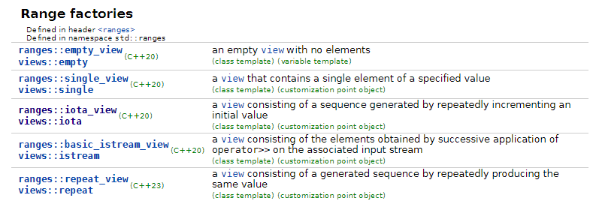
Factories
Views that do not need any underlying data structure
2023/2024
Programming in C++ (labs)
16

Slide 17
Filter & transform view
auto even = [](int i) { return 0 == i % 2; };
auto square = [](int i) { return i * i; };
for (int i : std::views::iota(0, 6)
| std::views::filter(even)
| std::views::transform(square))
std::cout << i << ' ';
2023/2024
Programming in C++ (labs)
17

Slide 18
Take & drop view
auto print = [](char x){ std::cout << x; };
constexpr char pi[]{'3', '.', '1', '4', '1', '5', '9', '2'};
// safely takes 8 chars only, i.e. min(pi.size(), 42)
std::ranges::for_each(pi | std::views::take(42), print);
// Drops the first 2 chars
std::ranges::for_each(pi | std::views::drop(2), print);
2023/2024
Programming in C++ (labs)
18

Slide 19
Keys & values views
std::map<std::string, int> map{{"one", 1}, {"two", 2}};
for (auto const& key : std::views::keys(map))
std::cout << key << ' ';
for (auto const& val : std::views::values(map))
std::cout << val << ' ';
2023/2024
Programming in C++ (labs)
19

Slide 20
Enumerate view
constexpr static auto v = {'A', 'B', 'C', 'D'};
for (auto const [index, letter] : std::views::enumerate(v))
std::cout << '(' << index << ':' << letter << ") ";
2023/2024
Programming in C++ (labs)
20

Slide 21
Zip view
auto x = std::vector{ 1, 2, 3, 4 };
auto y = std::list<std::string>{ "aa", "bb", "cc", "dd", "ee" };
auto z = std::array{ 'A', 'B', 'C', 'D', 'E', 'F' };
for (std::tuple<int&, std::string&, char&> elem : std::views::zip(x, y, z))
std::cout
<< std::get<0>(elem) << ' '
<< std::get<1>(elem) << ' '
<< std::get<2>(elem) << std::endl;
2023/2024
Programming in C++ (labs)
21

Slide 22
And many more…
https://en.cppreference.com/w/cpp/ranges#Range_adaptors
2023/2024
Programming in C++ (labs)
22

Slide 23
2) RAII

Slide 24
What is RAII?
Resource Acquisition Is Initialization or RAII
is a C++ programming technique which binds the life cycle of a (scarce) resource that must be acquired before use to the lifetime of an object.
allocated heap memory, thread of execution, open socket, open file, locked mutex, disk space, database connection
anything that exists in limited supply
We are already using RAII!
Indirectly by using STD.
or std::unique_ptr
Further reading
https://en.cppreference.com/w/cpp/language/raii
2023/2024
Programming in C++ (labs)
24

Slide 25
What is RAII?
Using RAII can be summarized as follows:
encapsulate each resource into a class, where
the constructor acquires the resource and establishes all class invariants or throws an exception if that cannot be done,
the destructor releases the resource and never throws exceptions;
always use the resource via an instance of an RAII class that either
has automatic storage duration or temporary lifetime itself, or
has a lifetime that is bounded by the lifetime of an automatic or temporary object.
2023/2024
Programming in C++ (labs)
25

Slide 26
Why is it important?
What is wrong here?
void f1(int i) {
int* p = new int;
foo();
delete p;
}
void f1(int i) {
auto p = std::make_unique<int>();
foo();}
What if this throws?
std::mutex m;
void f2() {
m.lock(); // acquiring the mutex
foo();
m.unlock(); // releasing the mutex
}
std::mutex m;
void f2() {
std::lock_guard<std::mutex> lock(m);
foo();
}
What if this throws?
2023/2024
Programming in C++ (labs)
26

Slide 27
Use RAII in your data structures
Don’t leak resources …
use RAII!
Horst Fuchs | foto: Slavomír Kubeš, MF DNES
2023/2024
Programming in C++ (labs)
27

Slide 28
3) Doxygen

Slide 29
Doxygen is a tool for generating documentation from sources
You provide config file
+ special comment blocks in your code
+ manual pages
-> then you generate
To see, what is possible with doxygen, see https://doc.magnum.graphics/magnum/
Alternative is Sphinx
2023/2024
Programming in C++ (labs)
29

Slide 30
Example for a function
/**
* @brief Calculates the area of a rectangle.
*
* This function takes the width and height of a rectangle and calculates its area. It demonstrates basic arithmetic operations
* and is an example of how to use Doxygen tags for documenting a function.
*
* @param width The width of the rectangle. Must be non-negative.
* @param height The height of the rectangle. Must be non-negative.
* @return The area of the rectangle. Returns 0 if either width or height is non-positive.
*
* @see getPerimeter() for calculating the perimeter of a rectangle.
* @ref SomeOtherFunction
*
* @note The function does not check for integer overflow in its calculations.
*
* @warning Ensure that width and height are non-negative to avoid unexpected results.
*
* Example usage:
* @code
* double area = calculateRectangleArea(5.0, 10.0);
* std::cout << "Area: " << area << std::endl;
* @endcode
*/
double calculateRectangleArea(double width, double height) {
return width * height;
}
2023/2024
Programming in C++ (labs)
30

Slide 31
Example for a class
/**
* @class ExampleClass
* @brief A brief description of the ExampleClass.
*
* This class serves as an example of how to use Doxygen for documenting a C++ class.
* It includes examples of tagging members, constructors, and methods.
*
* @author John Doe
* @version 1.0
* @date 2023-12-04
*
* Example usage:
* @code
* ExampleClass example;
* example.doSomething();
* @endcode
*
* @note This class is part of the Doxygen documentation example.
* @see SomeOtherClass
*/
class ExampleClass {}
2023/2024
Programming in C++ (labs)
31

Slide 32
Example for a file
/**
* @file ExampleFile.h
* @brief Brief description of the file.
*
* Detailed description of what this file contains, its purpose in the project, and how it should be used.
* This could include information about the classes, functions, variables, or any other entities defined in this file.
*
* @author John Doe
* @version 1.0
* @date 2023-12-04
* @note Additional notes about the file.
* @warning Any warnings related to the file.
*
* Example usage (if applicable):
* @code
* #include "ExampleFile.h"
* // Example usage of the file's contents
* @endcode
*
* @see Related files or modules.
*/
2023/2024
Programming in C++ (labs)
32

Slide 33
Doxygen is a tool for generating documentation from sources
https://www.doxygen.nl/download.html
Comment your code according to:
https://www.doxygen.nl/manual/docblocks.html#docexamples
doxygen <config-file>
To generate new config file:
doxygen –g <config-file>,
demo
2023/2024
Programming in C++ (labs)
33

Slide 34
4) (N)RVO

Slide 35
Return value optimisation
General concept is called copy elision
Why you should not always write `std::move`
a compiler optimization technique that eliminates the creation and copying of temporary objects during the return of a value from a function
the RVO to be applied, the returned object has to be constructed on a return statement
RVO constructs the object directly in the memory where `t` is placed
T f() {
if (....) {
return T(....);
} else {
return T(....);
}
}
// ... T t = f();
One tmp copy
The second copy for returning
The third one
2023/2024
Programming in C++ (labs)
35

Slide 36
Named return value optimisation
it can remove the intermediary objects even if the returned object has a name
The NRVO requires to return a local named variable
Thus, do not write std::move around returned values.
T f()
{
T res(....);
if (....) {
return res;
}
....
return res;
}
T t = f();
One constructed copy
The second copy for returning
The third one
2023/2024
Programming in C++ (labs)
36

Slide 37
Task 10

Slide 38
Task 10: Query processor with ranges
We will generate a database of properties to buy
We'll use random for that, we will generate a few thousand records and will use algorithms to do some statistics on them
A property has these attributes:
name - ASCII string - random ASCII string of length [5 - 10]
price - price in EUR - [100k - 500k]
area - property area in m2 - [20 - 200]
number of rooms - [1 - 10]
brightness factor - floating point number in interval [0, 1]
energy class - [A, B, C, D, E, F]
garage - [true, false]
Write a class `Database` that will implement a method
insert(…) for inserting the property, generate the values using random… try different distributions
find(Int<int> price, Int<int> area, Int<int> rooms, Int<float> bright, Int<EClass> eclass, bool garage, size_t max_res)
It will return at most `res` results that match the given query.
`Int<T> represents inclusive interval [from, to] of type T
Try to avoid manual iteration
Take the solution from the previous labs and rewrite it with using C++20 ranges
2023/2024
Programming in C++ (labs)
38

Slide 39
Coding: The approach
Use C++20 ranges as much as possible! Just for educational reasons.
code
2023/2024
Programming in C++ (labs)
39

Slide 40
Wrapping it up…

Slide 41
The final ReCodex assignment will be up this week!
You need this to pass the term test 8. 1. 2024!
Code this assignment with extensions in mind! It will save you time during the test!
Fantasy battle simulator!
2023/2024
Programming in C++ (labs)
41

Slide 42
Lab wrap up
You should know
what C++20 ranges are and how you can use them
What is the RAII technique and how to use it to write safer code
Next lab (the last lab with new stuff):
Intro to templates
How to write a parser
Doxygen et al
Your tasks until the next lab:
Task 10 (24h before, so I can give feedback).
Work on the ReCodex homework
2023/2024
Programming in C++ (labs)
42

