Slide 1
Lab 9
functors, lambdas
operator overloading, ++x vs x++
random numbers
27. 11. 2023

Slide 2
Outline
Functors and lambdas
Operator overloading
Random numbers
Intro to ranges
2023/2024
Programming in C++ (labs)
2

Slide 3
The helper codes are in public GitLab
https://gitlab.mff.cuni.cz/teaching/nprg041/mejzlik/labs-cpp-pub
2023/2024
Programming in C++ (labs)
3

Slide 4
0) Previously in the labs

Slide 5
From the second ReCodex assignment
Avoid manual iteration in favour of STD algos library and ranges
Less mistakes, less code
Unnecessary copies of non-trivial objects (mostly std::string)
foo(const std::string s) -> what is wrong?
Unnecessary use of operator+ on std::string
It creates a new copy each time you use it
Most of the time, you want to use `.append()` method or use std::format() / <<
Use type aliases when using long composite types
using QueryRes = std::vector<std::map<std::string, std::unique_ptr<size_t>>>;
Const methods where possible
2023/2024
Programming in C++ (labs)
5

Slide 6
1) Functors and lambdas

Slide 7
Functors
A functor is a struct/class with overloaded operator()
This means, that the instance is callable
The functor itself can be parametrised by constructor parameters
// Increasing add to elements
// 0: +n, 1: +2n, 2: +3n
class ftor {
public:
ftor(int step) : _step(step), _acc(0) {}
int operator() (int& x) { return x + (_acc += _step); }
private:
int _step;
int _acc;
};
// 0: +2, 1: +4, 2: +6, ...
std::transform(xs.begin(), xs.end(), xs.begin(), ftor(2));
// 3 6 9 18 22
// Indicates elements > n
class cmp {
public:
cmp(int n) : _n(n) {}
bool operator() (const int& x) { return x > _n; }
private:
int _n;
};
// Find element that is > 9
auto it = std::find_if(xs.begin(), xs.end(), cmp(9));
// *it: 10
Instantiating a new anonymous instance. This calls ctor!
Instantiating a new anonymous instance. This calls ctor!
2023/2024
Programming in C++ (labs)
7

Slide 8
Functors: adder
How to implement a functor that sums all numbers greater than 2?
class adder {
public:
adder(int limit) : res(0), _n(limit) {}
void operator() (int x) { if (x > _n) res += x; }
int res;
private:
int _n;
};
std::vector<int> ys({ 1, 2, 3, 4, 5});
auto s = std::for_each(ys.cbegin(), ys.cend(), adder(2));
std::cout << s.res << std::endl;
// 12
The functor instance will keep the inner state
Then we will access it?
2023/2024
Programming in C++ (labs)
8

Slide 9
Lambdas
[ captures ] ( params )_{opt} mutable_{opt} -> rettype_{opt} { statements; }
[ captures ]
access to external local variables - initialization
explicit/implicit, by-value/by-reference, generalized
( params )
call parameters, optional but usual
mutable
local copy of external variable can be modified
-> rettype
return type, "new" syntax
optional - compiler deduces type from the expression
class ftor {
private:
CaptTypes _captures;
public:
ftor( CaptTypes captures ) : _captures( captures ) {}
rettype operator() ( params ) { statements; }
};
[ captures ] ( params ) -> rettype { statements; }
2023/2024
Programming in C++ (labs)
9

Slide 10
Lambdas
since C++11
A syntactic sugar for functors
Shorter syntax, good for small functions
Further reading
https://en.cppreference.com/w/cpp/language/lambda
In capture, we can initialize new variables (in functors, these are member fields)
Using also algorithms for ranges
namespace rngs = std::ranges;
std::vector<int> ys({ 1, 2, 3, 10, 12 });
// Find element that is > 9
auto it1 = std::find_if(ys.begin(), ys.end(),
[](const int& x) { return x > 9; });
auto it2 = rngs::find_if(ys, [](auto x) { return x > 9; });
// *it1 == *it2: 10
namespace rngs = std::ranges;
std::vector<int> ys({ 1, 2, 3, 10, 12 });
// 0: +2, 1: +4, 2: +6, ...
rngs::transform(ys, ys.begin(), [acc=0](int& x) mutable {
return x + (acc += 2);
});
// 3 6 9 18 22
If non-const, declare it mutable
lambda type deduction, this implies copy
2023/2024
Programming in C++ (labs)
10

Slide 11
What is the difference?
These two snippets may seem to do the same
namespace rngs = std::ranges;
std::vector<int> ys({ 1, 2, 3, 10, 12 });
rngs::transform(ys, ys.begin(), [acc=0](int& x) mutable {
return x + (acc += 2);
});
Who shares this variable?
namespace rngs = std::ranges;
std::vector<int> ys({ 1, 2, 3, 10, 12 });
rngs::transform(ys, ys.begin(), [](int& x) {
static int acc = 0;
return x + (acc += 2);
});
And who shares this one?
2023/2024
Programming in C++ (labs)
11

Slide 12
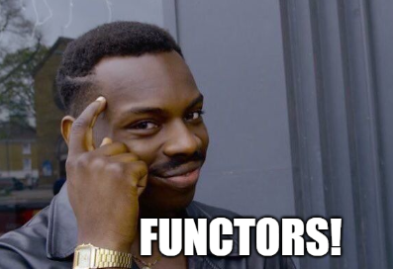
When in doubt, rewrite it to functors!
Just syntactic sugar!
struct ftor {
int acc; // Accumulator state
ftor(int initial) : acc(initial) {}
int operator()(int& x) {
return x + (acc += 2);
}
};
rngs::transform(ys, ys.begin(), ftor(0));
rngs::transform(ys, ys.begin(), [acc=0](int& x) mutable {
return x + (acc += 2);
});
struct ftor {
int operator()(int& x) {
static int acc = 0; // Static accumulator state
return x + (acc += 2);
}
};
rngs::transform(ys, ys.begin(), ftor());
rngs::transform(ys, ys.begin(), [](int& x) {
static int acc = 0;
return x + (acc += 2);
});
2023/2024
Programming in C++ (labs)
12

Slide 13
Lambda: adder
How to use lambda that sums all numbers greater than 2?
How to access the inner variable that was captured? Not directly possible
But you can capture by reference
Define and initialize a variable in the outer scope.
Capture it by reference
int sum = 0;
std::for_each(ys.cbegin(), ys.cend(), [&sum](int x) {
if (x > 2) sum += x;
});
std::cout << sum << std::endl;
// 12
Find the result inside it
2023/2024
Programming in C++ (labs)
13

Slide 14
Capturing all
Writing `=` captures all variables from the outer scope by copy
also `this`
Writing `&` capture all variables from the outer scope by reference
also `this`
int a = 10;
int b = 20;
auto lambda_by_value = [=]() {
// Inside this lambda, 'a' and 'b' are copies of the original variables.
// Modifying them here does not change the originals.
std::cout << "a (by value): " << a << ", b (by value): " << b << std::endl;
};
auto lambda_by_ref = [&]() {
// Modifying them here does change the originals.
std::cout << "a (by value): " << a << ", b (by value): " << b << std::endl;
};
2023/2024
Programming in C++ (labs)
14

Slide 15
Capturing this and *this
You can also capture pointer this
From C++17, you can capture also by copy *this
class MyClass {
private:
int _value = 0;
public:
void foo() {
// Accessing the private member variable 'value'
auto lambda1 = [this]() { this->_value = 42;
};
lambda1(); // Changes 'value' to 42
// Capture '*this' by value
auto lambda2 = [*this]() mutable {
// This modifies the copy, not the original 'this->value'
_value = 52;
};
lambda2(); // Still 42
}
};
Copies of all member fields are in the scope of lambda
2023/2024
Programming in C++ (labs)
15

Slide 16
Little practice #1
No manual iterations!
Only STD algorithms + functors or lambdas.
Transform range R in-place to values incremented by Y iff the element is greater than X
For example: R = (1, 2, 6, 7) X = 5, Y = 1
1 | 2 | 6 | 7
1 | 2 | 7 | 8
std::vector<int> R({ 1, 2, 6, 7 });
int X = 5;
int Y = 1;
std::transform(R.begin(), R.end(), R.begin(),
[X, Y](const int& x) {
if (x > X) return x + Y;
return x;
});
Output goes to the same range
Capturing variables by copy
2023/2024
Programming in C++ (labs)
16

Slide 17
Little practice #2
No manual iterations!
Only STD algorithms + functors or lambdas.
In range R, find the first element that is greater than the previous one by at least X
For example: R = (1, 4, 9, 10); X = 4
1 | 4 | 9 | 10
std::vector<int> R({ 1, 4, 9, 10 });
int X = 4;
auto it = std::find_if(R.begin(), R.end(),
[prev = std::optional<int>{}, X](const auto& x) mutable {
bool res = false;
if (prev.has_value()) res = (x - *prev) >= X;
prev = x;
return res;
});
if (it != R.end()) {
std::cout << *it << std::endl;
} else {
std::cout << "None!" << std::endl;
}
9
Initializing new variable in the capture part (since C++14)
Captured variables are mutable (not const)
We must test, if something was found, otherwise we'd get UB
2023/2024
Programming in C++ (labs)
17

Slide 18
Little practice #2
No manual iterations!
Only STD algorithms + functors or lambdas.
In range R, find the first element that is greater than the previous one by at least X
For example: R = (1, 4, 9, 10); X = 4
1 | 4 | 9 | 10
std::vector<int> R({ 1, 4, 9, 10 });
int X = 4;
auto it_fst = std::adjacent_find(R.begin(), R.end(),
[X](const auto& fst, const auto& snd) {
return snd - fst >= X;
});
if (it_fst != R.end()) {
// We want the second item
std::cout << *(++it_fst) << std::endl;
} else {
std::cout << "None!" << std::endl;
}
9
Points to the first of the elements
We inspect the adjacent pairs
We want the neighbour!
2023/2024
Programming in C++ (labs)
18

Slide 19
Little practice #3
No manual iterations!
Only STD algorithms + functors or lambdas.
Transform vector R into a new vector container, in a way that you multiply elements that are in the provided range [X, Y) by their index in the source vector.
For example: R = (1, 4, 9, 10); [X = 1, Y=3]
1 | 4 | 9 | 10
std::vector<int> R({ 1, 4, 9, 10 });
std::vector<int> S;
int X = 1;
int Y = 3;
// Materialize a vector of indices
std::vector<int> indices(R.size());
std::iota(indices.begin(), indices.end(), 0);
std::transform(R.cbegin(), R.cend(), indices.cbegin(), std::back_inserter(S),
[X, Y](const auto& x, const auto& idx) {
if (X <= idx and idx < Y) return x * idx;
return x;
});
1 | 4*1 | 9*2 | 10
We create vector of indices
And use std::transform running through two ranges at the same time
2023/2024
Programming in C++ (labs)
19

Slide 20
Little practice #3
No manual iterations!
Only STD algorithms + functors or lambdas.
Transform vector R into a new vector container, in a way that you multiply elements that are in the provided range [X, Y) by their index in the source vector.
For example: R = (1, 4, 9, 10); [X = 1, Y=3]
1 | 4 | 9 | 10
since C++20
std::vector<int> R({ 1, 4, 9, 10 });
std::vector<int> S;
int X = 1;
int Y = 3;
auto indices = std::views::iota(0) | std::views::take(R.size());
std::transform(R.begin(), R.end(), indices.begin(), std::back_inserter(S),
[X, Y](const auto& x, const auto& idx) {
if (X <= idx and idx < Y) return x * idx;
return x;
});
1 | 4*1 | 9*2 | 10
Infinite increasing sequence starting from 0
take just the right number of them
Well, it's a range too
2023/2024
Programming in C++ (labs)
20

Slide 21
Little practice #3
No manual iterations!
Only STD algorithms + functors or lambdas.
Transform vector R into a new vector container, in a way that you multiply elements that are in the provided range [X, Y) by their index in the source vector.
For example: R = (1, 4, 9, 10); [X = 1, Y=3]
1 | 4 | 9 | 10
since C++23
std::vector<int> R({ 1, 4, 9, 10 });
std::vector<int> S;
int X = 1;
int Y = 3;
auto r_w_idxs = R | std::views::enumerate;
std::transform(r_w_idxs.cbegin(), r_w_idxs.cend(), std::back_inserter(S),
[X, Y](const auto& pair) -> int {
const auto& [idx, x] = pair;
if (X <= idx and idx < Y) return x * idx;
return x;
});
1 | 4*1 | 9*2 | 10
Yes, finally the enumerate view!
2023/2024
Programming in C++ (labs)
21

Slide 22
Little practice #4
No manual iterations!
Only STD algorithms + functors or lambdas.
Given vector R, compute the sum of squares of the values.
For example: R = (1, 2, 3, 4);
1 | 2 | 3 | 4
1 + 4 + 9 +16
The accumulator provided as the first param
The initial value of accumulator
std::vector<int> R({ 1, 2, 3, 4 });
int res = std::reduce(R.cbegin(), R.cend(), 0,
[](int acc, int val) { return acc + val * val; });
std::cout << res << std::endl;
// 30
2023/2024
Programming in C++ (labs)
22

Slide 23
2) Operator overloading

Slide 24
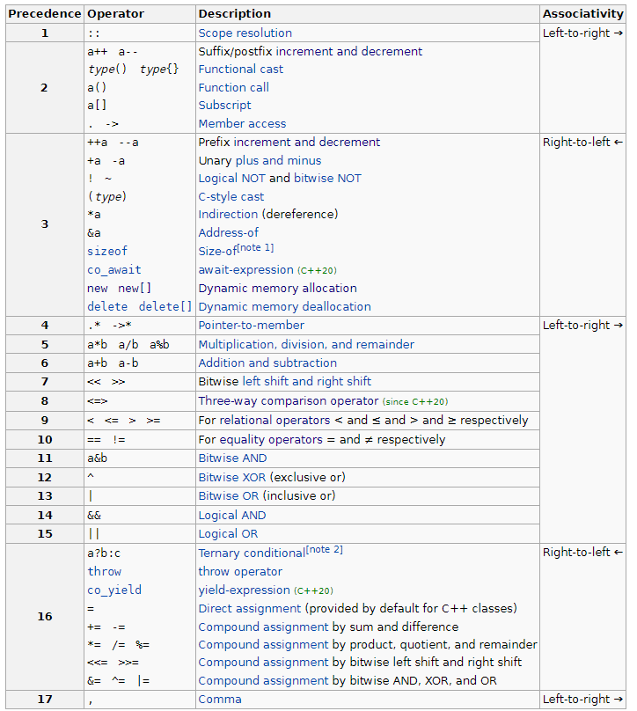
Operator overloading in C++
It is widely used in C++, can be user-defined functions
But we cannot change certain things about them
Their names and syntax
Binary +, unary -, …
Arity
Precedence
https://en.cppreference.com/w/cpp/language/operator_precedence
Associativity
You can overload these:
2023/2024
Programming in C++ (labs)
24

Slide 25
Operator ++/-- … prefix/postfix
Prefix and postfix operators behave differently!
Postfix creates a copy, increments the original value and returns the copy of the previous values
In general, prefer prefix if semantically correct, you'll avoid a copy
Determined by this useless parameter
It returns copy!
// Prefix increment operator
MyCounter& operator++() {
// Increment the count and return the updated object
++count;
return *this;
}
// Postfix increment operator
MyCounter operator++(int) {
// Create a copy of the current object
MyCounter temp = *this;
// Increment the count
++count;
// Return the copy (the original state before increment)
return temp;
}
2023/2024
Programming in C++ (labs)
25

Slide 26
Operator ,?
The comma operator is a binary operator that evaluates its first operand and discards the result, and then evaluates the second operand and returns this value (and type)
You can cause side effects caused by the first evaluations
class MyClass {
public:
int data; MyClass(int value) : data(value) {} // Overloading the comma operator
MyClass operator,(const MyClass& other) const {
// Define the behavior of the comma operator
// In this example, it returns a new object with combined data
return MyClass(data + other.data);
}
};
int main() {
MyClass obj1(10);
MyClass obj2(20);
// Using the overloaded comma operator
MyClass result = (obj1, obj2);
std::cout << "Result: " << result.data << std::endl;
return 0;
}
2023/2024
Programming in C++ (labs)
26

Slide 27
Overloading with non-member functions
Useful if the first argument is not the class type
For example, if I wanted to call binary + on my type with std::string
#include <iostream>
#include <string>
class MyNumber {
private:
int _value; public:
MyNumber(int val) : _value(val) {}
friend std::string operator+(const MyNumber& num, const std::string& str);
friend std::string operator+(const std::string& str, const MyNumber& num);
};
std::string operator+(const MyNumber& num, const std::string& str) {
return std::to_string(num._value) + str;
}
std::string operator+(const std::string& str, const MyNumber& num) {
return str + std::to_string(num._value);
}
2023/2024
Programming in C++ (labs)
27

Slide 28
Overloading with non-member functions
Then, you can use it like this
int main() {
MyNumber a(42);
std::string str = " is the answer.";
// Using the overloaded + operator in both orders
std::string result1 = a + str;
std::string result2 = str + a;
// Displaying the results
std::cout << "Result 1: " << result1 << std::endl;
std::cout << "Result 2: " << result2 << std::endl;
return 0;
}
2023/2024
Programming in C++ (labs)
28

Slide 29
3) Random numbers

Slide 30
Random numbers in C++
#include <random>
From C
rand()
people often forget to seed it correctly
C++ STD lib random
generators
produce a deterministic sequence of uniformly distributed numbers
linear_congruential, mersenne_twister, substract_with_carry, ...
default_random_engine - the implementators of STD lib choose for you
distributions
transform a generated sequence to a particular distribution
uniform, normal, poisson, student, exponential, ...
usage: `distributor(generator)`
2023/2024
Programming in C++ (labs)
30

Slide 31
Using of the distributor with a generator seeded by True RNG
Distribution generates numbers based on a uniform generator
// Use a true random number as a seed
std::random_device rd;
// Create a Mersenne Twister PRNG and seed it with the true random number
std::mt19937 gen(rd);
// Define the range for the uniform distribution
std::uniform_int_distribution<> dist(1, 6);
// Call it manually
std::cout << dist(gen) << std::endl;
// Bind it together with std::bind
auto dice1 = std::bind(dist, gen);
std::cout << dice1() << std::endl;
// Bind it using lambdas
auto dice2 = [&](){ return dist(gen); };
std::cout << dice2() << std::endl;
2023/2024
Programming in C++ (labs)
31

Slide 32
Using of the distributor with a generator seeded by a constant
Useful for reproducible results
PRNG will produce the same sequence when seeded with the same seed
It is a state machine
// Create a Mersenne Twister PRNG and seed it with the true random number
std::mt19937 gen1(42);
std::mt19937 gen2(42);
// Define the range for the uniform distribution
std::uniform_int_distribution<int> dist(1, 6);
std::cout << "gen1: " << dist(gen1) << std::endl;
// 3
std::cout << "gen2: " << dist(gen2) << std::endl;
// 3
std::cout << "gen1: " << dist(gen1) << std::endl;
// 5
std::cout << "gen2: " << dist(gen2) << std::endl;
// 5
2023/2024
Programming in C++ (labs)
32

Slide 33
Using other distributions
std::random_device rd;
std::mt19937 gen{rd()};
// Normal distribution, mean 5, stddev 2
std::normal_distribution<double> d(5.0, 2.0);
// Draw a sample from the normal distribution and round it to an integer
auto random_int = [&d, &gen] { return std::round(d(gen)); };
std::map<int, int> hist{};
for (int n = 0; n != 10000; ++n)
++hist[random_int()];
for (auto [x, y] : hist)
std::cout << std::setw(2) << x << ' ' << std::string(y / 200, '*') << std::endl; // 1 *
// 2 * **
// 3 * *****
// 4 * *******
// 5 * ********
// 6 * *******
// 7 * *****
// 8 * **
// 9 *
2023/2024
Programming in C++ (labs)
33

Slide 34
Using custom discrete distribution
std::random_device rd;
std::mt19937 gen(rd());
std::discrete_distribution<int> dist({ 10, 20, 100 });
std::map<int, int> map;
// Print the probabilities of each value [0..4)
std::cout << "Probabilities: " << std::endl;
print(dist.probabilities());
// Probabilities:
// 0.0769231 0.153846 0.769231
for (int n = 0; n < 10000; ++n)
++map[dist(gen)];
for (const auto& [num, count] : map)
std::cout << num << " generated " << std::setw(4) << count << " times" << std::endl;
// 0 generated 791 times
// 1 generated 1516 times
// 2 generated 7693 times
2023/2024
Programming in C++ (labs)
34

Slide 35
Task 9

Slide 36
Task 9: Statistics processor
We will generate a database of properties to buy
We'll use random for that, we will generate a few thousand records and will use algorithms to do some statistics on them
A property has these attributes:
name - ASCII string - random ASCII string of length [5 - 10]
price - price in EUR - [100k - 500k]
area - property area in m2 - [20 - 200]
number of rooms - [1 - 10]
brightness factor - floating point number in interval [0, 1]
energy class - [A, B, C, D, E, F]
garage - [true, false]
Write a class `Database` that will implement a method
insert(…) for inserting the property, generate the values using random… try different distributions
find(Int<int> price, Int<int> area, Int<int> rooms, Int<float> bright, Int<EClass> eclass, bool garage, size_t max_res)
It will return at most `res` results that match the given query.
`Int<T> represents inclusive interval [from, to] of type T
Try to avoid manual iteration
2023/2024
Programming in C++ (labs)
36

Slide 37
Intermezzo: raw string
R"delim(chars)delim"
Raw string literal
Everything inside is interpreted as character, no special symbols
Syntax is R"delim(chars)delim"
delim: any sequence of characters (also empty)
chars: literal itself
// This is broken due to \!
auto ifs = std::ifstream("C:\temp\new.txt");
// This is fine!
auto ifs = std::ifstream(R"xoxo(C:\temp\new.txt)xoxo");
2023/2024
Programming in C++ (labs)
37

Slide 38
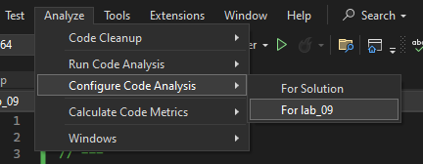
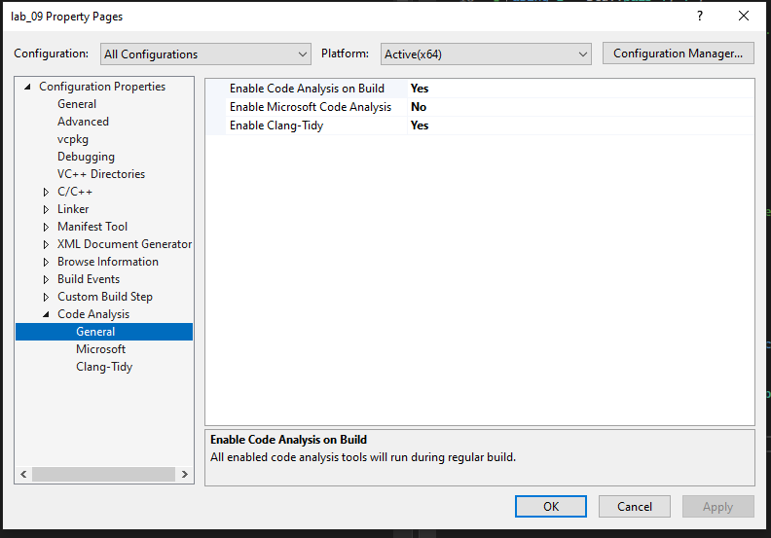
Intermezzo: better formatter and linter
Provide .clang-format and .clang-tidy configurations to the root directory of your project
https://gitlab.mff.cuni.cz/teaching/nprg041/mejzlik/labs-cpp-pub
CTRL+K, Ctrl + D -> format the source file
On compilation, you'll get linting warnings tips
Based on your configured rule sets in clang-tidy
2023/2024
Programming in C++ (labs)
38

Slide 39
Coding: The approach
The straightforward solution:
We can iterate over all elements and apply filters etc.
code
2023/2024
Programming in C++ (labs)
39

Slide 40
Wrapping it up…

Slide 41
Lab wrap up
You should know
How to use functors and lambdas
How to work with random numbers
How to overload different operators
Next lab:
C++20 ranges
RAII (Resource Acquisition Is Initialisation)
Your tasks until the next lab:
Deliver your term project specification!
One page specifying what it will do, what it will not do
What third-party libraries will you use
The ReCodex assignment #3 - will be used 18. 12. 2023
Task 9 (24h before, so I can give feedback).
2023/2024
Programming in C++ (labs)
41

