Slide 1
Lab 8
STD algorithm library, STD filesystem,
measuring time with std::chrono
23. 10. 2023

Slide 2
Outline
STD algorithms
STD filesystem library
Measuring time with std::chrono
Task 08 - recursive file searcher
2023/2024
Programming in C++ (labs)
2

Slide 3
1) STD algorithms

Slide 4
Motivation
It makes code more expressive
Less readable code, more useful work
Avoid common mistakes
Like off-by-one problems
Battle-tested and reasonably performant
Readibility
same interface across all C++ users
The part about algorithms is well presented in the cppcon talk here
Further reading
https://www.youtube.com/watch?v=2olsGf6JIkU
2023/2024
Programming in C++ (labs)
4

Slide 5
Overview of <algorithm>
#include <algorithm>
Permutations
Playing with the order of elements inside some range
Queries
Do not mutate the source ranges
Just retrieve/compute/aggregate some information about the range
Set algorithms
on any sorted range
Element movers
copy, move
Value modifiers
Modify the values in ranges
Structure changers
Remove certain elements from the range
std::transform and std::for_each
range ~ anything you can iterate over
(e.g. a container, range, initializer_list)
C++20 brings even more power and flexibility to STD algorithms
There is no longer need to provide iterator pairs all the time. std::vector is implicitly convertible to a range
Further reading
https://en.cppreference.com/w/cpp/algorithm
https://en.cppreference.com/w/cpp/algorithm/ranges
2023/2024
Programming in C++ (labs)
5

Slide 6
Be aware that functions taking iterators cannot change the actual container size
Functions in the algorithm library cannot change the size of the actual underlying structure
They can only work on the range provided
Move things around
Change values
Read values and compute things from it
E.g. function `std::pop_heap(it_begin, it_end);` cannot change the size of the underlying structure
It will leave the "popped" value at the end
You will need to call vec.pop_back() separately
2023/2024
Programming in C++ (labs)
6

Slide 7
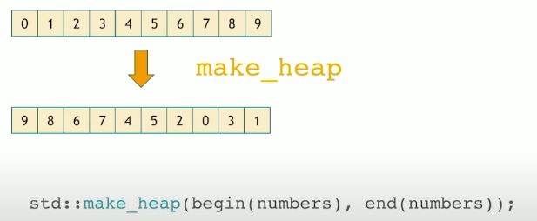
Permutations: heaps
For contiguous memory ranges
std::make_heap
Creates the heap structure in-place in the vector
std::push_heap
Takes the last element and inserts it into the heap
std::pop_heap
Moves the first element to the back, and creates heap on the range without the last element
2023/2024
Programming in C++ (labs)
7

Slide 8
Permutations: heaps
std::vector<int> xs1({3, 2, 4, 1, 5, 9});
// initially: 3 2 4 1 5 9
// Making the heap from range
std::make_heap(xs1.begin(), xs1.end());
// after make_heap: 9 5 4 1 2 3
// Pushing new element into the heap
xs1.push_back(10);
// after push_back: 9 5 4 1 2 3 10
std::ranges::push_heap(xs1); //< Using ranges!
// after push_heap: 10 5 9 1 2 3 4
// Poping the heap element
std::pop_heap(xs1.begin(), xs1.end());
// after pop_heap : 9 5 4 1 2 3 10
xs1.pop_back();
// after pop_back: 9 5 4 1 2 3
2023/2024
Programming in C++ (labs)
8

Slide 9
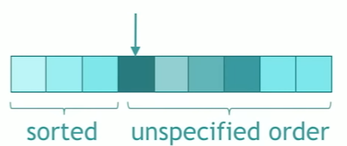
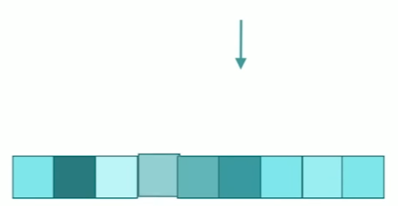
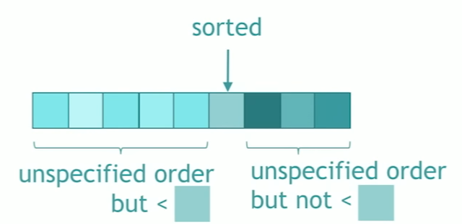
Permutations: sorting
std::sort
Sorts the provided range
std::partial_sort
Sorts the first `(middle - begin)` elements from the whole range and leaves them in the beginning
std::nth_element
Puts the element to the provided middle iterator what would be there if the range was sorted
the rest is in unspecified order
2023/2024
Programming in C++ (labs)
9

Slide 10
Permutations: sorting
std::vector<int> xs1({ 4, 9, 5, 1, 2, 3 });
std::vector<int> xs2, xs3, xs4, xs5;
xs2 = xs3 = xs4 = xs5 = xs1;
// initially: 3 2 4 1 5 9
std::stable_sort(xs1.begin(), xs1.end());
// after sort : 1 2 3 4 5 9
std::ranges::sort(xs2);
// after ranges sort : 1 2 3 4 5 9
std::ranges::sort(std::ranges::reverse_view(xs3));
// after reverse ranges sort : 9 5 4 3 2 1
std::partial_sort(xs4.begin(), xs4.begin() + 3, xs4.end());
// after partial_sort with mid 3: 1 2 3 9 5 4
std::nth_element(xs5.begin(), xs5.begin() + 3, xs5.end());
// after nth_element with mid 3: 3 2 1 4 9 5
2023/2024
Programming in C++ (labs)
10

Slide 11
Permutations: partitioning
Separates the range into those returning true from predicate
These are at the beginning
2023/2024
Programming in C++ (labs)
11

Slide 12
Permutations: partitioning
std::forward_list<int> xs1 {0, 1, 2, 3, 4, 5, 6, 7, 8, 9};
std::forward_list<int> xs2, xs3, xs4, xs5;
xs2 = xs3 = xs4 = xs5 = xs1;
// Returns partition point
auto par_point1 = std::partition(xs1.begin(), xs1.end(), [](int i) {return i % 2 == 0; });
// par_point1: 5
// after partition : 0 2 4 6 8 5 3 7 1 9
// Returns subrange to the second group
auto subrange = std::ranges::partition(xs2, [](int i) {return i % 2 == 0; });
// subrange: 5 3 7 1 9
// after partition : 0 2 4 6 8 5 3 7 1 9
2023/2024
Programming in C++ (labs)
12

Slide 13
Permutations: rotate and shuffle
std::rotate
Takes element from the back and puts it into the front
std::shuffle
std::next_permutation/prev_permutation
Useful if you want to iterate over all possible permutations
std::reverse
in-place reverse of the range
2023/2024
Programming in C++ (labs)
13

Slide 14
Permutations: rotate and shuffle
std::deque<int> xs1({1, 2, 3, 4, 5 });
std::deque<int> xs2, xs3, xs4, xs5, xs6;
xs2 = xs3 = xs4 = xs5 = xs6 = xs1;
// initially: 1 2 3 4 5
// simple rotation to the left
std::rotate(xs1.begin(), xs1.begin() + 2, xs1.end());
// rotate left by 2: 3 4 5 1 2
// simple rotation to the right
std::rotate(xs2.rbegin(), xs2.rbegin() + 2, xs2.rend());
// rotate right by 2: 4 5 1 2 3
// Shuffle randomly
std::random_device rd;
std::mt19937 g(rd());
std::shuffle(xs3.begin(), xs3.end(), g);
// shuffle: 3 1 2 5 4
std::ranges::shuffle(xs4, g);
// range shuffle: 1 4 2 5 3
// Next permutation
std::next_permutation(xs5.begin(), xs5.end());
// next permutation: 1 2 3 5 4
// Prev permutation
std::ranges::prev_permutation(xs6);
// prev permutation: 5 4 3 2 1
2023/2024
Programming in C++ (labs)
14

Slide 15
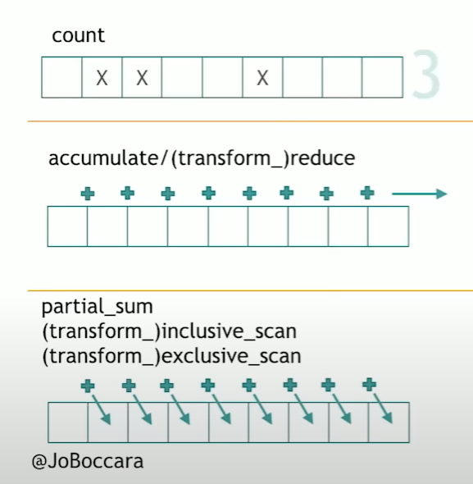
Queries
#include <numeric>
count
reduce
inclusive_scan
https://www.fluentcpp.com/2018/07/10/105-stl-algorithms-in-less-than-an-hour/
2023/2024
Programming in C++ (labs)
15

Slide 16
Queries
std::vector<int> xs1({ 1, 2, 3, 4, 5 });
// Use count
auto cnt1 = std::count(xs1.begin(), xs1.end(), 4);
// # elems == 4: 1
// Use count_if
auto cnt2 = std::count_if(xs1.begin(), xs1.end(),
[](int x) -> bool { return x >= 4; });
// # elems >= 4: 2
// Using reduce to sum
int sum = std::reduce(xs1.begin(), xs1.end());
// total sum: 15
// Inclusive sum
std::vector<int> incl_sum(xs1.size());
std::inclusive_scan(xs1.begin(), xs1.end(), incl_sum.begin());
// cumulative sum: 1 3 6 10 15
2023/2024
Programming in C++ (labs)
16

Slide 17
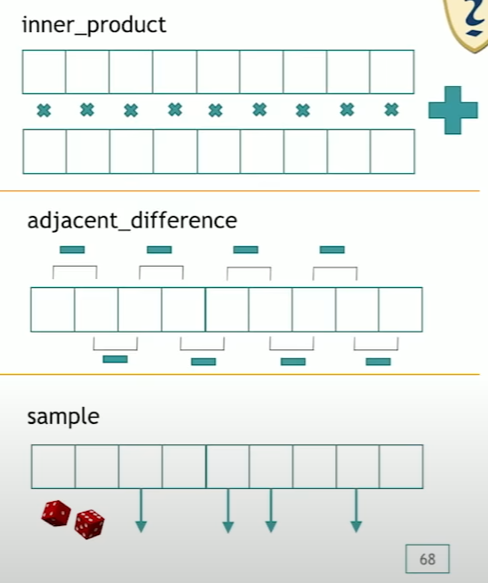
More queries
inner_product -> dot product
adjacent_difference
sample
https://www.fluentcpp.com/2018/07/10/105-stl-algorithms-in-less-than-an-hour/
2023/2024
Programming in C++ (labs)
17

Slide 18
More queries
// Example 1: Use std::inner_product to calculate the dot product of two vectors
std::vector<int> xs1 = { 1, 2, 3, 4, 5 };
std::vector<int> ys1 = { 2, 4, 6, 8, 10 };
int dot_product = std::inner_product(xs1.begin(), xs1.end(), ys1.begin(), 0);
// Dot product of xs1 and ys1: 110
// Example 2: Use std::adjacent_difference to calculate the differences between adjacent elements
std::vector<int> differences(xs1.size());
std::adjacent_difference(xs1.begin(), xs1.end(), differences.begin());
// The first element is untouched
// Adjacent differences: 1 1 1 1 1
// Example 3: Use std::sample to randomly sample elements from xs1
std::vector<int> sampled;
std::mt19937 generator(std::random_device{}());
std::sample(xs1.begin(), xs1.end(), std::back_inserter(sampled), 2, generator);
// Randomly sampled elements: 4 5
https://www.fluentcpp.com/2018/07/10/105-stl-algorithms-in-less-than-an-hour/
2023/2024
Programming in C++ (labs)
18

Slide 19
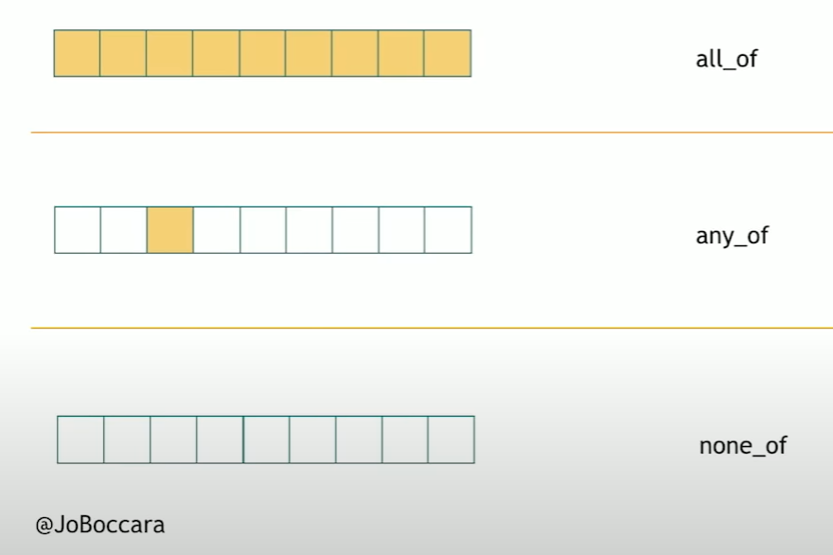
Queries: logical quantifiers
all_of
any_of
none_of
https://www.fluentcpp.com/2018/07/10/105-stl-algorithms-in-less-than-an-hour/
2023/2024
Programming in C++ (labs)
19

Slide 20
Queries: logical quantifiers
std::vector<int> xs1({ 2, 4, 6 });
std::cout << std::all_of(
xs1.cbegin(), xs1.cend(), [](int i) { return i % 2 == 0; }) << std::endl;
// 1
std::cout << std::none_of(
xs1.cbegin(), xs1.cend(), [](int i) { return i % 2 != 0; }) << std::endl;
// 1
std::cout << std::any_of(
xs1.cbegin(), xs1.cend(), [](int i) { return i % 2 != 0; }) << std::endl;
// 0
2023/2024
Programming in C++ (labs)
20

Slide 21
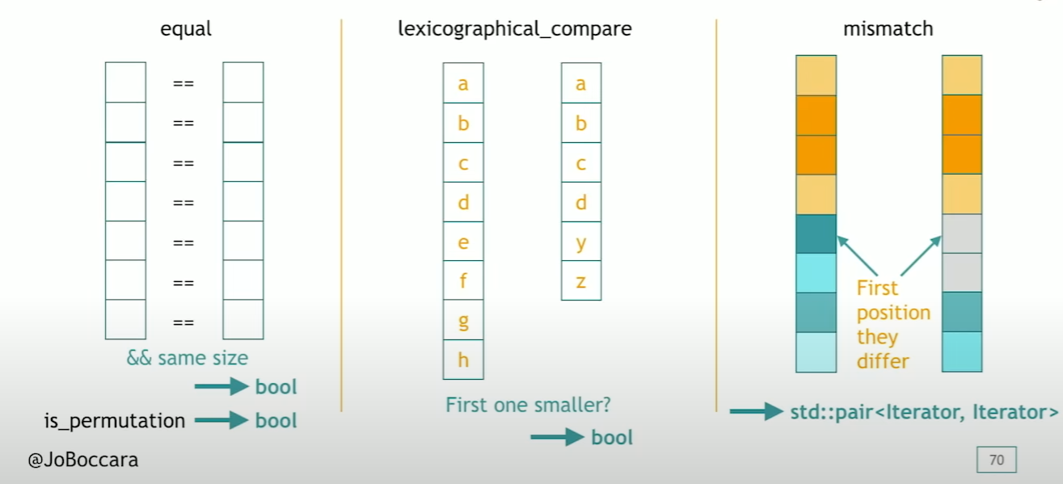
Queries: comparing ranges
equal
lexicographical_compare
mismatch
https://www.fluentcpp.com/2018/07/10/105-stl-algorithms-in-less-than-an-hour/
2023/2024
Programming in C++ (labs)
21

Slide 22
Queries: comparing ranges
std::deque<int> xs1({ 1, 2, 3, 4, 5 });
std::deque<int> xs2({ 1, 2, 3, 4, 4 });
// Example 1: Use std::equal to check if two ranges are equal
bool are_equal = std::equal(xs1.begin(), xs1.end(), xs2.begin());
std::cout << std::boolalpha << are_equal << std::endl;
// false
// Example 2: Use std::lexicographical_compare to check the lexicographical order of two ranges
bool is_less = std::lexicographical_compare(xs2.begin(), xs2.end(), xs1.begin(), xs1.end());
std::cout << std::boolalpha << is_less << std::endl;
// true
// Example 3: Use std::mismatch to find the first position where two ranges differ
auto [fst_it, snd_it] = std::mismatch(xs1.begin(), xs1.end(), xs2.begin());
// *fst_it: 5, *snd_it: 4
2023/2024
Programming in C++ (labs)
22

Slide 23
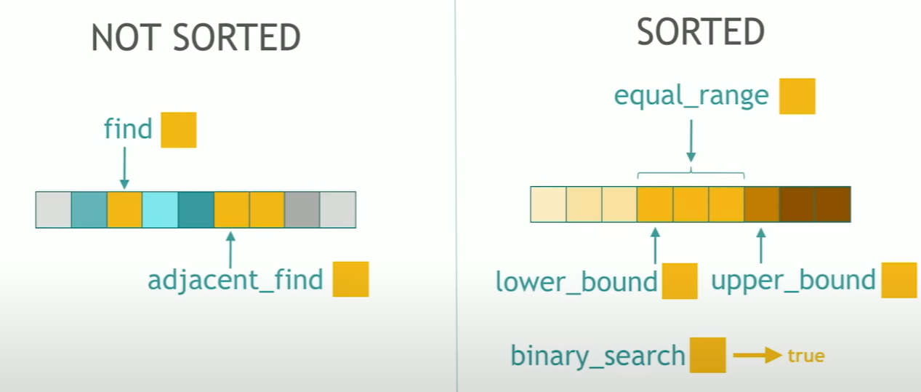
Queries: searching for values
find
adjacent_find
lower_bound
upper_bound
binary_search
returns bool, not iterator!
https://www.fluentcpp.com/2018/07/10/105-stl-algorithms-in-less-than-an-hour/
2023/2024
Programming in C++ (labs)
23

Slide 24
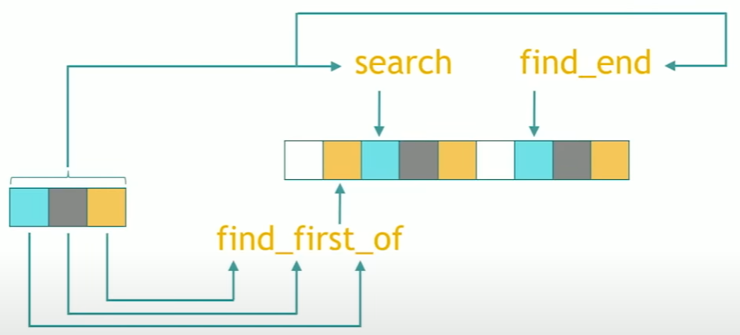
Queries: searching for range of values
Search for the sequence of elements
search
find_end
Search for one of the sequence elements
find_first_of
https://www.fluentcpp.com/2018/07/10/105-stl-algorithms-in-less-than-an-hour/
2023/2024
Programming in C++ (labs)
24

Slide 25
Queries: searching for relative values
max_element
min_element
minmax_element
https://www.fluentcpp.com/2018/07/10/105-stl-algorithms-in-less-than-an-hour/
2023/2024
Programming in C++ (labs)
25

Slide 26
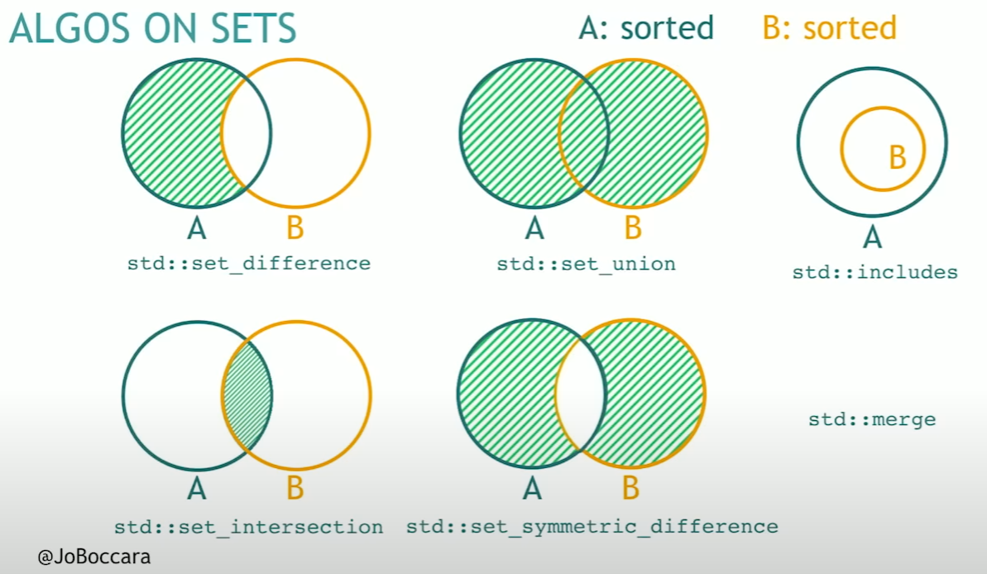
Algorithms on sets / sorted ranges
From the POV of the algorithm library, a set is any sorted container (also sorted std::vector)
i.e. iterators must iterate in a specific order
They are in O(n) time since they rely on the fact the inputs are sorted
https://www.fluentcpp.com/2018/07/10/105-stl-algorithms-in-less-than-an-hour/
2023/2024
Programming in C++ (labs)
26

Slide 27
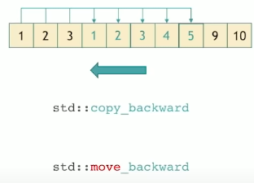
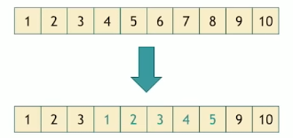
Element movers: backwards_copy/move
copy_backwards
move_backwards
How to transform this, into the bottom one?
we need to copy from the back to not rewrite the values that we will need
https://www.fluentcpp.com/2018/07/10/105-stl-algorithms-in-less-than-an-hour/
2023/2024
Programming in C++ (labs)
27

Slide 28
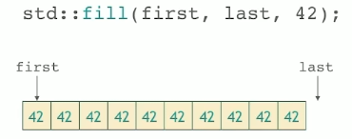
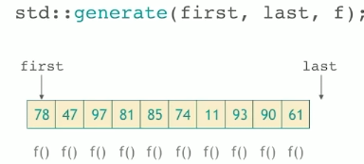
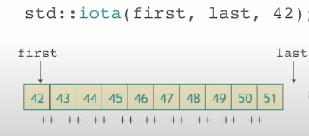
Value modifiers
fill
generate
function callable without any parameters
iota
fills with incremented values
replace
replaces the given values with the provided new value
https://www.fluentcpp.com/2018/07/10/105-stl-algorithms-in-less-than-an-hour/
2023/2024
Programming in C++ (labs)
28

Slide 29
Structure changers
remove
Does not change the size of the underlying container
Iterators cannot do that, they cannot change the size
pre-C++20 -> erase-remove idiom
https://en.wikipedia.org/wiki/Erase%E2%80%93remove_idiom
C++20, free functions
std::erase
does the erase-remove idiom for you
https://www.fluentcpp.com/2018/07/10/105-stl-algorithms-in-less-than-an-hour/
2023/2024
Programming in C++ (labs)
29

Slide 30
Structure changers
std::vector<int> xs1 = { 1, 2, 3, 4, 2, 5, 2, 6 };
// Example 1: Use std::remove with the remove-erase idiom to remove specific elements
int to_remove = 2;
auto it_to_erase = std::remove(xs1.begin(), xs1.end(), to_remove);
print("After removing " + std::to_string(to_remove), xs1);
// After removing 2: 1 3 4 5 6 2 2 2
// The 2s are left at the end, returned iterator to the first 2
xs1.erase(it_to_erase, xs1.end());
print("After erasing " + std::to_string(to_remove), xs1);
// After erasing 2: 1 3 4 5 6
// Example 2: Use std::erase to remove specific elements (C++20 and later)
std::erase(xs1, 4);
print("After removing 4 using std::erase", xs1);
// After erasing 4 using std::erase: 1 3 5 6
2023/2024
Programming in C++ (labs)
30

Slide 31
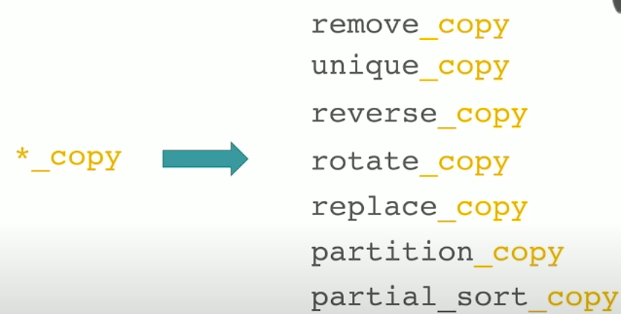
*_copy modifier
Algorithms that work in-place will produce the output to some other range
https://www.fluentcpp.com/2018/07/10/105-stl-algorithms-in-less-than-an-hour/
2023/2024
Programming in C++ (labs)
31

Slide 32
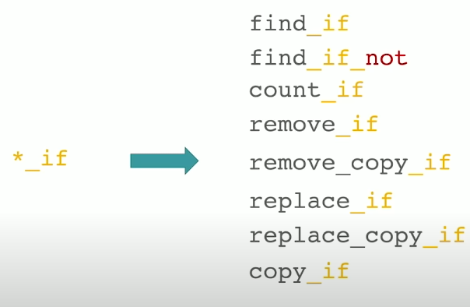
*_if modifier
Will do the operation on the element only if provided predicate holds (returns true)
https://www.fluentcpp.com/2018/07/10/105-stl-algorithms-in-less-than-an-hour/
2023/2024
Programming in C++ (labs)
32

Slide 33
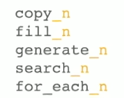
*_n modifier
Changes the interface
From [begin, end) to [begin, begin + N)
This inserts 5 elements of value 42 to the collection:
https://www.fluentcpp.com/2018/07/10/105-stl-algorithms-in-less-than-an-hour/
2023/2024
Programming in C++ (labs)
33

Slide 34
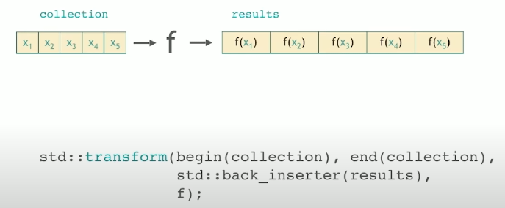
std::transform
Applies a function to a range
https://www.fluentcpp.com/2018/07/10/105-stl-algorithms-in-less-than-an-hour/
2023/2024
Programming in C++ (labs)
34

Slide 35
std::for_each
The function can return void
It is made for function f that does side effects
https://www.fluentcpp.com/2018/07/10/105-stl-algorithms-in-less-than-an-hour/
2023/2024
Programming in C++ (labs)
35

Slide 36
std::transform & std::for_each
std::vector<int> numbers = { 1, 2, 3, 4, 5 };
// Lambda to print each element in the vector
auto print_element = [](auto&& x) { std::cout << x << " "; };
// Lambda to square each element in the vector (used with std::transform)
auto square = [](auto&& x) -> int { return x * x; };
// Example 1: Use std::for_each to print each element (side effect)
std::for_each(numbers.begin(), numbers.end(), print_element);
// 1 2 3 4 5
// Example 2: Use std::transform to square each element in the vector
std::vector<int> squared_numbers(numbers.size());
std::transform(numbers.begin(), numbers.end(), squared_numbers.begin(), square);
// Print the squared numbers
std::for_each(squared_numbers.begin(), squared_numbers.end(), print_element);
// 1 4 9 16 25
2023/2024
Programming in C++ (labs)
36

Slide 37
2) STD filesystem

Slide 38
Overview of <filesystem>
#include <filesystem>
Library for manipulating the filesystem
Most operations throw, so handle that
Create/delete files/directories/hard links/symlinks
Copy/move directories/files
Iterating over directory entries
Even recursively
Option to follow symlinks
Reading file metadata
size, permissions, …
Further reading
https://en.cppreference.com/w/cpp/filesystem
2023/2024
Programming in C++ (labs)
38

Slide 39
Create, delete & copy, move
namespace fs = std::filesystem;
fs::create_directory("example_directory");
fs::create_directories("example/dir");
// Place your file creation or manipulation code here
fs::remove_all("example_directory"); // Deletes the directory and its contents
fs::remove("somefile.txt");
fs::copy("source_directory", "destination_directory"); // Copy
fs::rename("source_directory", "new_directory_name"); // Move/Rename
2023/2024
Programming in C++ (labs)
39

Slide 40
Iterating over directory entries
// Recursive iterator that DOES NOT follow symlinks
for (const auto& entry : fs::recursive_directory_iterator("./some_dir/")) {
std::cout << entry.path() << std::endl;
}
// Recursive iterator that follows symlinks
for (const auto& entry : fs::recursive_directory_iterator(
"./some_dir/", fs::directory_options::follow_directory_symlink)) {
std::cout << entry.path() << std::endl;
}
2023/2024
Programming in C++ (labs)
40

Slide 41
Reading metadata
// Prints the permissions like `ls -l`
void print_perms(std::filesystem::perms p)
{
using std::filesystem::perms;
auto show = [=](char op, perms perm)
{
std::cout << (perms::none == (perm & p) ? '-' : op);
};
show('r', perms::owner_read);
show('w', perms::owner_write);
show('x', perms::owner_exec);
show('r', perms::group_read);
show('w', perms::group_write);
show('x', perms::group_exec);
show('r', perms::others_read);
show('w', perms::others_write);
show('x', perms::others_exec);
std::cout << std::endl;
}
for (const auto& entry : fs::directory_iterator("file_directory")) {
std::cout << "File: " << entry.path() << std::endl;
std::cout << "Size: " << fs::file_size(entry) << " bytes" << std::endl;
print_perms(fs::status(entry).permissions());
}
2023/2024
Programming in C++ (labs)
41

Slide 42
3) Measuring time with C++ (std::chrono)

Slide 43
Overview of <chrono>
#include <chrono>
Library for measuring time
The wall clock is the normal time we are used to
A steady clock can be used only to measure relative times
Also for calendar functionality
Further reading
https://en.cppreference.com/w/cpp/chrono
2023/2024
Programming in C++ (labs)
43

Slide 44
How you can measure time in C++
Via <ctime>
Nah, it's too C
std::chrono
The syntax is quite long!
void long_function() {
// Place your function code here
for (int i = 0; i < 1000000; ++i) {
// Some computation
}
}
int main() {
auto start_time = std::chrono::high_resolution_clock::now();
// Call the function whose runtime you want to measure
long_function();
auto end_time = std::chrono::high_resolution_clock::now();
auto duration = std::chrono::duration_cast<std::chrono::microseconds>(end_time - start_time);
std::cout << "Runtime: " << duration.count() << " microseconds" << std::endl;
}
2023/2024
Programming in C++ (labs)
44

Slide 45
Task 8

Slide 46
Recursive file searcher (like grep)
Start from:
https://gitlab.mff.cuni.cz/teaching/nprg041/mejzlik/labs-cpp-pub/-/blob/master/lab_08/lab_08.cpp
Write a program that will recursively search the provided directory for per-line occurrences in those files
Will work only with directories, not single files
It will print the results in the given format (if `world` was the query):
[/abs/path/to/file.txt] Hello world!
On the last line, there will be a number of milliseconds (as integer, no floating point) it took to run the search
We will call it like this
lab_08 world ./dir/
Will traverse all files in the ./dir/ as well as all the subsequent directories
Do not follow symlinks
2023/2024
Programming in C++ (labs)
46

Slide 47
Example inputs
For `tests/test1/` in the public repo:
https://gitlab.mff.cuni.cz/teaching/nprg041/mejzlik/labs-cpp-pub/-/tree/master/lab_08/tests/test1
input: lab_08 brambory ./tests/test1/
On my computer, I'd get this:
You should get different absolute paths to the files
[C:\Users\frank\source\repos\cpp-labs\cpp-labs\lab_08\tests\test1\a.txt] Ahoj brambory!
[C:\Users\frank\source\repos\cpp-labs\cpp-labs\lab_08\tests\test1\dir2\b.txt] Ahoj brambory!
[C:\Users\frank\source\repos\cpp-labs\cpp-labs\lab_08\tests\test1\dir2\c.txt] Ahoj brambory!
2
2023/2024
Programming in C++ (labs)
47

Slide 48
Wrapping it up…

Slide 49
Lab 8 wrap up
You should know
Next lab:
Lambdas, functors
Operator overloading
Random numbers
Your tasks until the next lab:
Task 8 (24h before, so I can give feedback).
Just a directory lab_05 with one CPP file will do
2023/2024
Programming in C++ (labs)
49

Slide 50
ReCodex assignment 3
This one will be used as a basis for the extension for the mock term exam (18. 12. 2023)!
The better you code the assignment, the easier will be for you to extend it!
You will get an email when the assignment is ready in ReCodex.
It is a new assignment created by me, so there may be some technical issues
Feel free to contact me if you encounter some!
2023/2024
Programming in C++ (labs)
50

