Slide 1
Lab 5
exceptions, number parsing, casts,
inheritance and polymorphism
23. 10. 2023

Slide 2
Outline
Exceptions
Number parsing
Casting
Inheritance
Dynamic polymorphism
2023/2024
Programming in C++ (labs)
2

Slide 3
0) Previously in C++ labs

Slide 4
What is wrong #1?
The idea is good, to reuse copy constructor
But the copy must be moved to `this`
*this = std::move(ret)
return *this;
Bst& Bst::operator=(const Bst& bst) {
Bst ret(bst);
return ret;
}
Returning a reference to local variable.
2023/2024
Programming in C++ (labs)
4

Slide 5
What is wrong #2?
The code says:
Find class `Node`, and call a constructor that would accept `Node&` as a parameter
Node contains unique_ptr, it is not copyable by default
This is not deep copy!
mff::Bst::Node::Node(const mff::Bst::Node &)': attempting to reference a deleted function
Bst::Bst(const Bst& other) {
if (other._p_tree) {
_p_tree = make_unique<Node>(*other._p_tree); // Deep copy the root node
}
}
2023/2024
Programming in C++ (labs)
5

Slide 6
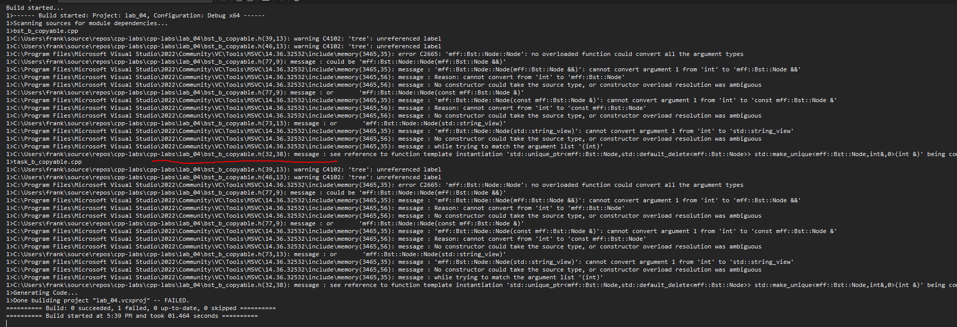
What is wrong #3?
You write this, and you get this mess!
Bst(int key) : _p_tree{ std::make_unique<Node>(key) } {}
code
2023/2024
Programming in C++ (labs)
6

Slide 7
What is wrong #4?
If assigning to self, we’d loose the data
What if `&tree` == `this`
Bst& Bst::operator=(const Bst& tree) {
// Clear the current tree
_p_tree.reset();
// Do the deep copy of the new one
for (auto&& key : tree.keys())
insert(key);
}
2023/2024
Programming in C++ (labs)
7

Slide 8
Always remember about self-assignment
When implementing operator=, always think about what happens if the `other` is the same instance as `*this`
If statement for optimization
Beware of some weird behaviour
In our Bst class, it only means extra copying
It is still correct
2023/2024
Programming in C++ (labs)
8

Slide 9
From the submitted labs
Good
reusing the existing code
reuse the copy constructor in operator= implementation
!Good
decorating methods as noexcept
For now, use only with destructors
Putting default/delete into .cpp files
Implementing move ctor/operator= when not needed
In our case, compiler implementation is OK (we used it in rule of 0 version)
Bst::~Bst() noexcept = default;
Bst::Bst() = default;
2023/2024
Programming in C++ (labs)
9

Slide 10
1) Exceptions

Slide 11
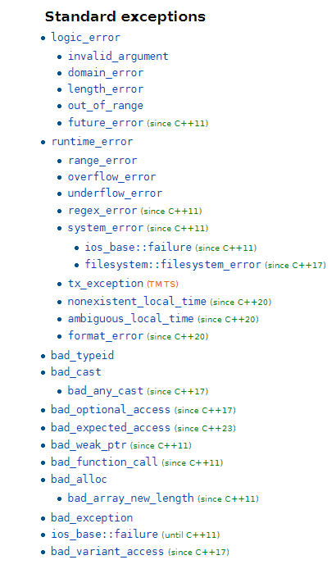
Exceptions in C++
#include <stdexcept>
You can throw anything. But don’t!
Throw instances of std::exception, there are many
https://en.cppreference.com/w/cpp/error/exception
Add your own message
They have a method .what()
You can define your own class for exceptions
Inherit from standard exceptions
2023/2024
Programming in C++ (labs)
11

Slide 12
Exceptions in C++
#include <stdexcept>
try {
throw std::runtime_error("Nooooo!");
} catch (const int& e) { // Cathces ints
cout << e << endl;
} catch (const std::exception& e) { // Catches std::exceptions + derived
cout << e.what() << endl;
} catch (...) { // catches all
cout << "Some except!" << endl;
}
2023/2024
Programming in C++ (labs)
12

Slide 13
Task 4 c): Exceptions
std::runtime_error
Use exceptions to signal any runtime error inside the tree methods.
Our BST will be an aggressive one! We throw whenever something is a bit off.
Catch these exceptions during usage of BST and print the according messages
Interface:
insert(x)
Throw if x is already present
Message: "The item is already present!"
erase(x)
Throw if not present
Message: "No item to erase!"
contains(x)
Throw if not there
Message: "The item is not present!"
keys()
Does not throw (noexcept)
2023/2024
Programming in C++ (labs)
13

Slide 14
Task 4 c): Example inputs
hey
jude,
don't
make
it
bad.
=end=
hey
hey
it
it
jude,
jude,
bad.
bad.
make
make
don't
don't
D: hey
"No item to erase!"
D: it
"No item to erase!"
D: jude,
"No item to erase!"
D: bad.
"No item to erase!"
D: make
"No item to erase!"
D: don't
"No item to erase!"
hey
hey
jude
don't
make
make
=end=
hey
hey
"The item is already present!"
"The item is already present!"
D: hey
"No item to erase!"
2023/2024
Programming in C++ (labs)
14

Slide 15
2) Number parsing

Slide 16
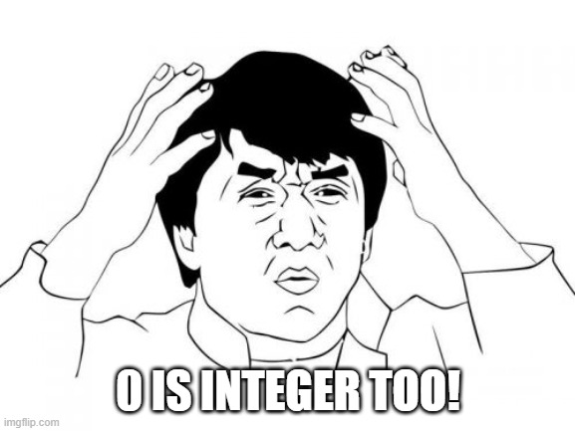
atoid, std::stoi, streams, from_chars
int i = atoi("42");
double d = atof("3.14");
Error signaled by returnin 0…. what?
C style - atoi, atof, …
#include <cstdlib>
C++ std::stoi, std::stof, …
#include <string>
Slow, simple to use
using C++ streams
#include <sstream>, <iostream>
Slow, simple to use
Using std::from_chars
#include <charconv>
Fast, low-level and unfriendly
int i = std::stoi("42");
double d = std::stod("3.14");
These throw exceptions on error
std::stringstream ss("42 3.14");
int i;
double d;
ss >> i >> d;
cin >> d;
These set bad bits, have overloaded bool() operator
std::string str = "42";
int value = 0;
auto [ptr, ec] = std::from_chars(str.data(), str.data() + str.size(), value);
if (ec == std::errc())
std::cout << "Parsed int value: " << value << std::endl;
else
std::cout << "Parsing failed" << std::endl;
2023/2024
Programming in C++ (labs)
16

Slide 17
Parsing number takeaway
Avoid C a-to-whatever
If performance is not an issue
use streams
or std::s-to-whatever
If performance is an issue
be careful
use std::from_chars
2023/2024
Programming in C++ (labs)
17

Slide 18
Task 4 d): Extend to support floats, ints, strings
std::variant
Extend it so the values in the nodes can be strings, ints or floats.
If you can't parse as other types, it is a string
Floats contain decimal dots, integers do not
Ordering: floats < strings < ints
Use `class Bst` to do the same as in Task 2 and 3 with the following changes:
When deleting the node, write also its type
string node "hey": "D: (s)hey"
int node -954: "D: (i)-954"
string float 19.255555: "D: (f)19.3" (print one decimal place!)
#include <iomanip>, std::setprecision, std::fixed
When EOF is parsed, print the remaining values in their ASC order in the following format:
(f)3.14 (f)19.3 (s)hey (s)jude (i)-22 (i)0 (i)954
std::variant::has_alternative or std::visit
2023/2024
Programming in C++ (labs)
18

Slide 19
Coding: std::variant
#include <variant>
since C++17
A union type
Holds exactly one instance of any of the provided types
Initialize
std::variant<int, float> v(12); // int
v = 42.0f;
To check what type is inside
std::holds_alternative<int>(v)
If you know what type is inside
std::get<float>(w)
Further reading
https://en.cppreference.com/w/cpp/utility/variant
2023/2024
Programming in C++ (labs)
19

Slide 20
Coding: std::variant
#include <variant>
since C++17
Cool thing: std::visit - on list of std::variants, it calls the correct function
// helper type for the visitor #4
template<class... Ts>
struct overloaded : Ts... { using Ts::operator()...; };
using BaseType = std::variant<int, float, double, std::string>;
std::vector<BaseType> vec = { 10, 1.3f, 1.5, "hello" };
for (auto& v: vec)
visit([](auto&& arg){cout << arg; }, v);
for (auto& v : vec)
visit(overloaded{
[](double arg) { cout << "(d)" << fixed << setprecision(2) << arg << endl; },
[](float arg) { cout << "(f)" << fixed << setprecision(1) << arg << endl; },
[](const string& arg) { cout << "(s)" << quoted(arg) << endl; },
[](auto arg) { cout << "(?)" << arg << endl; }
}, v);
std::variant
Any object that has operator()
code
Further reading
2023/2024
https://en.cppreference.com/w/cpp/utility/variant/visit
Programming in C++ (labs)
20

Slide 21
Task 4 d): Example inputs
hey
19.3
19.3
jude,
don't
3.14
16.8
-156
make
-156
954
0
make
it
-22
bad.
=end=
it
it
bad.
bad.
16.8
make
don't
-156
"The item is already present!"
"The item is already present!"
"The item is already present!"
D: (s)it
"No item to erase!"
D: (s)bad.
"No item to erase!"
D: (f)16.8
D: (s)make
D: (s)don't
D: (i)-156
(f)3.14 (f)19.3 (s)hey (s)jude (i)-22 (i)0 (i)954
2023/2024
Programming in C++ (labs)
21

Slide 22
3) Casting in C++

Slide 23
C-style cast and functional-style cast
C-style cast
Too powerful: tries all possible combinations const_cast, static_cast, reinterpret_cast
Do not use!
Does to many things!
functional-style cast
almost the same as C-style
only one-word types allowed
no CV-qualifiers
int i = 42;
double d = (double)i;
double p = (const char*)i;
int i = 42;
double d = double(i);
2023/2024
Programming in C++ (labs)
23

Slide 24
static_cast<T>(x)
Compile-time type conversion
There must be a defined way of conversion
E.g. implicit/explicit constructors From -> To
This is usually safe
When casting from Base class to Derived, be sure that it is Derived
No checks
If not sure -> dynamic_cast!
// Enum to float
int i = 42;
float f = static_cast<float>(i);
// Enum to int
enum class Color { RED, GREEN, BLUE };
int value = static_cast<int>(Color::RED);
auto p_orig = make_unique<Derived>();
// Pointer downcasting
Base* p_b = static_cast<Base*>(p_orig.get());
// Pointer downcasting (with caution!!!)
Derived* p_d = static_cast<Derived*>(p_b);
2023/2024
Programming in C++ (labs)
24

Slide 25
dynamic_cast<T>(x)
Works only on polymorphic types
class/struct with at least one virtual method
Used to cast between pointers/references of derived/base class
Use for safe downcasting (casting from base to derived)
Does runtime check
If unable, returns nullptr
In case of reference, throws std::bad_cast
Base* b_ptr = new Base();
Derived* d_ptr = dynamic_cast<Derived*>(b_ptr);
if (!d_ptr) {
std::cout << "Downcasting failed!";
}
Base& b_ref = *new Base();
try {
Derived& d_ref = dynamic_cast<Derived&>(b_ref);
d_ref.bar();
} catch (std::bad_cast& e) {
std::cout << "Downcasting failed: " << e.what();
}
2023/2024
Programming in C++ (labs)
25

Slide 26
const_cast<T>(x)
Used to remove a const qualifier
The underlying data must be non-const!
int x1 = 10;
const int x2 = 20;
process_int(x1); // OK
process_int(x2); // UB, x2 is const
// Can be called with non-const parameter
void process_int(const int& val) {
int& r = const_cast<int&>(val);
r = 10; // OK
}
Const just went away
UB in this case!
If you cast away const and modify the value that is const itself, it us UB
2023/2024
Programming in C++ (labs)
26

Slide 27
reinterpret_cast<T>(x)
Strong cast for pointers/reference
Says to the compiler that it should represent the underlying data as type T
Useful for e.g. loading binary data
Let's say we have a vector of 100 ints in a binary file
Make sure that the endianness of CPU and the file matches
Load as a bunch of bytes
Reinterpret pointer to int*
size_t n = 100;
unsigned char* p_byte_buffer;
// From now on, we behave like there is an array of ints
int* p_ints = reinterpret_cast<int*>(p_byte_buffer);
2023/2024
Programming in C++ (labs)
27

Slide 28
4) Inheritance and polymorphism

Slide 29
Classes can inherit from each other
Just as in C#
But multiple inheritance is allowed
Be careful with that
Use only one as the real base class
The rest, just as "interfaces"
If the class has at least one virtual function it defines a polymorphic type
If holding a reference/pointer to a polymorphic type and calling a virtual method, the dynamic dispatch and vtable is used
class Base1 {};
class Base2 {};
class Derived1 : public Base1 {};
class Derived2 : public Base2 {};
class Derived12 : public Base1, public Base2 {};
2023/2024
Programming in C++ (labs)
29

Slide 30
Warning!
Whenever writing a base class for polymorphic types, write a virtual constructor for it even if it is `= default`
This will guarantee that the correct destructor will be called in the future when holding a pointer to derived class
In the opposite case, the compiler will see pointer to Base, the destructor is not virtual, it does not bother looking into vtable, and will not call the Derived destructor
If base for polymorphic, always:
virtual ~Base noexcept = default;
2023/2024
Programming in C++ (labs)
30

Slide 31
Typical use case for inheritance
Other possibilities:
use std::variant
Typical problem in practice
A container containing different types
int, double, string, complex, Bst, ...
Technicalites
Class GenVector
Common ancestor AbstractVal
Concrete types IntVal, StringVal, ...
E.g. for std::vector<T>
Think about the difference
Array of values
Array of pointers
IV
SV
IV
AV
x
AV
s
AV
x
2023/2024
Programming in C++ (labs)
31

Slide 32
Pointing to the specific type via the base type
class AbstractVal {
public:
virtual void print() = 0;
};
using Valptr = ӁԘΨ<AbstractVal>;
class GenVector {
public:
void add( Valptr p);
void print();
private:
vector<Valptr> pole_;
};
The abstract ancestor provides the interface
Vector of references/pointers
Type of the reference
What to use as ӁԘΨ ?
iterator
☹ kam - jiný kontejner
AbstractVal *
☹ low-level, alokace a dealokace
AbstractVal &
☹ na co reference
shared_ptr<AbstractVal>
☹ sdílení vlastnictví, runtime režie
unique_ptr<AbstractVal>
☺ vlastnictví
int main() {
GenVector s;
s.add( ӁԘΨ<IntVal>(123) );
s.add( ӁԘΨ<StringVal>("abc") );
s.print();
}
The usage
2023/2024
Programming in C++ (labs)
32

Slide 33
Using the generic pointer type
#include <memory>
class AbstractVal;
using Valptr = unique_ptr<AbstractVal>;
class GenVector {
public:
void add( Valptr p) { pole.push_back( move( p)); }
void print() { for(auto&& x : pole_) x->print(); }
private:
vector<Valptr> pole_;
};
unique_ptr ≈ ownership of the object
Using '->', this is a pointer
int main() {
Seznam s;
s.add( make_unique<IntVal>(123));
s.add( make_unique<StringVal>("456"));
s.print();
}
2023/2024
Programming in C++ (labs)
33

Slide 34
Constructing the specific types
class IntVal : public AbstractVal {
public:
IntVal( int x) : x_( x) {}
virtual void print() { cout << x_; }
private:
int x_;
};
class StringVal : public AbstractVal {
public:
StringVal( string x) : x_( x) {}
virtual void print() { cout << x_; }
private:
string x_;
};
class DoubleVal : public AbstractVal;
class ComplexVal : public AbstractVal;
class LongintVal : public AbstractVal;
class FractionVal : public AbstractVal;
2023/2024
Programming in C++ (labs)
34

Slide 35
What about copying such GenVector?
The move operation is handled correctly by the default implementation
Move semantics on std::unique_ptr is fine
The rule of 0
The default copy implementation is not correct
Deleted by default, std::unique_ptr cannot copy
We need to define it manually
The rule of 5
They are deleted thanks to std::unique_ptr
class Seznam {
....
Seznam( const Seznam& s) = delete;
Seznam& operator=(const Seznam& s) = delete;
};
copy constructor
and operator= should behave the same
2023/2024
Programming in C++ (labs)
35

Slide 36
Yeah, but I really need the copy!
The first try
Well, the std::unique_ptr :(
So let's copy the object itself
But what type shall we construct?
Base? It's abstract!
No worries, let's instantiate it!
GenVector& GenVector::operator=(const GenVector& s)
{
for( auto&& x : s._data)
_data.push_back( x);
return *this;
}
compiler error:
XXXX unique_ptr XXX attempting to reference a deleted function
GenVector& GenVector::operator=(const GenVector& s)
{
for( auto&& x : s._data)
_data.push_back( make_unique<AbstractVal>( *x));
return *this;
}
class AbstractVal {
public:
virtual void print() {}
};
compiler error:
cannot instantiate abstract class
Let's remove the abstract!
Don't do that -> slicing
2023/2024
Programming in C++ (labs)
36

Slide 37
Class slicing
You construct only the abstract class
Your derived fields will be missing
It will compile!
for( auto&& x : s._data)
_data.push_back( make_unique<AbstractVal>( *x));
We wanted this
IV
SV
IV
AV
x
AV
s
AV
x
But we get this!
The data fields of derived classes are gone!
AV
AV
AV
2023/2024
Programming in C++ (labs)
37

Slide 38
Whats is the solution?
You could add an enum value to the instance to see what type it is
Don't!
Use the abstract class as an interface that requires the derived classes to support a method to clone itself
The dynamic dispatch via virtual methods will "choose" the correct type implementation
Dynamic dispatch by the type of x
class AbstractVal {
public:
virtual void print() = 0;
virtual Valptr clone() = 0;
};
class IntVal : public AbstractVal {
....
virtual Valptr clone() override
{ return make_unique<IntVal>(*this); }
};
IV
AV
x
IV
... operator=(const Seznam& s)
{
for( auto&& x : s.pole_)
pole_.push_back( x->clone());
return *this;
}
AV
x
We construct the correct instance
*this if of type IntVal
2023/2024
Programming in C++ (labs)
38

Slide 39
Downcasting in polymorphic hierarchy
☺ AbstractVal* av = .... ( ConcreteVal{});
☹ ConcreteVal* cv = .... ( AbstractVal{..});
static_cast
You must be sure that the instance is actually the derived
Otherwise, use dynamic_cast
dynamic_cast
If the conversion is OK, it will happen and return correct reference/pointer
otherwise, it will
Throw if reference -> std::bad_conv
Return nullptr if pointers
class AbstractVal {
public:
virtual void print() = 0;
virtual bool operator< (const AbstractVal& rhs) const = 0;
};
The interface is a reference to the interface
class ConcreteVal : public AbstractVal {
....
bool operator< (const AbstractVal& rhs) const override
{ return this->x_ < static_cast<const ConcreteVal &>(rhs).x_; }
};
!!! BEWARE !!!
You must be sure, that the rhs is of ConcreteVal type, if it's not UB!
2023/2024
Programming in C++ (labs)
39

Slide 40
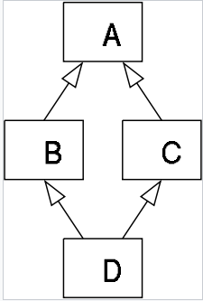
Beware of the diamond problem
The multiple inheritance feature allows this
In this case the instance of D would contain two copies of A's fields
There is ambiguity!
class A {
public:
void foo() { std::cout << ++_a << std::endl; };
int _a;
};
// ---
class B : public A {};
class C : public A {};
// ---
class D : public B, public C {}; D d;
// ERROR: ambiguous conversions from 'D *' to 'A *'
A* p_d = static_cast<A*>(&d);
Further reading
https://en.wikipedia.org/wiki/Multiple_inheritance
2023/2024
Programming in C++ (labs)
40

Slide 41
Solution to the diamond problem?
Change the design
Or use virtual inheritance
It changes the way it is handles
Apply it to the "middle classes"
class A {
public:
void foo() { std::cout << ++_a << std::endl; };
int _a;
};
// ---
class B : virtual public A {};
class C : virtual public A {};
// ---
class D : public B, public C {}; D d;
A* p_d = static_cast<A*>(&d);
There you go!
Compiles now! Only one copy of _a
2023/2024
Programming in C++ (labs)
41

Slide 42
Task 5

Slide 43
Task 5: ZOO simulator
Using dynamic polymorphism implement a program that simulates a ZOO
Support dogs, cats, flies
The simulation is driven by the commands (until EOF):
buy {dog|cat|fly} {name} {size of portion},
buy dog azor 10
Adds the animal to the zoo
sell {dog|cat|fly} {name},
sell dog azor
Removes the animal from the zoo
restock {units}
Adds a certain number of units of food to the zoo warehouse
feed
Feeds all the animals (each animal eats different sizes), print the remaining food to STDOUT
If not enough, throw exception `std::runtime_exception` with the message "Not enough food!"
If such an exception is caught, write the message to STDOUT and terminate
speak
All animals in alphabetic order shall speak (to STDOUT)!
After this, make class Zoo copyable!
When in doubt, refer to the previous labs -> rule of 5, manual copy, special member functions
How animals speak:
azor: Woof!
micka: Meow!
eda: Bzz!
2023/2024
Programming in C++ (labs)
43

Slide 44
Task 5: Inputs & outputs
buy dog azor 10
buy dog gigi 12
buy fly eda 1
buy cat micka 6
restock 100
feed
sell azor
feed
speak
feed
feed
feed
71
52
eda: Bzz!
gigi: Woof!
micka: Meow!
33
14
Not enough food!
2023/2024
Programming in C++ (labs)
44

Slide 45
Coding:
Build the class hierarchy for Animal
Create Zoo class and sketch the interface
Use the interface in the main function
Fill in the gaps
2023/2024
Programming in C++ (labs)
45

Slide 46
Intermezzi: std::map<K, V>
#include <map>
A dictionary-type mapping Keys to Values
In general, we work with pairs std::pair<KeyType, ValueType>
std::map<std::string, std::unique_ptr<Animal>>
Is a map that maps strings to owning instances of Animals (and their derived instances)
#include <map>
// The direct initialization is allowed
std::map<std::string, int> m{ {"CPU", 10}, {"GPU", 15}, {"RAM", 20} };
// Iteration over the map
for (const auto& [key, value] : m)
std::cout << '[' << key << "] = " << value << "; ";
const auto [it, success] = m.insert({"DISK", 55});
m["CPU"] = 25; // update an existing value
// (!) Beware that operator[] creates V() if not there
m["SSD"] = 30; // insert a new value
m.erase("GPU");
m.clear();
Watch out!
Further reading
code
https://en.cppreference.com/w/cpp/container/map
2023/2024
Programming in C++ (labs)
46

Slide 47
Wrapping it up…

Slide 48
Lab 5 wrap up
You should know…
exceptions, number parsing and casts
how to use inheritance
how to use polymorphism
how to avoid slicing
how to handle copying of polymorphic types
Next lab:
Using a build system for a C++ project, CMake, handling dependencies, vcpkg
Your tasks until the next lab:
Task 5 (24h before, so I can give feedback).
Just a directory lab_05 with one CPP file will do
This will change in the next lecture :)
2023/2024
Programming in C++ (labs)
48

