Slide 1
Lab 4
Parameter passing, class/struct, rule of 5
exceptions, number parsing, casts
23. 10. 2023

Slide 2
Outline
Points from lab 3
Parameter passing and const keyword
The build process
Structuring source code into multiple files - .h, .hpp, .cpp, .ixx
Classes and structs
2023/2024
Programming in C++ (labs)
2

Slide 3
The helper codes are in public gitlab
Directory `lab_04`:
https://gitlab.mff.cuni.cz/teaching/nprg041/mejzlik/labs-cpp-pub
Files are prefixed with the corresponding subchapter numbers
2023/2024
Programming in C++ (labs)
3

Slide 4
1) Previously in C++ labs

Slide 5
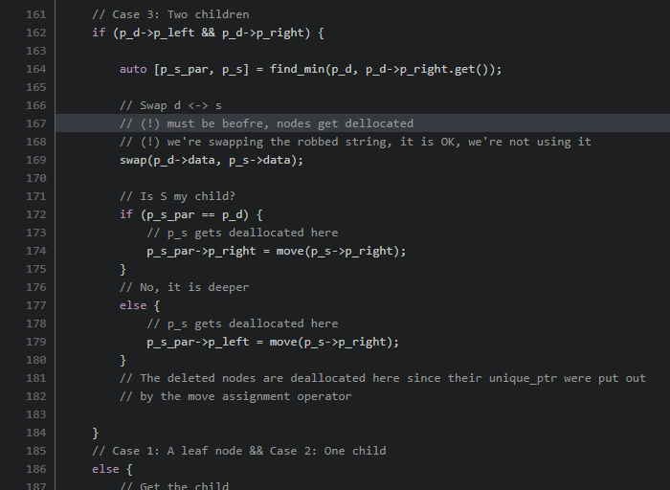
Lab 3 : Other things
Good:
Delivering CMake solution
!Good:
Doing node swap on the deallocated node (by dctor of unique_ptr)
Committing generated files (use .gitignore)
Excessively using unique_ptr where observer pointer is fine
e.g. find_node, find_successor
Not replacing char* with std::string
2023/2024
Programming in C++ (labs)
5

Slide 6
2) Parameter passing and returning in C++

Slide 7
Using const in parameters
Keyword from C, does not mean actual constant
Like a constant value written in RO memory
That is a constexpr variable.
const says that the value it protects is protected from modifications after initialisation
const variables can bind to non-consts
not vice versa
Use const for parameters as much as possible
When in doubt, use const!
Do not use in data members
You can relax const-ness later
Const with raw pointers have two semantically different positions.
// ptr to int
int* p_a;
// ptr to const int
const int* p_b;
// const ptr to int
int* const p_c = nullptr;
// const ptr to const int
const int* const p_d = nullptr;
2023/2024
Programming in C++ (labs)
7

Slide 8
The keyword const is weird
It is weird!
Const used on member functions in different semantics
Cont qualifier can be cast away using const_cast…
Wait… what?
// ptr to int
int* p_a;
// ptr to const int
const int* p_b;
// const ptr to int
int* const p_c = nullptr;
// const ptr to const int
const int* const p_d = nullptr;
2023/2024
Programming in C++ (labs)
8

Slide 9
Examples
// Can be called with non-const parameter
void process_int(const int& val) {
// val = 10; // ERROR
}
// The underlying values cannot be changed
void process_vec(span<const int> base) {
const int& x = base.back();
// base[0] = 10; // ERROR
}
// The original string cannot be modified
void process_str(string_view base) {
// base[0] = '0'; // ERROR
}
// Somewhat similar thing, but without string-ish interface
void process_str(span<const char> base) {
// base[0] = '0'; // ERROR
}
Value itself is not modifiable!
Value itself is not modifiable!
int x1 = 10;
const int x2 = 20;
process_int(x1);
process_int(x2);
vector<int> xs1({ 1, 2, 3 });
const vector<const int> xs2({ 4, 5, 6 });
process_vec(xs1);
process_vec(xs2);
string str1("Ahoy!");
const string str2("Heya!");
process_str(str1);
process_str(str2);
We'll get to this with const_cast!
2023/2024
Programming in C++ (labs)
9

Slide 10
constexpr, consteval
// Only for types that do not require allocation
// (will change in the future)
constexpr int VINT = 42;
constexpr bool VBOOL = false;
constexpr array<char, 2> VARR({ 'a', 'b' });
constexpr const char* VCSTR= "Hello!";
// constexpr string VSTR("Rly?!"); // Not yet!
constexpr
variables
The value of the variable must be known at compile time
functions
The compiler must try to evaluate the given function invocation at compile time
consteval
variables - NOPE
functions
The compiler must be able to evaluate the given function invocation at compile time
These are necessary when writing templates. Values and functions qualified like this can be used in template parameters.
Do not worry about these too much. Just use constexpr for true constants!
(no C preprocessor)
2023/2024
Programming in C++ (labs)
10

Slide 11
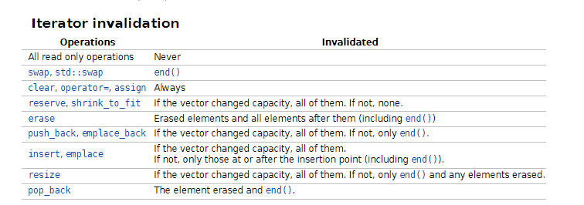
Returning references from functions
The object you return a reference to must live for at least a moment after the return.
A good example of returning references is iterators.
There is an object that will live on and the caller can use the iterators to refer to it.
Until the point where the iterators are invalidated.
When using STD containers and iterators, always watch for invalidation!
Typically, when the data must be re-allocated.
2023/2024
Programming in C++ (labs)
11

Slide 12
Return references from functions: Pitfalls
You saw the wrong examples during the lecture. Most of them won't compile.
Beware of those that will compile and are wrong!
Returning a reference to the global variable:
Parameters are evaluated first (standard does not specify order).
int tmp;
const int& add(const int& a, const int& b) // WRONG
{
tmp = a + b;
return tmp; // correct, but unusable for the users
}
void f1(int l, int r) { cout << l << ", " << r << endl; }
void f2(const int& l, const int& r) { cout << l << ", " << r << endl; }
f1(add(1, 2), add(3, 4)); // which values are passed to f1?
// 3, 7
f2(add(1, 2), add(3, 4)); // which values are passed to f2?
// 3, 3
The copy saved it here!
2023/2024
Programming in C++ (labs)
12

Slide 13
Return references from functions: Pitfalls
Never return a reference to a local object!
string& get_suffix(string_view base) {
string suffix(base);
suffix.push_back('_');
suffix += base;
return suffix; // Returning a reference to local
}
cout << get_suffix("xyz") << endl; // Anything can happen!
The `suffix` is allocated on heap, and once the function returns, it is deallocated (not in a heap way tho).
2023/2024
Programming in C++ (labs)
13

Slide 14
3) The build process

Slide 15
Compilation process (before C++ 20 modules)
Header files contain what is needed for compilation
Are just copy-pasted by the preprocessor
Using #include directive
Guards required, circular dependencies cause cryptic weird errors.
a.cpp
#include “a.hpp”
Compiler suite
Operating system
cc++
a.o
a.hpp
Execu-table
linker
loader
b.cpp
#include “a.hpp”
cc++
b.o
lib1.a
lib2.so
2023/2024
Programming in C++ (labs)
15

Slide 16
Compilation process (with C++ 20 modules)
Modules also use interfaces and module implementations
Interfaces (.ixx) are compiled and the result is used during the compilation of .cpp
No guards, allow partial implementation in different source files, circular dependencies reported.
a.cpp
module a;
/*implementation*/
cc++
a.o
Compiler suite
Operating system
Mind this step! Not dummy text anymore
a.ixx
export module a;
/*interface*/
Execu-table
cc++
a.???
linker
loader
b.cpp
module b;
import a;
cc++
b.o
lib1.a
lib2.so
2023/2024
Programming in C++ (labs)
16

Slide 17
4) Structuring code into multiple source files

Slide 18
Header files (.h)
Always include header guard preventing multiple includes
#ifndef H_04_HEADER_H_
#define H_04_HEADER_H_
#include <iostream>
#include <string>
// A function declaration
void foo();
// A class declaration
class A {
public:
A();
void greet();
bool ready;
protected:
int _count;
private:
size_t _height;
float _factor;
std::string _name;
};
#endif // H_04_HEADER_H_
They contain declarations
Just enough information for the compiler to let you use that interface
They also can contain definitions (usually .hpp)
Must contain header guards
#pragma once well supported, but not standard!
#ifndef / #define is standard
Since C++23 => modules
Do not use `using namespace x` in header files!
Also add closing directive
2023/2024
Programming in C++ (labs)
18

Slide 19
.cpp files
// Use angle brackets for third-party & STD
#include <iostream>
// Use "" quotes for your headers
#include "04_header.h"
using namespace std;
// Implement the function
void foo() {
cout << "I am foo!" << endl;
}
// Define default ctor
A::A() :
ready(false), _count(0), _height(0),
_factor(1.2f), _name("A") {}
// Define the method
void A::greet() {
std::cout << "Hey!" << endl;
}
.cpp files are the actual translation units (TU)
You do not compile .h or .hpp files
You compile .cpp files that provide definitions to declarations from .h/.hpp files.
2023/2024
Programming in C++ (labs)
19

Slide 20
.h + .cpp files
#ifndef H_04_HEADER_H_
#define H_04_HEADER_H_
#include <iostream>
#include <string>
// A function declaration
void foo();
// A class declaration
class A {
public:
A();
void greet();
bool ready;
protected:
int _count;
private:
size_t _height;
float _factor;
std::string _name;
};
#endif // H_04_HEADER_H_
// Use angle brackets for third-party & STD
#include <iostream>
// Use "" quotes for your headers
#include "04_header.h"
using namespace std;
// Implement the function
void foo() {
cout << "I am foo!" << endl;
}
// Define default ctor
A::A() :
ready(false), _count(0), _height(0),
_factor(1.2f), _name("A") {}
// Define the method
void A::greet() {
std::cout << "Hey!" << endl;
}
Include the header you're implementing for
Member initializer list. Special syntax!
2023/2024
Programming in C++ (labs)
20

Slide 21
Header files (.hpp)
Mind the inline keyword
#ifndef H_04_HEADER_HPP_
#define H_04_HEADER_HPP_ #include <iostream>
#include <string> // An inline function in a header file
inline void inline_foo() {
std::cout << "I am inline!";
}
// A class definition
class A {
public:
A() = default;
void greet() { std::cout << "Hey!"; }
bool ready;
protected:
int _count;
private:
size_t _height;
float _factor;
std::string _name;
}; #endif // H_04_HEADER_HPP_
Combination of header and .cpp file
Typical nowadays
Generic (templated) code required to have definitions in the same file
Functions defined (with body) in header files must be marked as inline
Must use namespaces! No using namespace!
2023/2024
Programming in C++ (labs)
21

Slide 22
Beware: Circular dependency!
Circular dependency means the cycle between your header file includes
The compiler must know the size of the class instance.
Solution?
Do not create circular dependencies!
Bad design maybe?
If you must, then
Forward declaration
Use pointer
#ifndef H_A_
#define H_A_
#include "A.h"
class B {
A obj_a;
}
#endif
#ifndef H_B_
#define H_B_
#include "B.h"
class A {
B obj_b;
}
#endif
Compiler must know the size of A
#include "A.h"
#include "B.h"
int main ()
{
A my_a;
B my_b;
}
Compiler must know the size of B, but it is the size of A.
2023/2024
Programming in C++ (labs)
22

Slide 23
Solution: Circular dependency!
Hey compiler, `A` is a class name! Promise!
Forward declaration tells the compiler what to expect
e.g. that `A` is a class type
#ifndef H_B_
#define H_B_
class B;
class A {
unique_ptr<B> p_b;
}
#endif
#ifndef H_A_
#define H_A_
class A;
class B {
unique_ptr<A> p_a;
}
#endif
Hey compiler, `B` is a class name! Promise!
Compiler: Cool, I know the size of this regardless of how big B is.
#include "A.h"
#include "B.h"
int main ()
{
A my_a;
B my_b;
}
Compiler: Cool, I know the size of this regardless of how big A is.
2023/2024
Programming in C++ (labs)
23

Slide 24
Keyword inline does not mean procedure integration optimisation
The inline keyword has nothing to do with the compiler optimization
inlining or procedure integration
It just says to the compiler that it is about to see multiple bodies of this exact same function and that it is all right.
Class methods are implicitly inline.
Functions in the global scope must be declared inline.
// An inline function in a header file
inline void inline_foo() {
std::cout << "I am inline!" << std::endl;
}
2023/2024
Programming in C++ (labs)
24

Slide 25
classes structs

Slide 26
Namespaces in C++
namespace lab_04 {
inline int foo() {
cout << "Hey!" << endl;
}
};
lab_04::foo();
"named boxes" where symbols are encapsulated
Used to avoid name collisions
Quite common in C
You can place your code inside your namespaces
Put your code into namespace(s)
Other that will use your code will not have name collisions
Namespace is like a class/struct that cannot be instantiated.
Is more flexible
Can reopen the same namespace and add to it
Supports Argument-dependent lookup (ADL)
Now you must scope it
2023/2024
Programming in C++ (labs)
26

Slide 27
Intro to class/struct
A way to bundle together data with functionality
The only difference between struct and class is the default visibility
class -> private
struct -> public
2023/2024
Programming in C++ (labs)
27

Slide 28
How a class is declared (e.g. in a header file)
#ifndef H_04_HEADER_H_
#define H_04_HEADER_H_
#include <iostream>
#include <string>
// A function declaration
void foo();
// A class declaration
class A {
public:
A();
void greet() const;
bool ready;
protected:
int _count;
private:
size_t _height;
float _factor;
std::string _name;
};
#endif // H_04_HEADER_H_
Const strikes again!
Used after declaration of a method
Const on method. Says that this method cannot modify any class/instance data.
i.e. member fields and static fields
2023/2024
Programming in C++ (labs)
28

Slide 29
How the methods are implemented in .cpp file
// Use angle brackets for third-party & STD
#include <iostream>
// Use "" quotes for your headers
#include "04_header.h"
using namespace std;
// Implement the function
void foo() {
cout << "I am foo!"<< endl;
}
// Define default ctor
A::A() :
ready(false), _count(0), _height(0),
_factor(1.2f), _name("A") {}
// Define the method
void A::greet() const {
cout << "Hey " << this->_name;
}
Methods have the implicit first parameter `this`.
It's a pointer to the instance in question.
You don't need to call it explicitly if there is no name collision on variables.
_name is the same as this->_name if there is no name collision with method arguments
Compiler tries local variables first
Don't forget to scope!
Don't forget to scope!
Pointer to this instance.
2023/2024
Programming in C++ (labs)
29

Slide 30
This-> scoping warning
// Use angle brackets for third-party & STD
#include <iostream>
// Use "" quotes for your headers
#include "04_header.h"
using namespace std;
// Implement the function
void foo() {
cout << "I am foo!"<< endl;
}
// Define default ctor
A::A() :
ready(false), _count(0), _height(0),
_factor(1.2f), _name("A") {}
// Define the method
void A::greet(string _name) {
cout << "Hey " << _name;
}
If we have the member field and method parameter with the same name, we may need to use this->
What variable is used?
2023/2024
Programming in C++ (labs)
30

Slide 31
Visibility - private, public, protected
#ifndef H_04_HEADER_H_
#define H_04_HEADER_H_
#include <iostream>
#include <string>
// A function declaration
void foo();
// A class declaration
class A {
public:
A();
void greet();
bool ready;
protected:
int _count;
private:
size_t _height;
float _factor;
std::string _name;
};
#endif // H_04_HEADER_H_
struct -> default public
class -> default private
Any code can access this via instance of A.
Only methods of A and A's derived classes can access these.
Only methods of A can access these.
2023/2024
Programming in C++ (labs)
31

Slide 32
Class member fields (data members)
#ifndef H_04_HEADER_H_
#define H_04_HEADER_H_
#include <iostream>
#include <string>
// A function declaration
void foo();
// A class declaration
class A {
public:
A();
void greet();
bool ready;
protected:
int _count;
private:
size_t _height;
float _factor;
std::string _name;
};
#endif // H_04_HEADER_H_
Non-static variables copied for each instance
Try to avoid references and const data members in types that are copyable or/and movable
They mess with copy and move ctors/operators
https://isocpp.github.io/CppCoreGuidelines/CppCoreGuidelines#Rc-constref
2023/2024
Programming in C++ (labs)
32

Slide 33
Class static fields and class static functions
#ifndef H_04_HEADER_H_
#define H_04_HEADER_H_
#include <iostream>
#include <string>
// A function declaration
void foo();
// A class declaration
class A {
public:
A();
void greet();
bool ready;
protected:
static int count();
static int _count;
private:
size_t _height;
float _factor;
std::string _name;
};
#endif // H_04_HEADER_H_
…
// 04_header.cpp
//
// Definitions for statics of A
//
// (!) Do not forget to initialize static fields
int A::_count = 0;
// Define the static method
int A::count() {
return A::_count;
}
Static fields must be initialized in some TU.
Added storage class specifier - static
Static methods cannot use `this` pointer.
But can access static fields.
2023/2024
Programming in C++ (labs)
33

Slide 34
Class static methods
Can only access static data fields.
These fields must be initialized somewhere
No implicit first parameter `this`
Shared for all instances
2023/2024
Programming in C++ (labs)
34

Slide 35
Beware of static keyword
Multiple semantics in different contexts
Member variables / methods in classes -> as previous slides
Global scope variables/functions -> not visible outside of TU
Static local variable -> shared across all function invocation
2023/2024
Programming in C++ (labs)
35

Slide 36
Nested classes
class List
{
public:
List() :
head(nullptr), tail(nullptr) {}
private:
class Node
{
public:
int data;
Node* next;
Node* prev;
};
private:
Node* head;
Node* tail;
};
Declare/define class inside the class
With private/protected/public visibility
Good for hiding implementation details
2023/2024
Programming in C++ (labs)
36

Slide 37
Special class member functions
Default constructor
Destructor
Copy constructor
Assignment operator
Move constructor
Move-assignment operator
These may be implemented by the compiler you don't need any special handling.
2023/2024
Programming in C++ (labs)
37

Slide 38
Class/struct: Rule of 5
https://en.cppreference.com/w/cpp/language/rule_of_three
2023/2024
Programming in C++ (labs)
38

Slide 39
Default constructor and other constructors
Default ctor is implicitly defined by the compiler if there is no other constructor defined
The compiler implementation does nothing for fundamental types
It calls the default constructor for user-defined types (classes/structs)
If you want to initialize also fundamental types, instantiate with {} -> value initialization
MyClass c{};
2023/2024
Programming in C++ (labs)
39

Slide 40
Destructors
The most problematic one!
The compiler will always define one for you. It calls a destructor on all the member fields.
But raw owning pointers do not have a destructor? -> memory leak!
Sometimes the default dctor is not correct!
But, think twice if you really need to define your own destructor!
Maybe a design flaw?
Usually, we need to deallocate some memory.
Maybe I shall use smart pointers?
class base_of_five_defaults {
public:
base_of_five_defaults(const base_of_five_defaults&) = default;
base_of_five_defaults(base_of_five_defaults&&) = default;
base_of_five_defaults& operator=(const base_of_five_defaults&) = default;
base_of_five_defaults& operator=(base_of_five_defaults&&) = default;
~base_of_five_defaults() noexcept = default;
};
2023/2024
Programming in C++ (labs)
40

Slide 41
Destructors
…
If you define our own destructor, the compiler will provide the default implementation for the copy constructor and assignment operator
Flaw in the standard, this is dangerous
If you need to define your own destructor
you (probably) must also implement your own copy constructor
and copy assignment operator.
2023/2024
Programming in C++ (labs)
41

Slide 42
Copy ctor, assignment operator
If you define one of these, the other is defaulted by the compiler
This is a flaw in the standard
If one of these requires special care, the other most probably too!
class base_of_five_defaults {
public:
base_of_five_defaults(const base_of_five_defaults&) = default;
base_of_five_defaults(base_of_five_defaults&&) = default;
base_of_five_defaults& operator=(const base_of_five_defaults&) = default;
base_of_five_defaults& operator=(base_of_five_defaults&&) = default;
~base_of_five_defaults() noexcept = default;
};
2023/2024
Programming in C++ (labs)
42

Slide 43
Move ctor, move assignment operator
If you define one of these, the other is NOT defaulted by the compiler
Newer additions in C++11
Define those if you want to utilise move semantics
class base_of_five_defaults {
public:
base_of_five_defaults(const base_of_five_defaults&) = default;
base_of_five_defaults(base_of_five_defaults&&) = default;
base_of_five_defaults& operator=(const base_of_five_defaults&) = default;
base_of_five_defaults& operator=(base_of_five_defaults&&) = default;
~base_of_five_defaults() noexcept = default;
};
2023/2024
Programming in C++ (labs)
43

Slide 44
Deleted implementations
You mark the definition as forbidden.
It is not undefined, it is defined
The compiler will error when it should use such a function
The user gets nice error
We have seen that in std::unique_ptr
https://en.cppreference.com/w/cpp/memory/unique_ptr/unique_ptr
Cannot copy or move this class
class base_of_five_defaults {
public:
base_of_five_defaults(const base_of_five_defaults&) = delete;
base_of_five_defaults(base_of_five_defaults&&) = delete;
base_of_five_defaults& operator=(const base_of_five_defaults&) = delete;
base_of_five_defaults& operator=(base_of_five_defaults&&) = delete;
~base_of_five_defaults() noexcept = default;
};
Destructor must be present. Always mark destructor as noexcept. Destructors cannot throw!
2023/2024
Programming in C++ (labs)
44

Slide 45
Defaulted implementations
Explicitly tell the compiler to use his default implementation.
Always think about allocated memory and other resources that the instance can hold (e.g. file handles)
class base_of_five_defaults {
public:
base_of_five_defaults(const base_of_five_defaults&) = default;
base_of_five_defaults(base_of_five_defaults&&) = default;
base_of_five_defaults& operator=(const base_of_five_defaults&) = default;
base_of_five_defaults& operator=(base_of_five_defaults&&) = default;
~base_of_five_defaults() noexcept = default;
};
Always be sure, that the default implementation does what you need to do.
2023/2024
Programming in C++ (labs)
45

Slide 46
Takeaway! Rule of 0 and rule of 5
If possible, strive for the Rule of 0
No need for special dctor, copy/move ctors and assignment operators
You can of course define your specialized ctors
Otherwise, use the Rule of 5
If you need to define dctor, move/copy ctors/assignment operators, define or delete them all
C.20: If you can avoid defining default operations, do
https://isocpp.github.io/CppCoreGuidelines/CppCoreGuidelines#c20-if-you-can-avoid-defining-default-operations-do
C.21: If you define or =delete any copy, move, or destructor function, define or =delete them all
https://isocpp.github.io/CppCoreGuidelines/CppCoreGuidelines#c21-if-you-define-or-delete-any-copy-move-or-destructor-function-define-or-delete-them-all
The Rule of 3 is just pre C++11 rule of 5. There were no move ctors/assignment operators.
2023/2024
Programming in C++ (labs)
46

Slide 47
Task 4 a): Wrap Task 3 in class
Make Task 3 BST a nice class with nice interface methods.
Support moving
Interface:
insert(x)
erase(x)
contains(x)
keys()
Returns an ordered list of all keys that are present
Target Rule of 0
2023/2024
Programming in C++ (labs)
47

Slide 48
Intermezzo: type size_t
Type that is guaranteed to be able to index into an array of any size
Use it whenever the value has the semantics of size, count, or number of something
Unsigned integer of size usually 64 bits (on x86_64)
2023/2024
Programming in C++ (labs)
48

Slide 49
Task 4 a): The approach
Create header and implementation file for the `class Bst`
Design the interface based on how it will be used
Provide dummy implementations
Use the interface in our main function
Start filling the definitions with our existing code
Polish the solution
code
2023/2024
Programming in C++ (labs)
49

Slide 50
We are rule of 0, what special members are defined by the compiler?
https://en.cppreference.com/w/cpp/language/rule_of_three
2023/2024
Programming in C++ (labs)
50

Slide 51
Task 4 b): Make the Bst class copyable
Make Task 3 BST a nice class with nice interface methods.
Support moving
Support copying!
Interface:
insert(x)
erase(x)
contains(x)
keys()
Returns an ordered list of all keys that are present
Target Rule of 5
This will break our rule of 0
2023/2024
Programming in C++ (labs)
51

Slide 52
Task 4 b): Approach
We cannot just copy `struct Node` it has deleted copies!
We must allocate new memory for each Node
The simplest solution for us seems to be
Get all keys present in the tree
Build a brand-new tree from scratch as if those keys were the input
Target Rule of 5
2023/2024
Programming in C++ (labs)
52

Slide 53
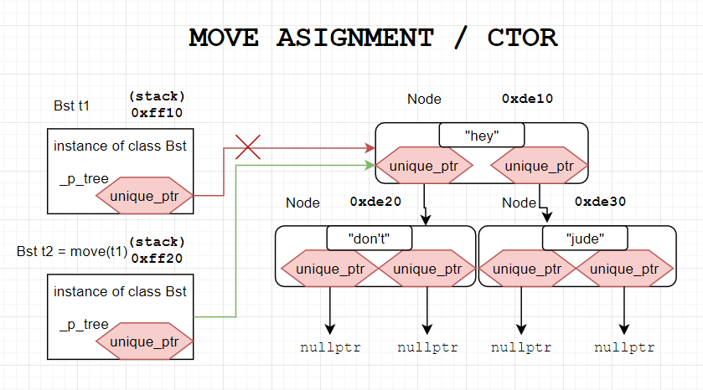
Moving: Meanwhile in the memory
New marker! Imortant stuff, try to understand this and ask questions right away
2023/2024
Programming in C++ (labs)
53

Slide 54
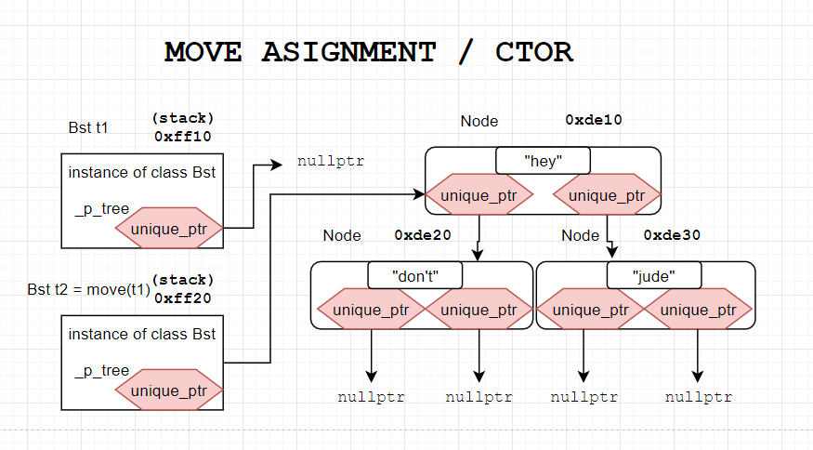
Moving: Meanwhile in the memory: after
Robbed Bst instance.
Owns no memory.
Can be destructed.
questions?
2023/2024
Programming in C++ (labs)
54

Slide 55
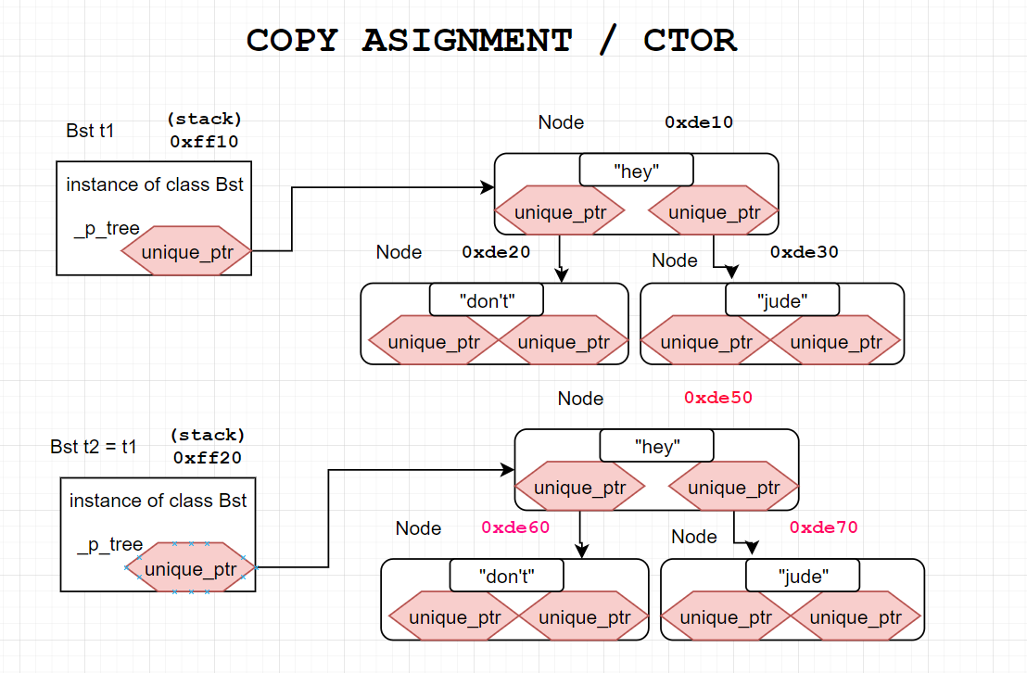
Copying: Meanwhile in the memory
Mind the new addresses!
New allocations!
questions?
code
2023/2024
Programming in C++ (labs)
55

Slide 56
We are rule of 5, what special members are defined by the compiler?
https://en.cppreference.com/w/cpp/language/rule_of_three
2023/2024
Programming in C++ (labs)
56

Slide 57
Task 4 (the whole assignment at one place)

Slide 58
Task 4 a): Wrap Task 3 in class
Make Task 3 BST a nice class with nice interface methods.
Support moving
Interface:
insert(x)
erase(x)
contains(x)
keys()
Returns an ordered list of all keys that are present
Target Rule of 0
2023/2024
Programming in C++ (labs)
58

Slide 59
Task 4 b): Make the Bst class copyable
Make Task 3 BST a nice class with nice interface methods.
Support moving
Support copying!
Interface:
insert(x)
erase(x)
contains(x)
keys()
Returns an ordered list of all keys that are present
Target Rule of 5
2023/2024
Programming in C++ (labs)
59

Slide 60
Wrapping it up…

Slide 61
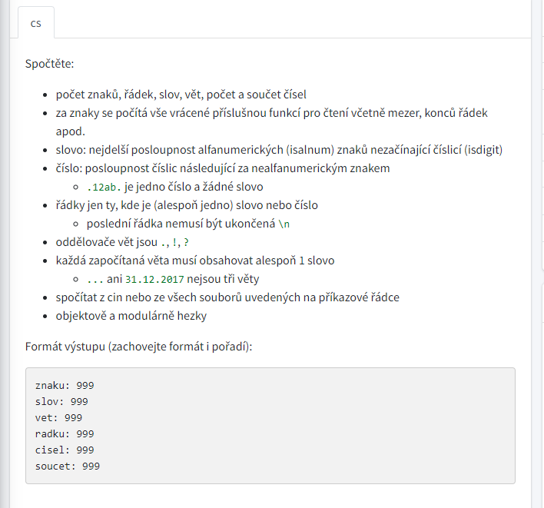
First homework assigned!
First homework added to ReCodex
Deadline in two weeks
24 h before the lab
Submit in time for feedback
https://recodex.mff.cuni.cz/
Further reading
https://en.cppreference.com/w/cpp/string/byte/isalnum
https://en.cppreference.com/w/cpp/string/byte/isdigit
2023/2024
Programming in C++ (labs)
61

Slide 62
Lab 4 wrap up
You should know
const and how to use it also pitfalls of returning references from functions
how to use classes/structs
how to use rule of 0 and rule of 5
Next lab:
Exceptions, number parsing, casting, Inheritance and runtime polymorphism, virtual methods
Your tasks until the next lab:
Task 4 (24h before, so I can give feedback).
Just a directory lab_04 with one CPP file will do
2023/2024
Programming in C++ (labs)
62

