Slide 1
Lab 2
Feedback from Lab 1, C-strings, memory management,
common C++ mistakes, archaic vs modern C++
9. 10. 2023

Slide 2
Outline
Feedback from Lab 1
Task 2 introduction
Brief overview of C-strings/std::string/std::string_view
Brief overview of smart vs raw pointers
Pitfalls of using old C++/C constructs
Do not use prinft in modern C++
Task 2 coding
2023/2024
Programming in C++ (labs)
2

Slide 3
Lab 1: C++ stack vs heap allocation
In contrast to other languages, C++ gives you full control over where your variables are allocated
Stack vs heap
By default you don't use the new keyword to allocate on the stack.
Keyword new allocates on the heap and returns a pointer.
In modern C++, new keyword should be avoided
Containers or smart pointers shall do allocation.
int a; // Stack
int* p_a = new int(); // Heap
array<int, 3> arr; // Stack
array<int, 3>* p_arr = new array<int, 3>(); // Heap
string s("Hey"); // Stack
string* p_s = new string("Hey"); // Heap
2023/2024
Programming in C++ (labs)
3

Slide 4
Lab 1: Comparing C-strings vs comparing std::strings
cout << argv[1] << endl; // --reverse
bool x1 = argv[1] == "--reverse"; // false
bool x2 = string(argv[1]) == "--reverse"; // true
What is going on here?
How to compare C-strings?
char*
ptr compare
const char*
std::string
const char*
thanks to std::string on the left, it looks for operator== implementation on std::string
No such overload exists, but there is an implicit conversion from const char* to std::string
C function strcmp.
Further reading
ctor const char* -> std::string: https://en.cppreference.com/w/cpp/string/basic_string/basic_string
cmp of std::string + std::string: https://en.cppreference.com/w/cpp/string/basic_string/operator_cmp
2023/2024
Programming in C++ (labs)
4

Slide 5
Lab 1: We used auto&&?
Further reading
https://www.fluentcpp.com/2018/02/06/understanding-lvalues-rvalues-and-their-references/
https://en.cppreference.com/w/cpp/language/value_category
lvalue
Denotes an object that you can repeatedly access from your program.
named variables, array elements, members
An lvalue reference (&) binds to an lvalue.
int i = 10;
int& ri = &i;
rvalue
If it is not lvalue, then it's rvalue.
Denotes an object that cannot be accessed in your code and thus its resources can be reused.
Usually, temporary objects!
An rvalue reference (&&) binds to an rvalue.
MyClass( vector<int>{1, 2 } )
const int& x = foo(); // int foo();
// Range-based for loop
for (auto&& x : xs)
cout << x << endl;
2023/2024
Programming in C++ (labs)
5

Slide 6
Lab 1: lvalues vs rvalues examples
Without the rvalue overload
int X = 10;
int& hoo() { return X; }
int goo() { return 50; }
int i = 42;
int& ri = &i; // OK
int& rx = &42; // ERROR: expression must be an lvalue
hoo() = 20;
int* p_h = &hoo(); // OK
goo() = 20; // ERROR: '=': left operant must be an lvalue
int* p_g = &goo(); // ERROR: expression must be an lvalue
void foo(const vector<int>& xs) { cout << "lvalue" << endl; }
vector<int> xs = vector<int>({ 1,2,3 });
foo(vector<int>({ 1,2,3 })); // lvalue, but arg is rvalue
foo(xs); // lvalue
With the rvalue overload
void foo(vector<int>&& xs) { cout << "rvalue" << endl; }
void foo(const vector<int>& xs) { cout << "lvalue" << endl; }
vector<int> xs = vector<int>({ 1,2,3 });
foo(vector<int>({ 1,2,3 })); // rvalue
foo(xs); // lvalue
rvalue reference overload preferred
Wait, how is this useful?
Performance!
Move semantics -> future labs
2023/2024
Programming in C++ (labs)
6

Slide 7
Lab 1: What is auto&& then?
Further reading
https://www.fluentcpp.com/2021/04/02/what-auto-means/
& is (lvalue) reference
&& is rvalue reference
BUT!
auto&& and T&& where T is a template type parameter is a forwarding reference
(SIMPLIFICATION) forwarding reference is a special reference that
Binds to both rvalues or lvalues
Takes the const qualification from the value itself (e.g. if it is const, FR is const too)
// Range-based for loop
for (auto&& x : xs)
cout << x << endl;
for (const int& x : xs)
cout << x << endl;
for (int& x : xs)
cout << x << endl;
for (int x : xs)
cout << x << endl;
Use for range-based for loops where you don't care about modifying the items -> concise syntax
Later use it in templates…
2023/2024
Programming in C++ (labs)
7

Slide 8
Lab 1: Minor things
// Reverse iteration over the container
for (int i = prefix.size() - 1; i >= 0; i--) {
cout << prefix[i] << " ";
}
Good
Decomposition of code to smaller functions
ternary if operator
<bool expr> ? <true expr> : <false expr>
It is an expression and thus it has value.
Not ideal
Manual indexing to containers
One solution used at least checked boundaries xs.at(i)
Using C function printf
Initialising bool variables with int literal (implicit conversion to bool).
#include <stdio.h>
Prefer C++ constructs
If you really have to, include C libs wrapped in STD namespace -> #include <cstdio>
Put tasks from labs (micro-homeworks) into "labs" directory.
Naming C++ files with suffixes .cpp, .h, .hpp …
Modules: .ixx, .cppm, and .cxx
// Using reverse iterators (without C++20 ranges)
for (auto it = xs.rbegin(); it != xs.rend(); ++it)
cout << *it << endl;
// Using C++20 ranges with pipe syntax
for (auto&& x : (xs | views::reverse))
cout << x << endl;
// Using C++20 ranges without pipes
for (auto&& x : ranges::reverse_view(xs))
cout << x << endl;
2023/2024
Programming in C++ (labs)
8

Slide 9
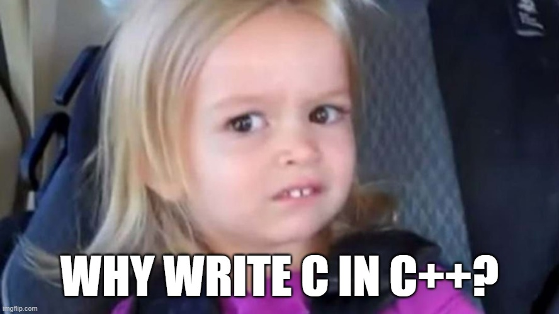
Task 2: Binary search tree for strings (old-school)
Takes an arbitrary number of ASCII strings from STDIN separated by a newline until the ‘=END=‘.
The program builds a BST from these strings for subsequent searches
Case insensitive, no duplicates in the tree.
The tree is not guaranteed to be balanced. It does not matter for our cause.
After that, the program waits for newline-separated input from STDIN in a loop.
Upon getting some input, the program shall find if the string is in the BST.
If yes, it shall delete the node and output its value to STDOUT (prefixed with "D: "); otherwise, it shall do nothing.
There’s a catch though. You must implement it without C++ string and smart pointers.
This is (probably) the last time we’re using `new` and `C-strings`.
2023/2024
Programming in C++ (labs)
9

Slide 10
Briefly: C-string vs std::string(_view)
#include <string>
Do not use if not necessary
char a[] = "ahoy";
const char* b = "ahoy";
char* c = a;
string d("ahoy");
string e(a);
string_view g("ahoy");
string_view h(c);
string_view i(d);
array of char ≡ C-string
raw pointer to C-string
non-owning view
'A' | 'h' | 'o' | 'y' | '\0'
a
'A' | 'h' | 'o' | 'y' | '\0'
'A' | 'h' | 'o' | 'y'
'A' | 'h' | 'o' | 'y'
g
 | 4
b
c
h
 | 4
d
i
 | 4
'A' | 'h' | 'o' | 'y'
e
'A' | 'h' | 'o' | 'y'
static RO memory
stack
data()
size()
heap
2023/2024
Programming in C++ (labs)
10

Slide 11
Briefly: Typical usage of strings and string views
implicit conversion std::string -> std::string_view
You can concatenate std::strings with operator+
std::string x = a + b + c
void foo(string_view s){ .... }
string x("ahoy");
string y(x);
f(x);
f(y);
f("ahoy");
string a("Hey");
string b("there");
string s = a + " " + b + "!";
typical usage:
std::string ctor with variable/C-string literál
overloaded operator+ for std::string
Programming in C++ (labs)
11

Slide 12
Briefly: Smart pointer vs raw pointer
Smart pointers
They take ownership of their memory seriously and will deallocate once when no one is using the memory.
No double frees or memory leaks.
They are usually as performant as raw pointers.
Whenever possible, use std::unique_ptr -> next lab
Raw pointers
You may think they take ownership seriously, but they couldn't be bothered.
If you don't delete the memory, no one will -> memory leak.
If you delete the memory twice, anything can happen (UB).
Use them only as non-owning observer pointers
2023/2024
Programming in C++ (labs)
12

Slide 13
What could go wrong?
The answer is, almost everything!
The worst nightmares of a C++ programmer:
Memory leaks – unused heap memory on which there wasn’t called delete
You can go OOM (not Out Of Mana, Out Of Memory)
Double frees – allocated memory on which there was called delete more than once
Undefined Behaviour
Dereferencing invalid pointer
Segmentation fault or you read garbage data and may not notice.
Reading uninitialized memory
You’re using garbage data but it is not always obvious.
Buffer overflows – C arrays/C-strings have no bounds checking and will let you write outside of it without even blinking
Memory corruption - Accidently rewriting bytes of your other structures.
Working with garbage data and now knowing is …
These problems are real
~70% of serious bugs is related to memory management
https://msrc.microsoft.com/blog/2019/07/a-proactive-approach-to-more-secure-code/
https://www.chromium.org/Home/chromium-security/memory-safety/
2023/2024
Programming in C++ (labs)
13

Slide 14
What about C-strings and printf?
Yes, C-string functions are very unsafe and there is always some UB waiting around the corner.
Invalid null termination
Going past the null terminating byte
Unmatching buffer sizes
Unsafe printf
Illegal format string
Not enough arguments for format specifier
char str[5];
str[0] = 'H’;
str[1] = 'i'; // Forgot to null-terminate
// Any operation expecting null-termination is UB
char str[] = "hello";
for(int i = 0; i <= 10; ++i) {
char c = str[i]; // Undefined behavior when i > 5
}
char dest[5];
strncpy(dest, "hello, world", 12); // No space for null-terminator
printf("%d %s\n", 10); // UB, missing arguments
printf("%d", 3.14f); // UB,conversion specification is invalid
2023/2024
Programming in C++ (labs)
14

Slide 15
Modern C++ for the rescue!
The good news is that modern C++ can help with these.
The worst nightmares of a C++ programmer:
Memory leaks & double frees – smart pointers
Dereferencing invalid pointer – smart pointers + observer pointers
The observer pointers are still dangerous if the programmer is not cautious.
Reading uninitialized memory – containers
Containers do not force us to initialize, but at least give us an easy interface to do so.
Buffer overflows – containers & iterators
Memory corruption - containers & iterators
raw arrays do not know their size, containers do know!
Missing null string termination – std::string is not null-terminated, it knows the size
Going past the null terminating byte – Not possible if using iterators.
Unmatching buffer sizes – The copying is handled by the library-defined operators.
Unsafe printf – Much harder to mess something with std::cout , std::format^{(C++20),} and std::print^{(C++23)}
Additionally, you get very nice and unified interface and utility functions on those classes
std::string – contains, starts_with, ends_with, (r)find, operator+
unique_ptr, shared_ptr – they behave almost like drop-in replacements for raw pointers
2023/2024
Programming in C++ (labs)
15

Slide 16
Task 2: Let's code
Takes an arbitrary number of ASCII strings from STDIN separated by a newline until the ‘=END=‘.
The program builds a BST from these strings for subsequent searches
Case insensitive, no duplicates in the tree.
The tree is not guaranteed to be balanced. It does not matter for our cause.
After that, the program waits for newline-separated input from STDIN in a loop.
Upon getting some input, the program shall find if the string is in the BST.
If yes, it shall delete the node and output its value to STDOUT (prefixed with "D: "); otherwise, it shall do nothing.
There’s a catch though. You must implement it without C++ string and smart pointers.
Hints:
#include <cstring>, str(n)cpy, str(n)cat, strlen, str(n)cmp
2023/2024
Programming in C++ (labs)
16

Slide 17
Code: The problem approach
BST is a binary tree (no duplicates).
Rooted, each node has at most two children (left, right).
For each node:
The left subtree contains only smaller items.
The right subtree contains only greater items.
Strings in C/C++ use lexicographical ordering.
Beware that you must have the same case to achieve alphabetical ordering!
E.g. "B" < "a" < "b"
hey
jude,
don’t
make
it
bad.
=end=
hey
don’t
jude,
bad.
it
make
Further reading
https://en.wikipedia.org/wiki/Binary_search_tree
https://pruvodce.ucw.cz/ (kapitola Binární vyhledávací stromy)
2023/2024
Programming in C++ (labs)
17
Notes:
https://icu.unicode.org/

Slide 18
Code: Represent the nodes & edges
struct Node
Node* p_left
Node* p_right
char* data
We will traverse it from the root
The whole tree is represented by the root Node
hey
jude,
don’t
make
it
bad.
=end=
hey
Node*
don’t
jude,
bad.
it
make
struct Node
stack
heap
This is not accurate the C-strings in the nodes are allocated somewhere else on the heap as well
hey
data
Node*
…
…
2023/2024
Programming in C++ (labs)
18

Slide 19
Intermezzo: type specifier auto
since C++11
No dynamic types! All types must be known at compile time!
The keyword auto just says "Please compiler, just deduce the type for me"
E.g. based on the expression on the right
Necessary to define the type of lambdas (later labs…)
The compilers get more powerful with their deduction capabilities over time.
Saves you keystrokes!
// Without auto
vector<map<size_t, unique_ptr<double>>> names;
vector<map<size_t, unique_ptr<double>>>::iterator it = names.begin();
// With auto
vector<map<size_t, unique_ptr<double>>> names;
auto it = names.begin();
Further reading
https://en.cppreference.com/w/cpp/language/auto
2023/2024
Programming in C++ (labs)
19

Slide 20
Intermezzo: nullptr
since C++11
Since C++11 we have the nullptr keyword.
It represents a null/invalid pointer but has the correct pointer type.
Readability
Type safety
Use it to represent invalid/null pointers.
Avoid C approaches - 0 (int) or NULL (preprocessor define)
Further reading
https://www.modernescpp.com/index.php/the-null-pointer-constant-nullptr/
https://en.cppreference.com/w/cpp/language/nullptr
2023/2024
Programming in C++ (labs)
20

Slide 21
Intermezzo: tuple/pair
since C++11
#include <tuple>
Heterogeneous container with known size at compile-time.
pair<bool, double> p(false, 3.6);
tuple<int, float, char> t(10, 20.0f, 'x');
p.first; // first item, not method!
p.second; // second item, not method!
get<0>(p); // first item
get<1>(p); // second item
get<0>(t); // first item
get<1>(t); // second item
get<1>(t); // third item
get<3>(t); // ERROR: Compile-time check
// since C++17
tuple<int, float, char> foo() {
return tuple(10, 20.0f, 'x');
}
// since C++11
tuple<int, float, char> foo() {
return make_tuple(10, 20.0f, 'x');
}
Stronger type deduction
Helper functions, make_*
Further reading
https://en.cppreference.com/w/cpp/utility/tuple
2023/2024
Programming in C++ (labs)
21

Slide 22
Intermezzo: structured bindings
since C++17
Simple way to unpack tuple-like, array or struct types.
// Array
int a[2] = {1, 2};
auto [x, y] = a; // x == 1, y == 2
auto& [xr, yr] = a; // xr refers to a[0], yr refers to a[1]
Other languages may call this unpacking, deconstructing, destructuring
// Tuple-like
tuple<float, char, int> tpl(0.2f, 'a', 42);
auto [a, b, c] = tpl;
auto& [ar, br, cr] = tpl;
With existing variables, you can fill them with std::tie
// Struct types
struct S {
int x1;
double y1;
};
S f() { return S{ 1, 2.3 }; }
auto [i, j] = f();
const auto& [icr, rcr] = f();
auto& [ir, jr] = f(); // Invalid
// Existing variables
int a = 0;
double b = 0.0;
char c = ' ';
// Some tuple
tuple<int, double, char> t = make_tuple(42, 3.14, 'x');
// Unpack the tuple into existing variables
tie(a, b, c) = t;
Further reading
https://en.cppreference.com/w/cpp/language/structured_binding
https://devblogs.microsoft.com/oldnewthing/20201014-00/?p=104367
2023/2024
Programming in C++ (labs)
22

Slide 23
Intermezzo: std::optional
since C++17
#include <optional>
Type representing a value of type T OR nothing/null/no value
optional<string> create(bool b) {
if (b)
return "Godzilla";
return nullopt;
}
cout << "create(false) returned " << create(false).value_or("empty") << endl;
cout << "create(false) returned " << *create(false) << endl; // UB, cannot get the value
// True if optional is not null
if (auto str = create(true))
cout << "create2(true) returned " << *str << endl;
Use for types, where "empty" is a valid state
Further reading
https://en.cppreference.com/w/cpp/utility/optional
2023/2024
Programming in C++ (labs)
23

Slide 24
Code: Print tree
Prints all the values in their order
It means, in order if you scan from left to right in symmetric tree
print_tree(p_root)
print_tree(p_root->left)
print(p_root->val)
print_tree(p_root->right)
hey
jude,
don’t
make
it
bad.
=end=
hey
Node*
don’t
jude,
bad.
it
make
struct Node
stack
heap
You can concatenate std::vectors with xs.insert()
vector<int> a({ 1, 2, 3 });
vector<int> b({ 3, 4, 5 });
// Taking copies
a.insert(a.end(), b.begin(), b.end());
// With move semantics
a.insert(a.end(), make_move_iterator(b.begin()), make_move_iterator(b.end()));
2023/2024
Programming in C++ (labs)
24

Slide 25
Code: Building the tree
hey
jude,
don’t
make
it
bad.
=end=
In a loop reading STDIN until line "=END="
We start with Node* tree = nullptr
With each word, allocate Node with new and attach it
smaller -> go/attach left
greater -> go/attach right
Compare C-strings with strcmp
hey
Node*
don’t
jude,
// Convert ASCII string to lowercase
string s("HeLlO!");
for (char& c : s)
c = tolower(static_cast<unsigned char>(c));
bad.
it
make
struct Node
stack
heap
Parameter of tolower must be representable by unsigned char
char can be both signed or unsinged (impl-defined)
unsigned char, signed char
uint8_t, int8_t
2023/2024
Programming in C++ (labs)
25

Slide 26
Code: Delete operation
Find what to delete
with a pointer to the parent
with "am I left/right child" indicator
DRY – Don't repeat yourself
Find a successor of a node
with a pointer to the parent
with "am I left/right child" indicator
hey
jude,
don’t
make
it
bad.
=end=
hey
Node*
don’t
jude,
bad.
it
make
struct Node
stack
heap
2023/2024
Programming in C++ (labs)
26

Slide 27
Code: Finding node's direct predecessor / successor
hey
jude,
don’t
make
it
bad.
=end=
hey
Predecessor:
The maximum from the left subtree
The "rightest" node in the left subtree
Successor:
The minimum from the right subtree
The "leftest" node in the right subtree
hey
Node*
don’t
jude,
bad.
it
make
struct Node
stack
heap
2023/2024
Programming in C++ (labs)
27

Slide 28
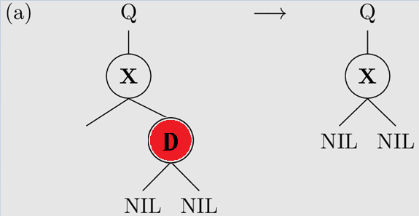
Code: Deleting the node
https://en.wikipedia.org/wiki/Binary_search_tree#Deletion
hey
jude,
don’t
make
it
bad.
=end=
make
Case 1: Delete leaf node
find(D)
p_d_par->right/left = nullptr
hey
Node*
p_d_par
don’t
jude,
jude,
jude,
it
make
bad.
struct Node
stack
heap
make
p_d
Watch out for case where p_d_par is nullptr (deleting root)
2023/2024
Programming in C++ (labs)
28

Slide 29
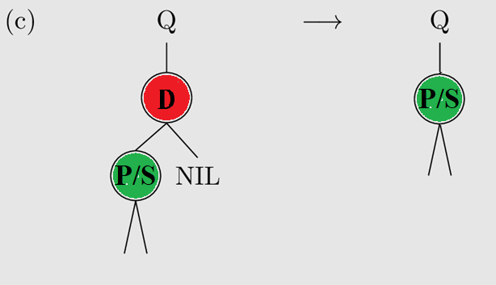
Code: Deleting the node
https://en.wikipedia.org/wiki/Binary_search_tree#Deletion
Case 2: Delete node with one child
find(D)
p_d_par->left/right = p_s
hey
jude,
don’t
make
it
bad.
=end=
don't
p_d
p_d_par
hey
Node*
don’t
bad.
don’t
jude,
p_s
bad.
it
make
struct Node
bad.
stack
heap
Watch out for case where p_d_par is nullptr (deleting root)
2023/2024
Programming in C++ (labs)
29

Slide 30
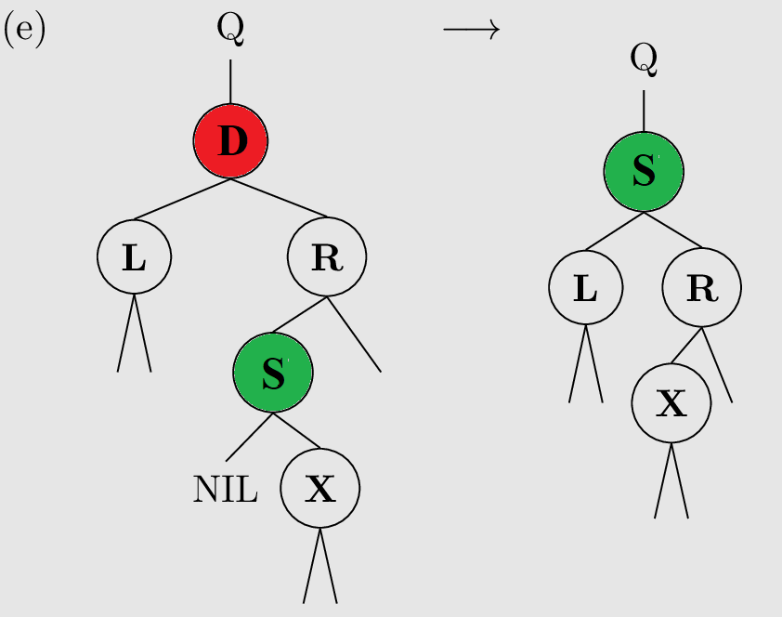
Code: Deleting the node
https://en.wikipedia.org/wiki/Binary_search_tree#Deletion
hey
jude,
don’t
make
it
bad.
=end=
hey
Case 3: Delete node with two children
Find successor S, swap with D, remove successor
Successor always has just one child
hey
Node*
hey
it
don’t
jude,
jude,
bad.
it
make
don’t
jude,
struct Node
don’t
stack
heap
it
nullptr
nullptr
2023/2024
Programming in C++ (labs)
30

Slide 31
Code: Deleting the node
https://en.wikipedia.org/wiki/Binary_search_tree#Deletion
Swap contents of S and D
if p_s_par != p_d: p_s_par->left = p_s->right
else: p_s_par->right = p_s->right
hey
jude,
don’t
make
it
bad.
=end=
hey
p_d
p_d_par
hey
Node*
don’t
jude,
bad.
it
make
struct Node
p_s
stack
heap
p_s_par
2023/2024
Programming in C++ (labs)
31

Slide 32
Code: Deleting the node
Do not forget to deallocate (delete)!
Memory leaks
But only once per allocated pointer!
Double free
hey
jude,
don’t
make
it
bad.
=end=
hey
Node*
don’t
jude,
bad.
it
make
struct Node
stack
heap
2023/2024
Programming in C++ (labs)
32

Slide 33
Code: Example inputs & outputs
hey
jude,
don’t
make
it
bad.
=end=
it
it
nothing
bad
bad.
1
2
3
4
5
=end=
5
4
3
2
1
D: it
D: bad.
D: 5
D: 4
D: 3
D: 2
D: 1
2023/2024
Programming in C++ (labs)
33

Slide 34
Lab 2: Wrap up
Manual memory management is problematic!
Modern C++ helps with that (-> next lab).
C-strings (char*) are still all over the place, and we should get rid of them ASAP.
The printf function is loved by many, but it’s time to say goodbye.
Do not repeat yourself -> good decomposition and avoid copy-paste
Memory leak, double free, dereferencing invalid pointer, uninitialized memory, buffer overflows.
Next lab:
We’ll write the same program, but this time using modern C++.
Your tasks until the next lab:
Task 2 (24h before, so I can give feedback).
Just a directory lab_02 with one CPP file will do
Feel free to deliver the whole project with some build system (CMake, make)
2023/2024
Programming in C++ (labs)
34

