Slide 1
Lab 1
Organisation, dev env, GIT,
Hello, world!, basic I/O
2. 10. 2023

Slide 2
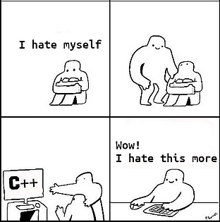
Outline
Organisational matters
Expected knowledge
Setting up the dev environment
GIT basics
Hello world in C++
Task 1: Print all subsets
2023/2024
2023/2024
2
Programming in C++ (labs)
2

Slide 3
Contact
Labs!
Mattermost lab room – things that can benefit others
https://ulita.ms.mff.cuni.cz/mattermost/
Workspace: 2324ZS
Room: nprg041-cpp-mejzlik
Mattermost private message
frantisek.mejzlik@matfyz.cz
2023/2024
2023/2024
3
Programming in C++ (labs)
3

Slide 4
What to expect from my labs?
I’ll do my best to share some of my excitement, knowledge and experience in C++ and CS.
Expect to learn new things.
But you have to do the heavy lifting!
Focus on practical aspects, portability, good practices, readable code and performance.
Please, ask questions!
I am just an older colleague of yours.
Don’t be afraid of embarrassing yourself or whatever. It is a natural thing to don’t know.
Asking will help you, your classmates and me as well.
If you struggle with anything, please contact me.
Feel free to ask during labs, on Mattermost or via email.
If it is something bigger, we can schedule a consultation (physical or online).
2023/2024
2023/2024
4
Programming in C++ (labs)
4

Slide 5
How to read the slides
Preferred / safe / better
Danger of slipping
"Death" hazzard
Additional resources related to the topic
You should keep in mind all the good practices you are taught here
But, there are exceptions to all rules and best practices
This is a code block
#include <iostream>
using namespace std;
int main(int argc, char** argv) {
cout << "Hello world!" << endl;
if argc >= 2 {
do_things(argc, argv);
}
return 0;
}
Further reading
https://en.cppreference.com/w/cpp/compiler_support#cpp20
2023/2024
2023/2024
5
Programming in C++ (labs)
5

Slide 6
Expected knowledge
Basic programming knowledge (in the scope of Programming I & II)
Familiarity with language with C-like syntax
Pointers, memory management (allocation & deallocation), heap, stack
Basic data type representations in memory (strings, (u)integers, floats, ...)
Basic understanding of time/space complexity (big O notation)
Compilation process (how we get from source code to machine code)
Rough understanding of how CPUs execute machine code
2023/2024
Programming in C++ (labs)
6

Slide 7
Getting the credit and passing the exam
Required for credit:
Finished solutions of tasks from labs
To MFF GitLab repository
At least 24 hours prior to the next lab (or contact me)
Will provide feedback on your solutions
Final homework (needed for the lab test)
Final lab test (coding)
Extension to the last homework
The last lab (8.1.2024, failed attempts again in January)
(!) On lab computers (get familiar with them)
(!) No AI or internet access other than cppreference
Term project.
On next slide…
Recommended:
First 3 homework assignments
Submit to ReCodex
Will provide feedback on your solutions
Exam
During exam period (~January/February)
(!) On lab computers (get familiar with them)
(!) No AI or internet access other than cppreference
2023/2024
Programming in C++ (labs)
7

Slide 8
Term project
Assignment
Project idea agreement (deadline 17. 11. 2023)
Short idea about the term project topic
Specification of idea (deadline 30. 11. 2023)
Specification (roughly 2 A4s ), functional and qualitative requirements, interface, and third-party libs that will be used
Technological demo (deadline 19. 1. 2024)
Cross-platform skeleton with all specified third-party libs that is buildable
No actual logic is required
Development
In GIT
Cross-platform (with some exceptions) – at least MSVC and GCC is required
Using the CMake build system (it should be easy for anyone to clone and try it)
All commits must be in the repo, not just the final commit-it-all commit!
Submission (deadline 30. 4. 2024)
Via MFF GitLab.
It should be simple to try and test the software
Simplicity of the build is an important aspect of it
2023/2024
Programming in C++ (labs)
8

Slide 9
ReCodex
https://recodex.mff.cuni.cz/
Assign yourself to the correct group in ReCodex
Programování v C++ (Po, 14:00, SW2)
Beware of older GCC version 12.2
2023/2024
Programming in C++ (labs)
9

Slide 10
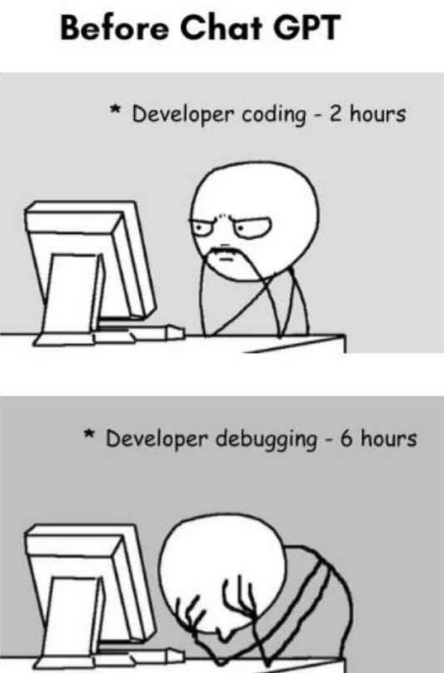
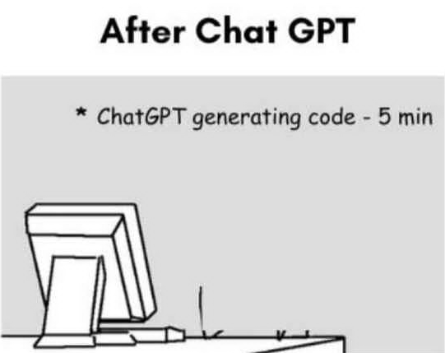
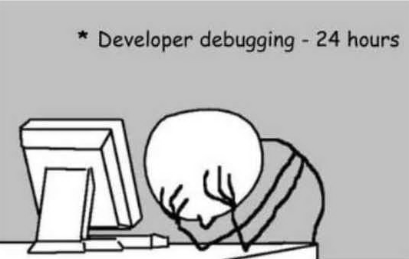
AI or not to AI?
Usage of models is allowed with the exception of the term test in the last week and during the exam.
Use these models for your education and inspiration.
Do not blindly trust any model.
Models are improving and becoming another tool in our toolboxes.
Models should not replace, they should complement.
TLDR: You can use them as you see fit, BUT not during the term test or exam
2023/2024
Programming in C++ (labs)
10

Slide 11
Useful tools and resources
Tools
Zeal - zealdocs.org
Offline documentation for various languages.
vcpkg - vcpkg.io
Dependency manager for C++ (useful especially on Windows, which has no package manager).
CMake - cmake.org
Cross-platform (meta)build system.
clang-format, clang-tidy - https://clang.llvm.org/extra/clang-tidy/
Formatter & linter for (not only) C++.
Resources
cppreference.com
stackoverflow.com
LLMs (! with caution !) - chat.openai.com, github.com/features/copilot, docs.sourcegraph.com/cody/overview
2023/2024
Programming in C++ (labs)
11

Slide 12
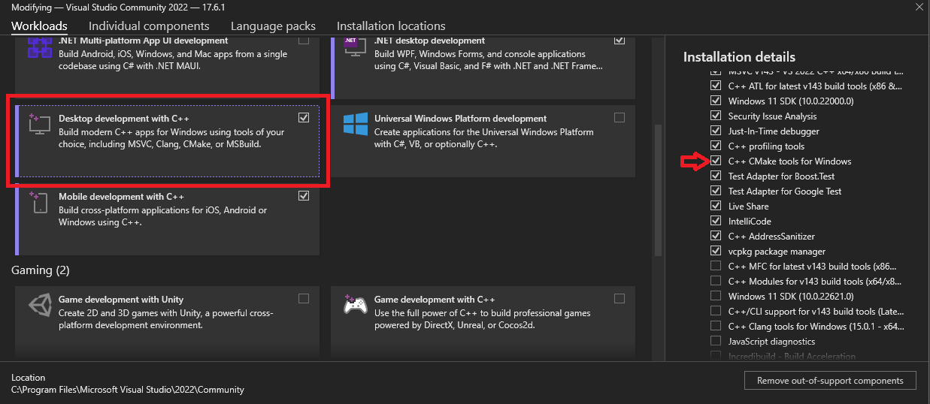
Setting up the development environment
Visual Studio IDE (Windows, Mac, used during labs)
https://visualstudio.microsoft.com/downloads/
The community version is enough, during installation, check “Desktop development with C++” & “CMake tools”.
Visual Studio Code + compiler e.g. GCC (All standard platforms)
https://code.visualstudio.com/
The compiler is not part of the VS Code, it’s just an editor.
Any editor + compiler toolchain/build system capable of C++20 will do.
2023/2024
Programming in C++ (labs)
12

Slide 13
Beware of compiler versions
We're targeting mostly C++20
Compilers' support: https://en.cppreference.com/w/cpp/compiler_support
The only current compiler supporting full C++20 is MSVC 19.28+
Visual Studio 2022 is fine
Run in 'Developer PowerShell for Visual Studio': cl --version
Almost full C++20 starting from GCC 13
with partial modules
with partial Calendar and Time zone
Available in Debian 13 (Trixie) repository (testing)
gcc --version
2023/2024
Programming in C++ (labs)
13

Slide 14
GIT
local computer
server
working copy (files)
hidden in the .git folder
ignored
untracked
tracked
staged(index)
local repo
remote repo
Basics:
git clone git@gitlab...
git pull
git status
git add .
git add somefile.cpp
git commit –m "…"
git push origin master
Useful:
git commit --amend
git checkout some-branch
git checkout –b new-branch
clone
checkout/merge
fetch
pull
Edit Compile
.gitignore
add
add
commit
push
commit -a
Visual Studio commit
2023/2024
Programming in C++ (labs)
14

Slide 15
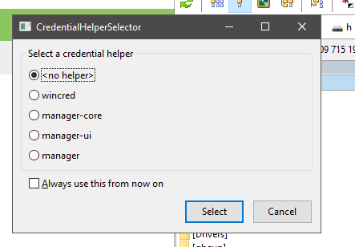
GIT at lab computers
Do not store your private SSH keys on lab computers.
All students share the same `students` directory
Setup username & password locally to repo (no --global flag)
git config user.email "frantisek.mejzlik@matfyz.cz"
git config user.name "Frantisek Mejzlik"
Instead, use the HTTPS version and when prompted do not use any credentials manager!
You will need to fill in your name & password, but it won't be stored
2023/2024
Programming in C++ (labs)
15

Slide 16
Hello world!
Further reading
https://stackoverflow.com/questions/28845058/why-does-constexpr-seemingly-not-imply-const-for-char
#-something => macro preprocessor
Just string manipulator (no types)
Use for #include & #ifndef guards
Otherwise try to stay away from it
Do not use to define constants
using namespace X
bringing items into the current scope
The main function
argc: number of params
argv: pointer to pointer to char?
constexpr size_t N = 0;
constexpr float M = 42.3;
constexpr const char* STR1 = "hello";
constexpr char STR2[] = "hello";
Number of arguments in argv.
! Including the name of the binary!
An array of C-strings (char*)
#include <iostream>
using namespace std;
int main(int argc, char** argv) {
cout << "Hello world!" << endl;
if argc >= 2 {
do_things(argc, argv);
}
return 0;
}
We'll get to args later…
2023/2024
Programming in C++ (labs)
16
Notes:
16

Slide 17
Task 1: Print all subsets
Submit to your GIT repo at least 24h before the next lecture
Write a program that takes a space-separated list of integers that define the set.
The program shall print all subsets to STDOUT.
Only one pass through the input set is required.
The solution shall traverse the tree of choices of (not) including the element in the subset.
Invalid input tokens (e.g. floats, strings) shall stop the parsing and print only the subsets of valid integers parsed up to this point.
Add cmd option `--reverse` that will reverse the order of items printed on each line.
2023/2024
Programming in C++ (labs)
17

Slide 18
Code: Example inputs & outputs
> lab_01
> 1 2 3 4 ^D
> lab_01
> 1 2 3 abracadabra 4 ^D
> lab_01 --reverse
> 1 2 3 4 ^D
4
3
3 4
2
2 4
2 3
2 3 4
1
1 4
1 3
1 3 4
1 2
1 2 4
1 2 3
1 2 3 4
3
2
2 3
1
1 3
1 2
1 2 3
4
3
4 3
2
4 2
3 2
4 3 2
1
4 1
3 1
4 3 1
2 1
4 2 1
3 2 1
4 3 2 1
2023/2024
Programming in C++ (labs)
18

Slide 19
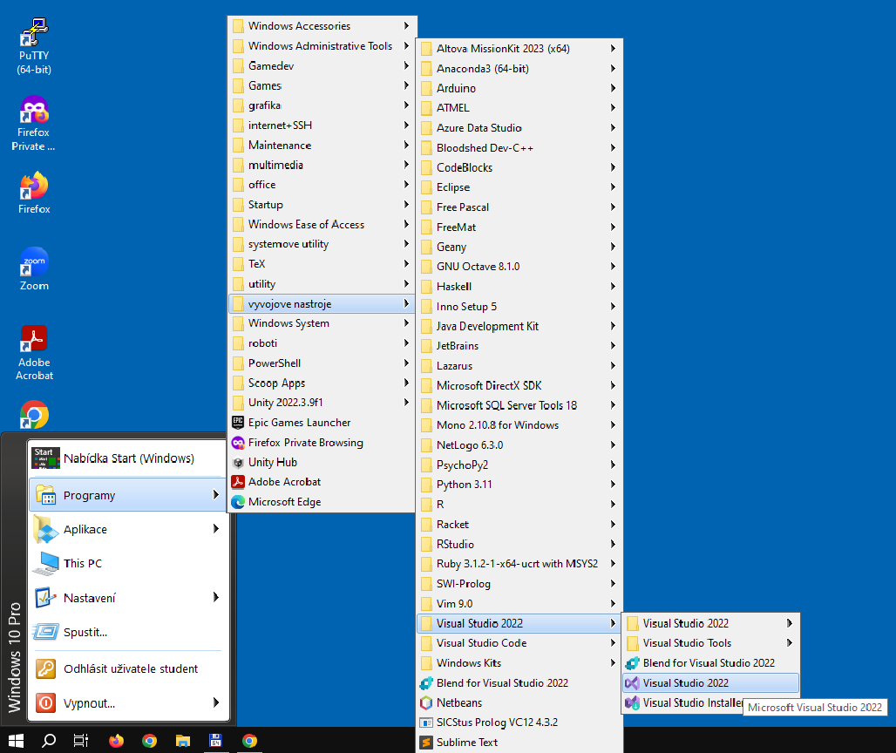
Coding: Visual Studio
Programy > vyvojove nastroje > Visual Studio
or
"Nabidka Start" > type in "Visual Studio"
2023/2024
Programming in C++ (labs)
19

Slide 20
Coding: Useful Visual Studio Settings
Set the C++ language standard version.
Right click project > Properties > C/C++ > Language > C++ Language Standard => /std:c++20 or latest.
Equivalent of ` -std=c++20` in GCC/Clang.
Add command line args to your debugged program.
Right click project > Properties > Debugging > Command Arguments => `-t -v --some=cool`.
Set up a warning level.
Right click project > Properties > C/C++ > General > Warning Level => W4.
(Somewhat) equivalent of `-Wall` in GCC/Clang.
Add additional include directories.
Right click project > Properties > C/C++ > General > Additional Include Directories => Add the desired dirs.
Equivalent of `-I <some dir>` in GCC/Clang.
Add additional directories where to look for libs for linking.
Right click project > Properties > Linker > General > Additional Library Directories=> Add the desired libs.
Equivalent of `-L /opt/libdir/` in GCC/Clang.
Add additional libraries to link with.
Right click project > Properties > Linker > Input > Additional Dependencies => e.g. somelib.lib.
Equivalent of `-l somelib` in GCC/Clang.
2023/2024
Programming in C++ (labs)
20

Slide 21
Coding: Useful Visual Studio Settings
Set the C++ language standard version.
Right click project > Properties > C/C++ > Language > C++ Language Standard => /std:c++20 or latest.
Equivalent of ` -std=c++20` in GCC/Clang.
Add command line args to your debugged program.
Right click project > Properties > Debugging > Command Arguments => `-t -v --some=cool`.
Set up a warning level.
Right click project > Properties > C/C++ > General > Warning Level => W4.
(Somewhat) equivalent of `-Wall` in GCC/Clang.
Add additional include directories.
Right click project > Properties > C/C++ > General > Additional Include Directories => Add the desired dirs.
Equivalent of `-I <some dir>` in GCC/Clang.
Add additional directories where to look for libs for linking.
Right click project > Properties > Linker > General > Additional Library Directories=> Add the desired libs.
Equivalent of `-L /opt/libdir/` in GCC/Clang.
Add additional libraries to link with.
Right click project > Properties > Linker > Input > Additional Dependencies => e.g. somelib.lib.
Equivalent of `-l somelib` in GCC/Clang.
2023/2024
Programming in C++ (labs)
21

Slide 22
Coding: Visual Studio debugging
When compiling, use the tab "Output" for error inspection not "Error List"
Always start from the top errors
The rest may be the consequence of the first one
In "Output" you can double-click the source filepath and it will jump to the line.
2023/2024
Programming in C++ (labs)
22

Slide 23
Task 1: Solution approach
We have a set of items and each item is either in the subset or not.
We can use recursion to print the subsets.
Depth-first search with backtracking
Each layer represents the i-th item in the input set.
https://media.geeksforgeeks.org/wp-content/uploads/20230829180317/subsetdrawio.png
2023/2024
Programming in C++ (labs)
23

Slide 24
Code: Taking input
Coding: Input/output with STDIN/STDOUT
#include <iostream>
#include<string>
C
(f)getc
(f)scanf
Prefer C++ functions.
C++
operator>> - overload for istream
std::getline
std::istream::get
2023/2024
Programming in C++ (labs)
24

Slide 25
Code: Taking input
Intermezzo: cin, cout, <<, >>
https://en.cppreference.com/w/cpp/io/cin
https://en.cppreference.com/w/cpp/io/cout
https://en.cppreference.com/w/cpp/string/basic_string/getline
https://en.cppreference.com/w/cpp/io/basic_istream/get
Taking/passing input from/to STDIN/STDOUT
cin >> i
extracts separated by whitespace and tries to parse into the target type.
getline(cin, line, '.')
reads by lines by default or by the third parameter (char)
Only to char*, std::string
cin.get(c)
Read char by char
For some lower-level manipulation
float f;
int i;
cin >> f; // Tries to parse as float
cin >> i; // Tries to parse as int
cout << "The number is " << f << " and " << i << "." << endl;
// C++20
cout << format("The number is {} and {}.", f, i) << endl;
// C++23
// println("The number is {} and {}.", f, i);
// Read whitespace-separated until first error/EOF
while (cin >> i) {
// Do something with i
}
// Read line by line until error/EOR
string buffer;
while (getline(cin, buffer)) {
// Do something with buffer
}
// Read with ";" separator
while (getline(cin, buffer, ';')) {
// Do something with buffer
}
// Read by characters
char c;
while (cin.get(c)) {
// Do something with c
}
2023/2024
Programming in C++ (labs)
25

Slide 26
Code: Taking input
Intermezzo: std::vector
https://en.cppreference.com/w/cpp/container/vector
An STD sequence container
std::vector implements an array with fast random access and the ability to automatically resize when appending elements.
Homogeneous (all of the same type) elements stored consecutively in memory (one after another)
If full, reallocates to the new more spacious memory location
this invalidates all references/iterators/ pointers to the vector
Interface:
Definition/construction
vector<int> x; // Empty (garbage data), with default capacity
vector<int> x(10); // Empty (garbage data), with size 10 (not capacity)
vector <int> x(10, 0); // With size 10, initialized to 10
Access
x[i]
x.front()/back()
Modifiers
x.push_back(1)
x.push_back(val)
x.pop_back()
2023/2024
Programming in C++ (labs)
26

Slide 27
Coding: Recursing on the input
Further reading
https://www.modernescpp.com/index.php/c-20-std-span/
Take the first element and recurse on the rest with this element OUT and IN
Provide a list of previous elements to print to each recursive call.
To represent a non-owning view to a contiguous container, you can use std::span
std::span is just a view into a contiguous container and the data it points to must live longer than the span
s([], [1,2,3])
s([], [2,3])
s([1], [2,3])
s([1,2], [3])
s([1], [3])
s([1,2], [])
s([1,2,3], [])
https://media.geeksforgeeks.org/wp-content/uploads/20230829180317/subsetdrawio.png
2023/2024
Programming in C++ (labs)
27

Slide 28
Coding: Processing cmd args
Get rid of C-strings ASAP!
Once in STL container, iterate over them and process them
In our case lab_01 --reverse
myprog -n -w a.txt b.txt
 |  |  |  |  | 0
argv
lab_01 --reverse
b | . | t | x | t | \0
argv
 |  | 0
argc
5
a | . | t | x | t | \0
- | w | \0
argc
2
- | - | r | e | v | e | r | s | e | \0
- | n | \0
l | a | b | _ | 0 | 1 | \0
Get rid of C-string args ASAP!
vector<string> arg( argv, argv+argc);
2023/2024
Programming in C++ (labs)
28

Slide 29
Coding: Example inputs & outputs
> lab_01
> 1 2 3 4 ^D
> lab_01
> 1 2 3 abracadabra 4 ^D
> lab_01 --reverse
> 1 2 3 4 ^D
4
3
3 4
2
2 4
2 3
2 3 4
1
1 4
1 3
1 3 4
1 2
1 2 4
1 2 3
1 2 3 4
3
2
2 3
1
1 3
1 2
1 2 3
4
3
4 3
2
4 2
3 2
4 3 2
1
4 1
3 1
4 3 1
2 1
4 2 1
3 2 1
4 3 2 1
2023/2024
Programming in C++ (labs)
29

Slide 30
Lab 1: Wrap up
You should know
what is required of you in order to get credit and pass the course.
what to expect from me and these labs.
what tools you can use to pass this course.
basic C++ syntax, parameter passing, functions, and basic cmd args parsing.
Next lab:
Dangers of archaic C++/C things
We will write a program in a bad way so we can appreciate modern C++ constructs and features.
Your tasks until the next lab:
Get your development environment ready.
Try out the GitLab repository.
Assign yourself to ReCodex group.
Task 1 (24h before, so I can give feedback).
Just a directory lab_01 with one CPP file will do
2023/2024
Programming in C++ (labs)
30

