Slide 1
DeCorAtor
Adam Budai

Slide 2
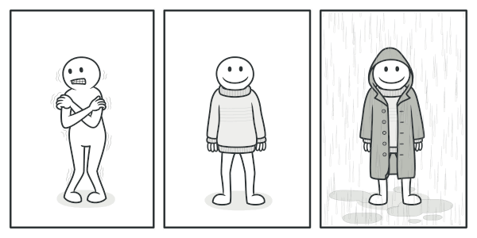
Intent
Attach additional responsibilities
Placing object inside special wrapper
Notes:
Refactoring Guru. Online. Dostupné z:https://refactoring.guru/images/patterns/content/decorator/decorator-comic-1.png?id=80d95baacbfb91f5bcdbdc7814b0c64d

Slide 3
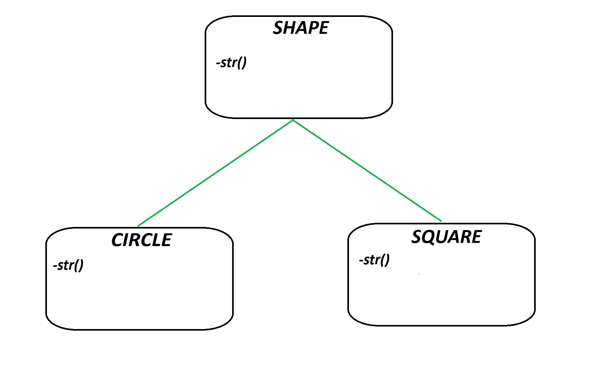
Example

Slide 4
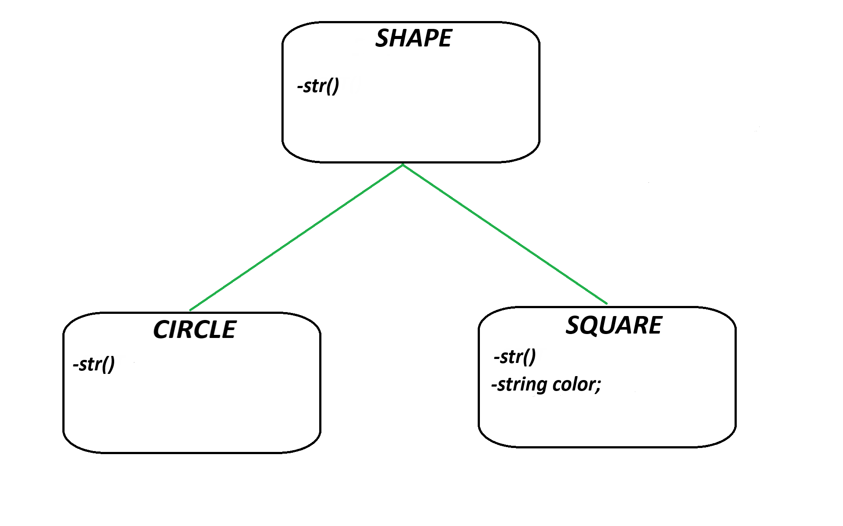
Example

Slide 5
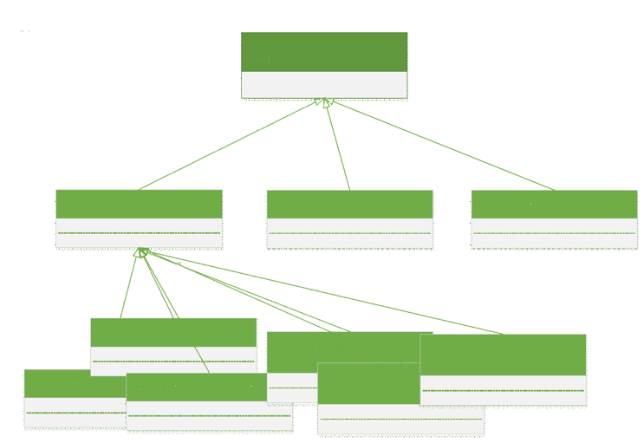
POSSIBLE SOLUTIONS
Restrict to a certain subset
So many classes, change of common attribute
Inheritance
Still a lot of classes, not flexible
Superclass
Wasteful, long…

Slide 6
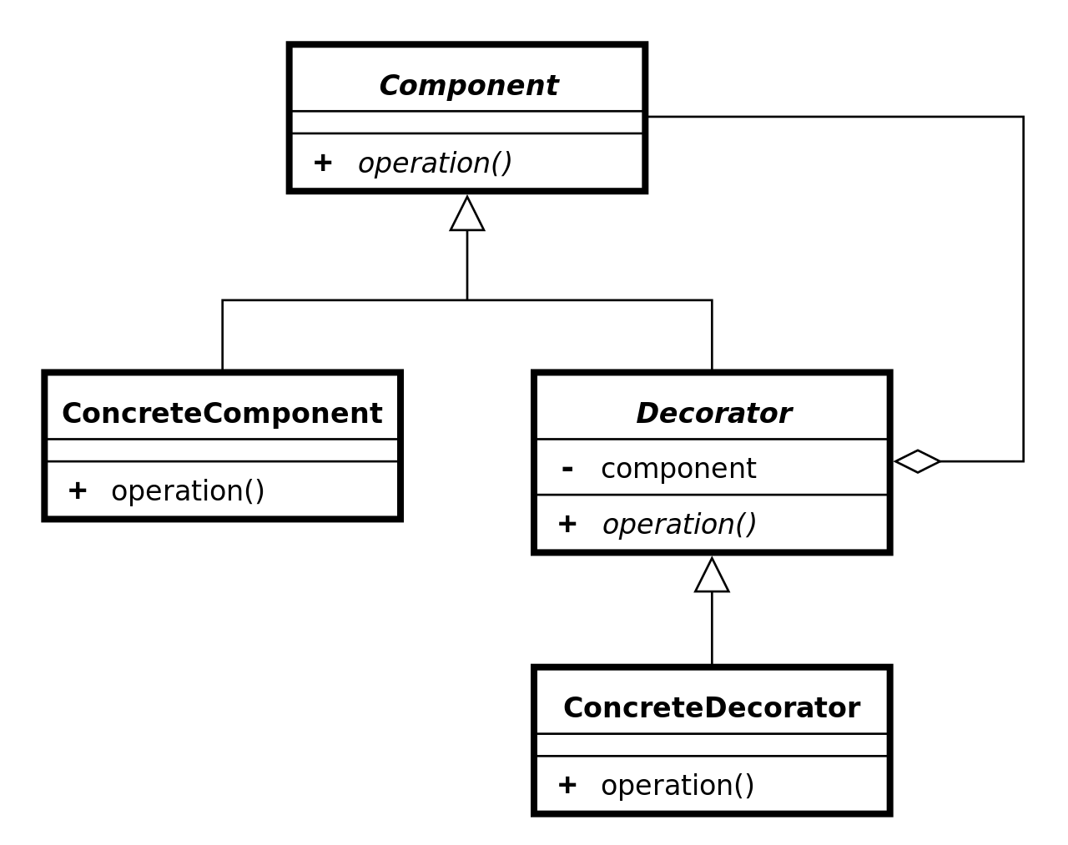
DECORATOR
Dynamically adding/removing responsibilities
Supports open-closed principle
Supports singe-responsibility principle
A flexible alternative to subclassing for extending functionality
Decorators can be recursively layered
Notes:
Decorator UML class diagram. Wikipedia. Online. Dostupné z: https://en.wikipedia.org/wiki/Decorator_pattern#/media/File:Decorator_UML_class_diagram.svg

Slide 7
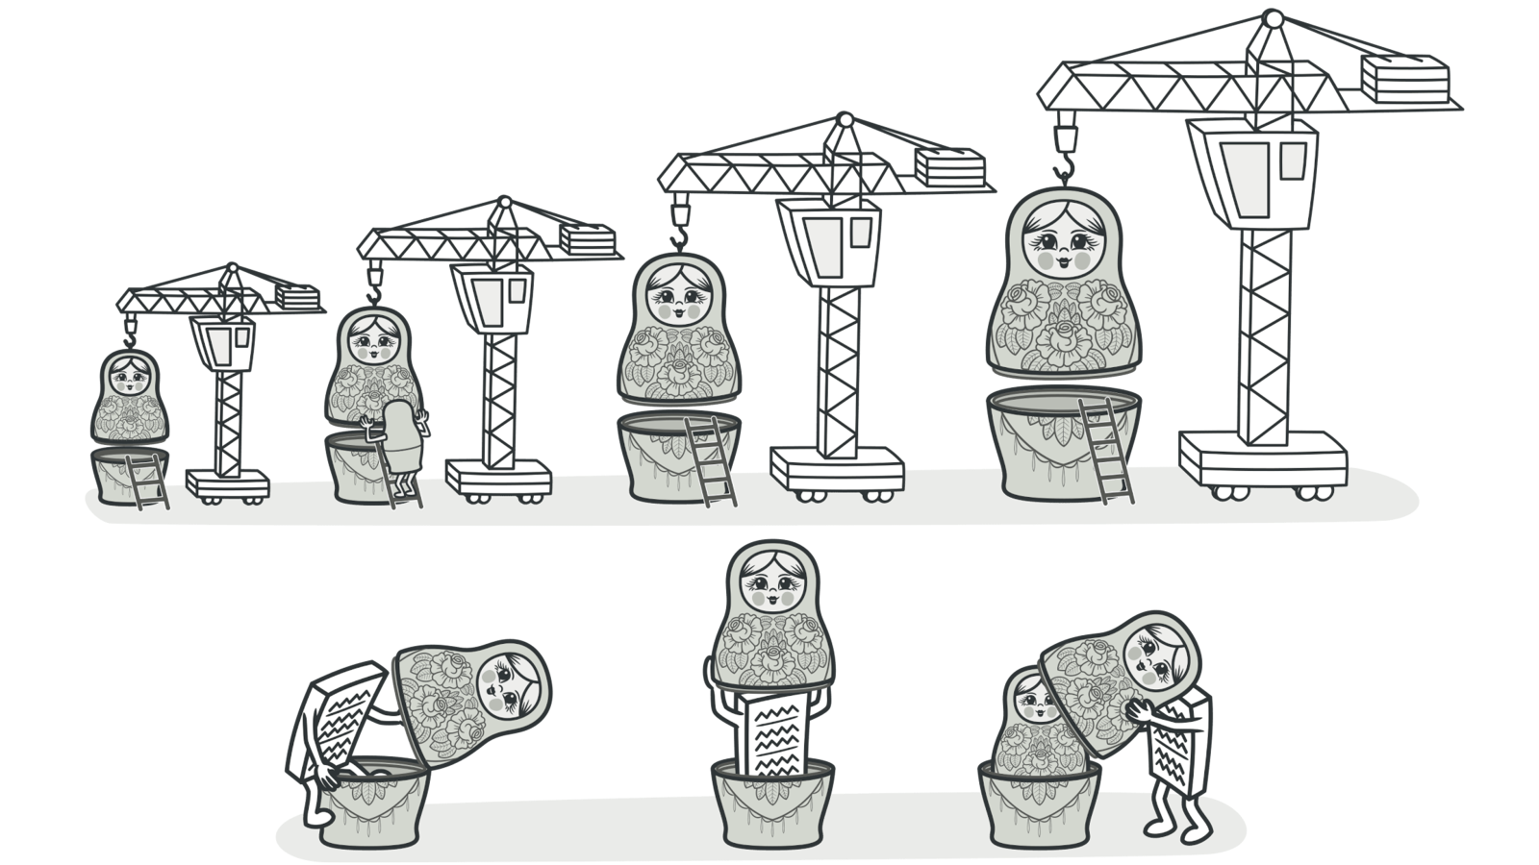
TYPES OF DECORATOR
Dynamic
Runtime flexibility
Dynamic composition
Static
Compile-Time optimization
Code clarity
Notes:
Refactoring Guru. Online. Dostupné z:https://refactoring.guru/images/patterns/content/decorator/decorator.png?id=710c66670c7123e0928d3b3758aea79e

Slide 8
IMPLEMENTATION

Slide 9
IMPLEMENTATION

Slide 10
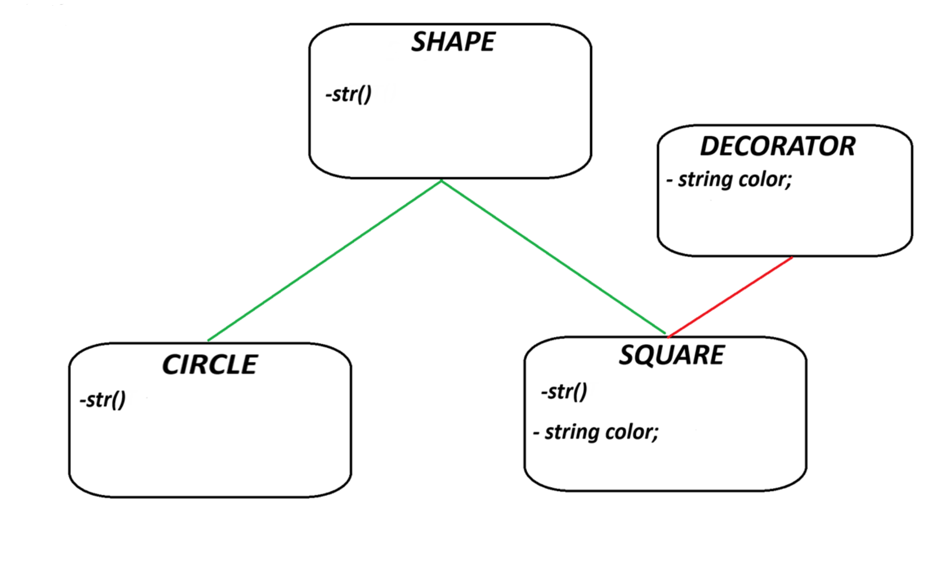
SOLUTION

Slide 11
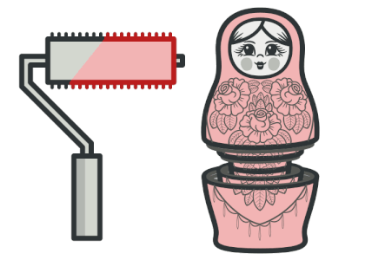
PROS AND CONS
+ extending an object’s behavior without making a new subclass
+ combining several behaviors by wrapping an object into multiple decorators
+ Single Responsibility Principle.
hard to remove a specific wrapper from the wrappers stack.
hard to implement a decorator in such a way that its behavior doesn’t depend on the order in the decorator's stack.
the initial configuration code of layers might look pretty ugly.
Notes:
Refactoring Guru. Online. Dostupné zhttps://refactoring.guru/images/patterns/cards/decorator-mini.png?id=d30458908e315af195cb183bc52dbef9

Slide 12
Related design patterns
Composite
Decorator is a modified version of Composite(only one component)
Decorator doesn’t aggregate objects
Strategy
Decorator changes the “outside” / Strategy changes the “inside” - of an object
Component in Strategy knows about its extensions
Adapter
Decorator only changes responsibilities of an object, not its interface
Adapter gives the object a new interface

Slide 13
Thank you for your attention!

