Slide 1
Beyond
Data Warehouse
NDBI046 - Introduction to Data Engineering
2024/2025
Petr Škoda
https://github.com/skodapetr
https://www.ksi.mff.cuni.cz
Notes:
The aim is to be data-driven company a company who decide and act effectively based on data. Reduction of operational cost, better customer experience. To do so we need the enablers in form of intelligent data platforms.

Slide 2
Data Warehouse
Data Source
Staging Area
Data Warehouse
Data Source
Extract
Load
Transform
Notes:
Last time we build data warehouse, just a reminder that we can implement it using tools like bash, SQL statements, cron etc. It is not about the technology but delivering value to business.

Slide 3
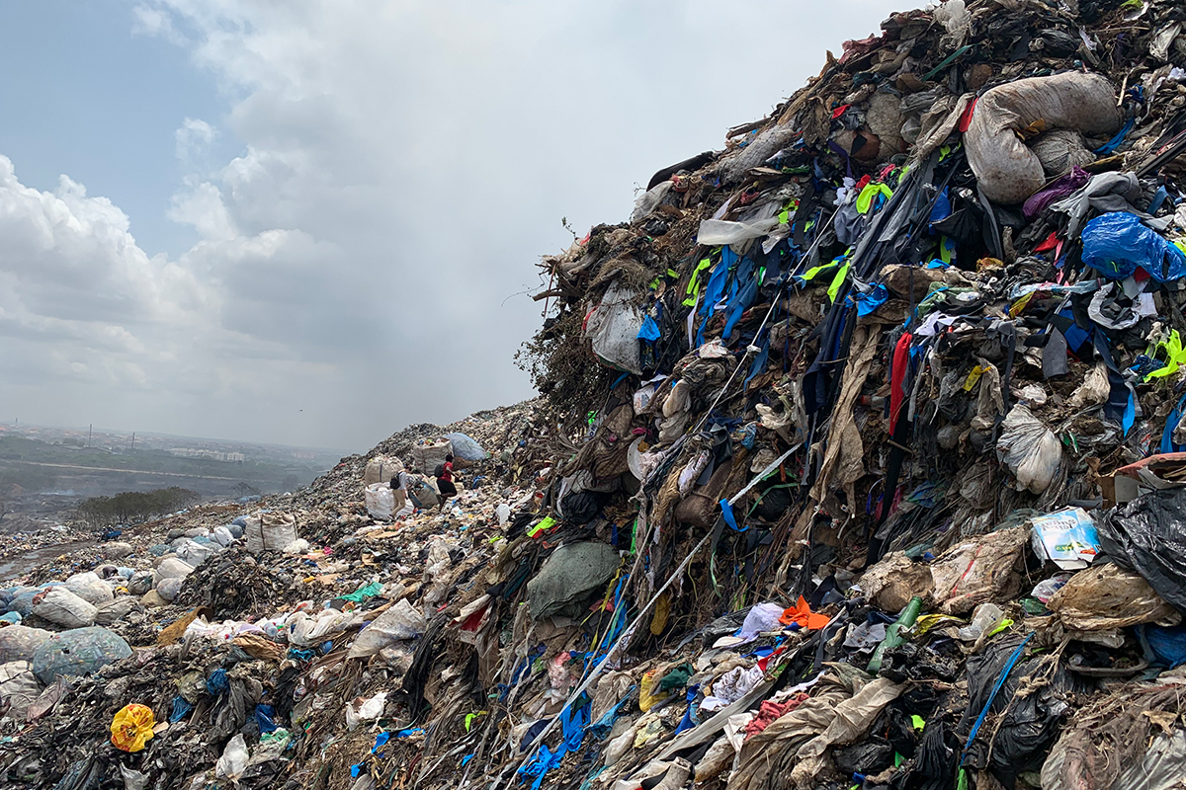
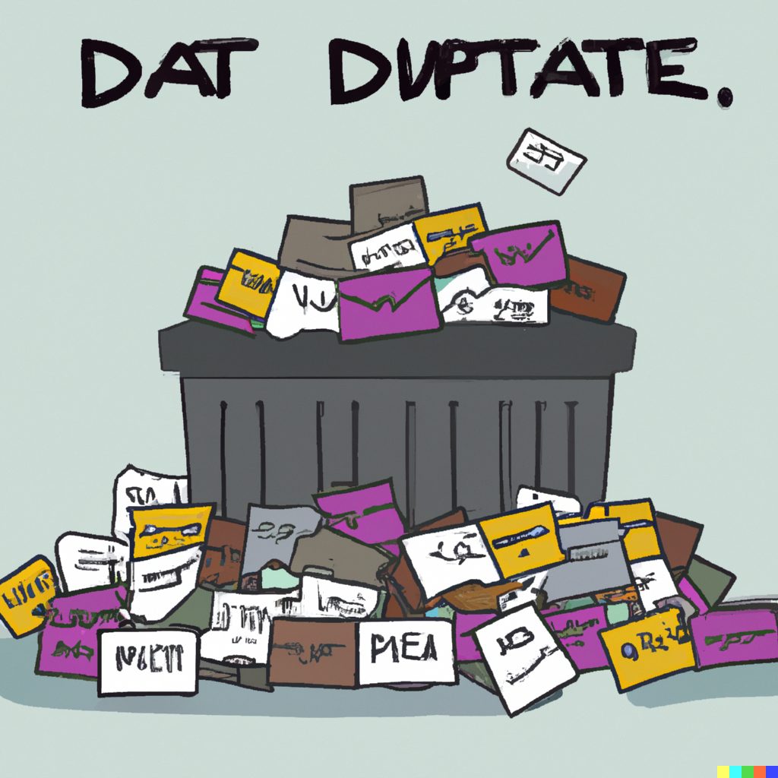
Data Warehouse goes wrong
Data Dump
The landfill site in Kpone is oversaturated with textile waste, Credit: The OR Foundation
Notes:
Left image is by Dall-e for prompt “data dump”, yet that may not capture the big picture.
Data dump may be well intended, there can be a lot of resources invested.
Yet there is no need/use for the content.
Scraping that project may also not be easy as there is huge investment made.
Resources:
https://dataproducts.substack.com/p/the-death-of-data-modeling-pt-1

Slide 4
Data Lake

Slide 5
Data lake
Large amounts of data
Cheaper to construct than Data Warehouse
Schema on read
Structured, semi-structured, non-structured data
Easy to make change
Users with computer science knowledge
Use-case: machine learning, deep analysis, discovery or undefined
“Next-generation hybrid data management solutions that can meet big data challenges and drive new levels of real-time analytics” -- Marketing Department
Notes:
Data warehouse: centralize and integrates data in a rigid schema which is slow to change. Build to manage analytics and aggregations to address needs of reporting and analytics.
We may need fast response time to changes, for example software team is rapidly evolving their MongoDB schema.
Users: data scientists, data engineers. Can be make approachable using Apache Hive. We delay decision of data processing after loading (ELT).
The structure may represent folders, each folder can be further partitioned. E.g., folder for “orders”, partitioned by day. There is no fixed file format.
We can still use it to do data reporting. At the end data lake can be a pre-step to loading data to data warehouse. It is just we need to be more technical to access the data.
- - - - - - - - - - - - - - - - - - - - - - - - - - - - - - - - - - - -
Resources:
https://aws.amazon.com/big-data/datalakes-and-analytics/what-is-a-data-lake/

Slide 6
Data lake
Opportunities
Moving fast, ELT
Easy data access
Large volumes of data
Risks
No vision
Data governance
Planning and commitment
Notes:
We can easily use new tools, formats, … but that may lead to bad design - same as with software development. Without clearly articulating and understanding how a data lake will benefit the business, a user might fail to acquire the approvals and buy-in needed to move forward.
We need to be able to trace the data, especially as there is no single source of truth. We only have the raw data at the input. It may also be harder to enforce policies on data access.
Marketing: With a well-built data lake, you can extend access to more users, including not only data scientists but also business users and application developers.
Pitfall: Enterprise-grade governance and security strategies are crucial. We need strong access control.
Data lake may run on commodity hardware, compared to more expensive warehouses. The most part comes from data distribution. Storage is separated from the computational resources.
Pitfall: A data lake requires a long-term commitment plus planning to accommodate continued data growth.
We basically take the difficult part (data integration) and postpone it. Yet such approach requires good management to handle. A corner stone for this approach is high quality metadata (what, where, why, how). In linked podcast Bill Inmon share a view that ELT is only a way how to sold software without solutions. Since the T is complicated, we leave it to the customer.
For example, for access control in data warehouse we have tables, data marts all aligned with business needs and thus business processes.
For data lake we just have centralized data store - can be an S3 bucket.
Resources:
https://open.spotify.com/episode/6UpQqSfwA7rgznqP364qL6?si=iYX_ZysvT1Ws4ZMOIImXcA

Slide 7

Data Swamp
Data lake goes wrong
Notes:
A magical place where everything is possible.

Slide 8
Data Lakehouse
Consider 2024/2025

Slide 9
Data Contracts
Notes:
As the next evolution of ETL.

Slide 10

Data Contracts
Data Contract ai an API-like agreements between Data producer and Data Consumers.
PayPal's Data Contract Template:
Demographics
Dataset & schema
Data quality
Pricing
Stakeholders
Roles
Service-level agreement
Other properties
Notes:
Resources:
https://dataproducts.substack.com/p/the-rise-of-data-contracts
https://www.dataengineeringweekly.com/p/data-engineering-weekly-130
https://github.com/paypal/data-contract-template/tree/main/docs
https://dataproducts.substack.com/p/an-engineers-guide-to-data-contracts
https://www.gable.ai/

Slide 11
Data Mesh

Slide 12
Data Mesh
Issues to address:
Changes in the data landscape
Proliferation of sources of data
Diversity of data use cases and users
Speed of response to change
Principles:
Domain-oriented decentralized data
ownership / responsibility and architecture
Data as a product / "first-class citizen"
Self-serve data infrastructure as a platform
Federated computational governance
“I suggest that the next enterprise data platform architecture is in the convergence of Distributed Domain Driven Architecture, Self-serve Platform Design, and Product Thinking with Data.” -- Zhamak Dehghani, May 2019
Notes:
The technology advances of the past decade have addressed the scale of volume of data and data processing compute, they have failed to address scale in other dimensions. It is basically a micro-services but for data. This is mostly to address issues of scale when it comes to organization size. While we decentralize and divide, employ bounded contexts for data we take pride in building a single store.
The idea is that data lake failed to deliver on its promises, the centralized store (same for data warehouse) prove to be a source of a problem. Distribution comes to the rescue. In other words, we try to tackle issues from different perspective. Probably the problem was not in the ETL but the centralization. At the same time, the objective is not to have siloed domain data that is hard to discover, make sense of and consume.
Principles (not aligned with points).
An operational system and its team or organizational unit provide a truths of their business domain as source domain datasets. There is mapping at the enterprise level to the source. They must have proper infrastructure to handle the data.
The consumer domain datasets and the teams who own them, aim to satisfy a closely related group of use cases.
The need for data transformation is still there. Data pipelines are part of domain complexity and implementation of the data domain and is handled internally within the domain.
Each domain dataset must establish a Service Level Objectives for the quality of the data it provides timeliness, error rates, etc.
Over the last decade operational domains have built product thinking into the capabilities they provide to the rest of the organization. We need to see datasets/data as products.
At the same time all the principles must consider scalability.
Sources:
https://martinfowler.com/articles/data-monolith-to-mesh.html
https://martinfowler.com/articles/data-mesh-principles.html
https://medium.com/@hannes.rollin/six-reasons-why-data-mesh-will-fail-195886c89bdd

Slide 13
Data as a Product
We can see it as an evolution of data contracts.
Discoverable via Data Catalog
Accessible
Trustworthy and truthful
Semantics and syntax
Interoperability
Access control
Teams
Ownership
Notes:
We must see datasets as products, users from organization are their customers.
A common implementation is to have a registry, a data catalogue, of all available data products with their meta information such as their owners, source of origin, lineage, sample datasets, etc. This centralized discoverability service allows data consumers, engineers and scientists in an organization, to find a dataset of their interest easily. Domain data must be registered by owners.
Organization should have conventions to make it easy to access the data. This may involve API, documentation, sandbox. Aim at easy of use. Data can be shared as: CSV, Kafka Topic, Parquet files …
No one will use a product that they can't trust. A fundamental shift requires the owners of the data products to provide an acceptable Service Level Objective around the truthfulness of the data. Applying data cleansing and automated data integrity testing at the point of creation of the data product are some of the techniques to be utilized to provide an acceptable level of quality.
Add examples, data should be standalone when it comes to understanding and consumption.
Main concerns for distributed data architectures, the hard part. We need standards as a part of governance. May include data format, codelists, resource identification.
Make sure only the right people can use the data. Similar to data lake.
A domain team need new skills: data product owner and data engineers. There is no longer a single organizational department “data engineers”, instead they are part of cross-functional teams. We need data engineers to design and deploy data systems. Similar to software engineers who develop operational systems.
We can still share resources. Sharing data processing environment is highly desirable as it is not easy to maintain it. The environment is owned by data infrastructure ream. At the end we already share standards, so it does not break any rules. This may also help with deduplication of efforts inside the organizational units. A success criteria for self-serve data infrastructure is lowering the 'lead time to create a new data product’.

Slide 14
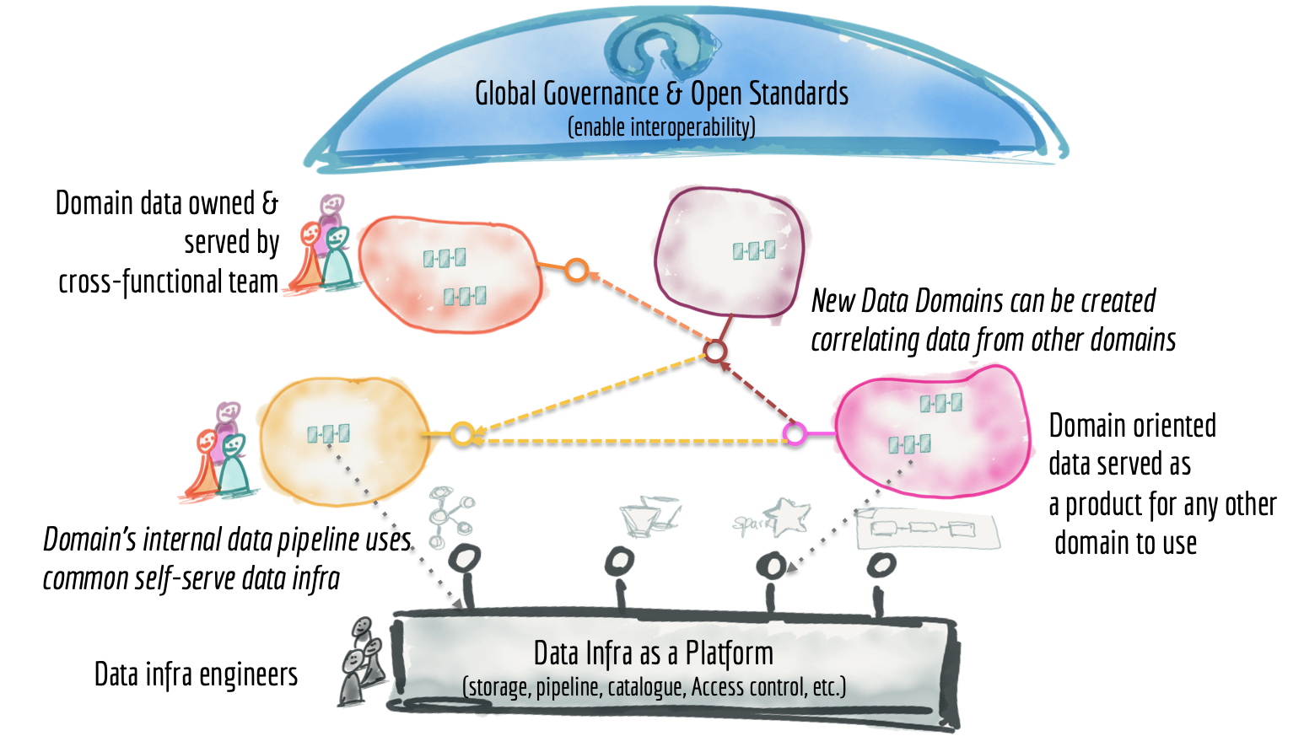
Data Mesh the Big Picture
Notes:
We now have connected nodes. They share governance and standards and utilize same data infrastructure. Data Lake and Data Warehouse are just nodes in this architecture. Unlike the classical centralized governance, the governance for Data Mesh embraces changes and multiple imperative contexts. While we aim at standards and interoperability, we need to respect autonomy of local domains. We need to mix global and local concerns.
The main shift is to treat domain data product as a first-class concern, and data lake tooling and pipeline as a second-class concern - an implementation detail.
Resources:
https://martinfowler.com/articles/data-monolith-to-mesh.html

Slide 15
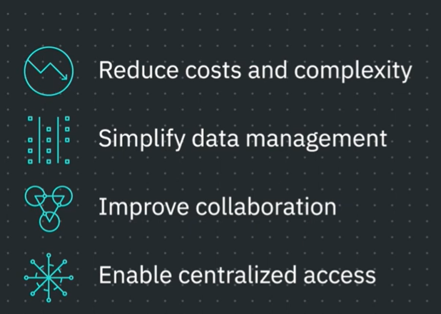
Data Fabric
Optional 2024/2025
Notes:
Resources:
https://www.youtube.com/watch?v=2XB4UaBIvNI

