Slide 1
Data Management
NDBI046 - Introduction to Data Engineering
2024/2025
Petr Škoda
https://github.com/skodapetr
https://www.ksi.mff.cuni.cz
Notes:
This presentation is heavily inspired by DAMA Book.

Slide 2
Data Asset
“An asset is an economic resource, that can be owned or controlled, and that holds or produces value. Assets can be converted to money.” -- Data Management Body of Knowledge
Value is the difference between the cost of and the benefit:
Cost of obtaining and storing data
Cost of replacing data if it were lost
Impact to the organization if data were missing
Cost of improving data
Benefits of higher quality data
What the data could be sold for
Expected revenue from innovative uses of data
….

Slide 3
Data Management
“Data Management is the development, execution, and supervision of plans, policies, programs, and practices that deliver, control, protect, and enhance the value of data and information assets throughout their lifecycles.” -- Data Management Body of Knowledge
Data management professionals (technical):
Database Administrators
Network Administrators
Developers
Data management professionals (business):
Data Stewards
Data Strategists
Chief Data Officers
Data Governance Council
“A strategy is a set of choices and decisions that together chart a high-level course of action to achieve high-level goals. “-- Data Management Body of Knowledge
Notes:
Data Management Professional is any person who works in any facet of data management (from technical management of data throughout its lifecycle to ensuring that data is properly utilized and leveraged to meet strategic organizational goals.
Data management requires both technical and non-technical (business) skills.
Goals:
Understanding and supporting the information needs.
Capturing, storing, protecting, and ensuring the integrity of data assets.
Ensuring the quality.
Ensuring the privacy and confidentiality of stakeholder data.
Ensuring data can be used effectively to add value to the enterprise.
The challenge is getting people with this range of skills and perspectives to recognize how the pieces fit together so that they collaborate well as they work toward common goals.
A data strategy should include business plans to use information to competitive advantage and support enterprise goals. In many organizations, the data management strategy is owned and maintained by the CDO and enacted through a data governance team, supported by a Data Governance Council.

Slide 4
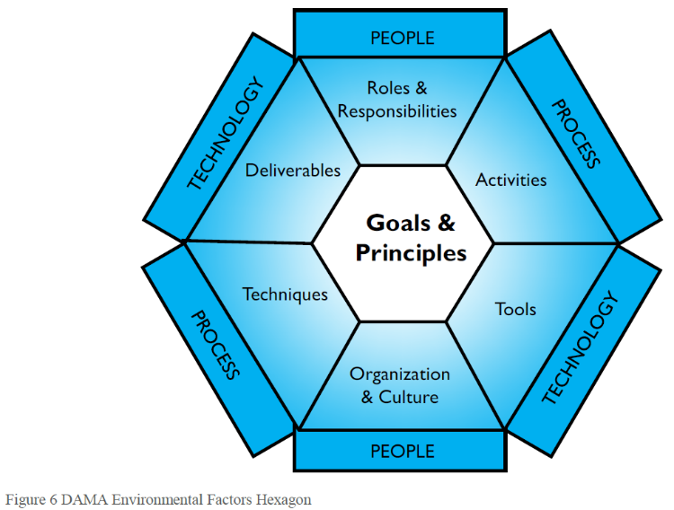
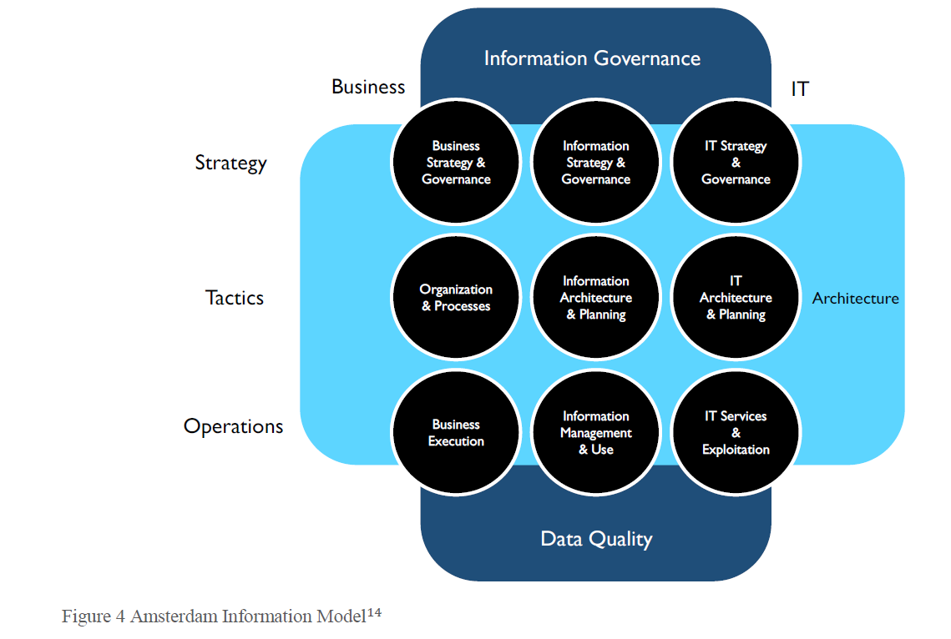
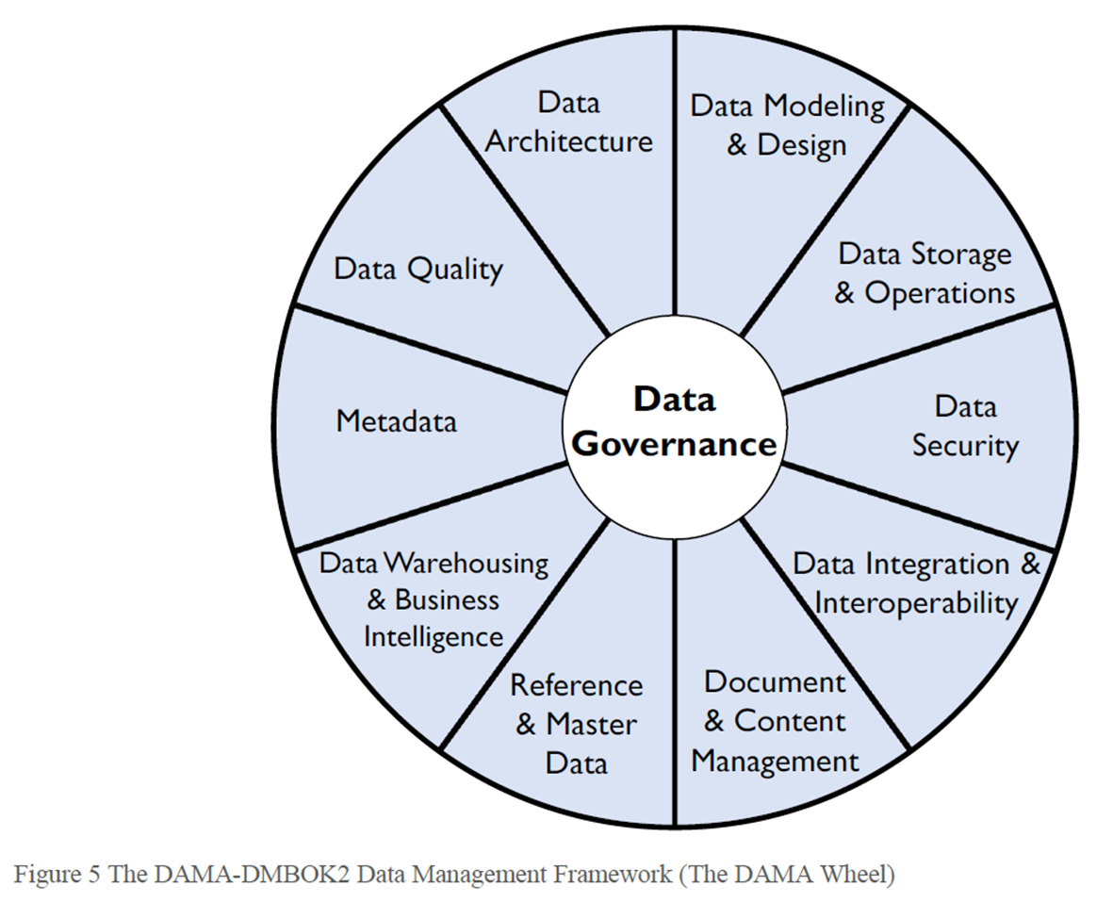
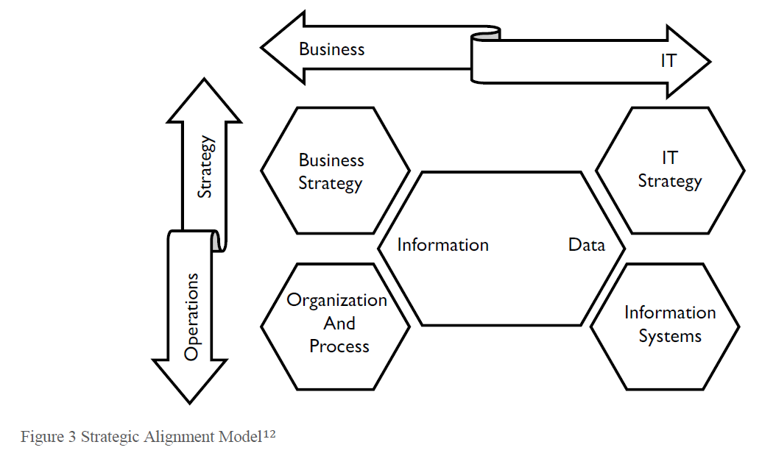
Data Management Frameworks
Strategic Alignment Model (Henderson and Venkatraman, 1999)
Amsterdam Information Model
The DAMA DMBOK Framework (The DAMA Wheel)
Hexagon, and Context Diagram
Notes:
There is a lot to keep track of, which is why it helps to have a framework to understand the data management comprehensively and see relationships between its component pieces. Frameworks developed at different levels of abstraction provide a range of perspectives on how to approach data management.
Figure is just a simplification.
It takes a strategic perspective on business and IT alignment. Known as the 9-cell, it recognizes a middle layer that focuses on structure and tactics, including planning and architecture.
DAMA Wheel - we already saw that. There are alternatives how to visualize it, just like software diagrams.
It shows the relationship between people, process, and technology and provides a key for reading the DMBOK context diagrams.

Slide 5
Aiken's pyramid
Phase 1 Application with database capabilities.
Phase 2 There are issues with quality.
Phase 3 Manage management ~ governance.
Phase 4 Profit.
Notes:
Aiken's pyramid describes how organizations evolve toward better data management practices.
Phase 1: The organization purchases an application that includes database capabilities. This means the organization has a starting point for data modeling / design, data storage, and data security (e.g., let some people in and keep others out). To get the system functioning within their environment and with their data requires work on integration and interoperability.
Phase 2: Once they start using the application, they will find challenges with the quality of their data. But getting to higher quality data depends on reliable Metadata and consistent Data Architecture. These provide clarity on how data from different systems works together.
Phase 3: Disciplined practices for managing Data Quality, Metadata, and architecture require Data Governance that provides structural support for data management activities. Data Governance also enables execution of strategic initiatives, such as Document and Content Management, Reference Data Management, Master Data Management, Data Warehousing, and Business Intelligence, which fully enable the advanced practices within the golden pyramid.
Phase 4: The organization leverages the benefits of well-managed data and advances its analytic capabilities.

Slide 6
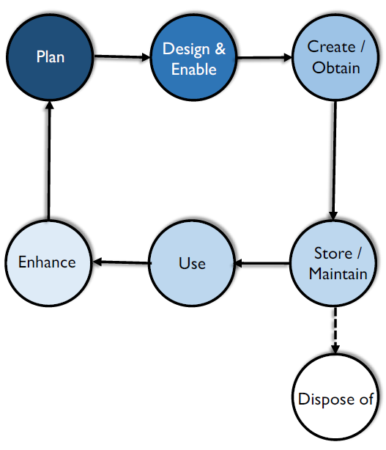
Data Life Cycle
Manage data flow from the first contact to the last.
Phases (incomplete list):
Data capture / creation
Data storage
Data maintenance
Data synthesis
Data usage
Data publication
Data archival
Data destruction / purge
Personal to global:
Panel on Climate Change (IPCC) expected > 80 PB
Large Synoptic Survey Telescope expected > 500 PB
Image of a supermassive black hole 4.5 PB
…
Notes:
There is no strict definition. We can see it as a sequence of phase/steps without a strict definition. The core idea remains the same, we have a lots of data, there are different transformations, and we need to describe and manage all of that somehow.
If you have your personal project or a small business with single database and few table, it may look like data life cycle is a trivial thing. We create data in our application, we stored them in a database, we show them using our application and we may delete them some day.
Phases:
Data Capture / Creation : Specification may include legal contracts, basic types:
Data Acquisition : Use existing data produced outside the company
Data Entry : Humans of devices create new data. Sometimes without devices here.
Signal Receipt / Capture : Capture by a device, usually important in the control system. More for the Internet of Things.
Storage : Prevent data loss, allow efficient retrieval, NDBI007, and data protection. Data location for cloud storages.
Maintenance : Apply processing, like cleaning, so they can be effectively used by the business. Does not add a business value. May include ETL processes.
Synthesis : Not common, make valuable data through inductive reasoning. This type of analysis is also used in risk modeling, accounting, and investment decisions. An example, Net Sales = Gross Sales – Taxes. If I know Gross Sales and Taxes, and I know the simple equation just outlined, then I can calculate Net Sales.
Usage : Depends on the business. Data can be viewed, processed, modified and saved. An audit trail should be maintained for all critical data to ensure that all modifications to data are fully traceable. There can be an extra phase for data processing (data cleaning, data wrangling, compression, encryption).
Publication : Even sending email with a table. How to handle incorrect data, they are outside our area of influence. Data governance may help to decide how to handle them.
Archival : May be required by a law (accounting data), data that are not needed.
Destruction / Data Purge : Some data must be deleted after there is no, legal, use for them - GDPR. Every copy must be deleted, even from the archive. From the perspective of Data Governance, the challenge is to make sure that has been done properly.
Defined by Linked Open Data 2 stack:
Interlinking (Creating and maintaining links)
Classification (Integration, Fusion)
Quality
Evolution
Exploration
If you have your personal project or a small business with single database and few table, it may look like data life cycle is a trivial thing. We create data in our application, we stored them in a database, we show them using our application and we may delete them some day. On the other hand, there are some projects with outstanding amount of data.
The latest round of the Intergovernmental Panel on Climate Change (IPCC) will produce up to 80 petabytes of data (Balaji et al., 2018).
The Large Synoptic Survey Telescope is expected to build over a period of 10 years a 500-petabyte database of images and a 15-petabyte catalog of text data (LSST Project Office, 2018).
The first-ever image of a supermassive black hole was orders of magnitudes larger, needing approximately 4.5 petabytes of astronomy data.
Data at Sanger Institute ~ custom power plant.
It is not only about the amount of the data but also the transformations, owner ships, visualizations ~ data flow in general. Data Lifecycle Management (DLM) allows companies/teams to manage the data flow from the first contact to the last.
Image is from DMBOOK. Keep in mind that Data Life Cycle is specific for a particular type of data.
Sources:
https://link.springer.com/chapter/10.1007/978-3-642-35173-0_1

Slide 7
Data Governance
All organizations make decisions about data, regardless of whether they have a formal Data Governance function.
Notes:
Part of this presentation is based at the Data Management Body of Knowledge book.
Resources:
https://www.youtube.com/watch?v=EdOzZJd8DNk

Slide 8
Data Governance
“Framework of people, policies, processes and technologies that define how you manage your organization’s data.” -- SAS
“The act or process of governing or overseeing the control and direction of something.” -- Merriam-webster
“the exercise of authority and control (planning, monitoring, and enforcement) over the management of data assets. The Data Governance function guides all other data management functions.” -- Data Management Body of Knowledge
Strategy
Policy (e.g., metadata management)
Standards and quality
Oversight
Compliance
Issue management
Data management projects (sponsoring)
Data asset valuation
Notes:
For most organizations, adopting formal Data Governance requires the support of organizational change management as well as sponsorship from a C-level executive, such as Chief Risk Officer, Chief Financial Officer, or Chief Data Officer. For many organizations, cultural change is a major challenge.
A common analogy is to equate data governance to auditing and accounting. Auditors and controllers set the rules for managing financial assets. Data governance professionals set rules for managing data assets.

Slide 9
Data Governance
Decisions that must be made to ensure effective data management.
Areas:
Data principles
Data quality
Metadata
Data access
Data lifecycle
…
Notes:
Designing data governance requires stepping back from day-today decision making and focusing on identifying the fundamental decisions that need to be made and who should be making them. We should not reverse engineer it from a particular task.
The scope is business wide, so it is not only IT, but IT department can help with the implementations. Since Data governance is fundamentally about organizational behavior, it can not be solved through technology. However, there are tools that support the overall process. For example, a collaboration portal with search capabilities for data and help to manage simple workflows.
Governance refers to what decisions must be made to ensure effective management and use of IT (decision domains) and who makes the decisions (locus of accountability for decision making).
Management involves making and implementing decisions.
Data governance ensures data (as an asset) is properly managed without directly executing data management. For example, governance includes establishing who in the organization holds decision rights for determining standards for data quality. Management involves determining the actual metrics employed for data quality.
Areas:
Data principles What are the uses of data for the business? How are opportunities for sharing and reuse of data identified? How does the regulatory environment influence the business uses of data?
Data quality What are the standards for data quality with respect to accuracy, timeliness, completeness and credibility? What is the program for establishing and communicating data quality? How will data quality as well as the associated program be evaluated?
Metadata What is the program for documenting the semantics of data? How will data be consistently defined and modeled so that it is interpretable? What is the plan to keep different types of metadata up-to-date?
Data access What is the program for periodic monitoring and audit for compliance? How is security awareness and education disseminated? What is the program for backup and recovery?
Data lifecycle : Determining the definition, production, retention and retirement of data. How is data inventoried?
Source
https://dl.acm.org/doi/abs/10.1145/1629175.1629210 [image]

Slide 10
Data Governance Organization
Functions:
Legislative-like Defining policies, standards, and the Enterprise Data Architecture.
Judicial-like Issue management and escalation.
Executive Protecting and serving, administrative responsibilities.
Members:
Steering Committee
Council
Stewardship Teams Data Stewardship is the most common label to describe accountability and responsibility for data and processes that ensure effective control and use of data assets.
Operating Model Types
Centralized
Federated
Notes:
There can be multiple layers to address consents at different levels - local, divisional, and enterprise-wide.
Data Governance Steering Committee - financing and highest authority.
Data Governance Council (DGC) - executives, managers of the Data Governance initiatives.
Data Stewardship Teams - teams focused on subject-areas or projects. Can be formal and informal.
A steward is a person whose job it is to manage the property of another person.
Data Stewards manage data assets on behalf of others and in the best interests of the organization. There is whole hierarchy of data stewards from Chief Data Officer, Data Owner to Technical and Coordinating Data Stewards.
Data Stewardship
Creating and managing core Metadata
Documenting rules and standards
Managing data quality issue
Executing operational data governance activities
Since data management is happing throughout the company, data stewards are there to support people when dealing with data. They should not be an external team or department; they should be part of the business teams.

