Slide 1
Data API
NDBI046 - Introduction to Data Engineering
2023/2024
Petr Škoda
https://github.com/skodapetr
https://www.ksi.mff.cuni.cz
Notes:
The idea is that we have data and now we need to provide others with access to your data, so more users can benefit from them. The others may be users inside our company, or business partners or even services - there is no limit to that.

Slide 2
Data dump
Full
Differential / Incremental
Notes:
We can see it as a backup exposed to data consumers.
For incremental we may need to provide checkpoints.

Slide 3
Representational State Transfer (REST)

Slide 4
HTTP API
Client
Server
GET /api/notes
POST /api/notes/detail
POST /api/create-note?identifier=00121
Notes:
HTTP API is an option, yet there is no standardization an it is not clear how to design the API.

Slide 5
Resources
Web Services (NSWI145)
Programming of Web Applications (NSWI142)
Advanced Programming of Web Applications (NSWI153)
Roy T. Fielding Blog
Roy T. Fielding , Dissertation, Doctor of Philosophy 2000 Architectural Styles and the Design of Network-based Software Architectures
5.1.2 Client-Server
5.1.3 Stateless
5.1.4 Cache
5.1.5 Uniform Interface
5.1.6 Layered System
5.1.7 Code-On-Demand
Optional: 2023/2024
Notes:
REST as an architectural pattern to design web applications.
Stateless : This constraint induces the properties of visibility, reliability, and scalability. Visibility is improved because a monitoring system does not have to look beyond a single request datum in order to determine the full nature of the request.
Cache : Cache constraints require that the data within a response to a request be implicitly or explicitly labeled as cacheable or non-cacheable. If a response is cacheable, then a client cache is given the right to reuse that response data for later, equivalent requests.
Layered System : For Internet-scale requirements. Component behavior such that each component cannot "see" beyond the immediate layer with which they are interacting. Latency can be offset by using caches.
Code-on-Demand : REST allows client functionality to be extended by downloading and executing code in the form of applets or scripts. This simplifies clients by reducing the number of features required to be pre-implemented.

Slide 6
REST
Notes:
The main ideas for use are Level 1 (ability to identify a resource), Level 3 (connected data). We talk about each level in detail on next slides.
Source:
https://martinfowler.com/articles/richardsonMaturityModel.html

Slide 7
Level 0: The Swamp of POX
Plain Old XML (POX)
Single URL for interaction
Similar to remote procedure calls (RPC)
URL design
Optional: 2023/2024
Notes:
A REST API should not be dependent on any single communication protocol, though its successful mapping to a given protocol may be dependent on the availability of metadata, choice of methods, etc.
The service, for example HTTP, may have single URI and mostly POST method for interaction.
Design recommendation:
Use “-” to increase readability, it is recommended to use spinal-case (which is highlighted by RFC 3986).
Do not use “_” as it gets visually obfuscated by browsers and editors that highlights URL by underlining it.
Use lowercase, as RFC 3986, defines URL as case-sensitive, so it is better to avoid confusion.
Do not include file extension, use content negotiation (headers) instead.
Source:
https://www.ietf.org/rfc/rfc3986.txt

Slide 8
Level 1: Resources
Add endpoint for each resource For example:
/articles,
/articles/1,
/articles/1/comments
Resource design “REST components communicate by transferring a representation of a resource in a format matching one of an evolving set of standard data types, selected dynamically based on the capabilities or desires of the recipient and the nature of the resource.” -- Roy Thomas Fielding
URL design
Optional: 2023/2024
Notes:
REST’s ‘resources’ are the core pieces of data that your application acts on. These will often correspond to the Models in your application (especially if you’re following the MVC - model, view, controller pattern).
Resource is the key abstraction: document, image, temporal service, non-virtual object (person), collection of resources. Each resource have unique resource identifier. Further, resource representations shall be self-descriptive: the client does not need to know if a resource is employee or device. Ultimately the resource is what you decided it is. The decision should be motivated by business needs.
There are static and dynamic resources:
Roy Thomas Fielding: For example, the "authors' preferred version" of an academic paper is a mapping whose value changes over time, whereas a mapping to "the paper published in the proceedings of conference X" is static. These are two distinct resources, even if they both map to the same value at some point in time. The distinction is necessary so that both resources can be identified and referenced independently.
Consideration:
Do not use verbs in URL. For example: “/addNewArticle”, “/updateArticle”, “/deleteArticle”.
A trailing forward-slash (/) should not be included in URIs as it adds no semantic value (at the end of the resource).
Forward slash separator (/) must be used to indicate a hierarchical relationship
Should the endpoint name be singular or plural? No - keep it simple, use singular as some plurals are more complex (person/people).
Roy Fielding: A REST API must not define fixed resource names or hierarchies (an obvious coupling of client and server). Servers must have the freedom to control their own namespace. Instead, allow servers to instruct clients on how to construct appropriate URIs, such as is done in HTML forms and URI templates, by defining those instructions within media types and link relations.
Roy Fielding: A REST API should never have “typed” resources that are significant to the client. Specification authors may use resource types for describing server implementation behind the interface, but those types must be irrelevant and invisible to the client. The only types that are significant to a client are the current representation’s media type and standardized relation names.

Slide 9
Level 2: HTTP Verbs
Use HTTP verbs
GET
POST Create new resource.
PUT Modify whole resource/replace.
DELETE
PATCH Partial resource update, not part of HTTP specification.
OPTIONS Return available methods for given resource.
Status codes
200 OK, 201 Created, 204 No Content
304 Not Modified
401 Unauthorized, 403 Forbidden
405 Method Not Allowed
URL query arguments
Pagination
Filtering
…
Non-RESTful actions like RPC
Sub-resources, a queue of actions that are executed.
Optional: 2023/2024
Notes:
We have resources with names, now we need to act, we need “verbs”.
We should also be prepared for URL query parameters like pagination, search, filter, sort.
Sometimes we need operation that does not fit into REST design. For example, we have more actions that looks same from outside but differ with side-effects. We can use sub-resources to create those actions which are basically remote call procedures (RPC). The subcollection is then a queue of actions that are executed.

Slide 10
Level 3: Hypermedia Controls
Content Negotiation
Hypertext as the Engine of Application State (HATEOAS)
RFC 5988 Use HTTP header: Link
JSON Hypermedia API Language
JSON:API
JSON-LD
Collection+JSON
SIREN
HTML
…
Notes:
Servers provide clients with possible actions, and their URLs. This allows the client to “discover” the service, for example how to modify resources, where find other resources (pagination).
Content Negotiation - “Accept” header from client for response, “Content-Type” from client for payload.
Not many really get to the point of: Glory of REST possible reasons (personal opinion):
No benefit for strongly de-coupled client-server.
No code-as-extension, client know all upfront ~ bundle.
But it might be beneficial for data API, where there is no specific client.
RFC 5988 Use HTTP header: Link

Slide 11
HATEOAS : JSON:API
{"data": {
"id": "13e1892765c5",
"type": "reservation",
"links": { "self": "https://jcg.com/res/13e18" },
"attributes": {
"from": "2020-01-01",
"to": "2020-01-05",
"vehicle": "Skoda“
},
"relationships": {
"customer": {
"links": {
"self": "https://jcg.com/res/13e18/relationships/customer",
"related": "https://jcg.com/res/13e18/customer"
}
}
}
}}
Notes:
From 2013, one of the most widely supported.
Source:
https://jsonapi.org/format/

Slide 12
HATEOAS : JSON Hypermedia API Language
{ "_links": {
"self": {
"href": "/orders/523"
},
"warehouse": {
"href": "/warehouse/56“
},
"invoice": {
"href": "/invoices/873“
}
},
"currency": "USD",
"status": "shipped",
"total": 10.20
}
Notes:
From 2013, one of the most widely supported.
Source:
https://jsonapi.org/format/

Slide 13
HATEOAS : JSON-LD
{
"@context": "http://schema.org/",
"@type": "Person",
"name": "Jane Doe",
"jobTitle": "Professor",
"telephone": "(425) 123-4567",
"url": "http://www.janedoe.com"
}
@prefix schema: <http://schema.org/>
[
schema:jobTitle "Professor" ;
schema:name "Jane Doe" ;
schema:telephone "(425) 123-4567" ;
schema:url <http://www.janedoe.com> ;
a schema:Person .
]
Notes:
Source:
https://json-ld.org/playground/

Slide 14
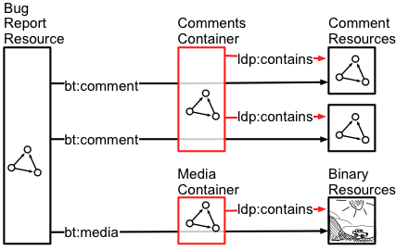
Linked Data Platform
Linking at the heart of the notion of data
Resources
Using HTTP:
find resources
follow links
publish new resources
edit resources
delete resources
Notes:
Source:
https://www.w3.org/TR/ldp-primer/

Slide 15
Demo
https://data.gov.cz/
Notes:
User Interface, Dump files (TriG, HDT, JSON, CSV), SPARQL, Linked Data Fragments, GraphQL
On other hand tools like FTP would work fine as well for large data.
Source:
https://data.gov.cz/

Slide 16
OpenAPI
Formerly known as Swagger
Notes:
The idea is that we have data and now we need to provide others with access to your data, so more users can benefit from them. The others may be users inside our company, or business partners or even services - there is no limit to that. To achieve this goal, we can expose the data using API. But the API is not only about services and calls, request .. but also, about communicating the information to the user. In order to use the API the user must be able to understand it. OpenAPI is a specification that allow us to describe the HTTP-based interface.
There was a competition like API Blueprint from Apiary, RAML from Mulesoft (now use OpenAPI). The power of OpenAPI is that it is open-standard, so the meetings decision, are open anyone can participate, and so single company has power to change it.

Slide 17
YAML Example
openapi: 3.0.0
servers:
- url: ‘https://example.com/api’
info:
title: My API
version: 1.0.1
description: Personal API for public
contact:
name: Petr Skoda
email: skoda@ksi.ms.mff.cuni.cz
termsOfService: ‘https://example.com/api/terms-of-use’
license:
name: ‘The MIT License (MIT)’
url: ‘https://opensource.org/licenses/MIT’
Optional: 2023/2024
Notes:
Metadata section.

Slide 18
YAML Example
paths
/:
get:
responses:
'200':
description: Success
schema:
$ref: '#/definitions/Data'
operationId: get_root_resource
tags:
- root
definitions:
Data:
properties:
_links:
example:
self:
href: /api/v2/
models:
href: /api/v2/models/
name: models
languages:
href: /api/v2/languages/
name: languages
allOf:
- $ref: '#/definitions/Links'
type: object
Optional: 2023/2024
Notes:
Metadata section.

Slide 19
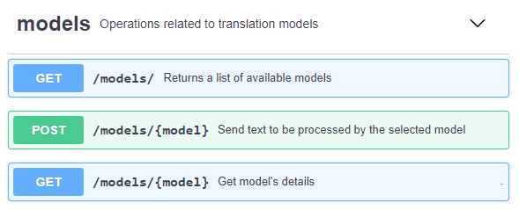
Tools
Validators
SDK Generators
DSL
Converters
GUI / Online Editors
OpenAPI Generator
Prism Server
ReDoc
…
Notes:
ReDoc - Generate Documentation, JavaScript tool, generates HTML, Heavy use of examples.
Prism Server - mockup server, using NodeJs, from StopLight,
OpenAPI Generator - OpenAPI Generator allows generation of API client libraries (SDK generation), server stubs, documentation and configuration automatically. One of advantages is to have intellisense in your IDE.
Converters: Various tools to convert to and from OpenAPI and other API description formats.
Data Validators: Check to see if API requests and responses are lining up with the API description.
Description Validators: Check your API description to see if it is valid OpenAPI.
Documentation: Render API Description as HTML (or maybe a PDF) so slightly less technical people can figure out how to work with the API.
DSL: Writing YAML by hand is no fun, and maybe you don't want a GUI, so use a Domain Specific Language to write OpenAPI in your language of choice.
GUI Editors: Visual editors help you design APIs without needing to memorize the entire OpenAPI specification.
Learning: Whether you're trying to get documentation for a third-party API based on traffic or are trying to switch to design-first at an organization with no OpenAPI at all, learning can help you move your API spec forward and keep it up to date.
Miscellaneous: Anything else that does stuff with OpenAPI but hasn't quite got enough to warrant its own category.
Mock Servers: Fake servers that take description document as input, then route incoming HTTP requests to example responses or dynamically generates examples.
Parsers: Loads and read OpenAPI descriptions, so you can work with them programmatically.
SDK Generators: Generate code to give to consumers, to help them avoid interacting at a HTTP level.
Security: By poking around your OpenAPI description, some tools can look out for attack vectors you might not have noticed.
Server Implementations: Easily create and implement resources and routes for your APIs.
Testing: Quickly execute API requests and validate responses on the fly through command line or GUI interfaces.
Text Editors: Text editors give you visual feedback whilst you write OpenAPI, so you can see what docs might look like.
Source:
https://github.com/Redocly/redoc

Slide 20
OpenAPI
Code First < Documentation First < Specification First
Wikipedia for WEB APIs active 2017
Notes:
Documentation first has the benefit is that non-technical people can interact with documentation as well. Spec-First API Design, we can generate documentation, so it has all benefits of documentation first. In addition, we can also generate code such as mock servers. So, developers can go and try the API. Still many companies generate API from code.
On the other hand, you can use extensions to generate specification, and HTTP endpoint for it, from code annotations
(Wikipedia for WEB APIs) - the goal is to share API definitions and allow other developers to use existing APIs. There can be added functionality for a price.

Slide 21
GraphQL
Notes:
It is a representative of command-based approach. In 2023 we have discussion whether we should not replace GraphQL with RPC.

Slide 22
Data model
Article
Author
What if …
{ articles : [ {
title
author { name }
comments {
author { name }
content
} ]
}
REST endpoints:
/article
/article/1
/author
/author/1
/article/1/comments
Comment
Notes:
Let us imagine a simple model, with three data sources. They can be tables, services, files .. does not matter. And we need to create an application that show us a list of articles, for each article we need to know the author details and also the comments. We can use REST and do bunch of queries to get the data. Now I’m not saying this is good REST design, but it may be what you get in most of the industry.
Imagine there is an alternative. What we need is something like this. What if we can just ask for data across multiple data sources ? Enter the world of GraphQL ...

Slide 23
GraphQL
2012, released 2015 by Facebook
Last specification from 2018 managed with GitHub and tags for releases
Language agnostic
Ecosystem
GraphQL Foundation 2019 Annual report, …
Resources
Blog GraphQL
@graphql
@graphqlsummit
Optional: 2023/2024
Notes:
The specification does not support Czech national characters as names of properties.
It is specification it is not restricted to certain language; you can implement the specification in any reasonable language.
The GraphQL website contains a lot of learning resources, so if you want to learn it yourself, do not waste time with this video :) The purpose of this video is to provide you with basic information, so you are able to consider GraphQL as a way to provide users with access to your data.
The GraphQL is specification but, there is a huge ecosystem build around it with tools/libraries.
The head of that ecosystem is the GraphQL Foundation, established in 2019. The members contribute and “sell” their technologies/tools. There is annual report, that can provide you with a good summary. Alternatively, there are other resources to follow, like a blog or Twitter. This is important not only to follow the progress on a new standard but also to stay in touch with tools.
Sources:
https://graphql.org/

Slide 24
Client Perspective
Query:
Result:
{
datasets {
data {
iri
title {
cs
}
}
}
}
{“data": {
"datasets": {
"data": [{
"iri": "https://example.com/88",
"title": { "cs": "Číselník" }
}, {
"iri": "https://example.com/67",
"title": { "cs": "Seznam" }
}]
}
}}
Optional: 2023/2024
Notes:
Let us take a look on the basic principles and building blocks. The aim here is not to teach you the details, just to show you the basics.
Example is from the Czech national open data catalog.
Query features:
Aliases You can ask for the root objects multiple times, for example you ask for two articles with different IRI. But you can not have two same keys in JSON, so you can use aliases to rename them.
Fragments Reusable parts of the query that can be used, go well with aliases so you do not have to write the same code twice. We can mix it with other definitions using … (spread operator from JavaScript). We need to define type on which the fragment can be used.
Variables Similar to SQL, you can put variables into the query and then provide the values of the variables. This allow you to add parameters to the fragments but should also be best practice as you should never build up your query using strings. Some of you may remember SQL injections. We can see that a variable can have a default value.
Directives For example, the @include, it can have arguments. We can use this as extension points to add additional information.
Mutations While query fields are executed in parallel, mutation fields run in series, one after the other.

Slide 25
Server Perspective
Schema:
type LanguageString {
cs: String
}
const textType =
new gql.GraphQLObjectType({
"name": "LanguageString",
"fields": {
"cs": {
"type": gql.GraphQLString
},
},
});
Optional: 2023/2024
Notes:
In this case I use JavaScript example as it was easy to find.
Schema features:
Schema design It is not easy to create good schema, it is not only about connecting tables together. On the other hand, some use-cases require specific design like https://graphql.org/learn/global-object-identification/ .
Pagination Limit / offset , next-page, cursor.
Caching Imagine you cache a list response, then user ask for detail and that may have changed. This is also issue for REST. But as GraphQL is more connected it gets a little more complicated. For example, the client may not know exact identification of the resources as they have no URL, so the schema may be designed to use unique identifiers.
Source:
https://github.com/opendata-mvcr/nkod-graphql/blob/main/server/schema.js

Slide 26
Server Perspective
Resolver:
const queryType = new graphql.GraphQLObjectType({
"name": "Query",
"fields": {
"datasets": {
"type": datasetsContainerType,
"args": {
"filters": {"type": graphql.GraphQLList(datasetFilter)},
"offset": {"type": graphql.GraphQLInt},
"limit": {"type": graphql.GraphQLInt},
},
"resolve": (source, params) => {
return database.selectDatasets(params);
},
},
}
});
Optional: 2023/2024
Notes:
The idea is that in the schema we have definition of properties, in this case we have a definition of a datasets - as a collection of datasets. Using the right library, we just need to implement the “resolve” function that returns representation of the datasets (full) - we provide resolver for each array and object and the library make sure it works just fine.

Slide 27
Selling points
Aggregate data from multiple UI components.
Create a representation of your data that feels familiar and natural (graph).
Ensure that all of your data is statically typed, and these types inform what queries the schema supports.
Reduce the need for breaking changes but utilize a built-in mechanism for deprecations when you need to.
Access to a powerful tooling ecosystem with GUIs, editor integrations, code generation, linting, analytics, and more.
Notes:
Now you know the basic stuff, so let’s take a step back and see the marketing. The GraphQL FAQ page does good job in addressing some of the important questions.
This point talks about UI, so you have a page in you application and a bunch of components, and each component need some sort of data. You can either make several requests to get the data or you can use GraphQL and get all the data at once.
The graph representation may help, and it actually allows you to ask only what you need and connect the data.
This is true for REST and OpenAPI as well, but here you get it in a single package. Why is that important? so you can work with the data - imagine that you need to show a price tag (number). But perhaps it is stored as float or integer, or even a string. Perhaps there are multiple price options .. the fact that you know that you expect makes your life easier. We can see this with Typescript for example, or Python types .. the advantage of not using types is, that it allow you to move fast. However, once the code base reach certain size, it becomes hard to manage.
This is true, only if you design your schema right. No free lunch there.
The last one is actually true; the tooling ecosystem is huge and as the technology is trending many companies want their share of the market, so they compete to provide developers with the best experience.
Source:
https://graphql.org/faq/

Slide 28
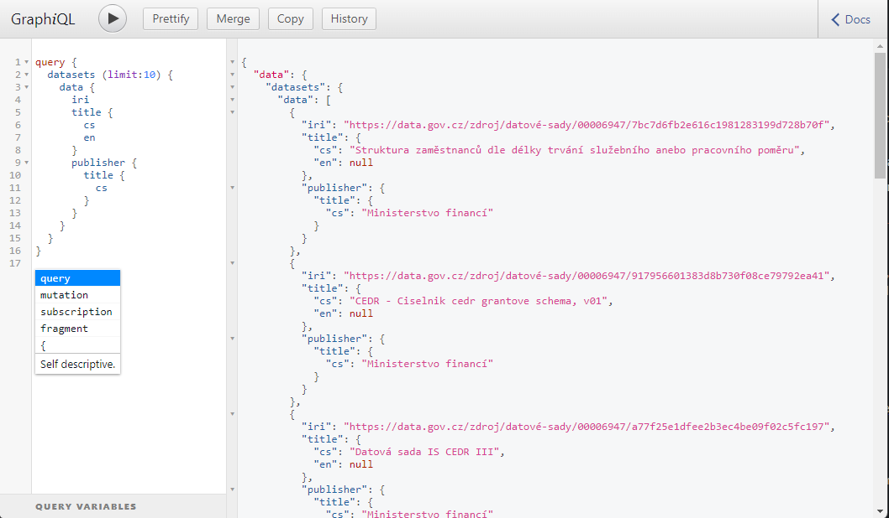
Ecosystem
GraphQL.js
Apollo Server / Apollo Client
graphql-hooks
GraphiQL
Graphene
Apache Camel
Relay
...
Notes:
The ecosystem is really the key here, and it make it easy to use GraphQL, for that reason I’ve decided to highlight a few tools. Keep in mind that we aim mostly at mobile/web applications, so a lots of JavaScript.
The reference implementation of the GraphQL specification, designed for running GraphQL in a Node.js environment.
A set of GraphQL server packages from Apollo that work with various Node.js HTTP frameworks (Express, Connect, Hapi, Koa etc.). There is also a client, if you want to start with GraphQL with as little effort as possible, I recommend you use this. They are for JavaScript.
This is example of specific library for react. If you know React and want to try GraphQL definitely give it a look, if not to use it, just to see how others think it can be done. In general, it is not bad idea to do a survey before you start doing something, so you get some inspiration.
A client for easy query, with support of introspection (can be turned on and off at the server side) allow you to see the schema and query. It is basically the experience you may get from OpenAPI, but in a more compact form. In my opinion this is how API should look like - obviously for larger APIs or if the schema design do not fit your needs, it may not help.
And one for Python, obviously server side. The page list three more, I just pick the one with most stars. The thing is that GraphQL server is mostly about integration of other resources, perhaps calling services/databases. So, there may not be any logic included, that may give you more freedom to use language of choice.
Speaking about integration one tool that is not on the list - Apache Camel, it is a Java framework build for integration. The idea is that you have a data flow from one component to another and you can manage this flow in a reasonable way using Apache Camel - and obviously you can add GraphQL there too. In this case it is client.
Client, provide additional benefits. The project also deal with issues like optimization, pagination, etc … from certain perspective it is the tools like this that move GraphQL froward.
So, JavaScript, Python, Java .. all the languages I use, but there are more tools and there is a good chance that for any reasonable language there a is a library that you can use.
Source:
https://graphql.org/code/

Slide 29
Why not GraphQL
“why not use graphql” ~ about 5 620 000 results
GraphQL is the better REST, ….
No more Over- and Under-fetching
No more versioned APIs
Rapid Product Iterations on the Frontend
Insightful Analytics on the Backend
...
Notes:
So why it can be a bad idea to use GraphQL, use your search engine and there is a lot of opinions out there. Same as with any technology there is no silver bullet and no free lunch. So you need to do your research. As with any technology it is about opinion and use-case. So here are some reasons from some articles. I’m not going to list of of them just those that I PERSONALLY found relevant based on my research.
At the same time there are enough resources, that have the opposite perspective. But I believe we talk about the positives long enough. Keep in mind this is not to play down GraphQL, just to remind you that regardless of the hype we should always focus on both sides of the coins. And instead of saying the GraphQL is bad I want to comment on the promises and hopefully show you that it is not only about GraphQL.
No more Over- and Under-fetching The idea is that the client get only what is needed as the client defines what is needed, while in REST you get the whole resource. This can be solved by the “backend for frontend” design, where you have extra REST API for each frontend application. The backend may not be complex, just integrating the resources - pretty much the same as done using GraphQL resolvers. It also provide you with better ability to perform caching, provide quality of service, you just have a single endpoint for application that gives you freedom. When you have just a single-entry point, there is a lot of weight on that - it is hard to change, restrict. It is owned by all, so any change may be actually hard to propagate.
No more versioned APIs The second promise is no more versions, the GraphQL does not support versions (although you may run multiple schemas side by side), instead the idea is to use the @deprated directive and just add a new fields as needed. You must need to make sure that you choose your names wisely. For example, you have a name as a string, but then some applications need firstName and lastName - you can just add them. So, the schema design is the key and if you are unlucky you may end up with some bad “names”.. with the concept of “backend for frontend” you know the application is used by a single frontend for example, so you can just change it or introduce another version.
Rapid Product Iterations on the Frontend The idea is that the client team can just ask for different data without the need to contact the backend team. As a result, they can move faster. That is true, but only if the backend team saw the future (or design the schema well enough) so the data that the new client feature need are in the schema. Otherwise, a change is required a change in a single endpoint.
Insightful Analytics on the Backend You can track the queries and know what users are asking for an optimize. This is true for the open world, but in closed business you know what your clients/applications need. If you do not have this knowledge, it is not issue of REST and benefit of GraphQL but rather bad practices like insufficient documentation/specification.
There can be more, the goal here was to say that many benefits that are being connected with GraphQL can be obtained by using different means. And perhaps introducing new technology is not worthy and you can get same benefits, and even more, by fixing the origins of the issues you try to solve using GraphQL.
Source:
https://www.howtographql.com/basics/1-graphql-is-the-better-rest/

