Slide 1
Data Management & FAIR
NDBI046 - Introduction to Data Engineering
2023/2024
Petr Škoda
https://github.com/skodapetr
https://www.ksi.mff.cuni.cz

Slide 2
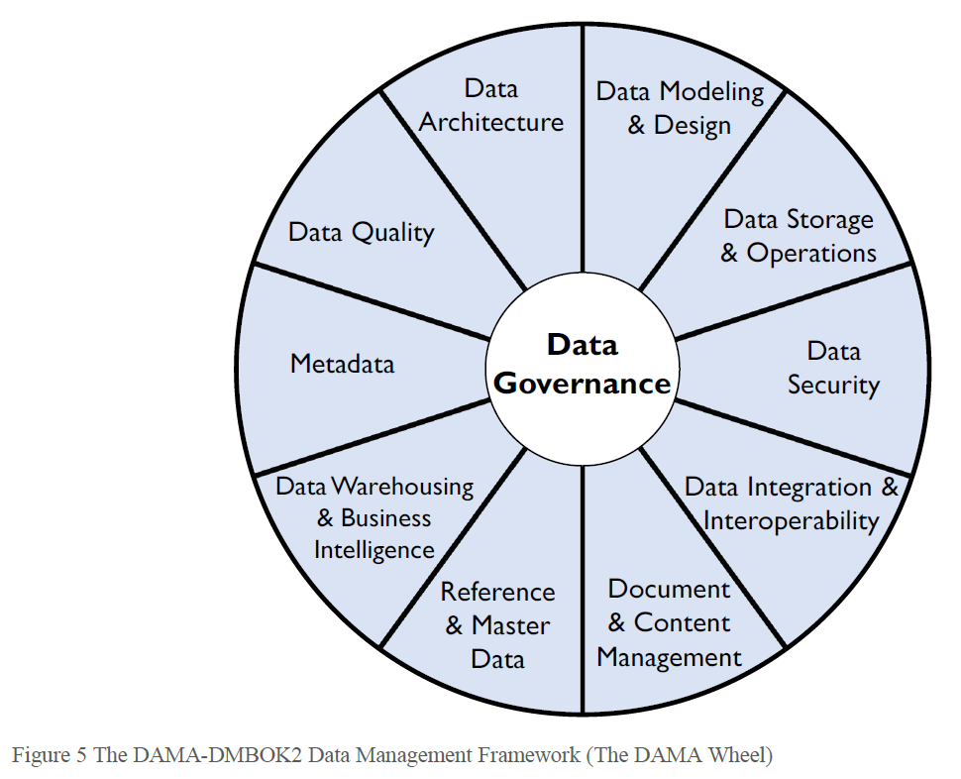
Notes:
Part of this presentation is based at the Data Management Body of Knowledge book.

Slide 3
Data Asset
“An asset is an economic resource, that can be owned or controlled, and that holds or produces value. Assets can be converted to money.” -- Data Management Body of Knowledge
Value is the difference between the cost of and the benefit:
Cost of obtaining and storing data
Cost of replacing data if it were lost
Impact to the organization if data were missing
Cost of improving data
Benefits of higher quality data
What the data could be sold for
Expected revenue from innovative uses of data
….
Notes:
In the early 1990s, some organizations found it questionable whether the value of goodwill should be given a monetary value. Now, the "value of goodwill" commonly shows up as an item on the Profit and Loss Statement (P&L).
Data not only represents value, but it also represents risk. Low quality data (inaccurate, incomplete, or out-of-date) obviously represents risk because its information is not right. But data is also risky because it can be misunderstood and misused.

Slide 4
Data Management
“Data Management is the development, execution, and supervision of plans, policies, programs, and practices that deliver, control, protect, and enhance the value of data and information assets throughout their lifecycles.” -- Data Management Body of Knowledge
Data management professionals (technical):
Database Administrators
Network Administrators
Developers
Data management professionals (business):
Data Stewards
Data Strategists
Chief Data Officers
Data Governance Council
“A strategy is a set of choices and decisions that together chart a high-level course of action to achieve high-level goals. “-- Data Management Body of Knowledge
Notes:
Data Management Professional is any person who works in any facet of data management (from technical management of data throughout its lifecycle to ensuring that data is properly utilized and leveraged to meet strategic organizational goals.
Data management requires both technical and non-technical (business) skills.
Goals:
Understanding and supporting the information needs.
Capturing, storing, protecting, and ensuring the integrity of data assets.
Ensuring the quality.
Ensuring the privacy and confidentiality of stakeholder data.
Ensuring data can be used effectively to add value to the enterprise.
The challenge is getting people with this range of skills and perspectives to recognize how the pieces fit together so that they collaborate well as they work toward common goals.
A data strategy should include business plans to use information to competitive advantage and support enterprise goals. In many organizations, the data management strategy is owned and maintained by the CDO and enacted through a data governance team, supported by a Data Governance Council.

Slide 5
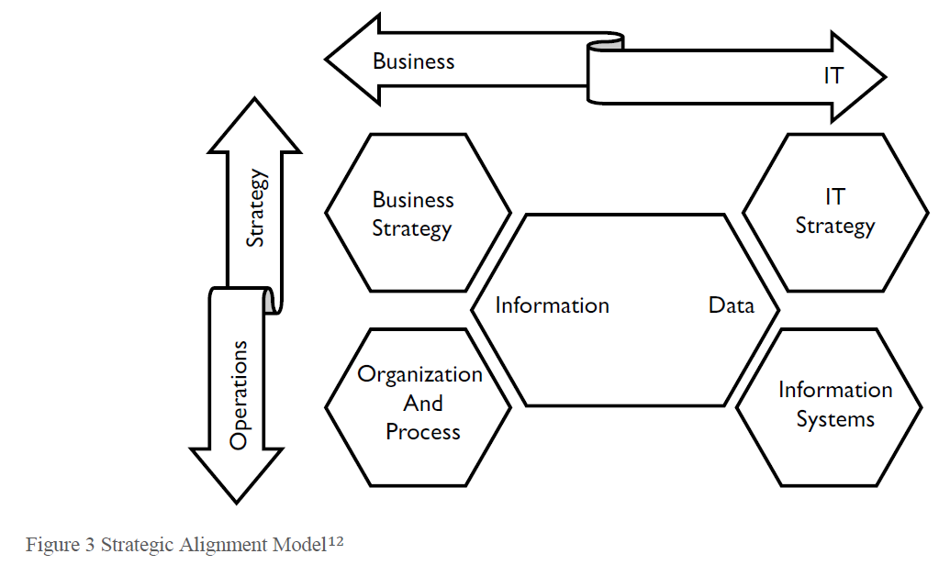
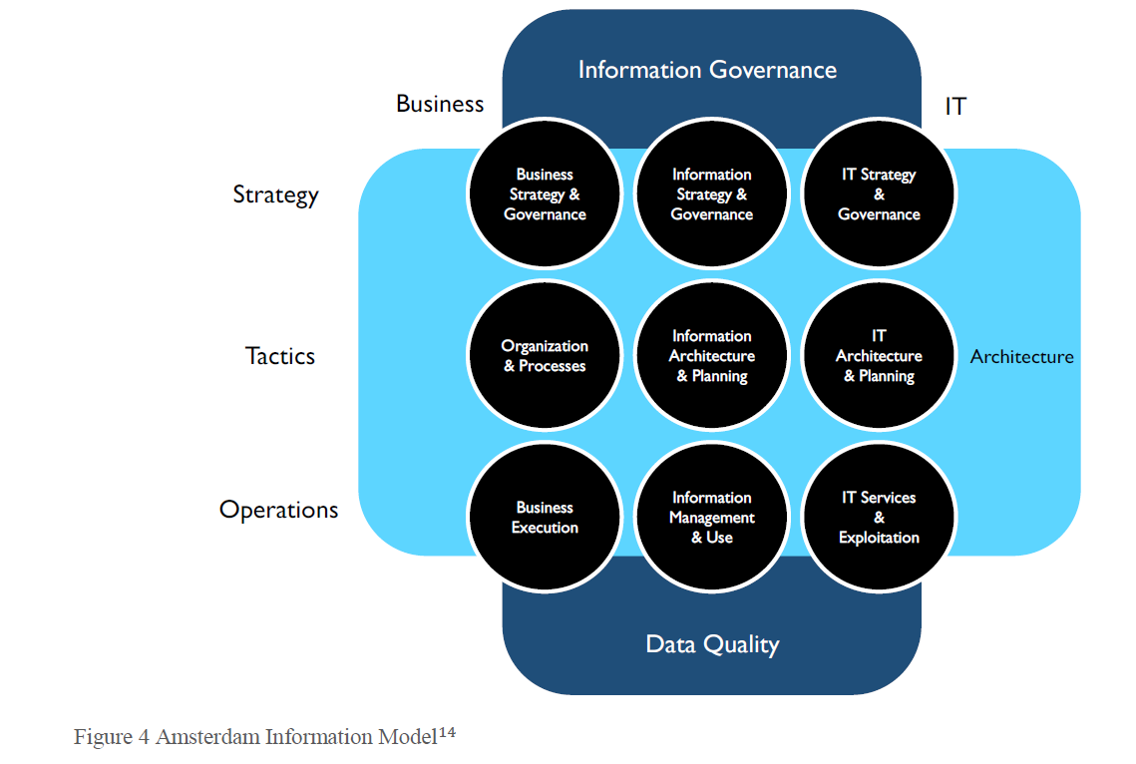
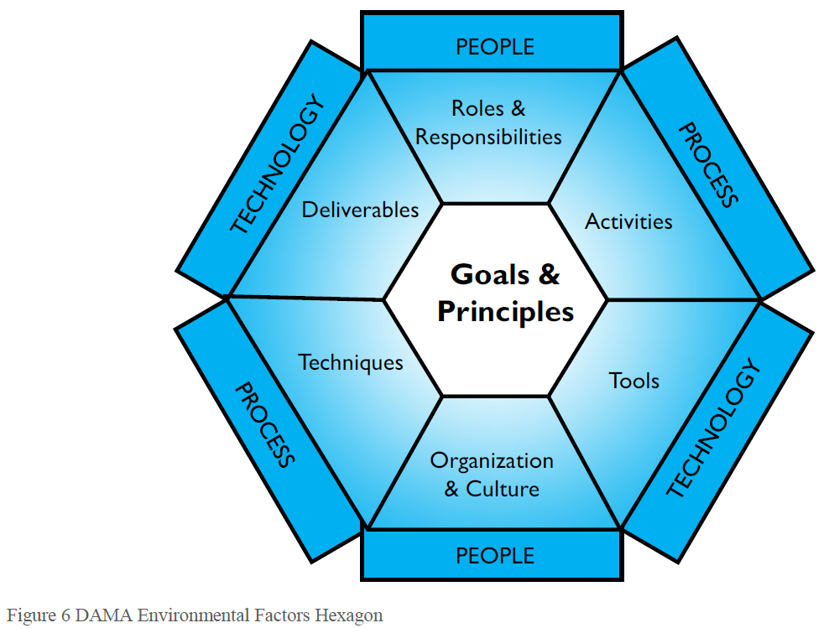
Data Management Frameworks
Strategic Alignment Model (Henderson and Venkatraman, 1999)
Amsterdam Information Model
The DAMA DMBOK Framework (The DAMA Wheel)
Hexagon, and Context Diagram
Notes:
There is a lot to keep track of, which is why it helps to have a framework to understand the data management comprehensively and see relationships between its component pieces. Frameworks developed at different levels of abstraction provide a range of perspectives on how to approach data management.
Figure is just a simplification.
It takes a strategic perspective on business and IT alignment. Known as the 9-cell, it recognizes a middle layer that focuses on structure and tactics, including planning and architecture.
DAMA Wheel - we already saw that. There are alternatives how to visualize it, just like software diagrams.
It shows the relationship between people, process, and technology and provides a key for reading the DMBOK context diagrams.

Slide 6
Aiken's pyramid
Phase 1 Application with database capabilities.
Phase 2 There are issues with quality.
Phase 3 Manage management ~ governance.
Phase 4 Profit.
Notes:
Aiken's pyramid describes how organizations evolve toward better data management practices.
Phase 1: The organization purchases an application that includes database capabilities. This means the organization has a starting point for data modeling / design, data storage, and data security (e.g., let some people in and keep others out). To get the system functioning within their environment and with their data requires work on integration and interoperability.
Phase 2: Once they start using the application, they will find challenges with the quality of their data. But getting to higher quality data depends on reliable Metadata and consistent Data Architecture. These provide clarity on how data from different systems works together.
Phase 3: Disciplined practices for managing Data Quality, Metadata, and architecture require Data Governance that provides structural support for data management activities. Data Governance also enables execution of strategic initiatives, such as Document and Content Management, Reference Data Management, Master Data Management, Data Warehousing, and Business Intelligence, which fully enable the advanced practices within the golden pyramid.
Phase 4: The organization leverages the benefits of well-managed data and advances its analytic capabilities.

Slide 7
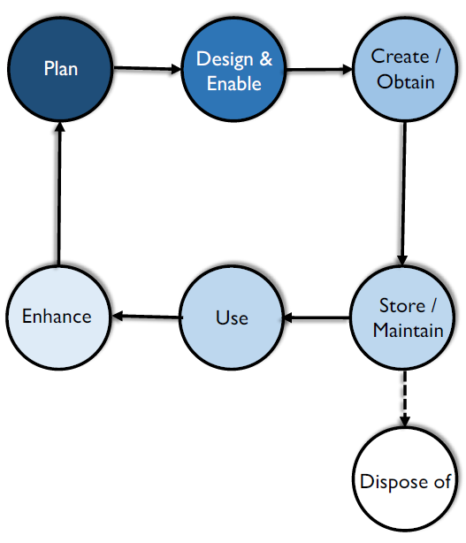
Data Life Cycle
Manage data flow from the first contact to the last.
Phases (incomplete list):
Data capture / creation
Data storage
Data maintenance
Data synthesis
Data usage
Data publication
Data archival
Data destruction / purge
Personal to global:
Panel on Climate Change (IPCC) expected > 80 PB
Large Synoptic Survey Telescope expected > 500 PB
Image of a supermassive black hole 4.5 PB
…
Notes:
There is no strict definition. We can see it as a sequence of phase/steps without a strict definition. The core idea remains the same, we have a lots of data, there are different transformations, and we need to describe and manage all of that somehow.
If you have your personal project or a small business with single database and few table, it may look like data life cycle is a trivial thing. We create data in our application, we stored them in a database, we show them using our application and we may delete them some day.
Phases:
Data Capture / Creation : Specification may include legal contracts, basic types:
Data Acquisition : Use existing data produced outside the company
Data Entry : Humans of devices create new data. Sometimes without devices here.
Signal Receipt / Capture : Capture by a device, usually important in the control system. More for the Internet of Things.
Storage : Prevent data loss, allow efficient retrieval, NDBI007, and data protection. Data location for cloud storages.
Maintenance : Apply processing, like cleaning, so they can be effectively used by the business. Does not add a business value. May include ETL processes.
Synthesis : Not common, make valuable data through inductive reasoning. This type of analysis is also used in risk modeling, accounting, and investment decisions. An example, Net Sales = Gross Sales – Taxes. If I know Gross Sales and Taxes, and I know the simple equation just outlined, then I can calculate Net Sales.
Usage : Depends on the business. Data can be viewed, processed, modified and saved. An audit trail should be maintained for all critical data to ensure that all modifications to data are fully traceable. There can be an extra phase for data processing (data cleaning, data wrangling, compression, encryption).
Publication : Even sending email with a table. How to handle incorrect data, they are outside our area of influence. Data governance may help to decide how to handle them.
Archival : May be required by a law (accounting data), data that are not needed.
Destruction / Data Purge : Some data must be deleted after there is no, legal, use for them - GDPR. Every copy must be deleted, even from the archive. From the perspective of Data Governance, the challenge is to make sure that has been done properly.
Defined by Linked Open Data 2 stack:
Interlinking (Creating and maintaining links)
Classification (Integration, Fusion)
Quality
Evolution
Exploration
If you have your personal project or a small business with single database and few table, it may look like data life cycle is a trivial thing. We create data in our application, we stored them in a database, we show them using our application and we may delete them some day. On the other hand, there are some projects with outstanding amount of data.
The latest round of the Intergovernmental Panel on Climate Change (IPCC) will produce up to 80 petabytes of data (Balaji et al., 2018).
The Large Synoptic Survey Telescope is expected to build over a period of 10 years a 500-petabyte database of images and a 15-petabyte catalog of text data (LSST Project Office, 2018).
The first-ever image of a supermassive black hole was orders of magnitudes larger, needing approximately 4.5 petabytes of astronomy data.
Data at Sanger Institute ~ custom power plant.
It is not only about the amount of the data but also the transformations, owner ships, visualizations ~ data flow in general. Data Lifecycle Management (DLM) allows companies/teams to manage the data flow from the first contact to the last.
Image is from DMBOOK. Keep in mind that Data Life Cycle is specific for a particular type of data.
Sources:
https://link.springer.com/chapter/10.1007/978-3-642-35173-0_1

Slide 8
Data Governance
All organizations make decisions about data, regardless of whether they have a formal Data Governance function.

Slide 9
Data Governance
“Framework of people, policies, processes and technologies that define how you manage your organization’s data.” -- SAS
“The act or process of governing or overseeing the control and direction of something.” -- Merriam-webster
“the exercise of authority and control (planning, monitoring, and enforcement) over the management of data assets. The Data Governance function guides all other data management functions.” -- Data Management Body of Knowledge
Strategy
Policy (e.g., metadata management)
Standards and quality
Oversight
Compliance
Issue management
Data management projects (sponsoring)
Data asset valuation
Notes:
For most organizations, adopting formal Data Governance requires the support of organizational change management as well as sponsorship from a C-level executive, such as Chief Risk Officer, Chief Financial Officer, or Chief Data Officer. For many organizations, cultural change is a major challenge.
A common analogy is to equate data governance to auditing and accounting. Auditors and controllers set the rules for managing financial assets. Data governance professionals set rules for managing data assets.

Slide 10
Data Governance
Decisions that must be made to ensure effective data management.
Areas:
Data principles
Data quality
Metadata
Data access
Data lifecycle
…
Notes:
Designing data governance requires stepping back from day-today decision making and focusing on identifying the fundamental decisions that need to be made and who should be making them. We should not reverse engineer it from a particular task.
The scope is business wide, so it is not only IT, but IT department can help with the implementations. Since Data governance is fundamentally about organizational behavior, it can not be solved through technology. However, there are tools that support the overall process. For example, a collaboration portal with search capabilities for data and help to manage simple workflows.
Governance refers to what decisions must be made to ensure effective management and use of IT (decision domains) and who makes the decisions (locus of accountability for decision making).
Management involves making and implementing decisions.
Data governance ensures data (as an asset) is properly managed without directly executing data management. For example, governance includes establishing who in the organization holds decision rights for determining standards for data quality. Management involves determining the actual metrics employed for data quality.
Areas:
Data principles What are the uses of data for the business? How are opportunities for sharing and reuse of data identified? How does the regulatory environment influence the business uses of data?
Data quality What are the standards for data quality with respect to accuracy, timeliness, completeness and credibility? What is the program for establishing and communicating data quality? How will data quality as well as the associated program be evaluated?
Metadata What is the program for documenting the semantics of data? How will data be consistently defined and modeled so that it is interpretable? What is the plan to keep different types of metadata up-to-date?
Data access What is the program for periodic monitoring and audit for compliance? How is security awareness and education disseminated? What is the program for backup and recovery?
Data lifecycle : Determining the definition, production, retention and retirement of data. How is data inventoried?
Source
https://dl.acm.org/doi/abs/10.1145/1629175.1629210 [image]

Slide 11
Data Governance Organization
Functions:
Legislative-like Defining policies, standards, and the Enterprise Data Architecture.
Judicial-like Issue management and escalation.
Executive Protecting and serving, administrative responsibilities.
Members:
Steering Committee
Council
Stewardship Teams Data Stewardship is the most common label to describe accountability and responsibility for data and processes that ensure effective control and use of data assets.
Operating Model Types
Centralized
Federated
Notes:
There can be multiple layers to address consents at different levels - local, divisional, and enterprise-wide.
Data Governance Steering Committee - financing and highest authority.
Data Governance Council (DGC) - executives, managers of the Data Governance initiatives.
Data Stewardship Teams - teams focused on subject-areas or projects. Can be formal and informal.
A steward is a person whose job it is to manage the property of another person.
Data Stewards manage data assets on behalf of others and in the best interests of the organization. There is whole hierarchy of data stewards from Chief Data Officer, Data Owner to Technical and Coordinating Data Stewards.
Data Stewardship
Creating and managing core Metadata
Documenting rules and standards
Managing data quality issue
Executing operational data governance activities
Since data management is happing throughout the company, data stewards are there to support people when dealing with data. They should not be an external team or department; they should be part of the business teams.

Slide 12
FAIR
Notes:
For scientific domain, yet we can draw inspiration for public and even private sector.

Slide 13
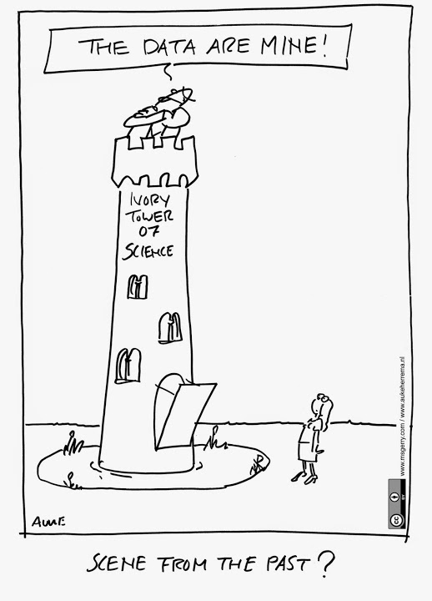
Removed: 2023/2024
Notes:
Ivory Tower ~ a state of privileged seclusion or separation from the facts and practicalities of the real world. To live or be in an Ivory Tower is not to know about or to want to avoid the ordinary and unpleasant things that happen in people's lives

Slide 14
FAIR
FAIR Guiding Principles for scientific data management and stewardship [2016]
There is an urgent need to improve the infrastructure supporting the reuse of scholarly data.
… have come together to design and jointly endorse a concise and measureable set of principles that we refer to as the FAIR Data Principles. The intent is that these may act as a guideline for those wishing to enhance the reusability of their data holdings.
… the FAIR Principles put specific emphasis on enhancing the ability of machines to automatically find and use the data, in addition to supporting its reuse by individuals.
… This Comment is the first formal publication of the FAIR Principles, and includes the rationale behind them, and some exemplar implementations in the community.

Slide 15
FAIR
… Good data management is not a goal in itself, but rather is the key conduit leading to knowledge discovery and innovation, and to subsequent data and knowledge integration and reuse by the community after the data publication process.
… What constitutes ‘good data management’ is, however, largely undefined, and is generally left as a decision for the data or repository owner.
… barriers to data discovery and reuse, not only for humans, but even more so for machines
Notes:
From the original publication.

Slide 16
FAIR principles
Findability Metadata and data should be easy to find for both humans and computers.
Accessibility The user needs to know how they can be accessed, possibly including authentication and authorisation.
Interoperability The data usually need to be integrated with other data / workflows.
Reusability Metadata and data should be well-described.
Notes:
From the original publication.
Data quality issues are not addressed by the FAIR principles. Keep in mind that data cleaning is not easy for scientists as they must be careful to not manipulate the date.
The first step in (re)using data is to find them. Machine-readable metadata are essential for automatic discovery of datasets and services.
Once the user finds the required data, they need to obtain them.
In addition, the data needs to interoperate with applications or workflows for analysis, storage, and processing.
The goal is to optimize the reuse of data. To achieve this, metadata and data should be well-described so that they can be replicated and/or combined in different settings. Think about it as protecting public money investments.

Slide 17
Resource types
Data or digital objects
Metadata Information about digital objects.
Infrastructure

Slide 18
FAIR
Rules
Notes:
For each attribute (FAIR) define a set of rules/requirements. I won’t go through all of them, instead on the following slides only highlight some of them. If you want to know all of them please refer to the source. The rules have identifiers where the letter denote the principle they are connected to.

Slide 19
Findability
F1. (meta)data are assigned a globally unique and persistent identifier
F2. data are described with rich metadata (defined by R1)
F3. metadata clearly and explicitly include the identifier of the data it describes
F4. (meta)data are registered or indexed in a searchable resource
F1: IRI, doi.org, zenodo.org
F2: …
F3: IRI, zenodo.org
F4: data.gov.cz
Notes:
F1. The idea is that we need to be able to uniquely identify a data or metadata. For example, if you use ID in an SQL database, two tables will have records with the same ID. But if the identifier is globally unique you can easily use it as a reference. This make data integration basically free. The next part is that the identifier must be persistent, so it does not change. That makes sense if you think about the use-case I’ve just described.
F2. So, we have an identifier it may be URL, what next? Is the identified document a table / web-page /software / when it was published / who is the author / … we can have all of those questions. Obviously, you can study the resource, if it is available, and find answers to many of those questions. But that would be time consuming, and machines can not really do that ~ well, they can to some extent but that is outside of scope of this video. A solution is to provide metadata - data about data. Metadata can (and should) be generous and extensive, including descriptive information about the context, quality and condition, or characteristics of the data. Supports findability and allows for automatic processing.
F3. Since the metadata and data may not be on the same place, you should use the unique identifier as a reference so user can connect data and metadata together.
F4. It only make sense that you need to be able to find the metadata first, in order to read them. This is why we have catalogs, so you can register the data into them.
Source:
https://blog.alexellis.io/docker-is-deleting-open-source-images/

Slide 20
Demo
Docker is deleting Open Source organisations - what you need to know
Notes:
From discussion:
-----
I love the ELIXIR idea that its services should be provided at not more than marginal costs. Let me explain.
One of the very confusing aspects of the basic equation:
“open science” = “open access” + ”open data”
Is that it is asymmetrical:
“open data” is a change of paradigm
“open access” is a change of business model.
Unfortunately, the business model that is often considered most useful for “open data” is the one that we are abandoning for publications: pay for access. If this continues, we will all be very sorry in 40 years when all biological researchers need 50 paid database subscriptions to do their work, and each of them, basically being monopolists, raises their price with double digit percentages for years in a row.
-----
I agree. There is a gold rush for both namespaces and intellectual contributions. Free software should not be held hostage by companies. I treasure we got this far, but there are no guarantees.
It is a dangerous path to walk if you get fully dependent on the whims of a company. Free this year can cost money next year. And more money the year after. People and countries get banned too.
-----

Slide 21
Accessibility
A1. (meta)data are retrievable by their identifier using a standardized communications protocol
A1.1 the protocol is open, free, and universally implementable
A1.2 the protocol allows for an authentication and authorization procedure, where necessary
A2. metadata are accessible, even when the data are no longer available
A1: HTTP, FTP
A1.1: HTTP, FTP
A1.2: HTTP (basic authentication), FTP
A2: zenodo.org
Notes:
A1. Principle A1 states that FAIR data retrieval should be mediated without specialized or proprietary tools or communication methods. This principle focuses on how data and metadata can be retrieved from their identifiers.
A1.1 The protocol should be free (no-cost) and open (-sourced) and thus globally implementable to facilitate data retrieval. Anyone with a computer and an internet connection can access at least the metadata.
A1.2 The ‘A’ in FAIR does not necessarily mean ‘open’ or ‘free’. Rather, it implies that one should provide the exact conditions under which the data are accessible. Ideally, accessibility is specified in such a way that a machine can automatically understand the requirements.
A2. The idea is that the data may become unavailable after some time, for example as they are big and there is no funding in keeping them online. But if they disappear completely then all the references using the global identifiers are now broken. So the idea is that the metadata should be preserved, they should be small compared to the data, so it should not be hard to keep them around.

Slide 22
Interoperability
I1. (meta)data use a formal, accessible, shared, and broadly applicable language for knowledge representation.
I2. (meta)data use vocabularies that follow FAIR principles
I3. (meta)data include qualified references to other (meta)data
I1: JSON-LD, RDF,
I2: …
I3: IRI
Notes:
Humans should be able to exchange and interpret each other’s data. But this also applies to computers, meaning that data that should be readable for machines without the need for specialized or ad hoc algorithms, translators, or mappings. Interoperability typically means that each computer system at least has knowledge of the other system’s data exchange formats.
I1. So, the machines need to understand the data, so they need to understand the vocabulary. Basically, all this leads to RDF and linked data. But this is actually hard, even if you decide to use RDF as you did. There is nothing preventing you from introducing your own predicates (vocabulary) to represent things. It is cheap, fast and it gets the job done. It will work for your group/company, you may have well defined meaning - all the benefits. But once the data got out, no machine will understand them. Perhaps humans, but even for them it may not be easy to understand your data. So, you need to map your data to some well know ontology, so you need to study and think .. and not for your benefit but for good of others. This may not be an easy selling point to the business. But there is movement called around “data centric application”, where you have your core ontology and then other build on top of that. This allow the company to decouple the data from applications and may lead to better overall software architecture.
I2. The controlled vocabulary used to describe datasets needs to be documented and resolvable using globally unique and persistent identifiers. This documentation needs to be easily findable and accessible by anyone who uses the dataset
I3. You are likely having more then one “dataset” or document described with metadata, it is then important to put those two into context. Was one document created from another, is one a version of another .. all of this should be included in the metadata. You can basically thing of the provenance vocabulary here. The goal therefore is to create as many meaningful links as possible between (meta)data resources to enrich the contextual knowledge about the data, balanced against the time/energy involved in making a good data model.

Slide 23
Reusability
R1. meta(data) are richly described with a plurality of accurate and relevant attributes
R1.1. (meta)data are released with a clear and accessible data usage license
R1.2. (meta)data are associated with detailed provenance
R1.3. (meta)data meet domain-relevant community standards
R1:
R1.1: MIT, CC-BY, …
R1.2: PROV-O
R1.3: SDMX
Notes:
R1 It will be much easier to find and reuse data if there are many labels are attached to the data. The data publisher should provide not just metadata that allows discovery, but also metadata that richly describes the context under which the data was generated.
R1.1 This one is important for the public data. The fact that you find something on the internet does not mean you can use it or modify it - we are now not talking about personal use. So, it is important to be clear about the license. This helps the publisher (clear communication of restriction and requirements) and consumer (know what are the limitations).
R 1.2 provenance
R1.3 It is easier to reuse data sets if they are similar: same type of data, data organised in a standardised way, well-established and sustainable file formats, documentation (metadata) following a common template and using common vocabulary. If community standards or best practices for data archiving and sharing exist, they should be followed.

Slide 24
FAIR
Aim on data publishers
Can be transformed for business (investment protection)
FAIRsFAIR project
The core requirements/rules
“Sometimes, if you don’t have the software, you don’t have the data” -- Christine Borgman, Paris, 2018
Notes:
All the requirements are on the side of the data publisher. In science this makes sense, especially if the science results are founded by public sector (taxes). As taxpayer you want your money to be well spend, so if something was produced you would want that to be FAIR.
The same principle apply in the business in form of “protecting the investment”. Imagine that company pay 10 millions for a new software, then a year later the same company decide to leave that software and buy a new one. Would you like that as the owner or share owner -probably not. Same goes for code, if you write a code, it is in the interest of the company to use that code as long as possible - so it gets the maximum value. The same apply for data, we want to be able to get maximum from our data. It is this reason why we have data management, so we know where are data are, where they come from, we ensure their quality. So, both worlds share the same objectives to certain extend, so it is natural that you can transition some of the FAIR principles into business. Although it may need to be a bigger company too see the impact.
However, as the FAIR is mostly about scientific data and public sector, I will mention few additional ideas for this area. As with most things in public sector in order to do something you need a funding a project. There is one called FAIRsFAIR, an EU project, 10M budgets, 3 years. The objective of the projects is roughly speaking to support and spread the ideas of FAIR among EU research institution / universities.
The problem with the core rules defined in the 2016 principle is that they do not provide a way how to track gradual progress. For that we may need more fine-grained list. They also do not to capture all what is required. For example, for software there is no information about interoperability (dependencies and execution environment), authors & contributors (software is important part of the research), software quality.
Also, the rules focus on resources data, that is ok, but in reality, not all the data can be used without specific software. In ideal world yes but, in reality no. Especially when it comes to science the software can be viewed from multiple angels.
Sources:
https://www.fairsfair.eu/sites/default/files/FAIR%20%2B%20software.pdf

Slide 25
Academic Publishers (ACM)
“An experimental result is not fully established unless it can be independently reproduced. A variety of recent studies, primarily in the biomedical field, have revealed that an uncomfortably large number of research results found in the literature fail this test, because of sloppy experimental methods, flawed statistical analyses, or in rare cases, fraud.” -- Artifact Review and Badging
Repeatability (same team, same experimental setup)
Reproducibility (different team, same experimental setup)
Replicability (different team, different experimental setup)
Optional: 2023/2024
Notes:
Repeatability - For computational experiments, this means that a researcher can reliably repeat her own computation.
Reproducibility - For computational experiments, this means that an independent group can obtain the same result using the author’s own artifacts.
Replicability - For computational experiments, this means that an independent group can obtain the same result using artifacts which they develop completely independently (no original artefacts can be used)..
Badges:
Functional - documented (so it can be used), consistent (documented artefacts are relevant for the paper), complete (what can be included is included), exercisable (scripts can be executed).
Reusable - Alternative (next level) to Functional, adhere to norms and standards of the community so it can be easily used.
Artefacts Available - Author-created artifacts relevant to this paper have been placed on a publicly accessible archival repository.
Badges has visually changed, yet I keep the initial version as they look cooler.
It is not only ACM, but other publishers have also their badges and focus on the same issues. For example, Center for Open Science Badges, IEEE, Springer Nature, Elsevier.
Source:
https://www.acm.org/publications/policies/artifact-review-and-badging-current

Slide 26
FAIR
Software

Slide 27
FAIRness of software
Towards FAIR principles for research software [2020]
Software Quality
Software Citation Principle
Survey (66 participants)
Software dependencies and environment
Documentation
Accessibility & Licensing
Time and skill
Quality control
Software sustainability & management plan
Metadata
Time scope in decades
Notes:
It is clear that the four foundational principles in are intended to apply to software, but can we apply them in a practical and useful way? The terminology and detail used in the 15 FAIR Guiding Principles is focused on their application to data, particularly in the life sciences, and can be confusing if applied to software without translation.
Another much-debated relationship is the one between FAIR and software quality. Ultimately, the quality of the content of digital resources is crucial for obtaining valid research results. The quality of its codebase is decisive for a software’s ability to evolve sustainably. This characteristic is often also referred to as maintainability, and includes aspects like modularity, understandability, changeability, analyzability and testability. Quality aspects that concern the functionality of software, on the other hand, go beyond what is covered by the FAIR principles. Arguably, the most important quality criterion for research software is functional correctness, i.e., the production of the correct results every time the software is run.
Somehow connected to the FAIR software is a citation. The idea that you can give a credit to author and collaborators.
It is important to realize that this software may be created by non-developers or self-educated programmers. For many of the main area of expertise is not software engineering. In addition, the software is often highly specialized and require domain knowledge to run. This was reflected in a survey of 66 participants. The create 6 categories:
Software dependencies and environment - technical challenge The difficulty is to identify the current or desired version and which other elements (dependencies, interpreters, libraries, etc.) are needed to understand and execute the software.
Documentation Multiple comments in the survey reflect the notion that a lack of documentation or low levels of support make it a challenge to re-use relevant software.
Accessibility & Licensing To access and reuse software, licensing is crucial. However, many software records lack in clarity on which license applies to a piece of software.
Time and skill Even if the software is findable, the challenge is to understand it properly so the user can install it, use it, debug it or integrate to other existing workflows, which requires time and skill.
Quality control In the case of software quality, knowing which software is adequate, tested and maintained is usually information that transfers with word of mouth.
Software sustainability & management plan It is sometimes unclear what is the level of support and if the software is maintained. Contact information and support information are hard to find.
Metadata Many responses have included the lack of metadata, metadata standards or the use of loose standards as a challenge when searching and reusing software.
Sources:
https://doi.org/10.3233/DS-190026

Slide 28
FAIR principles
Findability Unambiguous identification for common search strategies.
Accessibility A working version has to be either downloadable and/or accessible e.g., via a web interface, along with the required documentation and licensing information.
Interoperability The focus is on information exchange.
Reusability Aims for someone to be able to reuse software reproducibly.
Notes:
Findability The main concern of findability for research software is to ensure software can be identified unambiguously when looking for it using common search strategies.
Accessibility We found mere retrievability not enough. In order for anyone to use any research software, a working version of the software needs to be available. To use software, a working version (binary or code) has to be either downloadable and/or accessible e.g., via a web interface, along with the required documentation and licensing information.
Interoperability Already for data and its associated metadata, interoperability has been found to be “the most challenging of the four FAIR principles. This is even harder for software; the focus is on information exchange.
Reusability Reusability in the context of software has many dimensions. At its core, reusability aims for someone to be able to reuse software reproducibly. We can see it to reproduce results, use with different input data, use in different use-cases. Overall, the software reusability depends to a high degree on software maintainability including proper documentation at various levels of detail, license etc …

Slide 29
Findability
F1. (meta)data are assigned a globally unique and persistent identifier
F2. data are described with rich metadata (defined by R1)
F3. metadata clearly and explicitly include the identifier of the data it describes
F4. (meta)data are registered or indexed in a searchable resource
F1. Software and its associated metadata have a global, unique and persistent identifier for each released version.
F2. Software is described with rich metadata.
F3. Metadata clearly and explicitly include identifiers for all the versions of the software it describes.
F4. Software and its associated metadata are included in a searchable software registry.
Notes:
F1 - Like GIT SHA1, but GitHub may not be online in 20 years, so better to use for example Zenodo, platform to store data/code founded by European Commission’s.
F2 - There are projects working on specification of the metadata like. BiotoolsSchema, or CodeMeta.
F3 - Extends F1’s focus regarding the precise identification of versions and/or reference deployments beyond the software itself by including the metadata associated with each version and/or reference deployment of the software.
F4 - There are three groups of registry 1) Zenodo, Github 2) CRAN, PyPI 3) domain specific like BioConductor.
Source:
https://doi.org/10.3233/DS-190026

Slide 30
Accessibility
A1. (meta)data are retrievable by their identifier using a standardized communications protocol
A1.1 the protocol is open, free, and universally implementable
A1.2 the protocol allows for an authentication and authorization procedure, where necessary
A2. metadata are accessible, even when the data are no longer available
A1. Software and its associated metadata are accessible by their identifier using a standardized communications protocol.
A1.1 The protocol is open, free, and universally implementable.
A1.2 The protocol allows for an authentication and authorization procedure, where necessary.
A2. Software metadata are accessible, even when the software is no longer available.
Notes:
A1 -
A1.1 -
A1.2 - May be to download binary, see source code, or log into a web service.
A2 - To achieve this, metadata should be available separately from research software objects, here understood as either the source code, binaries and/or web servers hosting the deployed software. For example, GitHub can host the software source code and can be connected to Zendo, FigShare, bio.tools or FAIRsharing.org.
Source:
https://doi.org/10.3233/DS-190026

Slide 31
Interoperability
I1. (meta)data use a formal, accessible, shared, and broadly applicable language for knowledge representation.
I2. (meta)data use vocabularies that follow FAIR principles
I3. (meta)data include qualified references to other (meta)data
I1. Software and its associated metadata use a formal, accessible, shared and broadly applicable language to facilitate machine readability and data exchange.
I2S.1. Software and its associated metadata are formally described using controlled vocabularies that follow the FAIR principles.
I2S.2 Software use and produce data in types and formats that are formally described using controlled vocabularies that follow the FAIR principles.
I4S. Software dependencies are documented and mechanisms to access them exist.
Notes:
I1 - In contrast to data, which can be represented in very informal ways, software source code is written in a programming language, and is thus formal by design. When considering research software as part of a workflow, software should be able to share input and/or output data sets with other software. So, we focus on model of that input/output data.
I2S.1, I2S.2 - We consider two different cases here: the software itself and the data that it operates on (i.e., inputs and outputs). A registry of the available controlled vocabularies, data types, formats and schemas that may be used by the software can be found at FAIRsharing.org .
I4S - I3 aims to interconnect data sets by semantically meaningful relationships. However, such relationships are difficult to translate to the case of research software. We found the closest resemblance of this principle to be in software dependencies. Dependencies are a key element for building working software.
Source:
https://doi.org/10.3233/DS-190026

Slide 32
Reusability
R1. meta(data) are richly described with a plurality of accurate and relevant attributes
R1.1. (meta)data are released with a clear and accessible data usage license
R1.2. (meta)data are associated with detailed provenance
R1.3. (meta)data meet domain-relevant community standards
R1. Software and its associated metadata are richly described with a plurality of accurate and relevant attributes.
R1.1. Software and its associated metadata have independent, clear and accessible usage licenses compatible with the software dependencies.
R1.2. Software metadata include detailed provenance, detail level should be community agreed.
R1.3. Software metadata and documentation meet domain-relevant community standards.
Notes:
R1 -
R1.1 - Proper management of software licenses is a challenging task considering the multi-faceted nature of research software, which is often the product of combining libraries, modules, and execution environments with the software itself. The legal implications of misusing software by not considering dependencies and incompatibilities between the associated licenses can be severe. For example, Github provide fairly good support for explaining for what a licence allow you to do. But GitHub is not the only standard here, so it is beneficial to use a license from a list - so you do not need a lawyer.
R1.2 - PROV-O, software citation (work in progress).
R1.3 - CodeMeta and others work on how to document software.
Source:
https://doi.org/10.3233/DS-190026

Slide 33
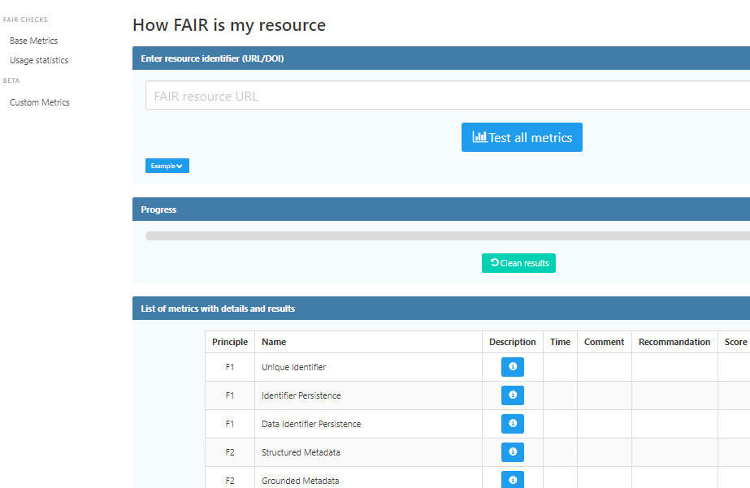
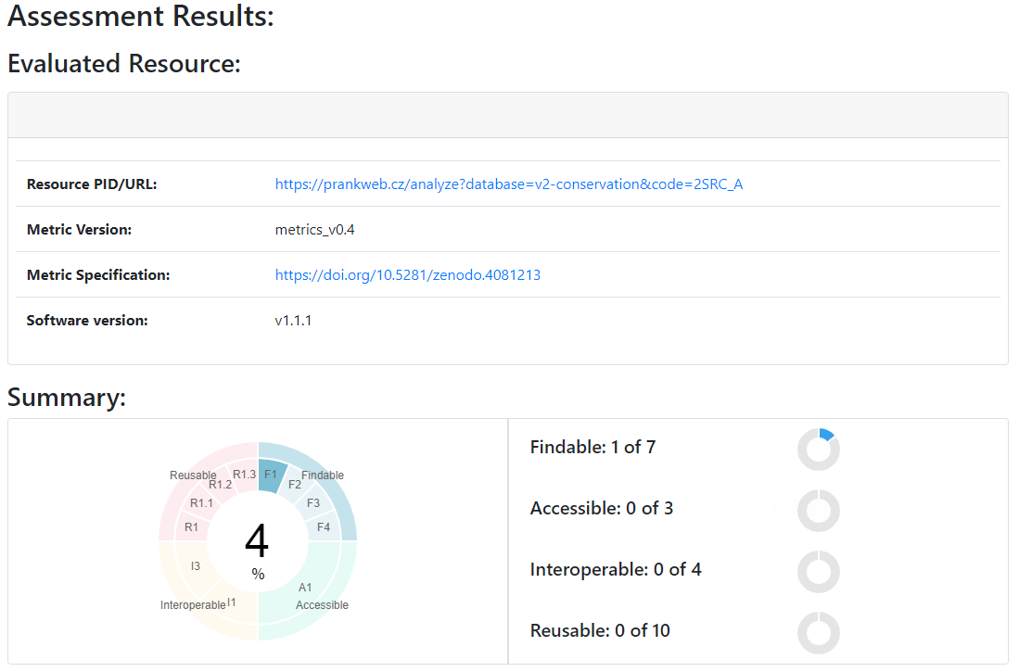
FAIRness
FAIR metrics
FsF-F1-01D - Data is assigned a globally unique identifier
FsF-F1-02D - Data is assigned a persistent identifier
…
CodeMeta (online generator)
How FAIR is my resource
F-UJI
Notes:
There are different ways how to make software/data FAIR. In addition, there is ongoing discussion about implementation. In order to support that discussion, we need measures. Since the rules are general there is huge space for interpretation. For example, F1. (Meta) data are assigned globally unique and persistent identifiers:
Data is assigned a globally unique identifier Globally unique means an identifier should be associated with only one resource at any time. Examples of unique identifiers of data are Internationalized Resource Identifier (IRI), Uniform Resource Identifier (URI) such as URL and URN, Digital Object Identifier (DOI), the Handle System, identifiers.org, w3id.org and Archival Resource Key (ARK). A data repository may assign a globally unique identifier to your data or metadata when you publish and make it available through its curation service.
Data is assigned a persistent identifier An HTTP URL (the address of a given unique resource on the web) is globally unique but may not be persistent as the URL of data may be not accessible (link rot problem) or the data available under the original URL may be changed (content drift problem). Identifiers based on, e.g., the Handle System, DOI, ARK are both globally unique and persistent. They are maintained and governed such that they remain stable and resolvable for the long term.
CodeMeta - Hosted on Github, CodeMeta contributors are creating a minimal metadata schema for science software and code, in JSON and XML. The goal of CodeMeta is to create a concept vocabulary that can be used to standardize the exchange of software metadata across repositories and organizations. They started by comparing what is available and then propose a common schema. This is important so we can compare the software and evaluate its properties. The cover areas such as: name, description, release date, authors, current version, contributors, discoverability/citations, repository, runtime environment (language, OS).
As since we have the rules metrics, how can we measure the FAIRness?
The idea is that you provide a resources, for example protein binding site prediction, and it runs a couple of tests and tells you which principles you do not satisfy. Now the principles are not limited to those you hear before, there are some more. Also, it is not that I do not know how to take an image (left) , but the site is not responsive - I hope that would not happen to your web application.
The F-UJI is part of FAIRsFAIR project, and it works in a similar fashion. On the image (right) you can see result summary for a particular resource. What is nice is the link to the specification of the metrics, also created by FAIRsFAIR project. But you can see nice persistent global identifier there.
The tools are not perfect in their implementation. For example, the first one was/is using Bing to test F4. Metadata in registry.
Source:
https://doi.org/10.5281/zenodo.4095092

Slide 34
Open Science
Consider: 2023/2024

