Slide 1
Data (Pre)Processing
NDBI046 - Introduction to Data Engineering
2024/2025
Petr Škoda
https://github.com/skodapetr
https://www.ksi.mff.cuni.cz
Notes:
This is not limited to Data Warehouse, many of the methods would be rather use as part of a data science pipeline.

Slide 2
[reminder] Data Warehouse
This time we focus on the process and working with the data.
Data Source
Staging Area
Data Warehouse
Data Source
Extract
Load
Transform

Slide 3
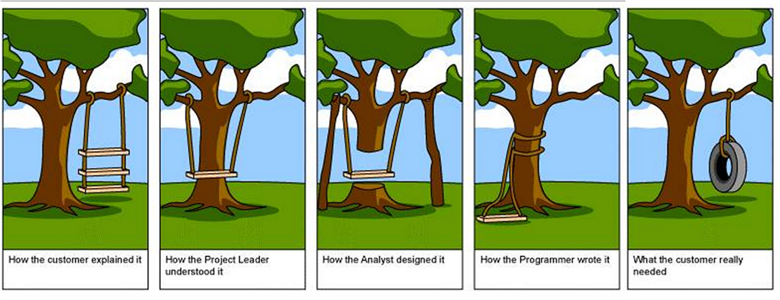
Data transformation
Data Wrangling
Know your tools
Know the "why"
Notes:
There is no strict definition, the idea is we collect, understand, select, and transform data. Data wrangling is more connected to task at hand compared to data transformation. Data wrangling is often mentioned in connection to data mining / data science. Where it refers to the data (pre)processing.
This process is mostly about transforming data from one format to another, from one schema to another. This is mostly about understanding source data, schema, format, and knowing the libraries. Some courses show students how to transform JSON to CSV and back. There is Data Formats or seminars for this. The message could be “know your tools”.
) How can we easily publish 1 TB file?
Resources:
https://missing.csail.mit.edu/2020/data-wrangling/
https://missing.csail.mit.edu/
Data Wrangling : Data transformation from one format to another, focus on bash tools.
https://www.youtube.com/watch?v=sXVP9256JSQ
https://www.youtube.com/channel/UCkRV9I1xz2KwlgvLQ8OadKw
Data Wrangling : Clean, reshape and restructure data using R.

Slide 4
Data transformation
Data Selection
Keep columns filter rows
SELECT * FROM customer WHERE city = 'Prague’;
Data Projection
Keep rows filter columns
SELECT city, state, zipcode FROM customer;
Data Summarization
Big picture
Data tendency and variance (dispersion) measures
Measures
  Distributive : sum, count, min, max
  Algebraic : mean
  Holistic : median
Visualizations
Notes:
For data selection and data projection we use relational terminology.
- - - - - - - - - - - - - - - - - - - - - - - -
For data preprocessing to be successful, it is essential to have an overall picture of your data. Descriptive data summarization techniques can be used. It is sometimes called data profiling.
Measures of central tendency include mean, median, mode (most frequent value), and midrange. We can then use the measures to for example find outliers. Measures of data dispersion-variance include quartiles, interquartile range (IQR, defined as distance between the first and third quartiles), and variance. Those measures capture the degree to which numerical data tend to spread. Be careful when using only some of the measures, they are summarization. Different inputs may produce same summary.
Visualization depends on the use case we have histograms, quantile plot (q-q plot), scatter plot, … based on the summary we may eliminate outliers or perform specific transformation like normalization.

Slide 5
Data transformation
Data Reduction
Data cube aggregation
Attribute subset selection
Dimensionality reduction
Numerosity reduction
Regression, Histograms, Clustering, …
Sampling
Discretization and concept hierarchy generation
Data Cleaning
“The quality of data refers to its ability to satisfy its usage requirements.”
Notes:
Data cube aggregation, where aggregation operations are applied to the data in the construction of a data cube. For example, in data cube we may need to see sales per year rather then per month. In fact, we are navigating the different cuboids in the hierarchy.
Attribute (feature) subset selection, where irrelevant, weakly relevant, or redundant attributes or dimensions may be detected and removed. We do not know which one to remove, so we use heuristics:
Stepwise forward selection, starts with empty add one at a time.
Stepwise backward elimination, starts with all and remove one at a time.
Combination of forward selection and backward elimination, in each step we add new and remove the worst.
Decision tree induction. Decision tree , such as ID3, C4.5, and CART, induction constructs a flow chart like structure where each internal node denotes a test on an attribute. We can use this and select the most important ones.
Dimensionality reduction, where encoding mechanisms are used to reduce the data set size. For example, PCA.
Numerosity reduction, where the data are replaced or estimated by alternative, smaller data representations such as parametric models (which need store only the model parameters instead of the actual data) or nonparametric methods such as clustering, sampling, and the use of histograms.
Regression : Approximate data using a single line. Multiple values can be used to model a response variable.
Histograms use binning to approximate data distributions and are a popular form of data reduction. This is similar to just truncating the numbers.
Clustering : the cluster representations of the data are used to replace the actual data. We can also use less traditional approaches like B-trees, that on given level provide us with clustering.
Sampling. represents large data sets using smaller samples. There are different ways how to select samples: Advantage of sampling is small computational complexity, potentially sub-linear. We can also use sampling to estimate the answer to an aggregate query. For example, mean value. It is possible, using the central limit theorem, to determine a sufficient sample size for estimating a given function within specified degree of error.
Discretization and concept hierarchy generation, where raw data values for attributes are replaced by ranges or higher conceptual levels.
There is another section on data quality. Yet from certain perspective and with certain data quality definition, we can see all transformations and a way to increase data quality.

Slide 6
Discretization and concept hierarchies
Data hierarchy
Discretization / Concept hierarchy as reduction
Discretization generation
  Binning
  Entropy-Based Discretization
  Clustering
  Intuitive Partitioning
Concept hierarchy generation
  Manual definition
  Partial ordering of attributes
  Set of attributes
  Semantics
Example age:
2 - Child
11 - Child
1 - Infant
16 - Adolescent
33 - Adult
Notes:
Data hierarchies, allow us to easily perform summarization and see data from different perspectives or different conceptual levels. We see them for business analytics. Yet they are not always given, a solution is to create them from data. Discretization and concept hierarchy generation are powerful tools for data mining, in that they allow the mining of data at multiple levels of abstraction.
If the discretization process uses class information (we know which data belongs together), then we say it is supervised discretization. Otherwise, it is unsupervised. We can do top-down (starting with single and splitting) or bottom-up (starting with all and merging ~ removing split points, i.e., the values). A concept hierarchy for a given numerical attribute defines a discretization of the attribute. Concept hierarchies can be used to reduce the data by collecting and replacing low-level concepts with higher-level concepts, see example.
Several discretization methods can be used to automatically generate or dynamically refine concept hierarchies for numerical attributes:
Binning : Unsupervised (no class information) top-down approach, can use equal-width or equal-frequency binning. Each values is replaced by the bin representative, e.g., mean/median.
Histogram Analysis : Like binning, partition values into disjoint ranges, called buckets. We can set minimum interval size and apply recursively to create a hierarchy.
Entropy-Based Discretization : Like building a decision tree, can be used to build the hierarchy. Entropy was proposed by Claude Shannon in pioneering work on information theory and the concept of information gain.
Cluster Analysis : Clusters can be nodes of hierarchy, can be bottom-up or top-down approach
Discretization by Intuitive Partitioning : For example, it is more desirable to have salary levels like 50K, 60K, 70K rather then 51.245, 63.786, 70.001 as may be obtained by some sophisticated algorithm. The idea is to split data into 3, 4, or 5 relatively equal-width intervals using the values of the most significant digits. The rule can be applied recursively to create a hierarchy.
Categorical data have no ordering, like location, job category, item category. As a result, we need different approach to create a hierarchy:
Manual definition of some part of the hierarchy, search existing codelists.
Specification of a partial ordering of attributes explicitly at the schema level by users or experts. E.g., street < city < state < country.
A user may specify a set of attributes forming a concept hierarchy but omit to explicitly state their partial ordering.
Consider the following observation that since higher-level concepts generally cover several subordinate lower-level concepts, an attribute defining a high concept level (e.g., country) will usually contain a smaller number of distinct values than an attribute defining a lower concept level (e.g., street). The attribute with the most distinct values is placed at the lowest level of the hierarchy. This does not work for dates for example.
Semantic based clustering. For example. we know the address is a hierarchical concept, if we also know mapping to the ontology, we can create hierarchies automatically.
Example on the right side is to illustrate the task at hand. Data quality determines what result we can get from discretization.

Slide 7
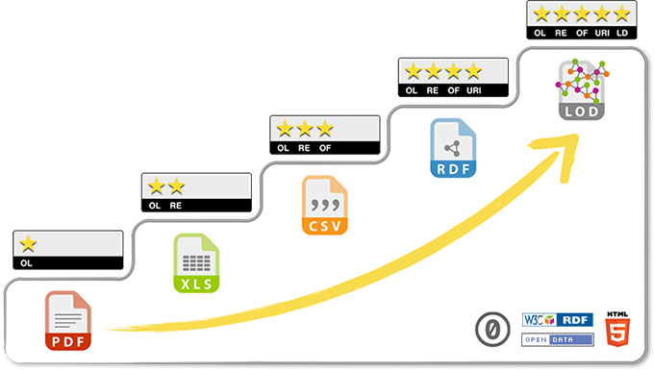
Reach for the stars
Data Integration
Entity identification
Named-entity recognition
Schema integration
Data Lowering / Lifting
Technical viewpoint
Semantic viewpoint
Notes:
We have information about the same entity encoded in different ways using different identifiers.
We may need to identify entities in semi/non-structured data.
The last is integrating schema, where we need to understand the source schemas. People try to address his using modeling and ontologies.
For example, converting CSV to RDF is technical lifting. This may not change the ontology of the data. For it to be semantic lifting we need to change the ontology to more specific one. For example, instead of using general ontology for tabular data we can employ domain ontology.
Levels (related to data quality):
Make your stuff available on the Web (whatever format) under an open license.
Make it available as structured data (e.g., Excel instead of image scan of a table).
Make it available in a non-proprietary open format (e.g., CSV instead of Excel).
Use URIs to denote things, so that people can point at your stuff.
Link your data to other data to provide context.
Resource:
https://docs.google.com/presentation/d/17DDuvBo2eldwcuMr0_3JLOz4WPTs5NCrB02vmjeP8T0/edit#slide=id.g84aded2c10_0_209

Slide 8
What and how
Process steps (WHAT):
Data Cleaning
Remove noise, correct inconsistencies.
Data Integration
Merge multiple data sources.
Data Transformation
Normalization, reduction, format.
Process attributes (HOW):
Automation
Performance
Scalability
Robustness
Provenance
Notes:
It is not only about what we do, but also how we do it. It is data engineering, we are professionals.
You ma write a script to perform data transformation. Yet what about quality of such solution. There is also lack of technical people, what about using some sort of tool?

Slide 9
Data shuffling
There is a cost to performing SQL JOIN, GROUP BY, ORDER BY operations.
ORDER BY - force all data one machine!
The objective is to prepare data and update SQL in a way to optimize execution time.
Cloud is often pay-as-you-go.
Consider: 2023/2024
Notes:
Shuffling isn’t just a fancy dance move! Shuffling is caused when you try to aggregate or join datasets in distributed environments like Spark or BigQuery. One time when I was working at Facebook, we had a 50 TB table joining with a 150 TB table. The shuffle caused by that join took up 30% of all of our compute! I eliminated that shuffle by bucketing the tables ahead of time and then joining!
Resource:
https://blog.dataengineer.io/p/how-to-save-millions-by-optimizing

Slide 10
Extract Transform Load

Slide 11
Towards Extract Transform Load
Building ETL depends on ... almost everything. Yet we should not use this as an excuse for an unstructured approach.
Business Needs
Compliance
Data quality
Security
Data Integration
Data Latency
Archiving and Lineage
BI Delivery Interfaces
Available Skills
Legacy Licenses
Notes:
) Business Needs
DW/BI information requirements.
) Compliance
Legal and reporting requirements, data protection, data completion, data quality. Proof final reports are derived from the right data sources.
) Data quality
The long-term cultural trend that says, “If only I could see the data, then I could manage my business better” continues to grow. Try to list quality requirements, what is acceptable and what is not. We may also need to setup monitoring.
4) Security
Privacy and security requirements, e.g. physical backups.
5) Data Integration
The ultimate objective is to integrate all systems together. The “360 degree view of the enterprise” is a familiar name for data integration. Data integration usually takes the form of conforming dimensions and conforming facts in the data warehouse.
6) Data Latency
How quickly we need to deliver data updates.
7) Archiving and Lineage
We recommend staging the data (writing it to disk) after each major activity of the ETL pipeline: after it’s been extracted, cleaned and conformed, and delivered.
8) BI Delivery Interfaces
We believe it’s irresponsible to hand off data to the BI application in such a way as to increase the complexity of the application, slow down the query or report creation, or make the data seem unnecessarily complex to the business users.
9) Available Skills
10) Legacy Licenses

Slide 12
Extract Transform Load
Category of specialized tools
(for Data Warehouse)
Pipeline / Workflow / Process
Components / Plugins
Benefits:
  Visual representations of a data flow
  Parallelization
  Monitoring
  Failover features
  Information clarity, completeness, quality, velocity
  ...
Users:
  End users
  Business users.
  Designers
  Conceptual modeling, design transformation.
  Developers
  Implementation ETL, plugins.
Notes:
While small operations could be carried out using SQL or script. For long running operations we may employ a specialized tools.
ETL has taken its name and existence as a separate set of tools and processes in the early ‘00s. Till then ETL was just some materialization of data warehouse and industry focused on fast query in operational databases. So, when ETL come to be, many companies and researchers jump in to make contributions or profit. As of 2002, ETL tools are estimated to cost at least one third of effort and expenses in the budget of the data warehouse. Nowadays it is possible to buy a complete ETL solution or use it as a service. Still some organizations may decide to develop their own ETL tools.
The task of ETL is to extract data from data sources (files, services, relational databases), then perform the transformation, and at the end load the data into the storage (data warehouse).
But it is not only implementation of the ETL tool, but also management of the workflow/pipelines that defined the operation. This pipeline may consist of wide variety of steps. To accommodate for this the ETL is often extensible using plugins/components. But just the fact that we have the workflow captured is a huge benefit when it comes to data governance, ensuring digital privacy (GDPR). Also, the fact that the ETL can be responsible for many transformations make it easier to manage them. Also, the automation reduce the opportunity for errors and increase reproducibility.
The ETL tools has many advantages, yet many of those may not be apparent for developers who know how to code. In other words, why should use some tool instead of my programming language? I would have it faster and better. Yet on large scale, it is better to leverage existing environment. Like for Data Mesh infrastructure.

Slide 13
Extract
Capturing data from *:
Full refresh
Log capture
Time-stamped source
Change transaction files
Stream vs File
Structured vs semi/un-structured data
…
*) anything
Challenges:
Data latency / volume / validation
Source limits
Monitoring / errors / reliability
Disparate sources
Limited resources/API
Data encryption and compression
….
Notes:
Primary capture methods:
The data in the warehouse may be either replaced, or the full copy can be used to generate updates.
Log capture : Focus on DBMS’s log file.
Time-stamped source : Select data only from the previous processing.
Change transaction files : Change/Diff file.
Another distinction is FILE vs STREAM.
For a file we may need to: extract the file, move file to ETL server, transform the file, load into staging area.
Stream extraction can be appealing as we get data directly, but it is hard to restart or verify content.
Based on your choices of data latency, volume, source limits and data quality (validation), you need to orchestrate your extraction scripts to run at specified times or triggers.
There can be limits on number of request, size of the result query (for example only 100 rows from 100K table). Also, legal issues, data protection.
Disparate sources (open data, internet of things, social networks), vendor specific technologies. Adaptation to changes with new versions.
Disparate data sources refers to different types or formats of data that reside in separate systems, databases, or file formats, and that are not necessarily designed to be integrated or compatible with each other.
The extraction software must incur minimum overheads to the source system both at runtime or use at the nightly time window that is dedicated to the refreshment, but if many jobs are running at night there is still an issue. The source schema can be inconsistent, there can be breaking changes.
We will talk about compression and encryption later. We want speed when transferring (compression) and security (encryption). We will talk about the options later on, there is a separate lecture.

Slide 14
Change Data Capture System (CDC)
The ideas is to isolate and transfer the data that has changed since the last load. Building good system is not easy. Data loss or duplicity are off the table.
Ideas:
Isolate the changed data sources to implement a selective processing.
Capture all changes (create, edit, delete).
Time-based vs. index-based.
Think about nonstandard interfaces.
Database log scraping, message-queue monitoring.
Tag changed data to distinguish from error corrections.
Use audit columns.
Notes:
Database log scraping. We take a snapshoot of a database log file. We can then identify and process relevant transactions.
We can not use time-based loading, think about process restart. We need to use index-based approach instead. This may be easiest to integrate to, just observe the system.
We can try to use full-diff, but that may not be an option as the changes just keep coming.
Audit columns that store the date and time a record was added or modified. They can be populated by external system of a database trigger. How to deal with deletion, then there is no audition data.
Resources:
The Data Warehouse Toolkit, Chapter 19

Slide 15
Transform / Cleaning and Conforming Data
This is where the value is born as we aim to enhance data quality. It is about integration and dealing with data quality issues.
At the same time DW/BI should provide accurate picture of data captured by the organization's production system.
Techniques and steps:
... you name it
Challenges:
Different formats / ontologies
Business logic
Scaling
Error handling
Monitoring
Quality screens.
Notes:
We may need to improve business processes and data quality culture. This may improve input data quality. We talk about data quality later.
There is no need to list transformation techniques here. But often this is about SQL.
Challenges:
Data are in different formats and use different ontologies.
Object mapping can also be an issue as we can have different ways how to represent a customer. Lack of (changing) business logic.
As an example: the business rule for determining a new customer is the date of their first product purchase. But what do we do for customers who paid for shipping, but not for a product?
Scaling issues, especially holistic operations can be an issue. Also, we may need to perform the transformation faster, minutes instead of hours.
What to do when we encounter quality issue: A) stop the process B) send to the suspense file for later processing - missing records! C) tag data as problematic using an extra dimension D) fix the data.
We need to know what happen; best case is the monitor with alerts.

Slide 16
Load
Loading data to *:
Vendor specific
Full load / Incremental load
Indices
Materialized views
Challenges:
Order of insertions
Schema changes
Limited resources
Availability and consistency
Notes:
The bulk update is performed at start, later an incremental updates can be performed to improve performance. On the other hand, incremental updates are more complicated to design / run / maintain. Incremental loading may not be optimal for indices, for example R*-tree (spatial data) reinsert.
Another issues is how to propagate changes to materialized views (pre-computed tables), or overall, with all the systems that need to recompute their data in reaction to change of data. The materialized views are often defined by queries, so we can try to propagate the changes rather then rebuild from scratch.
Challenges:
We need to insure data consistency. So which data should we load first, which second .. for example, should we first load product (and we have product with ho sales) or sales for non-existing product? Another issue can be with incremental loading, the result should be same as with full load.
This may be solved in the transformation phase. What should happen for incremental load when new property is added?
If we have privileged access and can use all resources, then easy. But what if there are other analytic tools running. Should we use bulk loading, incremental changes?
Can we use the database while loading? What if we are loading to multiple databases, the state would not be consistent.

Slide 17
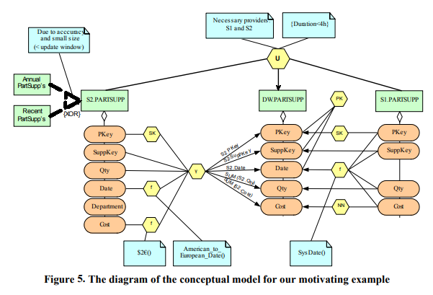
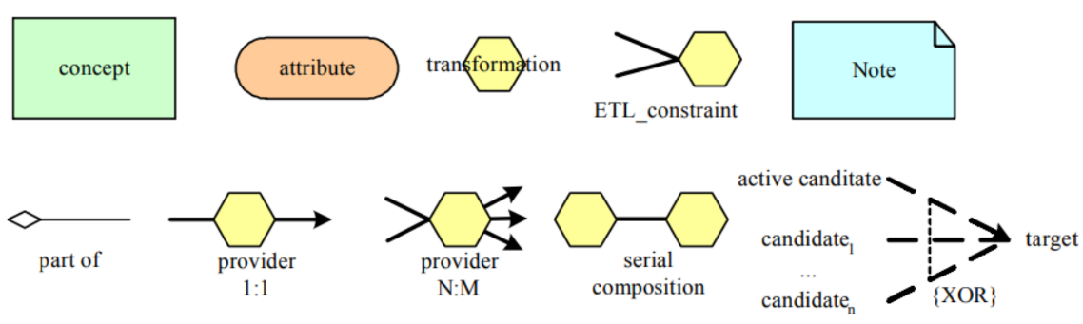
Extract Transform Load
Graphical notation
Conceptual modeling for ETL processes
Inspired by Business Process Modeling Notation
WOL, Horn clause language
Workflow as a graph
Unified Modeling Language
Semantic design methods
Notes:
ETL was design for data warehouse, as a result, originally the graphical notation focused on capturing conceptual characteristics of the star schema and subsequent aggregations. But overtime the notation changed and now there are many different notations available. This is only a short overview of selected approaches, to hint the explored ideas.
There is no single universal specification only alternatives.
Other approaches utilize Business Process Modeling Notation (conceptual model), it can then be translated into executable specification using Business Process Execution Language [0].
In 1999, Davidson and Kosky [1] presented WOL, a Horn-clause language for specifying transformations between complex types. Where transformations are Horn clause language (a disjunction of literals) .
[Example at the right side] In 2002 Vassiliadis [2] model ETL workflow as a graph. Nodes are activities, recordsets (files) and attributes. Each node has input/output/rejection schema. Edges connect attributes with their encompassing nodes and providers, so they show how are values propagated among multiple schemas. The ETL workflow is a serializable combination of ETL activities, provider relationships and data stores. The workflow is thus part of the Architecture Graph, overall modeling of the environment m ~ logical description of the data flow. They also introduce a template language for reusable templates as macros. They do not use UML as they need attributes to be first class citizen, similar to object relation models, i.e., they need a box for the attributes.
In 2003 Trujillo and Luján-Mora [3] try to use UML to model the ETL workflows. It is interesting that they use class diagrams not the activity diagrams, as the activity would better capture the process. The reason is that they focus on interconnection of activities and data stores not on the actual steps in each activity. They use packages to allow for nesting, together with zooming the user can see the transformation on different levels. They design generic process with six stages: source selection, source data transformation, source data join, target selection, attribute mapping, data loading.
In 2005 Simitsis, and later in 2008 Simitsis and Vassiliadis [4], proposed semi-automatic transition from the conceptual to the logical model (implementation). It involve mapping of concepts to relations and mapping of transformations and constraints to respective activities. In 2006 and 2007 Skoutas and Simitsis [5] propose to employ ontologies to construct the conceptual model of ETL process. The designer can use domain knowledge (data sources, data warehouse) and user requirements to construct OWL ontology and annotations that connect it with schema and data stores. Then OWL reasoner is employed to propose conceptual ETL operations ~ pipeline.
Resource:
https://dl.acm.org/doi/abs/10.1145/583890.583893
[0] https://ceur-ws.org/Vol-28/paper6.pdf
[1] https://www.semanticscholar.org/paper/Specifying-Database-Transformations-in-WOL-Davidson-Kosky/46f68ba2de84e7894ea0aa09fe0c1c579336bc87
[2] https://dl.acm.org/doi/abs/10.1145/583890.583893
[3] https://link.springer.com/chapter/10.1007/978-3-540-39648-2_25
[4] https://link.springer.com/chapter/10.1007/978-0-387-87431-9_2
[5] https://www.igi-global.com/article/ontology-based-conceptual-design-etl/2840

Slide 18
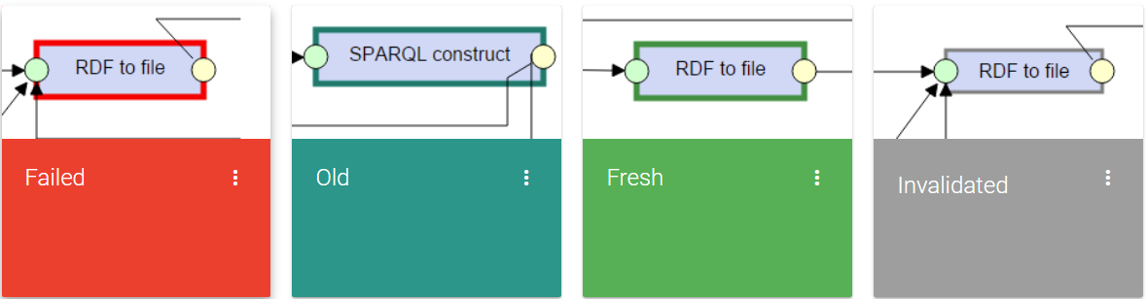
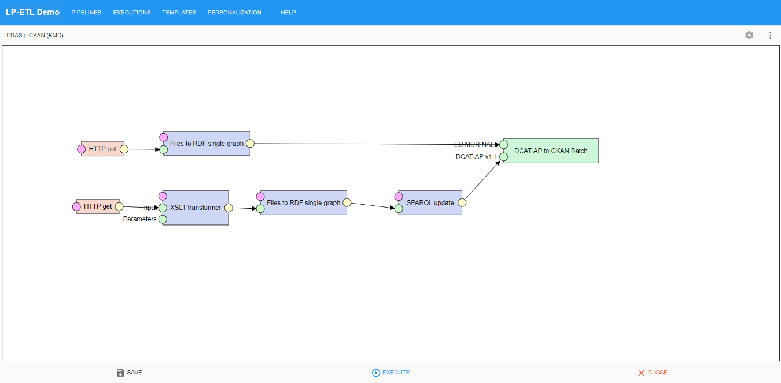
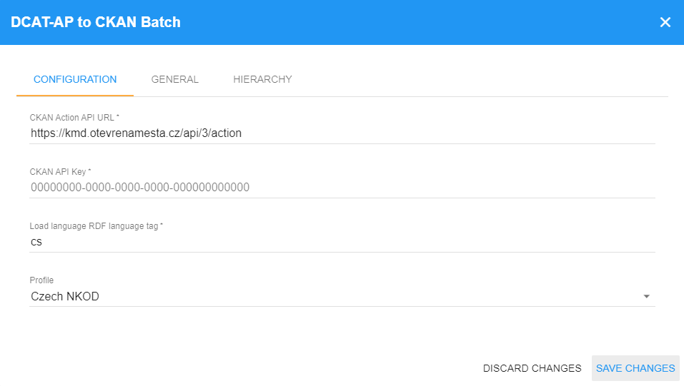
Extract Transform Load
LinkedPipes: ETL
Notes:
This is optional content. Having ETL can be a good business.
Resource:
https://github.com/linkedpipes/etl

Slide 19
ETL with Data Warehouse
The "The Data Warehouse Toolkit" defines 34 ETL sub-systems.
Extraction (1-3)
Data Profiling
Change Data Capture System
Extract System
Cleaning and Conforming Data (4-8)
Data Cleansing System
Error Event Schema
Audit Dimension Assembler
Deduplication System
Conforming System
Delivering (9-21)
Slowly Changing Dimension Manager
Surrogate Key Generator
Hierarchy Manager
...
Managing (22-34)
Job Scheduler
Backup System
Lineage and Dependency Analyzer
...
Notes:
) Data Profiling
Got to know your data, like SELECT DISTINCT. Should be part of data sources identifications. Basically, know your data sources, it is a protection from an unexpected diversion of building systems to deal with dirty data.
) Audit Dimension Assembler
This about the dimension we attach to the regular fact tables to provide information about errors and data issues.
) Conforming System
For two dimensions to be conformed, they must share at least one common attribute with the same name and same contents.
To accomplish this, incoming data from multiple systems needs to be combined and integrated, so it is structurally identical, deduplicated, filtered of invalid data, and standardized in terms of content rows in a conformed image.
Delivering:
The primary mission of the ETL system is the handoff of the dimension and fact tables in the delivery step.
) Slowly Changing Dimension Manager
Here we may need to implement different types.
For type 3, 4, ... we may need to alter the table schema.
) Hierarchy Manager
We have different ways how to handle hierarchies, now we need to implement this.

Slide 20
Alternatives
Extract Transform Load
  Pull approach, works on demand or on schedule.
Extract Load Transform
  Suitable for data lake.
Enterprise Service Bus
  Push model, gets data as needed.
No-ETL
  Initiative https://noetl.org/
Notes:
ETL is not the only available solution. Here are some alternatives for context.
ELT
Transformation before load is complex and there is already a lots of complexity for extract-load phase.
Business can define transformations and run them in the target system - storage. This is useful for cloud-native data warehouse, where the transformation can happen when needed at any time. It is not a fixed step in a pipeline.
The ELT can be transparent part of ELT + analyze. Where use the ELT just to get the data, just as a single data source and transformation engine.
ESB
One of cornerstones of service-oriented architecture. It can be viewed as the implementation (middleware) or part of the architecture (design choice).
You just say what you want, and a middleware (ESB) gets that for you.
NoETL
Focus on API gateways - standardized API, Data Marts, … using those we can get that data we need just in time.
There is business, as you need to get the APIs right. They create REST API for all sources and then allow for easy combination of those data. Like query driven approach. Then Python, JavaScript or PHP can perform the transformation.

Slide 21

Data Provenance

Slide 22
Data lineage / provenance
“The present invention provides a system and method for tracking the lineage of data within database tables.”
Data lineage Patent, Microsoft, 1998
Level of detail:
Technical lineage
Business lineage
Purpose:
"Where lineage"
Given an output, which inputs did the output come from?
"How lineage"
Given an output, how were the inputs manipulated to produce the output?
Notes:
Patent: Data within the tables are tracked by attaching lineage information to the data, preferably, by adding a lineage identifier to each row in a table. Data that share a common lineage can be identified by virtue of sharing a common lineage identifier. The lineage identifier can then be used to trace the source of the data.
- - - - - - - - - - - - - -
Data lineage shows what source(s) the data comes from, where is it flowing to in the environment, and what happens to it along the way. Technical lineage is a necessity for technical members of the team such as software developers, DBA’s, and report developers who are interested in the inner workings of their code, the movement of data through it, and the impact of their code on upstream and downstream data flows. Business lineage allows users to see the journey of their data from a higher perspective, without fine-grained technical details. They often need to know how things are connected, but without having to view detailed transformation syntax.
What are the benefits?
For example, molecular biology databases, which mostly store copied data, can use lineage to verify the copied data by tracking the original sources.
Data warehouses can use the lineage of anomalous view data to identify faulty base data.
Relevant to data life cycle - what is happening to the data. So, all the benefits of the data life cycle also apply here.
So, what is the content of a data lineage record? Lineage data can be quite large .. for instance, the Gene Ontology database has up to 10MB of lineage for single tuples. We may need specific implementation for particular transformation and database relational database, probability database (each tuple has probability), curated databases (information manually assembled by domain experts). The lineage is type of metadata (data about data).
We can also focus on Schema-level or Instance-level.
Schema-level where-lineage answers questions such as which data sets were used to produce a given output data set.
Schema-level how-lineage answers questions such as which transformations were used to produce a given output data set.
Instance-level lineage treats individual items within a data set separately, so we ask more fine-grained questions.
Data Provenance Vs. Data Lineage, there are other like “pedigree”, “parentage”, “genealogy”, "filiation”. Although there are distinction made by bloggers and other internet users, it is on company-bases. The key goal of a data lineage tool is data lifecycle management right from the data origination to the data exhaustion. Key goal of data provenance is to specifically track the data origination and segregating data in three key stages. These stages are data-in-motion, data-in-process, and data-in-rest. In simple words, we can conclude that a data provenance system is a combination of data lineage and input sources, input methods, and channels. This may not be only about metadata, but about visualisation of the data flow and increased understanding of the data solution.
Lineage information can be created as a part of the transformation, in an eager mode. Or on request, lazy mode, from some information related to transformations. Different implementation for relational database, probability database (each tuple has probability), curated databases (information manually assembled by domain experts), data warehousing systems. There is research on how to, in general/specific areas, work with lineage data for particular transformation.
Provenance is type of metadata.

Slide 23
Data Provenance
PROV
Notes:
Source:
https://www.w3.org/TR/prov-o/
https://www.w3.org/TR/2013/NOTE-prov-primer-20130430/
https://www.w3.org/TR/2013/REC-prov-o-20130430/

Slide 24
PROV
Provenance is information about entities, activities, and people involved in producing a piece of data or thing, which can be used to form assessments about its quality, reliability or trustworthiness.
The PROV Family of Documents defines a model, corresponding serializations and other supporting definitions to enable the inter-operable interchange of provenance information in heterogeneous environments such as the Web.
The provenance of digital objects represents their origins. PROV is a specification to express provenance records, which contain descriptions of the entities and activities involved in producing and delivering or otherwise influencing a given object.
Notes:
Source:
https://www.w3.org/TR/2013/NOTE-prov-overview-20130430/

Slide 25
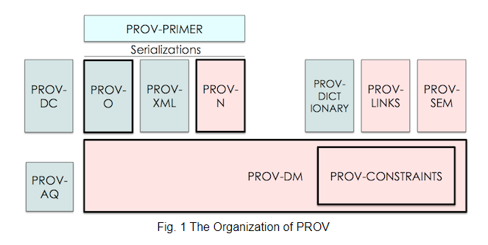
Documents
Notes:
Light Green for users. Green for developers. Red for advanced users / validators / new serializations..
PROV-PRIMER is the entry point to PROV offering an introduction to the provenance data model. This is where you should start and for many may be the only document needed.
PROV-DC defines a mapping between Dublin Core and PROV-O.
PROV-O defines a light-weight OWL2 ontology for the provenance data model. This is intended for the Linked Data and Semantic Web community.
PROV-XML defines an XML schema for the provenance data model. This is intended for developers who need a native XML serialization of the PROV data model.
PROV-N defines a human-readable notation for the provenance model. This is used to provide examples within the conceptual model as well as used in the definition of PROV-CONSTRAINTS.
PROV-DICTIONARY defines constructs for expressing the provenance of dictionary style data structures.
PROV-LINKS defines extensions to PROV to enable linking provenance information across bundles of provenance descriptions.
PROV-SEM defines a declarative specification in terms of first-order logic of the PROV data model.
PROV-AQ defines how to use Web-based mechanisms to locate and retrieve provenance information.
PROV-DM defines a conceptual data model for provenance including UML diagrams. PROV-O, PROV-XML and PROV-N are serializations of this conceptual model.
PROV-CONSTRAINTS defines a set of constraints on the PROV data model that specifies a notion of valid provenance. It is specifically aimed at the implementers of validators.
Source:
https://www.w3.org/TR/2013/NOTE-prov-overview-20130430/

Slide 26
Demo
PROV
Consider 2024/2025
Notes:
Example with building a PROV for a data workflow.
Use to replace the starting point below.

Slide 27
Starting point
prov:DerivedFrom
prov:Entity
prov:wasAttributedTo
prov:wasGeneratedBy
prov:used
prov:Agent
prov:Activity
prov:wasAssociatedWith
Notes:
In PROV, physical, digital, conceptual, or other kinds of thing are called entities.
Activities are how entities come into existence and how their attributes change to become new entities, often making use of previously existing entities to achieve this. They are dynamic aspects of the world, such as actions, processes, etc. Activities start and end at particular points in time (described using properties prov:startedAtTime and prov:endedAtTime, respectively) and during their lifespan can use and generate a variety of Entities (described with prov:used and prov:wasGeneratedBy, respectively).
An agent takes a role in an activity such that the agent can be assigned some degree of responsibility for the activity taking place. An agent can be a person, a piece of software, an inanimate object, an organization, or other entities that may be ascribed responsibility. When an agent has some responsibility for an activity, PROV says the agent was associated with the activity, where several agents may be associated with an activity and vice-versa.
We can create Action chain using only activities with prov:wasInformedBy predicate. This predicate state that there is a dependency (the informed activity used entity produced by the informing) without stating the time or the entity.
Alternatively, we can use prov:wasDerivedFrom to chain only entities. A derivation is a transformation of one entity into another.
Source:
https://www.w3.org/TR/2013/NOTE-prov-primer-20130430/

Slide 28
Data Quality
NDBI046 - Introduction to Data Engineering
2024/2025
Petr Škoda
https://github.com/skodapetr
https://www.ksi.mff.cuni.cz

Slide 29
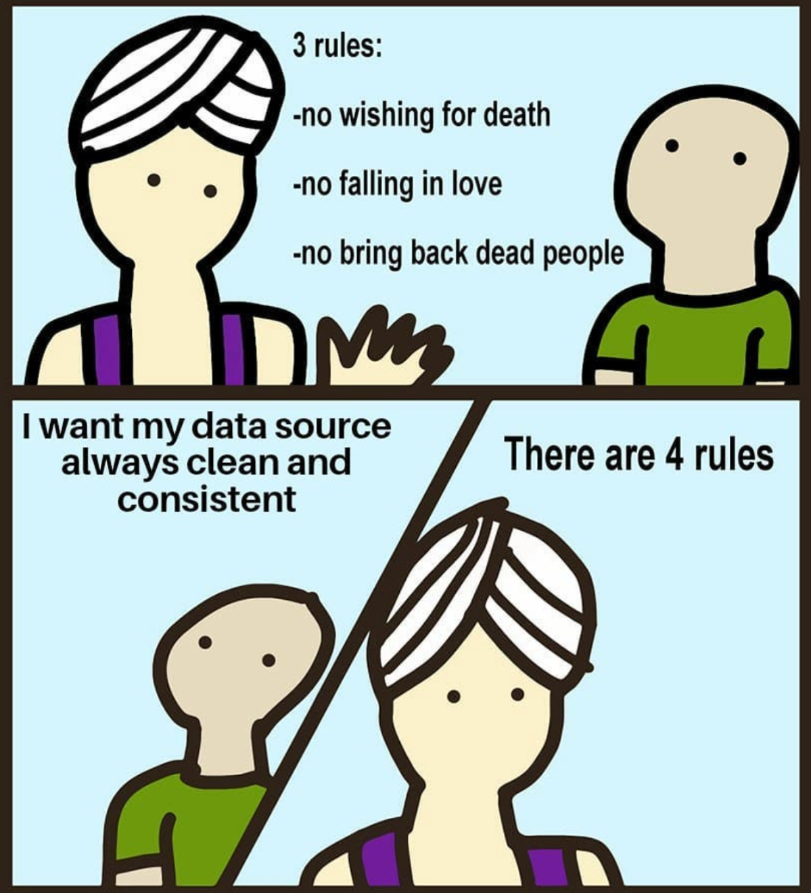
Data Quality
Data Talk Newsletter
Notes:
The joke is, that this was also a data quality issue.

Slide 30
Data Quality
Garbage In, Garbage Out (GIGO)
Notes:
The first recorded use of the phrase "garbage in, garbage out" dates back to 1957.
However, George Fuechsel, an IBM programmer and instructor, is generally credited with coining the term in the early 1960s.
Paraphrasing Michael Hammer: "Seemingly small data quality issues are, in reality, important indications of broken business processes.".
-- Michael Hammer, Reengineering the Corporation (Collins, revised 2003)
It is about a culture. Think of a Japanese company vs ... low quality.
This may be also connected to low software support and low data-readiness of the company.
The path is not to occasionally scold employees.
Resource:
https://www.techtarget.com/searchsoftwarequality/definition/garbage-in-garbage-out

Slide 31
Why? - Marketing edition
Bad data wastes time, increases costs, weakens decision making, angers customers, and makes it more difficult to execute any sort of data strategy.
On average, 47% of newly-created data records have at least one critical (e.g., work-impacting) error.
Only 3% of the data quality scores in our study can be rated “acceptable” using the loosest-possible standard.
Notes:
Sources:
https://hbr.org/2017/09/only-3-of-companies-data-meets-basic-quality-standards

Slide 32
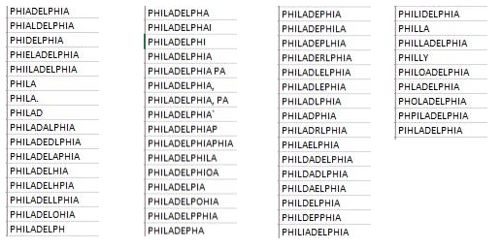
Why? - Science edition
Levels:
  Operational level
  Tactical level
  Strategic level
Issues
  Inaccurate data: 1-5% of data fields are erred
  Inconsistencies across databases
  Unavailable data necessary for certain operations or decisions
Impacts
  Lowered customer / employee satisfaction
  More difficult to implement data warehouses
  Increased organizational mistrust
Notes:
Poor data quality has far-reaching effects and consequences.
1)
Operational level::
Customers have every right to expect that their names and addresses will be correct, that the products and services they order will be properly delivered, that they will be billed properly, and that their accounts will be properly serviced.
Poor data quality increases operational cost because time and other resources are spent detecting and correcting errors.
Finally, at the operational level, poor data quality lowers employees’ job satisfaction. One simply cannot expect the hotel clerk dealing with tired travelers whose reservations have been lost to exhibit a high level of positive morale.
Tactical level:
There is no evidence that the data needed and used by managers is any better than the data used by customer-service employees.
It is a widely accepted maxim that decisions are no better than the data on which they are based.
One executive explained it to me this way: “We spend about half our (decision-making) time just arguing about whose data is better!”
Strategic level:
There is less direct evidence of the impact of poor data quality at the strategic level, as practitioners are only beginning to work there.
- - - - - - - - - - - - - -
2) Article from 2010. Problems in data quality reportedly cost US businesses more than $611 billion every year in postage, printing, and staff overhead.
Source:
https://dl.acm.org/doi/abs/10.1145/269012.269025
https://dl.acm.org/doi/abs/10.1145/1629175.1629210
https://twitter.com/quaesita/status/1283787303886954498

Slide 33

Why? - Machine learning edition
Science
Data Collection / Questionnaires
Initial phases of data-intensive research
Manipulation / Responsible data editing
Machine learning / Data science
Notes:
Science:
A questionnaire is a research instrument consisting of a series of questions for the purpose of gathering information from respondents. Like questionaries even sensors may produce inaccurate / invalid data, or they can be wrongly recorded by the researchers.
We see data cleaning as the initial phases of data-intensive research - so it does not have to be “cleaning”. One reason can be that there is a little value in the ability to describe more in depth what is happening, or the cost of doing so is so high. Another reason for missing details is that overall researchers consider impact of this phase as not to threaten the value of any findings.
Example: [1]
In clinical epidemiological research, errors occur in spite of careful study design, conduct, and implementation of error-prevention strategies. Data cleaning intends to identify and correct these errors or at least to minimize their impact on study results. Little guidance is currently available in the peer-reviewed literature on how to set up and carry out cleaning efforts in an efficient and ethical way. Concerns about where to draw the line between data manipulation and responsible data editing are legitimate. Yet all studies, no matter how well designed and implemented, have to deal with errors from various sources and their effects on study results. Data cleaning deals with data problems once they have occurred. Error-prevention strategies can reduce many problems but cannot eliminate them. We present data cleaning as a three-stage process, involving repeated cycles of screening, diagnosing, and editing of suspected data abnormalities.
- - - - - - - - - - - - - -
Machine learning:
Enough of high-quality data is a prerequisite for almost any machine learning method. The same holds true for data science, you just need to have the data in sufficient enough quality. What is the quality is another question.
- - - - - - - - - - - - - -
Example from 3, AI bias towards classification wit ruler.
Source:
https://doi.org/10.1371/journal.pmed.0020267 [2005]
https://towardsdatascience.com/is-the-medias-reluctance-to-admit-ai-s-weaknesses-putting-us-at-risk-c355728e9028
https://doi.org/10.1016/j.jid.2018.06.175
https://info.ultranauts.co/blog/chatgpt-and-data-quality

Slide 34
Data quality
"The quality of data refers to its ability to satisfy its usage requirements."
"Fitness for use."
Current status
Reporting /
Verifying
Assessment /
Inspection
Action /
Cleaning
Notes:
There is no strict/single definition of data quality. Yet we should always consider data quality with respect to use-case.
We can see data quality as a process or methodology. Obviously, there are differences when dealing with personal data, company data or data for machine learning.
- - - - - - - - - - - - - -
Know the current situation. Document the organization processes and services. Collect the data, identify known issues - speak with businesspeople. Is the problem in a database / data flow / data model?
- - - - - - - - - - - - - -
In order to improve something, we need to be able to measure the difference. There are quality dimensions, representing different types of quality, that we can use to measure the quality. Sometimes this can be replaced by inspection, where we are looking for errors instead of measuring.
- - - - - - - - - - - - - -
Next, we need to analyze and act. Perhaps some issues are too expensive to be tackled or have insignificant impact. So, we need to know how to fix things, who is responsible what is the cost. We can employ some “well known” strategies / techniques / methodology how to address common issues, but most of the time they are use-case specific. Also called cleaning when we address issues from previous step.
We can view ‘data cleaning’ as a part of the data quality process, where the focus is on data distribution: removing outliers, missing values, smoothing noisy data. This is more relevant for data science and machine learning projects, where the whole process has only a single pass. In other fields we may define data cleaning as increasing data quality.
- - - - - - - - - - - - - -
We keep track of the changes and new quality score. We should also check that all rules and constraints holds. For example, number of customers is an integer not decimal.
Overall, the process is never ending, so the quality should be part of the day-to-day operation rather than one-time action. It should be part of the data governance and incorporated into data life cycle. So, every time a data flow happens, every time new Excel file is received data quality process kick in. There may even be attempts to prevent the creation of low-quality data in the first place. For example, using code lists, businesspeople education, ..
Source:
https://docs.google.com/presentation/d/1OB6R9GriyQJd1k7GnNtOnAZE858lL-xvBJpJl1AhFvE

Slide 35
Assessment / Inspection
Quality dimensions groups
Accessibility dimensions
Intrinsic dimensions (completeness, consistency, …)
Contextual dimensions (relevance, timeliness, … )
Representational dimensions (interoperability, …)
Inspection
Data profiling
Visualizations
Notes:
In order to perform any data cleaning or carry out data quality related action we first need to define what is “data quality”. This definition lies in the eye of the beholder. We can use quality dimensions to measure the quality. Alternative approach, mostly for data science and smaller data, is inspection. When user interactively inspect the data instead of applying fixed measure techniques.
Accessibility dimensions - These dimensions involve aspects related to the access, authenticity and retrieval of data to obtain either the entire or some portion of the data (or from another linked dataset) for a particular use case.
Intrinsic dimensions - Intrinsic dimensions are those that are independent of the user’s context. Would be shared by multiple users, like completeness, consistency.
Contextual dimensions - Contextual dimensions are those that highly depend on the context of the task at hand, like relevance, timeliness.
Representational dimensions - Representational dimensions capture aspects related to the design of the data, like interoperability.
As you can see this is more general, some groups may not be applied at all if you start with data on your computer. Those dimensions may not only influence what data should be used, but also the way how they are processed.
Widely used alternative in data science and machine learning, or general to the data processing, is to manually inspect the data. During inspection, a domain expert looks for data issues. The main methods to use here are:
Data profiling - summary statistics, mean, variance ..
Visualizations - extension to data profiling, where we create some graphics.
The idea of inspection is to find patterns or values that are unexpected and thus erroneous. While you can establish dimension measurement into a workflow, it is hard to do the same for data inspection as it may not have predefined steps and outcome.

Slide 36
Quality Dimensions / Screens
Use-case based dimensions.
There is not definition ...
We need to have measures.
Data quality screens, Data Warehouse:
Column screens
Structure screens
Business rule screens
Notes:
For most dimensions there is no a single definition. The ideas is that we should, with respect to use-case, define measures for selected dimensions. We can try to think about measures for each dimension.
) Column screens test the data within a single column, test of expected values, range, format.
) Structure screens test the relationship of data across columns, series, many-to-one, primary keys, foreign kyes (missing product).
) Test rules, like the user discount is what it should be based on their lifetime spending.
Resources:
Data Quality: The Accuracy Dimension (Morgan Kaufmann, 2002)

Slide 37
Dimension: Accuracy
Definition:
The extent to which data are correct, reliable and certified.
Definition:
The data values stored in the database correspond to real-world values.
Definition:
Trustworthiness is defined as the degree to which the information is accepted to be correct, true, real and credible.
Notes:
For example, we have price in database equal to 12. Yet the real value is 12.5 or 12.7. We could lose precision by data conversion.
Example with address: I need the exact address of a customer to send a package. But I do not need it to decide where most of my customers live (State, City).
We can relate the data correctness to data reliability. In other words, can we trust the data? One way how to support the trust is by certification, where an authority declare data as correct. This is connected to the trust that can be its own dimension.

Slide 38
Dimension: Completeness
Definition:
The degree to which a given data collection includes data describing the corresponding set of
real-world objects.
Definition:
Extent to which data are of sufficient breadth, depth, and scope for the task at hand.
Definition:
Completeness refers to the degree to which all required information is present in a particular dataset.
Notes:
Missing data records, missing some sales (breath), missing sales per region (depth), or missing sales at all (scope) for task where we may need sales.
Nice example is NULL in relational database for field “website”, what is the meaning?
The object does not have such property, like website.
The object has no website.
The object may have a website, but we have no knowledge about it.
In addition, it may not be about data but schema:
Do we have all columns?
Do we know all possible values?
Do we know value ranges?

Slide 39
Dimension: Consistency
Definition:
Violation of semantic rules defined over a set of data items.
Definition:
Consistency means that a knowledge base is free of (logical/formal) contradictions with respect to particular knowledge representation and inference mechanisms.
Notes:
Like schema completeness but with focus on restriction applied to data.
For example, age should be between 0 and 120. Amount of bought items should be positive number - but this one is not true, is it? So be careful with setting up constraints, they must be aligned with a business.
Consistency is corner stone for relational databases, one of the reasons to have transactions and normal forms. Consistency rules can be defined and enforced by business like: There must be no sale to a customer, if they are late with any payment more then 7 days, or the product sold is in a promotion.
Another example is different representation of the same information. We can have addressed as GPS coordinate and in structure form. They should point to the same location. What if they do not?

Slide 40
Dimension: Availability
Definition:
Availability of a dataset is the extent to which data (or some portion of it) is present, obtainable and ready for use.
Notes:
This may seem trivial but consider situation where you find the data using data catalog, like in the home assignment. This may not only be a public open data catalog, but also an internal data catalog with references to data or services. But the data may not be available, or the access may be limited (legal reasons, lack of computational resources).

Slide 41
Dimension: Licensing
Definition:
Licensing is defined as the granting of permission for a consumer to re-use a dataset under defined conditions.
Notes:
When data are extracted from external source you need to know the license, though there are some exceptions for personal use. For example, GDPR allow you to manage personal data, contacts in you phone, without having to satisfy the same requirements as the business. We can expand this dimension into the legal perspective and some internal company regulation, where it can be an issue of user rights.
Obviously, this is most relevant for public data, it may not only be about the license itself, but is the license machine readable? So, our tools can manage the licensing for us?

Slide 42
Dimension: Timeliness
Definition:
Timeliness measures how up-to-date data is relative to a specific task.
Notes:
You may not want to use 2 years old sales reports to make predictions for this year. So, the easiest measure is how old the data are. But there are more complex situations, imagine we have a report available, and the report is recomputed once upon a time, for example data cube of sales. We can measure the duration between last modification of the data source and our summary. This better reflects the situation where the source is not changing.
Another thing to consider is velocity, i.e., how quickly the data change, i.e., how long are they valid. If the data change every minute, we may need to process them online. On the other hand, if the data change once per month, we can cache the results.

Slide 43
Dimension: Understandability
Dimension:
Understandability refers to the ease with which data can be comprehended without ambiguity and be used by a human information consumer.
Notes:
This is mostly related to the schema - for example given a table about population migration, can you understand what the data means? Do you know what particular column mean? Do you know the units used in the column? So mostly documentation, but also the complexity of the documentation.

Slide 44
Dimension: Interoperability
Definition: Interlinking
Interlinking refers to the degree to which entities that represent the same concept are linked to each other, be it within or between two or more data sources.
Notes:
Interlinking is designed for linked data, yet the ideas of referencing other sources is quite important aspect of interoperability. We talk more about interoperability in FAIR section.

Slide 45
Dimension: …
Notes:
You can define your own. In fact, you should! In practice it is important to focus on the use-case and talk to businesspeople. On the other hand, it is good to have intuition so you know what questions you may ask to get the overall understanding of the data quality or search for the core issues.

Slide 46
DEMO
Otevřená data snadno a rychle
Removed: 2023/2024
Notes:
Czech open data publication guide also mention few issues related to data quality.

Slide 47
Data Quality
Issues / Data Cleaning

Slide 48
Data type specific issues
String
Standardize casing
Remove whitespaces, new lines
Correcting typos
Standardize encoding
Map to type / categorical variables
Remove stop words
Date and time
Format
Time zones
Notes:
This is just an illustration other data types may have their own issues.

Slide 49
Missing values
Drop rows and/or columns with missing data
Look for patterns of missing data
  Missing completely at random
  Missing at random
  Non-ignorable
Fill in missing values (imputation)
  Manually
  Use global constant such as N/A or Unknown
  Use imputation method
Imputation Methods
Process of estimating missing data of an observation, based on valid values of other variables.
K-Nearest Neighbors
Mean based imputation
Hot deck imputation
Imputation using decision tree
...
Notes:
The missing data may be a column, property of a label, for example in machine learning training data.
Pattern of missing data:
This is not a realistic assumption for many real time data.
When missingness does not depend on the true value of the missing variable, but it might depend on the value of other variables that are observed.
If not the first two cases, then the this one.
- - - - - - - - - - - - - -
The idea is to preserve the data, which are expensive to collect, by replacing the missing values with some possible values. In addition, the objective is to minimize the bias.
Instead of mean we can use or majority nominal value, median or mode. We can also use the most probable value. Using algorithms like regression and decision tree, the missing values can be predicted and replaced the value. We try to learn the value from other properties. If we know the expected data model, we can use this knowledge to estimate values by using the maximum likelihood procedure. We employ version of Expectation–Maximization algorithm, to estimate the model parameters in the presence of missing data. Then we can get the best estimate as we have the model.
It is better if we can narrow down the scope, so for example instead of using k-NN on all data we only use data from the same class, if there is a notion of classes.
Hot deck imputation - use random observed value.
Imputation using decision tree - use decision tree classifier, or any other, to predict missing values.

Slide 50
Noisy data
Noise is a random error or variance in a measured variable.
Box plot / scatter plot / ...
Outliers:
  Remove
  Have an extra group / statistical methods
Data smoothing techniques:
  Binning
  Clustering
  Regression
Notes:
Box plots and scatter plots can be used to identify outliers. To deal with these anomalous values, data smoothing techniques are applied (methods). While the outliers are the most focused, we also need to check for data distribution, as many methods assume normal distribution.
Methods:
The sorted values are then divided into “bins”. Values are replaced by using the values around them - replace with mean/median of the given bin. Alternatively, we can smooth each value with min/max based on their distance.
Group values in clusters and then detect and remove outliers (automatic or manual). Alternatively, we can also use to smooth the data as we have the values inside the cluster.
Smooth by fitting the data into regression functions, i.e., linear regression.
Overall, many of the smoothing methods are similar to data reduction with discretization. We need to create groups and replace some values - outliers.

Slide 51
Inconsistent / Invalid data
Example:
“Raspberry”, “raspberry”, “RASPBERRY”, “Raspberry pi”, “Raspberry pie”
Solutions:
  Domain/business knowledge
  Levenshtein distance
  Association Rule
  Clustering
  …
  Remove
Notes:
Inconsistent representation of the same real-world object in the database. Sometimes this can be fixed only by domain experts, see the example. Fortunately, the values belong to attributes that does not live in a vacuum, they belong to entities. So, we can use some rules based on the data, what we can do depends on the data available.
If we know the correct value, we can use Levenshtein distance, and normalization (to-lower-case) to address many issues.
Basically, we need to establish representatives and then replace values with representatives, this is like reduction by discretization - we could also see this as a deduplication task.
The data can be invalid as the do not respect a business rule (negative age), but then the handling of the data is completely use-case specific. The only universal solution may be to remove the data.
[BONUS]
We can be creative as in thesis “KDD Techniques for Diagnosis of Cardiac Data Sets”.
Context Dependent Attribute Correction Association Rule (CDACAR).
Generate all the frequent sets and from the association rules (only one predicted value ~ successor).
Then we can check the data using the rules, the suspicious entities are compared with all others for that rule.
Then we use Levenshtein distance to make the final decision.
Context Independent Attribute Correction Clustering Technique (CIACCT).
First cleaning process, for that all attributes convert from lower case to upper case, all the non-alpha numeric values are removed and then the number of occurrences of all the values in the cleaned data set is calculated.
Then we merge clusters based on the Levenshtein distance of representatives, the most common items.
Once clustered check for distances in a cluster, if bigger than threshold extract to extra cluster.

Slide 52
Deduplication
Token-Based
Record linkage
...
Consider: 2023/2024
Notes:
Determines, whether two or mode records defined differently in a database, actually represent the same real-world object. This is similar task as to data integration.
Token-Based Data Cleaning Technique : Score and threshold.
There are proposals to eliminate the need of threshold using Smart Tokens (https://www.igi-global.com/article/use-smart-tokens-cleaning-integrated/1749).
Record Linkage: Similarity Measures and Algorithms : We have two entities, and we want to connect / link them based on their properties.
Atomic Similarity Measures : Similarity between entries: edit distance, phonetic distance (soundex), the Jaro and Winkler measures.
Functions to combine similarity measures : Pairs of attributes belonging to two entities (tuples), each pair is tagged with its own approximate match score. Methods are Naive Bayesm Fellegi-Sunter model, linear SVM and algorithms based on voting theory.
Similarity between linked entities : Before we resolve duplicates, we link entities together via foreign keys.

Slide 53
Data Cleaning Checklist
Irrelevant Data
Duplicates
Type conversions
Syntax errors
Missing values
Normalization
Transformation
Standardize
Outliers
Consistency
Notes:
That was few examples so let’s zoom out and take a look on a possible actions in a data cleaning process.
Irrelevant data : Irrelevant data are those that are not actually needed, and don’t fit under the context of the problem we’re trying to solve.
Duplicates : Duplicates are data points that are repeated in your dataset. Can be using same primary key, unique identifier, or (name, address) ... problem may be when data records contradicts one another.
Type conversion : Make sure numbers are stored as numerical data types. A date should be stored as a date object, or a Unix timestamp (number of seconds), and so on. Categorical values can be converted to codelists.
Syntax errors: Remove white spaces, pad strings, fix typos.
Standardize: For strings, make sure all values are either in lower or upper case. For numerical values, make sure all values have a certain measurement unit.
Scaling / Transformation
Normalization : In most cases, we normalize the data if we’re going to be using statistical methods that rely on normally distributed data.
Missing values
Outliers : Outliers are innocent until proven guilty. They should not be removed unless there is a good reason for that.
In-record & cross-datasets errors : These errors result from having two or more values in the same row or across datasets that contradict with each other.

Slide 54
Data Cleaning Checklist
Remove missing data
Remove outliers
Recode different versions of the same data to a common denominator. For example, “M”, 1, “male”, “masculine” to “Male”
Convert data types to standard forms. For example, convert DateTime objects and Unix timestamps to the same data type
You need to test:
COUNT of new records added each day > 0
Percent of new records with NULL or 0 values < 99%
SUM of new records = 7-day avg +- 25%
...
Notes:
There are some checklist around, but you should be careful. It is not that the steps are bad or wrong, but it is all about the context. There is nice article that express that point of view.

Slide 55
Data Cleaning is Analysis, Not Grunt Work
“Existing data cleaning writing is pretty useless”
Data cleaning is not easy, we wouldn’t be spending so much time doing it
Use-case specific
Data cleaning and understanding
Data Cleaning as “Building Reusable Transformations”
Objectives:
  Fix things that break the algorithm
  Reduce Unwanted Variation
  Eliminate Bias
Documentation is essential
Notes:
The whole process is sometimes seen as grunt work, something not that important. But in fact, it is the first contact with the data, so it is the start of the analysis as we impose values/judgments/interpretations upon data. There is no checklist for data analysis similar, there should be no check list for data cleaning. We apply data cleaning, invest the time and resources, when we assume that the information, we are looking for is there buried under noise.
The example with Philadelphia, should we replace the values? Perhaps the objective is to do study in linguistics, then the answer is no. In general, we must keep the follow-up use-case and algorithm in mind. We need to prepare the data, so the algorithm produce interpretable data. If the algorithm would be able to handle the raw data as we get them, there would be no data cleaning step in machine learning pipelines.
In order to be able to do data cleaning you need to understand the purpose and the data (source, how were the data collected, what are the hidden dependencies, ...). This is different to data warehouse where there is mostly no such knowledge - so you get only as far as the model goes. There is a story, a nice illustration, I do not know if it is true or not. The idea is that during the war, there was a need to add plating to airplanes, so they can more likely make it back home from the mission. So, they take a look on the airplanes, look for the holes from the bullets, do the statistics and add plating. Is that correct? It may not be, as obviously the airplane could still fly with all the holes. In fact, the better idea might to put extra plating to places with no holes, as it is possible that holes in those places cause the plane to not return. This is called survival bias and is just one of many issues that may originate in lack of understanding of data.
We can look at cleaning transformation as a part of data transformation. So, we can have a collection of reusable components that we can assemble and run different pipelines to understand the data and impact of the transformations.
Source:
https://counting.substack.com/p/data-cleaning-is-analysis-not-grunt
https://counting.substack.com/p/whys-it-hard-to-teach-data-cleaning

Slide 56
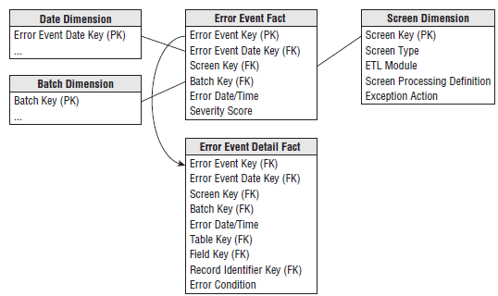
Data Quality & Provenance & Data Warehouse
We should provide user access to metadata in form of a dimensional table (Audit dimension) as a part of the data warehouse solution.
Grain is an error thrown (produced) by a quality screen in the transformation.
Error event schema:
Notes:
It is crucial to communicate data issues to the user!
The additional dimension (Audit Dimension) can store quality rating, complete flag, validation flag, out of bounds flag, record modified flag, ...
Error event schema:
Remember the grain of a fact table is the physical description of why a fact table row exists.
The screen dimension is basically the source (test) of the error.
There is also extended fact table. Here we represent an individual field of the record that caused the error. The are connected using the "Error Event Key".
Resources:
The Data Warehouse Toolkit chapter 19

