Slide 1
Data Modelling
NDBI046 - Introduction to Data Engineering
2024/2025
Petr Škoda
https://github.com/skodapetr
https://www.ksi.mff.cuni.cz

Slide 2
Data Modeling
Normalized Modeling, Bill Inmon
...
Denormalized Modeling, Ralph Kimball
...
Consider
Notes:
Bill Inmon is normalized collection of tables. Mostly reflecting the sources, just integrating data together. From the Data Warehouse data are loaded into Data Marts where they are consumed by analytics. Here just for a reference to know the is more then one approach. There are other approaches ... se the source literature.

Slide 3
Kimball Dimensional Modeling Techniques
Kimball group defines for modeling data in a dimensional way. The outline is:
Gather Business Requirements and Data Realities (Analysis) Collect business objectives, key performance indicators (KPI), decision making processes, supporting analytical needs, and data realities.
Dimensional Modelling Should lead by the data modeler in collaboration with the subject matter experts and data governance representatives.
Dimensional Design Process (Design) There are four steps:
Select the business process
Declare the grain
Identify the dimensions
Identify the facts
Notes:
This lecture is based on "The Data Warehouse Toolkit 3rd Edition, 2013" book.
) It is not only about the business, but we also need to know the data landscape of the company. What data are available, where, what is the meaning of the data. This is the hardest part.
) One more place to align with the business. This is also why we stay close to the business vocabulary, so we can communicate. It is a learning experience like software development.
) We are searching for schema that would answer the needs. We also involve multiple parties to buy them in the project.
)) Do not establish departmentally bound dimensional models. By focusing on business processes, rather than on business departments, we can deliver consistent information more economically throughout the organization.
))
)) “How do businesspeople describe the data that results from the business process?” Expect under 15-dimension tables, when over 25 we need to merge some dimensions together.
Warning we do not cover all that is in the book!

Slide 4
Dimensional Design Process, Star Schema
Fact tables focus on the results of a single business process. How can we create a fact table? We start by defining grain, dimensions and facts.
Business Intelligence
The grain establishes exactly what a single fact table row represents. The grain is the first step, every fact or dimension must be considered in relation to the grain.
Atomic grain refers to the lowest level at which data is captures by a given business process.
Dimension table
Dimension table
Fact table
Dimension table
Dimension table
Notes:
) We have a business process, and we want to know something about it. This is the role for business intelligence. BI tools utilize multidimensional data -- Online-Analytical Processing (OLAP) cubes. We can get them from a database schema with facts and dimensions. We seen this with the pivot table.
Dimensions provides answer to "who, what, where, when, why and how", they are the context. BI use them for filtering. There should be a simple association (number) between fact table row and a dimension.
Facts are measurements (observation of events, business measure) that result from the business process. The fact table is the main source, It contains foreign keys to dimensions. Facts are mostly numerical. As a results they are fully additive (ready for aggregation). Semi-additive can be added across some dimensions, built balance amounts can not be added across time. Non-additive, such as ratios are better to be avoided, we can try to store their additive components instead.
There are various other facts like Transaction (measurement event in time), Periodic snapshot (summary of measurements in given time frame), Accumulating, etc ..
Factless fact table may have no measure, just a row in the table, e.g. student attendance in a class.
Consolidated fact tables can be built by combining multiple fact tables, like connecting sales and sales predictions.
What we get is called a star schema, wit the fact table in the middle.
) But where to start? We start with the grain. What is a grain ..
) It is like a seed from which all grows, at which all depends. Atomic grains are easier to identify so they can be a good start. We can have more then one grain. Each grain can have at most one fact table.
Resources:
https://trueleafmarket.com/pages/gardening-memes

Slide 5
Demo
Retail Sales

Slide 6
Extensions to a Dimensional Model
The dimensional model should be resilient to change. We can deal with different changes without a need to change a single SQL BI query.
New facts can be added by creating new columns.
We can add new dimension tables.
We can add attributes to dimension tables by adding columns.
We can increase the level of detail (make grain mode atomic) by introducing new columns.
Just keep it true to the grain!
Notes:
This is about investment protection.
We also do not want to break existing BI, or in fact any other downstream tools.

Slide 7
Demo
Inventory
Notes:
This is another process.
We saw that the retail sales is just one fact table, it does not span the entire business.
So how to we add more?

Slide 8
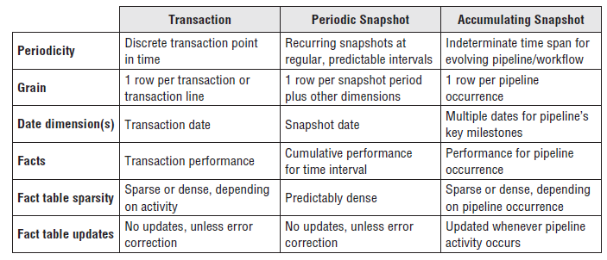
Working with Facts
Additive, non-additive and derived facts
Centipede fact table
No Null in a fact table
Surrogate, natural and durable keys
Value Chain Integration
Fact table types:
Transaction
Periodic Snapshot
Accumulating Snapshot

Slide 9
Working with Dimensions
Casual dimension
Degenerate dimension
Value Chain Integration
Data Governance and Stewardship
Conformed dimensions / master dimensions
Drill across
Dimensional Hierarchies
Fixed Depth Positional Hierarchies E.g. product < brand < category
Variable Depth Hierarchies / Slightly Ragged Convert to previous by declaring the maximum depth.
Variable Depth Hierarchies / Ragged Recursive dependencies.
Notes:
)
)
) Dimensional Hierarchies
)) Fixed Depth
Hierarchy levels should appear as separate positional attributes in a dimension table.
This provides predictable performance.
When the hierarchy is not a series of many-to-one relationships or the number of levels varies such that the levels do not have agreed upon names, a ragged hierarchy technique, described
below, must be used.
)) Variable Depth
E.g. geography with 3 - 6 levels.
)) Variable Depth Hierarchies
We can solve using a bridge table. The table contains row for every possible path in the hierarchy. We can also use pathstring attributes instead of a table. This is not as robust as the bridge table.

Slide 10
Dimensional Modeling
Snowflake Model
Galaxy Model
Week
Month
Customer Dimension
Time Dimension
Customer Dimension
Time Dimension
Location Dimension
Sales Facts
Sales Facts
Shipping Facts
Seller Dimension
Product Dimension
Seller Dimension
Product Dimension
Shipper Dimension
Outlet
Region
Type
Notes:
The snowflake model (called snowflaking, is result of dimensional model normalization) is result of decomposing dimensions into hierarchies. As a result of decomposition dimension table can be normalized, yet the saved space may not balance the time required by additional join operations. It also defeats the use of bitmap index. It may be a little complex for the businesspeople (it is not visible when used to build the data-cube). We may also need to consider the requirements of BI tool at hand.
Sophisticated applications may require multiple facts table, those may share dimension tables. This is basically a collection of stars, i.e., galaxy.

Slide 11
Demo
Slowly Changing Dimension

Slide 12
Slowly Changing Dimension (SCD)
How can we accommodate changes in the dimension attributes?
Type 0: Retain original We never change; we are not up to date.
Type 1: Overwrite The attribute always reflects the most recent assignment. We are losing history.
Type 2: Add new row Add a new row in to the dimension table. We need to update the primary key.
Type 3: Add new attribute / alternate reality Used infrequently, user can select which reality they want to use for grouping.
Type 4: Add mini-dimension / rapidly changing monster dimension Move rapidly changing attributes to a separate mini-dimension.
...
Notes:
) We can easily imagine that dimensions will change at different paste, and we need to handle the change, best without or user noticing and consuming too many resources.
This is not a complete list but should be fine to get the idea.
Add mini-dimension: we can also use this when there are too many rows in the dimensional table (millions).

Slide 13
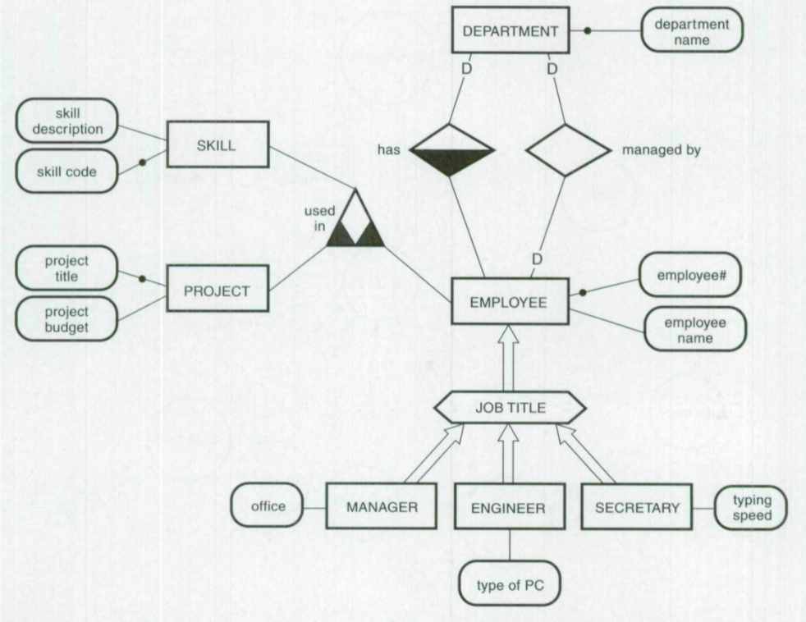
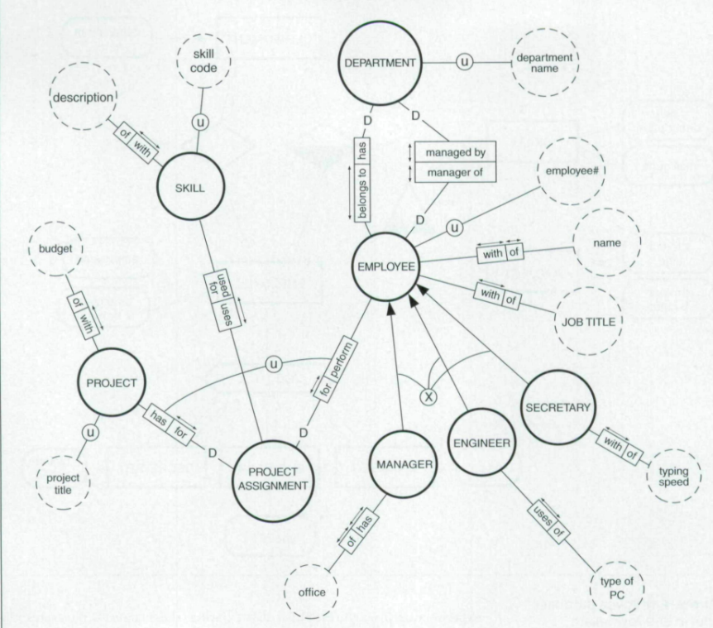
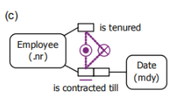
Semantic Data Models
Developed in late 1970 and early 1980
Created by application of data abstraction concepts
“Leitheiser found that a semantic model (LDS) was easier to learn and resulted In higher understanding and recall) of a database schema than a tabular representation”
Consider
Notes:
Semantic data models were developed to provide a precise and unambiguous representation of organizational information requirements.
Images: Extended Entity Relationship model, Nijssen information analysis methodology, exclusive OR constrain in ORM
NORMA’s verbalization language is an output language, designed for validation by business users.
Resources:
Leitheiser, R. An examination of the effects of alternative schema descriptions on the understanding of database structure and the size of a query language. Ph.D. dissertation, Univ. of Minnesota, Minneapolis, 1988
https://doi.org/10.1145/203241.203265 The article compare two semantic models the extended entity relationship (EER), the EER model is a more powerful version of the original entity-relationship (ER) model. The Nijsseii information analysis methodology (NIAM) model (an OR model). Given a small amount of training, users were able to read and validate application data models of nontrivial size and complexity. This is important to make sure that the information systems are right.
https://doi.org/10.4018/jismd.2010092302 Object-Role Modeling (ORM) is a conceptual approach for modeling, querying, and transforming information. Unlike ER modeling and UML class diagrams, fact-oriented models are attribute-free, treating all facts as relationships (unary, binary, ternary etc.). One reason is to ensure that models may be easily verbalized and populated using natural sentences.

