Slide 1
Data Warehouse
NDBI046 - Introduction to Data Engineering
2024/2025
Petr Škoda
https://github.com/skodapetr
https://www.ksi.mff.cuni.cz

Slide 2
Why Data Warehouse ?
"The primary driver for data warehousing is to support operational functions, compliance requirements, and Business Intelligence (BI) activities."
-- DAMA DMBOK
Notes:
Don’t build a data warehouse unless you can directly relate the project to a specific set of business needs. It is not a toy project.
In 1970s IT professionals realized that you first had to determine the business requirements you were trying to satisfy and then take a number of steps to specify and design the programs you plan to develop. Then, after gaining a good understanding of these details, you could make an informed decision about your hardware and development software. Business may be eager to jump the gun by selecting vendor first. We need to prevent this, same as prevent ever changing requirements and priorities.
We should also consider protection of investment, in other words should a company spend millions implementing Data Warehouse, it should get as much value as possible for longest time possible. 5, 10, 15, 20 years? Think about changes in technology. Rewriting and updating (React 16 to React 18) without change for business is a hard sell.
If you build a data warehouse without clearly understanding what types of business intelligence your organization needs, you’re almost certain to build and put into use something that doesn’t even come close to providing the business value you’re seeking, regardless of how error-free your data, how sophisticated your user tools, and how wonderful your environment’s performance.

Slide 3
Data access
Query driven
Wrappers / Integrators / Mediators / ..
Metadata dictionary
Distributed query
Update driven
Integration into a single data storage
Cloud / Streaming / …
Public
Sales
Customer
Marketing
Sales
Business Intelligence
Social
Accounting
Notes:
Imagine we have different data sources; we need to see data from multiple of them. We need consistent data for Business Intelligence. We may even integrate data from various sources like social and customer data source (it may not be a database).
For query driven metadata dictionary is used to locate local data sources, query is executed in distributed / federated fashion. Partial answers are used to build global answer set. This process is error prone (distributed system), inefficient (sorting, filtering) and require maintenance of all data sources.
Update driven solution can be updated once a week, every day. There are also solution based on streaming where data are updated in real time. We have better control over the process. This is where Data Warehouse is.
Data integration are hard, some estimates are $9.3 billion in 2003, expected over $13.5 billion in 2008.

Slide 4
Data Analyst
Scope
Structured data
Static data
Small data
Objective
Answer specific questions
Support business decisions
Output
Data visualization
Story telling
Skill
SQL
Programming : Julia / R / SAS / Python / …
Excel
Data visualization tools
Communication skills
Intermediate statistics
Notes:
Mostly bachelor degree.

Slide 5
Data Scientist
Scope
Un/Semi/Structured data
Dynamic data
Big data
Objective
Define new business opportunities
Output
Data visualization
Story telling
Skill
SQL, NoSQL
Programming : Julia / R / SAS / Python / …
Data visualization tools
Communication skills
Advanced statistics
Notes:
Mostly masters or Ph.D. degree.

Slide 6
This is Data Engineering …
Data Warehouse
Business Intelligence
Public
Sales
Customer
Data Lake
Custom Pipelines
Data Analyst / Scientist
Marketing
Sales
Use-Case specific
Big Data
Social
Accounting
Notes:
Data Engineering is about building system to collect, process and deliver data.
1) Imagine we have different data sources; we need to see data from multiple of them. Same as in the previous slide.
2) We have data, and we have different use-cases. Each require different approach. Business Intelligence require report and OLAP.
3) Data Analyst may need access to SQL database. Data Scientist may need raw data or custom data flows to deliver required data. Data Cube can be output for data scientist.
4) When it comes to big data, either for processing or for feeding machine learning model you probably resort to a specialized solution outside other workflows. It will probably involve streaming and distributed processing. (NDBI040 : Modern Database Systems, NDBI048 : Data Science, Apache Spark )

Slide 7
Data Engineers
Scope
Objective
Build data transformation pipelines
Deploy data transformation pipelines
Skill
SQL, NoSQL, Database Management
Programming : ...
Infrastructure
Data visualization tools
Data modeling
Data governance
Communication skills
Googling
Searching something on internet using google or any other search providers.
Notes:
Support role, not core for the business. Implement based on business requirement.
Data transformation pipelines are often called workflows.
Strong focus on tools and even entire eco-systems.

Slide 8
Data Warehouse
Place for Your Data Assets
Notes:
- Data: Facts and information about something
Warehouse: A location or facility for storing goods and merchandise
This is where we store Monitor-the-business data.
Previously we have: Run-the business, Integrate-the-business, and Monitor-the-business data.

Slide 9
History
1872–1942 The continuous marketing research conducted by Charles Coolidge Parlin
1923 Arthur C. Nielsen, Sr., established ACNielsen
1970s From mainframe, data files, and database to minicomputer
Database management system for parallel processing with multiple microprocessors
1980s Personal Computers, problem islands of data
Distributed database management system (distributed DBMS)
1983 Teradata deploy first relational database management system (relational DBMS)
1986 Ralph Kimball founded Red Brick Systems
Required high-quality data
Notes:
Let us start with a little bit of history, as the ideas we are talking about are not new.
The first customer research to better target advertisement in a magazine. Parlin is the father of Marking Research.
Help to access competitive impact of marketing, giving practical meaning to the concept of market share.
At best, in order to see data, you must write request to data-processing department. To put another request to queue.
Minicomputers were getting traction. We can identify core data (sales) and load them from data-processing department to minicomputers.
Data were shared using tapes. They copy data to the tape at weekend, this save request to the "data-processing department".
Timeline: 1970 RAM with 1024 bits, 1971 first home computer, 1973 TCP/CP protocol
This did not scale well, yet later people start to work on databases.
1980s Now we have data on multiple places (computers), rendering them inaccessible.
We could just connect to all computers and get all the data we need. Although cool idea, it did not work at that time. (query-driven approach)
1983 software and hardware solution
1986 they used indices (Principles of Data Organization) to provide fast access to data, a pure software answer to Teradata solution. The key technology was to use an index !!!

Slide 10
History
1988 Barry Devlin and Paul Murphy of IBM coined term Business Data Warehouse
“ease access to the data and to achieve a coherent framework for such access, it is vital that all the data reside in a single logical repository”
1990s Back to 1970s copy data to one place
1993, 1996 Bill Inmon : Building the Data Warehouse (Wiley)
“A data warehouse is a subject-oriented, integrated, time-variant, and nonvolatile collection of data in support of management’s decision-making process”
Kimball defines a warehouse as “a copy of transaction data specifically structured for query and analysis.”
2000s Consolidation of vendor community
…
Notes:
1988 based on relational DBMS
Since distributed approach in 80s did not work, we go back to 70s
1993 father of Data Warehouse
Kimball's approach calls for a dimensional model. These are two approaches.
2000s big companies buy small ones
Yet despite the development the core questions are the same, what data are we interested in.
Bill Inmon:
Subject-oriented: A data warehouse is organized around major subjects, such as customer, supplier, product, and sales. Rather than concentrating on the day-to-day operations and transaction processing of an organization, a data warehouse focuses on the modeling and analysis of data for decision makers. Hence, data warehouses typically provide a simple and concise view around particular subject issues by excluding data that are not useful in the decision support process.
Integrated: A data warehouse is usually constructed by integrating multiple heterogeneous sources, such as relational databases, flat files, and on-line transaction records. Data cleaning and data integration techniques are applied to ensure consistency in naming conventions, encoding structures, attribute measures, and so on.
Time-variant: Data are stored to provide information from a historical perspective (e.g., the past 5–10 years). Every key structure in the data warehouse contains, either implicitly or explicitly, an element of time.
Nonvolatile: A data warehouse is always a physically separate store of data transformed from the application data found in the operational environment. Due to this separation, a data warehouse does not require transaction processing, recovery, and concurrency control mechanisms. It usually requires only two operations in data accessing: initial loading of data and access of data.

Slide 11
Requirements
What is and what we need to implement data warehouse:
Easily accessible organization’s information.
Consistent and credible presentation of information.
Data warehouse must be adaptive and resilient to change.
Security and controlled access.
Foundation for improved decision making.
Collaboration with business community.
Notes:
The data must be intuitive and obvious. Understandability implies legibility. The tools that access the data warehouse must be simple and easy to use.
Relevant user can just ask the questions they need.
Clean, integrated, .. data. If two measures don’t mean the same thing, then they should be labeled differently.
We can not avoid change; we need to design for inevitable change. New requirement should not break existing stuff.
.
There is only one true output from a data warehouse: the decisions that are made after the data warehouse has presented its evidence.
Unlike an operational system rewrite, where business users have no choice but to use the new system, data warehouse usage is sometimes optional
Resource:
The Data Warehouse Toolkit Second Edition, Chapter 1, Goals of a Data Warehouse

Slide 12
Data Warehouse
Data Warehouse not Data Dump
Data Warehouse is not another database (OLTP, OLAP, …)
Data Source
Staging Area
Data Warehouse
Data Source
Extract
Load
Transform
Notes:
0) Data sources should be identified as part of the analysis in design step. Keep in mind we need to drive this by business, no technology or size. Aggregating as much data as possible is not our goal! It is Data Warehouse not Data Dump.
1) Staging Area is the working data area. There can be more then one in hierarchical fashion.
2) Data Warehouse is sort of a database; it can be even relational one.
3) The process of getting data from source to Data Warehouse is called Extract-Transform-Load and stands in the heart of the Data Warehouse. This is what you may develop and deploy as data engineer.
4) The sole purpose of Data Warehouse is to support decisions. In order to do this, we need to hook up with the business. During their training we should not only show how to access the data but also add real use-cases to demonstrate the potential.
We can split all components to two categories: to the database (here Data Warehouse), and all the support software. The second group may also contain databases with historical data. The database can be partitioned or replicated to multiple places, databases. In broadest context, a data warehouse includes any data stores or extracts used to support the delivery of data for BI purposes. I explain some of the terms here later, like data marts.
Minimal implementation with custom code:
Scripts for data extraction / scraping
Employ FTP to transfer the data to single place (staging area)
Optional transformation
Use SQL statements to load the data into relational database.
With grooving amount of data, historical data, the database may not be able to serve the users.

Slide 13
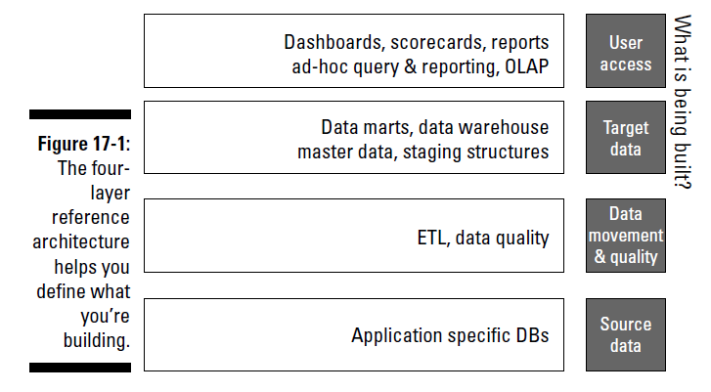
Architecture
Enterprise Data Warehouse
Optional
Notes:
Different viewport from the Data Warehouse for Dummies.
“The software architecture of a system is a set of structures needed to reason about the system, which comprise software elements, relations among them, and properties of both.” NSWI130, Bass, Clemens, Kazman, “Software Architecture in Practice, 3rd Edition”
Tiers:
The Source Data are external, so we start with Data Movement and Quality.
The Target Data layer is sometimes called Bottom Tier. This is where we have data, servers. There is non-functional level like administration, and monitoring.
Sometimes there is another level called Middle Tier above with OLAP servers. They provide the OLAP functionality to the upper layer.
At the top there is Top Tier.
An Enterprise Data Warehouse (EDW) is a centralized data warehouse designed to service the BI needs of the entire organization. An EDW adheres to an enterprise data model to ensure consistency of decision support activities across the enterprise. This is risky, top-down created enterprise data models are almost an anti-pattern.

Slide 14
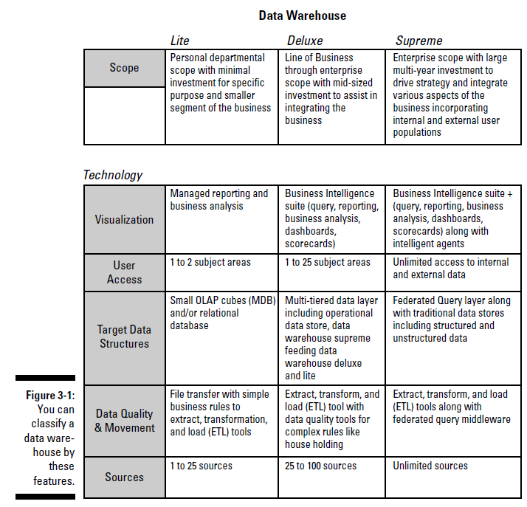
Data Warehousing Classification
Lite
Get the job done with minimum resources.
Deluxe, The Data Warehouse
Accommodate for broader scope.
Prepare for the challenge!
Supreme, Distributed
Basically, a distributed environment.
Notes:
This is based on the book, yet it may help you to better understand the concept and see different options. Each Data Warehouse is different. The ultimate measure is the added value for business. Simple, reliable and cheap implementation is better then long running unfinished project.
Sections: 1) Subject areas and data content, 2) Data sources, 3) Business intelligence tools, 4) Database, 5) Data Processing, 6) Architecture.
Data Warehouse Lite
A data warehouse lite is a no-frills (re-use existing tools), bare-bones, low-tech approach to providing data that can help with some of your business decision-making. Often can be seen as a data mart.
1) Scope limited to 1-2 subject areas.
2) We can just restructuralize (de-normalize) data from a single data source.
3) Focus at "Tell me what happened".
4) It is sufficient to employ relational database with proper schema.
5) Can be just SQL dump, load to staging, insert with sub-selects to target, at the end check quality.
6) Simple architecture: database, backend, frontend.
Data Warehouse Deluxe
1) Based on use-cases, broad range of subject areas. It follow natural way of thinking.
2) Need to address different encoding for similar information (identifiers, codelists, representations), data integrity issues, different platforms (software).
3) From simple reporting, business analysis, dashboards, data mining, statistical analysis.
4) Size in terabytes, with historical data.
5) Prepare for the challenge! Various data sources, size in terabytes. Inconsistent state during updates, batch windows.
6) There can be transformation sites close to sources, data can be published to Data Marts.
Data Warehouse Distributed
1) Unlimited, access to resources on the internet/intranet. Consume unstructured data, video, audio.
2) We need to deal with management or external sources.
3) Focus on data mining. Intelligent assistant (AI).
4) Distributed, with metadata catalog user does not need to know where data are.
5) Similar to delux version, we may work directly with data from operational databases.
6) Business and technology specific.

Slide 15
Data Mart
Data Warehouse lite
Limited scope (subject specific, …)
Can be sourced by Data Warehouse
Top-down implementation
Fast implementation (90 - 120 days)
Lower cost, lower risk
Bottom-up implementation
Vision of distributed Data Warehouse
Notes:
STORY: Buy here we have less stuff, searching for a customer. Data Warehousing For Dummies Chapter 4, idea of the data mart.
As revolutionary assets can have higher prices, vendors often market Data Mart as revolutionary, yet it is mostly scale down data warehouse - the data warehouse lite.
It is just your friendly local data source.
Sometimes data warehouse consists of subject-specific databases called data marts.
Sometimes data marts act as sources for data warehouses.
-- There is no clear definition.
Scope can be:
Geography-bounded
Organization-bounded, like department.
Function-bounded data cross organization boundaries. For example, sales and marketing data from different locations and thus organizations.
Answers to specific business questions, mostly to automate answering to "How are we doing?” questions.
… any custom criteria. Just be careful about scope creep.
Can be sourced by Data Warehouse. In this case data marts is a retail outlet sourced by data warehouse.
Data Warehouse distribute data to Data Marts (retails)
Data Mart can order data from Data warehouse
Data Mart can add additional information
We talk about implementation later, just now as we have data mart as a piece of data warehouse, we can start thinking.
Top-down implementation
There is no Data Warehouse, just Data Marts
2024 Average data engineer salary by indeed.com in US is 9K USD per month, so 36K per person, for a 4-person team (pizza size team), we get to 140K USD ~ 3.2 M CZK.
Bottom-up
Difficult to implement
Better used as part of mixed approach

Slide 16
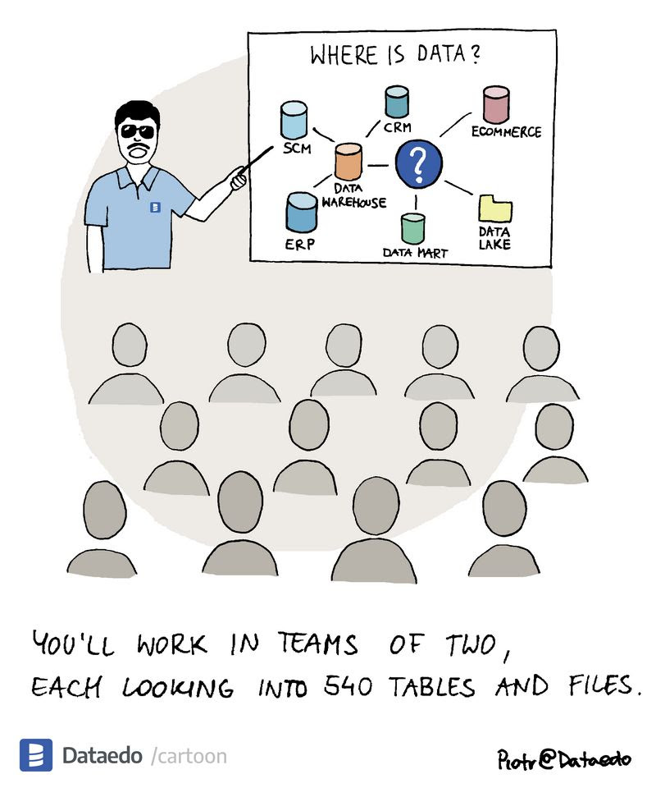
DEMO
SIS
Notes:
Show list of tables and column from SIS: AUCHA(398), PARAMS (487).
> Data Warehousing for Dummies:
Under the guiding principles of the good data warehousing seal of approval, you want to bring into your warehouse only the data that’s part of your business intelligence picture.
Source:
Data Talk, 2023-09-16

Slide 17
Data Warehousing
How to Data Warehouse?
Notes:
Data warehousing is therefore the process of creating an architected information management solution to enable analytical and informational processing despite platform, application, organizational, and other barriers.
The key concept in this definition is that a data warehouse breaks down the barriers created by non-enterprise, process-focused applications and consolidates information into a single view for users to access.

Slide 18

How to build a ....
Requirements
Design
Development and testing
Deployment
Notes:
Little bit of methodology to building a project .. any project in fact. You can apply knowledge from Software Engineering here.
Capture business needs. Identify scope. All stakeholders must agree why and what should be build.
Identify questions and answers business needs.
Define key business objects, not vendor products!
User-data interaction, facts, dimensions.
Create prototype for example using Balanced Insight Consensus.
Decide technical details.
Identify all candidate data sources.
Extract data samples.
Create database prototype, collect feedback on views.
Create database, start moving data, starting with BI.
Design database.
Analyze data sources, talk with data owners.
Use existing or develop custom solutions.
Conduct end-to-end performance testing.
Deployment
Monitoring
Purge and Archive strategy
This may not be a waterfall; we can employ agile methods as well. We may deliver fast (days, weeks) and work with stake holders. Yet we must not create Field of Dreams project, keep the scope and the boundaries.
While for data engineers Data Warehouse is significant project, it may not be seen as such by others. Some users already use the data in you source applications. Other have existing workflows. The resistance is large for bigger companies; It starts to be problem for 500+ people. And yes, there are executives (COE, COO, CFO, …) for each division.
Resources:
Image DALL·E 2024-03-04

Slide 19
Building
Top-down
Enterprise Data Warehouse Model
Bottom-up
Integration of smaller projects.
Components may not fit together.
Mixed-mode
Guiding principles
Focus on business goals
Define scope and process
Data integration
Build metadata
Collaborate with other data initiatives
Data Governance, Data Quality, …
Security
Maintenance
Notes:
Top-Down
Some people were though this is the best way to deal with large projects.
While conceptually it makes sense, it is difficult to carry out.
The model is hard to design and maintain.
We need precise and complete definition of requirements here.
Once we commence building, nothing can be changed.
Bottom-Up
Business questions motivating Business Intelligence:
How many profitable customers do we have?
Which profitable products are being cannibalized by new products?
What market scenarios pose the greatest risk to our success?
From whom do you receive information you need? (process)
Which questions, answers, and decisions do you need to manage, and which are optional and therefore nothing needs to be done about them? (value of information)
Mixed
Start with project scope
Initiate warehouse architecture phase.
Overall architecture, data sources; Objective is to get the overall picture.
Create develop plan for infrastructure and functionality.
Decompose into serries of projects.
We also need the right people with the right skills. A C# coder may not be able to handle data warehouse or BI tools. The team may include project manager, technical leader, data architect, business analyst, data modeler, administrator, data engineer (middleware specialist), front-end developer/specialists, quality assurance specialist, source data analyst, user-community interaction manager, …
- - - - - - - - - - - - - - - - - -
We already know this, yet it is important: sponsorship, goals and scope, resources, readiness, vision alignment.
We need to know what we are building, why, when it should be delivered (release roadmap).
The transformation is in fact data integration job. A solid taxonomy is necessary to map data elements in different systems to a consistent structure in the data warehouse.
Data may need to be masked or obfuscated to prevent access by unauthorized personnel. Access is not straight forward with OLAP or Data Analysists.
Maintenance: Release management, development lifecycle, sandbox for experiments, monitoring, optimization.
There is need to monitor BI usage, feedback.
Also keep in mind that Data warehouse exists in the IT business eco-system.

Slide 20
Data Warehousing
"Data warehousing involves facilitating change in business processes."
Process:
Coordinated, architected, and periodic maintenance the data in a data warehouse
Operational extract, cleansing, transformation, control, and load processes
Enforce business rules and maintain appropriate business data relationships
Interaction with Metadata repositories
Notes:
The benefits of data warehouse are not as tangible as new software. It is not only about managers, but we also need collaboration for all users. Otherwise, they may just ignore the data warehouse.
There is also not one-fit-all-solution.
STORY: Managers using and not using the data warehouse searching for cause. They may even go through training before.
Alternative to hawing Data Warehouse is to ask people to respond with the information, wait, check, re-request, compile, check for errors, ...
The idea is to implement data warehouse, in other words to enable analytical and information processing despite platform, application, organizational and other barriers.
We can load data from internal as well as external data source. With external data source, we should not be afraid to transform them. Do not force your business into external formats.

Slide 21
Governance
Govern the business-operated discovery or refinement area, it increase business acceptance.
Conceptual Data Model
Data Quality feedback
End-to-end metadata
Data lineage
Service level agreements
Reporting Strategy
Notes:
For example, how we handle requests, SIS has many ad-hoc functionality added on somebody's request. Ultimately this can harm the project.
We need to be partner for business:
Conceptual Data Model : What information is core to the organization? What are the key business concepts and how are they related to each other?
Data quality feedback loop: How are data issues identified and remediated?
Metadata, what does this report mean how was it created?
Lineage, where is the data source? If there is a problem in the report is there a problem in the source data, where?
Response time, data retention, and availability requirements.
Feedback again are the reports used or just printed?
We may get back to governance later.

Slide 22
Implementation details
Data Warehouse
Online Analytical Processing
…

Slide 23
Database
Relational database
1970 E.F.Codd, A Relational Model of Data for Large Shared Data Banks
1970s, 1980s Query Optimizer
Online Transactional Processing
Normalization (3.NF)
Online Analytical Processing
Multi-dimensional analytic queries
XML for Analysis (XMLA)
Relational Online Analytical Processing
Start schema
Multi-dimensional Online Analytical Processing
Multidimensional database
Hybrid Online Analytical Processing
Data partitioning
Desktop Online Analytical Processing
Client-side storage
Online Analytical Mining
Notes:
Relational database management systems (RDBMS) have their roots in relational data model developed by E.F.Codd then with IBM in 1970. Database is using secondary memory. We do not have data in memory like in (NTIN060 Algorithms and Data Structures 1) but in secondary memory (NDBI007 Principles of Data Organization). Yet it is not only about indices, sometimes it is better to scan the whole table. Query optimizer may employ statistics for example. For the whole-time database vendors optimize for Online Transactional Processing, a lot of small queries (1-3 tables). At the end most of the corporate became convinced that you could use (RDBMS).
OLAP is the exact opposite, we read from many tables, join a lot of data and need flexibility. XMLA is an attempt to standardize communicating with OLAP databases or applications, for example MS Power BI.
- - - - - - - - - - - - - - - - - -
For HOLAP we employ combination of ROLAP and MOLAP. Implementations vary on the control a designer has to vary the mix of partitioning.
For DOLAP data are stored at the client computer. Mostly laptops without internet connection.
Think about SAP and their thin client.
Resources:
https://dl.acm.org/doi/abs/10.1145/362384.362685
https://learn.microsoft.com/en-us/analysis-services/xmla/xml-for-analysis-xmla-reference
https://powerbi.microsoft.com/en-us/blog/power-bi-open-platform-connectivity-with-xmla-endpoints-public-preview/
- - - - - - - - - - - - - - - - - -
That is not all we have other ways how to approach data in data warehouse. OLAM, also called OLAP mining, is integration of OLAP and data/knowledge mining in multidimensional databases. It leverage high quality data in data warehouse and potentially the infrastructure as well. Here only as a hint that there is no complete list, and you need to be guided by the business requirements.

Slide 24
Enterprise Information Integration
Consider
Notes:
Virtual or federated data access can be another service. Around 1995 vendors start marketing their services virtual data warehousing tools. But just because you can get to data at its source (in almost any database or file structure) doesn’t mean that data provides the necessary business intelligence when it’s in your hands. To solve these data quality issues, many data architects have begun to perform bottom-up data mart construction to develop a component-based data warehouse. Instead of having a single database a multiple databases are employed. Additional components can handle particular functionality. Together, these data marts (or components) comprise a data warehousing environment.
This component-based, dynamic access data architecture is the basis for virtual data warehousing and, more specifically, what Enterprise Information Integration (EII) servers are offering to the market.
Enterprise Information Integration (EII) creates a data warehousing environment in which users can access each component’s contents from a business intelligence tool like they were all stored together, even though they’re not. I highly recommended that you don’t build a virtual data warehousing environment to access source data directly, in its native format. The objective is not to integrate various databases. Each application should therefore be warehouse-enabled and contain a data publisher that’s responsible for all the middleware services (such as extraction and quality assurance), as specified in the environment’s business rules.
When you think of virtual data warehousing, replace the question “Can I get to the data?” with the question “Can I get to usable data?”. We also need to keep data architecture in mind.
Additional EII services
* A unified metadata service: Users see a single logical view of the environment’s contents without having to know the location and particulars of each component.
* A directory service: Individual components within the environment, even if they’re relocated or otherwise modified.
* Security services: These services handle permissions, authentication, and other security needs in a distributed environment.
* Synthesis services: A virtual data warehouse might have to combine facts from one component with facts from another.
* Transaction-management services: In addition to the synthesis service, which is a type of transaction-management function, these services provide routing, load balancing, conflict resolution, and other functions necessary to ensure data integrity. We need those even in read-only situation.
Until an organization’s communications infrastructure can pump the data through, EII services and concepts (such as virtual data warehousing) probably will remain on the fringes, just out of reach.

