Slide 1
Towards
Data Warehouse
NDBI046 - Introduction to Data Engineering
2024/2025
Petr Škoda
https://github.com/skodapetr
https://www.ksi.mff.cuni.cz
Notes:
Resources:
Data Warehousing For Dummies
ISBN: 978-0-470-40747-9

Slide 2
Outline
Prerequisites
Business process
Data engineering and data engineer
Outcomes
Data-Information-Knowledge-Wisdom pyramid
On-line Transaction Processing (OLTP) systems
Business Intelligence
On-Line Analytical Processing (OLAP)
Multidimensional data
Data cube, operations, representation

Slide 3
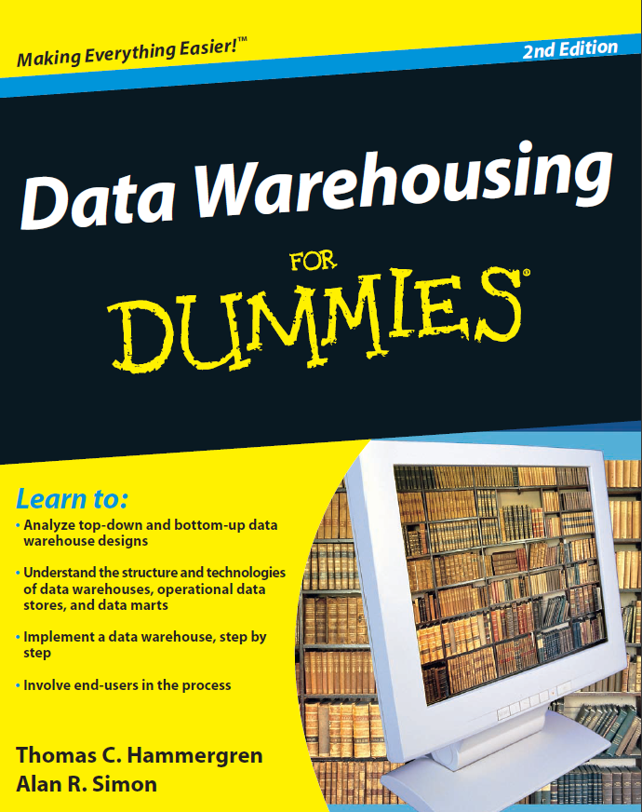
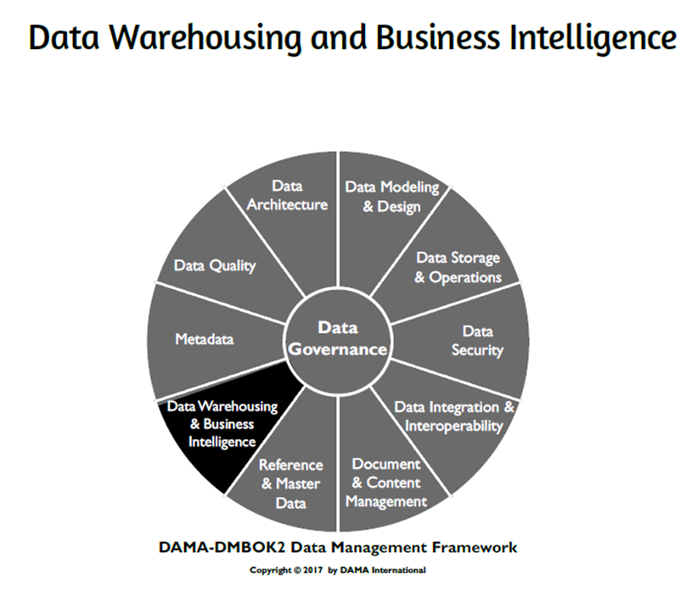
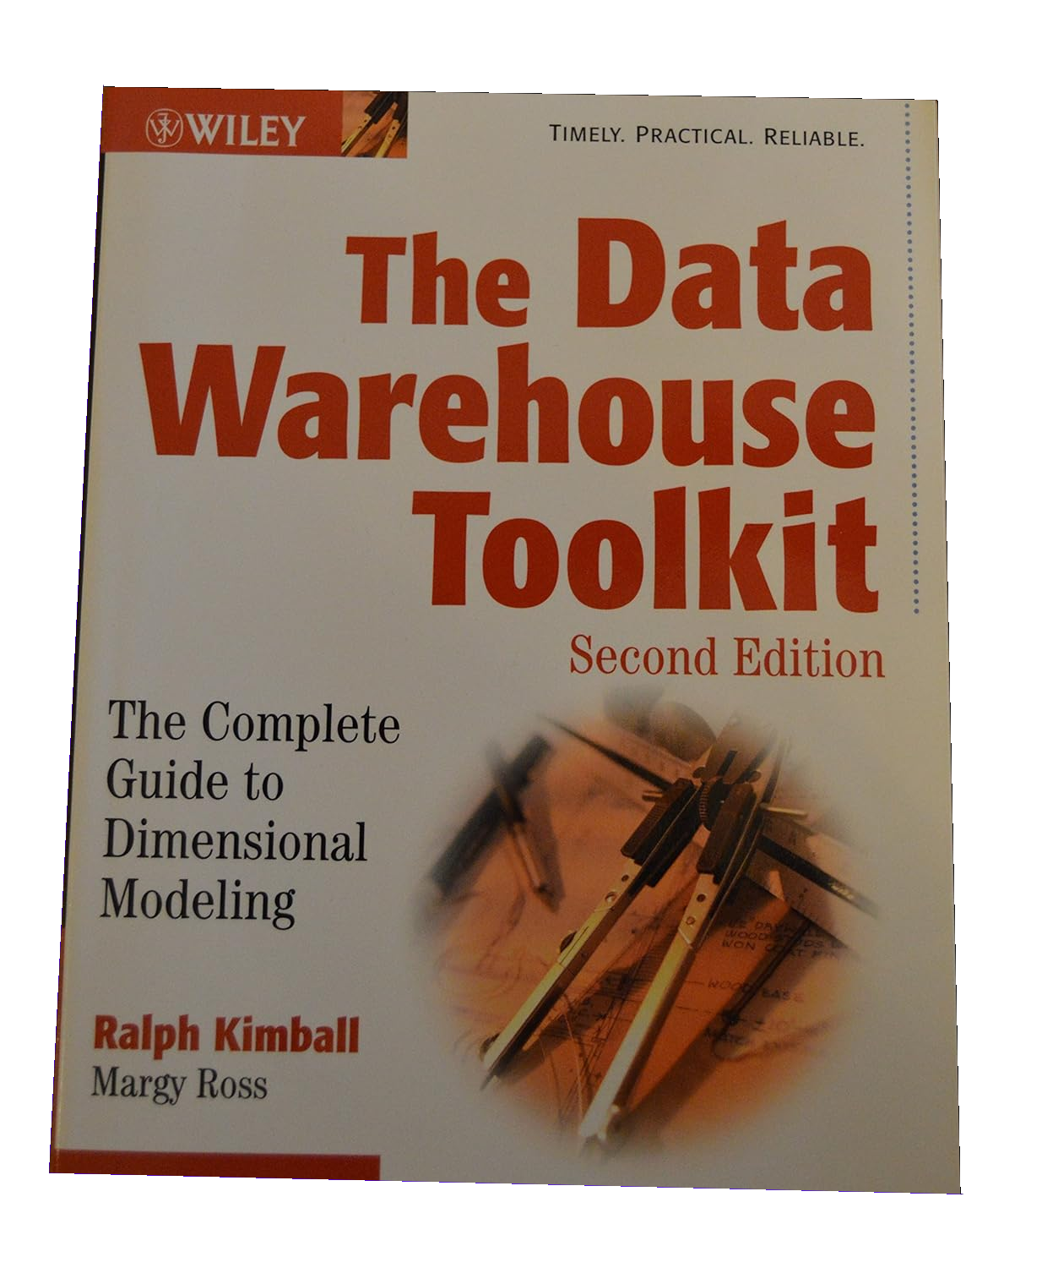
Resources
Notes:
There are number of resources you can follow to expand this topic.
DMBOK can provide more of an overview in fixed framework.
The other title is more practical but can be too low-level.
Resources:
Data Warehousing For Dummies
ISBN: 978-0-470-40747-9

Slide 4
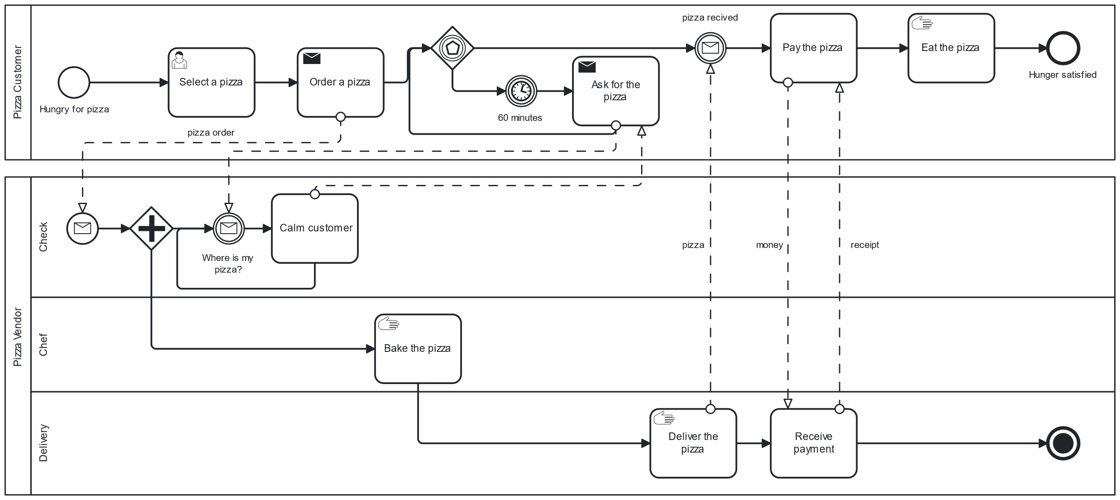

Business - Where is data?
Business Process Model and Notation (BPMN)
Notes:
ACTIVITY: Imagine we want to support the pizza business how can we do it? Focus on services as well as data. Are technologies relevant?
Example: When the company buy something, we need to put that into an inventory as well as into the financial system.
Resources:
https://www.bpmn.org/
https://demo.bpmn.io/

Slide 5
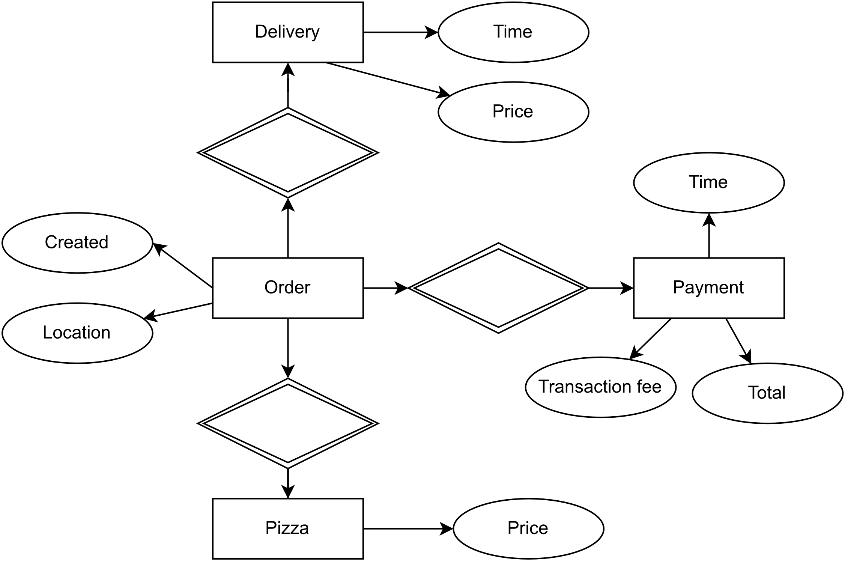
Operational Database Systems
On-line Transaction Processing (OLTP) systems
Support day-to-day operation
Thousands of users, small read / write operations
Transaction oriented
High performance
High availability
Normalized schema
Notes:
The goal of normalized schemas is to avoid storage of duplicate data so that stored data can't become inconsistent.
The ER model is not complete it is here just for illustration.

Slide 6
DIKW
There are different definitions of the pyramid:
NDBI025
…
Wisdom
Knowledge
Information
Data
Data are not good enough for management.
E.g.: explanation and reasons
Synthesis of multiple information sources over time.
E.g.: a trend
Symbols that represent properties of objects, events and their environment. Product of observation.
E.g.: observations
Add context and interpretation. Classification, calculation, selection, aggregation.
Notes:
Many authors agree that the first appearance of the hierarchy was in T.S. Eliot’s poem The Rock in 1934. The hierarchy is not strict, and there are modifications and interpretations.
Data are of no use until they are in a useable (i.e., relevant) form. The difference between data and information is functional, not structural. Data has no meaning or value because it is without context and interpretation.
Information is contained in descriptions, answers to questions that begin with such words as who, what, when and how many. Information systems generate, store, retrieve and process data. Information is inferred from data.
Knowledge is know-how and is what makes possible the transformation of information into instructions. Knowledge can be obtained either by transmission from another who has it, by instruction, or by extracting it from experience.
Not many books define wisdom compared to other levels. One definition is the ability to increase effectiveness.
Bonus: Milan Zelený (economist) also discusses the DIKW hierarchy, and proposes an additional level, enlightenment, at the top of the hierarchy. Adding concepts of truth, right and wrong, respect, and social acceptance. Zelený also has custom interpretation of levels compare to Ackoff.
[] Final message is, that data are not enough.
Resource:
https://journals.sagepub.com/doi/10.1177/0165551506070706
https://softwarezen.me/wp-content/uploads/2018/01/datawisdom.pdf

Slide 7
Data classification
Run the business data
Produced by day-to-day operation
Run the business data
Place an order
Schedule shipment
Receive payment
Process orders
Process shipments
Process payments
Integrate the business data
Improve business efficiency
E.g.: Master data
Integrate the business data
Customer Master Data
Monitor the business data
High quality data
Support decision making
Monitor the business
Financial dashboard
Customer demographic analysis
Notes:
We use data here, but is may be information. You can see this as orthogonal to levels from previous slide.
Run the business data
Can be in multiple places serving different processes (order, shipment, payment)
E.g.: customer data, financial transactions
Integrate the business
Integrated data used to optimize the performance.
For example, master data.
E.g.: master list of customers (master data) : Customer can have multiple names used in different parts of the business; master data provide single source of truth for selected business entities. This can be even worse, when we integrate multiple systems: legacy system, mobile app, call centrum, loyalty application. We can have different name, addresses, etc..
Monitor the business
Presented to end users for reporting and decision support, such as your financial dashboard. The data is cleansed to enable users to better understand progress and evaluate cause-and-effect relationships in the data. Design to support decision, provide understanding.
E.g.: financial dashboard
Resource:
Data Warehousing For Dummies [2016] / page 12
https://www.youtube.com/watch?v=l83bkKJh1wM

Slide 8
Business - What data?
Notes:
ACTIVITY: What data types do we have and how we can use them? (Run the business, Integrate the business, Monitor the business)
Source:
https://www.bpmn.org/
https://demo.bpmn.io/

Slide 9
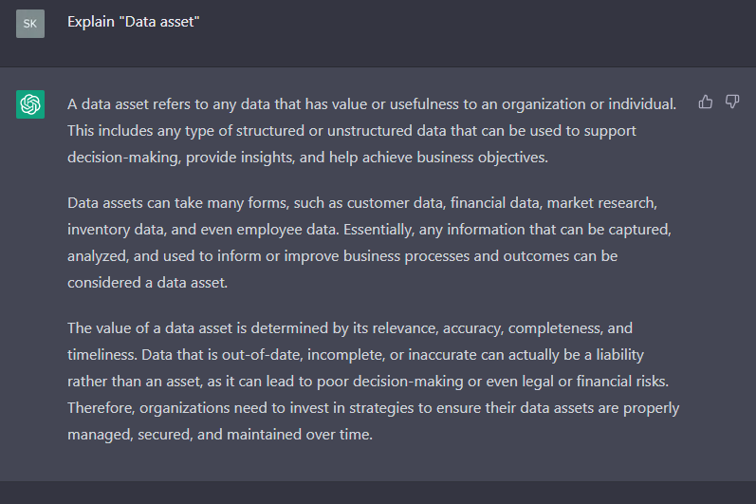
Data asset
A data asset refers to any data that has value or usefulness to an organization or individual.
Data assets can take many forms, such as customer data, financial data, market research, inventory data, and even employee data.
The value of data assets is determined by data quality.
Value is in ability to be used to support decision-making, provide insights, and help achieve business objectives.
2022/2023
Notes:
We may need to create the data assets from another data, like from the day-to-day operational data.
The last point defines the value from one perspective. The question is how … how exactly data support decision-making, etc..

Slide 10
Business Intelligence
10000-foot view
Notes:
Following slides should give you idea what to expect from BI.

Slide 11
Business Intelligence (BI)
Type of data analysis aimed at understanding organizational activities and opportunities.
Results of such analysis are used to improve organizational success.
A set of technologies that support this kind of data analysis. An evolution of decisions support tools, BI tools enable querying, data mining, statistical analysis, reporting, scenario modeling, data visualization, and dashboarding.
It is rare to build custom BI tool.
Notes:
You probably do not need to implement BI tool, as there is a mature market: SAP, Microsoft, Oracle, IBM, … we talk about some examples later.
The objective is to support management decisions by use of data analysis.

Slide 12
Business Intelligence Categories
Querying and reporting ~ what happened
Standard reports presented in a specific format, on screen or in a printout.
Answer to a particular question, an ad-hoc query, or key performance indicators (KPI).
Little to no interaction, static and predictable.
Notes:
This is structured mostly on an amount of effort user should and can put into the process. There are no strict borders and definitions.
ACTIVITY: Talking about KPI what about a North Star Metric?
It is a single metric that best captures the value customers derive from your product.
It may not be easy to determine and can change over time.
Hints: represent value users gets from out product, is within our sphere of influence, is a leading indicator of revenue.
Report types:
Regular reports (sales in last week)
Listings (salespeople in company), can be sorted

Slide 13
Business Intelligence Categories
Business analysis ~ what happened and why
Visualizing data in a multidimensional manner.
Typically presented as table, with dimensions mapped to columns and rows.
User can manipulate the data and visualization.
Executive Information Systems (EIS): Dashboard, Scorecard,
Data mining
Predictive and discovery-oriented.
Requires specific knowledge and education : NDBI023 Data Mining, …
Notes:
Continue from previous slide.
Examples from query and reporting, for users who want to receive key business information and indicators that can help them understand how the users are performing:
Dashboard presents current information on your operational as a collection of graphs, reports, and key performance indicators (KPI) that can help monitor such business activities as progress on a specific initiative. You know dashboard from car.
Briefing book is an electronic sequence of key information and indicators that someone regularly uses for decision-making or performance monitoring.
The command center might be a console of on-screen push-buttons (perhaps a lot of them), each of which shows the user a different kind of information - a report, document, image, or indicator.
Scorecard shows your performance against a plan or set of objectives, for example for certain initiative, e.g., data quality. User does not have to search for information in reports.
The idea is delivering the information with minimal effort on user side. For example, an executive manger can have 5-7 KPI to monitor. Those ideas got popular in mid 1980s as executive information systems (EIS) technology.
Query and reporting is basically a subset of OLAP. It handles “tell me what happened” types od questions. There is little change to reports and almost no user interaction. Reports are standard we may need to generate dozens of them from dozens of tables.
For business analysis the interaction allow to get the answer “why”.

Slide 14
Business Intelligence Categories
Operational reporting
Short and long, year to year, trends and patterns
Support short-term business decisions
Business performance management (BPM)
Metrics aligned with organizational goals
Support long-term business decisions, executive level
Optimize execution of business strategy
Operational analytics (Analytic Applications)
Employ near-real-time analytics to guide operational decisions
Business Intelligence for front lines of the business
Notes:
We can also split approaches / tools based on the scope and expected decision type. This is again not strictly defined just to deliver the idea.
Operational: Custom query and visualization
BPM: Scorecards, budgeting, planning, and financial consolidation.
Operation Analytics: Not only for executives and managers. Include Descriptive, self-service analytics. More about software. Can help optimize functional area (people management) or industry vertical (retail analytics).
The term Analytics Application (AA) is coined by Henry Morris in 1990, who also explain difference of AA to general OLAP and BI tools.
Self-service may be a portal with reports that a user-can navigate. User is given option, and they pick what they need.
Resources:
Morris, Henry. “Analytic Applications and Business Performance Management.” DM Review Magazine, March, 1999.

Slide 15
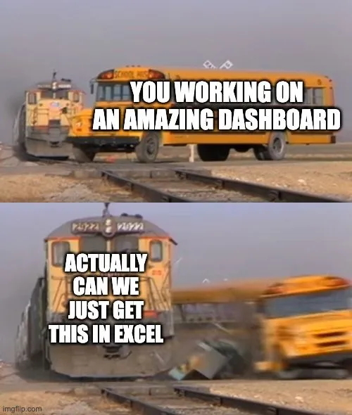
DEMO
Pivot Table

Slide 16
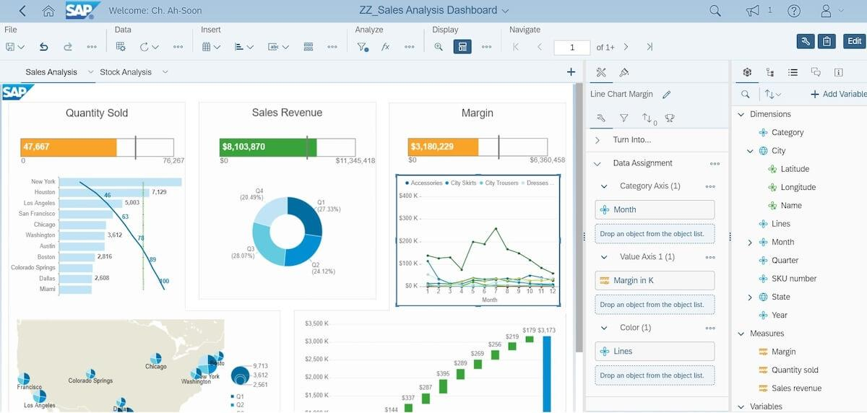
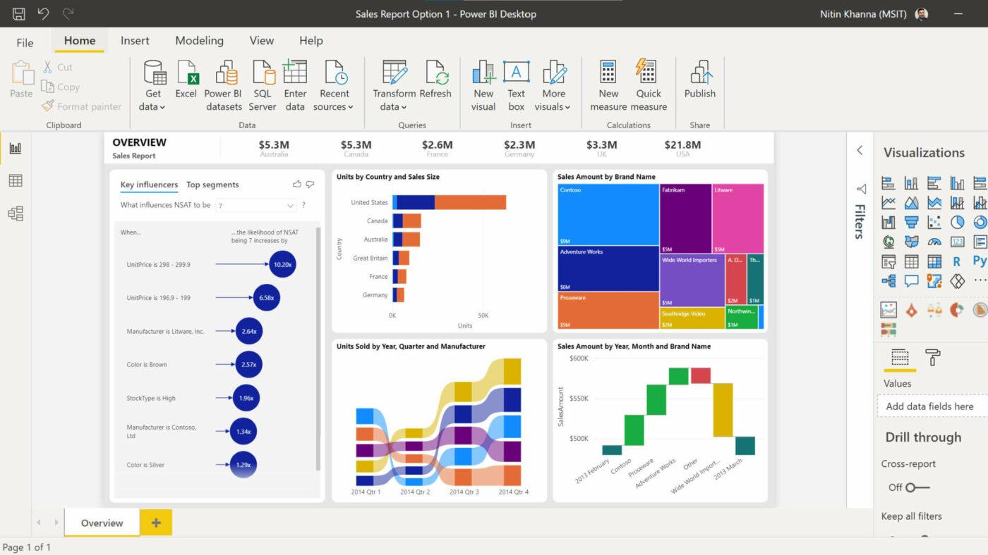
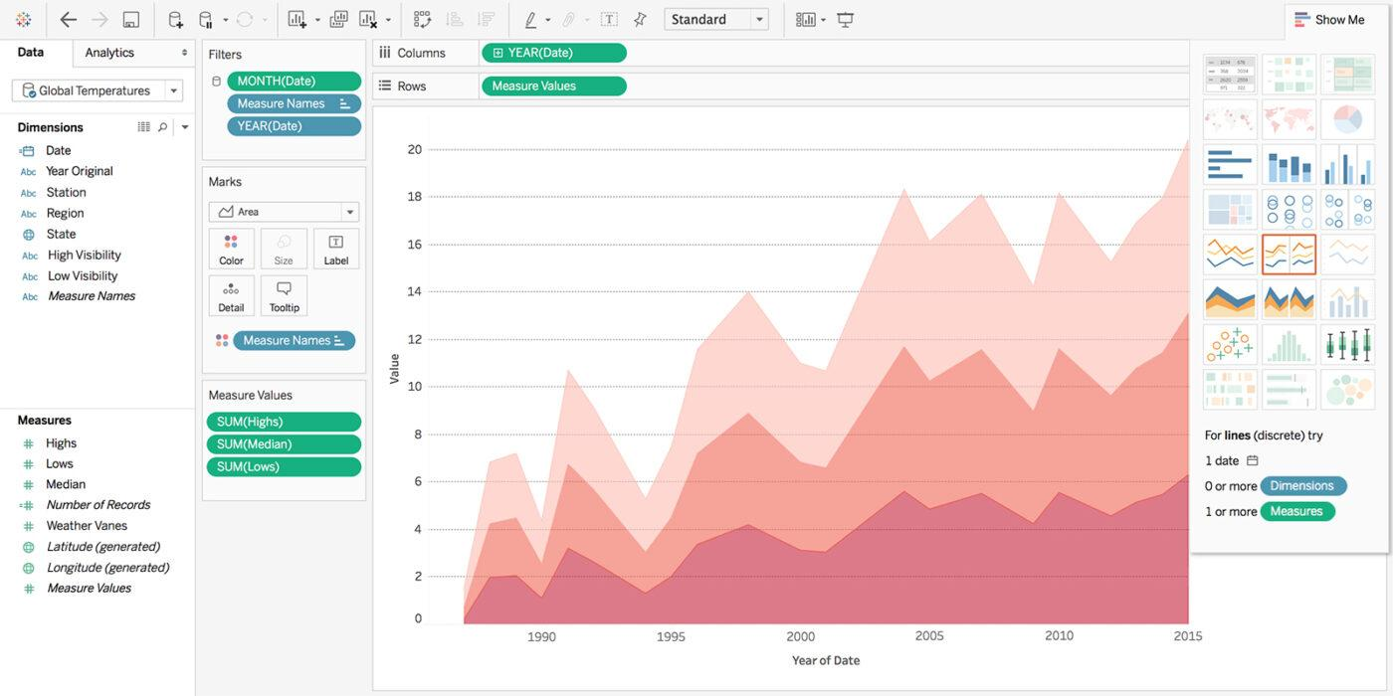
Tools
SAP BusinessObjects Business Intelligence
Microsoft Power BI
Tableau (NPGR023)
Notes:
SAP (the big one)
Single space, real-time data, high price.
MS Power BI (available online)
Connect data sources to OneLake data hub.
Build-in AI features.
Integration with MS eco-system.
Tableau (you can try free version)
Better visualization options, drag-and-drop functions.
Expensive compared to MS Power BI.
IBM Watson can also be a BI tool
Resources:
https://clickup.com/blog/business-intelligence-software/ - 2023/2024 screens.

Slide 17
Business - What is BI?
Notes:
ACTIVITY: Where are the business intelligence opportunities?
Categories: Operational reporting, Business performance management (BPM), Operational analytics (Analytic Applications).
Keep in mind we are here to support the business. It is not about artificially inventing a reason for existence.
Source:
https://www.bpmn.org/
https://demo.bpmn.io/

Slide 18
Business perspective
Information Technology
Unrealistic expectations for new applications of enhancements of existing application
Little participation during design
Little participation during testing
Lack of training
Business
IT have no idea about business
Random features
Slow response time
It does not work !
Notes:
Why do we even talk about this? Remember communication was an important skill, you need to effectively communicate with businesspeople.
IT:
They have no idea about the complexity “Just add this one number here”.
Example: Like a sum of table values.
They may not be able to express and define their requirements.
Example: Mews
They are not paid to test your software.
Example: Shell
They focus on moving graphs and visuals not functionality or even data.
Example: Project
Business
We are the one making money, deciding, they are just support.
Example: You have analytics or consultants who should understand the business not your average developer.
Developer just put random features into applications.
Example: Feature request from different sources.
There is not enough skilled personal.
Thinks break when something is happening.
Example: warehouse inventory
Our objective should be to bridge this gap.
Agile Manifesto: Customer collaboration …
Resource:
https://agilemanifesto.org/

Slide 19
On-Line Analytical Processing (OLAP)
Multidimensional data
Notes:
OLAP was introduced some time ago, the magic behind derived from its ability to pre-calculate and pre-aggregate data. Without it would take long time to get result to the complex SQL queries.
There were some limitations:
For data schema we require start or snowflake.
There may be a limited number of possible dimensions.
It was hard to access the translational data in the cube.

Slide 20
OLTP vs. OLAP
On-line Transaction Processing (OLTP) systems
Support day-to-day operation
Thousands of users, small read / write operations
Transaction oriented
High performance
High availability
Normalized schema
On-Line Analytical Processing (OLAP)
Decision support
Hundreds of users, read only
Multi-dimensional analytic queries
High flexibility
Downtime, regular updates
Implementation architectures:
ROLAP, MOLAP, HOLAP, …
Query result is a matrix ~ data cube
Notes:
We already talk about OLTP at the start, we can use it as a baseline.
OLAP server can be placed between client and a database to provide OLAP services.
(Relational)-ROLAP - is using data in the relational database, may be the data warehouse. It may create a table to store the aggregation. The advantage is flexibility (we can use relation database), the drawback is sub-optimal performance and computation requirement on the relation database. Yet it can handle large and amounts of data which are changing.
Examples by sisense: Metacube by Stanford Technology Group, Red Brick Warehouse by Red Brick Systems, and AXSYS Suite by Information Advantage.
(Multidimensional)-MOLAP - is using array-based multidimensional database directly, again may be data warehouse. It provide better performance to ROLAP as there is no need to execute complex SQL join queries. Can not handle that much data, we need to prepare the data. Unlike ROLAP we compute the data in advance, often utilize smaller cubes.
Examples by sisense: Oracle Essbase, IBM Cognos, and Apache Kylin.
(Hybrid)-HOLAP - is a combination of both. Analysis is carried out over relation data, but the results tables are stored in multidimensional database.
Examples by sisense: Microsoft Analysis Services and SAP AG BI Accelerator.
There is also DOLAP, where the data cube is created in-memory with obvious limitation. The advantage is best flexibility.
Resources:
https://homel.vsb.cz/~dan11/is_skripta/IS%202010%20-%20Danel%20-%20OLAP.pdf
https://dl.acm.org/doi/10.1145/276305.276386 - The multidimensional database system RasDaMan
https://www.sisense.com/glossary/olap/ - They have custom product ElastiCube

Slide 21
Apache Kylin
https://kylin.apache.org/

Slide 22
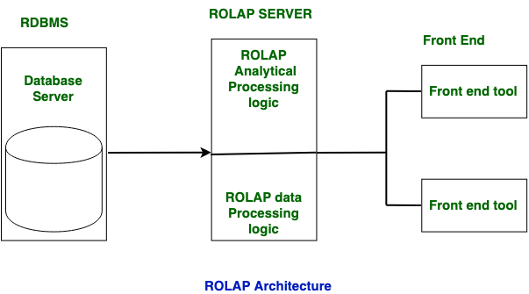
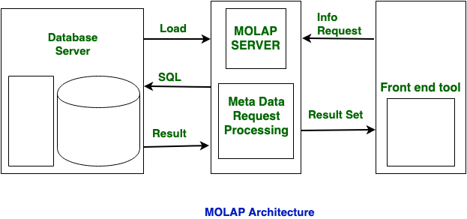
OLAP
OLAP
Definition with 12 rules by Coddem 1993
Fast Analysis of Shared Multidimensional Information 1995
Consider 2024/2025
Notes:
ROLAP is used for large data volumes and in this data is stored in relation tables. In ROLAP, Static multidimensional view of data is created.
MOLAP is used for limited data volumes and in this data is stored in multidimensional array. In MOLAP, Dynamic multidimensional view of data is created.
MOLAP does not use relational database to storage. It stores in optimized multidimensional array storage. The storage utilization may be low with multidimensional data stores.
Resources:
https://www.geeksforgeeks.org/difference-between-rolap-and-molap/
https://www.geeksforgeeks.org/difference-between-rolap-molap-and-holap/

Slide 23
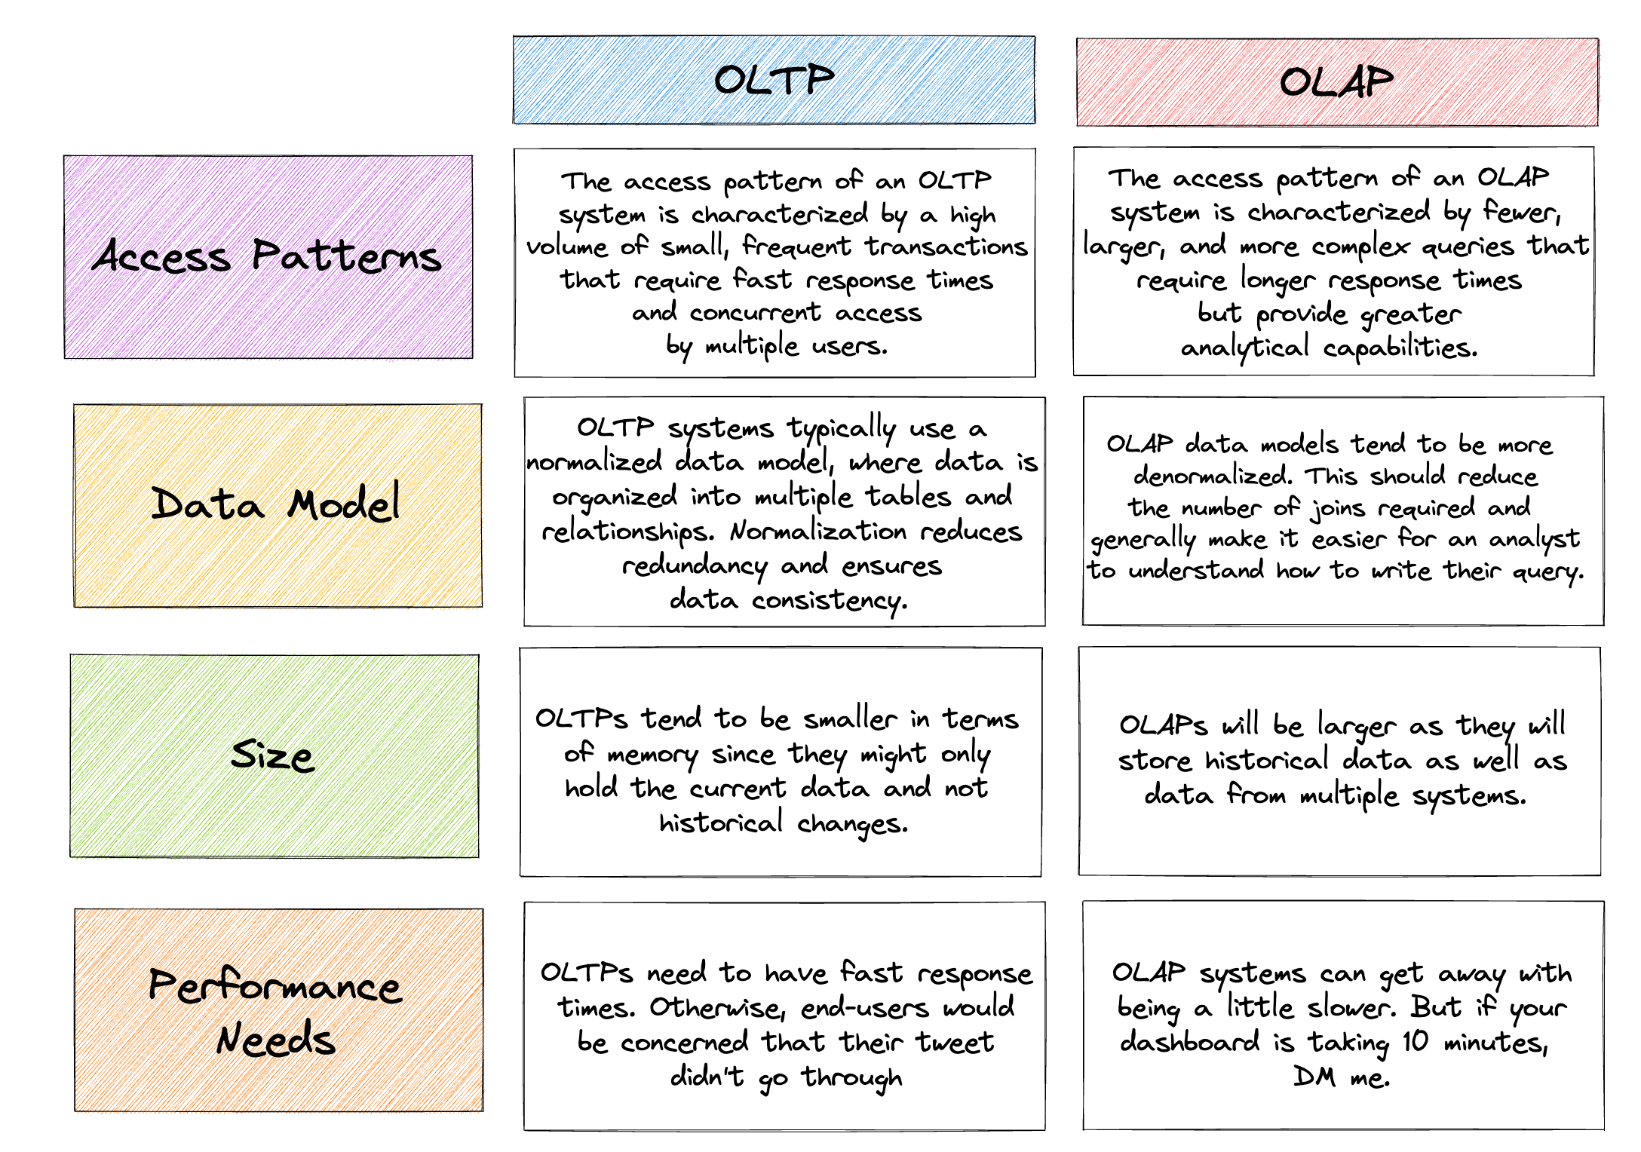
OLTP vs. OLAP
Notes:
Source:
Seattle Data Guy, 2023

Slide 24
Multidimensional data
Multidimensional data
Dimensions
Dimension hierarchy
Facts
Measures
Time
time = Monday
product = Pizza Hawaii
units sold = 4
Dimension
Fact
Product
Dimension
Measure: total units sold in … = 45
Notes:
Dimensions are the perspectives or entities with respect to which an organization wants to keep records. Each dimension may have a dimension table, codelist, domain, associated with it.
Facts are numerical value, or observations for given dimensions. There may be no fact for given dimensions.
Measures, computed values along selected dimensions:
We can have aggregations, like sum, min, max when not all dimensions are provided. Those listed are called distributive and can be computed in distributed manner.
Functions like n-th min or max, mean can be computed from m-arguments, where each argument is a distributive function.
Holistic requires all data like median.
By taking a bunch of multidimensional data, we can create a data cube.

Slide 25
Data cube operations
Hierarchical dimensions
Additional dimensions
 | 2019 |  |  |  | 2020
 | 1. Q | 2. Q | 3. Q | 4. Q | 1. Q | 2. Q | 3. Q | 4. Q
Hawaii | 10 | 14 | 12 | 9 | 15 | 18 | 3 | 8
Drill Down
Drill Up
 | 1. Quarter |  |  | 2. Quarter |  |  | …
 | January | February | March | April | May | June | …
Hawaii | 2 | 4 | 4 | 7 | 3 | 4 | …
Notes:
Drill Down:
We can add a new dimension to the data. Special case is to add one from dimensional hierarchy.
Increase level od detail.
Drill Up:
Remove dimension.
Data are aggregated, like measures.

Slide 26
Data cube operations
 | 1. Quarter |  |  | …
 | January | February | March | …
Hawaii | 2 | 4 | 4 | …
Slice
Slice
Dice
 | 1. Quarter |  |  | …
 | January | February | March | …
Hawaii | 1 | 2 | 2 | …
Monday
Slice
Notes:
Slice is about taking sub-set of data cube, by selecting value(s) not included in the subset.
Dice is slice using multiple dimensions, or just a sequence of slices.

Slide 27
Data cube operations
Pivot
Nesting
Drill-across
Drill-through / reach-through
Trending
…
Notes:
Honorable mentions.
Pivot re-arrange the visualization, like moving dimension from column to rows.
Nesting is about placing more dimensions, not necessarily hierarchical on column or rows.
It allows user to see the raw data, like final drill-down. Like the individual sales record, yet this is not as common and there are multiple names.
See trend in respect to one dimension, often time.

Slide 28
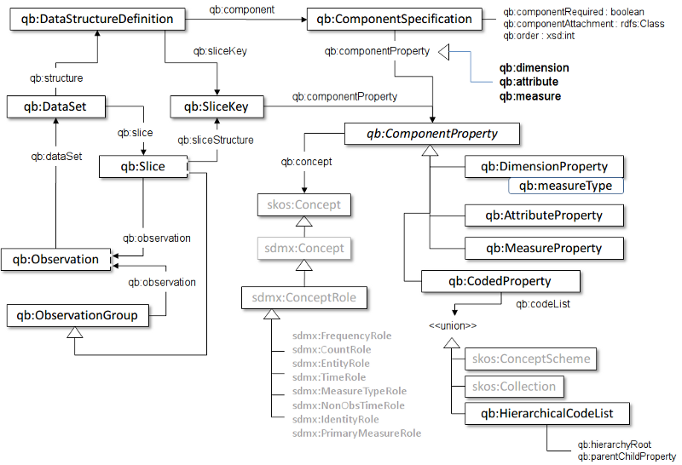
Data Cube Vocabulary
RDF vocabulary
W3C recommendation from January 2014
Based on Statistical Data and Metadata eXchange (SDMX)
Notes:
We focus on an open way to transport data.
We do not need the whole vocabulary; we focus on just a few selected classes. The objective is to show you how we can store the data cube.
Resource:
https://www.w3.org/TR/vocab-data-cube/
https://www.youtube.com/watch?v=af0gpvesWaY

Slide 29
Data Cube Vocabulary
Observations
Time
eg: measureMonHawaii a qb:Observation ;
qb:dataset eg:DataSet ;
eg:time eg:Monday ;
eg:product eg:PizzaHawaii ;
eg:unitsSold 4 .
time = Monday
product = Pizza Hawaii
units sold = 4
eg:unitsSold a rdf:Property, qb:MeasureProperty;
rdfs:label "Units sold"@en;
rdfs:subPropertyOf sdmx-measure:obsValue;
rdfs:range xsd:positiveInteger .
Product
eg:dataSet a qb:DataSet;
qb:structure eg:cubeDefinition ;
sdmx-attribute:unitMeasure
<http://dbpedia.org/resource/Day> .
Notes:
This is just a part of the metadata we can provide.

Slide 30
Data Cube Vocabulary
Observations
Time
eg: measureMonHawaii a qb:Observation ;
qb:dataset eg:DataSet ;
eg:time eg:Monday ;
eg:product eg:PizzaHawaii ;
eg:unitsSold 4 .
time = Monday
product = Pizza Hawaii
units sold = 4
Product
Notes:
This is just the observation, yet there is lot missing, what is the meaning the of predicates anyway?

Slide 31
Data Cube Vocabulary
Observations
eg: measureMonHawaii a qb:Observation ;
qb:dataset eg:DataSet ;
eg:time eg:Monday ;
eg:product eg:PizzaHawaii ;
eg:unitsSold 4 .
eg:time a rdf:Property, qb:DimensionProperty;
rdfs:label "Time"@en;
rdfs:subPropertyOf sdmx-dimension:refPeriod;
rdfs:range interval:Interval;
qb:concept sdmx-concept:refPeriod .
......
eg:unitsSold a rdf:Property, qb:MeasureProperty;
rdfs:label "Units sold"@en;
rdfs:subPropertyOf sdmx-measure:obsValue;
rdfs:range xsd:positiveInteger .
Notes:
There is lot missing, we are not even using the qb: prefix here.
We can see measure is used in a different context here.

Slide 32
Data Cube Vocabulary
Observations
eg: measureMonHawaii a qb:Observation ;
qb:dataset eg:DataSet ;
eg:time eg:Monday ;
eg:product eg:PizzaHawaii ;
eg:unitsSold 4 .
Dataset
eg:dataSet a qb:DataSet;
qb:structure eg:cubeDefinition ;
sdmx-attribute:unitMeasure
<http://dbpedia.org/resource/Day> .
Notes:
Now we have bunch of new properties … so let us unpack them.

Slide 33
Data Cube Vocabulary
Observations
eg: measureMonHawaii a qb:Observation ;
qb:dataset eg:DataSet ;
eg:time eg:Monday ;
eg:product eg:PizzaHawaii ;
eg:unitsSold 4 .
eg:cubeDefinition a qb:DataStructureDefinition;
qb:component
[ qb:dimension eg:time; qb:order 1 ] ,
[ qb:dimension eg:product; qb:order 2 ] ,
[ qb:measure eg:unitsSold] ,
[ qb:attribute sdmx-attribute:unitMeasure ;
qb:componentRequired "true"^^xsd:boolean ;
qb:componentAttachment qb:DataSet ; ] .
Dataset
eg:dataSet a qb:DataSet;
qb:structure eg:cubeDefinition ;
sdmx-attribute:unitMeasure
<http://dbpedia.org/resource/Day> .
Notes:
Now we have bunch of new properties … so let us unpack them. For full example see the documentation.
Resource:
https://www.w3.org/TR/vocab-data-cube/

Slide 34
Data Cube Vocabulary
Slices
Handling multiple measures
Concept schemes and code lists
Hierarchical code lists
DataSet metadata
Normalization algorithm
Well-formed cubes
Notes:
We ignored lot of concepts; you get chance to revisit some of them at the seminar.

Slide 35
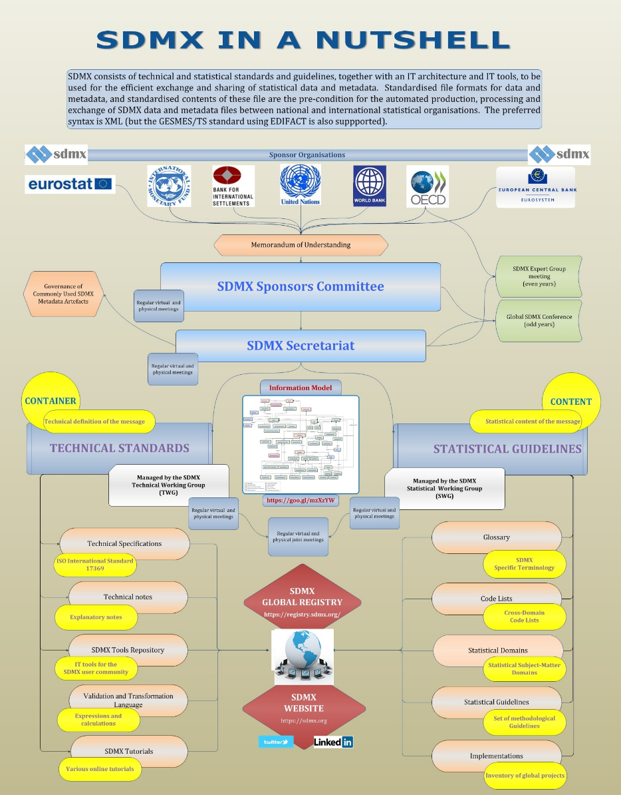
Common statistical concepts
The SDMX set of Content-Oriented Guidelines (COG)
as RDF resources
http://purl.org/linked-data/sdmx/2009/concept#
http://purl.org/linked-data/sdmx/2009/code#
http://purl.org/linked-data/sdmx/2009/dimension#
http://purl.org/linked-data/sdmx/2009/attribute#
http://purl.org/linked-data/sdmx/2009/measure#
Statistical Data and Metadata eXchange (SDMX)
Technical standards and guidelines
Statistical standards and guidelines
Tools and architecture
Notes:
We saw use of sdmx prefix before. COG which define a set of common statistical concepts and associated code lists that are intended to be reusable across data sets. A community group has developed RDF encodings of these guidelines.
This is super useful when you need to share your data. We talk about interoperability and FAIR later.
SDMX is popular mostly in statistical domains and banking as ii address their needs. They define how to store data for CSV, JSON, XML. There is nice tutorial on publishing data for foreign exchange reference rates by ECB.
There are tools to support developers in particular languages (SDMX.NET, SDMX Java Suite, Excel), format conversion tools.
Resource:
https://sdmx.org/
https://www.ecb.europa.eu/stats/ecb_statistics/co-operation_and_standards/sdmx/html/tutorial.en.html

Slide 36
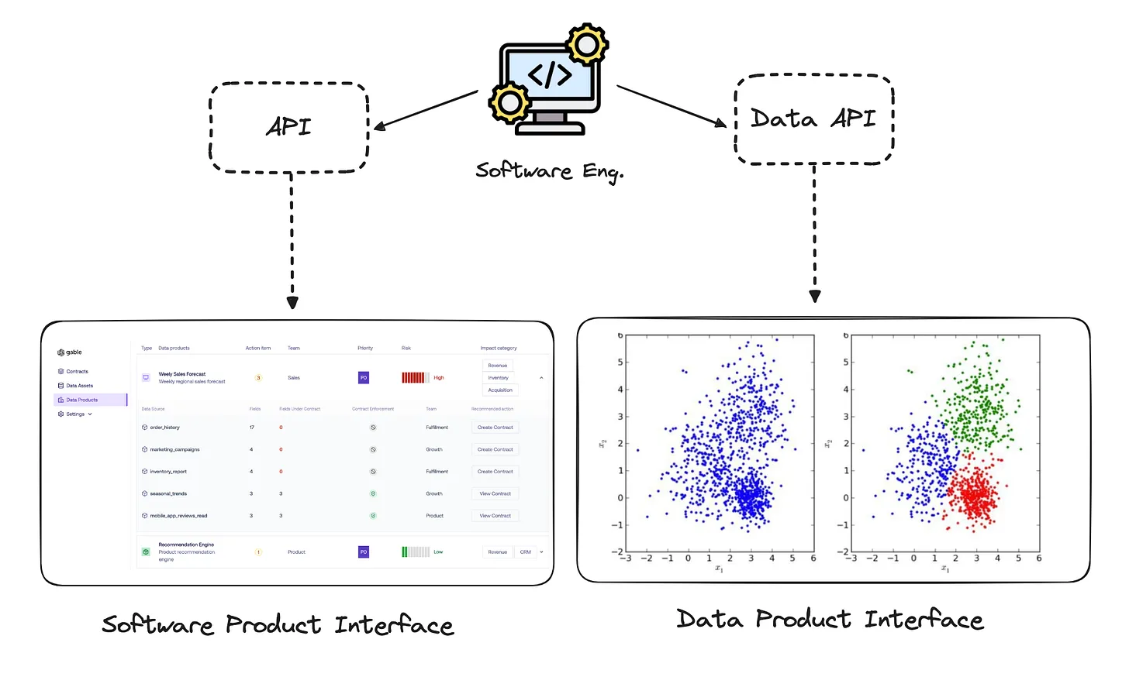
OLTP vs. OLAP
We can see similar for products
Notes:
Resources:
https://dataproducts.substack.com/p/the-consumer-defined-data-contract

