Slide 1
Introduction
NDBI046 - Introduction to Data Engineering
2024/2025
Petr Škoda
https://github.com/skodapetr
https://www.ksi.mff.cuni.cz

Slide 2
Outline
Prerequisites
Web and Data-Oriented Programming, 3rd year
Programming 1 (NPRG030)
Programming 2 (NPRG031)
Programming in Java / C++ / C# / Web ...
Database Systems (NDBI025)
Individual Software Project (NPRG045)
Database Access Methods (NDBI046)
Optional
Software System Architectures (NSWI130)
Outcomes
Business process
Data use-case(s)
Data management
Data engineering and data engineer

Slide 3

Question
Why?
Notes:
ACTIVITY:
Why do we write software?
What is a business-case, business process?
How do we know what to create?

Slide 4
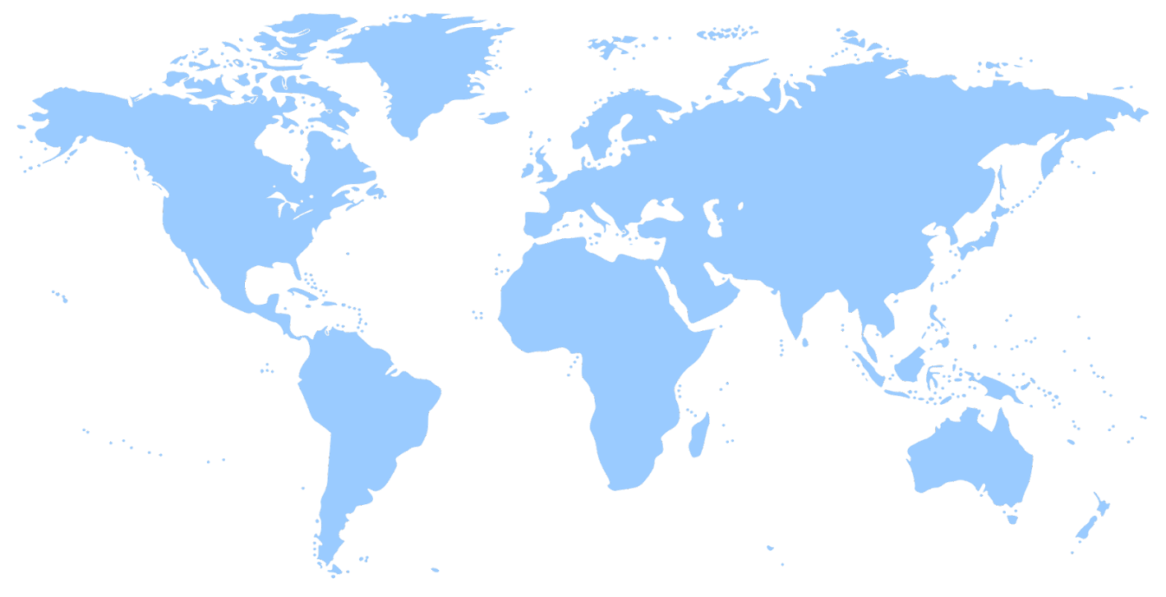
Data use-cases
What is the best way to recommend a product to a customer?
Understand your customers, make predictions.
Product, supply lines, stock management.
Data protection and regulatory framework.
What about the public sector?
Government / public-sector system.
Scientific data management.
https://openclipart.org/detail/1733/world-map
Notes:
(2) For example, you need to know where products from a single product batch are. They may have different prices, you may be required to withdraw them from the market, … but the only difference is there they come in a different box, once unpacked you can not tell the difference.
(3) Banks / Health care .. data needs to be organized and protected, as otherwise there it may have negative impact to money and even people’s health.
(4) Government can we have a vaccination system, but there are others related to driving license, taxes, alcohol production, …
(5) For science we have FAIR initiative. Research funded by government should protect the investment.
Each of those has specific needs and requirements.
Yet the ideas and principles are shared.

Slide 5
Motivation
Positive
… the amount of information generated will increase 10-fold by 2025. (*)
Provides the structure for information to be easily shared with others. (*)
Makes it easier for your employees to find and understand the information that they need to do their job. (*)
…
Negative
… computer attacks which led to the theft of over 77 million … users’ bank details. (*)
93% of companies that lost their data center for 10 days or more due to a disaster filed for bankruptcy within one year of the disaster. (*)
IBM estimated the cost of poor-quality data in the US in 2016 was $3.1 Trillion (DMBoK)
…
Notes:
Data assets
Asset is an economic resource that can be owned or controlled. It holds or produce value and can be converted to money. Data assets can make business more productive for example by recommending products to customers or decreasing operational cost.

Slide 6
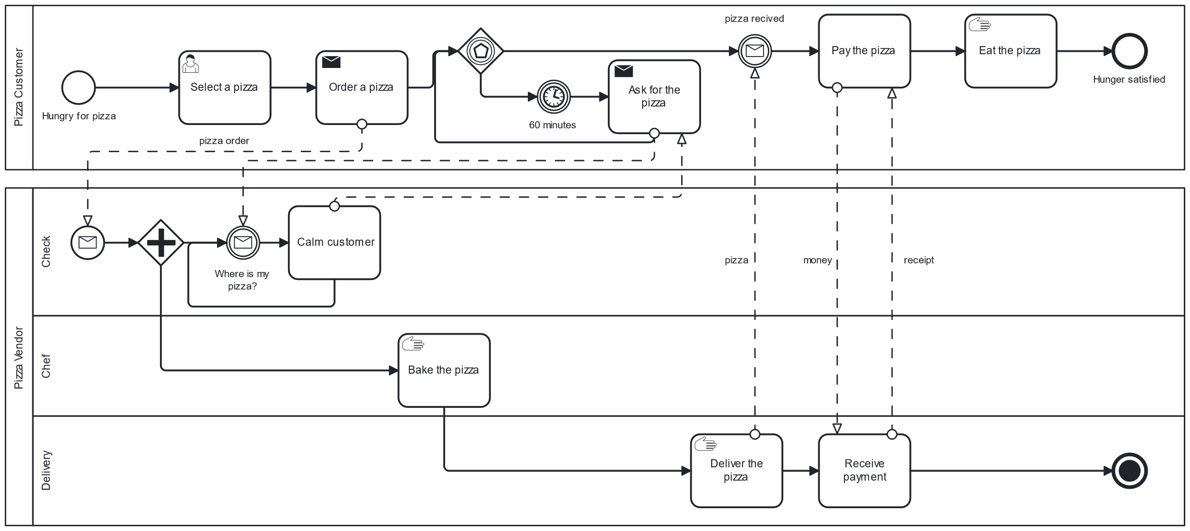
Business
Business Process Model and Notation (BPMN)
https://www.omg.org/cgi-bin/doc?dtc/10-06-02.pdf, 5.2 The Pizza Collaboration
Notes:
Example of a toy business process, based on BPMN examples. We can see interaction of people. It is a process that provide business wit certain value. Image you, as the owner, pay the people to do it. It can all be handled manually (although the notation used suggest otherwise). We seek to improve this process using software.
During this process business generates data (user preferences, baking time, used resources, delivery time, tip, user satisfaction, etc.. ). Data can be lost (no feedback collected), stored on a paper, or be managed by software. For many data are the crucial component of a business. We aim to help business with data management.
At the end it is the business making may for our paychecks.
Resources:
https://www.bpmn.org/
https://demo.bpmn.io/

Slide 7

Motivation Story
Ailish in the Wonderland Dataland
https://openclipart.org
Notes:
Let me introduce Ailish to you.
She work in MyFood, in the office.
She have some knowledge of the company, she can use excel, word, send an email.
Despite all of that, her steps are fairly like to what a developer need to do.

Slide 8
Story: Setup
MyFood is a fictional pizza company focusing on delicious eco-friendly meals and monthly promotions. Area managers have suggested that retail shops near public transport stops can use additional personnel. From their personal experience, those shops are unable to serve customers fast enough. As a result, MyFood is losing money and position on the market.
Decision
Should MyFood provide local shops with money for additional employees?
Question
Sales of promoted products per local shop, for each shop that is at most 100 meters from a public transportation stop.
https://openclipart.org
Notes:
The main objective is to support the business by providing information, so it is possible to make an informed decisions.
The objective is not only to deliver the raw data here but add something, like presentation.
Why bother?
Shadow IT
Supporting business
Need to automation

Slide 9
Story: Now what?
What data do we need?
What data sources are available?
What is the meaning of the data?
What data sources should be used?
What transformation should be used?
How should the data be published?
https://openclipart.org
Notes:
The exact process is not that important as we do not know details of the company.
But we can focus on the steps, basic building blocks.
(1) Sales, promoted products, shops, public transportation stops, ...
(2) Database, excel files, emails, maps, …

Slide 10
Data Sources
My computer
Paper
People
Internal network
Internet
Another department
…
File system
NoSQL
Data warehouse
Data lake
Data mesh
API
…
Text
PDF
JPEG
JSON
XML
Domain specific formats
…
Notes:
ACTIVITY:
What data sources Ailish may encounter?
Can you think of any obstacles related to using the data sources?

Slide 11
Data is all you need, right?
0111101100100010011101100110000101101100011101010110010100100010001110100010000000100010001100010011100000101110001100100010001001111101
ASCII, ...
There is more!
Temperature
Two devices next to each other
Prague, Czechia, Living room
15:00 UTC+01:00
2025-02-16
TFA 30.5027.02, Honeywell CM927
...
{"value": "18,2-19"}
JSON
Range 18.2 to 19.0
....
Notes:
Here we have data using binary encoding. Do we need anything else?
(NEXT) That was just a single measure, we need more.

Slide 12
Data types
Java
int
float
char
double
String
…
JavaScript
Number
String
Boolean
null
undefined
…
C
int
long int
unsigned int
…
SQL
INT
VARCHAR
DECIMAL
TEXT
BLOB
…
CSV
Text
…
GraphQL
String
…
XML
xsd:Date
…
Notes:
The data type may be precise representation of reality or just an approximation.
We have only a limited precision.
Nothing prevents you from creating a new type of yours, but then other will not understand it. To get interoperability, we need to use something well known, well defined. Thus, we can share data with others and even with our future self.
XML is used widely in enterprise and some of its data types were adopted by other technologies.
xsd:date - Gregorian calendar date. As a result, there is more to date only then a day, month and a year.
Also comes with predefined format ISO 8601 [-]CCYY-MM-DD[Z|(+|-)hh:mm] .
With an optional timezone.
Most of the time this is not an issue, but it is important to keep that in mind.
Also consider the amount of knowledge a person needs to have to integrate several data sources.

Slide 13
Three layers of database modeling
Physical Data Model
Add details, like data types or stored procedures, required for a particular database. Names are database compatible. Specifies how logical structures are implemented at given technical level.
Logical Data Model
Add more details such as attributes, foreign keys, key attributes. It is database agnostic. Specifies how conceptual components are represented in a database structure.
Conceptual Data Model
They are also referred to as domain models and offer a big-picture view of what the system will contain, how it will be organized, and which business rules are involved. Capture entities, without details, and their relations.
NDBI025 lecture 2
Notes:
We need to store information about business objects, so we start to combine them together.
They often reflect business object like customer, order, product, invoice, etc..
We may call them entities, in entity-relationship models.
Developers may call them classes, C developers' structures as there are no classes.
In a database we can see them as tables.
So, we have different representations, in general we can split them to three groups.
How to communicate the information on different levels?
There are level of details, or stages:
Conceptual Data Model
Use simple or ad-hoc notation. As such it is highly abstract and should be easily understandable. This Data Model defines WHAT the system contains. This model is typically created by Business stakeholders and Data Architects.
Logical Data Model
One of several formal data modeling notation systems is followed. Defines HOW the system should be implemented regardless of the DBMS. This model is typically created by Data Architects and Business Analysts.
Physical Data Model
For relational databases: entities are now tables, attributes may be columns. This model is typically created by database administrators and developers.

Slide 14
Story: Now what?
What data do we need?
What data sources are available?
What is the meaning of the data?
What data sources should be used?
Ask colleagues, internal regulations, law, international law, data quality, …
What transformation should be used?
How should the data be published?
Data Management
Data Catalog
https://openclipart.org
Notes:
We know data are on different places (files, databases, service, departments, .. ).
We know that the data have some internal structure and meaning defined by the data model.
What if there are multiple sources of the same data?
For example, sales report.
Ailish may have an e-mail from colleague, printed report from last meeting and an Excel table downloaded a week ago.

Slide 15
Story: Now what?
What data do we need?
What data sources are available?
What is the meaning of the data?
What data sources should be used?
What transformation should be used?
How should the data be published?
ETL or not to ETL?
Shadow IT
https://openclipart.org
Notes:
The implementation of this step depends on a huge number of factors with huge influence of skills.
Often there are limited resources, as a result IT may not provide sufficient support, or is not able to.
Consequently, shadow IT may be created, and parts of the process may become undocumented.
Data manipulation may include but is not limited to:
Transformation between formats
Data cleaning
Data integration
Data lifting/lowering
Overall, we can see the process as ETL where we get data, transform them and load them.

Slide 16
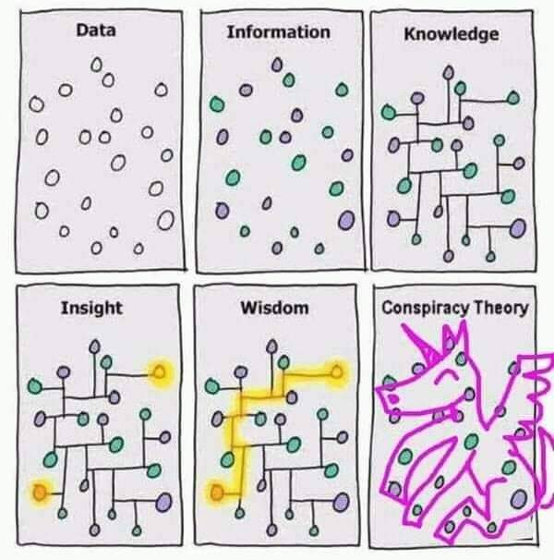
What are we building, and why?
Data-Information-Knowledge-Wisdom pyramid
https://twitter.com/PaulTubb1/status/1294204993290080256
Notes:
What we need to support the business decision?
It is not an SQL table or event logs in their raw format.
We may talk more about DIKW pyramid later.
Now only with this twitter example.
Some people suggest that computers are good for data or information processing.
On the other hand, people are better for higher levels.
Here enters the ChatGPT.
Overall, the message is that we need to start, but NOT end, with the data.
We talk more about DIKW in the second lecture.

Slide 17
Story: Now what?
What data do we need?
What data sources are available?
What is the meaning of the data?
What data sources should be used?
What transformation should be used?
How should the data be published?
Print excel file, scan and send, expose as a service,
load to database, register to data catalog ...
https://openclipart.org

Slide 18

Law(s) and regulations
GDPR (2018)
Fairness
Lawfulness
Transparency
Purpose Limitation
Data Minimization
Accuracy
Storage Limitation
Integrity and Confidentiality
Accountability
NIS (2016), NIS2 (2023)
Final legislation ready
Dec. 2022.
Transposition
Oct. 2024
Implementation
One year period
EU AI Act (2024)
Risk-based approach:
Unacceptable
High-Risk - regulated
... - unregulated
https://imgflip.com/i/1rfxwa
Notes:
GDPR: Limits who can work with the personal data, where the data can be stored, for how long. In addition, company must be able to prove compliance with GDPR. There are alternatives to GDPR in Canada, USA, and OECD Fair Information Processing Guidelines.
NIS2: Act, need transposition to local regulations. Czech regulation scheduled for the second half of 2024.
EU AI Act:
Unacceptable (government run social scoring in China) are banned
High-risk (CV-scanning for job applications] are subject to legal regulations
Not banned or listed as high-risk are largely left unregulated
In addition, there can be restriction inside a company.
Resources:
https://osveta.nukib.cz/course/view.php?id=145
https://artificialintelligenceact.eu/
https://digital-strategy.ec.europa.eu/en/policies/regulatory-framework-ai

Slide 19
NIS2
https://portal.nukib.gov.cz/informace/legislativa/zakon-o-kyberneticke-bezpecnosti/okruh-obecne-informace-o-smernici-nis2

Slide 20
EU AI Act
https://digital-strategy.ec.europa.eu/en/policies/regulatory-framework-ai

Slide 21

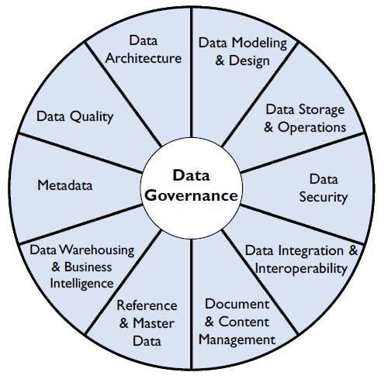
Data management
The Global Data Management Company
https://dagny.com/whose-job-is-qa/
Notes:
While all of this may seem like it is nor our problem, it may well be.
At the end of the day those are going to impact the processes in the company we want to support.
While data management presents many challenges, few of them are new.
Since at least the 1980s, organizations have recognized that managing data is central to their success.
DAMA was founded to address these challenges.
The DMBOK, an accessible, authoritative reference book for data management professionals.
Resources
https://cdmp.info/

Slide 22
Data Engineering

Slide 23
* Engineering
Civil Engineering
Civil engineering is a professional engineering discipline that deals with the design, construction, and maintenance of the physical and naturally built environment, including public works such as roads, bridges, canals, dams, airports, sewage systems, pipelines, structural components of buildings, and railways.
Software Engineering
Software engineering is the branch of computer science that deals with the design, development, testing, and maintenance of software applications. Software engineers apply engineering principles and knowledge of programming languages to build software solutions for end users.
Data Engineering
???
Notes:
ACTIVITY
Describe engineering practices.
What do you expect from end engineer?
Resources:
https://en.wikipedia.org/wiki/Civil_engineering
https://en.wikipedia.org/wiki/Software_engineering

Slide 24
ChatGPT
Prompt: Explain data engineering like I am 5.
Data engineering is like building a big lego tower. Just like how you take lots of little lego blocks and put them together to make a big tower, data engineers take lots of little pieces of data and put them together to make a big, useful structure.
Data engineers have to make sure the lego blocks fit together perfectly, just like they have to make sure the data fits together perfectly. They also have to make sure the tower is strong and won't fall apart, just like they have to make sure the data is stored securely and can be easily accessed when needed.
Data engineering is important because it helps people and organizations make sense of all the information they have. By putting the data together in a useful way, they can use it to make better decisions and solve problems. Just like how your lego tower can be a castle or a spaceship, the data structure that data engineers create can be used for many different purposes!
https://chat.openai.com/ 2023.02.13
Notes:
Highlights added manually.
Source:
https://chat.openai.com/

Slide 25
ChatGPT
Prompt: Explain data engineering like I am 5.
Alright, imagine you're playing with Lego blocks. You have all these different pieces and you want to build something cool, like a spaceship. Data engineering is like putting those Lego blocks together to make sure they fit just right and that your spaceship doesn't fall apart.
But instead of Lego blocks, we're dealing with lots of information, like numbers, words, and pictures, that we want to organize and use in different ways. Data engineers are like the architects and construction workers who figure out how to arrange all this information so that it's easy to find and use when we need it.
They make sure the data is clean, meaning it doesn't have any mistakes or missing pieces, and they build special structures called databases to store the data securely. They also create pipelines, which are like tunnels that help move the data from one place to another safely and quickly, so we can use it to learn new things, make important decisions, or just have fun!
https://chat.openai.com/ 2024.02.14
Notes:
Highlights added manually.
Source:
https://chat.openai.com/

Slide 26
ChatGPT
Prompt: Explain data engineering like I am 5.
Alright! Imagine you have a big box of LEGO bricks, all jumbled up in different colors, shapes, and sizes. But you want to build a cool castle!
Data engineers are like the people who sort the LEGO bricks, organize them by color and shape, and put them in neat little boxes so that when someone wants to build something (like a castle), they can find exactly what they need quickly and easily.
Instead of LEGO, data engineers work with information—like numbers, words, and pictures. They take messy data, clean it up, and store it neatly so other people (like scientists, businesses, and apps) can use it to do amazing things! 🚀
https://chat.openai.com/ 2025.02.16
Notes:
Highlights added manually.
Source:
https://chat.openai.com/

Slide 27



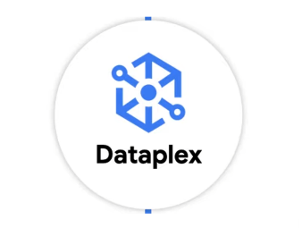

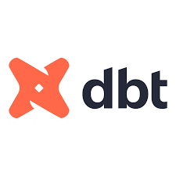

Data Engineer
A data engineer is a practitioner of data engineering.
There is no single roadmap or definition. Yet we can look at various sources and put the pieces together.
Market (*)
Building ***** a data analytical and AI platform.
Responsibilities includes:
Data extraction, transformation, loading, archiving
Cloud
Data lake implementation
Data governance: data catalog, data quality, data lineage ...
...
YouTube
Scripting / programming language
SQL
Linux commands
Data warehouse concepts
Docker, Kubernetes, Cloud
Orchestration
Distributed systems
....

Slide 28
Roadmap by YouTube (2022)
Prerequisites
  DBMS, SQL (Solve), Python (Solve), Linux
Everything Data
  Data Warehouse, …
Distributed system
  Hadoop, Hive, Spark, …
Cloud
  Certified Professional Data Engineer, …
Tools
  Orchestration: AirFlow
  Compute: Databricks, Snowflake
  CI/CD: Jenkins, Sonarqube
  Streaming: Kafka
  Containers: Docker (2019)
Project
Optional
  Build, train and deploy ML model
  Data visualization: Tableau, Powe BI, Looker
  ETL/ELT: Matillion, Talend
  Containers: Kubernetes
Subject Matter Expert (SME)
Notes:
What is the job:
Prepare data that others need
Scalable pipelines, orchestration, monitoring
Select data model
Data cleaning, provenance, data integration
.. and others
The levels should be in given order.
You can solve some problems online to self-test.
Linux for basic commands and ability to navigate a system.
Next is about concepts: Data Lake, Data Mart, Data Fabric, Data Mesh, Data Catalog, Slowly Changing Dimensions, …
Deal with large data, first two little outdated. We can try PySpark, it is not easy to install.
Cloud - basic principles, there are certificates out there.
Orchestration (run your pipeline), Databricks is more fore Spark workload, Snowflake is for SQL (there are alternatives, like cloud specific: AWS EMT, GCP Dataproc, AWS Redshift, GCP Big Query).
Project streaming or batch.
https://www.startdataengineering.com/post/data-engineering-project-for-beginners-batch-edition/
Some additional stuff good to know.
Last you can specialize in something and go to SME (hard to do for teaching).
Resources:
https://www.youtube.com/watch?v=WgCavqDntlQ&list=WL God Tier Data Engineering Roadmap (By a Google Data Engineer)

Slide 29
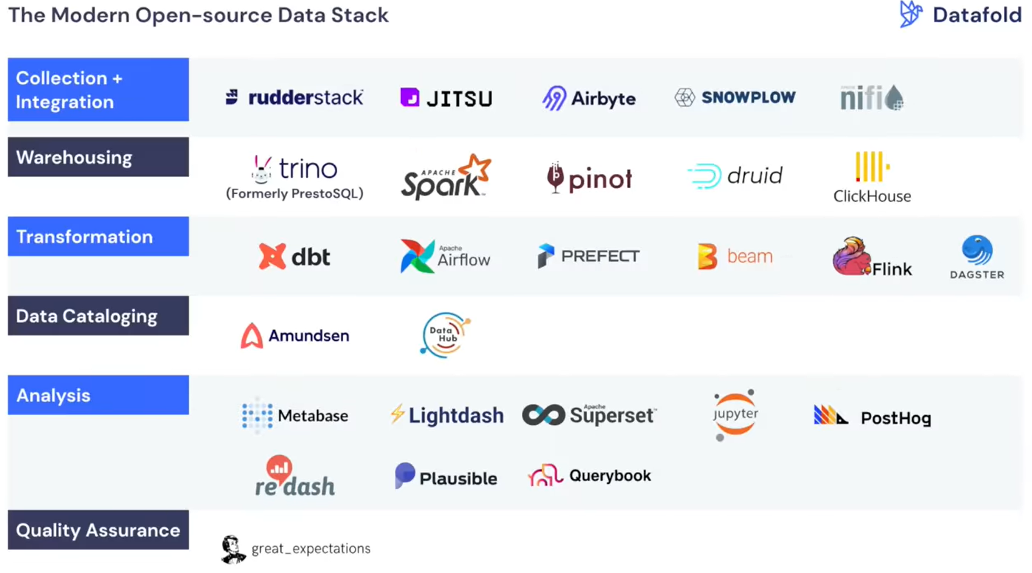
Roadmap by YouTube (2023)
Section 1
  Java / Scala / Python (recommended)
  Structured Query Language (SQL)
  Shell scripting
Section 2
  Data Warehouse
  Concepts and Tools
  Data processing frameworks
  Batch and streaming (Kafka)
  Cloud (Azure, AWS, Google cloud)
  Orchestration (Apache Airflow)
Section 3
  Learn modern stack (dbt)
  Deployment (Docker, Kubernetes)
Notes:
Quote from video “just by watching this video you are not going to become a data engineer”.
Linux commands: cd, chmod, chown, clear, cp, crontab, df, du, exit, find, grep, history, man, mkdir, mv, netstat, nslookup, pwd, rm, scp, ssh, su, sudo, tar, touch
Data warehouse concepts (OLTP, ALAP, ETL, ER-modelling, dimension-modeling) and tools (snowflake, BigQuery, RedShift, ..). Book “The Data Warehouse Toolkit” by Kimball.
Tools for data processing: Databrics, Amazon EMR, AWS Glue, Dataproc, Spark with Python. In 2023/2024 criticism appears of moder data stack, i.e. having multiple tools.
You are a data engineer after Section 2, congratulation.
Resources:
https://www.youtube.com/watch?v=alrP72UoDWw
https://docs.google.com/document/d/1MEFXQhtcOZrJGztsAhAu7SJj181toHL0IEVNbVmr61o

Slide 30
Showcase
The Machine Learning, AI and Data Landscape
Notes:
Show https://mad.firstmark.com/ there are also companies.
The idea is there are a huge number of tools out there.
Resources:
https://mattturck.com/MAD2024/

